Slide 1

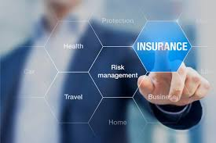
Risk Management
Prepared by Dr. Majid Saad
MGM510
INSURANCE AND RISK

Slide 2
Risk Management
Lecture 2

Slide 3

Lecture objectives
After this lecture, you should be able to:
Explain the basic characteristics of insurance.
Explain the law of large numbers.
Describe the characteristics of an ideally insurable risk from the viewpoint of a private insurer.
Identify the major insurable and uninsurable risks in our society.
Describe the major types of insurance.
Explain the social benefits and social costs of insurance..
www.midocean.ae

Slide 4
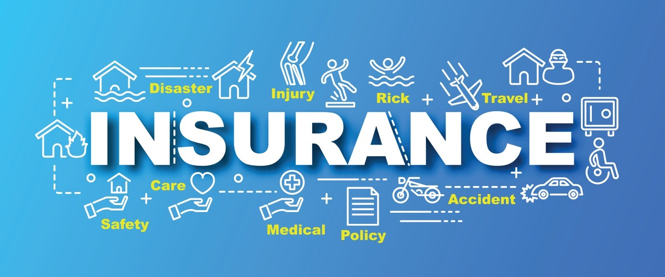
Introduction
“Insurance: An ingenious modern game of chance in which the player is permitted to enjoy the comfortable conviction that he is beating the man who keeps the table.”
Ambrose Bierce
private insurance is the most important technique for managing risk.
In this chapter, we examine the basic characteristics of insurance, characteristics of an ideally insurable risk, major types of insurance, and the social benefits and costs of insurance.
www.midocean.ae

Slide 5
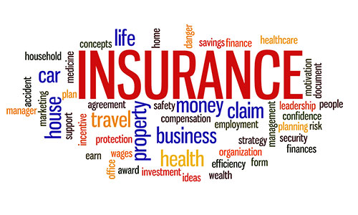
Definition of insurance
Insurance can be defined from the viewpoint of several disciplines, including law, economics, history, actuarial science, risk theory, and sociology.
Insurance is the pooling of fortuitous losses by transfer of such risks to insurers, who agree to indemnify insureds for such losses, to provide other pecuniary benefits on their occurrence, or to render services connected with the risk.
Although this lengthy definition may not be acceptable to all insurance scholars, it is useful for analyzing the common elements of a true insurance plan.
www.midocean.ae

Slide 6
Basic Characteristics of insurance
Based on the preceding definition, an insurance plan or arrangement typically includes the following characteristics:
Pooling of losses
Payment of fortuitous losses
Risk transfer
Indemnification.
www.midocean.ae

Slide 7
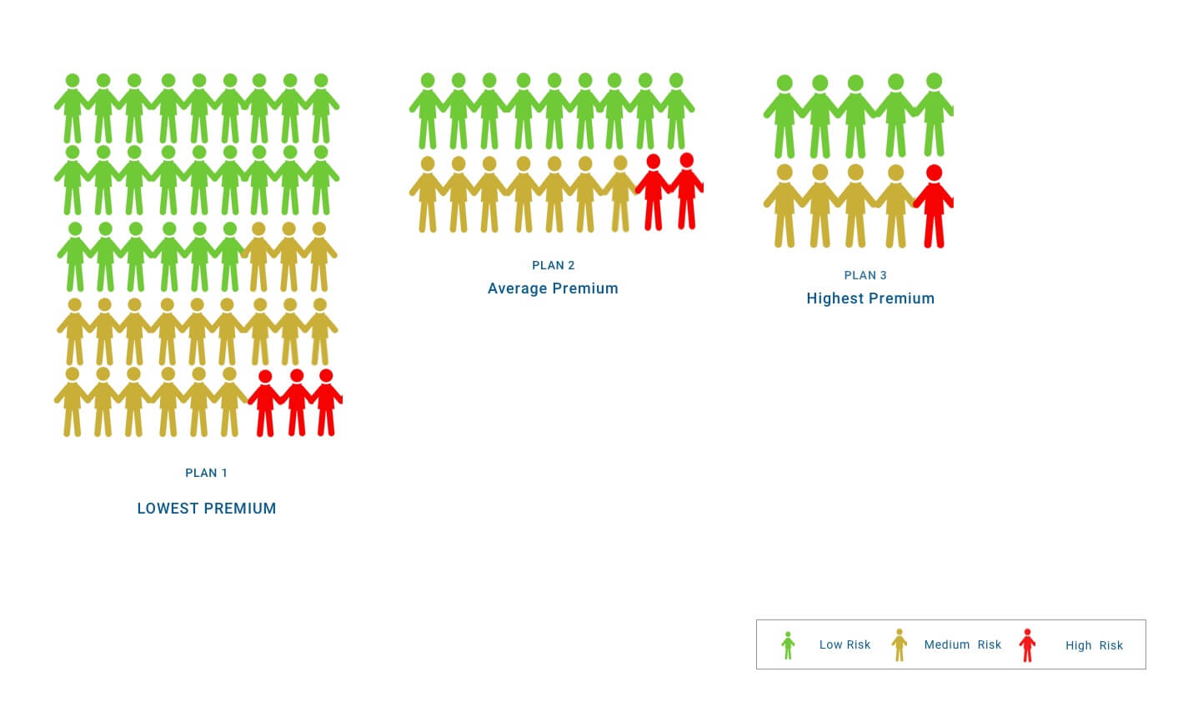
Pooling of Losses
Pooling or the sharing of losses is the heart of insurance. Pooling is the spreading of losses incurred by
the few over the entire group, so that in the process, average loss is substituted for actual loss . In addition, pooling involves the grouping of a large number of exposure units so that the law of large numbers can operate to provide a substantially accurate prediction of future losses.
www.midocean.ae

Slide 8
Pooling of Losses
The primary purpose of pooling, or the sharing of losses, is to reduce the variation in possible outcomes as measured by the standard deviation or some other measure of dispersion, which reduces risk..
A common measure of risk is the standard deviation, which is the square root of the variance.
The law of large numbers states that the greater the number of exposures, the more closely will the
actual results approach the probable results that are expected from an infinite number of exposures.
www.midocean.ae

Slide 9
Payment of Fortuitous Losses
A second characteristic of private insurance is the payment of fortuitous losses. A fortuitous loss is one that is unforeseen and unexpected by the insured and occurs as a result of chance . In other words, the loss must be accidental. The law of large numbers is based on the assumption that losses are accidental and occur randomly. For example, a person may slip on an icy sidewalk and break a leg. The loss would be fortuitous..
www.midocean.ae

Slide 10
Risk Transfer
Risk transfer is another essential element of insurance. With the exception of self-insurance, a true insurance plan always involves risk transfer. Risk transfer means that a pure risk is transferred from the insured to the insurer, who typically is in a stronger financial position to pay the loss than the insured . From the viewpoint of the individual, pure risks that are typically transferred to insurers include the risk of premature death, excessive longevity, poor health, disability, destruction and
theft of property, and personal liability lawsuits.
www.midocean.ae

Slide 11

Indemnification
A final characteristic of insurance is indemnification for losses. Indemnification means that the insured is restored to his or her approximate financial position prior to the occurrence of the loss . Thus, if your home burns in a fire, a homeowners policy will indemnify you or restore you to your previous position. If you are sued because of the negligent operation of an automobile, your auto liability insurance policy will pay those sums that you are legally obligated to pay. Similarly, if you become seriously disabled, a disability-income insurance policy will restore at least part of the lost wages
www.midocean.ae

Slide 12
characteristics of an ideally insurable risk
Private insurers generally insure only pure risks. However, some pure risks are not privately insurable.
From the viewpoint of a private insurer, an insurable risk ideally should have certain characteristics. There are ideally six characteristics of an insurable risk :
There must be a large number of exposure units.
■ The loss must be accidental and unintentional.
■ The loss must be determinable and measurable.
■ The loss should not be catastrophic.
■ The chance of loss must be calculable.
■ The premium must be economically feasible.
www.midocean.ae

Slide 13
Large Number of Exposure Units
The first requirement of an insurable risk is a large number of exposure units . Ideally, there should be a large group of roughly similar, but not necessarily identical, exposure units that are subject to the same peril or group of perils. For example, a large number of frame dwellings in a city can be grouped together for purposes of providing property insurance on the dwellings.
The purpose of this first requirement is to enable the insurer to predict loss based on the law of
large numbers. Loss data can be compiled over time, and losses for the group as a whole can be predicted with some accuracy. The loss costs can then be spread over all insureds in the underwriting class.
www.midocean.ae

Slide 14
loss should be accidental and unintentional
second requirement is that the loss should be accidental and unintentional; ideally, the loss should
be unforeseen and unexpected by the insured and outside of the insured’s control. Thus, if an individual
deliberately causes a loss, he or she should not be indemnified for the loss.
www.midocean.ae

Slide 15
Determinable and Measurable Loss
A third requirement is that the loss should be both determinable and measurable . This means the loss should be definite as to cause, time, place, and amount. Life insurance in most cases meets this requirement easily. The cause and time of death can be readily determined in most cases, and if the person is insured, the face amount of the life insurance policy is the amount paid.
The basic purpose of this requirement is to enable an insurer to determine if the loss is covered under the policy, and if it is covered, how much should be paid.
www.midocean.ae

Slide 16
No Catastrophic Loss
The fourth requirement is that ideally the loss should not be catastrophic .
This means that a large proportion of exposure units should not incur losses at the same time. As we stated earlier, pooling is the essence of insurance. If most or all of the exposure units in a certain class simultaneously incur a loss, then the pooling technique breaks down and becomes unworkable. Premiums must be increased to prohibitive levels, and the insurance technique is no longer a viable arrangement by which losses of the few are spread over the entire group.
www.midocean.ae

Slide 17
No Catastrophic Loss
Several approaches are available for meeting the problem of a catastrophic loss.
First, reinsurance can be used by which insurance companies are indemnified by reinsurers for catastrophic losses. Reinsurance is an arrangement by which the primary insurer that initially writes the insurance transfers to another insurer (called the reinsurer) part or all of the potential losses associated with such insurance..
Second, insurers can avoid the concentration of risk by dispersing their coverage over a large geographical area.
Finally, financial instruments are now available for dealing with catastrophic losses.
www.midocean.ae

Slide 18
Calculable Chance of Loss
A fifth requirement is that the chance of loss should be calculable . The insurer must be able to calculate both the average frequency and the average severity of future losses with some accuracy. This requirement is necessary so that a proper premium can be charged that is sufficient to pay all claims and expenses and yields a profit during the policy period. Certain losses, however, are difficult to insure
because the chance of loss cannot be accurately estimated, and the potential for a catastrophic loss is present. For example, floods, wars, and cyclical unemployment occur on an irregular basis, and prediction of the average frequency and severity of losses is difficult. Thus, without government assistance, these losses are difficult for private carriers to insure..
www.midocean.ae

Slide 19
Insurance and Gambling Compared
Insurance is often erroneously confused with gambling. There are two important differences between them.
First, gambling creates a new speculative. risk, while insurance is a technique for handling an already existing pure risk .
The second difference is that gambling can be socially unproductive, because the winner’s gain comes at the expense of the loser . In contrast, insurance is always socially productive, because neither the insurer nor the insured is placed in a position where the gain of the winner comes at the expense of the loser.
www.midocean.ae

Slide 20
Insurance and Hedging Compared
An insurance contract, however, is not the same thing as hedging. Although both techniques are similar in that risk is transferred by a contract, and no new risk is created, there are some important differences between them.
First, an insurance transaction typically involves the transfer of pure risks because the characteristics of an insurable risk generally can be met .
A second difference between insurance and hedging is that insurance can reduce the objective risk of an insurer by application of the law of large numbers .
Thus, many insurance transactions reduce objective risk. In contrast, hedging typically involves only risk transfer, not risk reduction.
www.midocean.ae

Slide 21
Types of Insurance
Insurance can be classified as either private or government insurance. Private insurance includes life and health insurance and property and liability insurance. Government insurance includes social insurance programs and other government insurance plans.
Life Insurance : Life insurance pays death benefits to designated beneficiaries when the insured dies. The benefits pay for funeral expenses, uninsured medical bills, estate taxes, and other expenses. The death proceeds can also provide periodic income payments to the deceased’s beneficiary.
Some life insurers also sell (1) individual and group health insurance plans that cover medical
expenses because of sickness or injury; (2) disability income plans that replace income lost during a
period of disability; and (3) long-term care policies that cover care in nursing facilities.
www.midocean.ae

Slide 22
Types of Insurance
Health Insurance : the health insurance industry overall is highly specialized and controlled by a relatively small number of insurers..
Property and Liability Insurance :
Property insurance indemnifies property owners against the loss or damage of real or personal property caused by various perils, such as fire, lightning, windstorm, or tornado. Liability insurance covers the insured’s legal liability arising out of property damage or bodily injury to others; legal defense costs are also paid.
www.midocean.ae

Slide 23
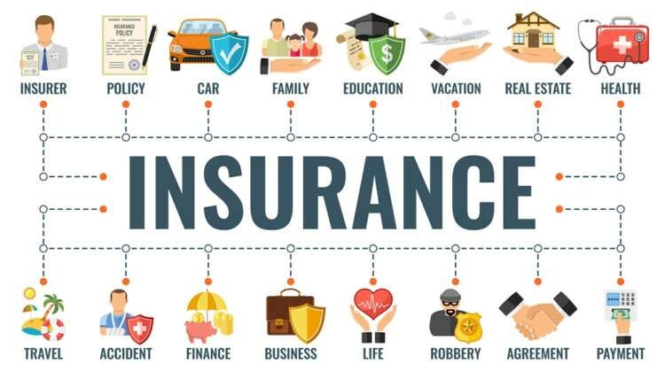
Types of Insurance
Casualty insurance is a broad field of insurance that covers whatever is not covered by fire, marine, and life insurance; casualty lines include auto, liability, burglary and theft, workers compensation, and health insurance.
www.midocean.ae

Slide 24
Property and Casualty Insurance Coverages
1- Personal Lines.
Personal lines refer to coverages that insure the real estate and personal property of individuals and families or provide them with protection against legal liability. Major personal lines include the following:
■Private passenger auto insurance protects the insured against legal liability arising out of auto accidents that cause property damage or bodily injury to others. Auto insurance also includes physical damage insurance on a covered auto for damage or loss resulting from a collision, theft, or other perils. Medical expense coverage and uninsured motorist coverage are also available.
www.midocean.ae

Slide 25
Property and Casualty Insurance Coverages
Homeowners insurance is a package policy that provides property insurance and personal liability insurance in one policy. There are a number of homeowners policies available that cover the dwelling, other structures, and personal property against loss or damage from numerous perils, including fire, lightning, windstorm, or tornado .
Personal umbrella liability insurance provides protection against a catastrophic lawsuit or judgment.
Earthquake insurance covers damage that can result from the shaking and cracking of buildings and damage to personal property in an earthquake. Homeowners policies and business insurance policies do not cover damage from earthquake.
Federal flood insurance is a federal program that provides coverage for flood losses to homeowners and business firms in flood zones.
www.midocean.ae

Slide 26
Property and Casualty Insurance Coverages
2- Commercial Lines.
Commercial lines refer to property and casualty coverages for business firms, nonprofit organizations, and government agencies. Major commercial lines include the following:
Fire insurance covers losses caused by fire and lightning; it is usually sold as part of a package policy, such as a commercial multiple-peril policy. Allied lines refer to coverages that are usually purchased with fire insurance.
Commercial multiple-peril insurance is a package policy, which can be written to include property insurance, general liability insurance, business income insurance, equipment breakdown insurance, and crime insurance.
www.midocean.ae

Slide 27
Property and Casualty Insurance Coverages
General liability insurance covers the legal liability of business firms and other organizations that arise out of property damage or bodily injury to others. Legal liability can arise out of the ownership of business property, sale or distribution of products, and manufacturing or contracting operations.
Products liability insurance covers the legal liability of manufacturers, wholesalers, and retailers to persons who are injured or incur property damage from defective products.
Workers compensation insurance covers workers for a job-related accident or disease. The insurance pays for medical bills, disability income benefits, rehabilitation benefits, and death benefits to the dependents of an employee whose death is job-related.
www.midocean.ae

Slide 28
Property and Casualty Insurance Coverages
Commercial auto insurance covers the legal liability of business firms arising out of the ownership or operation of business vehicles. It also includes physical damage insurance on covered business vehicles for damage or loss resulting from a collision, theft, or other perils..
Accident and health insurance is also sold by some property and casualty insurers. This line is similar to the health insurance coverages sold by life and health insurers.
Inland marine insurance covers goods being shipped on land, which include imports, exports, domestic shipments, and instrumentalities of transportation (for example, bridges, tunnels, and pipelines). Inland marine insurance also covers personal property such as fine art, jewelry, and furs.
www.midocean.ae

Slide 29
Property and Casualty Insurance Coverages
Ocean marine insurance covers ocean-going vessels and their cargo from loss or damage because of perils of the sea; contracts are also written to cover the legal liability of shippers and owners.
Professional liability insurance provides protection against malpractice lawsuits or lawsuits that result from a substantial error or omission. Professional liability insurance covers the professional acts or omissions of physicians, surgeons, attorneys, accountants, and other professionals.
Directors and officers (D & O) liability insurance provides financial protection for the directors and officers and the corporation if the directors and officers are sued for mismanagement of the company’s affairs.
www.midocean.ae

Slide 30
Property and Casualty Insurance Coverages
Boiler and machinery insurance (also known as mechanical breakdown, equipment breakdown,
or systems breakdown coverage ) is a highly specialized line that covers losses due to the accidental breakdown of covered equipment. Such equipment includes steam boilers, air conditioning and refrigeration equipment, and electrical generating equipment.
Fidelity bonds cover loss caused by the dishonest or fraudulent acts of employees, such as embezzlement and the theft of money.
Crime insurance covers the loss of money, securities, and other property because of burglary, robbery, theft, and other crime perils.
www.midocean.ae

Slide 31
Property and Casualty Insurance Coverages
Other coverages include aircraft insurance , which provides physical damage insurance on covered
aircraft and liability coverage for legal liability arising out of the ownership or operation of
aircraft. Credit insurance covers manufacturers and wholesalers against loss because an account receivable is uncollectible.
Financial guaranty insurance guarantees the payment of principal and interest on debt instruments issued by the insured. Private mortgage insurance (PMI) guarantees the mortgage lender for a loss up to certain limits for a property foreclosure if the borrower defaults on the mortgage..
www.midocean.ae

Slide 32
Government Insurance
Numerous government insurance programs are in operation at the present time. Government insurance
can be divided into social insurance programs and other government insurance programs.
Social Insurance Social insurance programs are government insurance programs with certain characteristics that distinguish them from other government insurance plans. These programs are financed entirely or in large part by mandatory contributions from employers, employees, or both, and not primarily by the general revenues of government.
www.midocean.ae

Slide 33
Government Insurance
Major social insurance programs in the United States include the following:
■ Old-Age, Survivors, and Disability Insurance (Social Security)
■ Medicare
■ Unemployment insurance Workers compensation
■ Compulsory temporary disability insurance
■ Railroad Retirement Act
■ Railroad Unemployment Insurance Act
www.midocean.ae

Slide 34
Government Insurance
Old-Age, Survivors, and Disability Insurance, commonly known as Social Security, is a massive public income-maintenance program that provides retirement, survivor, and disability benefits to eligible
individuals and families.
Unemployment insurance programs provide weekly cash benefits to eligible workers who experience short-term involuntary unemployment.
workers compensation insurance covers workers against a job-related accident or disease.
compulsory temporary disability insurance, which exists in five states, Puerto Rico, and the railroad industry, provides for the partial replacement of wages that may be lost because of a temporary nonoccupational disability
www.midocean.ae

Slide 35
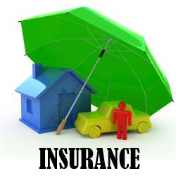
Benefits of Insurance to Society
The major social and economic benefits of insurance include the following:
■ Indemnification for loss
■ Reduction of worry and fear
■ Source of investment funds
■ Loss prevention
■ Enhancement of credit
www.midocean.ae

Slide 36

Indemnification for Loss
Indemnification permits individuals and families to be restored to their former financial position after a loss occurs. As a result, they can maintain their financial security. Because insureds are restored either in part or in whole after a loss occurs, they are less likely to apply for public assistance or welfare benefits, or to seek financial assistance from relatives and friends.
In short, the indemnification function contributes greatly to family and business stability and therefore is one of the most important social and economic benefits of insurance.
www.midocean.ae

Slide 37
Reduction of Worry and Fear
second benefit of insurance is that worry and fear are reduced. This is true both before and after a loss. For example, if family heads have adequate amounts of life insurance, they are less likely to worry about the financial security of their dependents in the event of premature death; persons insured for long-term disability do not have to worry about the loss of earnings if a serious illness or accident occurs; and property owners who are insured enjoy greater peace of mind because they know they are covered if a loss occurs. Worry and fear are also reduced after a loss occurs, because the insureds know that they have insurance that will pay for the loss..
www.midocean.ae

Slide 38
Source of Investment Funds
The insurance industry is an important source of funds for capital investment and accumulation. Premiums are collected in advance of the loss, and funds not needed to pay immediate losses and expenses can be loaned to business firms.
www.midocean.ae

Slide 39
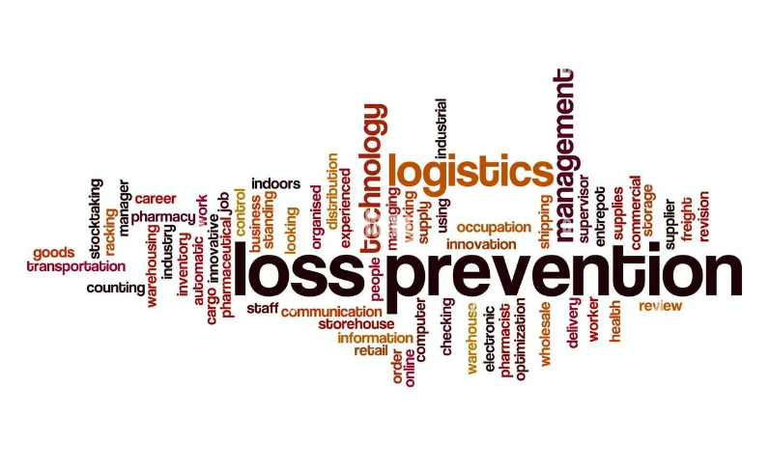
Loss Prevention
Insurance companies are actively involved in numerous loss-prevention programs and also employ a
wide variety of loss-prevention personnel, including safety engineers and specialists in fire prevention,
occupational safety and health, and products liability.
www.midocean.ae

Slide 40
Loss Prevention
Some important loss-prevention activities that property and casualty insurers strongly support include the following:
■ Highway safety and reduction of auto accidents and deaths
■ Fire prevention
■ Reduction of work-related injuries and disease Prevention of auto thefts
■ Prevention and detection of arson losses
■ Prevention of defective products that could injure the user
■ Prevention of boiler explosions
■ Educational programs on loss prevention
The loss-prevention activities reduce both direct and indirect, or consequential, losses. Society
benefits, because both types of losses are reduced..
www.midocean.ae

Slide 41
Enhancement of Credit
A final benefit is that insurance enhances a person’s credit:
Insurance makes a borrower a better credit risk because it guarantees the value of the borrower’s collateral or gives greater assurance that the loan will be repaid.
The property insurance protects the lender’s financial interest if the property is damaged or destroyed. Similarly, a business firm seeking a temporary loan for Christmas or seasonal business may be required to
insure its inventories before the loan is made.
www.midocean.ae

Slide 42

Costs of Insurance to Society
Although the insurance industry provides enormous social and economic benefits to society, the social
costs of insurance must also be recognized. The major social costs of insurance include the following:
■ Cost of doing business
■ Fraudulent claims
■ Inflated claims
www.midocean.ae

Slide 43
Cost of Doing Business
One important cost is the cost of doing business.
Insurers consume scarce economic resources—land, labor, capital, and business enterprise—in providing
insurance to society. In financial terms, an expense loading must be added to the pure premium to cover
the expenses incurred by insurance companies in their daily operations.
An expense loading is the amount needed to pay all expenses, including underwriting and loss-adjustment expenses, commissions, general administrative expenses, state premium taxes, acquisition expenses, and an allowance for contingencies and profit
www.midocean.ae

Slide 44
Cost of Doing Business
These additional costs can be justified for several reasons.
First, from the insured’s viewpoint, uncertainty concerning the payment of a covered loss is reduced because of insurance.
Second, the costs of doing business are not necessarily wasteful, because insurers engage in a wide variety of loss-prevention activities.
Finally, the insurance industry provides jobs to millions of workers in the United States. However, because economic resources are used up in providing insurance to society, a real economic cost is incurred.
www.midocean.ae

Slide 45
Fraudulent Claims
A second cost of insurance comes from the submission of fraudulent claims. Examples of fraudulent claims include the following:
Auto accidents are faked or staged to collect benefits.
Dishonest claimants inflate or pad an insurance claim to cover a required deductible.
Dishonest claimants fake slip-and-fall accidents.
Phony burglaries, thefts, or acts of vandalism are reported to insurers.
False health insurance claims are submitted to collect benefits.
Dishonest policyholders take out life insurance policies on unsuspecting insureds and later arrange to have them killed.
www.midocean.ae

Slide 46
Inflated Claims
Another cost of insurance relates to the submission of inflated or “padded” claims. Although the loss is not intentionally caused by the insured, the dollar amount of the claim may exceed the actual financial loss. Examples of inflated claims include the following:
■■ Attorneys for plaintiffs sue for high-liability judgments that exceed the true economic loss of the victim.
■■ Insureds inflate the amount of damage in auto collision claims so that the insurance payment will cover the collision deductible.
■■ Disabled persons often malinger to collect disability- income benefits for a longer duration.
■■ Insureds exaggerate the amount and value of property stolen from a home or business
www.midocean.ae

Slide 47
Cost to Society of Fraudulent and Inflated Claims
Fraudulent and inflated claims are another important social cost of insurance in the economy. The amount of fraudulent claims is difficult to measure and varies by line of insurance, economic conditions, attitude of the public toward insurers, and other factors as well.
However, estimates of fraudulent claims indicate that the problem is serious.
www.midocean.ae

Slide 48



Thank You

