Slide 1





Lecture: #06
User Authentication
Dr. Hesham Abou Elfetouh
Cybersecurity Department
Faculty of Informatics
Midocean University
Secure Operating Systems (CYB610)
www.midocean.ae

Slide 2
Chapter
Outline
06
    This chapter covers the following topics and concepts: User authentication
- Password authentication
- Probable Passwords
- Passwords Likely for a User
- Password Selection Criteria
- One-Time Passwords
- Salt
Access Control
Implementation of Access Control
2
www.midocean.ae
Secure Operating Systems

Slide 3
Chapter
Introduction
06
In Previous Lecture you learned:
What is “Program security”
Basic approaches to having secure programs
Controls for Security
Developmental Controls for Security
Administrative Controls for Security
Operating System Controls for Security
3
www.midocean.ae
Secure Operating Systems

Slide 4
Chapter
CHAPTER 6 GOALS
06
When you complete this chapter, you will be able to:
Know What is the “User authentication”
Explain the Password Authentication
Illustrate the Implementation of Access Control
Know the Passwords Likely for a User
4
www.midocean.ae
Secure Operating Systems

Slide 5


Chapter
User authentication
06
“The process of verifying an identity claimed by or for a system entity.”
  driver's license
  passports
  voice recognition
  fingerprint
  retina matching
5
www.midocean.ae
Secure Operating Systems

Slide 6
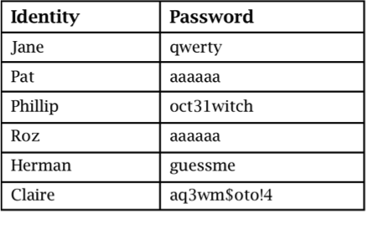
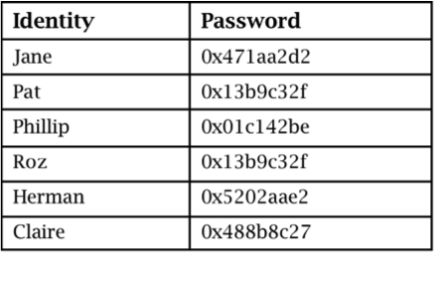
Chapter
Password Storage
06
Plaintext
Concealed
6
www.midocean.ae
Secure Operating Systems

Slide 7
Chapter
Password Authentication
06
The most common authentication mechanism for user to operating system is a password.
A "word" known to computer and user.
widely used line of defense against intruders
  user provides name/login and password to the security system (identification step)
  system compares password with the one stored for that specified login (verification step)
The user ID:
  determines that the user is authorized to access the system
  determines the user’s privileges
  is used in access control
7
www.midocean.ae
Secure Operating Systems

Slide 8
Chapter
Authentication Methods
06
The four means of authenticating user identity are based on:
Something the individual knows
  password,
  PIN,
  Answers to prearranged questions
Something the individual possesses (token)
  Smartcard,
  Electronic keycard,
  Physical key
Something the individual is (static biometrics)
  Fingerprint,
  Retina,
  Face
something the individual does (dynamic biometrics)
  Voice pattern,
  Handwriting,
  Typing rhythm
8
www.midocean.ae
Secure Operating Systems

Slide 9
Chapter
Authentication Mechanisms
06
    Two or more forms can be combined for more solid authentication.
    a bank card and a PIN combine something the user has with something the user knows.
9
www.midocean.ae
Secure Operating Systems

Slide 10
Chapter
Why Passwords?
06
Why is “something you know” more popular than “something you have” and “something you are”?
Cost: passwords are free
Convenience: easier for System Administrator to reset password than to issue user a new thumb
10
www.midocean.ae
Secure Operating Systems

Slide 11
Chapter
Basic Password Scheme
06
Password file
User
kiwifruit
exrygbzyf
kgnosfix
ggjoklbsz
…
…
hash function
11
www.midocean.ae
Secure Operating Systems

Slide 12
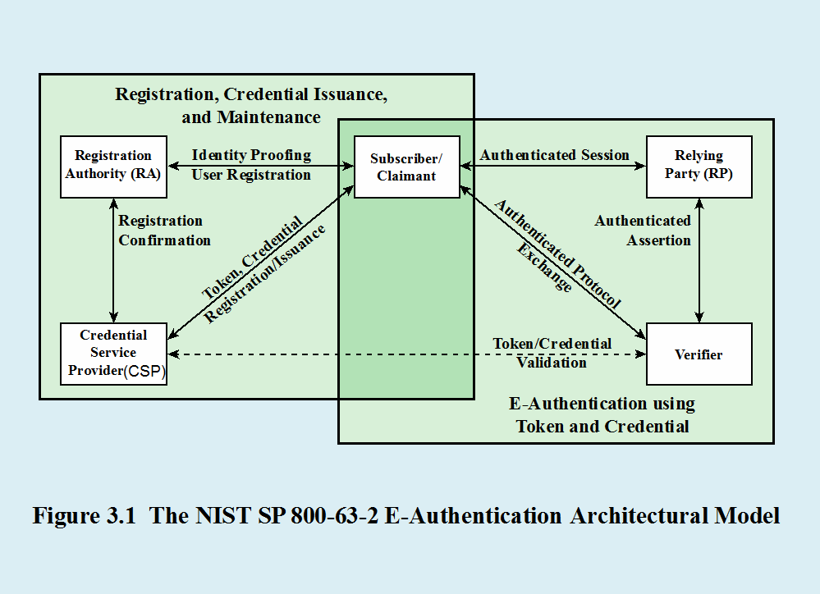
Chapter
Authentication model
06
12
www.midocean.ae
Secure Operating Systems

Slide 13
Chapter
Basic Password Scheme
06
Hash function h : strings → strings
  Given h(password), hard to find password
  No known algorithm better than trial and error
User password stored as h(password)
When user enters password
  System computes h(password)
  Compares with entry in password file
No passwords stored on disk
13
www.midocean.ae
Secure Operating Systems

Slide 14
Chapter
Passwords Difficulties
06
Loss
  if the user loses the password, a new one must be assigned.
Use
  Supplying a password for each access to a file can be inconvenient and time consuming.
Disclosure
  If a password is disclosed to an unauthorized individual, the file becomes immediately accessible.
  If the user changes the password, all the other users must be informed of the new password because their old password will fail.
Revocation
  To revoke one user's access right to a file, someone must change the password, thereby causing the same problems as disclosure.
14
www.midocean.ae
Secure Operating Systems

Slide 15
Chapter
Password Vulnerabilities
06
offline dictionary attack
popular password attack
workstation hijacking
exploiting multiple password use
specific account attack
password guessing against single user
exploiting user mistakes
electronic monitoring
15
www.midocean.ae
Secure Operating Systems

Slide 16
Chapter
Countermeasures
06
  Controls to prevent unauthorized access to password file
  Intrusion detection measures
  Rapid re-issuance of compromised passwords
  Account lockout mechanisms
  Policies to inhibit users from selecting common passwords
  Training in and enforcement of password policies
  Automatic workstation logout
  Policies against similar passwords on network devices
16
www.midocean.ae
Secure Operating Systems

Slide 17
Chapter
Additional Authentication Information
06
Limiting users to certain workstations or certain times of access.
Using additional authentication information is called multifactor authentication
Two forms of authentication (which is, not surprisingly, known as two-factor authentication) are better than one,
17
www.midocean.ae
Secure Operating Systems

Slide 18
Chapter
Risk Assessment for User Authentication
06
Assurance Level
Potential impact
Areas of risk
There are three separate concepts:
18
www.midocean.ae
Secure Operating Systems

Slide 19
Chapter
Assurance Level
06
Describes an organization’s degree of certainty that a user has presented a credential that refers to his or her identity
More specifically is defined as:
Four levels of assurance
The degree of confidence in the vetting process used to establish the identity of the individual to whom the credential was issued
Level 1
  Little or no confidence in the asserted identity's validity
Level 2
  Some confidence in the asserted identity’s validity
The degree of confidence that the individual who uses the credential is the individual to whom the credential was issued
Level 3
  High confidence in the asserted identity's validity
Level 4
  Very high confidence in the asserted identity’s validity
19
www.midocean.ae
Secure Operating Systems

Slide 20
Chapter
Potential Impact
06
There are three levels of potential impact on organizations or individuals should there be a breach ( failure) of security:
  Low
    An authentication error could be expected to have a limited adverse effect on organizational operations, organizational assets, or individuals
  Moderate
    An authentication error could be expected to have a serious adverse effect
  High
    An authentication error could be expected to have a severe or catastrophic adverse effect
20
www.midocean.ae
Secure Operating Systems

Slide 21
Chapter
Access Control
06
Two parts to access control
Authentication: Are you who you say you are?
  Determine whether access is allowed
  Authenticate human to machine
  Or authenticate machine to machine
Authorization: Are you allowed to do that?
  Once you have access, what can you do?
  Enforces limits on actions
Note: “access control” often used as a synonym for authorization
21
www.midocean.ae
Secure Operating Systems

Slide 22
Chapter
Federated Identity Management
06
22
www.midocean.ae
Secure Operating Systems

Slide 23
Chapter
Single Sign-On
06
23
www.midocean.ae
Secure Operating Systems

Slide 24
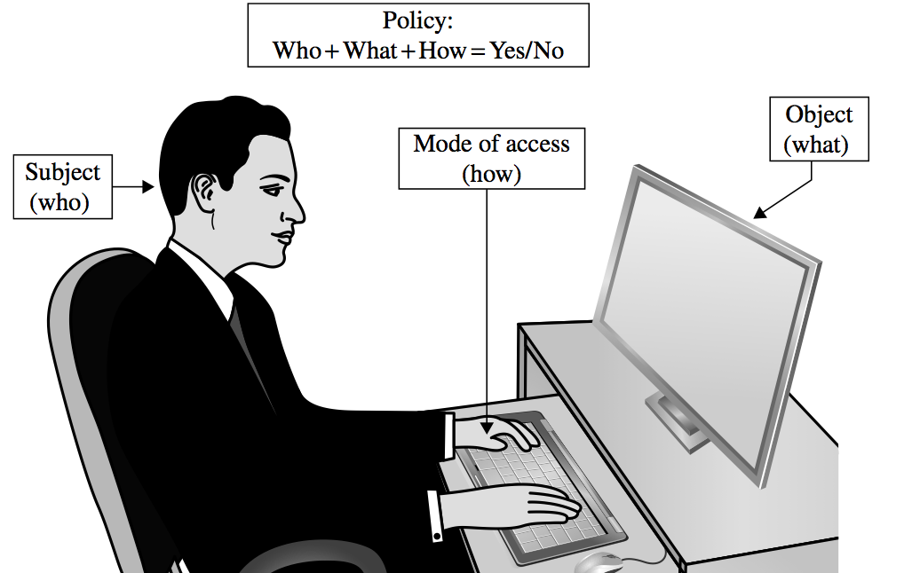
Chapter
Access Control
06
24
www.midocean.ae
Secure Operating Systems

Slide 25
Chapter
Access Policies
06
Goals:
  Check every access
  Enforce the least privilege
  Verify acceptable usage
25
www.midocean.ae
Secure Operating Systems

Slide 26
Chapter
Implementing Access Control
06
Reference monitor
Access control directory
Access control matrix
Access control list
Privilege list
Capability
Procedure-oriented access control
Role-based access control
26
www.midocean.ae
Secure Operating Systems

Slide 27
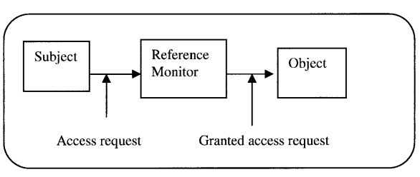
Chapter
Reference Monitor
06
The subject, for example a user, initiates an access request for a specified system resource, such as a Web resource.
The request goes to the reference monitor.
The job of the reference monitor is to check on the hierarchy of rules that specify certain restrictions.
A set of such rules is called an access control list (ACL).
The access control hierarchy is based on the URL path for a Web access, or file path for a file access such as in a directory.
When a request for access is made, the monitor or server goes in turn through each ACL rule, continuing until it encounters a rule that prevents it from continuing and results in a request rejection or comes to the last rule for that resource, resulting into access right being it granted.
27
www.midocean.ae
Secure Operating Systems
Notes:
Ordinary عادي

Slide 28
Chapter
Access Control Directory
06
28
www.midocean.ae
Secure Operating Systems

Slide 29
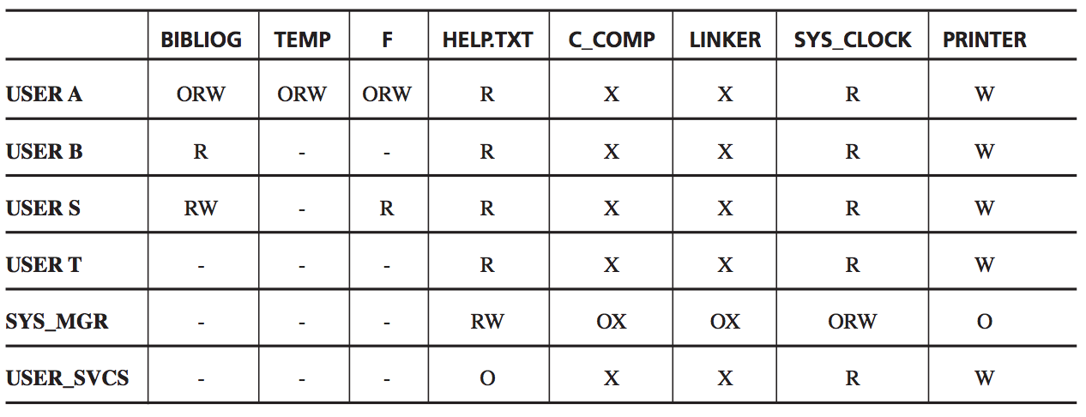
Chapter
Access Control Matrix
06
29
www.midocean.ae
Secure Operating Systems

Slide 30
Chapter
Access Control List
06
30
www.midocean.ae
Secure Operating Systems

Slide 31
Chapter
Probable Passwords
06
Think of a word
31
www.midocean.ae
Secure Operating Systems

Slide 32
Chapter
Probable Passwords (cont..)
06
  Is the word you thought of long?
  Is it uncommon?
  Is it hard to spell or pronounce?
The answer to all three of these questions is probably no.
32
www.midocean.ae
Secure Operating Systems

Slide 33
Chapter
Probable Passwords (cont..)
06
If people prefer short passwords to long ones, the penetrator will plan to try all passwords but to try them in order by length.
There are only 26¹ + 26² + 26³=18,278 passwords of length 3 or less.
At the assumed rate of one password per millisecond, all of these passwords can be checked in 18.278 seconds,
33
www.midocean.ae
Secure Operating Systems

Slide 34
Chapter
Probable Passwords (cont..)
06
The trials to 4 or 5 characters raise the count only to 475 seconds (about 8 minutes) or 12,356 seconds (about 3.5 hours), respectively.
People tend to choose names or words they can remember
Many computing systems have spelling checkers that can be used to check for spelling errors and typographic mistakes in documents.
Trying all of these words as passwords takes only 80 seconds.
34
www.midocean.ae
Secure Operating Systems

Slide 35
Chapter
Passwords Likely for a User
06
People typically choose personal passwords, such as the name of a spouse, a child, a brother or sister, a pet, a street name, or something memorable or familiar.
If we restrict our password attempts to just names of people (first names), streets, projects, and so forth, we generate a list of only a few hundred possibilities at most.
35
www.midocean.ae
Secure Operating Systems

Slide 36
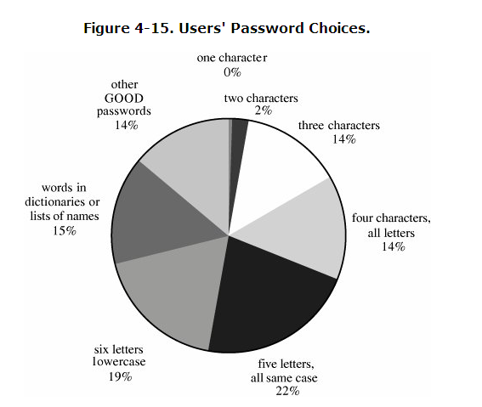
Chapter
Passwords Likely for a User (cont..)
06
36
www.midocean.ae
Secure Operating Systems

Slide 37
Chapter
Passwords Likely for a User (cont..)
06
The British online bank found users still choosing weak passwords :
  A full 50 percent of passwords for their online banking service were family members' names
  23 percent children's names
  19 percent a spouse or partner
  9 percent their own
37
www.midocean.ae
Secure Operating Systems

Slide 38
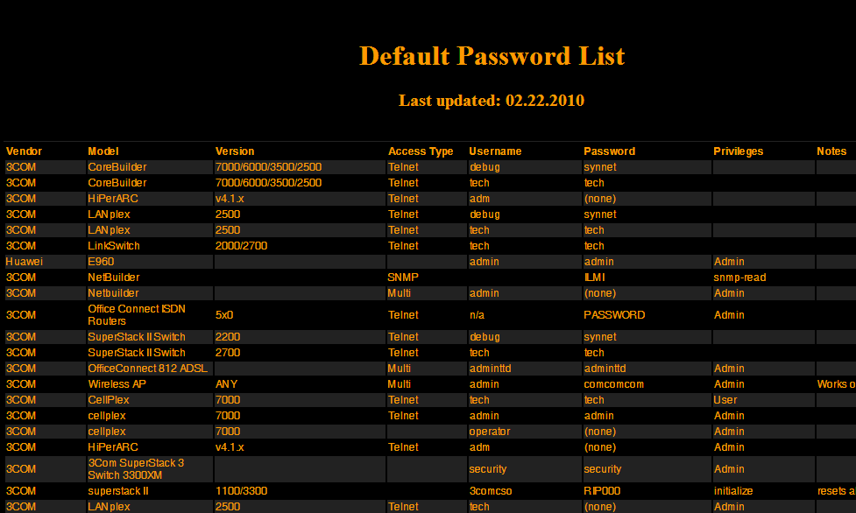
Chapter
Passwords Likely for a User (cont..)
06
www.phenoelit.de/dpl/dpl.html
38
www.midocean.ae
Secure Operating Systems

Slide 39
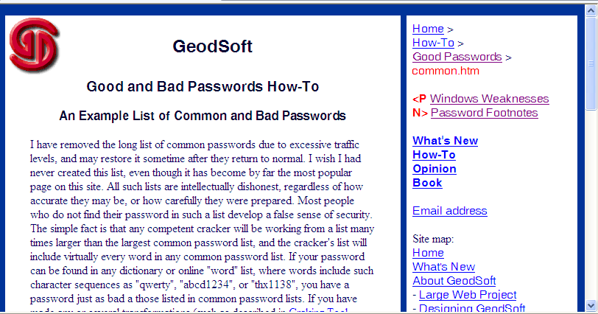
Chapter
Passwords Likely for a User (cont..)
06
geodsoft.com/howto/password/common.htm
39
www.midocean.ae
Secure Operating Systems

Slide 40
Chapter
Passwords Likely for a User (cont..)
06
Several network sites post dictionaries of phrases, science fiction characters, places, mythological names, Chinese words, and other specialized lists.
All these lists are posted to help site administrators identify users who have chosen weak passwords.
but the same dictionaries can also be used by attackers of sites
40
www.midocean.ae
Secure Operating Systems

Slide 41
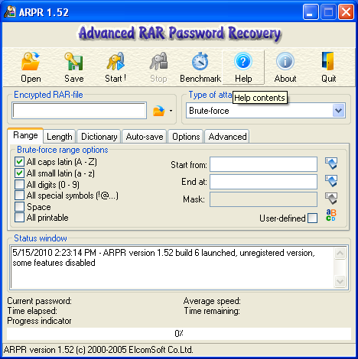
Chapter
Passwords Likely for a User (cont..)
06
Now Internet sites offer so-called password recovery software as freeware or shareware.
41
www.midocean.ae
Secure Operating Systems

Slide 42
Chapter
Summary
06
In this lecture we talked about :
User authentication and its definition and we know that it is the process of verifying an identity claimed by or for a system entity.
The most common authentication mechanism for user to operating system is a password.
We discussed the access control.
We discussed the Probable Passwords and the Passwords Likely for a User.
42
www.midocean.ae
Secure Operating Systems

Slide 43



Thank You

