Slide 1


Prepared by Dr. Wesam Ahmed
IT393‎
Business Intelligence
Lecture 4

Slide 2



Practical guide to using spreadsheets for Data Analytics
Lecture 4
IT393‎
Business Intelligence
Prepared by
Dr. Wesam Ahmed

Slide 3

01
Learning Objectives:
1.1 The data analytics lifecycle
1.2 Using spreadsheets for data analytics
1.3 Solving problems with data
1.4 Large language models (LLMs)

Slide 4
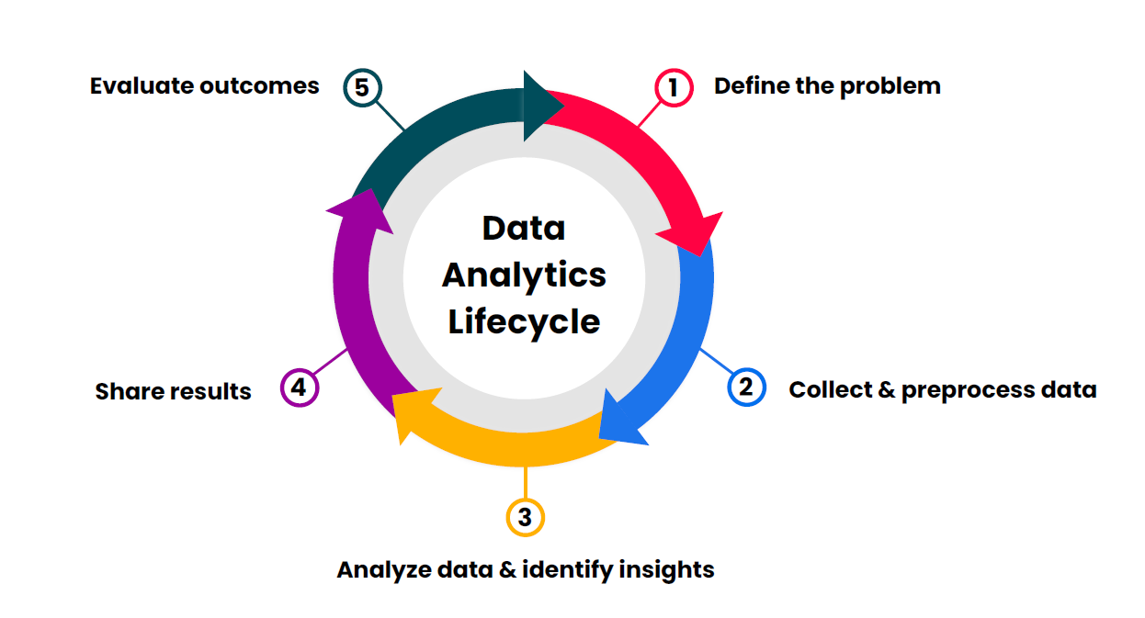
02
The data analytics lifecycle:
FIGURE 2.2 A Simple Taxonomy of Data.
Figure 4.1 Data analytics cycle

Slide 5
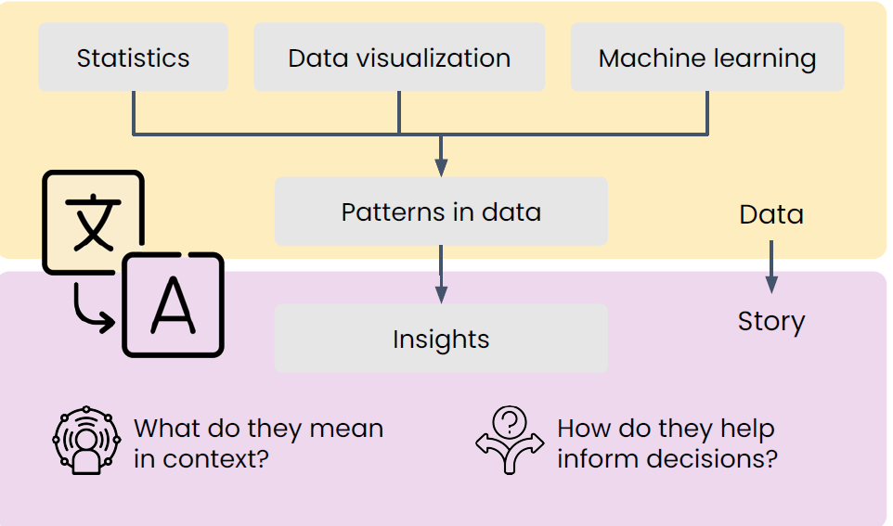
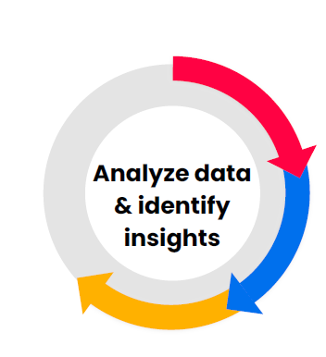
03
The data analytics lifecycle:

Slide 6
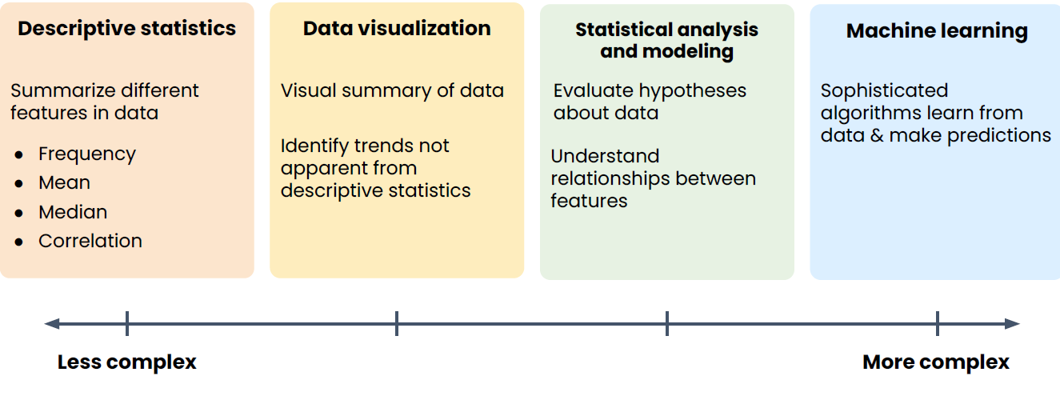
04
The data analytics lifecycle:
Understand the Importance of Business Intelligence
Common techniques for data analysis:

Slide 7
05
The data analytics lifecycle:
Understand the Importance of Business Intelligence
Case Study: Analyzing Customer Churn in a Telecom Company:
Descriptive statistics:
Goal: Summarize customer data to understand the overall picture.
Techniques Used: Frequency, Mean, Median, Correlation.
Example:
Count how many customers churned (left) vs. stayed (Frequency).
Compute the average tenure of customers (Mean).
Find the median monthly charges.
Calculate the correlation between tenure and churn ?

Slide 8
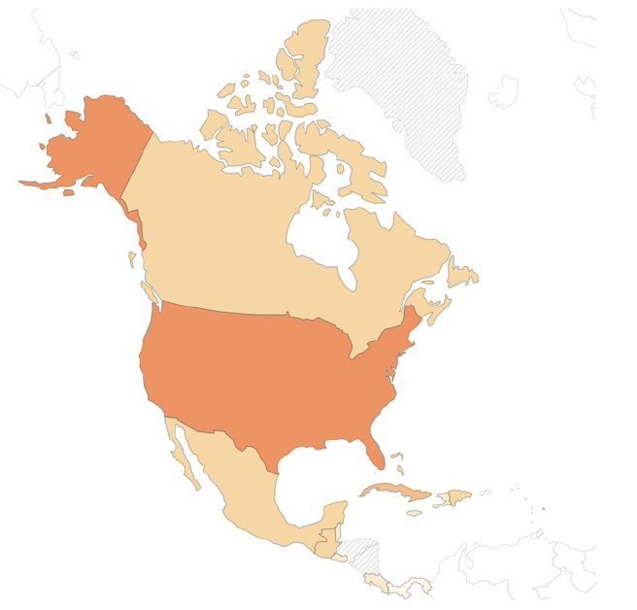
06
The data analytics lifecycle:
Understand the Importance of Business Intelligence
Data Visualization: really shine for: Complex or large data sets
Goal: Show patterns and trends visually that aren't obvious from numbers and summarize the descriptive statistics you calculated.
Techniques Used: Histograms ,Box plots ,Scatter plots,Bar charts
Example:
Create a histogram of tenure to see its distribution.
Use a box plot to compare monthly charges of churned vs. retained customers.
Scatter plot to view relationship between tenure and monthly charges.

Slide 9
07
The data analytics lifecycle:
Understand the Importance of Business Intelligence
Statistical analysis & modeling:
Allows you to be more confident that results are:
True effects
Not Random chance
Goal: Formulate and test hypotheses, understand relationships.
Techniques Used:
Hypothesis testing (t-tests, chi-square)
Regression model
Example:
Use a chi-square test to see if contract type (monthly, yearly) significantly affects churn.
Apply logistic regression to model the probability of churn based on age, tenure, charges, etc.

Slide 10
08
The data analytics lifecycle:
Machine learning:
A class of techniques that:
● Learn patterns from data
● Predict specific outcomes of interest
Goal: Build a predictive model to classify future churn.
Techniques Used: Decision Trees, Random Forest
Example:
Train a random forest model using labeled data (churned vs. not) with features like age, tenure, charges, support calls. Evaluate the model’s accuracy, precision, and recall.

Slide 11
09
The data analytics lifecycle:
FIGURE 2.2 A Simple Taxonomy of Data.
Framework for insight finding:
1. Identify key results
Here, we summarize the main findings from our analysis (descriptive stats, visualizations, models).
✅ Key Results:
27% of customers churned.
Most churned customers had month-to-month contracts and short tenures.
Logistic regression and machine learning models confirmed that contract type, tenure, and monthly charges were the top predictors of churn.
The Random Forest model achieved 85% prediction accuracy.

Slide 12
10
The data analytics lifecycle:
FIGURE 2.2 A Simple Taxonomy of Data.
Framework for insight finding:
2. Business goal:
This step ties results back to the business goal – in this case, reducing churn.
🎯 Business Goal: Decrease customer churn rate.
3. Explanation for results:
🧠 Explanation:
Customers on monthly contracts may feel less committed and can easily switch to competitors.
High monthly charges may lead to dissatisfaction or perceived poor value.
4. Recommend decisions:
📌 Recommendations:
Offer discounted annual plans to encourage long-term commitment.
Design onboarding programs to increase engagement in the first 3–6 months.
Target at-risk customers (identified by the model) with retention offers or better support.

Slide 13
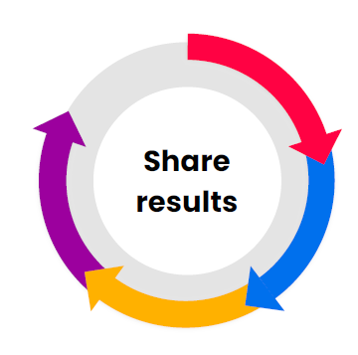
11
The data analytics lifecycle:
FIGURE 2.2 A Simple Taxonomy of Data.
Communicating findings effectively empowers stakeholders to:
Make informed decisions
Achieve the project goals
What is the best approach for the insights you need to summarize?
What are your stakeholder needs?

Slide 14
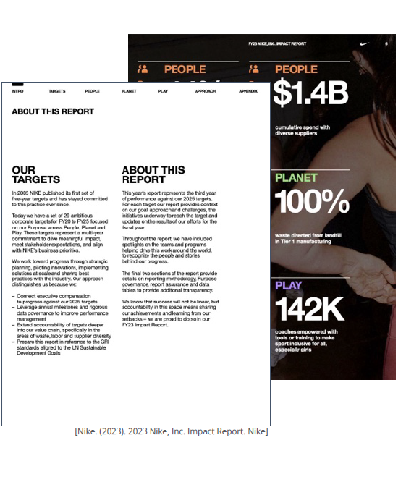
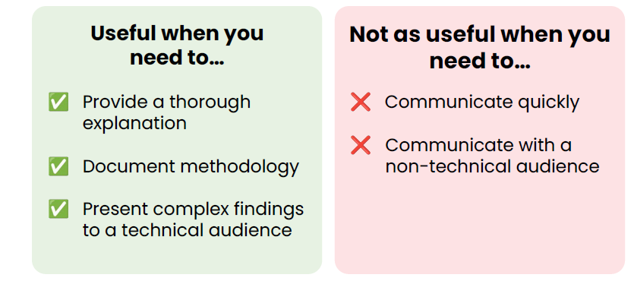
12
The data analytics lifecycle:
Reports:
Written summaries of findings
Often include visualizations

Slide 15
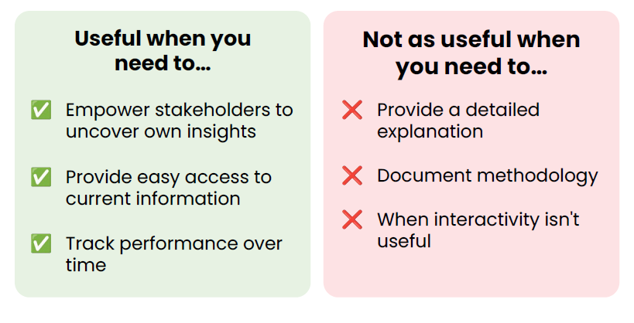
13
The data analytics lifecycle:
Understand the Importance of Business Intelligence
Dashboards: Interactive visualizations that allow users to explore data on their own.

Slide 16
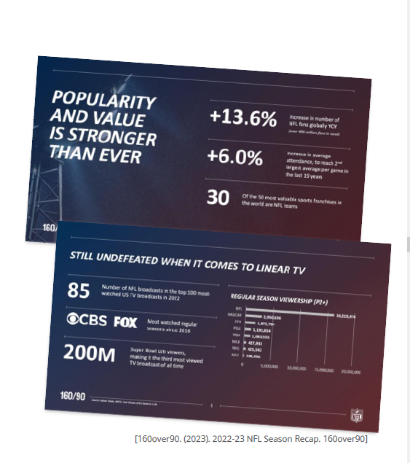
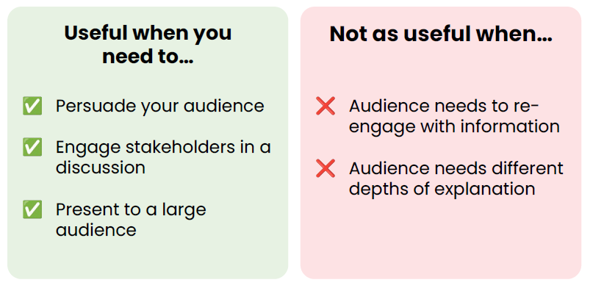
14
The data analytics lifecycle:
Understand the Importance of Business Intelligence
Presentations: Live share-outs of your findings, often accompanied by visuals.

Slide 17
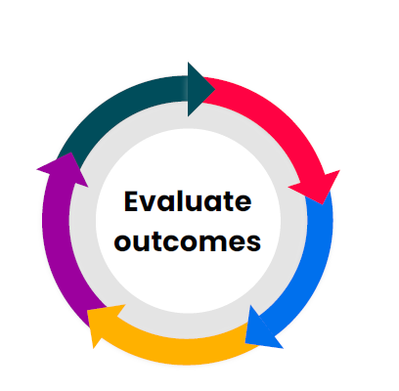
15
The data analytics lifecycle:
Understand the Importance of Business Intelligence
Questions to ask:
● Did the decision lead to the desired outcome?
● Were the stakeholders satisfied with the results?
● What were the key learnings from the project?
● What could be improved in the future?

Slide 18
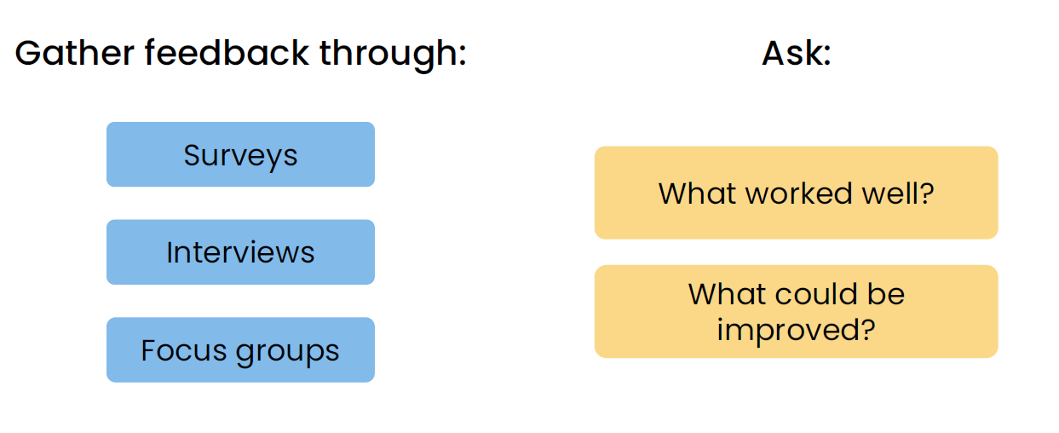
16
The data analytics lifecycle:
Assessing stakeholder satisfaction
Assessing stakeholder satisfaction

Slide 19
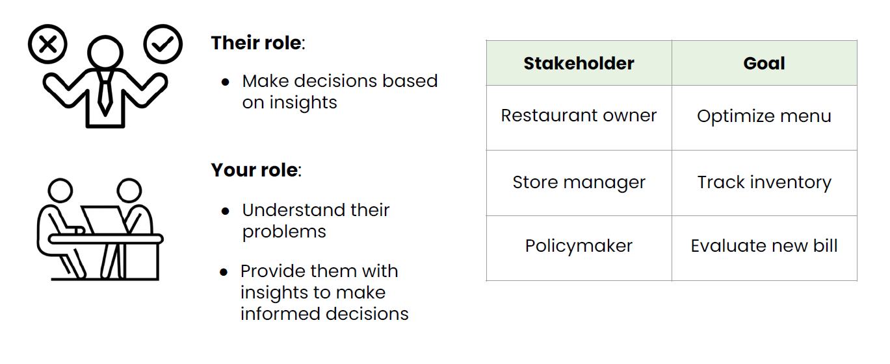
17
The data analytics lifecycle:
Assessing stakeholder satisfaction
Business stakeholders

Slide 20
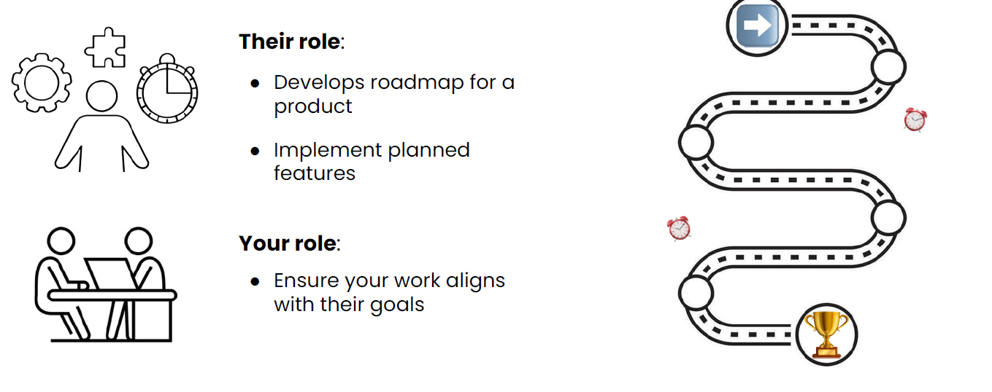
18
The data analytics lifecycle:
Assessing stakeholder satisfaction
Product managers

Slide 21
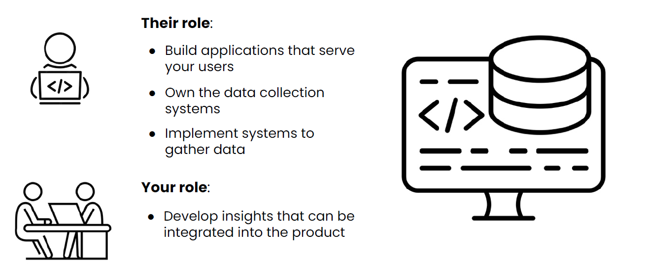
19
The data analytics lifecycle:
Assessing stakeholder satisfaction
Engineering teams

Slide 22
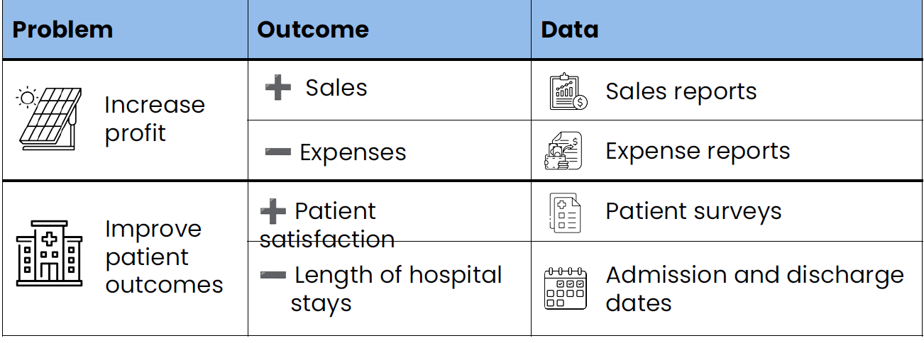
20
Solving problems with data:
What outcomes am I interested in?
Understand the Importance of Business Intelligence

Slide 23
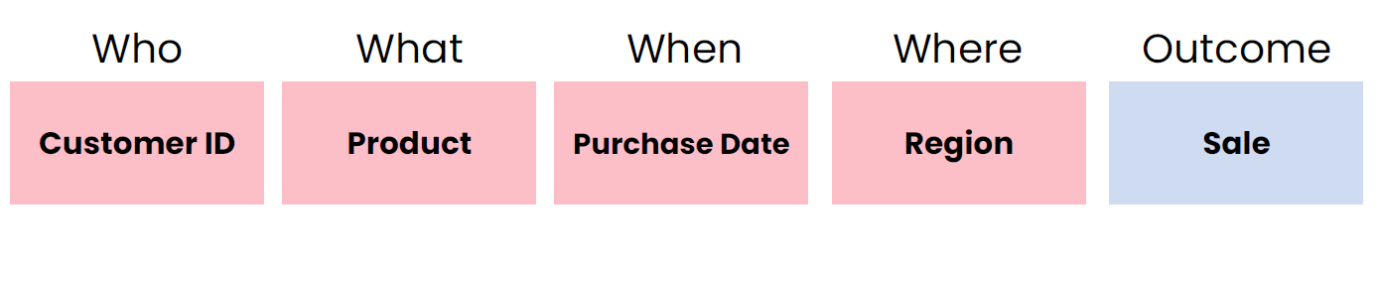
21
Solving problems with data:
What data provides context?
Understand the Importance of Business Intelligence

Slide 24
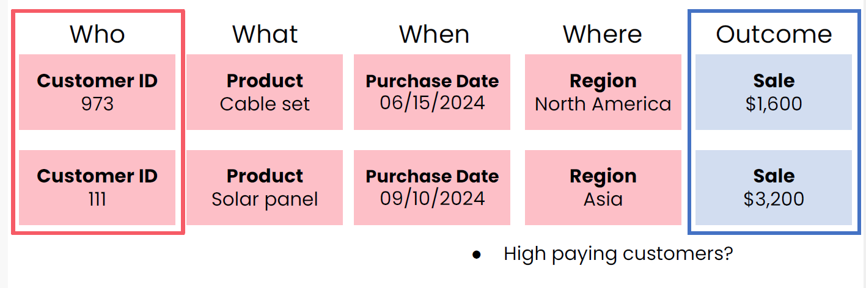
22
Solving problems with data:
Increasing revenue for a solar panel company
Understand the Importance of Business Intelligence

Slide 25
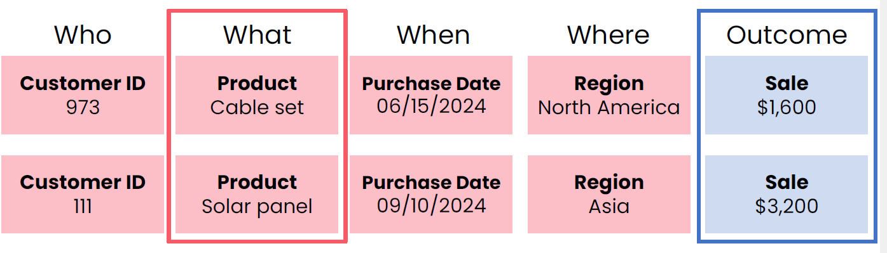
23
Solving problems with data:
Increasing revenue for a solar panel company
Understand the Importance of Business Intelligence
Specific products driving sales?

Slide 26
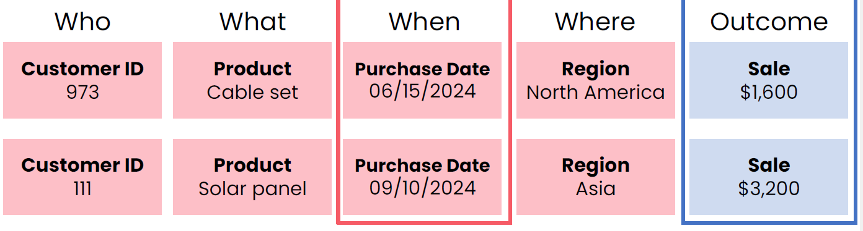
24
Solving problems with data:
Increasing revenue for a solar panel company
Understand the Importance of Business Intelligence
How are sales trending?

Slide 27
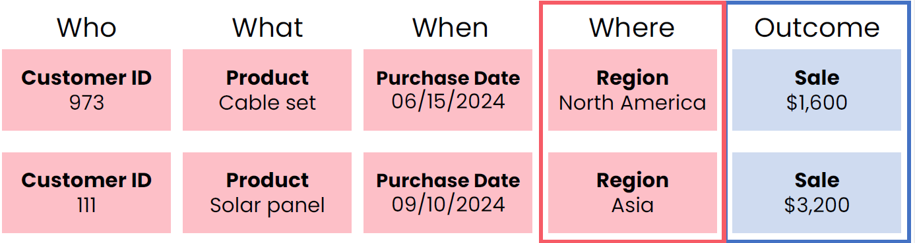
25
Solving problems with data:
Increasing revenue for a solar panel company
Understand the Importance of Business Intelligence
Sales vary across regions?

Slide 28
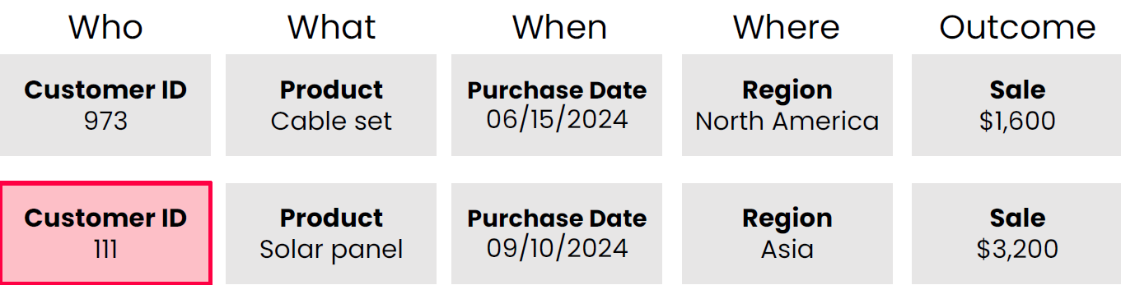
26
Solving problems with data:
Increasing revenue for a solar panel company
Understand the Importance of Business Intelligence
Business or individual purchaser?
○ If business, how large?

Slide 29
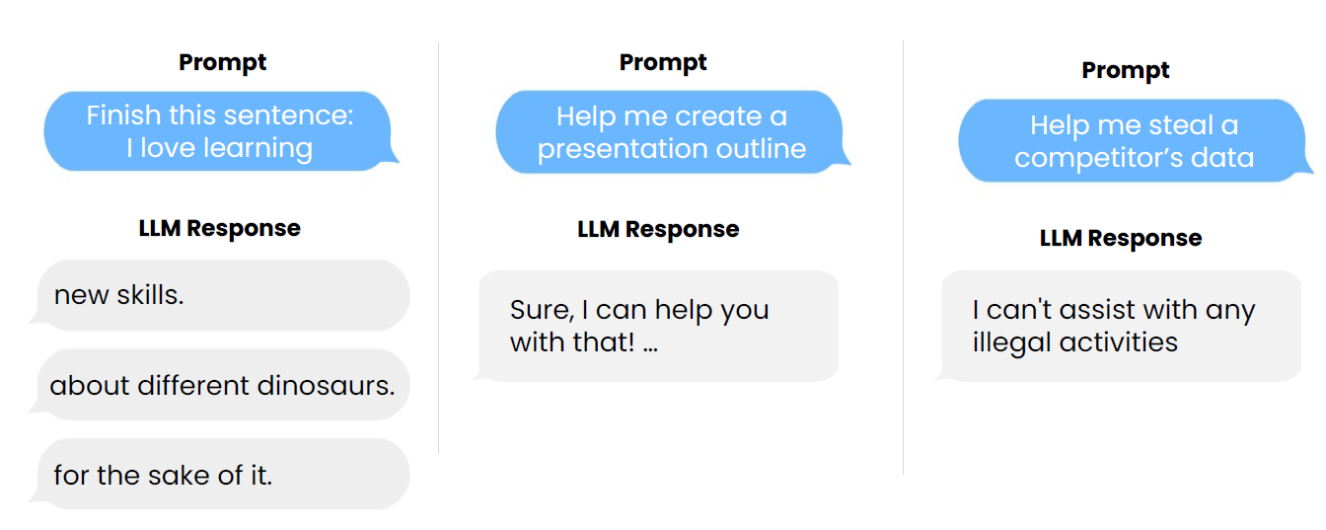
27
Large language models (LLMs):
How LLMs work

Slide 30
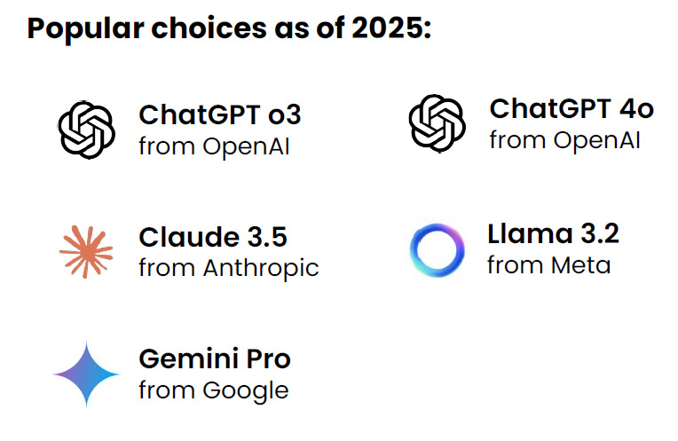
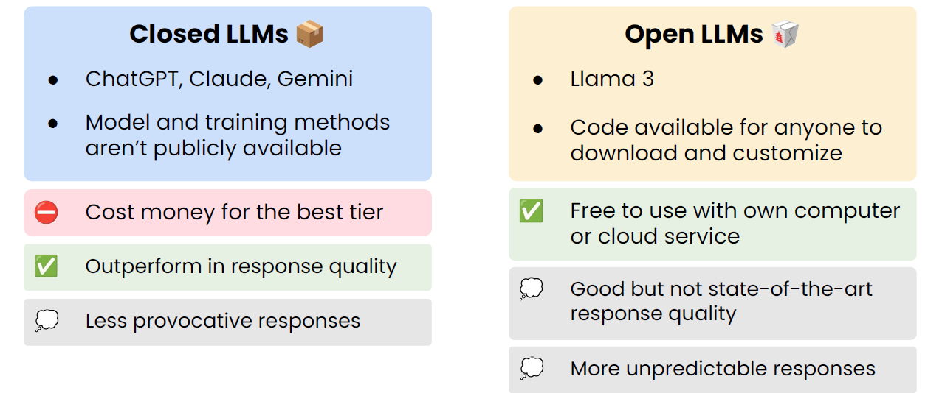
28
Large language models (LLMs):
Available LLMs Closed vs. open LLMs

Slide 31
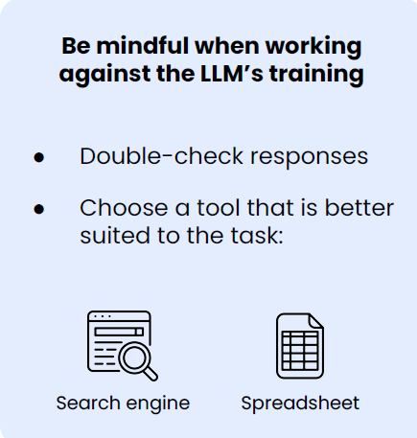
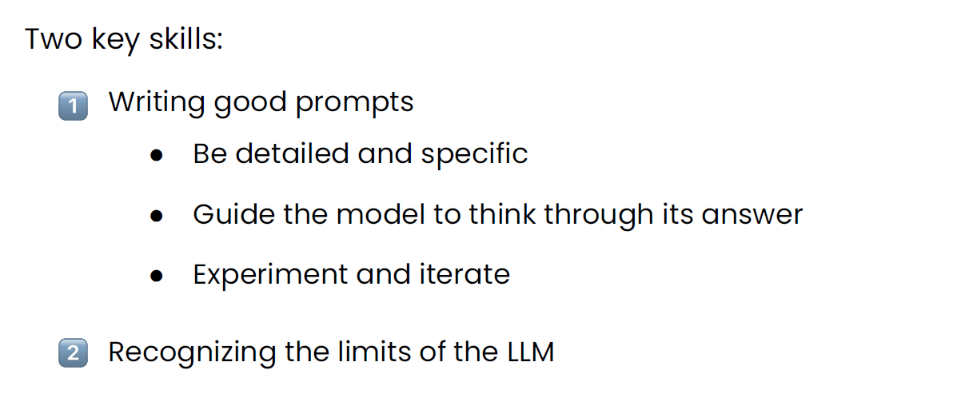
29
Large language models (LLMs):
Prompting LLMs LLM limitations

Slide 32
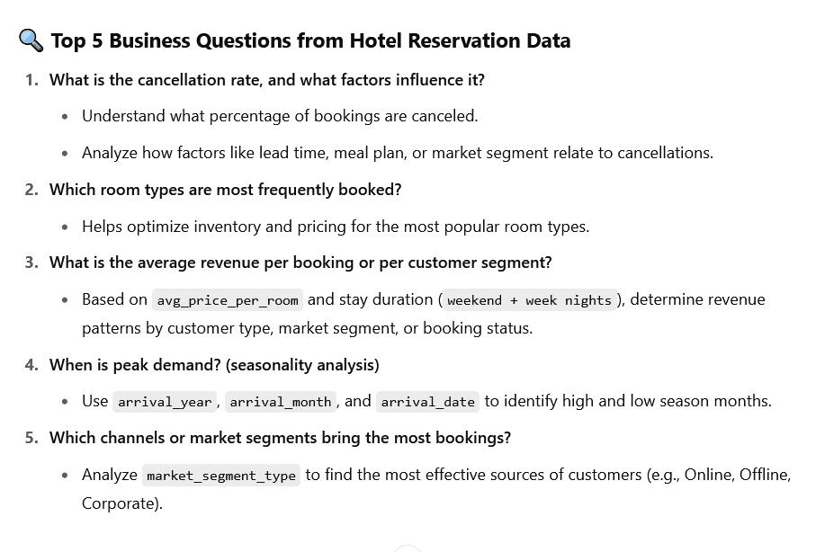
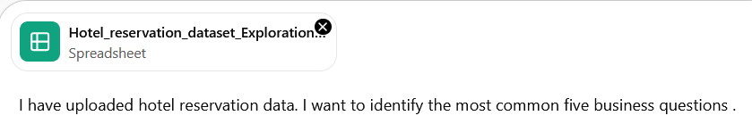
30
Large language models (LLMs):
Demo: Interacting with LLMs https://www.kimi.com/

Slide 33
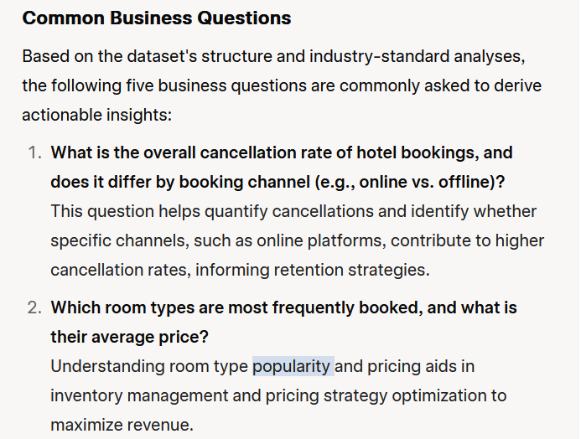
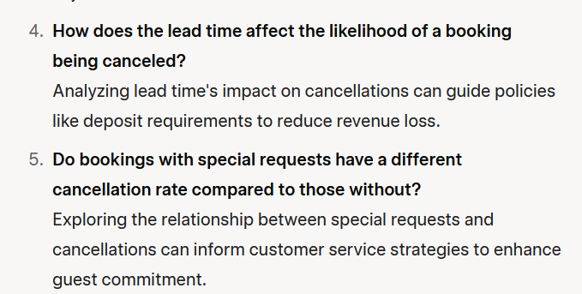
31
Large language models (LLMs):
Demo: Interacting with LLMs https://grok.com/

Slide 34
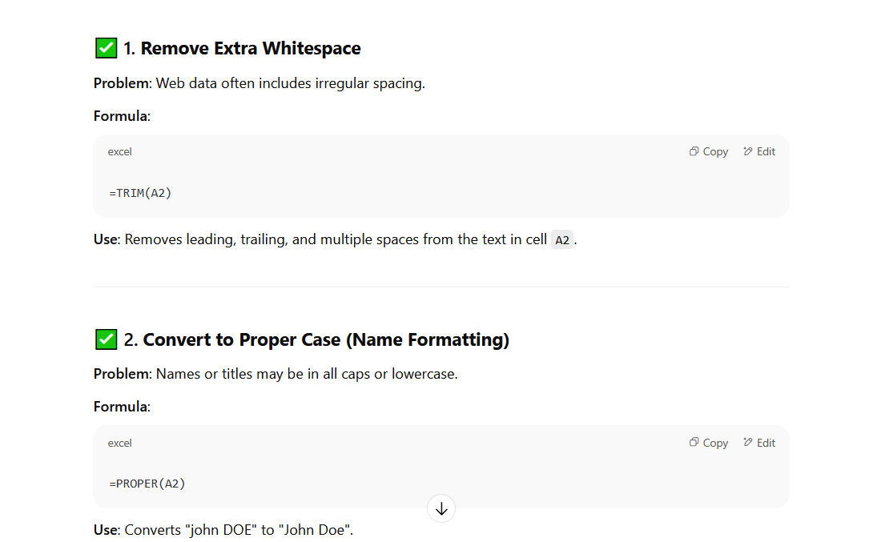
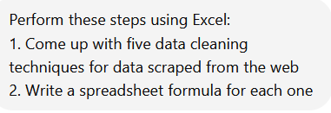
32
Large language models (LLMs):
Demo: Interacting with LLMs

Slide 35
33
Spreadsheets for business analytics:
Click OK and observe the regression analysis output created by Excel.
Excel is a spreadsheet program from Microsoft and a component of its Office product group for business applications.
Microsoft Excel enables users to format, organize and calculate data in a spreadsheet.
By organizing data using software like Excel, data analysts and other users can make information easier to view as data is added or changed. Excel contains a large number of boxes called cells that are ordered in rows and columns. Data is placed in these cells.

Slide 36
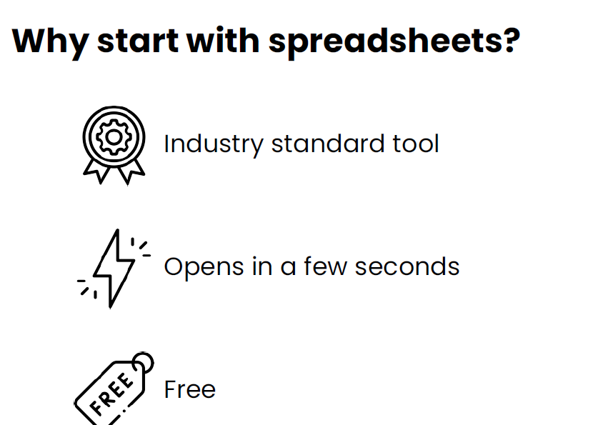
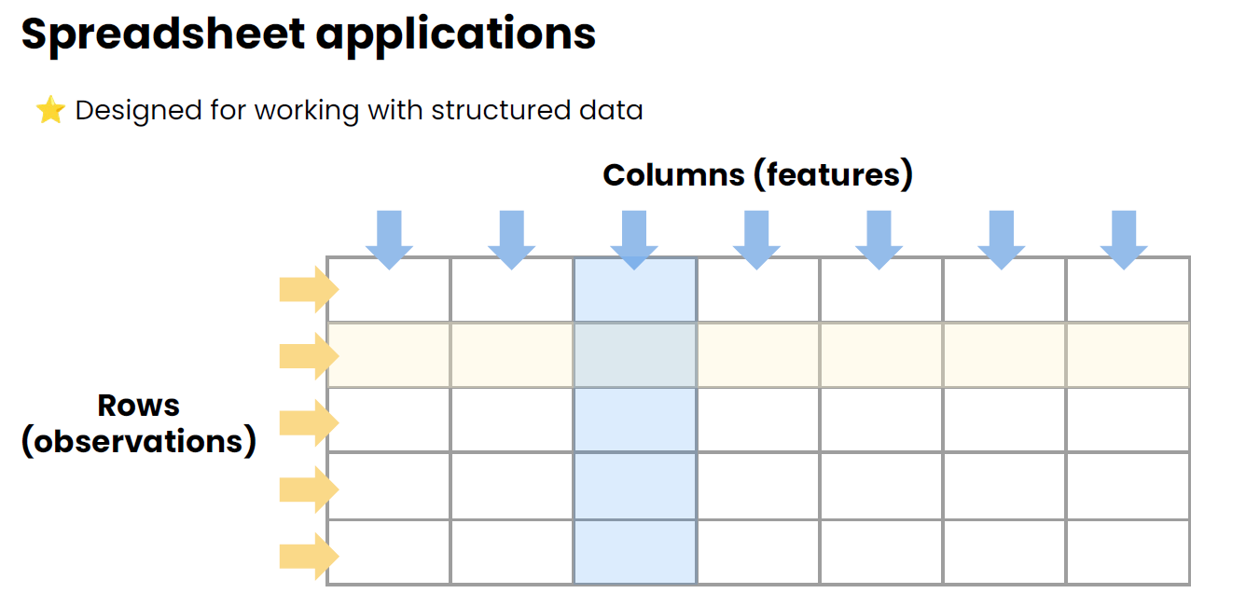
33
Spreadsheets for business analytics:
Click OK and observe the regression analysis output created by Excel.

Slide 37
33
Spreadsheets for business analytics:
Click OK and observe the regression analysis output created by Excel.
Excel terminology and components
Cell: A user enters data into a cell, which is the intersection of a column and row.
Workbook: This is an Excel file that contains one or more worksheets.
Worksheet: These are the different documents nested within a Workbook.
Column and row headings: These are the numbered and lettered cells located just outside of the columns and rows. Selecting a header highlights the entire row or column.
Formula: Formulas are mathematical equations, cell references or functions that can be placed inside a cell to produce a value. Formulas must start with an equal "=" sign.
Formula bar: This is the long input bar that is used to enter values or formulas in cells. It is located at the top of the worksheet, next to the "fx" label.

Slide 38
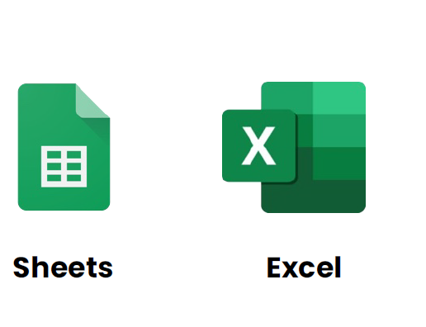
34
Spreadsheets for business analytics:
Click OK and observe the regression analysis output created by Excel.
Navigating Excel Sheets
https://workspace.google.com/products/sheets/

Slide 39
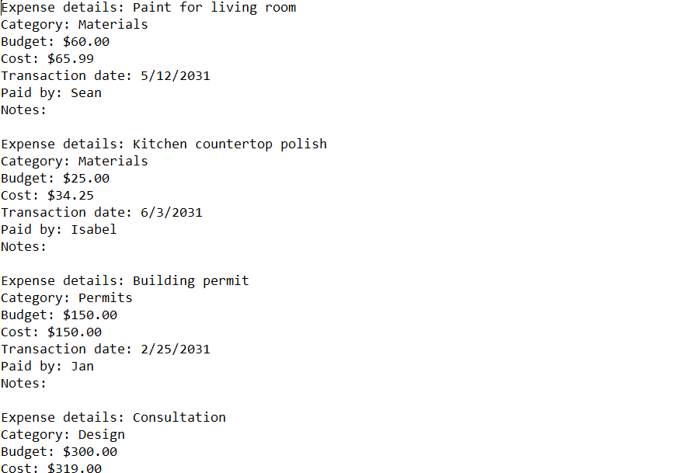
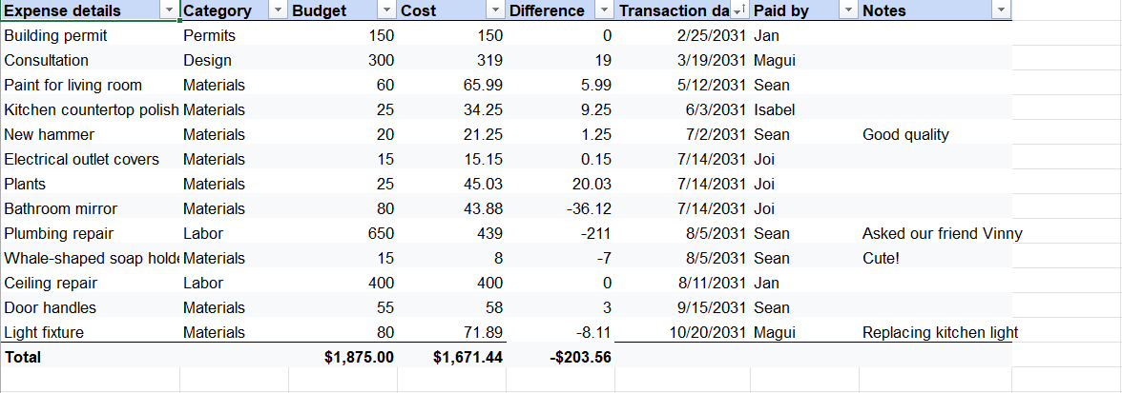
35
Spreadsheets for business analytics:
Click OK and observe the regression analysis output created by Excel.
Navigating Excel Sheets

Slide 40
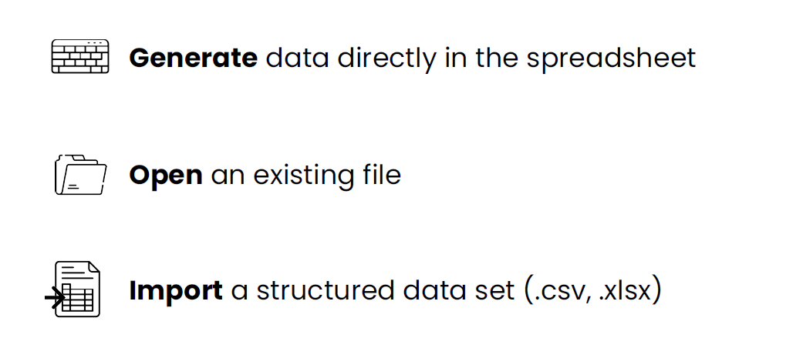
36
Spreadsheets for business analytics:
Click OK and observe the regression analysis output created by Excel.
Loading data into Excel Sheets

Slide 41
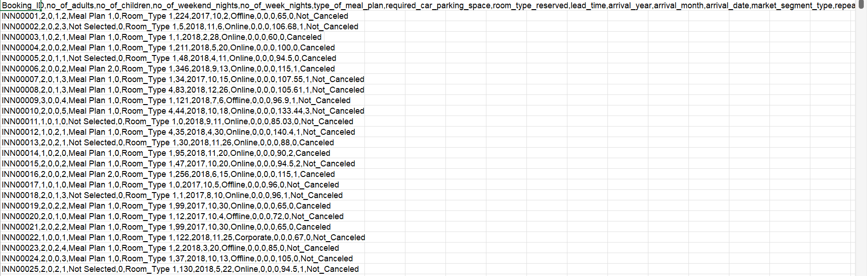
37
Spreadsheets for business analytics:
Click OK and observe the regression analysis output created by Excel.
Loading data into Excel Sheets

Slide 42
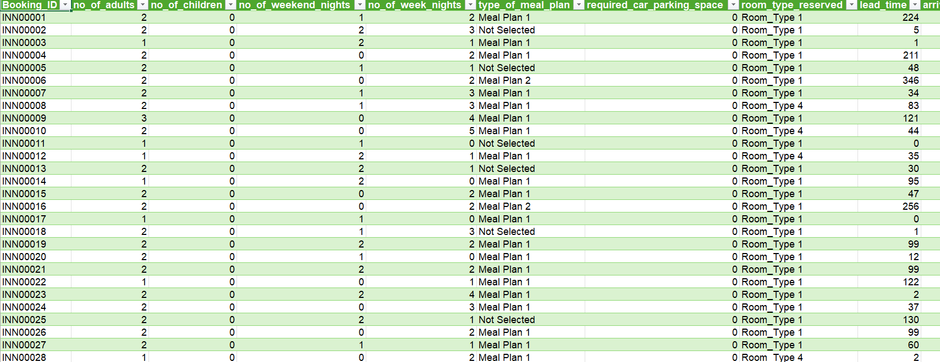
38
Spreadsheets for business analytics:
Click OK and observe the regression analysis output created by Excel.
Loading data into Excel Sheets

Slide 43
39
Summary
The data analytics lifecycle.
How to use LLMS for data analysis.
Using spreadsheets for data analytics.

Slide 44


Thank You

