Slide 1



Introduction to Economics
Lecture 3
MGM112
Supply
Prepared by
Lec. Dina ElWakkad
www.midocean.ae

Slide 2

Chapter
Supply
03
  If a firm supplies a good or service, then the firm:
  1. Has the resources and the technology to produce it,
  2. Can profit from producing it, and
  3. Has made a definite plan to produce and sell it.
www.midocean.ae

Slide 3
Chapter
Supply
03
  The quantity supplied of a good or service is the amount that producers plan to sell during a given time period at a particular price
www.midocean.ae

Slide 4
Chapter
The Law of Supply
03
The law of supply states:
Other factors being constant (cetris peribus), price and quantity supplied of any good and service are positively related to each other.
www.midocean.ae

Slide 5
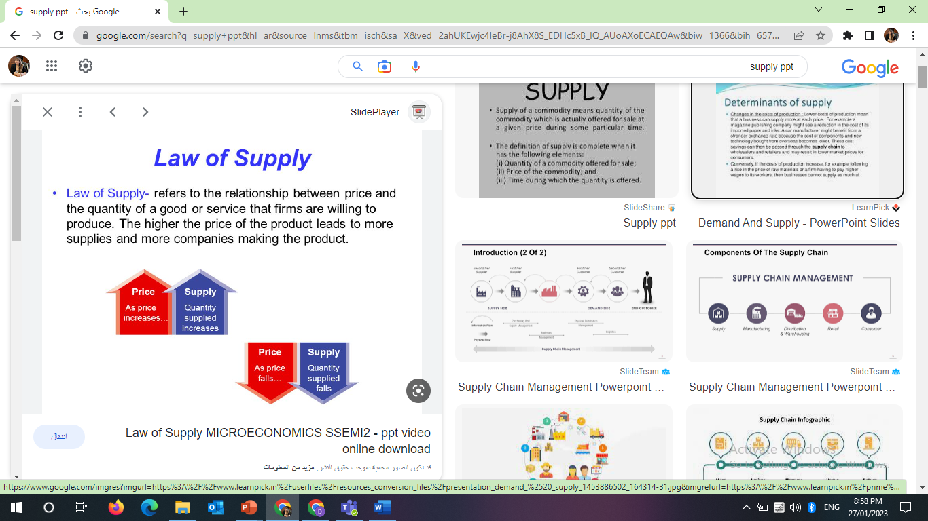
Chapter
The Law of Supply
03
www.midocean.ae

Slide 6
Chapter
The Law of Supply
03
The law of supply states:
  The higher the price of a good, the greater is the quantity supplied.
  The lower the price of a good, the smaller is the quantity supplied.
www.midocean.ae

Slide 7
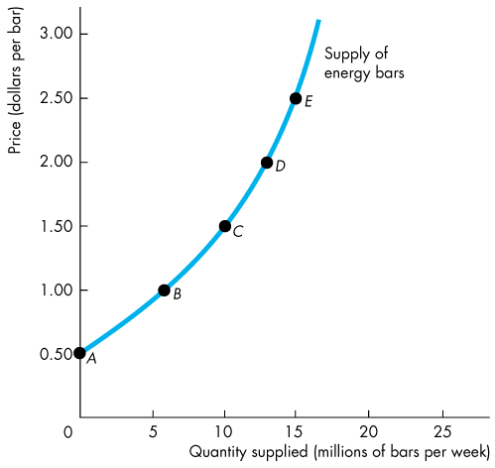
Chapter
The Law of Supply
03
The law of demand is illustrated by:
An upward-sloping supply curve drawn with the quantity supplied on the horizontal axis and the price on the vertical axis
The slope is positive to show the positive relation between P & Qs
www.midocean.ae

Slide 8
Chapter
Change in Quantity Supplied
03
The Price of the good is the only one factor that affects Quantity Supplied ∆P → ∆Qs
Change the Price of the good → Change in quantity Supplied → Movement along the Supply curve P↓→ Qs ↓→ Move down along supply curve. P↑ → Qs↑→ Move up along supply curve
www.midocean.ae

Slide 9
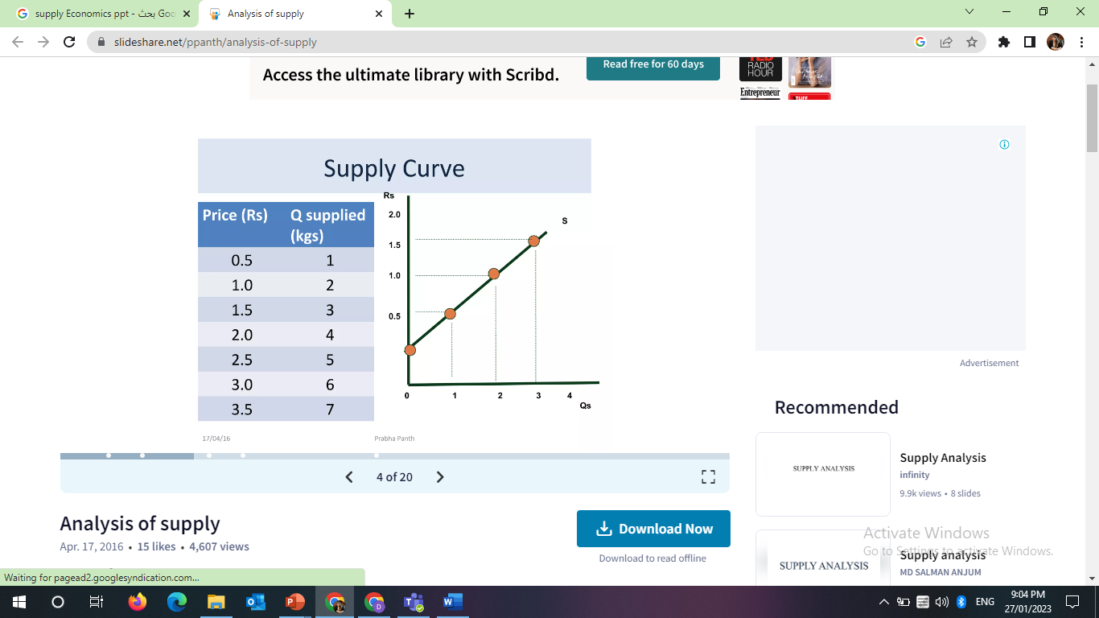
Chapter
Change in Quantity Supplied
03
The Price of the good is the only one factor that affects Quantity Supplied ∆P → ∆Qs
www.midocean.ae

Slide 10
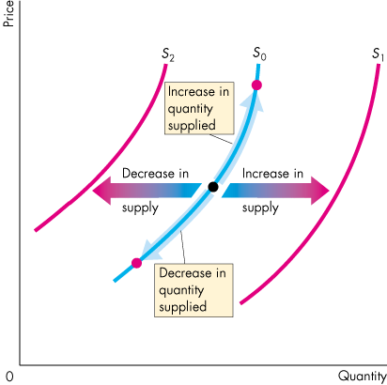
Chapter
Change in Supply
03
When price is constant, as the other Factors that affects the supply of the good changes, Supply will change
Shift Supply curve at given price level
  Factor changes→ S ↑→ Shift Right
  Factor changes→ S ↓→ Shift Left
www.midocean.ae

Slide 11

Chapter
Change in Supply
03
“I.N.S.T.E.P”
www.midocean.ae

Slide 12
Chapter
Change in Supply
03
At given price level, the Main factors that change supply are:
I nputs (-)
N umber of suppliers (+)
S tate of nature (-)
T echnology (+)
E xpected future prices (-)
P rices of related goods produced)
  (substitute (-) or complementary (+)
“I.N.S.T.E.P”
www.midocean.ae

Slide 13
Chapter
Change in Supply
03
1) Inputs (-VE)
If the price of a factor of production or materials needed to produce a good rise,
The minimum price that a supplier is willing to accept for producing each quantity of that good rises.
the costs of production increases
This exerts a Negative effect on the supply curve shifting it leftward.
So, the price of a factor of production has a Negative relation with supply curve.
www.midocean.ae

Slide 14
Chapter
Change in Supply
03
2) Number of suppliers (+VE)
The larger the number of suppliers of a good, the greater is the supply of the good.
This exerts a positive effect on the supply curve shifting it rightward.
So, Number of suppliers has a positive relation with supply curve.
www.midocean.ae

Slide 15
Chapter
Change in Supply
03
3) State of nature(-VE)
The state of nature includes all the natural forces that influence production—for example, the weather.
A natural disaster decreases supply and shifts the supply curve leftward.
So, the State of nature has a Negative relation with supply curve.
www.midocean.ae

Slide 16
Chapter
Change in Supply
03
4) Technology(+VE)
When use Advances in technology or Achieve Improvements in machines and production leads to
Increase productivity and create new products
Lower the cost of producing existing products.
This exerts a positive effect on the supply curve shifting it rightward
So, Technology has a positive relation with supply curve
www.midocean.ae

Slide 17
Chapter
Change in Supply
03
5) Expected future prices(-VE)
If the expected future price of a good rises, the supply of the good today decreases and the supply curve shifts leftward
So, Expected future prices of goods has a Negative relation with supply curve
www.midocean.ae

Slide 18
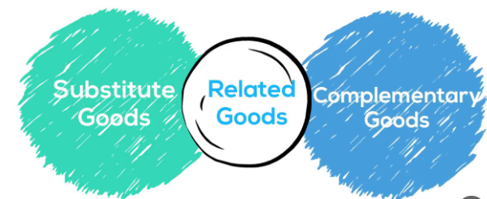
Chapter
Change in Supply
03
6) Prices of related goods produced:
www.midocean.ae

Slide 19

Chapter
Change in Supply
03
6) Prices of related goods produced:
Substitute goods (-VE)
A substitute in production for a good is another good that can be produced using the same resources. The supply of good increases if the price of a substitute in production falls. P. coffee↓ → Qs. coffee ↓ → supply. tea ↑ A decrease in the price of a substitute(coffee), increases the supply of Tea The supply curve of tea shifts rightward, and vice versa
So, the price of substitute goods has a Negative relation with supply curve.
www.midocean.ae

Slide 20

Chapter
Change in Supply
03
6) Prices of related goods produced:
Complementary goods (+VE)
Goods are complements in production if they must be produced together. The supply of good increases if the price of a complement in production rises. P. sugar↓ → Qs. sugar ↓ → supply. tea ↓ A decrease in the price of a complement (sugar), decreases the supply of Tea The supply curve of tea shifts leftward, and vice versa
So, the price of Complementary goods has a Positive relation with supply curve.
www.midocean.ae

Slide 21
Chapter
The supply curve & the willingness -to-sell
03
A supply curve is a minimum-supply-price curve, because the minimum price is:
The lowest price at which supplier is willing to sell an additional unit of output.
As a result, the price is the marginal cost (MC) of the last unit produced at this level of output.).
( Minimum. P = MC)
For any fixed quantity of a good available, the greater the quantity available, the higher Mc
www.midocean.ae

Slide 22
Chapter
The supply curve & the willingness -to-sell
03
If available quantity of good 10 units, the producer is WTS = MC = P = 1.50 (At C)
If available quantity of good decreases to 5 units, the producer is WTS = MC = P = 1 (At B)
www.midocean.ae

Slide 23
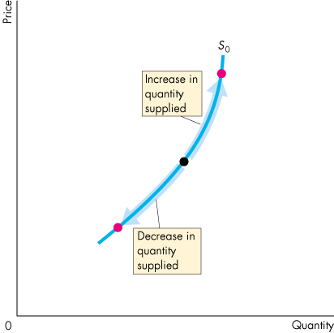
Chapter
A Change in the Quantity Supplied Vs a Change in Supply
03
  Movement Along the Supply Curve
  When the price of the good changes and other influences on sellers’ plans remain the same, the quantity supplied changes and there is a movement along the supply curve.
www.midocean.ae

Slide 24
Chapter
A Change in the Quantity Supplied Vs a Change in Supply
03
  A Shift of the Supply Curve
  If the price remains the same but one of the other Factors on sellers’ plans changes, supply changes and the supply curve shifts.
www.midocean.ae

Slide 25
Chapter
A Change in the Quantity Supplied Vs a Change in Supply
03
What happens to the quantity of energy bar supplied and the supply of energy bar if the price of energy bar falls?
  If the price of energy bar falls and all other factors are constant, then the quantity of energy bar supplied will decrease and there is a movement down along the supply curve for energy bar.
  But, the supply of energy bar remains unchanged, and the supply curve does not shift.
    Because price does not influence or lead to shift in supply curve, price is the only factor that leads to change the Quantity supplied and cause a movement along supply curve
www.midocean.ae

Slide 26
Chapter
A Change in the Quantity Supplied Vs a Change in Supply
03
Change Quantity supplied | Change Supply curve
Other factors constant, as the price change, Quantity supplied will change at same direction Movement along supply curve | When price is constant, as the other factors on producing plans change, Supply will change. Shift Supply curve at given price level.
www.midocean.ae

Slide 27

Think
The quantity supplied of a good or service is the amount that------------
A) producers wish they could sell at a higher price.
B) is actually bought during a given time period at a given price.
C) people are willing to buy during a given time period at a given price.
D) producers plan to sell during a given time period at a given price.
www.midocean.ae

Slide 28
Think
The "law of supply" refers to the fact that, all other things remaining the same, when the price of a good rises---------------------------
A) the supply curve shifts leftward.
B) the supply curve shifts rightward.
C) there is a movement up along the supply curve to a larger quantity supplied.
D) there is a movement down along the supply curve to a smaller quantity supplied.
www.midocean.ae

Slide 29
Think
A supply curve shows the relation between the quantity of a good supplied and-----------
A) income. Usually, a supply curve has negative slope.
B) income. Usually, a supply curve has positive slope.
C) the price of the good. Usually, a supply curve has negative slope.
D) the price of the good. Usually, a supply curve has positive slope.
www.midocean.ae

Slide 30
Think
Which of the following is NOT held constant while moving along a supply curve?
A) expected future prices
B) the number of sellers
C) the price of the good itself
D) prices of factors of production
www.midocean.ae

Slide 31
Think
Each point on a supply curve represents---------------------
A) the highest price buyers will pay for the good.
B) the lowest price for which a supplier can profitably sell another unit.
C) the lowest price buyers will accept per unit of the good.
D) the highest price sellers can get for each unit over time.
www.midocean.ae

Slide 32
Think
An increase in the number of fast-food restaurants-------
A) raises the price of fast-food meals.
B) increases the demand for fast-food meals.
C) increases the supply of fast-food meals.
D) increases the demand for substitutes for fast-food meals.
www.midocean.ae

Slide 33
Think
Which of the following decreases the supply of popcorn?
A) a decrease in the price of popcorn
B) an increase in the price of popcorn
C) a technological advance in the production of popcorn
D) a decrease in the number of popcorn producers
www.midocean.ae

Slide 34
Think
Which of the following increases the supply of popcorn?
A) a decrease in the price of popcorn
B) an increase in the price of popcorn
C) a technological advance in the production of popcorn
D) a decrease in the number of popcorn producers
www.midocean.ae

Slide 35
Think
A change in which of the following would NOT shift the supply curve for sneakers?
A) an increase in technology for making sneakers
B) an increase in the price of rubber, used to make sneakers
C) an increase in the price of sneakers
D) None of the above, that is, each change shifts the supply curve.
www.midocean.ae

Slide 36
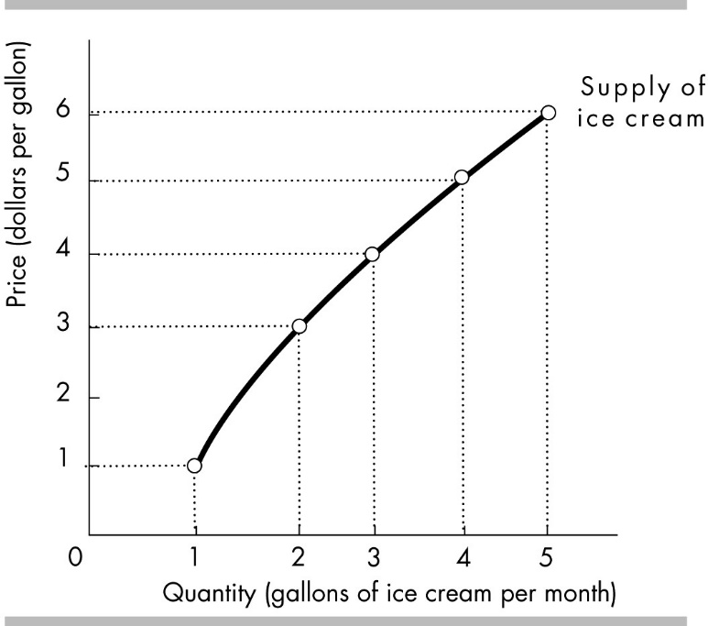
Think
In the figure, what is the minimum supply price for the Second gallon of ice cream?
A) $2.00
B) $3.00
C) $4.00
D) $5.00
www.midocean.ae

Slide 37
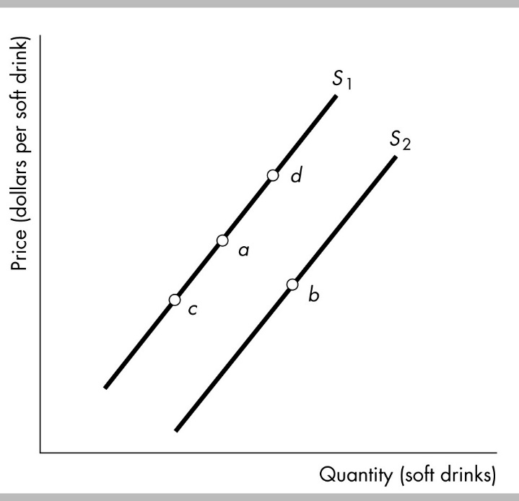
Think
The figure shows supply curves for soft drinks. Suppose the economy is at point a. A movement to point c could be the result of
A) a decrease in technology.
B) a decrease in the relative price of a soft drink.
C) an increase in the relative price of a soft drink.
D) an increase in the money price of a soft drink.
www.midocean.ae

Slide 38
Think
The figure above shows supply curves for soft drinks. Suppose the economy is at point a. An increase in the price of a soft drink is shown as a movement from point a to
A) none of the points that are illustrated.
B) point b.
C) point c.
D) point d.
.
www.midocean.ae

Slide 39
Summary outlines
Supply
The Law of Supply
Change in Quantity Supplied
Change in Supply Curve
The Supply curve & the willingness -to-sell.
A Change in the Quantity Supplied Vs a Change in Supply
www.midocean.ae

Slide 40


Thank You

