Slide 1




DIGITAL MARKETING STRATEGY
Prepared by
Dr. HEBA ZIAD
Lecture 6
www.midocean.ae

Slide 2
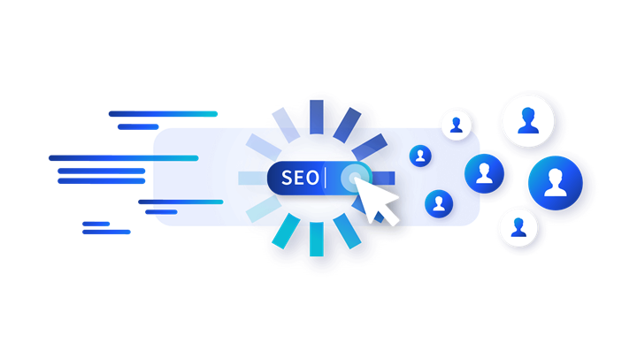
www.midocean.ae
search engine optimization strategies
TABLE OF CONTENTS
Table of contents
What does SEO stand for?
What is SEO?
Benefits of SEO
Types of SEO
How does SEO work?
SEO ranking factors
On-page optimization
Off-page optimization
Technical SEO
SEO tools
SEO strategies and best practices

Slide 3
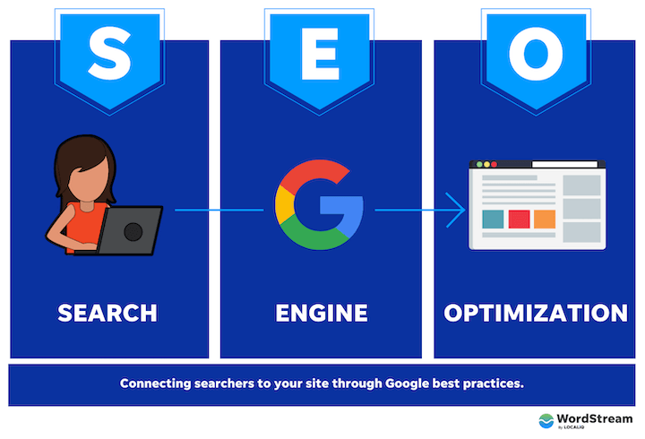
www.midocean.ae
What does SEO stand for?
SEO stands for search engine optimization. Let’s break that down in the context of your website.
Search: What people do when they want to find an answer to a question or a product or service that meets their needs.
Search engine: A site (like Google or Bing) where a person can perform said search.
Search engine optimization: What you do to get said search engine to connect said search with your site.
Chapter 6

Slide 4
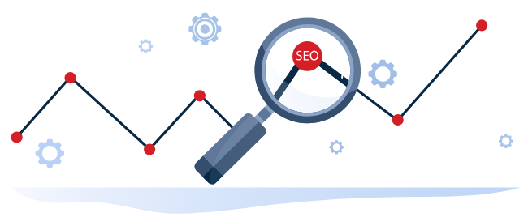
www.midocean.ae
A formal definition of SEO
Search engine optimization is a set of technical and content practices aimed at aligning a website page with a search engine’s ranking algorithm so it can be easily found, crawled, indexed, and surfaced in the SERP for relevant queries.

Slide 5
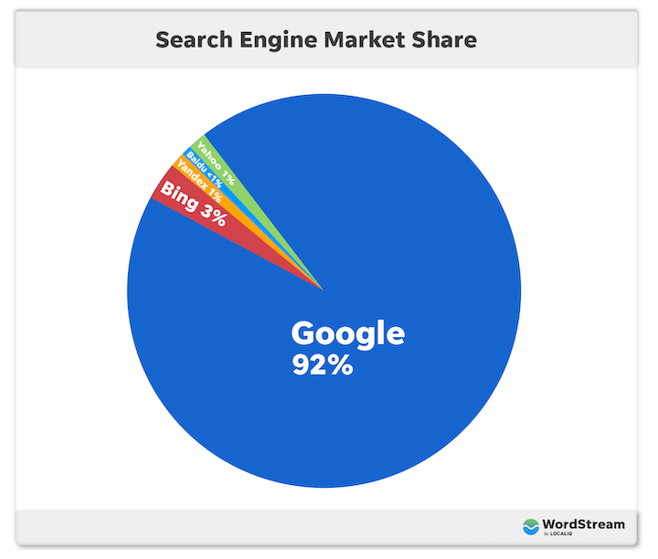
www.midocean.ae
The simplest definition of SEO:
SEO is what you do to rank higher on Google and get more traffic to your site.
Yes, Google is just one search engine of many. There’s Bing. Directory search engines. Even Instagram is a search engine. But capturing 92% of the market share, the terms “Google” and “search engine” are synonymous for the intents and purposes of this post.
Chapter 6

Slide 6
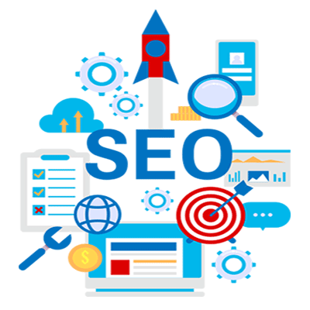
www.midocean.ae
Benefits & importance of SEO
People are searching for any manner of things both loosely and directly related to your business. These are all opportunities to connect with these people, answer their questions, solve their problems, and become a trusted resource for them.
More website traffic: When your site is optimized for search engines, it gets more traffic which equates to increased brand awareness, as well as…
More customers: To get your site optimized, it has to target keywords—the terms your ideal customers/visitors are searching—meaning you’ll get more relevant traffic.

Slide 7
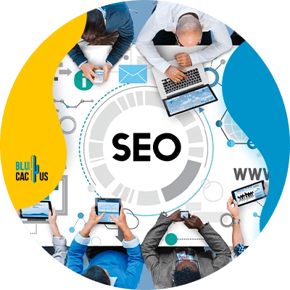
www.midocean.ae
Benefits & importance of SEO
Better reputation: Ranking higher on Google builds instant credibility for your business. If Google trusts you, then people trust you.
Higher ROI: You put money into your website, and into the marketing campaigns that lead back to your website pages. A top-performing site improves the fruits of those campaigns, making your investment worth it.
So whether you want more brand awareness, online visibility, leads, sales, or loyal customers, SEO is your answer.

Slide 8
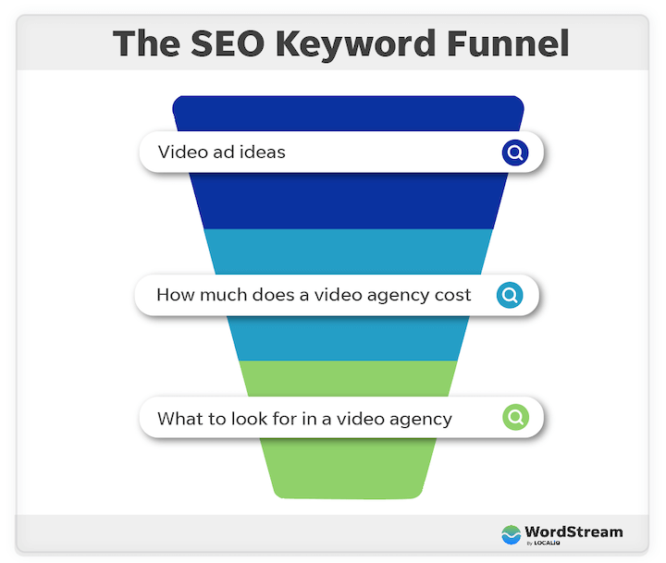
www.midocean.ae
SEO is your chance to get in front of potential customers at any stage of their customer journey.
Chapter 6

Slide 9
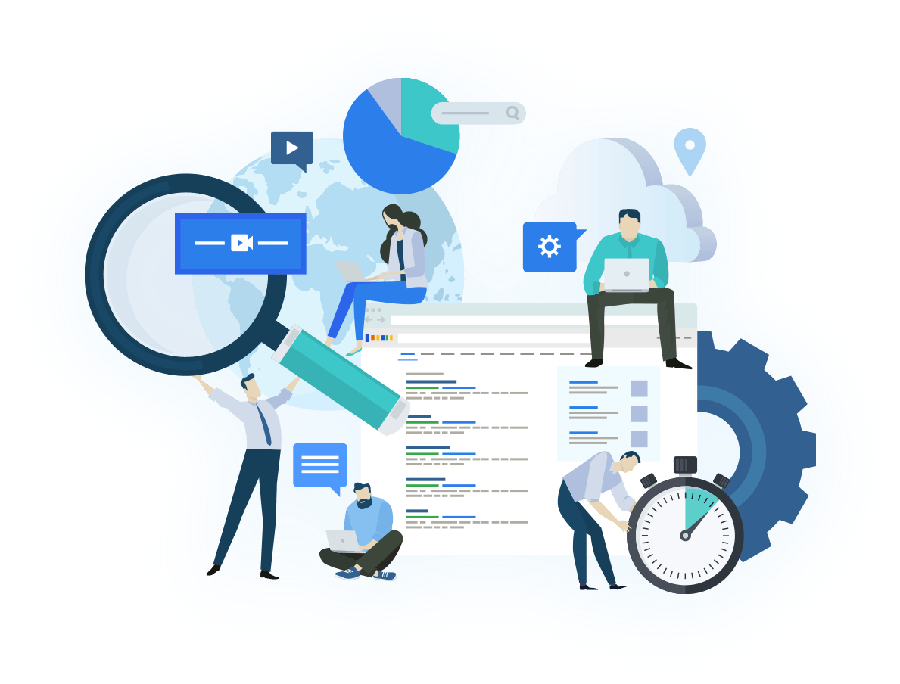
www.midocean.ae
Types of SEO
Google and other search engines take several factors into account when ranking content, and as such SEO has many facets. The core three types of SEO are on-page, off-page, and technical SEO:
On-page SEO: Optimizing the quality and structure of the content on a page. Content quality, keywords, and HTML tags are the key players for on-page SEO.
Off-page SEO: Getting other sites, and other pages on your site to link to the page you are trying to optimize. Backlinks, internal linking, and reputation are your off-page MVPs.
Technical SEO: Improving your site’s overall performance on search engines. Site security (SSL certificates), UX, and structure are key here.

Slide 10
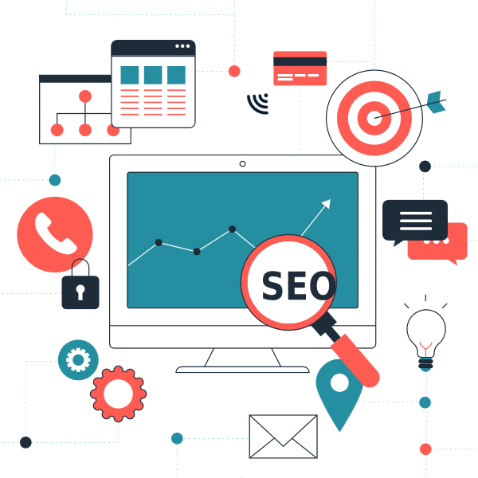
www.midocean.ae
Types of SEO
The above three types of SEO are used for websites and blogs, but they also apply to three subtypes of SEO:
Local SEO: Getting your business to rank as high as possible in Google Maps and on the local results of the SERP. Reviews, listings, and Google Business profile optimization are most important here.
Image SEO: A mix of on-page and technical strategies to get images on your website pages to rank in Google image search.
Video SEO: A mix of on-page, technical, and off-page strategies to get your videos to rank in YouTube or Google video results

Slide 11
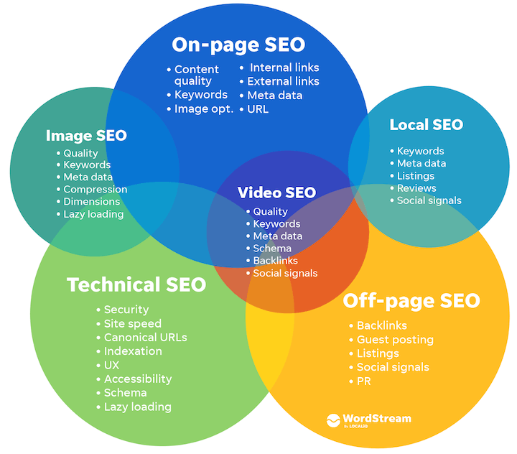
Image SEO relies heavily on technical and on-page optimizations while local SEO is more about off-page and on-page optimizations.
While all three subtypes require all three core types of SEO, they do vary in how heavily they rely on each core type.

Slide 12
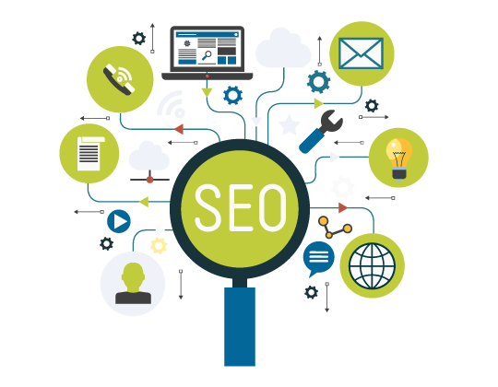
www.midocean.ae
How does SEO work?
So how does Google determine which pages to surface in the search engine results page (SERP) for any given query? How does this translate into traffic to your website? Let’s take a look at how SEO works.
Google’s search crawlers constantly scan the web, gathering, categorizing, and storing the billions of web pages out there in its index. When you search for something and Google pulls up results, it’s pulling from its index, not the web itself.

Slide 13
www.midocean.ae
How does SEO work?
Google uses a complex formula (called an algorithm) to order results based on a number of criteria (ranking factors—which we’ll get into next) including the quality of the content, its relevance to the search query, the website (domain) it belongs to, and more.
How people interact with results then further indicates to Google the needs that each page is (or isn’t) satisfying, which also gets factored into the algorithm.

Slide 14
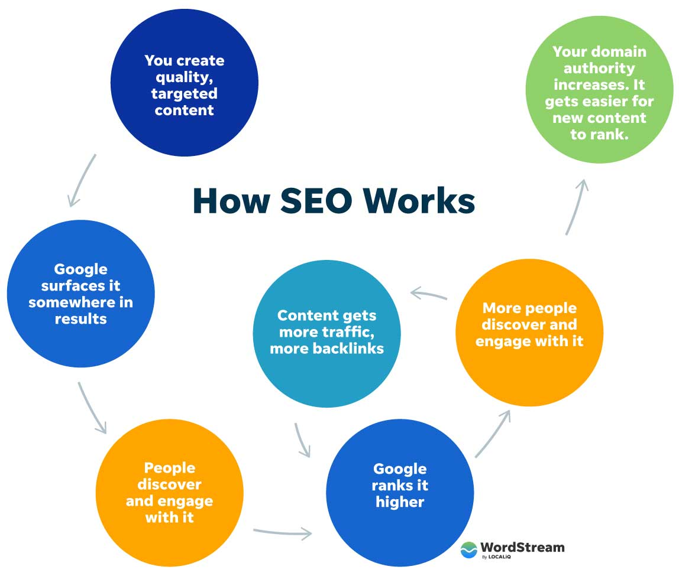
In other words, SEO works like a complex feedback system—to surface the most accurate, trustworthy, and relevant results for any given search using input from you, Google, and searchers. Your role is to produce content that satisfies Google’s experience, expertise, authority, and trust requirements (E-E-A-T), which satisfy its searchers’ requirements.

Slide 15
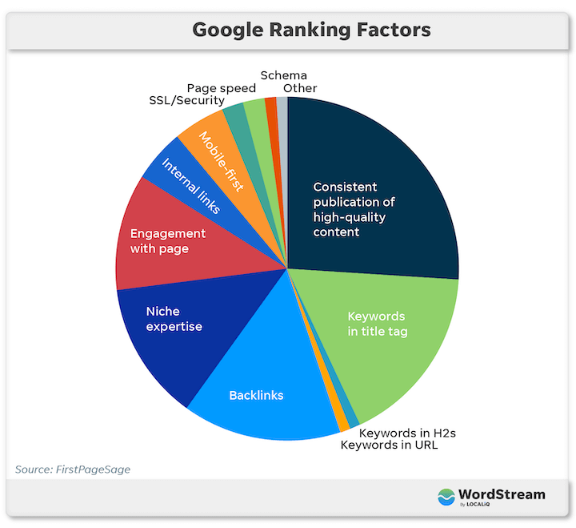
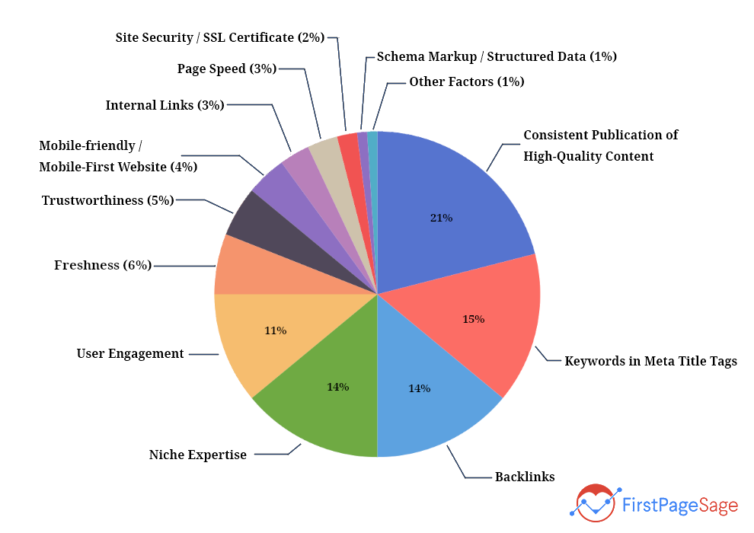
www.midocean.ae
SEO ranking factors on Google
So what are those requirements? What actually constitutes quality, targeted, EAT-friendly, and SEO-optimized content? Well, there are hundreds of Google ranking factors, and Google is also constantly evolving and refining its algorithm to continue providing the best experience possible, but there are 12 that should be prioritized.
Chapter 05

Slide 16
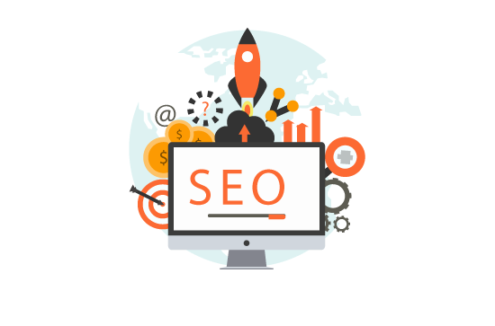
www.midocean.ae
How to do SEO: On-page optimization
how to actually do SEO—how to optimize your website for these factors so you can rank higher on Google and get more traffic. This requires a combination of on-page, off-page, and technical optimizations, so we’re going to organize the steps in that manner. Here are your on-page optimization steps:
Start with keyword research
Create quality content targeting those keywords
Place your keywords
Optimize your titles
Optimize your meta descriptions
Include and optimize images
Internal and external links
Chapter 06

Slide 17

www.midocean.ae
Start with SEO keyword research
The first step in search engine optimization is to determine what keywords you’re optimizing for. These are terms that your ideal website visitors are likely to type into Google or other search engines, and each page on your site should target a different keyword cluster so they don’t compete with each other
Chapter 06

Slide 18

www.midocean.ae
How to do keyword research for SEO
These are your basic steps for finding the best keywords to target with your organic content:
Create your seed list: Start by listing out the words and phrases your ideal customers are typing into Google. Think about their interests, desires, pain points, and goals, and think in terms of the language they’re using, which may be different from what you (as the expert) use.
Plug them into a keyword research tool: Keyword research tools will give you data around these keywords so you can see which terms you can conceivably rank for and where the best opportunities actually lie. Metrics include:
  Search volume: How many times that term is searched per month.
  Competition: How difficult it is to rank for that keyword.

Slide 19
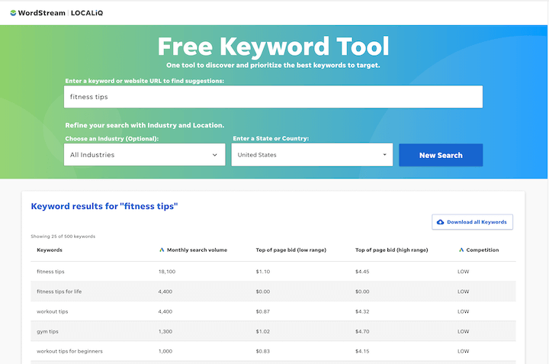
www.midocean.ae
Chapter 06
Sort and prioritize: Put the resulting terms and data into a spreadsheet. Now you can group them into core themes and also prioritize them. Ideally, you’ll want to target keywords with a high enough search volume to give you decent reach, but not so high that the keyword becomes too competitive to rank for. Better to show up on page one for a lower volume, lower competition keyword than to not rank at all for a high volume, high competition keyword.

Slide 20

www.midocean.ae
2. Create quality content targeting those keywords
Your main navigation pages (homepage, about us, contact, products, services) will target keywords, but the bulk of your keyword targeting will come from long-form content in the form of blog posts. Quality, SEO content is:
Aligned with the keyword’s intent: Make sure your content provides the information people are seeking when they search this keyword. This is why you should always search the keyword on Google first.
Provides a good experience: It’s free of overly aggressive pop-ups or CTAs or other distracting elements; uses images to depict concepts, and loads quickly and properly on all devices (more on this later in the technical SEO section).

Slide 21

www.midocean.ae
Reads naturally: Don’t keyword-stuff. Write like a human being speaking to your audience; not a content writer trying to optimize for a search engine.
In-depth: Google isn’t interested in thin, duplicate, or low-value pages. This means 1,500-2,500 words of accurate, up-to-date, information.
Organized: Use your heading tags to indicate the hierarchy of information on the page.

Slide 22
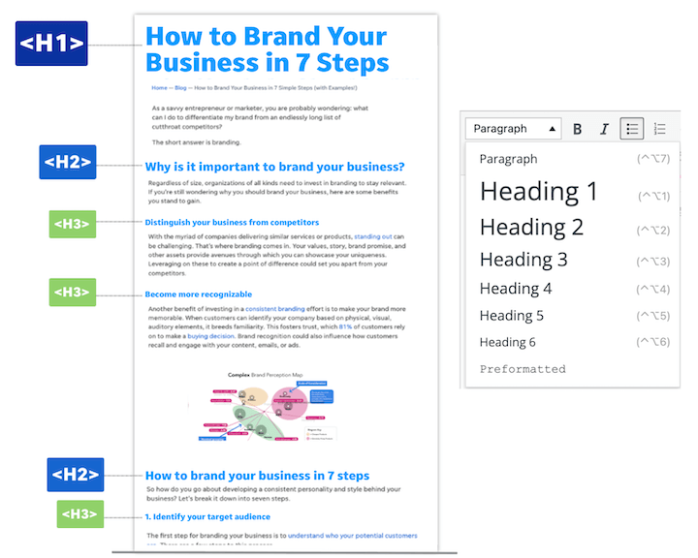
www.midocean.ae

Slide 23
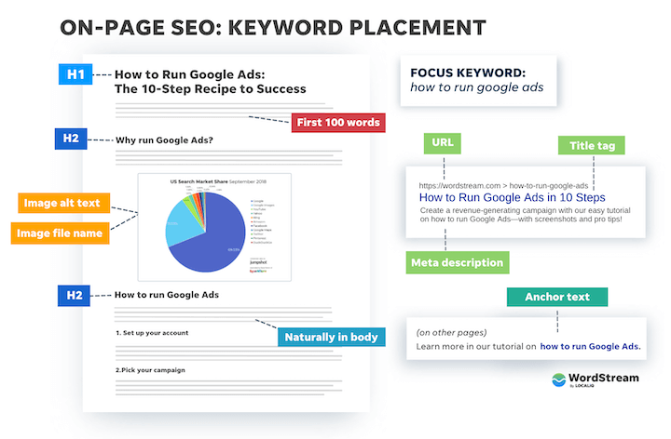
www.midocean.ae
3. Place your keywords
In addition to naturally in the body of your content, you’ll want to place your keyword into specific spots on the page to indicate to Google what you’re looking to rank for. This includes:
SEO title (title tag)
Page title (H1 tag)
At least two H2 headings
Image alt text
Image file name
Naturally in the body
URL
Meta description

Slide 24
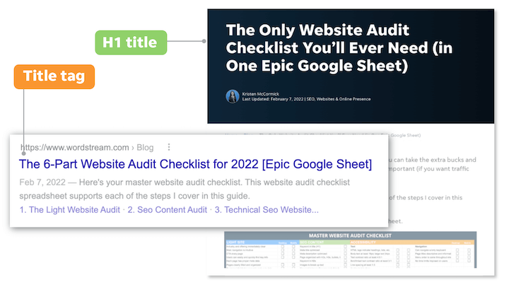
www.midocean.ae
4. Optimize your titles
For any page on your website, you actually have two titles. The title tag is the title that appears on the SERP and is the single most impactful place you can put your keyword. The H1 tag is the title that appears on the page when you click into it. Whether or not these are the same depends on the page.
To optimize your titles, be sure to:
Include the keyword: If you can do it in a natural and compelling way, add some related modifiers around that term as well.
Have only one H1 per page: This should be your main headline, and H2s should be used to label your main sections.
Keep title tags to 55-60 characters: How much Google will show varies (it’s based on pixels, not character counts), so frontload with the keyword.
Indicate value: What does a user get out of the page? This influences whether they click on it in the SERP or on your site, and whether they keep reading.

Slide 25
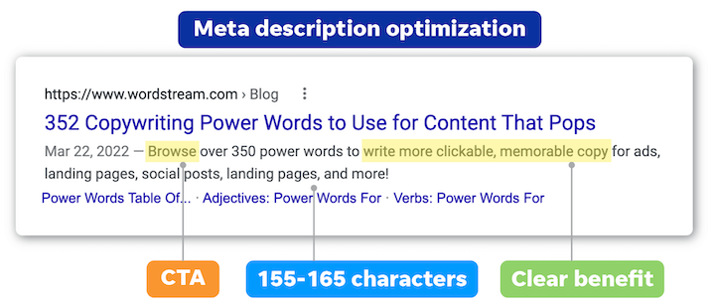
www.midocean.ae
example of a real-world meta description in search results:
Meta descriptions = SEO “ad copy”

Slide 26

www.midocean.ae
6. Include and optimize images
Images are a key player in SEO optimization. They keep users engaged with your pages, enhance the quality of the information, and provide opportunities for you to rank and generate traffic to their host pages through image results. Plus, Google has increasingly been making the SERP more visual.

Slide 27

www.midocean.ae
6. Include and optimize images
Here’s how to do SEO optimization for images:
File name: Save the file name with the keyword, with dashes instead of spaces.
Add alt text: Alt text stands for the text alternative of an image, and it’s how Google “sees” an image on a page and detects its relevance to the keyword. It also makes your site accessible for screen readers, and if images break, the alt text will still appear. Don’t keyword stuff here. Imagine you’re describing the image to someone who can’t see it—that’s what it’s there for!
Compress: Large images can slow down the speed of your site. Compress them to reduce file size and properly size them. You shouldn’t need images much wider than 1000px, but every site is different.

Slide 28
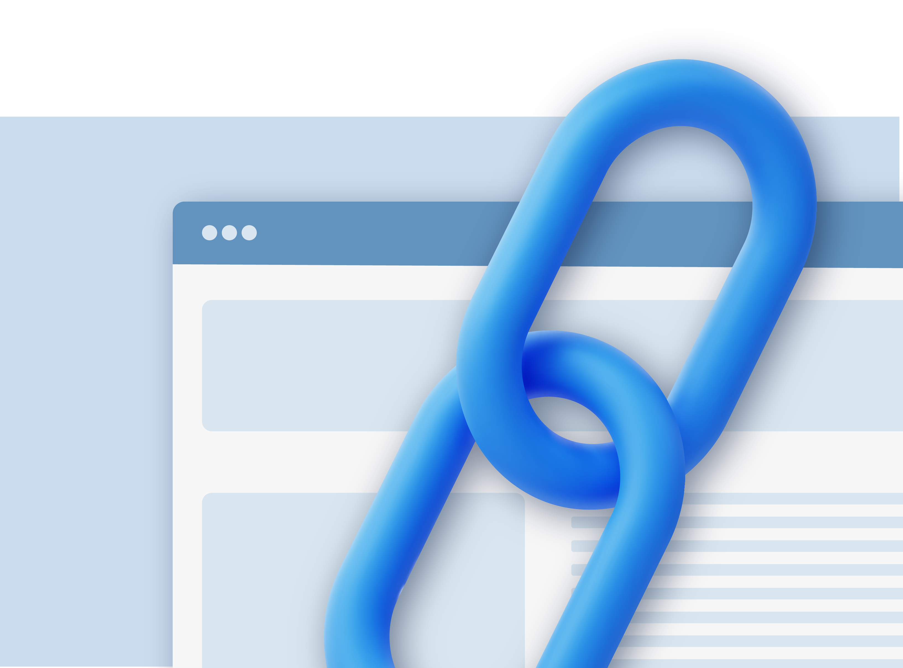
www.midocean.ae
7. Internal and external links
When doing SEO for blog posts, you’ll want to add both internal and external links.
External links: Find 1-3 pages relevant to the topic you’re targeting, on other sites that have high domain authority, and link to them in your post. This helps to build trust with Google.
Internal links: Link to other blog posts on your site in the content of the post you’re writing—just like I did in that last bullet, using “high domain authority” as my anchor text. This gives Google multiple pathways to any given post, making your site easier to crawl as a whole. How many to include here depends on the length of the post and the amount of other content you have available to link to. Keep the links relevant to the page and to the anchor text you use.

Slide 29
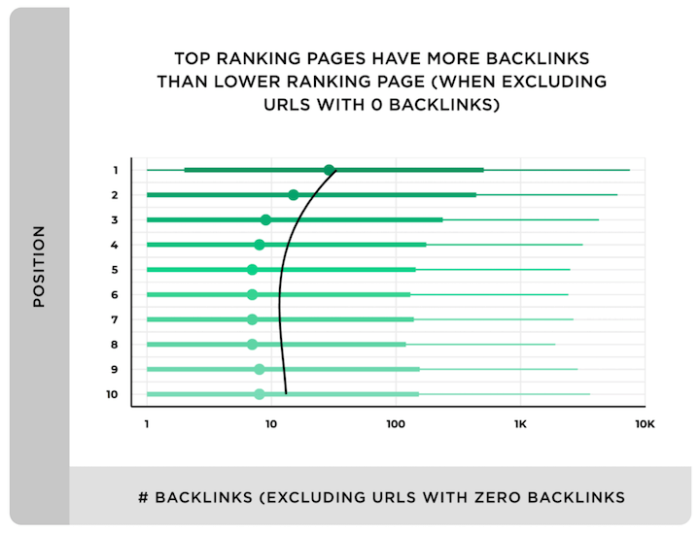
www.midocean.ae
How to do SEO: Off-page optimization
All of the steps above are on-page SEO strategies. Off-page SEO, on the other hand, is what you do on other pages of your website, other websites, and even other platforms to help your page to rank. Here are some off-page SEO tactics
8. Earn and reach out for backlinks
Backlinks, or links to your site from other websites, are the third most important Google ranking factor. Backlinks from higher credibility sites are, of course, more valuable than those from lower credibility sites. The more high-quality backlinks you have, the higher you’ll rank.

Slide 30
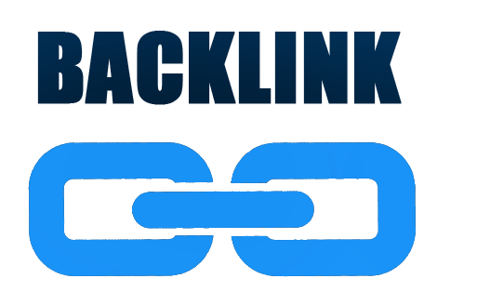
www.midocean.ae
how do you get more backlinks?
So There are several strategies, but a few include:
Producing original, authentic content worthy of getting backlinks.
Proactively reaching out to sites for which a link to your content would be a useful addition.
Guest posting
PR coverage

Slide 31

www.midocean.ae
9. Share your content on social media
In addition to linking to your homepage in social media profiles, you should also be regularly sharing your blog posts with your feed. This earns you referral traffic, and the more eyes on a post, the higher the chances of generating backlinks. Social media itself isn’t a direct google ranking factor, but your activity on the platforms and users’ engagement with your content there send social signals to Google that influence your ranking.

Slide 32
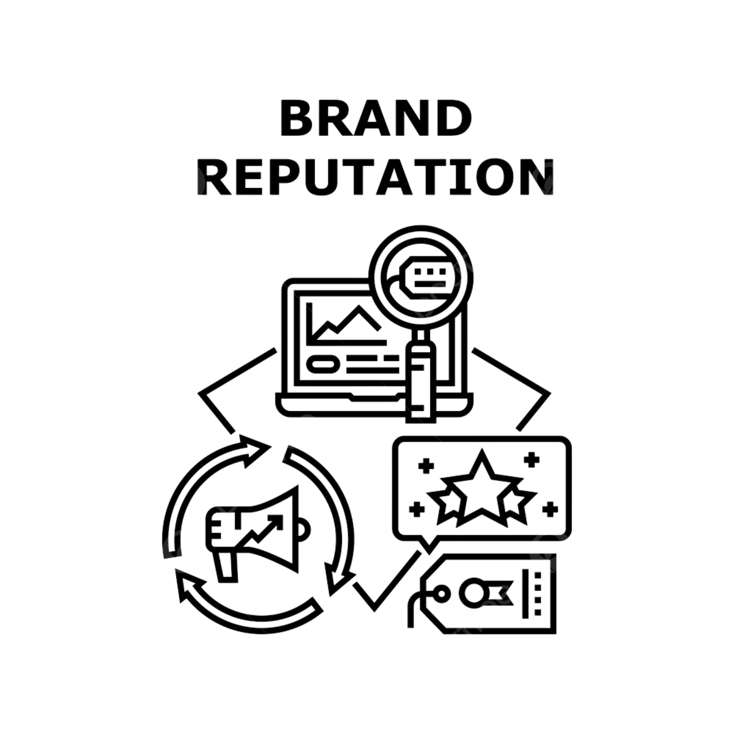
www.midocean.ae
10. Build your brand reputation
When determining how high to rank a particular page on your site, Google doesn’t just look at that one page. It takes into account your brand as a whole, which it does so by looking at other information about it across the web—including reviews, ratings, listings, awards, and even unlinked brand mentions. As such, building your brand reputation by optimizing your listings, gaining positive press, and asking for reviews is essential for SEO. Much of this falls under the realm of local SEO but there are plenty of brand-building strategies that apply to non-brick-and-mortar businesses too.

Slide 33
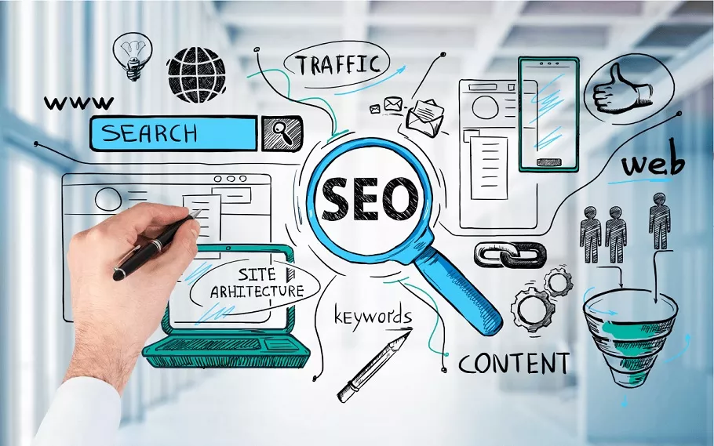
www.midocean.ae
How to do SEO: Technical optimizations
Technical SEO optimizations are done on the back end of your website to make sure it meets Google’s site security and user experience requirements, as well as to make it as easy as possible for Google to do its job on your site. Here are some of the main technical optimizations to take care of:
Page speed: In addition to image sizes, the code behind your website content and the order in which it loads can impact page speed. This where lazy loading and page speed optimizations come into play.
Security: Make sure your site is using HTTPS rather than HTTP.
Mobile-first: Being mobile-friendly doesn’t cut it anymore. Google’s indexing is now mobile-first, so your site needs to be fully responsive.

Slide 34
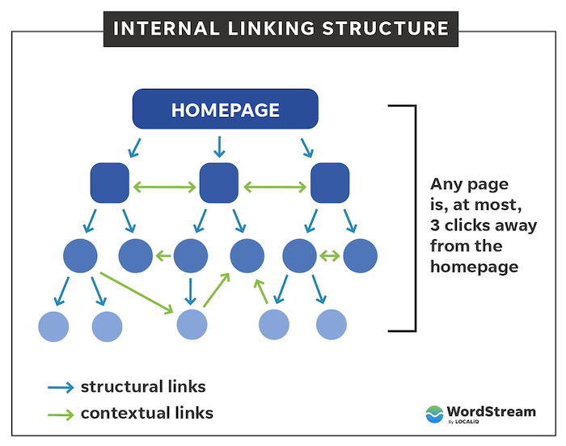
www.midocean.ae
How to do SEO: Technical optimizations
Core Web Vitals: These three metrics are used to quantify a user’s experience with your page. You can learn how to improve your Core Web Vitals here.
URL structure: An organized site structure, such as by using /blog, /landing page, /product buckets, makes it easier for Google to crawl your site, for users to navigate it, and for you to segment data in reports.
Site architecture: Ideally, a user should be able to access any page on your site in three clicks or less. Internal linking is key here.

Slide 35
www.midocean.ae
Canonical URLs
A canonical URL is the URL that you want to represent a set of duplicate pages. Google will do its best to identify the canonical URL for any given set of duplicates, but you can also indicate this to Google through canonical tags or 301 redirects. For example, we have:
  http://wordstream.com
  http://wordstream.com/
  https://wordstream.com
  https://wordstream.com/
  https://www.wordstream.com/
All redirecting to this one canonical URL:
  https://www.wordstream.com
Crawlability/indexability: Your sitemap and robots.txt together tell Google what you do and don’t want Google to crawl and index.

Slide 36
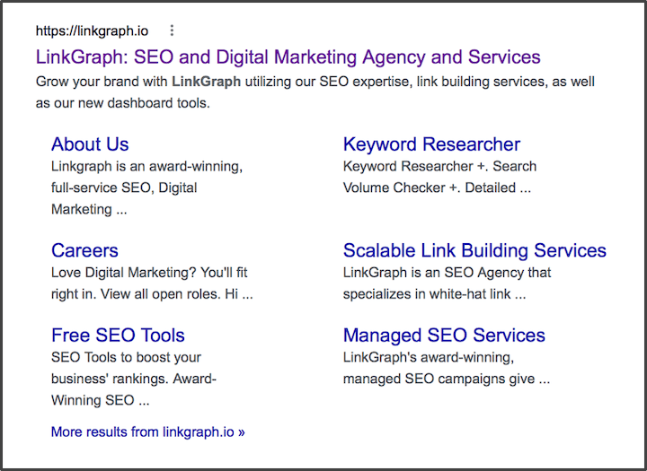
www.midocean.ae
Schema markup:
Schema markup helps Google (and other search engines) understand the types of content you have, allowing it to display rich results when applicable. For example, site link schema can give you more real estate on the SERP:

Slide 37
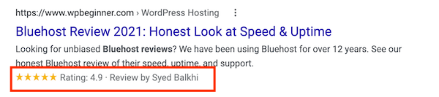
www.midocean.ae
While review schema can give you more appeal:
There are lots of schema types that apply to different types of businesses. You can learn more about schema & markup in our guide to schema for SEO.

Slide 38
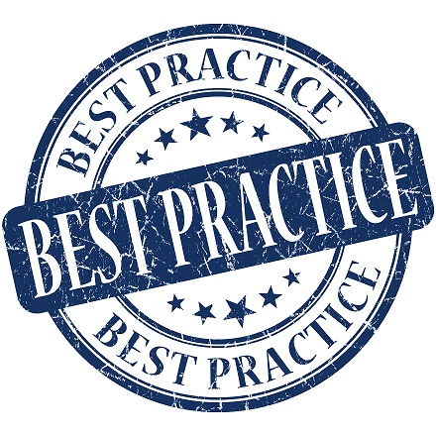
www.midocean.ae
SEO strategies and best practices
SEO strategies, best practices, and tips to help you get the most out of your time.
Always search the keyword:
Be patient: SEO takes time.
Focus on quality: Google is always updating its algorithm and coming out with new SERP features,
Maintain your content: While the consistent publication of quality content is the top Google ranking factor
Track and measure: Report on your traffic and site data regularly so you can see what topics resonate most with your audience, detect issues, and set goals for traffic growth.

Slide 39
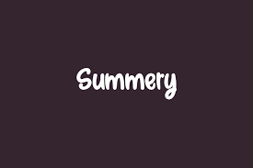
www.midocean.ae
summery OF CONTENTS
What does SEO stand for?
What is SEO?
Benefits of SEO
Types of SEO
How does SEO work?
SEO ranking factors
On-page optimization
Off-page optimization
Technical SEO
SEO tools
SEO strategies and best practices

Slide 40



Thank You

