Slide 1


Human-Robot Interaction and Autonomous Systems
AI 616
Master of Science in Artificial intelligence
Prepared by Dr. Khaled Eskaf
Lecture :Intro

Slide 2
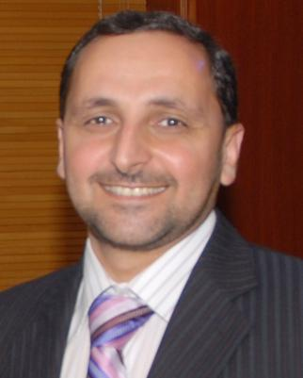
1-Khaled Eskaf: Assistant Professor of Intelligent System.
2-Ph.D. in Computer Science from the University of Salford in the UK.
Academic Experience:
  3-held several academic positions in Middle East, UK, and Canada.
  4-served as assistant professor, department head of the Faculty of Computing and Information Technology at several universities.
Research Focus:
  5-Researcher in AI, machine learning (ML), deep learning (DL), and robotics
  6-Applies intelligent systems in medical fields and climate change
Work Experience:
  7- Over 20 years of experience in education at universities and colleges.
  8- working in MILA as mentor for graduate students in Canada, and teaching computer science courses and robotics.
  9- International Expert Judge for robotics competitions, First Robotics-Canada and MakesX Mbot Robotics competition.
www.midocean.ae

Slide 3




khaledeskaf@midocean.edu.km
Note: for sending email, Please include:
Subject: course name + your Student ID.
:Robotics+ your Student ID
Thursday 9 PM – 10.30 PM
https://scholar.google.com/citations?user=TeE2zCUAAAAJ&hl=en
https://www.linkedin.com/in/keskaf/
www.midocean.ae

Slide 4





www.midocean.ae

Slide 5
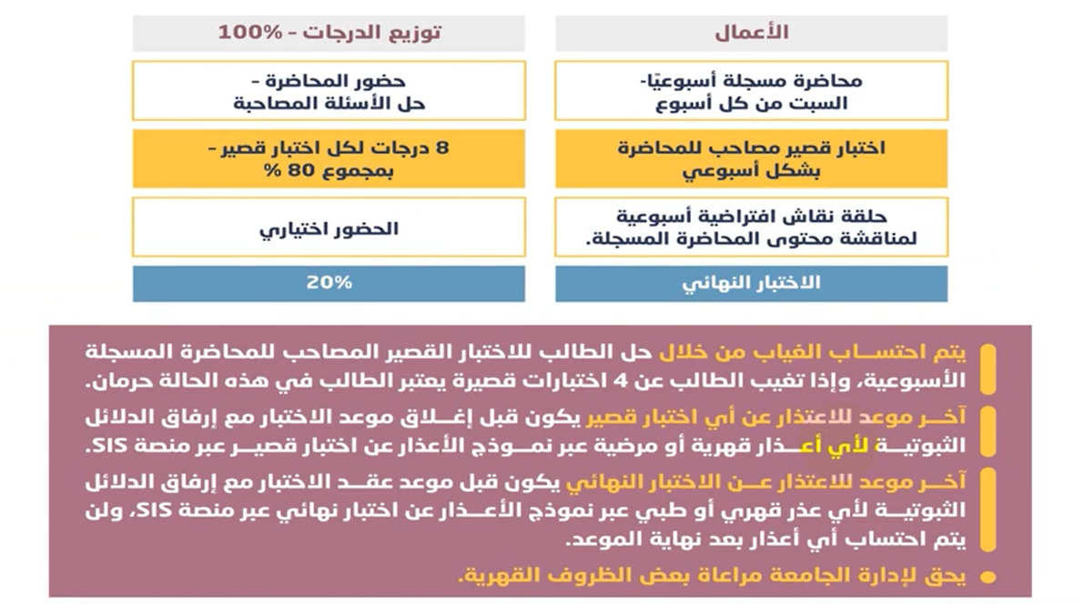
www.midocean.ae

Slide 6

Learn Basics of Robots and People Working Together: Get to know how robots and humans can interact and work side by side.
Designing How Robots Look and Work: Discover ways to make robots that are easy to use, helpful, and safe for people.
Testing How Well Robots and People Work Together: Learn to check if the robots are doing a good job and are easy for people to work with.
Understanding Different Kinds of Robots: Find out about various types of robots and how much they can do on their own.
Classifying Robot Systems: Learn to sort and categorize different robot systems.
Looking at Human Aspects: Study how working with robots affects people's minds and bodies.
Using AI in Robots: Learn how to use artificial intelligence to make robots smarter.
Making and Controlling Robots in Simulations: Get hands-on experience by creating and managing virtual robots.
Practical Projects with Real-World Focus: Apply what you've learned to design and test robot systems for real-life uses.
www.midocean.ae

Slide 7

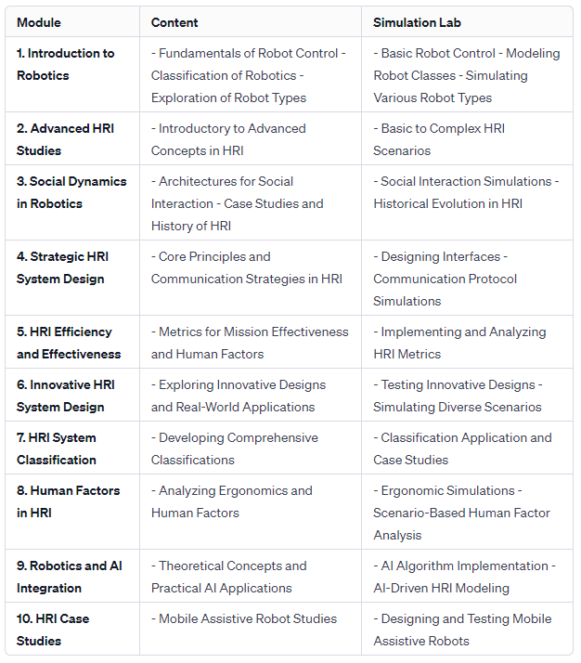
www.midocean.ae

Slide 8
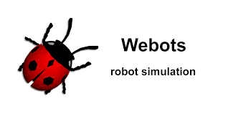

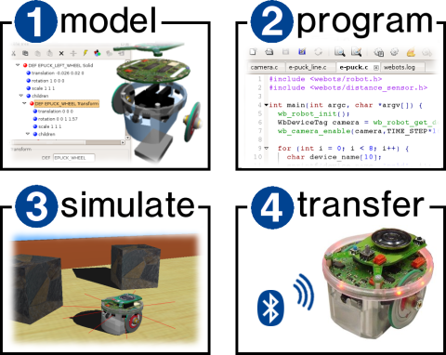
Human-Robot Interaction An Introduction
By Christoph Bartneck, Tony Belpaeme, Friederike Eyssel, Takayuki Kanda, Merel Keijsers, Selma Šabanović · 2020
Webots is an open source and multi-platform desktop application used to simulate robots
https://cyberbotics.com/
www.midocean.ae

Slide 9



Thank You

