Slide 1



Prepared by Dr. Mohamed Owies
(DGM 729)
Interaction Design
Lecture 10

Slide 2

Chapter 10
What’s Next?
Interaction Design

Slide 3
Lecture 10
Content
lecture 10 includes the following points:
The Evolution of UX
The Endurance of Design
The Secret Agenda of the UX Team of One
If You Only Do One Thing…

Slide 4

Lecture 10
Chapter 10 What’s Next?
The idea for this book was born in 2008. That’s when I first saw that there were people who, like me, felt that they were staking out a user experience practice in a place where it had not previously existed. It is now five years later, and a lot has changed in the user experience field.

Slide 5
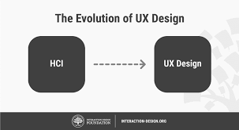
Lecture 10
The Evolution of UX
Five years ago, Web and software design were the standard. Today, mobile and app design are taking the lead. Five years ago, it was more common to talk about user experiences as existing within the context of a single channel or touch point.
Today, we understand that a digital product is often a full, multichannel experience and that our job is to give people a seamless product experience even as they jump from PC to mobile to tablet and back again. Even the concept of PC, mobile, and tablet is, ultimately, very 2008.

Slide 6
Lecture 10
The Evolution of UX
The field of user experience (UX) has evolved significantly over the years, as technology has advanced, and user needs and expectations have changed. Here is a brief overview of the evolution of UX:
Early Days: In the early days of computing, UX wasn't really a consideration. Designers and engineers focused on creating software that worked, without much thought given to how it was used or how users interacted with it.

Slide 7
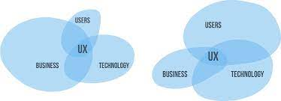
Lecture 10
The Evolution of UX
Graphical User Interface (GUI): The introduction of graphical user interfaces (GUI) in the 1980s marked a significant step forward for UX. With the advent of the Macintosh, users could interact with their computers in a more intuitive way, using a mouse to point and click on graphical icons and menus.
Web 1.0: In the early days of the web, UX was still a relatively new concept. Web pages were simple and text-heavy, with few graphics or interactive features. Navigation was often confusing, and users had to scroll through long pages of content to find what they were looking for.

Slide 8
Lecture 10
The Evolution of UX
Web 2.0: With the rise of Web 2.0, the focus shifted towards creating more interactive and engaging user experiences. Social media, user-generated content, and interactive features like drag-and-drop interfaces and animations became more common.
Mobile: The proliferation of smartphones and tablets has had a significant impact on UX. Mobile devices have smaller screens and different input methods than desktop computers, requiring designers to rethink how they approach UX.

Slide 9
Lecture 10
The Evolution of UX
Artificial Intelligence (AI): The rise of AI has the potential to revolutionize UX, allowing for more personalized and predictive experiences. Chatbots, voice assistants, and recommendation engines are just a few examples of how AI is already changing the way we interact with technology.
Overall, the evolution of UX has been driven by a desire to create better experiences for users, as well as advances in technology that have enabled new types of interactions and experiences. As technology continues to evolve, it's likely that UX will continue to evolve along with it, adapting to meet the changing needs and expectations of users.

Slide 10
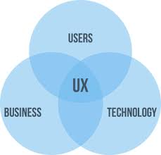
Lecture 10
The Evolution of UX
Today, digital experiences are embedded in our homes, in our cars, and in what we wear on our bodies. Today, the very idea of a stand-alone user experience seems old-fashioned.
Open APIs mean that our products now exist in an interconnected ecosystem of interoperable services. The user experiences enabled by that ecosystem are sometimes awesome and, more often, still pretty fragmented.

Slide 11
Lecture 10
The Evolution of UX
All of this change just means more opportunities for UX teams of one. It’s five years later, and there are now more UX education options, more UX practitioners, and more UX jobs than ever.
Undoubtedly, many of these jobs will require teams of one who are prepared to lead multifunctional teams to better designs. And how will they do this? By focusing on the durable value and purpose of design.

Slide 12

Lecture 10
The Endurance of Design
Design is the act of creating new solutions under constrained circumstances, whether those constraints are aesthetic, technological, or resource-driven. That may sound like a restriction, but actually it’s a gift. Constraints, in the end, are a designer’s friend. They give you boundaries, sure, but those boundaries become landmarks of inspiration that are just as instrumental for expanding your thinking as they are for limiting it.
For UX teams of one, constraints largely come in the form of other people. The product managers, engineers, marketers, and decision-makers you work with to put products into the world challenge you to be creative within constraints.

Slide 13
Lecture 10
The Endurance of Design
UX design is a critical aspect of modern technology, shaping how people interact with digital products and services. The endurance of UX design can be attributed to several factors, including:
User-Centered Approach: UX design is focused on the needs and preferences of users, ensuring that digital products and services are intuitive, easy to use, and enjoyable. By prioritizing user experience, UX design has become a crucial factor in determining the success of digital products and services.

Slide 14
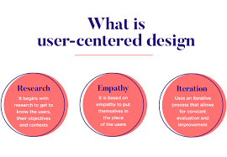
Lecture 10
The Endurance of Design
Constant Innovation: As technology continues to evolve, UX design must keep up with the latest trends and technologies. UX designers are constantly exploring new ways to improve user experience, whether through new interaction models, emerging technologies, or innovative design techniques.
Multidisciplinary Nature: UX design is a multidisciplinary field that draws on a wide range of skills and knowledge, including psychology, anthropology, design, and engineering. This multidisciplinary approach allows UX designers to understand the needs and preferences of users from various perspectives, resulting in more effective and user-friendly products and services.

Slide 15
Lecture 10
The Endurance of Design
Business Impact: Good UX design can have a significant impact on a company's bottom line. By creating products and services that are easy to use and enjoyable, UX design can increase customer satisfaction, retention, and loyalty, leading to increased revenue and profitability.
Continuous Improvement: UX design is an iterative process that involves continuous testing and refinement. By gathering feedback from users and analyzing data, UX designers can identify areas for improvement and make ongoing adjustments to improve the user experience.

Slide 16
Lecture 10
The Endurance of Design
The endurance of UX design can be attributed to its user-centered approach, constant innovation, multidisciplinary nature, business impact, and focus on continuous improvement. As technology continues to evolve and shape the way we interact with digital products and services, UX design will continue to play a critical role in creating effective and enjoyable user experiences.
Successful teams of one know that this is the role that their teams and colleagues play, and like a master designer working with the best materials, they work within these constraints in a purposeful way.

Slide 17
Lecture 10
The Endurance of Design
They provide supplemental thinking to your own singular point of view. They help you be a better designer. When handled confidently and patiently, your colleagues can become your own landmarks for inspiration, and they can help you make far more impact than you could on your own.

Slide 18
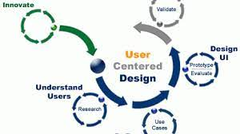
Lecture 10
The Secret Agenda of the UX Team of One
The role of a UX team of one is to single-handedly design and execute a user-centered design strategy for a project or organization. The secret agenda of a UX team of one is to achieve the following:
Build Strong Relationships: As a UX team of one, building strong relationships with stakeholders, team members, and users is key. The agenda is to cultivate a culture of empathy, open communication, and trust, to ensure that everyone is aligned with the user-centered design goals of the project.

Slide 19
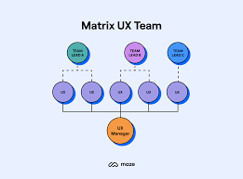
Lecture 10
The Secret Agenda of the UX Team of One
Focus on Prioritization: Prioritization is crucial for a UX team of one. The agenda is to work closely with stakeholders and team members to prioritize features, tasks, and design decisions that are critical to the success of the project. This involves conducting user research, understanding business goals, and balancing constraints to make informed design decisions.
Leverage Data and Analytics: A UX team of one needs to be data-driven and leverage analytics to support design decisions. The agenda is to use analytics tools to track user behavior, identify pain points, and optimize the user experience. Data analysis can also help to identify trends, insights, and opportunities for improvement.

Slide 20
Lecture 10
The Secret Agenda of the UX Team of One
Maintain a User-Centered Approach: The agenda of a UX team of one is to keep the user at the center of the design process. This involves conducting user research, creating personas, and testing design solutions with users to ensure that they meet their needs and preferences. It is important to continually gather feedback from users throughout the design process to ensure that the user-centered approach is maintained.
Educate and Evangelize: The secret agenda of a UX team of one is to educate and evangelize about the importance of user-centered design to stakeholders and team members. This involves communicating the value of UX design, sharing insights and data, and building buy-in for the user-centered design process.

Slide 21
Lecture 10
The Secret Agenda of the UX Team of One
As much as a book can have a secret agenda, here is this book’s secret agenda: to give you the confidence and ready tools to take on the non-UX world as unwitting allies, essential and welcome co- conspirators in creating the human-inspired, technology-enabled world of tomorrow.

Slide 22
Lecture 10
The Secret Agenda of the UX Team of One
Hopefully, this book has given you some comfort and confidence in knowing that you are by no means alone—neither in your passion for user experience nor in the constraints that shape your work. You may even have seen that you’re already doing a lot of the best practices and techniques that work well for UX teams of one.

Slide 23
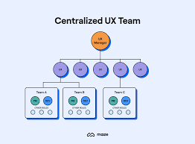
Lecture 10
The Secret Agenda of the UX Team of One
Perhaps, you’ve added some new tools to your toolkit as well. But far more than methods and tools, this book has aimed to inspire you to think about what it is that you’re trying to accomplish in your work—what changes you’re trying to effect, what kind of future you’re trying to make possible.

Slide 24
Lecture 10
If You Only Do One Thing…
If You Only Do One Thing…
While this book has focused heavily on methods, ultimately, winning the hearts and minds of the non-UX world requires more than method-by-method or project-by-project thinking. It requires you to get clear with yourself on your own master plan. A master plan might sound daunting, but it doesn’t have to be (see Figure 10.1).

Slide 25
Lecture 10
If You Only Do One Thing…
We’ll close out this book with one final method, one that’s just for you:
Clear five minutes on your calendar.
Grab a piece of paper and something to write with.
Quickly, without thinking too much about it, write down 3–5 things that you want to be true about your work in five years.

Slide 26
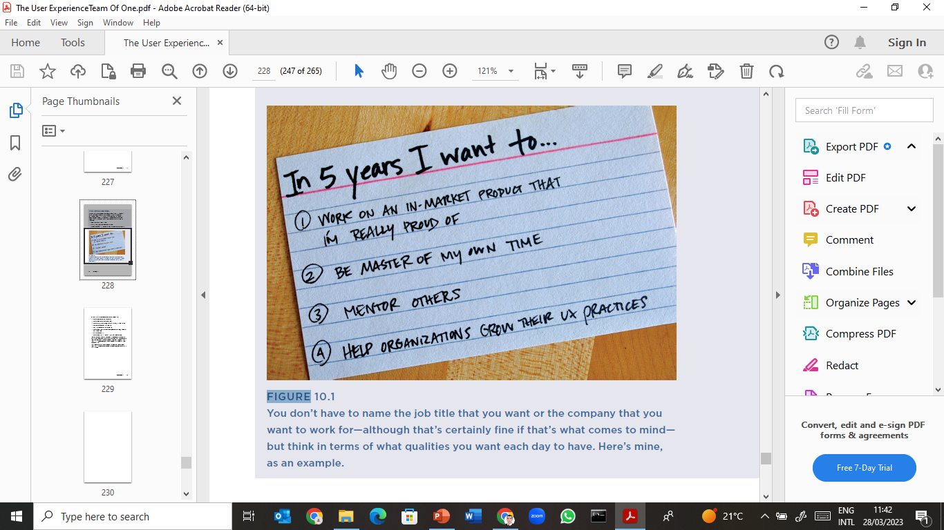
Lecture 10
If You Only Do One Thing…

Slide 27
Lecture 10
If You Only Do One Thing…
If you feel stuck, here are some questions you can ask yourself:
What kind of work do I want to be doing?
What kind of team do I want to work with?
What kinds of products and experiences do I want to put into the world?
What do I want my success stories to be?

Slide 28
Lecture 10
If You Only Do One Thing…
If you feel stuck, here are some questions you can ask yourself:
Who do I want my allies and friends to be?
What kind of education do I want to have? How do I want to apply that education in daily life?
How do I want to work?
What kind of culture do I want to be a part of and contribute to?

Slide 29
Lecture 10
If You Only Do One Thing…
And then, once you’ve got your list, see if there is anything on it that surprises you. Odds are, you may have put down something that you didn’t know mattered to you. But the list never lies.
There’s something beautifully simple and effective about giving yourself a quiet space and a few moments of reflection to discover some hard truths.
The funny thing is, once you’ve admitted to yourself that this is what matters to you, it usually doesn’t take five years to achieve it. You pretty much get moving on it right away.

Slide 30
Lecture 10
Guide to the Methods in Part II
The table below lists all the methods that are included in Part II. They are sequenced to suggest a logical order for a UX project from start to finish, although by no means do you have to do them all or follow them in order. Refer to the “Method Focus” column to determine when and why to use a particular method.

Slide 31
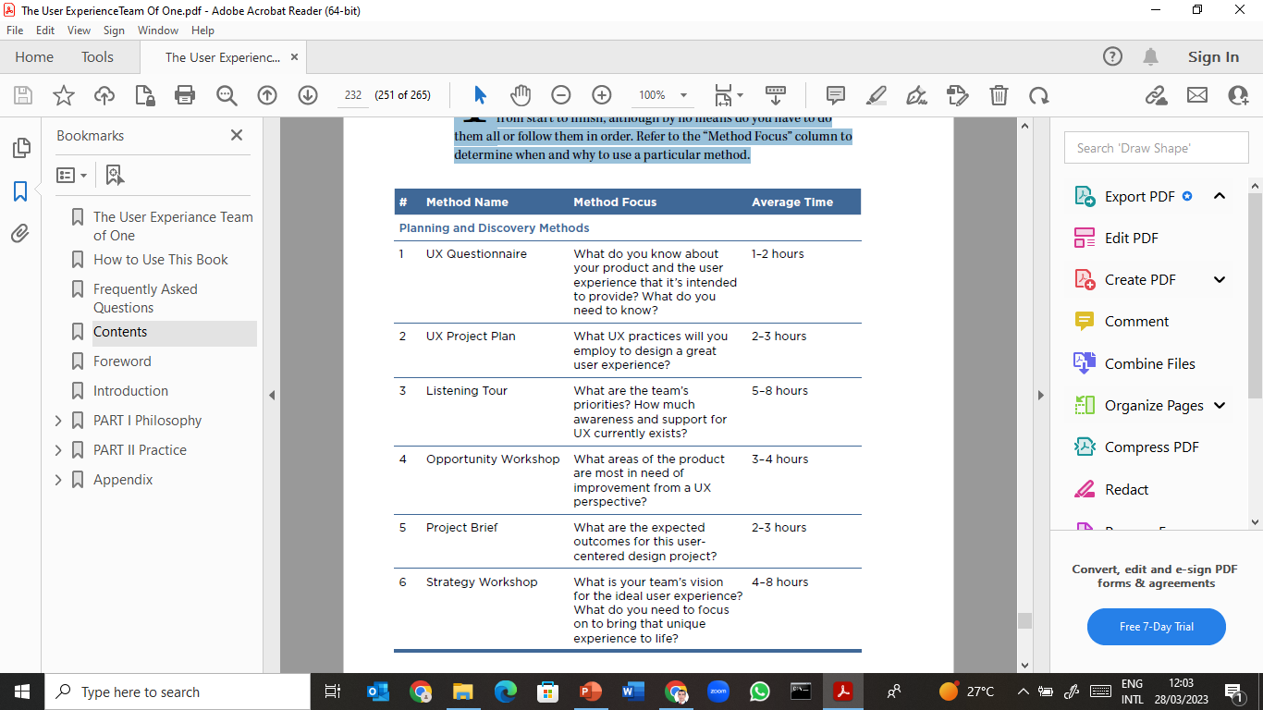
Lecture 10
Guide to the Methods in Part II

Slide 32
Lecture 10
Guide to the Methods in Part II

Slide 33
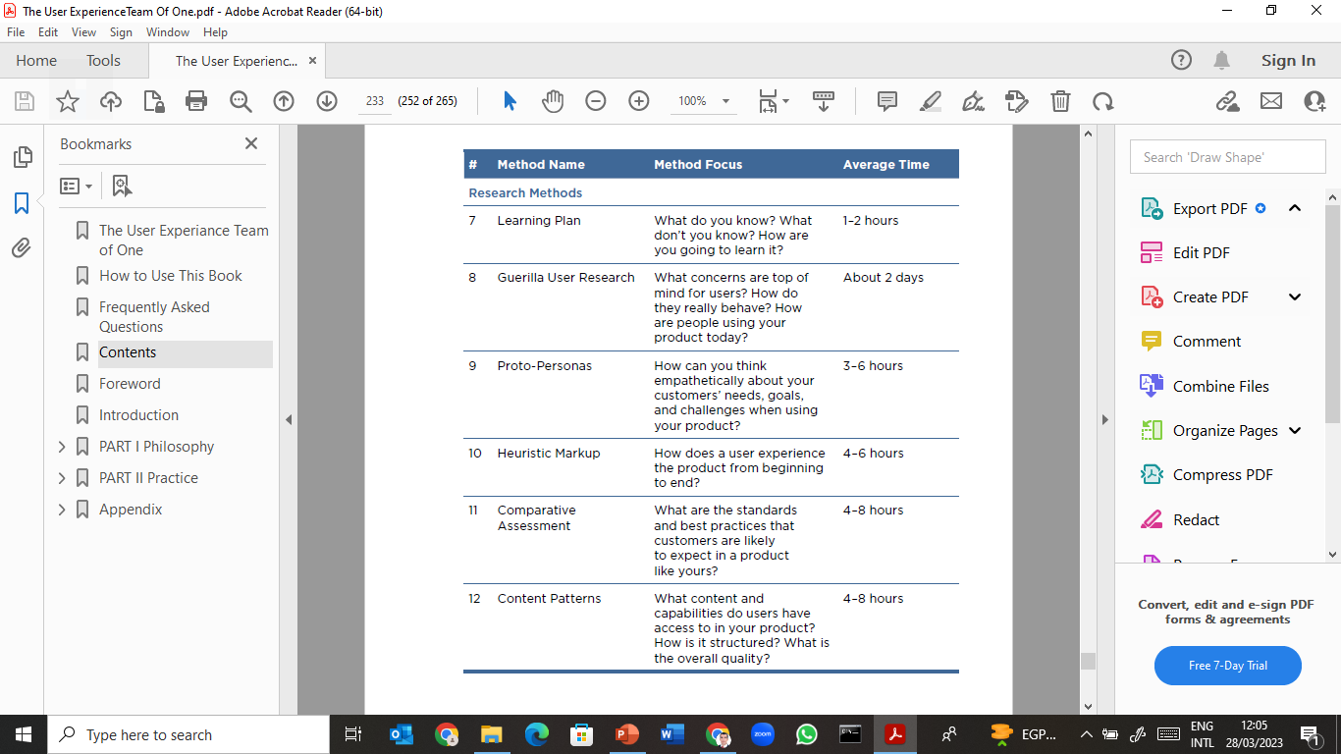
Lecture 10
Guide to the Methods in Part II

Slide 34
Lecture 10
Guide to the Methods in Part II

Slide 35
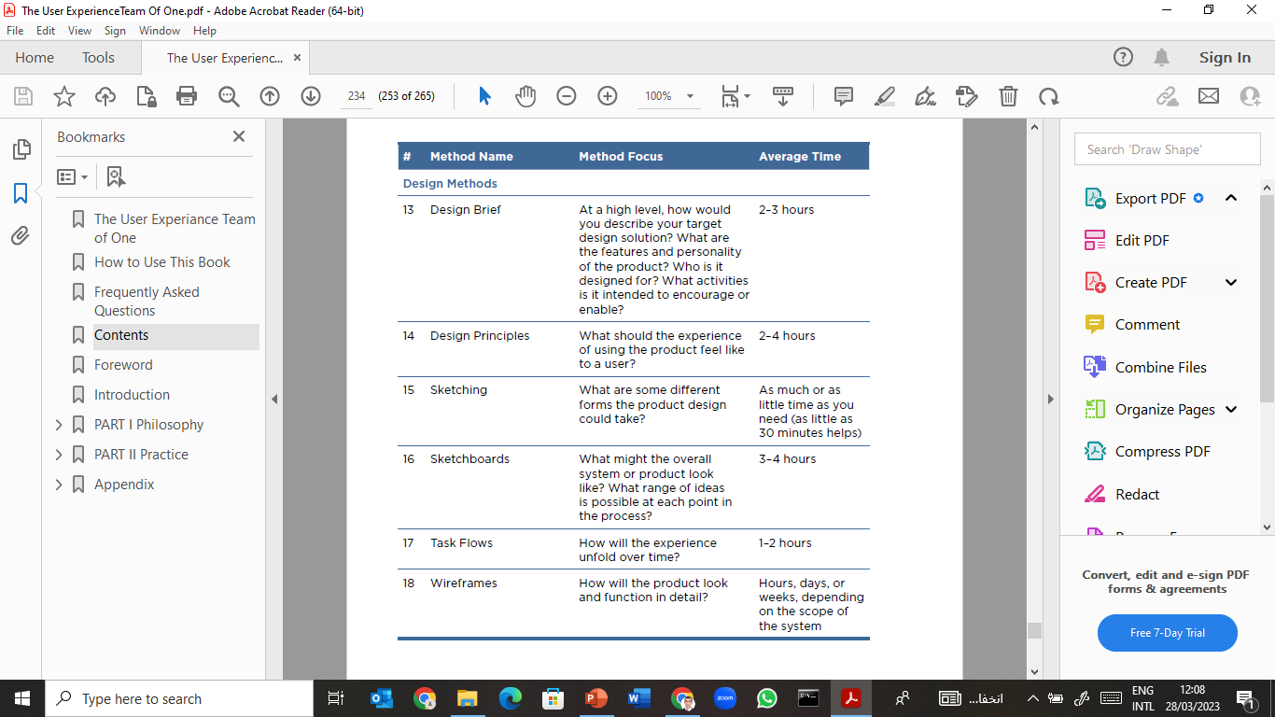
Lecture 10
Guide to the Methods in Part II

Slide 36
Lecture 10
Guide to the Methods in Part II

Slide 37
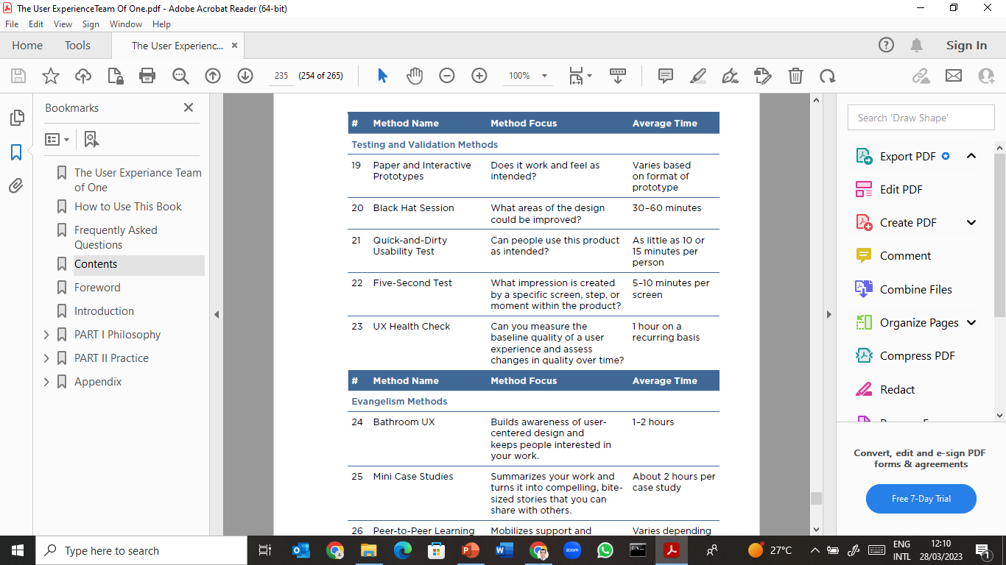
Lecture 10
Guide to the Methods in Part II

Slide 38
Lecture 10
Guide to the Methods in Part II

Slide 39
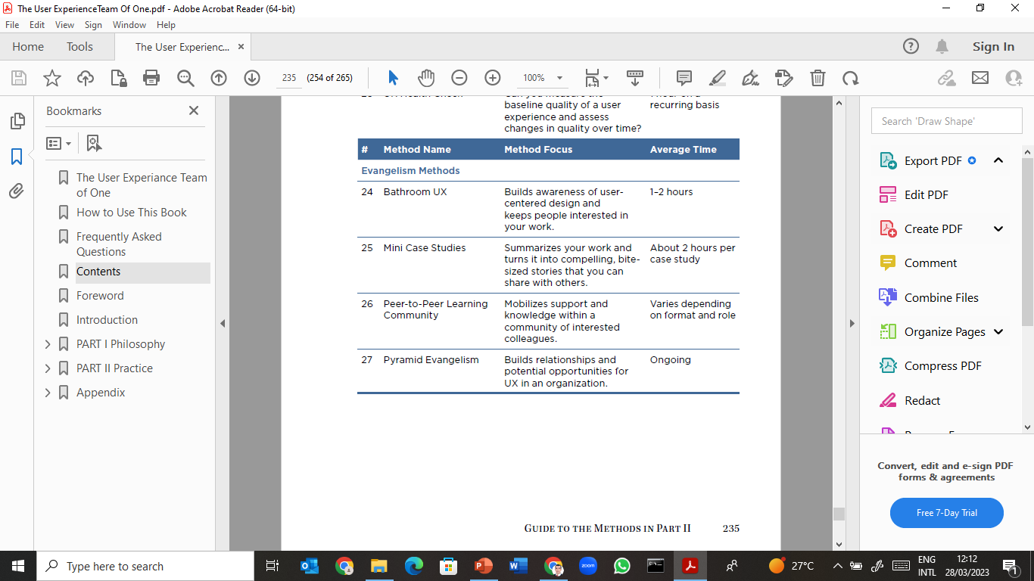
Lecture 10
Guide to the Methods in Part II

Slide 40
Lecture 10
Guide to the Methods in Part II

Slide 41
Lecture 10
Thank You

