Slide 1



Number Systems
Lecture 3
CCNA – Introduction to Networks V7.0 (ITN)
Prepared by
Dr. Abdelrhman Ahmed

Slide 2
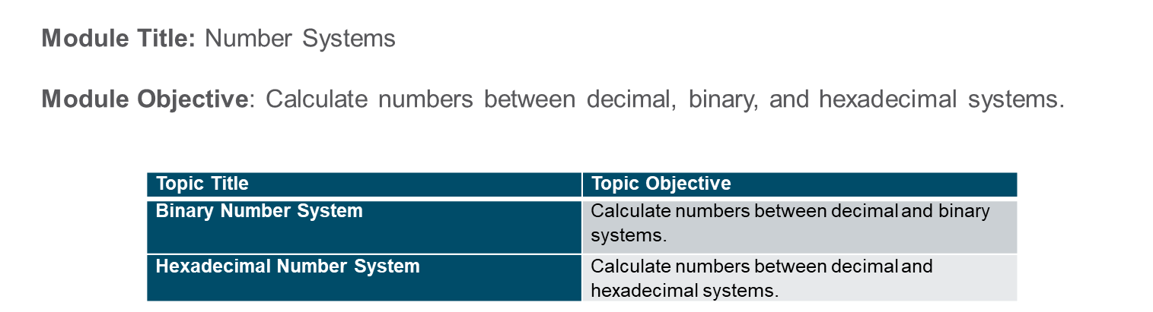
Chapter
Module Objectives
03

Slide 3
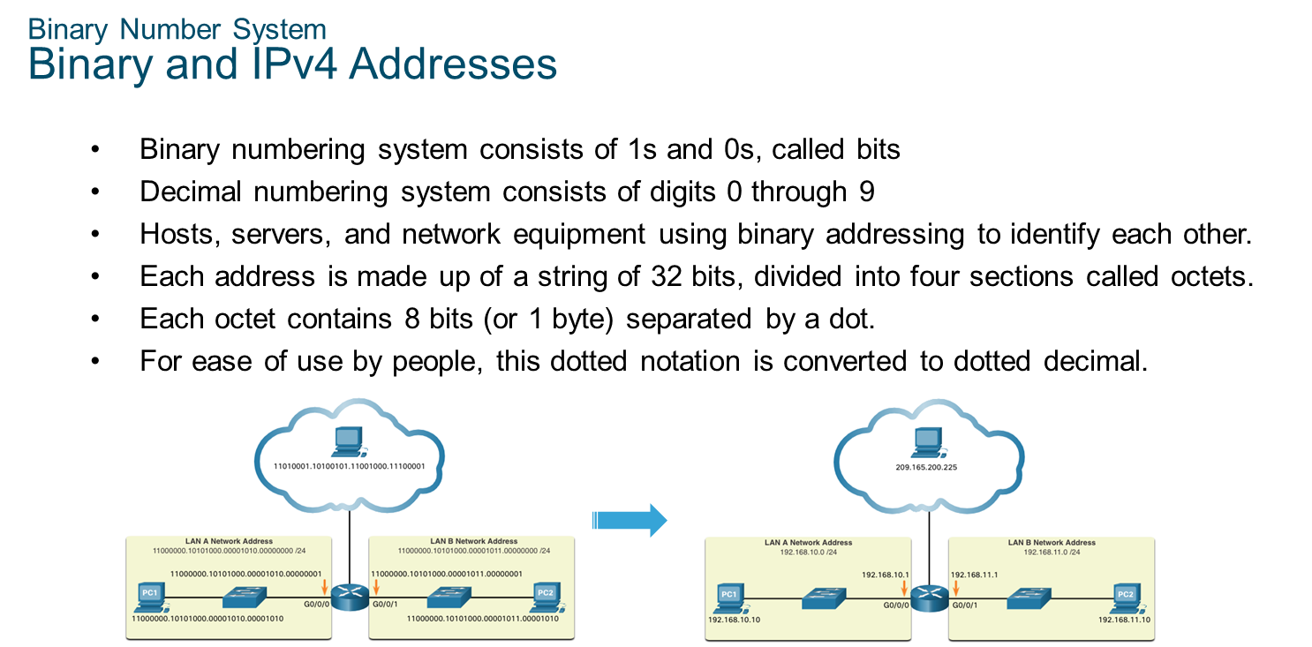
Chapter
Binary Number System
03

Slide 4
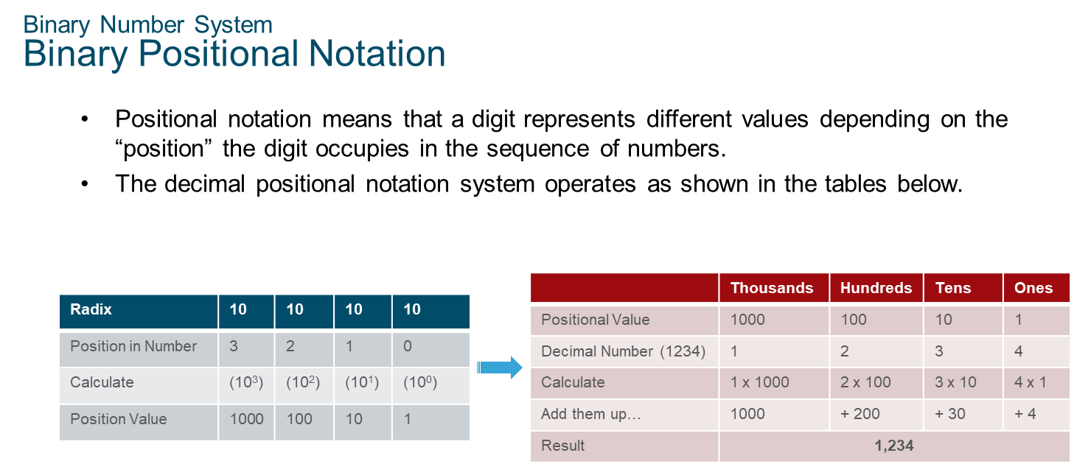
Chapter
Binary Number System
03

Slide 5
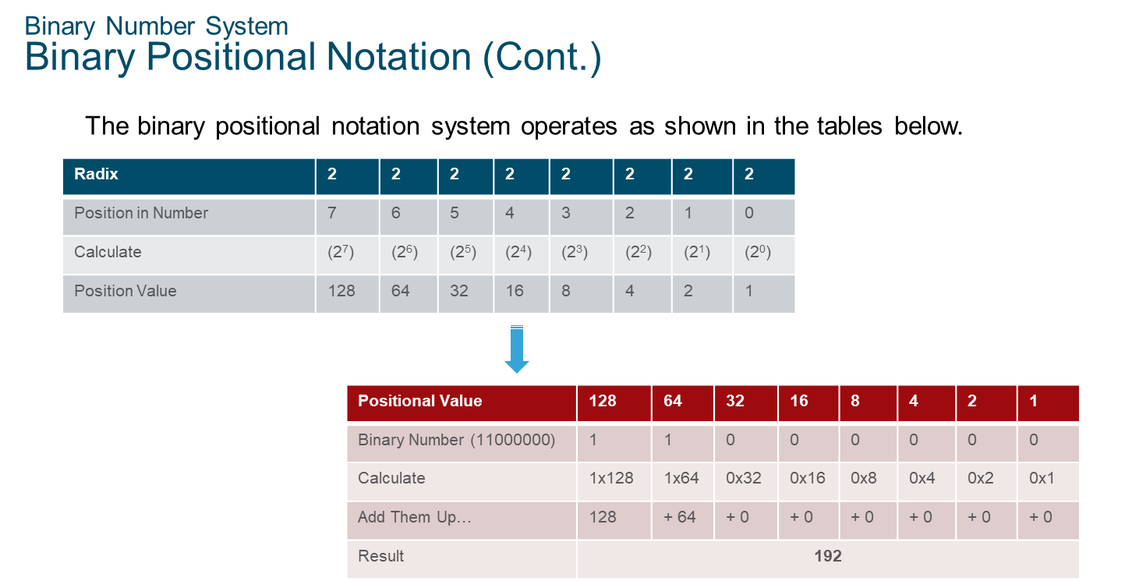
Chapter
Binary Number System
03

Slide 6
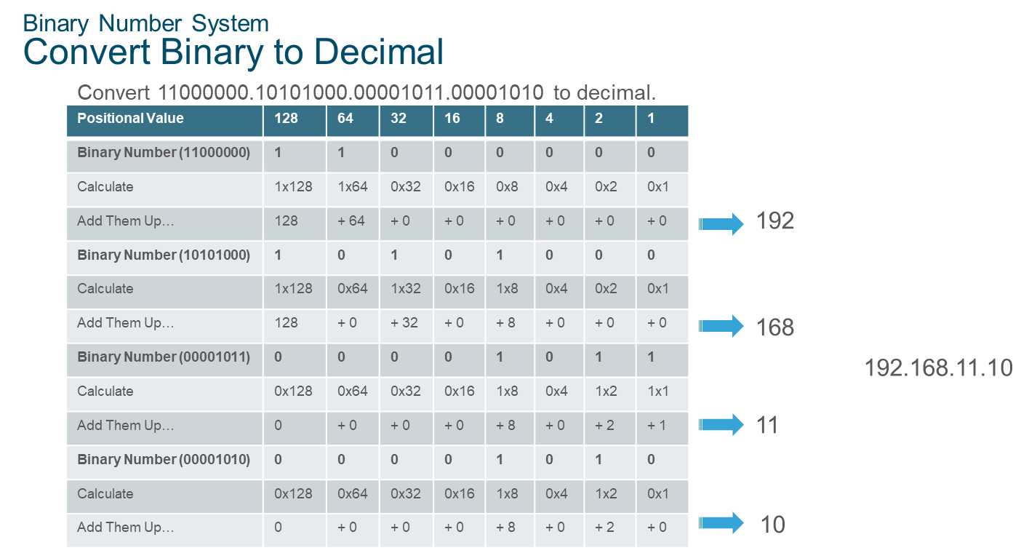
Chapter
Binary Number System
03

Slide 7
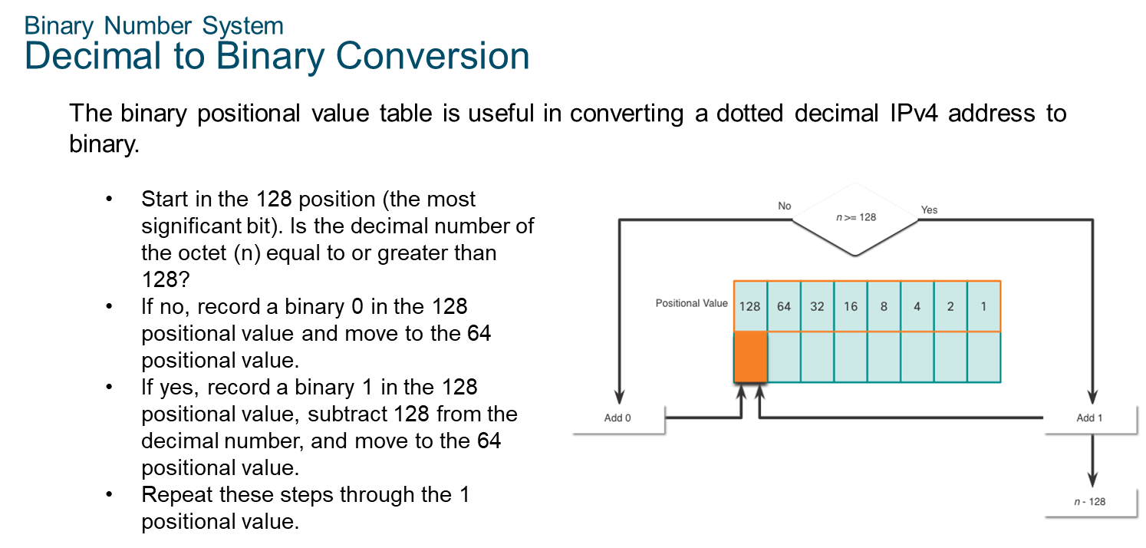
Chapter
Binary Number System
03

Slide 8
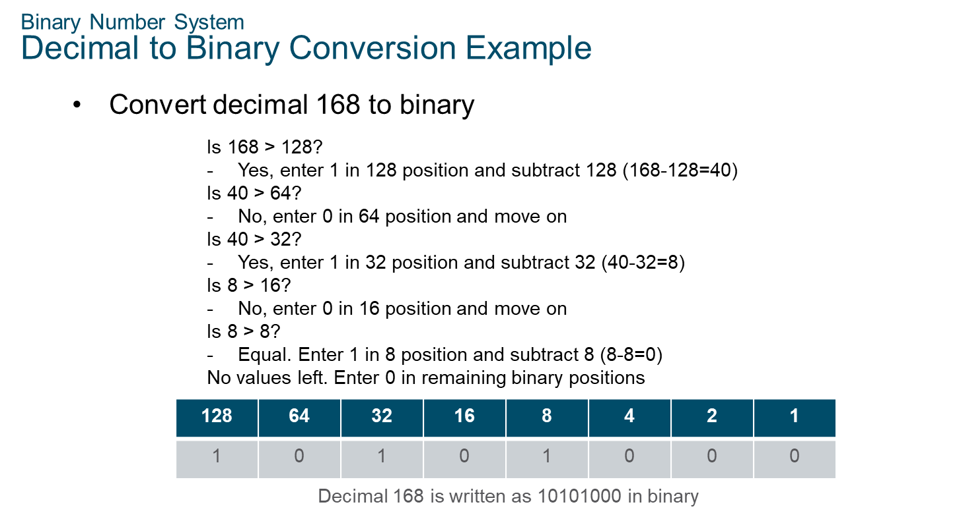
Chapter
Binary Number System
03

Slide 9
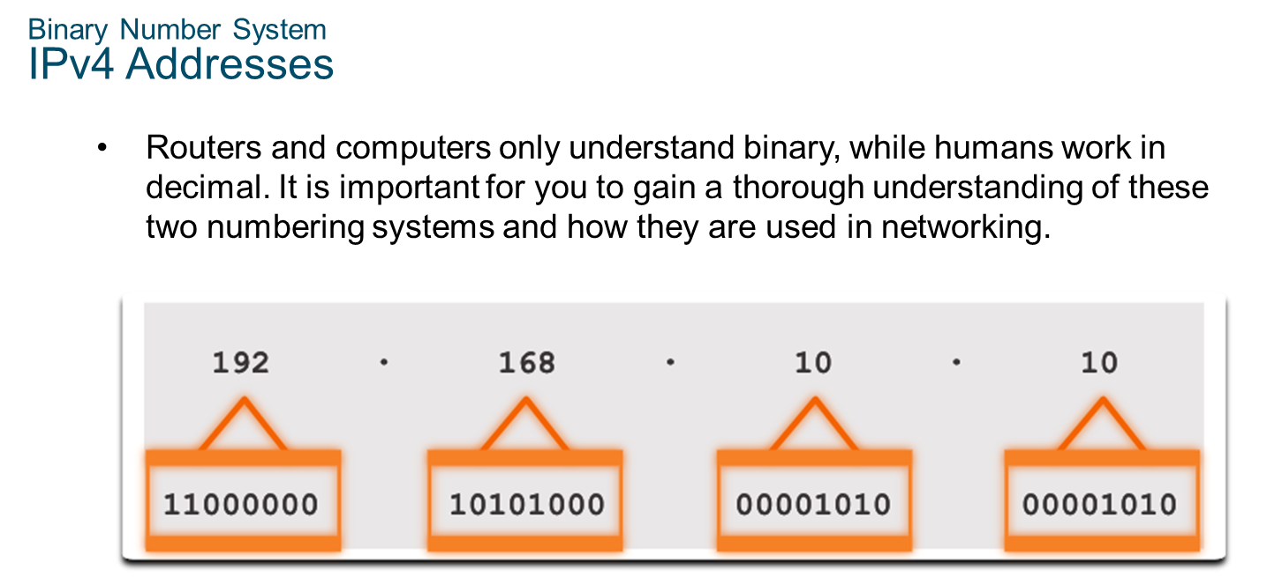
Chapter
Binary Number System
03

Slide 10
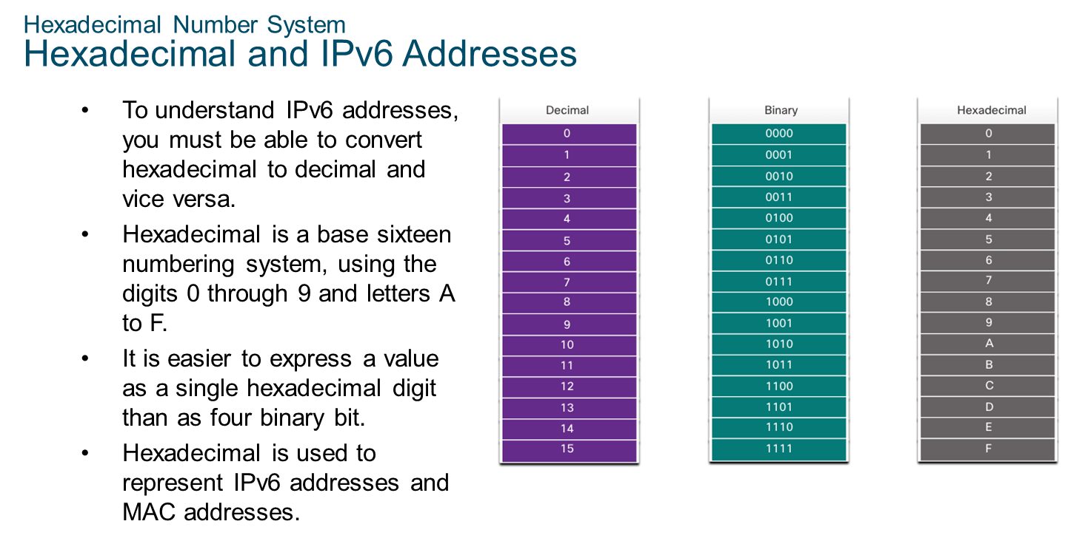
Chapter
Hexadecimal Number System
03

Slide 11
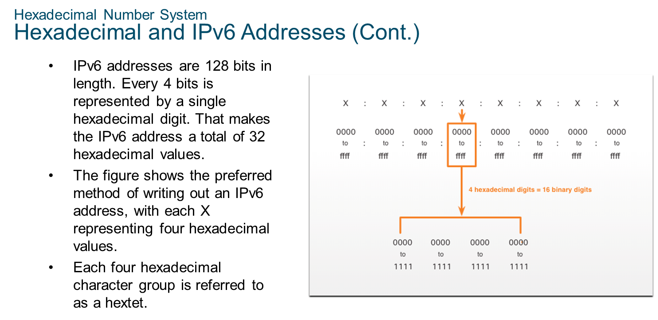
Chapter
Hexadecimal Number System
03

Slide 12
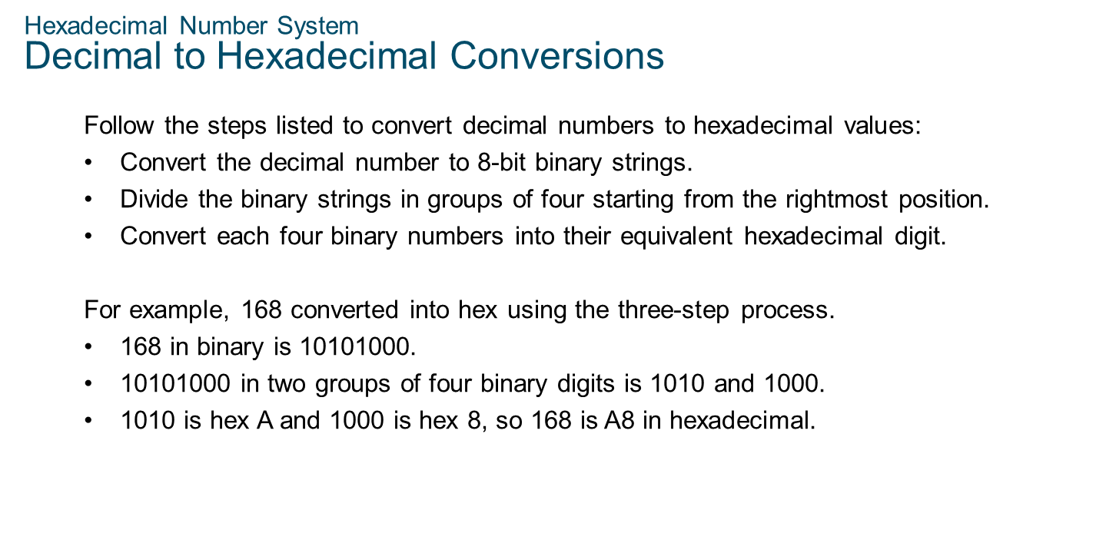
Chapter
03
Hexadecimal Number System

Slide 13
Chapter
Hexadecimal Number System
Hexadecimal to Decimal Conversions
03
Follow the steps listed to convert hexadecimal numbers to decimal values:
Convert the hexadecimal number to 4-bit binary strings.
Create 8-bit binary grouping starting from the rightmost position.
Convert each 8-bit binary grouping into their equivalent decimal digit.
For example, D2 converted into decimal using the three-step process:
D2 in 4-bit binary strings is 1101 and 0010.
1101 and 0010 is 11010010 in an 8-bit grouping.
11010010 in binary is equivalent to 210 in decimal, so D2 is 210 is decimal

Slide 14



Thank You

