Slide 1


Strategic And Operational Risk Management
Prepared by Dr. Ayman Hassan
  PMG 630
  “The Strategic nature of risk management"
Lecture 10

Slide 2



Strategic And Operational Risk Management
Lecture 10
PMG 630
The Strategic nature of risk management
Prepared by
Dr. Ayman Hassan

Slide 3
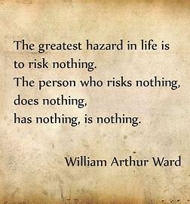
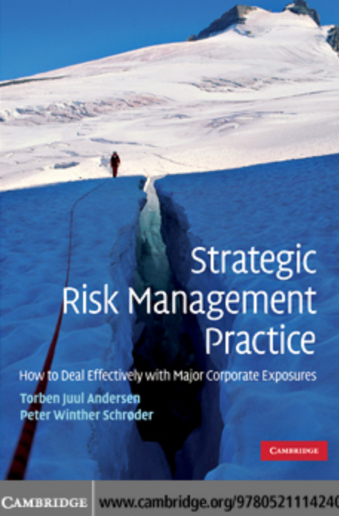
Important note, 1
Chapter 9
r
Nice quotes
Chapter 9
Risk taking means life
without it, life has no meaning.
Ayman Hassan
REF,2

Slide 4
Lecture No.10, The Content
Chapter 9
Summary of the previous lecture
Introduction
  The nature of risk management
  The Strategic nature of risk management
The conventional risk management process
From the conventional to the strategic
What are strategic risks?
Examples of strategic risk
The link between risks and decision making
Risk management effects strategy process
What's the general difference between (ERM) and (ORM)
An anonymous poem
References & Resources

Slide 5
Chapter 9
Introduction
Risks are everywhere, and it is well known that companies in general are not isolated entities from their surroundings and environment in all its forms ...
There is a large dynamic process that is not static from the cases of influence and impact, whether direct or indirect
The world is witnessing a steady increase in man-made disasters in various parts of the world, and even the emergence of major disasters resulting from deliberate human actions that have direct and indirect economic impacts.
These developments have led to intensifying our focus on the risks facing companies and the public and the risk management processes that may be necessary to circumvent the negative economic impacts resulting from such events.

Slide 6
Chapter 9
Introduction, 2
At the same time, we have seen a general perception of risk that aims to reduce system errors, operational failures, and uncontrolled human behaviours that affect the way we try to manage the risks facing companies.
Thus, managing corporate risk has become a central theme, and arguably constitutes a new lens through which we can view the development of corporate strategy – because poor risk management can lead to bankruptcy, while good risk management practices can lead to superior corporate performance outcomes.
Risk management can thus be viewed as a process that allows an organization to achieve its full potential and obtain optimal economic returns, or, in strategic terms, effective risk management can be viewed as a means of creating sustainable competitive advantage.

Slide 7
Chapter 9
  The nature of risk management,1
We have seen the introduction of formal enterprise-wide risk management frameworks that may help us contain specific exposures, but these approaches do not necessarily constitute sufficient conditions for effective risk management outcomes.
Hence, there may be too many aspects of risk that cannot be contained within simple formalized control systems.
That is, the importance of risks and the importance of strategic risk factors and related corporate responsiveness in increasingly turbulent market environments point to a need for an extended view of the risk management process.

Slide 8
Chapter 9
  The nature of risk management,2
Risk events are typically conceptualized as hazards and risks arising from identifiable triggers, such as accidents, human error, natural phenomena, etc. Traditional risk management seeks to minimize the likelihood of negative losses resulting from such events.
If we interpret risk as the volatility of performance outcomes, then the risk management task is seen as being able to eliminate the potential for poor performance while recognizing the positive gains associated with emerging business opportunities.
There is a strategic element to the concept of risk management that must also take into account the possibility of new opportunities arising from radical changes in the business environment and that may constitute some of the most important concerns of risk management.

Slide 9
Chapter 9
  The nature of risk management,3
While the nature of common downside risk events is well defined and accounted for in statistical records, many of the emerging operational and strategic risks are less precise and thus much harder to describe and predict.
Much of the contemporary risk management literature is supported by calculable odds for identifiable risk events determined by analysis of objective historical records.
However, true uncertainty arises when one is unable to determine the odds or even foresee the future risk events.
There seems to be a trend towards higher uncertainty due to the emergence of new risks caused by terrorist acts, natural catastrophes, political events, path breaking technologies and continuous innovation

Slide 10
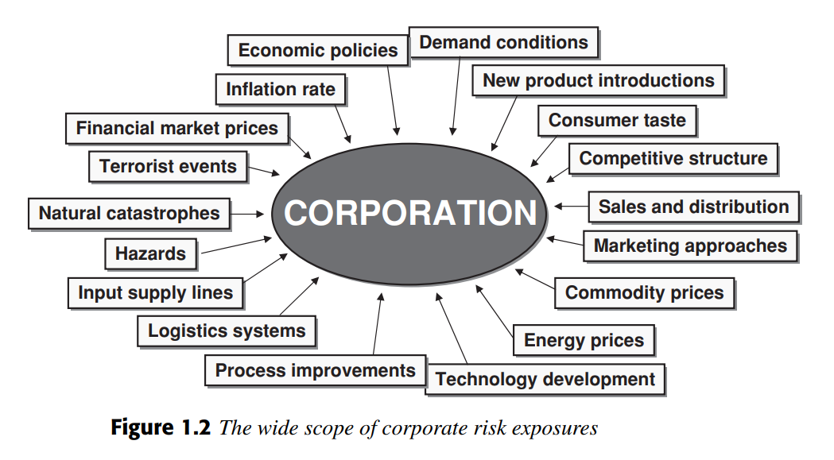
Chapter 9
  The Strategic nature of risk management
All in all, there is virtually no end to potential sources for economic disruption.
A conventional risk management focus has been concentrated on volatile financial markets, insurable casualties and macroeconomic conditions. However, these risks have been extended to include many other factors beyond managerial control, including systemic disruptions, industry paradigm changes, competitive initiatives, technological shifts, political incidents, mega-terrorist events and the like, many of which are hard to foresee and predict (Figure 1.2).

Slide 11
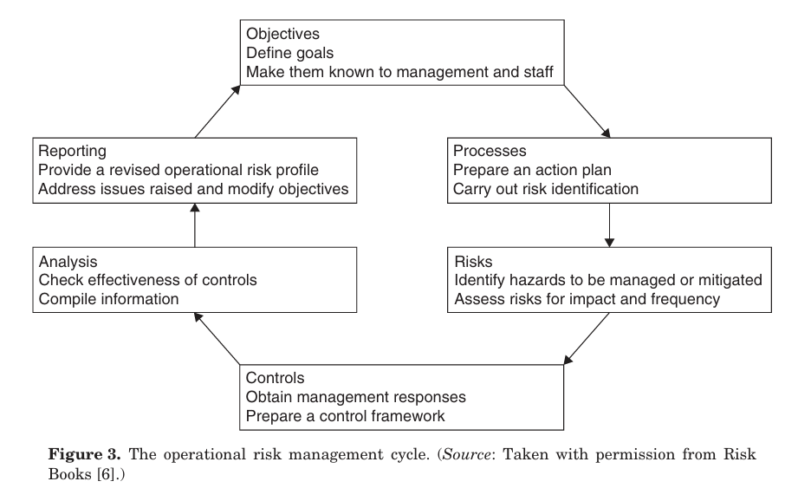
Chapter 9
The conventional risk management process
Four consecutive activities that continue over time.
First, the major risks that expose the corporation must be identified.
Once this is done, various techniques are adopted to analyze event frequencies and the potential economic effects of the identified exposures.
Based on assessments of potential exposures, corporate management decides whether these exposures are acceptable in view of prevailing organizational responses.
within regular time intervals.
Finally, the exposures are modified through risk mitigation efforts and adoption of various risk-transfer activities, so the corporation retains a risk level that is acceptable within the overall corporate risk policy.
As risk factors and the associated economic exposures may change dynamically over time, the described elements of the formal risk management process should be repeated

Slide 12
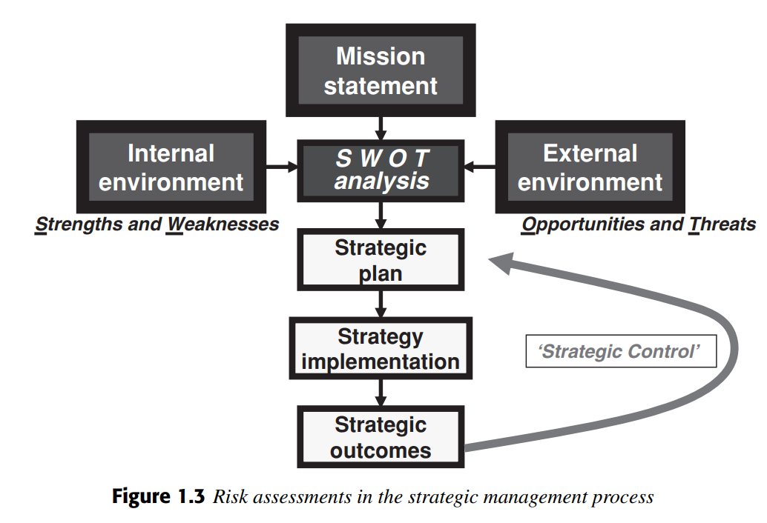
Chapter 9
From the conventional to the strategic
Risk assessments in project management see a need to balance advance planning with adaptive solutions that arise as the projects are implemented.
We may even extend this perspective to corporate strategy

Slide 13
Chapter 9
What are strategic risks?
Strategic risks are generally defined as those that threaten a company’s ability to develop and implement its chosen strategy.
These risks may be external; events such as the COVID-19 pandemic are a prime example.
They may also be “self-induced,” arising from an organization’s own strategy and decision-making.
An example of this is the accelerating digital transformation of companies, which has brought many positives but has also exposed new types of risks.

Slide 14
Chapter 9
Examples of strategic risk
Competitive risk. The risk is that you fall behind your competitors as they innovate and improve their offerings faster than you.
Change risk. The digital transformation risk we cited above is a prime example of this ' the inherent risks of introducing any change program.
Regulatory risk. Any new regulation has the potential to:
Disrupt your business
Create new responsibilities
Demand new technologies (and therefore linking back to change risk)
Distract your business leaders from their operations as their time is abstracted to put in place new governance processes and control measures

Slide 15
Chapter 9
Examples of strategic risk
Reputational risk. The risk that your corporate standing is threatened. The potential causes of this are legion, from regulatory compliance breaches to shareholder activism or poor performance in public ratings, such as those used to measure ESG performance.
Political risk. The potential for political change, or the political landscape overall, to disrupt your business. For example, through volatility in a country within your supply chain.
Governance risk. The risk brought about by poor governance, risk and compliance processes within your organization.
Financial risk. Risks relating to the financial health of the organization. This differs from...

Slide 16
Chapter 9
Examples of strategic risk
Economic risk. This refers to the broader economic landscape and its potential to affect the success of your business strategy.
Operational risk. The risk is that your operations and business processes are not up to standard.
Many of these examples of strategic risk are inter-connected. For instance, if you face operational risks around the efficacy and rigor of your processes, this is likely to expose you to financial or regulatory risk. Similarly, if you fail to tackle governance risks, you may well encounter reputational risk.
The intertwined nature of the types of strategic risk emphasizes how important it is to take an integrated approach to address them.

Slide 17
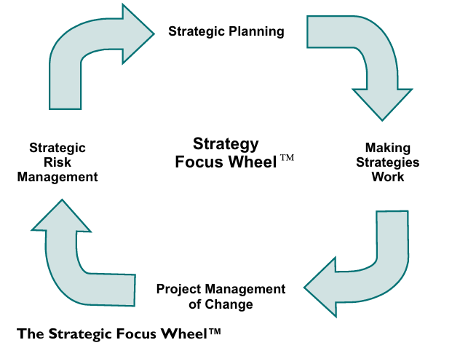
The Strategic Focus Wheel
Chapter 9
In a world of rapid change, organisations that can identify the need for change, design the changes required and implement these changes more effectively and efficiently than others are more likely to survive and prosper. Those that cannot adapt to change are likely to
perish.

Slide 18
Chapter 9
Strategic planning & strategies work
The wheel is used to focus the efforts and resources of organisations on delivering their intended strategic objectives, and has four core elements.
Strategic planning revolves around identifying the options available to an organisation and selecting the most appropriate., If strategic planning is done poorly, even the best implementation capability is unlikely to compensate.
Making strategies work is a process for connecting the high-level strategic plan to the day-to-day activities that are critical to its delivery.

Slide 19
Chapter 9
Project management
Project management of change ensures completeness and control over the physical realisation of the chosen strategy, Project management provides a comprehensive set of tools and techniques that enable managers to plan and implement change effectively and increase the likelihood of achieving the various objectives of the change process. Used effectively project management is a central element of the wheel in that it makes things
happen and delivers results.

Slide 20
Strategic risk management
Chapter 9
Strategic risk management (SRM) identifies, monitors and manages the risk profile of the organisation. Major changes in this profile can result in the need to revise or change the elements listed above and, in particular, to devise new strategic plans. Alternatively,
changes may be due to the implementation of a new strategy. Strategic risk management covers four primary risk areas or levels. These are strategic risk, change or project risk, operational risk and unforeseeable risk.

Slide 21
Chapter 9
The strategic dimension in risk management
Strategic risk includes risk relating to the long-term performance of the organisation.
This includes a range of variables such as the market, corporate governance and stakeholders.
The market is highly variable and can change at relatively short notice, as can the economic characteristics of the country or countries in which a given organisation is operating
The corporate governance risk of the organisation includes risk relating to the reputation of the organisation and the ethics with which it operates.
Stakeholder risk includes the risk associated with the shareholders, business partners, customers and suppliers. Shareholder attitudes can change quickly if dividends fall.

Slide 22
Chapter 9
Strategic plan and internal and external variables
The original strategic plan may have been correct but internal changes may have compromised it.
− Internal reorganisations may have led to a loss of efficiency.
− Required changes in operational processes may not have been introduced.
− Planned changes may not have delivered what was required.
The original strategic plan may have been correct but external changes may have compromised it.
− The external environment may have changed significantly.
− New competitors may have emerged.
− New competing products may have been released.
− Statutory controls may have changed.

Slide 23
Chapter 9
Strategic plan and internal and external variables
Operational risk can be defined as ‘the risk of direct or indirect loss, resulting from inadequate or failed internal processes, people and systems or from external events’.
Operational risk also effectively includes anything that can impact on the overall performance of the organisation and on the ability of the organisation to create value.
Operational risk therefore includes events such as mistakes or missed opportunities.

Slide 24
Chapter 9
The link between risks and decision making
Risk is intrinsically linked to decision making.
It is one of the three primary conditions under which decisions have to be made.
The three primary conditions that apply in virtually all cases are:
• conditions of risk;
• conditions of certainty;
• conditions of uncertainty.

Slide 25
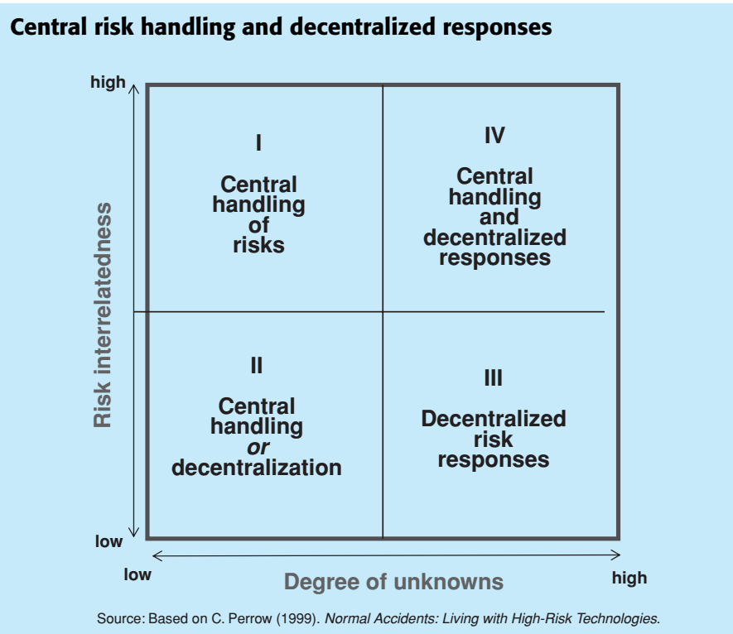
Chapter 9
Risk management effects strategy process
The interrelatedness of risk factors and the degree of unknown events
occurring are two important aspects of the environmental context that can facilitate our understanding of how to handle and respond to corporate risk effectively. In environments where risk events are intertwined and affect each other, risk relatedness is very high. These circumstances require a central function to analyze the aggregate exposures and devise appropriate corporate responses to deal with these risks.

Slide 26
Chapter 9
Risk management effects strategy process
In environments where risk factors are difficult to identify, measure and foresee, the degree of unknowns is very high. These circumstances require a decentralized capability that can identify emerging events and respond to these occurrences (see graphic below – ‘Central risk handling and decentralized responses’).
However, contemporary business environments are often haracterized
by very complex and tightly coupled business systems, i.e. high on both dimensions (section IV in the graphic), which will result in interacting and highly unpredictable risk effects. Under these circumstances, the previous logic suggests that effective risk management will require a combination of central coordination and decentralized responsiveness at the same time.

Slide 27
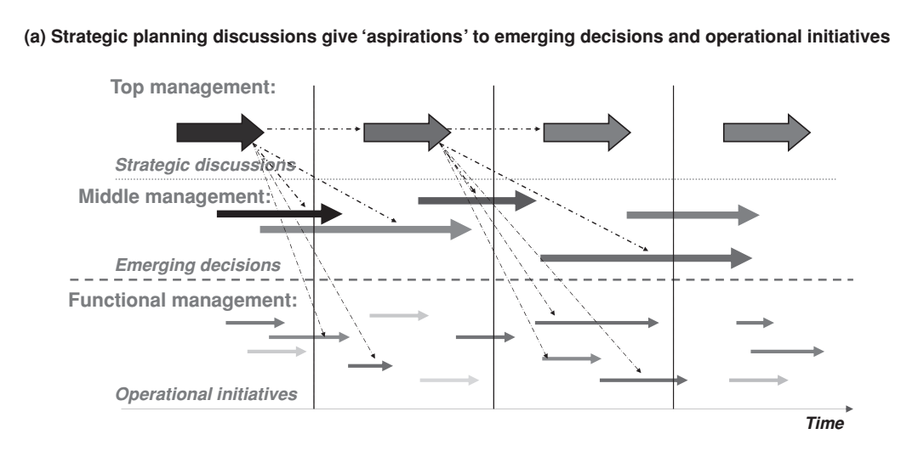
Chapter 9
Strategic planning and operational initiatives

Slide 28
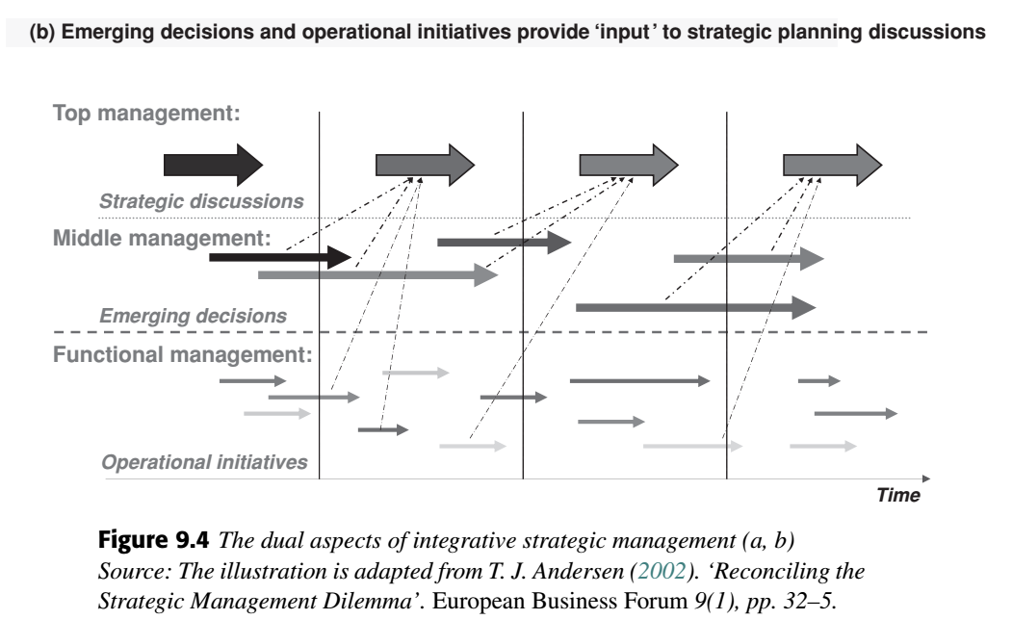
Emerging decisions and operational initiatives
provide ‘input’
Chapter 9

Slide 29
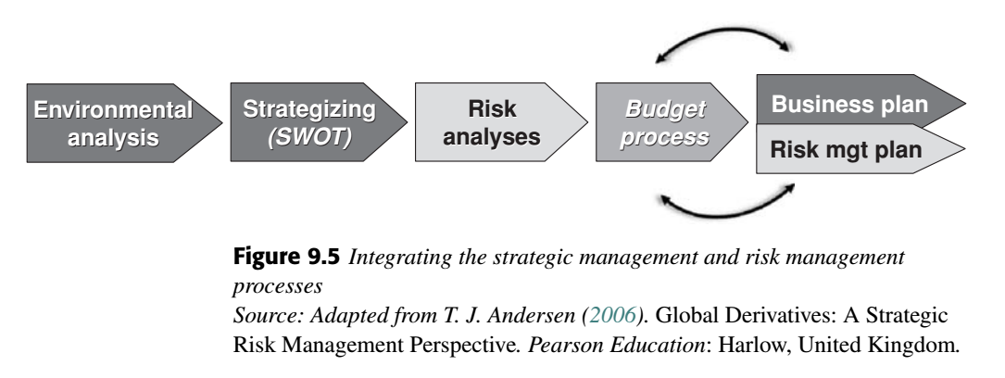
Chapter 9
Integrating the strategic MG, and risk MG, processes

Slide 30
Chapter 9
Levels of Risk Identification and Assessment
We must know that risk management operates at two levels to identify and assess risks, namely the institutional level and the functional level.
The institutional level deals with “big” risks often associated with strategic and economic concerns; the functional level deals with more specific risks associated with operational issues and specific market exposures.
The role of the risk management department in this context is to support corporate-level risk analyses and reporting on aggregate exposures, while providing the necessary support to functional entities in risk management activities and possibly stimulating workshops where functional risk management ideas and experiences can be exchanged.
This means that the risk management department was not established as a central control function, but rather as a “service” entity that supports the central risk management perspective by aggregating risk information from business units and supporting the executive management team through the analysis of “big risks”

Slide 31
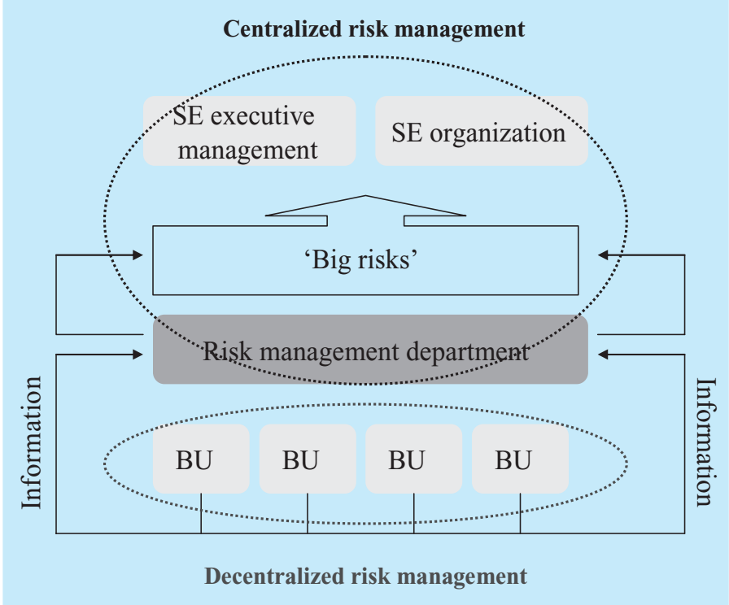
Chapter 9
Levels of Risk Identification and Assessment

Slide 32
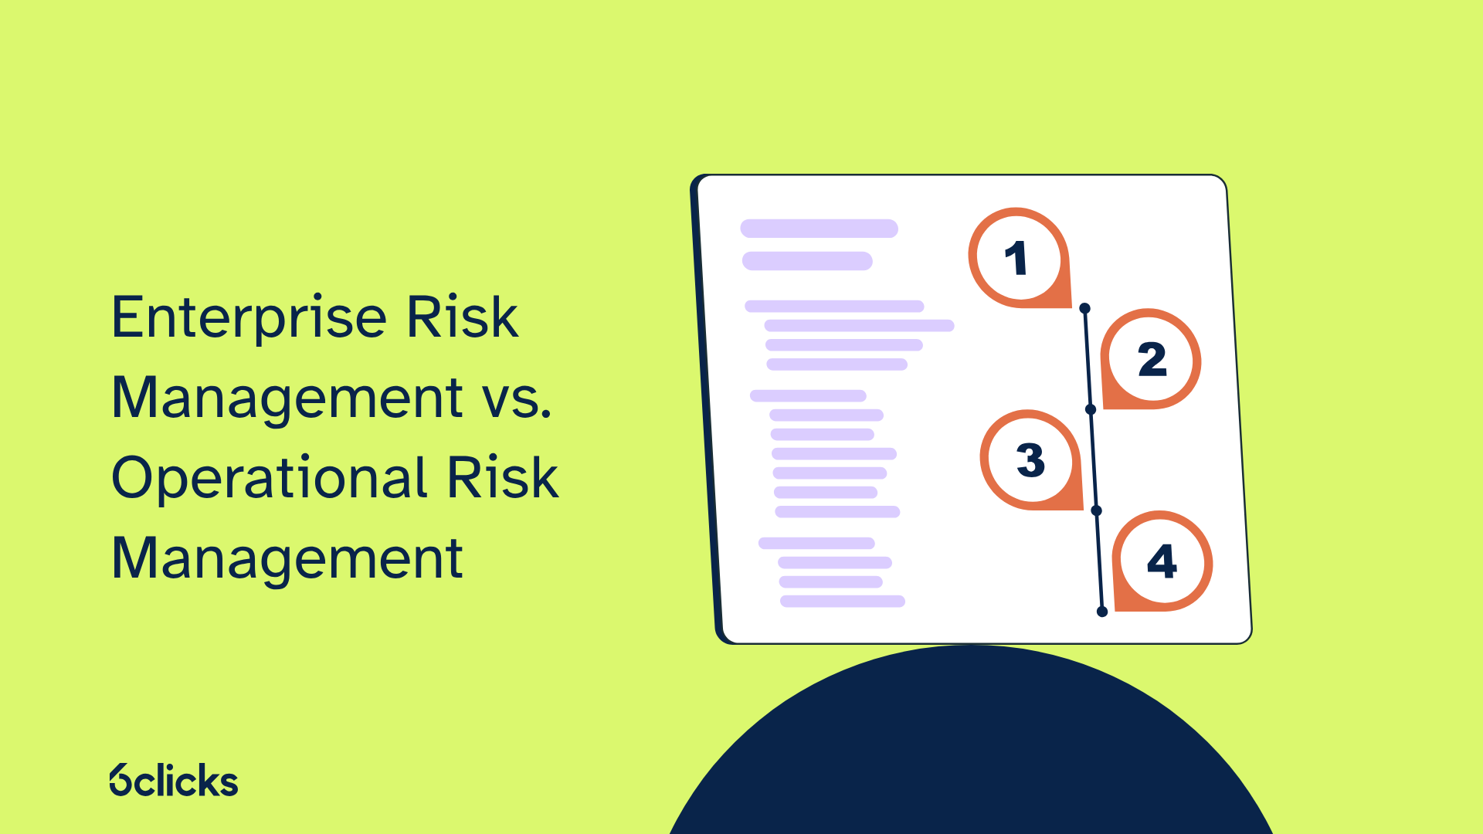
Chapter 9
Lecture .10

Slide 33
Chapter 9
What's the general difference between
(ERM) and (ORM)
Because organizations face increasingly sophisticated risks, enterprise risk management (ERM) and operational risk management (ORM) have emerged as crucial components of a comprehensive risk mitigation strategy.

Slide 34
Chapter 9
(ERM) & (ORM)
Enterprise risk management (ERM) focuses on a holistic view of risk across the entire organization. It entails identifying, assessing, and managing enterprise-wide risks. It also seeks to align risk management with strategic objectives, enhancing decision-making and optimizing resource allocation.
operational risk management (ORM) narrows its focus to risks associated with day-to-day operations. It identifies and mitigates risks within specific processes, systems, and activities. ORM aims to ensure operational resilience, protect assets, and maintain business continuity.
&

Slide 35
Chapter 9
What is enterprise risk management?
ERM is a comprehensive framework that addresses an organization's aggregate risk, encompassing operational, strategic, financial, and compliance risks. This holistic approach ensures that risk management is not siloed but integrated into every level of decision-making, aligning with the organization's overall strategy and objectives.
ERM's scope is broad, involving senior management and the board, and focuses on long-term, strategic risks that can impact the organization's ability to achieve its goals.

Slide 36
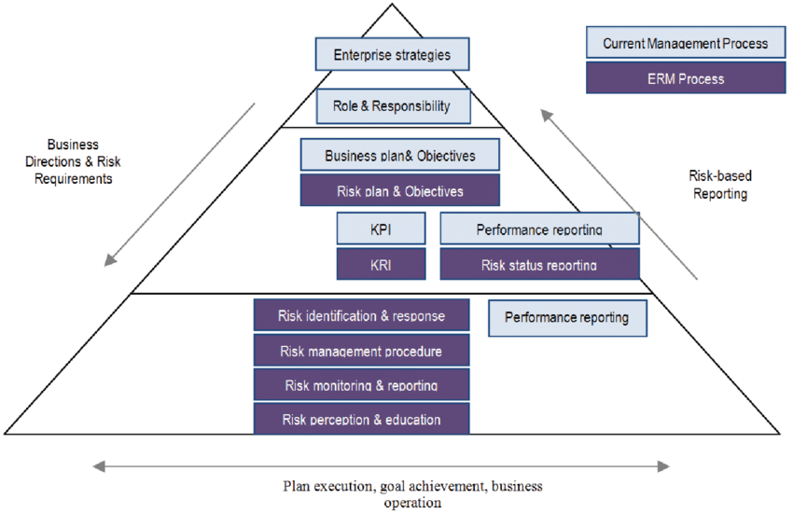
Chapter 9
The Scope of ERM
ERM doesn't just focus on individual risks in silos. It takes a big-picture view of all types of risks an organization might face, including financial, strategic, operational, reputational, environmental, and even technological. ERM isn't also limited to specific departments. It applies to all organizational levels and units, from the executive boardroom to the frontline employees.

Slide 37
Chapter 9
Objectives of ERM
Mitigate negative impacts:
ERM aims to minimize the potential harm caused by identified risks. That involves developing strategies to prevent, avoid, or reduce the likelihood and severity of their occurrence.
Optimize risk appetite:
ERM isn't just about eliminating all risks. It's about finding the right balance between taking calculated risks and protecting the organization's value. That means understanding how much risk the organization will tolerate in pursuing its goals.
Enhance decision-making:
By providing a clear picture of the risk landscape, ERM helps leaders make decisions that are less susceptible to surprises and setbacks

Slide 38
Chapter 9
Pillars of ERM
Risk identification: Pinpointing all potential threats that could impact the organization.
Risk assessment: Evaluating the likelihood and potential impact of each identified risk.
Risk response: Developing and implementing strategies to mitigate, avoid, or transfer risks.
Risk monitoring: Continuously track and evaluate the effectiveness of implemented risk management strategies and adapt them as needed.
Risk appetite and strategy are also two intricately connected pillars of effective ERM. Understanding and aligning them ensures organizations strike the right balance between seizing opportunities and avoiding pitfalls.

Slide 39
Chapter 9
Risk appetite and strategy
Strategic objectives drive risk appetite.
Ambitious, growth-oriented strategies may necessitate a higher risk appetite to navigate competitive landscapes and explore new markets., Conversely, a risk-averse strategy might involve a lower appetite for volatility and prioritize stability.
Risk appetite informs strategic choices.
Understanding risk appetite equips an organization to assess strategic options' potential risks and rewards.
Risk appetite must also adapt to the organization's strategic direction and external environment. Regular review and calibration are essential to ensure its continued relevance and effectiveness.

Slide 40
Chapter 9
Examples
A technology start-up CO, seeking rapid growth may have a higher risk appetite when launching innovative products, and accept the possibility of higher failure rates.
A financial institution focused on stability and customer trust may have a lower risk appetite when it comes to investment strategies, prioritizing security over high returns.
Balancing risk appetite and strategy is an ongoing challenge.
By understanding this critical relationship and integrating it into their enterprise risk management, organizations can effectively manage risk, seize opportunities, and achieve their long-term goals.

Slide 41
The components ERM
Chapter 9
Risk Management Framework defines eight interconnected components :
1- Internal environment
The internal environment sets how risk is viewed and addressed within the organization. It encompasses factors like:
Organizational culture: Risk-averse, compliance-oriented, or innovative?
Ethics and values: How does the organization handle ethical dilemmas and potential misconduct?
Governance structure: How are decisions made and responsibilities allocated?
Management philosophy: How does leadership approach risk-taking and risk mitigation?

Slide 42
The components ERM
Chapter 9
2- Objective setting
Objective setting involves defining the organization's goals and objectives across various areas and providing direction for risk identification and assessment. Objectives should be:
Specific – Measurable – Achievable – Relevant- Time-bound ( SMART)
3- Event identification
This proactive stage involves pinpointing potential risks that could impact achieving objectives. Sources of potential risks include:
Internal: Processes, systems, people, and culture.
External: Market, economic, technological, and environmental factors.
Emerging: New threats and unforeseen challenges.

Slide 43
Chapter 9
The components ERM
4- Risk assessment
Once identified, risks need to be evaluated in terms of:
Likelihood and Impact
By prioritizing risks based on these factors, the organization can focus resources on the most critical threats.
5- Risk response
Risk response is including options like:
Avoidance - Mitigation - Transfer - Acceptance
6- Control activities
Internal controls - Compliance programs - Technology solutions:

Slide 44
Chapter 9
The components ERM
7- Information and Communication
To ensure that risk-relevant information flows effectively across all levels of the organization, facilitating decision-making and ongoing collaboration. Key aspects include:
Clear communication channels: upward, downward and horizontal.
Transparency and openness: sharing risk information without fear of repercussions.
Reporting and escalation procedures: reporting identified risks and concerns in a timely manner.

Slide 45
Chapter 9
The components ERM
8- Monitoring
Monitoring involves continually monitoring risks and control activities, evaluating their effectiveness, and adapting strategies as needed. That includes:
Regular monitoring and testing: Ensuring controls are functioning as intended.
Emerging risk awareness: Staying vigilant for new threats and changes in the risk landscape.
Review and adaptation: Updating the ERM framework based on lessons learned and changing circumstances.
Together these components provide a comprehensive and strategic approach to managing risks across the enterprise

Slide 46
Chapter 9
Finally..
We must take into consideration the following points
Institutions are not isolated entities
Institutions are affected by the environment in which they operate, whether internal or external
Risk management affects the decision and works to achieve the objectives of the decision
Operational risk management is not separate from corporate risk management
Harmony between different departments within institutions achieves effectiveness and efficiency in decision-making
Institutions face internal risks in operation as they face external threats
Accurately identifying risks achieves effectiveness in the decision
Dealing with the risk must be consistent with the institution's strategy
Risk appetite depends on strategic directions

Slide 47
Chapter 9
An anonymous poem
To laugh is to risk appearing the fool.
To weep is to risk appearing sentimental.
To reach out for another is to risk involvement.
To expose feelings is to risk exposing our true self.
To place your ideas, your dreams, before the crowd is to risk loss.
To love is to risk not being loved in return.
To live is to risk dying.
To hope is to risk despair.
To try at all is to risk failure.
إن الضحك يعني المخاطرة بالظهور بمظهر الأحمق.
إن البكاء يعني المخاطرة بالظهور بمظهر العاطفي.
إن مد يد العون إلى شخص آخر يعني المخاطرة بالتورط.
إن فضح المشاعر يعني المخاطرة بكشف حقيقتنا.
إن وضع أفكارك وأحلامك أمام الحشد يعني المخاطرة بالخسارة.
إن الحب يعني المخاطرة بعدم الحصول على الحب في المقابل.
إن العيش يعني المخاطرة بالموت.
إن الأمل يعني المخاطرة باليأس.
إن المحاولة على الإطلاق تعني المخاطرة بالفشل.

Slide 48
Chapter 9
References and sources
Operational_Risk.pdf
Enterprise Risk Management vs. Operational Risk Management (6clicks.com)

Slide 49



Thank You

