Slide 1

Financial Risk Management
Prepared by Dr. Walaa Mohamed
Lecture 2
PMG 633
Banking Risks

Slide 2
Lecture 2
Introduction
Banking Risks:
There are multiple definitions of risk. Everyone has a definition of what risk is, and everyone recognizes a wide range of risks. Some of the more widely discussed definitions of risk include the following:
The likelihood an undesirable event will occur
The magnitude of loss from an unexpected event
The probability that “things won’t go well”
The effects of an adverse outcome

Slide 3
Lecture2
Banks face several types of risk. All the following are examples of the various risks banks encounter:
Borrowers may submit loan repayments late or fail to make repayments.
Depositors may demand the return of their money at a faster rate than the bank has reserved for.
Market interest rates may change and hurt the value of a bank’s loans.
Investments made by the bank in securities or private companies may lose value.
A bank may discover that it has acted in a way that is contrary to a law or regulation and be fined by its regulator or by a court of law.
Human input errors or fraud in computer systems can lead to losses.
TITLE OF SLIDE

Slide 4
Lecture2
Banking Risks
To monitor, manage, and measure these risks, banks are actively engaged in risk management. In a bank, the risk management function contributes to the management of the risks a bank faces by continuously measuring the risk of its current portfolio of assets and other exposures; by communicating the risk profile of the bank to others within the bank, to the bank’s regulators, and to other relevant parties; and by taking steps either directly or in collaboration with other bank functions to reduce the possibility of loss or to mitigate the size of the potential loss.
TITLE OF SLIDE

Slide 5
Lecture2
Banking Risks
TITLE OF SLIDE
From a regulatory perspective, the size and risk of a bank’s assets are the most important determinants of how much regulatory reserve capital the bank is required to hold. A bank with high-risk assets faces the possibility that those assets could quickly lose value. If the market—depositors—perceives that the bank is unstable and deposits are in peril, then nervous depositors may withdraw their funds from the bank. If too many depositors want to withdraw their funds at the same time, then fear that the bank will run out of money could break out (Section 3.1 discusses how bank runs occur).
And when there is a widespread withdrawal of money from a bank, the bank may be forced to sell its assets under pressure. To avoid this, regulators want a bank with high-risk assets to have more reserves available. Therefore, understanding banking regulation requires understanding financial risk management.

Slide 6
Banking Risks
This section introduces the various types of risk a bank may face and provides examples that demonstrate each risk. Later chapters explore these risks and their regulatory implications in more detail. The key risks discussed below are those identified by the Basel Accords, the cornerstone of international risk-based banking regulation.
The Basel Accords, described in greater detail in Section 3.3 and throughout the book, are the result of a collaborative attempt by banking regulators from major developed countries to create a globally valid and widely applicable framework for banks and bank risk management.

Slide 7
Banking Risks
The Basel III Accord, the most recent of these accords, focuses primarily on four types of risk (see Figure 1.4):
1. Credit risk
2. Market risk
3. Operational risk
4. Liquidity risk
The Basel Accords also recognize that there are other types of risk that may include these different core risk types.

Slide 8
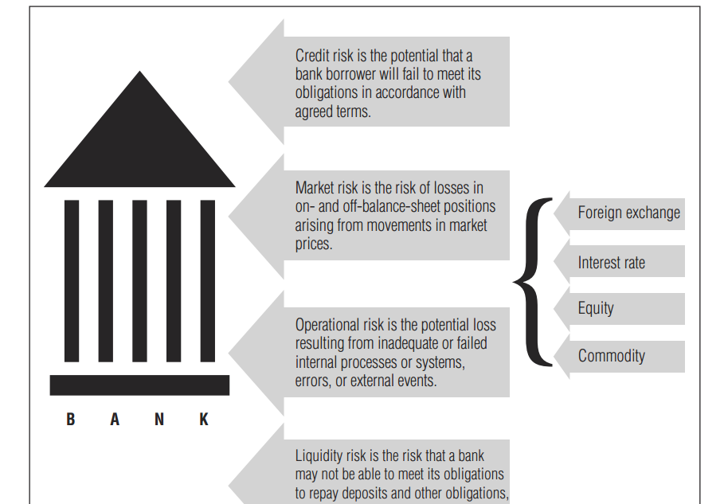

Slide 9
Banking Risks
1. Credit Risk
Credit risks the risk that a bank borrower, also known as a counterparty, may fail to meet its obligations—pay interest on the loan and repay the amount borrowed—in accordance with agreed terms. Credit risk is the largest risk most banks face and arises from the possibility that loans or bonds held by a bank will not be repaid either partially or fully. Credit risk is often synonymous with default risk.
Credit risk affects depositors as well. From the depositors’ perspective, credit risk is the risk that the bank will not be able to repay funds when they ask for them.

Slide 10
Banking Risks
The underwriting process aims to assess the credit risk associated with lending to a particular potential borrower. Chapter 4 contains a detailed description of the underwriting process. Once a loan is underwritten and the loan is received by the customer, the loan becomes a part of the bank’s banking book. The banking book is the portfolio of assets (primarily loans) the bank holds, does not actively trade, and expects to hold until maturity when the loan is repaid fully. Section 2.2 discusses the banking book further. Nearly all of a bank’s credit risk is contained in the credit risk of the assets in its banking book, although some elements of credit risk can also exist in the trading book.

Slide 11
Banking Risks
EXAMPLE
In December 2007, the large Swiss bank UBS announced a loss of USD 10 billion due to the significant loss in value of loans made to high-risk borrowers (subprime mortgage borrowers). Many high-risk borrowers could not repay their loans, and the complex models used by UBS to predict the likelihood of credit losses turned out to be incorrect. Other major banks all over the world suffered similar losses due to incorrectly assessing the likelihood of default on mortgage payments. The inability to assess or respond correctly to this risk resulted in many billions of U.S. dollars in losses to companies and individuals around the world.

Slide 12
Banking Risks
2. Market Risk
Market risks the risk of losses to the bank arising from movements in market prices as a result of changes in interest rates, foreign exchange rates, and equity and commodity prices. The various components of market risk, and the forces that give rise to them, are covered more extensively in Chapter 6. The components of market risk are as follows:

Slide 13
Banking Risks
Interest rate risk is the potential loss due to movements in interest rates. This risk arises because bank assets (loans and bonds) usually have a significantly longer maturity than bank liabilities (deposits). This risk can be conceptualized in two ways. First, if interest rates rise, the value of the longer-term assets will tend to fall more than the value of the shorter-term liabilities, reducing the bank’s equity. Second, if interest rates rise, the bank will be forced to pay higher interest rates on its deposits well before its longer-term loans mature and it is able to replace those loans with loans that earn higher interest rates.

Slide 14
Banking Risks
EXAMPLE
American savings and loans (S&Ls), also called thrifts, are essentially mortgage lenders. They collect deposits and underwrite mortgages. During the 1980s and early 1990s, the U.S. S&L system underwent a major crisis in which several thousand thrifts failed as a result of interest rate risk exposure.
Many failed thrifts had underwritten longer-term (up to 30-year) fixed-rate mortgages that were funded by variable-rate deposits. These deposits paid interest rates that would reset, higher or lower, based on the market level of interest rates. As market interest rates increased, the deposit rates reset higher, and the interest payments the thrifts had to make began to exceed the interest payments they were receiving on their portfolios of fixed-rate mortgages. This led to increasingly large losses and eventually wiped out the equity of thousands of S&Ls and led to their failures. As shown in Figure 1.5, as interest rates rose, the payments the S&Ls had to make on variable rate deposits became larger than the payments received from the fixed-rate mortgage loans, leading to larger and larger losses.

Slide 15
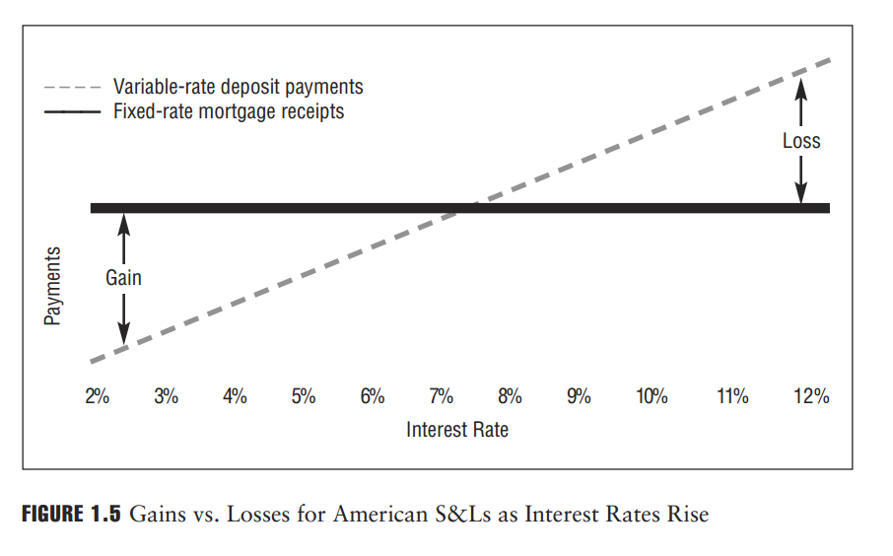

Slide 16
Banking Risks
Equity risk is the potential loss due to an adverse change in the price of stock. Stock, also referred to as shares or equity, represents an ownership interest in a company. Banks can purchase ownership stakes in other companies, exposing them to the risk of the changing value of these shares.
Foreign exchange risk is the risk that the value of the bank’s assets or liabilities changes due to currency exchange rate fluctuations. Banks buy and sell foreign exchange on behalf of their customers (who need foreign currency to pay for their international transactions or receive foreign currency and want to exchange it to their own currency), and they also hold assets and liabilities in different currencies on their own balance sheets.

Slide 17
Banking Risks
Commodity risk is the potential loss due to an adverse change in commodity prices. There are different types of commodities, including agricultural commodities (e.g., wheat, corn, soybeans), industrial commodities (e.g., metals), and energy commodities (e.g., natural gas, crude oil). The value of commodities fluctuates a great deal due to changes in demand and supply.

Slide 18
Banking Risks
Market risk tends to focus on a bank’s trading book. The trading book is the portfolio of financial assets such as bonds, equity, foreign exchange, and derivatives held by a bank either to facilitate trading for its customers or for its own account or to hedge against various types of risk. Assets in the trading book are generally made available for sale, as the bank does not intend to keep those assets until they mature. Assets in the bank’s banking book (held until maturity) and trading book (not held until maturity) collectively contain all the various investments in loans, securities, and other financial assets the bank has made using its deposits, loans, and shareholder equity.

Slide 19
Banking Risks
Distinguishing between the trading and banking books is essential to understand how banks operate and how they manage their risks. The value of assets and liabilities in the trading book can change quickly, and the bank has to recognize those changes immediately. In contrast, changes to the value of the banking book generally take longer to happen.
The Basel Accord does not provide a definition for the term banking book; this is an important and easily forgotten point. In effect, what is included in the banking book is what is not included in the bank’s trading book, which is defined by the Basel II and Basel III Accords. The trading and banking books will be discussed in later chapters (see Section 2.2).

Slide 20
Banking Risks
3. Operational Risk
Operational risk is the risk of loss resulting from inadequate or failed internal processes, people, and systems or from external events. This definition includes legal risk, but excludes strategic and reputational risk. Compared to credit, market, and liquidity risk, operational risk is the least understood and most challenging risk to measure, manage, and monitor. A wide range of loss events can be categorized as operational risk events. Chapter 7 discusses how banks measure and manage the different types of operational risks they are exposed to as part of the banking business.

Slide 21
Banking Risks
EXAMPLE
In 1995, Baring Brothers and Co. Ltd. (Barings) collapsed after incurring losses of GBP 827 million following the failure of its internal control processes and procedures. One of its traders in Singapore hid trading losses for more than two years. Because of insufficient internal control measures, the trader was able to authorize his own trades and book them into the bank’s systems without any supervision. The trader’s supervisors were alerted after the trades started to lose significant amounts of money and it was no longer possible for the trader to keep the trades and the losses secret.

Slide 22
Banking Risks
4. Liquidity Risk
Liquidity risk is the risk that a bank may not be able to meet its obligations to repay deposits and other funding, or to continue financing its assets. There has been far greater focus on banks’ liquidity risk following the global financial crisis of 2007–2009 when several banks needed to be supported by their governments because they were unable to meet their obligations to repay depositors and bondholders.
The most recent Basel Accord includes new standards on banks’ liquidity to complement its standards on banks’ capital levels: Basel I and Basel II had provided standards only for capital levels. Liquidity risk will be discussed in greater detail in Chapters 3 and 6.

Slide 23
Banking Risks
5. Systemic Risk
Systemic risk refers to the possibility that an entire banking system may face losses or even collapse, with all banks operating in that system being affected.
Systemic risk can arise due to macroeconomic or monetary events, such as a currency devaluation, or it can result from the failure of a single “systemically important” financial institution, whose problems cause difficulties for all other banks in the system.

Slide 24
Banking Risks
EXAMPLE
In 1991, Argentina pegged its currency to the U.S. dollar, but over time people came to believe that this relationship was not sustainable and that the Argentine government would be forced to devalue the peso. In November 2001, interest rates rose dramatically in response to expectations of a devaluation, and depositors began to withdraw funds from their banks. The following day, the minister of the economy announced restrictions on banks’ ability to pay clients and on customers’ ability to withdraw deposits. All banks in the system were affected by these restrictions. Even banks that had been financially strong and conservatively managed were not able to meet their obligations.

Slide 25
Banking Risks
6. Other Risks That Banks Face:
Beyond the types of risk mentioned previously, there are other risks banks face and must manage appropriately. Here is a listing of some of them:
Business risk is the potential loss due to a decrease in the competitive position of the bank and the prospect of the bank prospering in changing markets.
EXAMPLE
In 2003 HSBC bought the U.S. consumer, credit card, and mortgage lender Household Inter- national (later named HSBC Finance Corporation) to gain a slice of the booming U.S. property market. Expansion into this new market was seen as the answer to improving profitability and return on capital, although it was a departure from HSBC’s traditional conservative banking culture.

Slide 26
Banking Risks
Household International was a poor fit with HSBC operations, as much of its business was in second-line mortgages (equity loans or lines of credit which use the home as collateral) known in the United States as piggyback loans, marketed to low-income homeowners who used the loans to make a down payment on their home to avoid mortgage insurance, or purchase cars and other consumables. These loans were ultimately considered of dubious quality and a result of poor underwriting standards coupled with high-pressure selling.
When house prices fell in the United States, the equity supporting these loans was reduced to the point that in many cases the total loans outstanding were greater than the value of the property, resulting in negative equity.
Household International, which was bought for USD 15.3 billion, by 2006 had lost USD 30 billion for HSBC. The chairman said that, in retrospect, HSBC should not have acquired Household International.
In 2009 HSBC Finance Corporation announced the discontinuation of loan origination of all products by its consumer lending business, but continued to service, assist, and collect the existing receivable portfolio as it closed down its business.

Slide 27
Banking Risks
Reputational risk is the potential loss resulting from a decrease in a bank’s standing in public opinion. Recovering from a reputation problem, real or perceived, is not easy. Organizations have lost considerable business for no other reason than loss of customer confidence over a public relations problem, even with relatively solid systems, processes, and finances in place.

Slide 28
Banking Risks
Compliance risk is the risk that a bank may suffer losses as a result of its failure to comply with laws and regulations or with internal policies and procedures that govern the way it operates. This risk has been increasing in recent years, and oversight and scrutiny of banks have intensified following the global financial crisis of 2007–2009.
The result is that the number of laws and regulations that a bank has to comply with has greatly increased, and so has the risk of non-compliance. Furthermore, regulations on money laundering and financial crime (including tax evasion) have become stricter in recent years, and governments and regulators are far less tolerant of any breaches than they were in the past.

Slide 29
Forces Shaping the Banking Industry
There are numerous other aspects of banking that have not been covered in this chapter but will be briefly touched upon in later parts of the book—either directly or as part of a discussion about other topics.
Regulation, deregulation, and globalization. In the 1990s and the early years of the 21st century, deregulation led to a relaxing of restrictive banking regulations in many countries around the globe. This allowed many banks to compete against each other and other financial services providers with less direct government oversight. The theory behind less oversight was that increased competition among banks would increase their efficiency. Deregulation puts market pressures on banks from organizations that offer similar banking services.

Slide 30
Forces Shaping the Banking Industry
Additionally, it was felt that banks would, in their own self-interest, effectively regulate themselves with little need for heavy-handed oversight from government regulators. The idea was that it is in a bank’s self-interest to ensure that it functions properly to compete in an increasingly competitive world.
However, as became apparent during the global financial crisis of 2007–2009, banks were unable to police themselves effectively. Their lack of discipline resulted in a virtual col-lapse of the global financial system. It has also become clear that many banks are now considered “too big to fail "due to their global connectivity and importance to the worldwide financial system.

Slide 31
Forces Shaping the Banking Industry
Since then, governments have introduced numerous banking regulation reforms and have, for the first time, been considering adopting some type of cooperative system to allow for the rapid sharing of information among world financial regulators with the intent of more proactively addressing future financial services–related risks and issues.
The trend toward deregulation of financial markets that was seen in the years that preceded the global financial crisis has now been put into reverse. Not only are banks more heavily regulated than before, but there is general agreement among policy makers and regulators that this heavier regulation is justified. There has also been much more attention given to how banks conduct themselves and whether they are treating customers fairly, regardless of whether they are operating in a financially prudent manner.

Slide 32
Forces Shaping the Banking Industry
Competition. Banks are facing increasing competition from specialized financial services providers. Examples of such non-depository financial intermediaries that now compete with banks include:
• Retirement systems—pension plans and retirement funds
• Collective investment pools—mutual funds, unit trusts, and hedge funds
• Finance companies—leasing and equipment finance
• Payment services
• Insurance companies
• Hedge funds
• Private equity companies

Slide 33
Forces Shaping the Banking Industry
Private equity is the term used to describe a situation in which an investor, or investors, pools money to acquire stakes in a company. Venture capital is technically PE, but it normally goes into startup companies with a great idea but an unproven track record. PE is most often used to buy part or all of older companies that may be making money but need help to achieve their full potential.

Slide 34
Forces Shaping the Banking Industry
A hedge fund is a pooled investment fund that trades in relatively liquid assets and is able to make extensive use of more complex trading, portfolio-construction and risk management techniques in an attempt to improve performance, such as short selling, leverage, and derivatives. Financial regulators generally restrict hedge fund marketing to institutional investors, high net worth individuals and others who are considered sufficiently sophisticated.

Slide 35
Forces Shaping the Banking Industry
Hedge funds are considered alternative investments. Their ability to use leverage and more complex investment techniques distinguishes them from regulated investment funds available to the retail market, commonly known as mutual funds and ETFs.
They are also considered distinct from private-equity funds and other similar closed-end funds, as hedge funds generally invest in relatively liquid assets, and are usually open-ended. This means they allow investors to invest and withdraw capital periodically based on the fund's net asset value, whereas private-equity funds generally invest in illiquid assets and only return capital after a number of years.

Slide 36
Forces Shaping the Banking Industry
Securitization. Bundling together various debt capital assets, such as mortgages, credit cards, and loans, and selling securities representing various types of ownership in the resulting portfolio, is a relatively new financial product.
The securitization process is explained in greater detail in Section 5.2.3. Securitization is a threat to banks since it enables non-banks to offer loans and financing at a lower cost than what banks historically charge. Securitization, however, can also benefit banks by offering them a way to sell some of the higher-risk assets they would prefer not to hold on their books.

Slide 37
Forces Shaping the Banking Industry
أسهمت عمليات التوريق، والتعاملات الربوية علي اختلاف ألوانها ومصادرها والجهات التى تعاملت وتتعامل بها ومستويات هذا التعامل ولبوسه وصيغه وعقوده وكذلك الوليد الشرير المسمى بالمشتقات في انفجار الأزمة المالية العالمية وصعوبة التراجع عنها ووقفها وسوف نعالج ذلك بإيجاز يفيد القارىء علي النحو التالي:
أولا: عمليات التوريق: لا شك أن عمليات التوريق رقم مهم في معادلة الاقتصاد العالمي بأزمته الحالية . . وتلك العملية فيها كلام كثير للشريعة الإسلامية . فكيف تتم هذه العملية أساساً، وما دورها في تلك الأزمة؟
“التوريق” باختصار هو قيام البنوك وشركات التمويل العقاري مثلاً ببيع دين القروض المتجمعة لديها على العملاء الذين اشتروا العقارات إلى إحدى الشركات المتخصصة، والتي تسمى قانوناً (هناك) “شركات التوريق”، وهذا البيع يكون بمقابل معجل أقل من قيمة الدين . ثم تقوم شركة التوريق بإصدار سندات بقيمة هذه الديون بقيمة اسمية لكل سند، وتطرحها للاكتتاب العام (بيعها) للأفراد والمؤسسات بقيمة أكبر أو أقل من القيمة الاسمية (أي بعلاوة أو خصم إصدار) ويحصل حملة السندات على فوائد القروض.
وفي المقابل فإنه عندما يقترض مشترو العقارات من مؤسسات مالية أخرى برهن نفس العقارات، تقوم هذه المؤسسات ببيع هذه القروض إلى شركة توريق التي تصدر بها سندات وتطرحها في الأسواق . وبالتالي يصبح للعديد من الناس والمؤسسات حقوق على العقار، وتتزايد قيمة الأوراق المالية المصدرة عن قيمة العقارات، وإذا حدث وتحولت هذه القروض إلى قروض رديئة لتعثر مالكي العقارات عن السداد، أو تنخفض قيمة العقارات في الأسواق، فإن حملة السندات يسارعون إلى بيع ما لديهم فيزيد العرض وينخفض سعرها، وتزيد الضغوط على كل المؤسسات المالية وشركات التوريق . وهكذا يمكن القول إن التوريق بما ينتجه من تضخم لقيمة الديون وانتشار حملة السندات الدائنين وترتيب مديونيات متعددة على نفس العقار هو حجر الزاوية في حدوث الأزمة المالية .
وعملية التوريق بهذه الصورة محرمة شرعاً، بل إن التوريق للديون في حد ذاته غير جائز شرعاً؛ لأن عملية التوريق تكون ببيع الدين لشركة التوريق بأقل من قيمته، وهذا يعني أن تدفع الشركة أقل وتأخذ أكثر وهو عين الربا .

Slide 38
Forces Shaping the Banking Industry
Technological advances. Improvements in computing power, telecommunications, and information technology have allowed banks to offer new ventures such as Internet-based banking. Technological advances continue to reduce the cost of routine banking services, such as payments and withdrawals.
Inflation and interest rate uncertainty. Both bank balance sheets and profits are highly sensitive to changes in interest rates. When inflation increases, interest rates tend to increase, and many banks—as we will see in later sections—suffer. When interest rates change considerably and frequently, banks must focus on managing these risks.

Slide 39
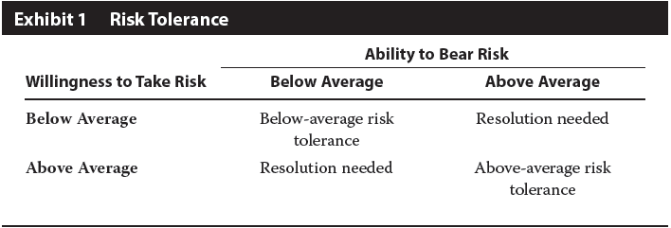
Risk Objectives
When constructing a portfolio for a client, it is important to ensure that the risk of the portfolio is suitable for the client. The Investment Policy Statement (IPS) should state clearly the risk tolerance of the client. Risk objectives are specifications for portfolio risk that reflect the risk tolerance of the client.
Quantitative risk objectives can be absolute or relative or a combination of the two.
A client’s overall risk tolerance is a function of the client’s ability to bear (accept) risk and his or her “risk attitude,” which might be considered as the client’s willingness to take risk. For ease of expression, from this point on we will refer to ability to bear risk and willingness to take risk as the two components of risk tolerance.

Slide 40
The ability to bear risk is measured mainly in terms of objective factors, such as time horizon, expected income, and the level of wealth relative to liabilities.
The willingness to take risk, or risk attitude, is a more subjective factor based on the client’s psychology and perhaps also his or her current circumstances.
When ability to take risk and willingness to take risk are consistent, the investment adviser’s task is the simplest. When ability to take risk is below average and willingness to take risk is above average, the investor’s risk tolerance should be assessed as below average overall. When ability to take risk is above average but willingness is below average, the portfolio manager or adviser may seek to counsel the client and explain the conflict and its implications.

Slide 41
Main reference:
Foundations of Financial Risk.
An Overview of Financial Risk and Risk-Based Regulation.
Richard Apostolik
Christopher Donohue
Chapter 1

