Slide 1

Digital Consumer Behavior
Prepared by Dr. Noha El Aswad
Lecture 6
MKT713_
Master of Digital Marketing

Slide 2
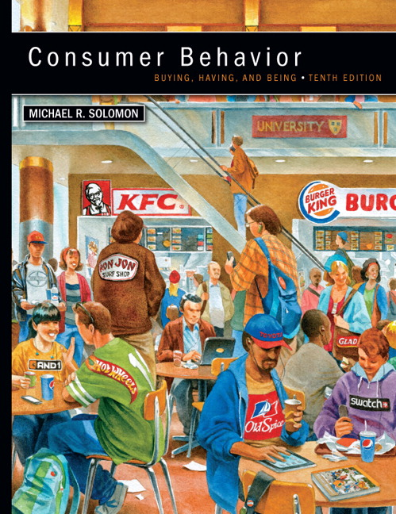

Chapter
02
Buying, Having, Being
CONSUMER BEHAVIOR, 10e
Michael R. Solomon

Slide 3
Chapter
02
Chapter Objectives
When you finish this chapter, you should understand why:
  Ethical business is good business.
  Marketers have an obligation to provide safe and functional products as part of their business activities.
  Consumer behavior impacts directly on major public policy issues that confront our society.
  Consumer behavior can be harmful to individuals and to society

Slide 4
Chapter
02
Learning Objectives
When you finish this chapter, you should understand why:
  Ethical business is good business
  Marketers have an obligation to provide safe and functional products as part of their business activities.
  Consumer behavior impacts directly on major public policy issues that confront our society.
  Consumer behavior can be harmful to individuals and to society

Slide 5
Chapter
02
Lecture Objectives
When you finish this chapter, you should understand why:
Case study to revise chapter one
Part 1 in Learning objective one in chapter 2
  Ethical business is good business.
    Business ethics and Consumer rights Mainstream
    Business ethics
    Do Marketers Manipulate Consumers?
    Who controls the market, companies or consumers?
    Do Marketers Create artificial needs
    Is Marketing necessary

Slide 6
Chapter
01
Case study on chapter one 1/ 10
HONDA’S ASIMO
Meet ASIMO! He is 4 feet tall, with a pleasant childish voice, and the ability to recognize and interact with people; however, ASIMO is no child. He is the humanoid robot “brainchild” of scientists at Honda. ASIMO’s technology includes two camera eyes to map its environment and recognize unique faces. Its body construction is so humanlike that it can run at 3.5 mph, toss a ball to play with a child, and use its opposable thumbs to open a bottle and serve you a cold drink. ASIMO is the perfect household companion.

Slide 7
Chapter
01
Case study on chapter one 2/ 10
HONDA’S ASIMO
Honda has not yet made ASIMO available to purchase for home use, but it is only a matter of time until families can have their own humanoid robot. But not everyone is interested. Although some consumers have interacted with robotic kiosks that can process food orders and provide rudimentary in-store customer service, many are a bit nervous about an actual robot serving them meals or sitting down and telling them the news of the day. Why? Perhaps it is Hollywood’s influence on our perception of robots. It might not be the sweet WALL-E that comes to mind when we think about robots, but the Terminator or another threatening machine.

Slide 8
Chapter
01
Case study on chapter one 3/ 10
HONDA’S ASIMO
Even robot developers have differing views on the roles robots could play or how they should look. Some see them as humanistic in appearance, serving as kind, compassionate companions for the aging or lonely. The movie Her explored the human-like connection that could exist with a computer-generated being. However, the developers of a robot called Leonardo describe wanting to create a social robot with a whimsical appearance, intentionally not human or animal. They believe that “robots will be their own kind of creature and should be accepted, measured, and valued on those terms.”

Slide 9
Chapter
01
Case study on chapter one 4/ 10
HONDA’S ASIMO
If consumers are not ready for ASIMO, perhaps they are ready for some of its features. Facial recognition technology (FRT), the ability for a computer to “read” your face, is seeing strong development and application. According to some analysts, the FRT market is expected to grow from $1.92 billion to $6.5 billion within the next 5 years.

Slide 10
Chapter
01
Case study on chapter one 5/ 10
Advertisers and big brands are taking notice of FRT. Imagine a billboard in a mall that advertises Abercrombie to a teen girl and Target to a busy mom. Immersive Labs, recently acquired by Kairos, has developed digital billboards that measure the age range, gender, and even attention level of a passerby to deliver a tailored ad. With the addition of Immersive Labs, Kairos believes it has become the only facial biometrics company in the world that offers both facial recognition and emotion analysis tools.

Slide 11
Chapter
01
Case study on chapter one 6/ 10
According to researchers, FRT can do more than read your face and estimate general physical characteristics. It can map out a biometric profile that is as unique as your fingerprint. Red Pepper is a company that uses this advanced technology to develop Facedeals, a smartphone app that provides personalized offers to consumers. Here’s how it works. You download the app, walk into a store with a Facedeals camera and are recognized. Facedeals interfaces with your Facebook information, analyzing your content for favorite brands, relationship status, places, visited, and other information. Then Facedeals presents you with a personalized offer.

Slide 12
Chapter
01
Case study on chapter one 7/ 10
Google is considering letting individuals use a body motion, perhaps a “wink” or “eyebrow movement,” as their FRT password. Forbes.com has unveiled an app where your webcam watches your facial responses when you view ads to learn what products and ads you like and dislike. Although the marketing applications for FRT are numerous, companies should be aware that a recent study found that 75 percent of respondents were uncomfortable with in-store facial recognition technology that could identify them as a high value shopper and then alert a salesperson. That could change as technology continues to permeate our lives and as consumers become convinced of the value of real-time personalized offers made possible only by having their unique facial features recognized.

Slide 13
Chapter
01
Case study on chapter one 8/ 10
DISCUSSION QUESTIONS
CS 1-1 What are the most likely consumer market segments for robots? Which consumer characteristics would be important to determine these market segments? What types of roles do you envision robots playing for these consumers?

Slide 14
Chapter
01
Case study on chapter one 9/ 10
DISCUSSION QUESTIONS
CS 1-2 Reflect on the value of FRT as a marketing tool. Give one example that illustrates how this technology can be most effectively used by marketers.

Slide 15
Chapter
01
Case study on chapter one 10/ 10
DISCUSSION QUESTIONS
CS 1-3 Discuss the “creepiness” concerns that some consumers have about robots and FRT. How can marketers address or even overcome these issues?

Slide 16
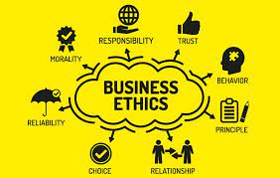
Chapter
2
Part 1 in Learning objective one chapter 2
Ethical business is good business.

Slide 17
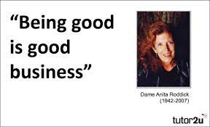
Chapter
2
Business ethics and Consumer rights Mainstream 1/4
Ethical business is good business.

Slide 18
Chapter
2
Business ethics and Consumer rights Mainstream 2/4
A global survey by Nielsen reported that 50 percent of consumers are willing to pay more for goods and services from companies that have implemented programs to give back to society.

Slide 19
Chapter
2
Business ethics and Consumer rights Mainstream 3/4
Consumers think better of the products a firm sells when the organization behaves ethically.

Slide 20
Chapter
2
Business ethics and Consumer rights Mainstream 4/4
For Refelection
Give examples about ethical business in your consumption community?

Slide 21
Chapter
2
Business ethics 1/2
Are rules of conduct that guide actions in the marketplace; these are the standards against which most people in a culture judge what is right and what is wrong, good or bad. These universal values include honesty, trustworthiness, fairness, respect, justice, integrity, concern for others, accountability, and loyal.

Slide 22
Chapter
2
Business ethics 2/2
Because each culture has its own set of values, beliefs, and customs, companies around the world define ethical business behaviors quite differently.

Slide 23
Chapter
2
Do Marketers Manipulate Consumers?
One of the most common and stinging criticisms of marketing is that companies convince consumers they “need” many material things, and that they will be unhappy and inferior people if they do not have these “necessities.” The issue is a complex one and is certainly worth considering: Do marketers give people what they want, or do they tell people what they should want?

Slide 24
Chapter
2
Do Marketers Manipulate Consumers?
Response
Profound changes in consumer behavior are influencing how people search for product information and evaluate alternative brands. In the brave new world of consumer-space, we have much greater potential to shape our own marketing destinies.
The following slides will discuss this response in more details by answering the question Who controls the market, companies or consumers?

Slide 25
Chapter
2
Who controls the market, companies or consumers? 1/3
It seems that the “good old days” of marketer-space—a time when companies called the shots and decided what they wanted their customers to know and do—are dead and gone.

Slide 26
Chapter
2
Who controls the market, companies or consumers? 2/3
Many people now feel empowered to choose how, when, or if they will interact with corporations as they construct their own consumer -space.

Slide 27
Chapter
2
Who controls the market, companies or consumers? 3/3
In this new environment, individuals dictate to companies the types of products they want and how, when, and where (or even if) they want to learn about those products. In turn, companies need to develop and leverage brand equity in bold new ways to attract the loyalty of these consumer “nomads.”

Slide 28
Chapter
2
Do Marketers Create artificial needs? 1/3
The marketing system creates demand— demand that only its products can satisfy..

Slide 29
Chapter
2
Do Marketers Create artificial needs? 2/3
Response
a need is a basic biological motive; a want represents one way that society has been taught to satisfy the need.

Slide 30
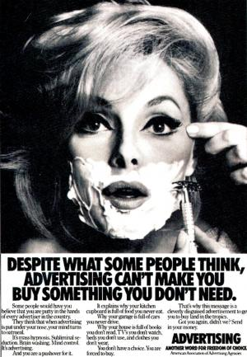
Chapter
2

Slide 31
Chapter
2
Do Marketers Create artificial needs? 3/3
For example, thirst is a biologically based need. Marketers teach us to want Coca-Cola to satisfy that thirst rather than, say, goat’s milk. Thus, the need is already there; marketers simply recommend ways to satisfy it. A basic objective of marketing is to create awareness that needs exist, not to create needs.

Slide 32
Chapter
2
Is Marketing necessary? 1/6
Some people charge that marketers arbitrarily link products to desirable social attributes,
so they foster a materialistic society where what we own defines our value as a person. One influential critic even argued that the problem is that we are not materialistic enough: We do not sufficiently value goods for the utilitarian functions they deliver but instead focus on the irrational value of goods for what they symbolize.

Slide 33
Chapter
2
Is Marketing necessary? 2/6
For example A washing machine would be a useful machine to wash clothes, rather than an indication that we are forward-looking or an object of envy to our neighbors.

Slide 34
Chapter
2
Is Marketing necessary? 3/6
Response
Products meet existing needs, and marketing activities only help to communicate their availability.

Slide 35
Chapter
2
Is Marketing necessary? 4/6
The economics of information perspective regards advertising as an important source of consumer information.

Slide 36
Chapter
2
Is Marketing necessary? 5/6
This view emphasizes the economic cost of the time we spend to search for products.

Slide 37
Chapter
2
Is Marketing necessary? 6/6
Accordingly, advertising is a service for which consumers are willing to pay because the information it provides reduces their search time.

Slide 38
Chapter
2
Lecture summary
We have been learning:-
Ethical business is good business
Business ethics
Do Marketers Manipulate Consumers ?
Who controls the market, companies or consumers?
Do Marketers Create artificial needs?
Is Marketing necessary?

Slide 39


