Slide 1

Probability and Statistics
Prepared by Dr.Israa Lewaa
Lecture 7
STA 201
Hypothesis Testing with One Sample

Slide 2

Chapter
07
Hypothesis Testing with One Sample
7.1 Introduction to Hypothesis Testing
7.2 Hypothesis Testing for the Mean (Large Samples)
7.3 Hypothesis Testing for the Mean (Small Samples)
7.4 Hypothesis Testing for Proportions

Slide 3
Chapter
07
7.1 Introduction to Hypothesis testing
Hypothesis test
A process that uses sample statistics to test a claim about the value of a population parameter.
For example: An automobile manufacturer advertises that its new hybrid car has a mean mileage of 50 miles per gallon. To test this claim, a sample would be taken. If the sample mean differs enough from the advertised mean, you can decide the advertisement is wrong.

Slide 4
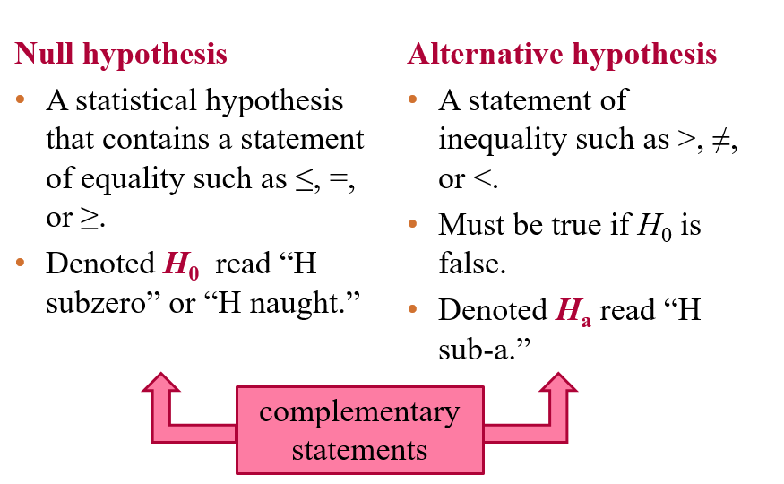
Chapter
07
Stating a Hypothesis

Slide 5
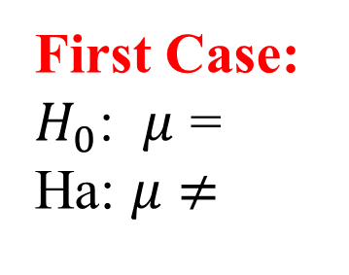

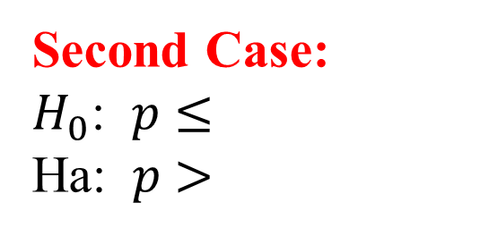
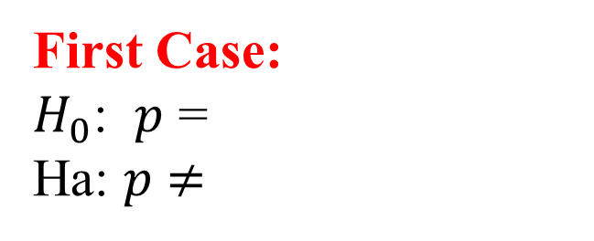


Chapter
07
Stating a Hypothesis
Population Mean Population Proportion
First Case:
$H_{0}$: $μ$ =
Ha: $μ$ $≠$
First Case:
$H_{0}$: $p$ =
Ha: $p$ $≠$
Second Case:
$H_{0}$: $μ$ $≤$
Ha: $μ$ $>$
Second Case:
$H_{0}$: $p$ $≤$
Ha: $p$ $>$
Third Case:
$H_{0}$: $μ$ $≥$
Ha: $μ$ $<$
Third Case:
$H_{0}$: $p$ $≥$
Ha: $p$ $<$

Slide 6
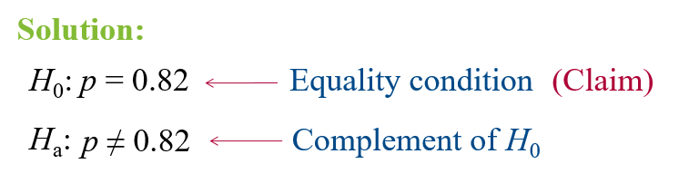
Chapter
07
Example: Stating the Null and Alternative Hypotheses
Write the claim as a mathematical sentence. State the null and alternative hypotheses and identify which represents the claim.
A university publicizes that the proportion of its students who graduate in 4 years is 82%.

Slide 7
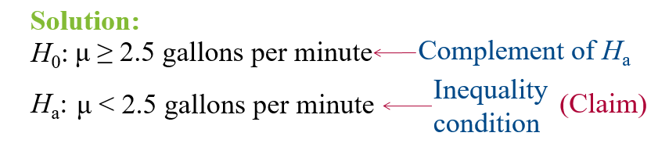
Chapter
07
Example: Stating the Null and Alternative Hypotheses
Write the claim as a mathematical sentence. State the null and alternative hypotheses and identify which represents the claim.
A water faucet manufacturer announces that the mean flow rate of a certain type of faucet is less than 2.5 gallons per minute.

Slide 8
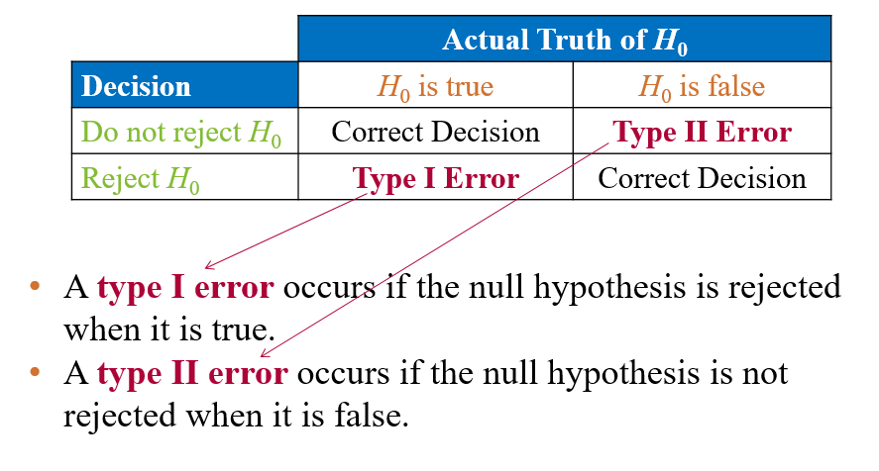
Chapter
07
Types of Errors

Slide 9
Chapter
07
Types of Errors

Slide 10

Chapter
07
Example: Identifying Type I and Type II Errors
The USDA limit for salmonella contamination for chicken is 20%. A meat inspector reports that the chicken produced by a company exceeds the USDA limit. You perform a hypothesis test to determine whether the meat inspector’s claim is true. When will a type I or type II error occur? Which is more serious? (Source: United States Department of Agriculture)

Slide 11
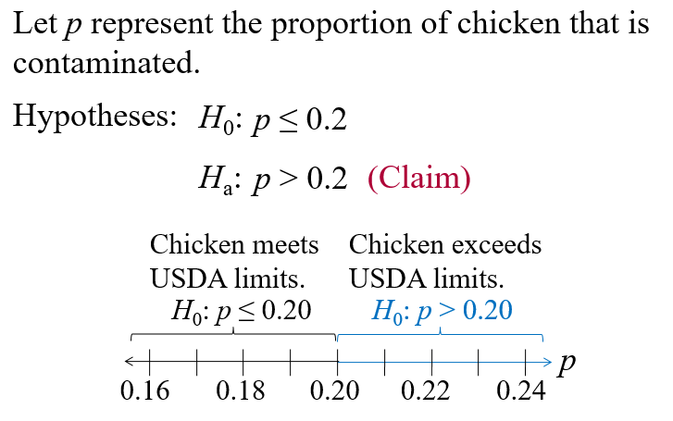
Chapter
07
Solution: Identifying Type I and Type II Errors

Slide 12
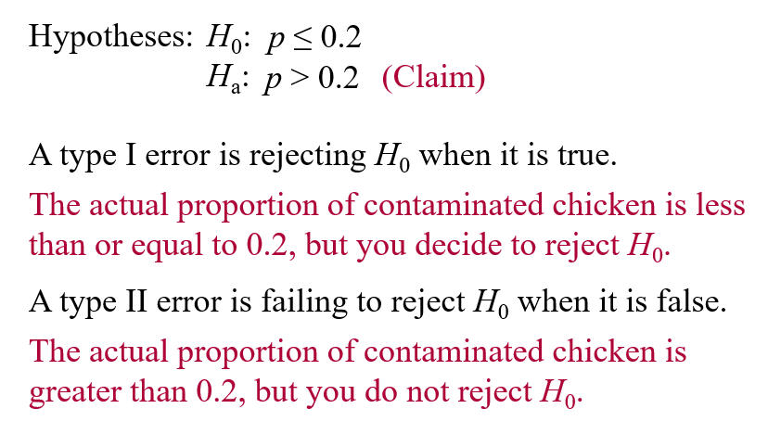
Chapter
07
Solution: Identifying Type I and Type II Errors

Slide 13
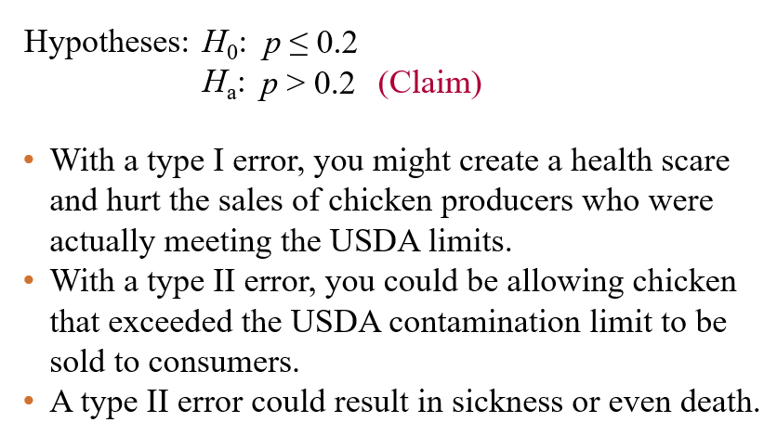
Chapter
07
Solution: Identifying Type I and Type II Errors

Slide 14
Chapter
07
Level of significance
Level of significance
Your maximum allowable probability of making a type I error.
  Denoted by α, the lowercase Greek letter alpha.
By setting the level of significance at a small value, you are saying that you want the probability of rejecting a true null hypothesis to be small.
Commonly used levels of significance:
  α = 0.10 α = 0.05 α = 0.01
P(type II error) = β (beta)

Slide 15
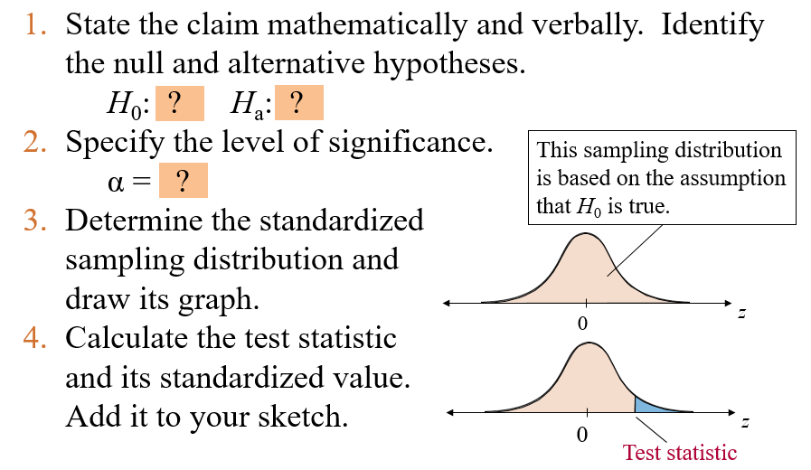
Chapter
07
Taking decision by Traditional way - First way

Slide 16
Chapter
07
Making a Decision by P-value – Second way
P-value (or probability value)
The probability, if the null hypothesis is true, of obtaining a sample statistic with a value as extreme or more extreme than the one determined from the sample data.
Depends on the nature of the test.

Slide 17
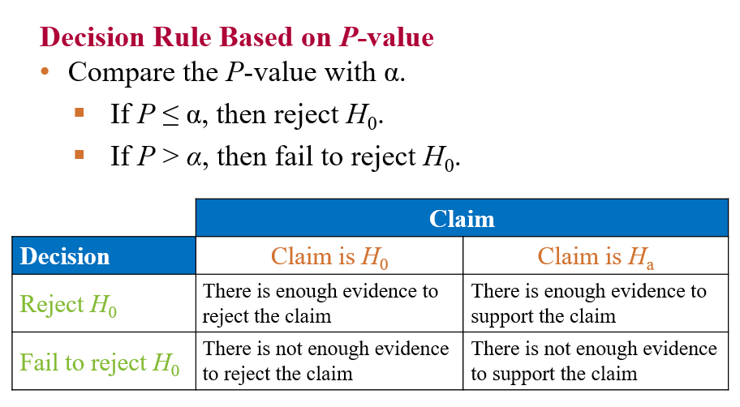
Chapter
07
Making a Decision by P-value – Second way

Slide 18

Chapter
07
Example: Interpreting a Decision
You perform a hypothesis test for the following claim. How should you interpret your decision if you reject H₀? If you fail to reject H₀?
H_{a} (Claim): Consumer Reports states that the mean stopping distance (on a dry surface) for a Honda Civic is less than 136 feet.
Solution:
The claim is represented by H_{a}.
H₀ is “the mean stopping distance…is greater than or equal to 136 feet.”

Slide 19
Chapter
07
Solution: Interpreting a Decision
If you reject H₀ you should conclude “there is enough evidence to support Consumer Reports’ claim that the stopping distance for a Honda Civic is less than 136 feet.”
If you fail to reject H₀, you should conclude “there is not enough evidence to support Consumer Reports’ claim that the stopping distance for a Honda Civic is less than 136 feet.”

Slide 20
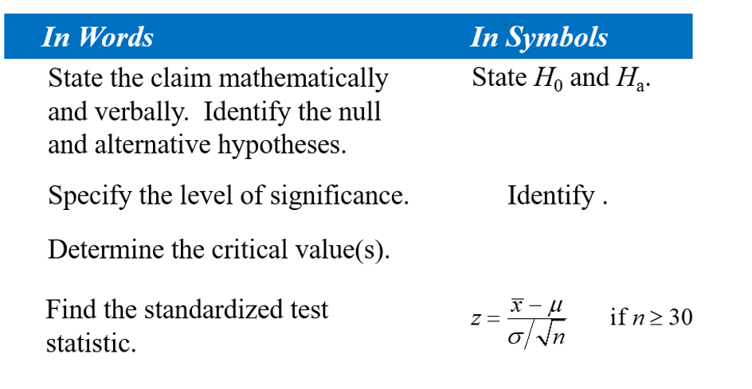
Chapter
07
7.2 Hypothesis Testing for the Mean (Large Samples)
When n ≥ 30, the sample standard deviation s can be substituted for σ.

Slide 21




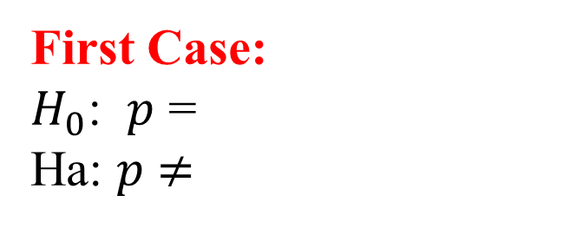

Chapter
07
Taking Decision – Graphically
Population Mean Population Proportion
First Case:
$H_{0}$: $μ$ =
Ha: $μ$ $≠$
First Case:
$H_{0}$: $p$ =
Ha: $p$ $≠$
Two Tail Test
Second Case:
$H_{0}$: $μ$ $≤$
Ha: $μ$ $>$
Second Case:
$H_{0}$: $p$ $≤$
Ha: $p$ $>$
Right Tail Test
Third Case:
$H_{0}$: $μ$ $≥$
Ha: $μ$ $<$
Third Case:
$H_{0}$: $p$ $≥$
Ha: $p$ $<$
Left Tail Test

Slide 22
Chapter
07
Example: Testing with Rejection Regions ( First way )
Employees in a large accounting firm claim that the mean salary of the firm’s accountants is less than that of its competitor’s, which is $45,000. A random sample of 30 of the firm’s accountants has a mean salary of $43,500 with a standard deviation of $5200. At
α = 0.05, test the employees’ claim.
Note: Critical value = -1.645

Slide 23
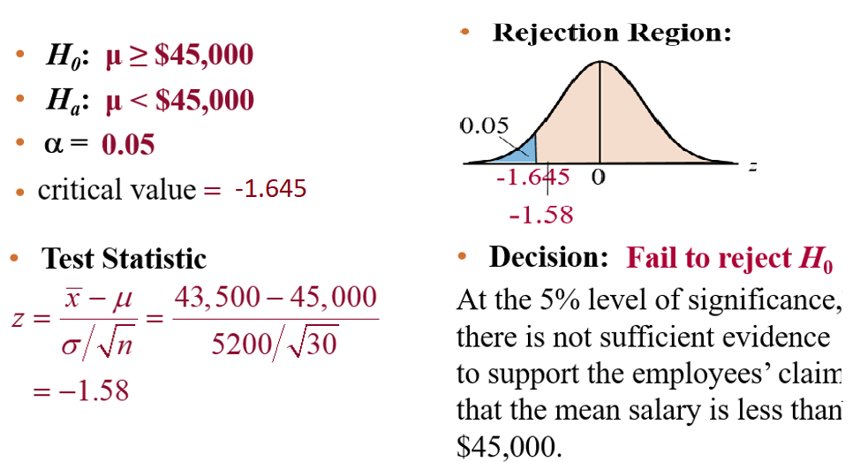
Chapter
07
Solution: Testing with Rejection Regions( First way )

Slide 24
Chapter
07
Hypothesis Testing by P-value – Second way
Decision Rule Based on P-value
To use a P-value to make a conclusion in a hypothesis test, compare the P-value with α.
  If P ≤ α, then reject H₀.
  If P > α, then fail to reject H_{0.}

Slide 25
Chapter
07
Example: Hypothesis Testing Using P-values
In an advertisement, a pizza shop claims that its mean delivery time is less than 30 minutes. A random selection of 36 delivery times has a sample mean of 28.5 minutes and a standard deviation of 3.5 minutes. Is there enough evidence to support the claim at α = 0.01? Use a P-value. P-value = 0.0051

Slide 26
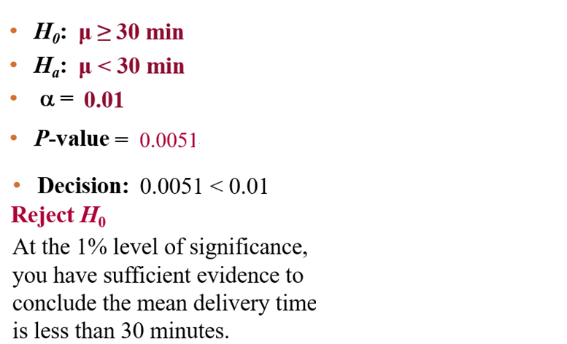
Chapter
07
Solution: Hypothesis Testing Using P-values

Slide 27
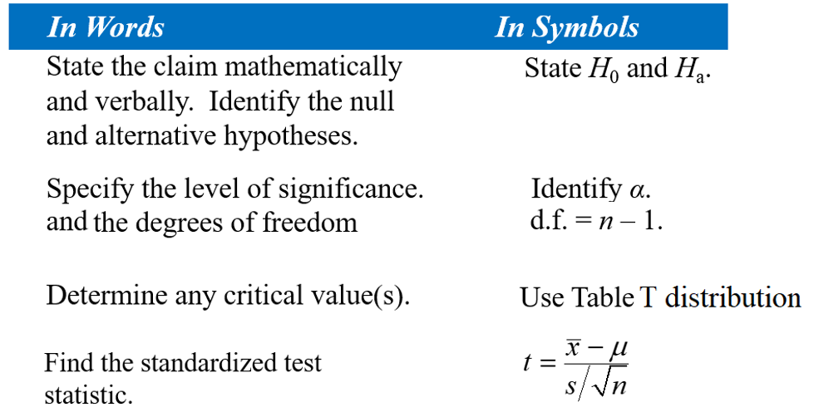
Chapter
07
7.3 Hypothesis Testing for the Mean (Small Samples)

Slide 28
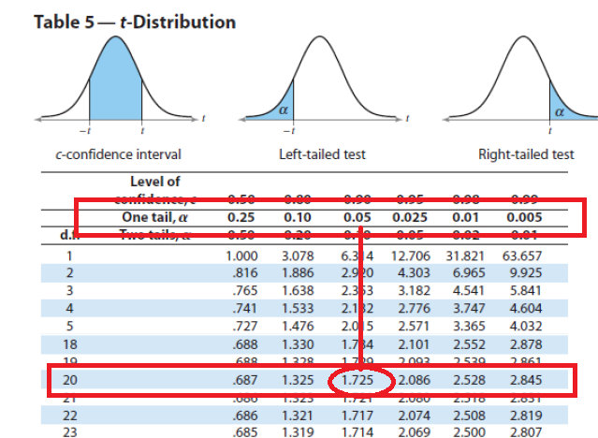
Chapter
07
Example: Finding Critical Values for t
Find the critical value t₀ for a left-tailed test
given α = 0.05 and n = 21.
Solution:
The degrees of freedom are d.f. = n – 1 = 21 – 1 = 20.
Look at α = 0.05 in the “One Tail, α” column.
Because the test is left-tailed, the critical value is negative.
0.05
-1.725
0
t

Slide 29
Chapter
07
Example: Testing μ with a Small Sample – First Way
A used car dealer says that the mean price of a 2005 Honda Pilot LX is at least $23,900. You suspect this claim is incorrect and find that a random sample of 14 similar vehicles has a mean price of $23,000 and a standard deviation of $1113. Is there enough evidence to reject the dealer’s claim at α = 0.05? Assume the population is normally distributed. (Adapted from Kelley Blue Book)

Slide 30
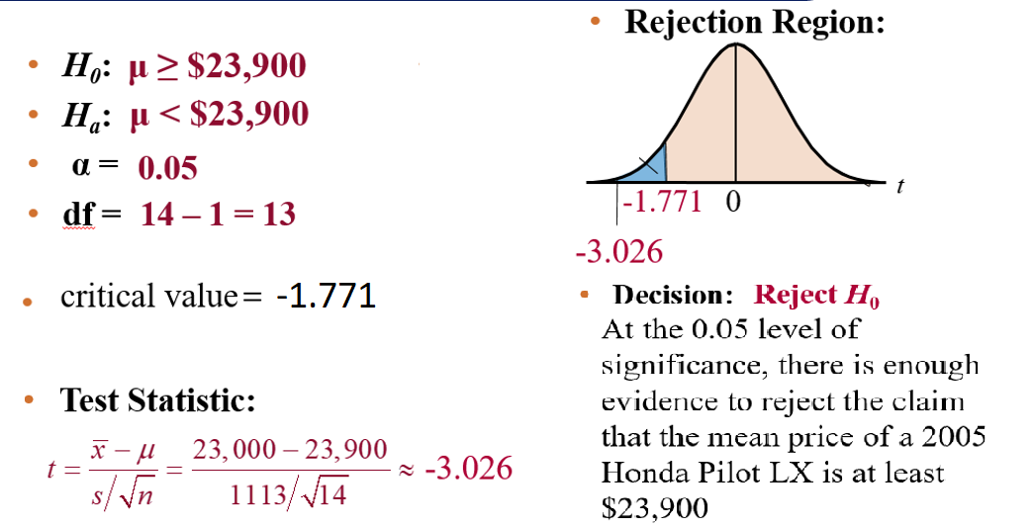
Chapter
07
Solution: Testing μ with a Small Sample

Slide 31
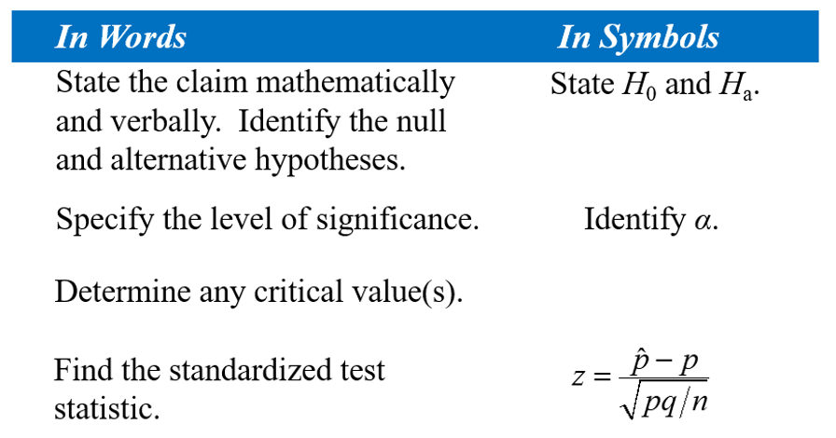
Chapter
07
7.4 Hypothesis Testing for the Proportion p
Verify that np ≥ 5 and nq ≥ 5

Slide 32

Chapter
07
Example: Hypothesis Test for Proportions
Zogby International claims that 45% of people in the United States support making cigarettes illegal within the next 5 to 10 years. You decide to test this claim and ask a random sample of 200 people in the United States whether they support making cigarettes illegal within the next 5 to 10 years. Of the 200 people, 49% support this law. At α = 0.05 is there enough evidence to reject the claim?
Note: Critical values = -1.96 and 1.96
Solution:
Verify that np ≥ 5 and nq ≥ 5.
np = 200(0.45) = 90 and nq = 200(0.55) = 110

Slide 33
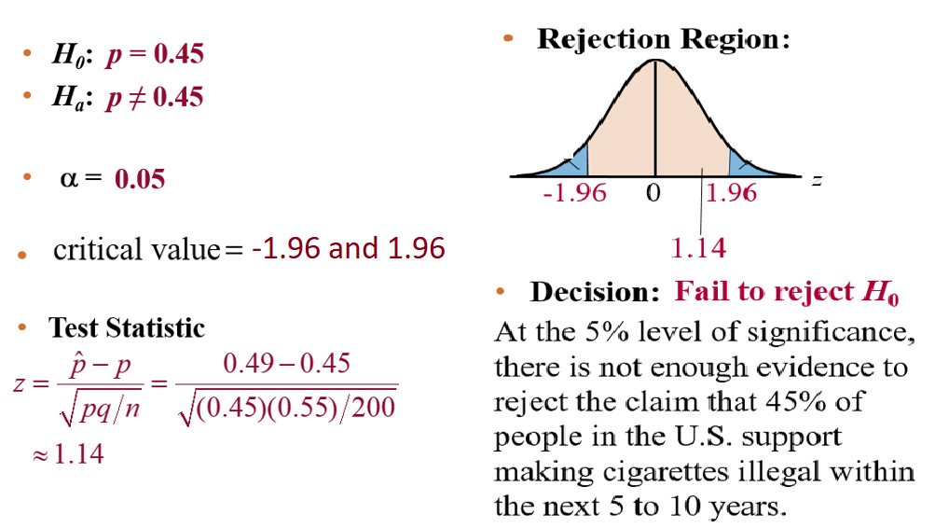
Chapter
07
Solution: Hypothesis Test for Proportions

Slide 34
Chapter
07
Chapter Summary
7.1 Introduction to Hypothesis Testing
7.2 Hypothesis Testing for the Mean (Large Samples)
7.3 Hypothesis Testing for the Mean (Small Samples)
7.4 Hypothesis Testing for Proportions

