Slide 1


College of Humanities
Master of Financial
Technology-
FinTech
Business Analysis
FNT613
Lecture 5
Prepared By:
Dr. Abeir Moussa

Slide 2

Investigation Techniques of business situation cont.
5th Lecture
FNT613
Prepared By:
Dr. Abeir Moussa

Slide 3

Investigation Techniques of business situation cont.
Week6
Chapter5 cont.

Slide 4

Lecture 5
Learning objectives
Understand the importance of investigation techniques in analyzing business situations.
Learn the different types of investigation techniques used in business analysis.
Gain knowledge of how to gather and analyze data effectively.
Develop skills in conducting interviews and surveys to gather information.
Learn how to use observation techniques to gather insights about business situations.

Slide 5
Lecture 5
Learning objectives Cont.
Learn how to use scenario analysis to assess potential outcomes and make informed business decisions.
Understand the importance of ethical considerations in conducting investigations and gathering information.
Develop skills in presenting investigation findings and recommendations effectively.
Learn how to use visual aids and data visualization techniques to present complex information in a clear and concise manner.

Slide 6
Lecture 5
Learning objectives Cont.
Gain knowledge of how to write comprehensive investigation reports that provide a thorough analysis of the business situation.
Understand the role of critical thinking and problem-solving skills in conducting effective investigations.
Develop skills in working collaboratively and communicating effectively with stakeholders during the investigation process.
Develop skills in presenting investigation findings and recommendations in a clear and concise manner.

Slide 7
Lecture 5
Chapter outline
Introduction
Prior research
Investigation techniques; Interviews, Observation, Workshops, scenarios
User analysis
Prototyping
Quantitative approaches
Suitability of techniques
Documenting the current situation

Slide 8
Lecture 5
INTRODUCTION
When business analysts first enter an area of study, they need a range of tools and techniques to help them understand the breadth and depth of issues. While they will be making use of background research, workshops, one-to-one interviews and quantitative methods of verification of data, they must also use diagnostic tools for understanding a problem area, and different approaches to documenting their findings, according to the focus.

Slide 9
Lecture 5
INTRODUCTION
The assumption behind this chapter is that the analyst will be responsible for performing a broad study that begins with a general understanding of the situation, then produces a diagnosis of the underlying causes and subsequently understands the requirements for a solution.

Slide 10
Lecture 5
3. User analysis
It will be evident from the description of scenario modelling that it is important to understand who the actual users of the proposed system are likely to be and this is also true of prototyping which we discuss next. However, sometimes these generic titles do not tell us enough about the business users for us to envisage how and why they might want to use an information system. ‘Customer’, for example, is a very broad term that may not capture the different sets of characteristics displayed by the actual customers of an organization. A good way of understanding customers is to create ‘personas’ for them.

Slide 11
Lecture 5
4. Prototyping
Prototyping is an important technique for eliciting, analyzing, demonstrating and validating requirements. Analysts often complain that the business users do not know what they want, and that as a result it is difficult to define the requirements. If business users are unclear about their requirements, prototypes can help them visualize the new system and provide insight into possible requirements.

Slide 12
Lecture 5
4. Prototyping
Prototypes also offer a way of demonstrating how the new processes or system might work and provide a concrete basis for evaluation and discussion. Agile software development approaches, such as DSDM and Scrum, use evolutionary prototyping as an integral part of their development lifecycle.

Slide 13
Lecture 5
4. Prototyping
Prototyping involves building simulations of a process or system in order to review them with the users to increase understanding about the requirements. There is a range of approaches to building prototypes. They may be built using the organization’s system development environment so that they exactly mirror the future system. Images of the screens and navigations may be built using presentation software packages such as Microsoft PowerPoint or they may be mock-ups on paper. A quick but effective form of prototyping is to use flipchart sheets, pens and packs of sticky notes and work with the users to develop paper prototypes. This will enable the users to develop screens, identify navigation paths, define the data they must input or refer to, and prepare lists of specified values that they know will apply.

Slide 14
Lecture 5
4. Prototyping
There is a strong link between scenarios and prototyping because scenarios can be used as the basis for developing prototypes. As well as confirming requirements, prototyping can often help the users to identify some that they had not considered previously.

Slide 15
Lecture 5
4. Prototyping
Advantages of Prototyping
Clarify any uncertainty on the part of the analysts and confirm to the user that we have understood what they asked for;
Help the user identify new requirements as they gain an understanding of what the system will be able to do to support their jobs;
Demonstrate the look and feel of the proposed system and elicit usability requirements;
Validate the system requirements and identify any errors;
Provide a means of assessing the navigation paths and system performance.

Slide 16
Lecture 5
4. Prototyping
Disadvantages of Prototyping
Prototyping has a number of hazards, most of which can be avoided by setting clear objectives for the prototyping exercise and managing the stakeholders’ expectations. The hazards include:
The prototyping cycle can spin out of control with endless iterations taking place.
If the purpose of the exercise has not been explained clearly, the users may think that when they are happy with the mock-up, the system is now complete and ready for use.

Slide 17
Lecture 5
4. Prototyping
In an Agile software development environment, prototyping sessions are used to elicit and analyze requirements, and to construct and test working functionality. The development work is conducted iteratively, with each iteration using the concept of a time-box or sprint, typically a predefined number of weeks, within which certain functionality is delivered. The prototyping approach allows the business to receive the most critical pieces of functionality when it needs it, and the less urgent functionality will be delivered in future iterations.

Slide 18
Lecture 5
5. Quantitative approaches
Quantitative approaches are used to obtain data that is needed to quantify the information that has been provided during interviews, workshops or other qualitative techniques. Examples of the quantitative data we need could be the following: we might want to know the number of workers who use a particular system, the number of complaints received during a set period or the number of orders processed each day.

Slide 19

Surveys or questionnaires
Special Purpose Record
Activity Sampling
Document Analysis
Lecture 5
5. Quantitative approaches

Slide 20
Lecture 5
5. Quantitative approaches
Surveys or questionnaires
Surveys can be useful if we need to get a limited amount of information from a lot of people and interviewing them individually or running a series of workshops would not be practical or cost-effective. However, surveys are difficult to design and this has to be done with care in order to have any possibility of success.
The exact design of a survey depends upon its purpose but there are three main areas to consider: the heading, classification and data sections.

Slide 21
Lecture 5
5. Quantitative approaches- Surveys or questionnaires
Heading section
This is where the purpose of the survey is explained and where instructions for returning it are given.
Classification section
This is where the details about the respondent are captured. This data provides the basis for categorizing the respondents using predefined analysis criteria, like age, gender or length of service.
Data section
This is where the main body of questions is posed. It is vital to think carefully about the phrasing of the questions. They must be unambiguous and, ideally, allow for straightforward answers such as ‘yes/no’, ‘agree/neutral/disagree’ or ‘excellent/satisfactory/inadequate’.

Slide 22
Lecture 5
5. Quantitative approaches
Special Purpose Record
Special purpose records are data-gathering forms used by the analyst; the format is usually decided by the analyst and they are not company records. They can be completed either by the analyst during an observation session or given to the business users to complete over a period of time.
Notwithstanding this, it can still be useful sometimes to get people to keep such records as they help avoid the problems associated with observation and it can be an effective use of the analyst’s time.

Slide 23
Lecture 5
5. Quantitative approaches
Activity Sampling
This is a further quantitative form of observation and can be used when it is necessary to know how people divide their work time among a range of activities. For example, how much time is spent on the telephone? How much time spent on reconciling payments? How much time on sorting out complaints?
An activity sampling exercise is carried out in five steps:
1. Identify the activities to be recorded. This list should include a ‘not working’ activity as this covers breaks or times away from the desk. It might also include a ‘not-related’ task, such as first aid or health and safety officer duties.
2. Decide on the frequency and timings, i.e. when and how often you will record the activities being undertaken.
3. Visit the study group at the times decided upon and record what each group member is doing.
4. Record the results.
5. After a set period, analyze the results.

Slide 24
Lecture 5
5. Quantitative approaches
Activity Sampling
The results from an activity sampling exercise provide quantifiable data about the number of times an activity is carried out per day by the group studied. By analyzing that figure against other data, such as the total amount of time available, we are able to calculate the total length of time spent on that activity and the average time one occurrence of the activity will take. This information can be useful when developing business cases and evaluating proposed solutions. Also, it will raise other questions such as whether the average time is reasonable for this task or whether it indicates a problem somewhere else in the process.

Slide 25
Lecture 5
5. Quantitative approaches
Document Analysis
Document analysis involves reviewing samples of source documents to uncover information about an organization, process or system. For each document, we might analyze:
How is the document completed?
Who completes the document?
Are there any validations or controls on the document?
Who uses the completed document?
When is the document used?
How many are used or produced?
How long is the document retained by the organization, and in what form?
What are the details of the information shown on the document?
Where is the data or information obtained?
Are other names used in the organization for any of the items of data?
Are all the data items on the document still needed, or are any redundant?
Is there other data that is not entered on the document, but would be useful for this process?

Slide 26
Lecture 5
5. Quantitative approaches
Document Analysis
Document analysis is useful to supplement other techniques such as interviewing, workshops and observation. For example, analyzing the origin and usage of a document can prove very enlightening when investigating a process. Samples of completed documents or system printouts also help to clarify the key items of data used to carry out the work and can prove an excellent basis for modelling data.

Slide 27
Lecture 5
6. Suitability of Techniques
Some of the techniques described in this chapter are suitable for general investigation of the problem situation and others more for eliciting requirements for the new system. Of those suitable for requirements, some are more suitable for a waterfall approach and others geared more towards Agile developments. Some techniques are suitable in all situations. Table 5.1 gives a guide to the suitability of these techniques for the different situations.

Slide 28
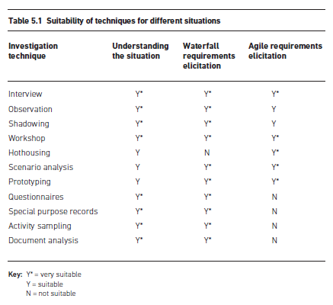
Lecture 5
6. Suitability of Techniques

Slide 29
Lecture 5
7. Documenting the Current Situation
While the investigation of the current situation is going on, the analyst will need to record the findings, in order to understand the range of issues and the business needs. Meeting reports should be produced for each interview and workshop so that they can be agreed with the participants. It is also helpful to use diagrams to document the business situation. There are five suggested diagrammatic techniques that help the analyst understand the information that has been obtained and find the root cause of any problems.

Slide 30
Rich pictures
Mind maps
Business process models
Spaghetti maps
Fishbone diagrams
Lecture 5
7. Documenting the Current Situation

Slide 31
Lecture 5
7. Documenting the Current Situation
Rich pictures
The rich picture technique is one of the few that provide an overview of an entire business situation. Whereas modelling approaches such as data or process modelling provide a clear representation of a specific aspect of a business system, rich pictures show all aspects. For this reason the rich picture can show the human characteristics of the business situation and can reflect intangible areas such as the culture of the organization. A rich picture allows the analyst to document all of the human and cultural aspects as well as information flows and information usage. Its strength is that the process of building the rich picture helps the analyst to form a mental map of the situation and see connections between different issues.
Figure 5.5 shows an example of a rich picture for a business system called Rake’s Wines.

Slide 32
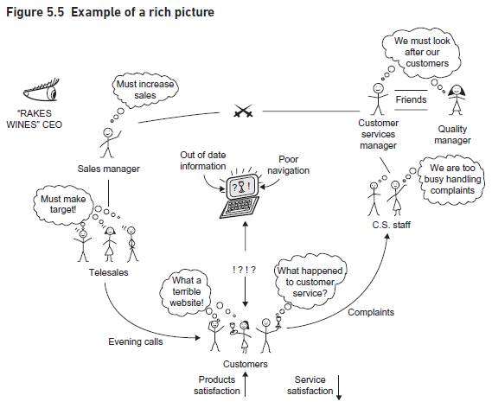
Lecture 5
7. Documenting the Current Situation- Rich pictures

Slide 33
Lecture 5
7. Documenting the Current Situation
2. Mind maps
Mind maps are a useful tool for summarizing a lot of information in a simple visual form that is structured to highlight connections between different ideas and topics. The business system or problem under consideration is drawn at the center of the diagram with the main elements shown as first level of branches radiating from the central point. The branches might represent such matters as particular processes, the equipment and systems used, relationships between the staff that do the job and so on. For example, the branch for equipment might show problems with the printing or photocopying equipment and the branch for systems might show the key failings of the IT system. Mind maps are extremely useful in helping analysts to order their thinking, and they work well both on their own and when used in conjunction with rich pictures.
The mind map in Figure 5.6 for Rake’s Wines relates to the rich picture shown in Figure 5.5.

Slide 34
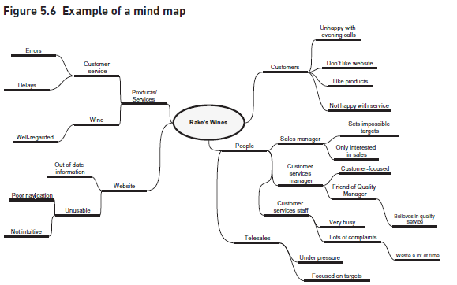
Lecture 5
7. Documenting the Current Situation

Slide 35
Lecture 5
7. Documenting the Current Situation
3. Business process models
In order to understand fully how a process is carried out, it is helpful to draw a ‘swimlane’ diagram, which shows the tasks in a process, the actors responsible for carrying them out, and the process flow. These models are easy to draw and business stakeholders find them accessible, so they provide a good communication tool between the analyst and the business staff. Business process models are also invaluable as a diagnostic aid since they help identify problems such as delays, bottlenecks and duplicate tasks. They are described in greater detail in the future chapters.

Slide 36
Lecture 5
7. Documenting the Current Situation
4. Spaghetti maps
A spaghetti map is a tool to show the movement and interactions of the stakeholders in a particular environment, when performing particular tasks and processes. It is called aspaghetti map simply because as the movements are drawn, the diagram created resembles a plate of spaghetti, with lines crossing back and forth without any apparent formality or design. Spaghetti maps can be drawn up during an observation session, mapping the movements of users across the room to meet different actors or to use equipment such as printers or photocopiers.
Figure 5.7 shows a spaghetti diagram drawn while observing a clerk in the service department of a garage checking in a car for repair and allocating a courtesy car to the customer.
This diagram represents one person executing one instance of a common task, and makes clear the scope for efficiency gains.

Slide 37
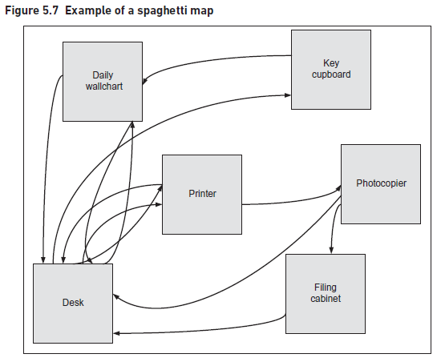
Lecture 5
7. Documenting the Current Situation

Slide 38
Lecture 5
7. Documenting the Current Situation-Spaghetti maps
It is interesting to note that a swimlane diagram would not show the physical movement required for an actor to perform a task, so it would not highlight the potential for improvement. The two diagrams together help identify the scope for improvement in the process.

Slide 39
Lecture 5
7. Documenting the Current Situation
5. Fishbone diagrams
One of the major objectives in investigating and modelling a business system is to identify where there are problems and discover their underlying causes. Some of these may be obvious, or the stakeholders may be aware of the root causes of their problems. The fishbone diagram is a problem-analysis technique, designed to help understand the underlying causes of an inefficient process or a business problem. The technique was invented by Dr Kaoru Ishikawa (Ishikawa 1985), and the diagrams are sometimes known as Ishikawa diagrams. Radiating up and down from this backbone are spines; the spines suggest possible areas for causes of the problem.
A number of approaches may be used when labelling the spines:

Slide 40
Lecture 5
7. Documenting the Current Situation
5. Fishbone diagrams
A number of approaches may be used when labelling the spines:
The four Ms: manpower, machines, measures and methods.
An alternative four Ms: manpower, machines, materials and methods.
The six Ps: people, place, processes, physical evidence, product/service and performance measures.
The four Ss: surroundings, suppliers, systems and skills.
These categories help because they list areas that have been found to be the sources of inefficiencies in many business systems.

Slide 41
Lecture 5
7. Documenting the Current Situation
5. Fishbone diagrams
In practice we often consider a range of categories and might combine the most relevant elements from the approaches above, or even define some categories that are particularly relevant to a given project. Data for this analysis can be found from interviews, workshops, activity sampling, observation and special purpose records. The categories to be used on the fishbone diagrams can also provide a structure to a workshop discussion. As with mind maps, the spines have more detailed elements associated with them. The resultant diagram is shaped like a fishbone – hence the name fishbone diagrams.
An example of a fishbone diagram (for the Rake’s Wines scenario) is shown in Figure 5.8.

Slide 42
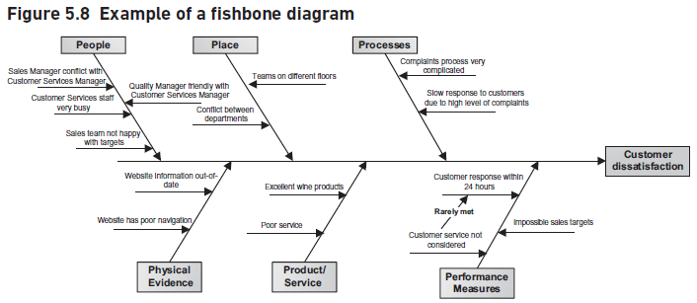
Lecture 5
7. Documenting the Current Situation-Spaghetti maps

Slide 43
Lecture 5
7. Documenting the Current Situation
5. Fishbone diagrams
Once the diagram has been completed, we can analyze the results by looking for the key causes of problems. These are the items that are listed several times, since they are the ones that are likely to be having a broad impact upon the situation. They should be considered for rapid action in order to help address the issue promptly.

Slide 44
Lecture 5
CONCLUSION
Any business analysis project will inevitably include investigating business situations in order to clarify the problem to be addressed. To do this effectively, the business analyst needs a toolkit containing a range of investigative and diagrammatic techniques. This toolkit provides the basis for a key competency of a business analyst which is the ability to appreciate when particular techniques are relevant and the ability to apply them effectively.

Slide 45
Lecture 5
important links
Business analysis real life case studies
https://www.thecareeraccelerators.ca/blog/real-world-applications-of-Business-Analysis#:~:text=Real%2Dworld%20example%3A%20A%20retail,is%20to%20boost%20online%20sales.
https://www.theknowledgeacademy.com/blog/business-analysis-example/
https://www.knowledgehut.com/blog/business-management/example-business-analysis
Samples of Companies’ mission and vision
https://blog.hubspot.com/marketing/inspiring-company-mission-statements
https://www.hubspot.com/hubfs/100%20Mission%20Statement%20Templates%20%26%20Examples-V2.pdf?hubs_signup-url=offers.hubspot.com%2F100-mission-statements&hubs_signup-cta=Submit&hubs_offer=offers.hubspot.com%2F100-mission-statements

Slide 46
REFERENCES
Required Reference:
Debra Paul and James Cadle, et al, (2020). “Business Analysis”. BCS, 4th Edition. ISBN:978-1-78017-5102
Recommended Reading
James Cadle, Debra Paul, Jonathan Hunsley, Adrian Reed, David Beckham, Paul Turner (2021). “Business Analysis Techniques” 3rd Edition, BCS. ISBN: 978-1-78017-5690

Slide 47



The End of Lecture
Thank You
Dr. Abeir Moussa

