Slide 1


English Course- Intermediate Level
Prepared by
Ahmed Soliman

Slide 2



Lecture 7
www.midocean.ae

Slide 3
Warm up
2 truths and a lie
www.midocean.ae

Slide 4
Listening: ESL Program Meeting
Pronunciation: linking vowel to vowel
www.midocean.ae

Slide 5
Listening
ESL Program Meeting
www.midocean.ae

Slide 6
Vocabulary
go over (verb): review
– We still need to go over the final proposal before Friday.
tentative (adjective): not certain, not finalized, still in review
– Here are our tentative travel plans for next week’s trip.
commence (verb): begin, start
– The meeting was supposed to commence at 9:00 AM, but it was postponed until tomorrow.
originally (adverb): in the beginning, in the first place
– We were scheduled originally to go over the proposal today, but let’s review it later.
extracurricular (adjective): outside the regular curriculum
– Several extracurricular activities are being organized for the students this semester.
www.midocean.ae

Slide 7
shuttle (also noun): in this case, a bus that carries passengers from one point to another
– The shuttle should arrive in 10 minutes.
to be up to your ears in (verb phrase): to be extremely busy
– I’ll try to complete that report by 5:00 PM, but I’m up to my ears in other paperwork, so I can’t guarantee it will be finished.
get things rolling (verb phrase): to start something
– If you help, we can get things rolling and complete the assignment by tomorrow.
jot down (verb): to write down a quick note
– Let me jot down your phone number so I don’t forget it.
to find a needle in a haystack (verb phrase): extremely difficult or impossible to find something
– Locating the report in this filing cabinet like finding a needle in a haystack.
www.midocean.ae

Slide 8
to lend a hand (verb phrase): to help
– Could you lend me a hand to move these boxes?
to give the green light (verb phrase): to give the okay or permission to
– The president of the company must give the green light before we proceed with the plan.
to wrap things up (verb phrase): to complete or finish
– Since everyone lent a hand to the project, we were able to wrap things up in time for the party.
bottom line (noun): the most important point
– We want to emphasize that the bottom line in our business is great customer satisfaction.
www.midocean.ae

Slide 9
Listen to the recording and answer the questions.
https://www.esl-lab.com/academic-english/esl-program-meeting/
1- The orientation meeting is on _______.
Friday
Wednesday
Thursday
2- The woman wants to end the meeting at _____.
11:00 a.m.
10:00 a.m.
10:30 a.m.
www.midocean.ae

Slide 10
3- The campus tour will end around ______.
1:45 p.m.
2:15 p.m.
2:00 p.m.
4- During the tour, the students will see the union building, the library, and the _______.
student services building
cafeteria
health center
www.midocean.ae

Slide 11
5- Why will it be difficult to find a pen on Randall's desk?
His desk is messy.
He never uses a pen to write.
The lights are off in his office.
www.midocean.ae

Slide 12
Listening Script
Randall: Hi Faith. Do you have a minute?
Faith: Sure. What’s up?
Randall: Well, I just wanted to go over the schedule for Wednesday’s orientation meeting to make sure everything is ready.
Faith: Okay. Here’s a copy of the tentative schedule. [Okay.] Now, the registration starts at 8:30 [Alright] and goes until 9:15. Then, the orientation meeting will commence at 9:30.
Randall: Okay. Now, we had planned originally for the meeting to go until 10:30, but now we have someone from the international center coming to speak to the students on extracurricular activities, so how about ending the meeting around 11:00?
Faith: Fine. And, uh, then students will take the placement tests from 11:15 until noon [Okay.], followed by a twenty-minute break before lunch. [Okay.] And, immediately after lunch, we have reserved a campus shuttle to give students a forty-five-minute tour starting at 1:30. [Oh. Okay.] We want to show students around the university, including the union building, the library, and the student services building.
www.midocean.ae

Slide 13
Randall: Great. Now, how about the oral interviews?
Faith: Well, we’re planning to start them at two fifteen.
Randall: Oh, well, teachers are going to be up to their ears in preparations, and they’ll be hard-pressed to start then.
Faith: Okay, let’s get things rolling around 2:45.
Randall: Okay, here, let me jot that down. Uh, could you grab a pen off my desk?
Faith: Right. Finding anything on your desk is like finding a needle in a haystack. [Oh, it’s not that bad.] Here, use mine.
Randall: Okay. And we’ll need 150 copies of this program guide by then.
Faith: Hey. That’s a tall order on such short notice! How about lending me a hand to put things together by this afternoon[Okay] so we don’t have to worry about them?
www.midocean.ae

Slide 14
Randall: Okay. And I think the manager has given the green light to go ahead and use the more expensive paper and binding for the guides this time.
Faith: Okay. So the interviews will go from two forty-five until, let’s say, 4:30. [Okay.] I hope we can wrap things up by 5:00.
Randall: Great. And I think the bottom line is to keep things running smoothly throughout the day.
Faith: I agree. I’ll pass this schedule by the director for a final look.
www.midocean.ae

Slide 15
Pronunciation
linking vowel to vowel
www.midocean.ae

Slide 16

www.midocean.ae

Slide 17
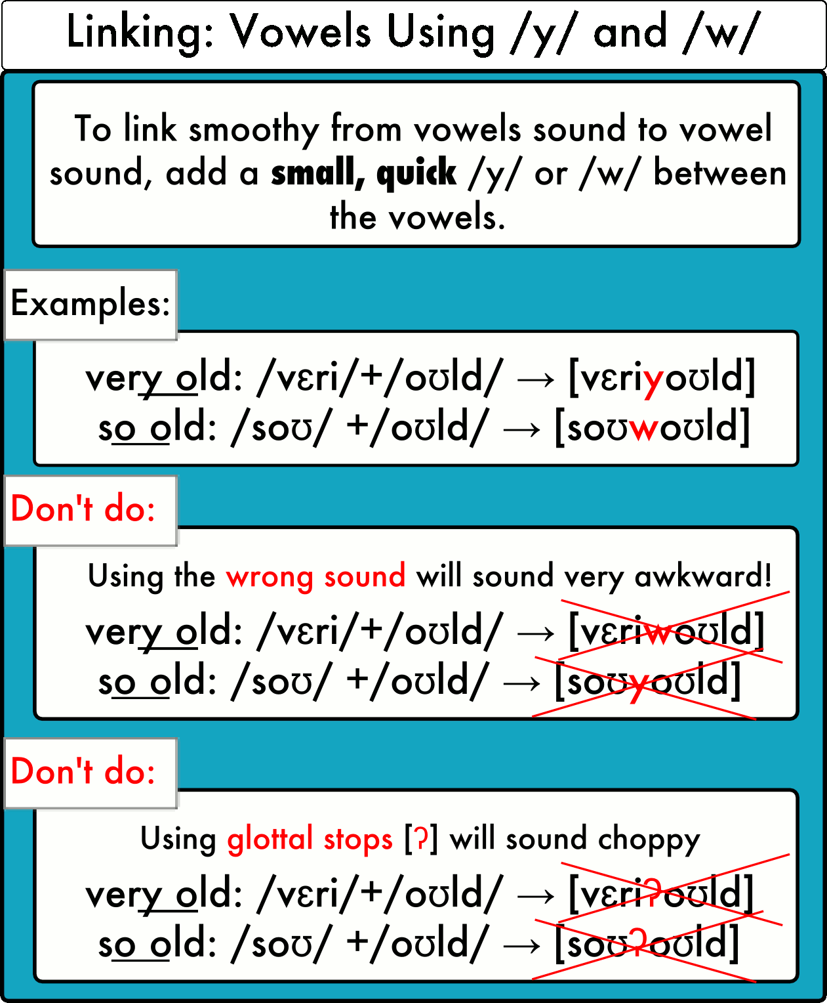
www.midocean.ae

Slide 18
Practice
https://pronuncian.com/linking-vowels-into-vowels
www.midocean.ae

Slide 19




Thank You

