Slide 1


HRM Strategy
HRM 611
Lecture 2: HRM Strategy
Prepared by Dr. Sahar Ahmed

Slide 2

Ch.
02
Main Topics
Explain why strategic planning is important to all managers.
Explain each of the seven steps in the strategic planning process.
List with examples the main generic types of corporate strategies and competitive strategies.
Define strategic human resource management and give an example of strategic human resource management in practice.
Briefly describe three important strategic human resource management tools.
www.midocean.ae

Slide 3
Week
Strategic Management
Introduction
Strategic management is the process of formulating and implementing an action plan to achieve corporate objectives, specifically including how these objectives are to be met.
Senior management must find “fit” between the organization, its strategy and its environment. Strategic plans are long-range in nature, and require review and updating to ensure continued fit.
www.midocean.ae

Slide 4
Ch.
The Hierarchy of Goals
02
Strategic planning involves setting goals and developing a course of action to achieve them.
Goals are typically structured in a hierarchy, from top-level strategic goals (set by top-level executives to operational goals (set by subsequent levels)
The planning process begins with formulating long-term strategic plans and goals.
This hierarchical structure ensures alignment and consistency throughout the organization.
www.midocean.ae

Slide 5
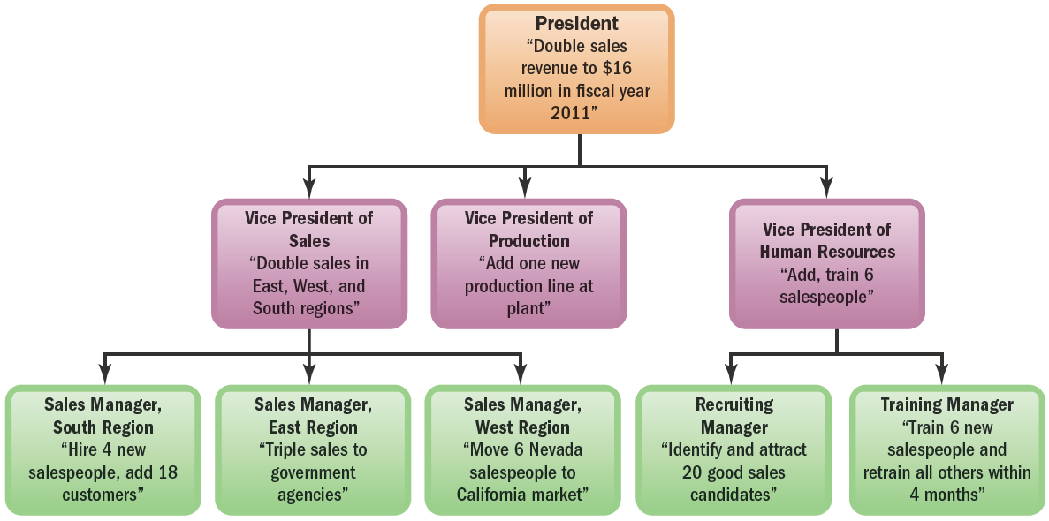
Ch.
Example- The Hierarchy of Goals
02
In this Figure. At the top, the president sets long term or strategic goals (such as Double sales revenue to $16 million in fiscal year 2011 ).
His or her vice presidents/Lower levels then set goals, such as add one production line at plant, which flow from and make sense in terms of accomplishing the presidents' goal.
www.midocean.ae

Slide 6
Ch.
Strategic Planning
02
Strategic planning is the process of aligning a company's internal capabilities with external opportunities and threats to achieve a competitive advantage.
It involves defining the company's mission, assessing its strengths and weaknesses, formulating a new direction, setting strategic goals, and implementing and evaluating a strategic plan.
It focuses on the overall direction and goals of the company.
www.midocean.ae

Slide 7
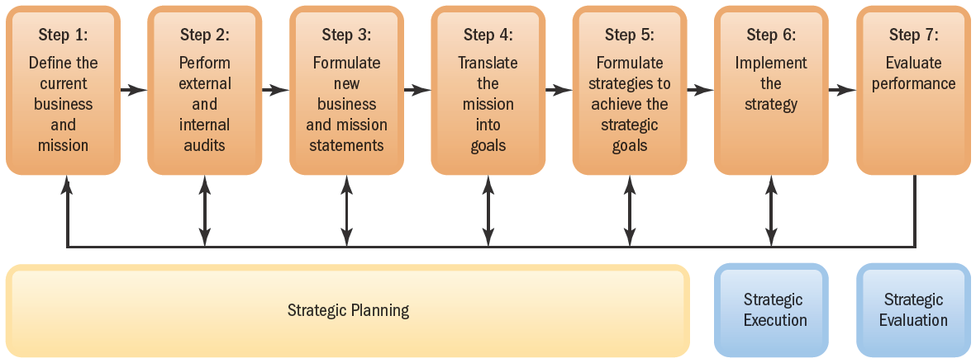
Ch.
Strategic Planning
02
www.midocean.ae

Slide 8
Ch.
Strategic Planning Process
02
Define the business and develop a mission: Clearly articulate the company's purpose and values.
Conduct a SWOT analysis: Evaluate the company's internal strengths and weaknesses, as well as external opportunities and threats.
Formulate a new business direction: Determine the desired future state of the company.
Translate the mission into strategic goals: Set specific, measurable, achievable, relevant, and time-bound (SMART) goals.
Formulate strategies: Develop action plans to achieve the strategic goals.
Implement the strategic plan: Put the strategies into action.
Evaluate the strategic plan: Assess the effectiveness of the plan and make adjustments as needed.
www.midocean.ae

Slide 9

Ch.
Step 1: Define Your Current Business
02
Core Business: Clearly identify the products or services you offer, your target market, and how your offerings differ from competitors.
Example
Products and Services: Ford offers a wide range of vehicles, including cars, trucks, SUVs, and commercial vehicles.
Target Market: Ford targets a diverse customer base, including individuals, families, businesses, and government agencies.
Competitive Differentiation: Ford differentiates itself through its brand heritage, strong dealer network, and focus on innovation and technology.
www.midocean.ae

Slide 10
Ch.
Step 2: Conduct External and Internal Audits
02
Environmental Scan: Analyze external factors like economic conditions, competition, and political trends that may impact your business.
Example:
Economic Trends: The global automotive market is facing challenges due to economic uncertainty and geopolitical tensions.
Competitive Landscape: The automotive industry is highly competitive, with major players like Toyota, Volkswagen, and General Motors.
Technological Advancements: Rapid advancements in electric vehicles, autonomous driving, and connected car technologies are reshaping the industry.
Regulatory Environment: Governments worldwide are imposing stricter regulations on fuel efficiency, emissions, and vehicle safety.
www.midocean.ae

Slide 11
Ch.
Step 2: Conduct External and Internal Audits
02
SWOT Analysis: Assess your company's internal strengths, weaknesses, opportunities, and threats.
Example:
Strengths: Strong brand recognition, extensive global presence, robust manufacturing capabilities, and a diverse product portfolio.
Weaknesses: Dependence on traditional internal combustion engine vehicles, challenges in transitioning to electric vehicles, and high costs associated with research and development.
Opportunities: Growth in emerging markets, increasing demand for electric vehicles and autonomous driving technologies, and opportunities for partnerships in mobility services.
Threats: Competition from emerging electric vehicle manufacturers, potential disruptions
from new technologies, and regulatory challenges.
www.midocean.ae

Slide 12
Ch.
Step 3: Formulate a New Direction
02
Vision Statement: Define the company's desired future state and the essence of its business.
Example: Ford Vision Statement: "To be the world's leading mobility company, providing sustainable and innovative transportation solutions that enrich people's lives.“
Ford Mission Statement: To help build a better world, where every person is free to move and pursue their dreams.
www.midocean.ae

Slide 13
Ch.
Step 4: Translate the Desired New Direction into Strategic Goals
02
Specific Goals: Break down the vision into concrete, measurable goals.
Goal 1: Accelerate the transition to electric vehicles, with a target of 50% of global sales to be electrified by 2030.
Goal 2: Expand into new mobility services, such as ride-sharing and autonomous driving.
Goal 3: Enhance customer satisfaction and loyalty through exceptional product quality and customer service.
www.midocean.ae

Slide 14
Ch.
Step 5: Formulate Strategies to Achieve Strategic Goals
02
Action Plans: Develop specific strategies or courses of action to achieve the goals.
Strategy to Accelerate the Transition to Electric Vehicles:
Invest heavily in research and development of electric vehicle technologies.
Expand manufacturing capabilities for electric vehicles.
Develop a comprehensive charging infrastructure.
Partner with suppliers and technology companies to accelerate the development of electric vehicle components.
www.midocean.ae

Slide 15
Ch.
Step 5: Formulate Strategies to Achieve Strategic Goals
02
Strategy to Expand into New Mobility Services:
Acquire or invest in mobility startups.
Pilot and scale mobility services in select markets.
Leverage existing technology and infrastructure to support mobility services.
Strategy to Enhance Customer Satisfaction:
Implement a customer-centric approach throughout the organization.
Invest in customer experience initiatives, such as personalized services and digital tools.
Continuously monitor and address customer feedback.
www.midocean.ae

Slide 16
Ch.
Step 6 Implement the Strategies
02
Allocate resources to support the implementation of the strategic plan.
Create a cross-functional team to oversee the execution of the strategies.
Monitor progress and make necessary adjustments.
www.midocean.ae

Slide 17
Ch.
Step 7: Evaluate Performance
02
Continuous Assessment: Monitor the progress of the strategic plan and make adjustments as needed.
Example:
Track key performance indicators such as market share, sales volume, customer satisfaction, and profitability.
Conduct regular reviews of the strategic plan to assess progress and identify areas for improvement.
Utilize customer feedback to inform future strategy development.
www.midocean.ae

Slide 18
Ch.
Improving Productivity with Technology
02
HRIS (Human Resource Information Systems): Streamline HR functions and improve employee productivity through automated tasks and data management. (Not mentioned in the provided excerpt).
Business Planning Software: Facilitate the creation of strategic plans:
  CheckMATE (www.checkmateplan.com [invalid URL removed]): Offers user-friendly tools like SWOT analysis for strategic planning, even for beginners.
  Business Plan Pro from Palo Alto Software: Provides comprehensive templates and guidance for crafting business plans, including sample plans, step-by-step instructions, and financial planning tools.
www.midocean.ae

Slide 19
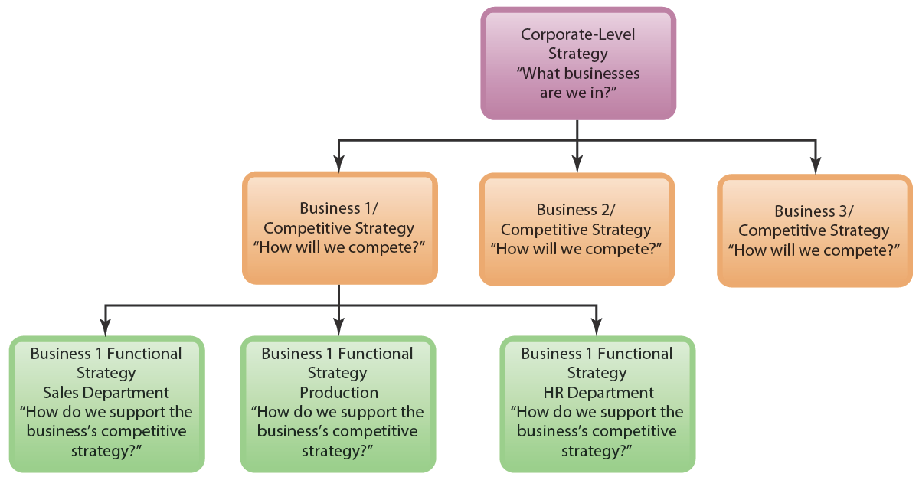
Ch.
Types of Strategies
02
Types of Strategies
In practice, managers formulate three strategies. There is corporate-wide strategic planning, business unit (or competitive) strategic planning, and functional (or departmental) strategic planning.
www.midocean.ae

Slide 20
Corporate Strategies
Concentration
Diversification
Consolidation:
Geographic Expansion
Vertical Integration
  Focus on a single product or product line within a specific market.
Example: Tesla: Primarily focuses on electric vehicles, energy storage, and solar panels, maintaining a strong concentration in the sustainable transportation and energy sectors.
  Expand into new product lines or markets.
  Example: PepsiCo, which diversified into snacks and beverages.
  Reduce the company's size through measures like divestitures or layoffs.
EX. General Motors: In recent years, GM has consolidated its operations by divesting non-core businesses and focusing on its core automotive business.
  Enter new territorial markets, such as expanding into foreign countries.
Ex. Netflix has successfully expanded its operations globally, offering its streaming service in numerous countries and regions.
  Expand by taking control of different stages of the value chain, such as producing raw materials or selling directly to consumers.
  Example: Apple opening its own retail stores.

Slide 21
Business Strategies
Cost Leadership
Differentiation
Differentiation Focus
Operational Efficiency: focus on optimizing operations to reduce costs. This can involve streamlining processes, improving supply chain management, and investing in cost-saving technologies.
Economies of Scale: they can reduce costs per unit as they produce larger quantities.
Bargaining Power with Supplier: Greater bargaining power with suppliers due to large purchasing volume.
Unique Value Proposition: Differentiated companies offer products or services that are perceived as superior to competitors in terms of quality, features, performance, or design.
Premium Pricing: Differentiated products often command premium prices, allowing for higher profit margins.
Customer Loyalty: Differentiation can create strong customer loyalty, reducing price sensitivity and increasing customer retention.
Niche Market: target specific market segments with unique needs or preferences.
Specialized Expertise: Companies pursuing a focus strategy often have deep knowledge and expertise in their niche market.
Customer Intimacy: Focus strategies allow companies to develop close relationships with their customers, understanding their needs and providing tailored solutions.

Slide 22
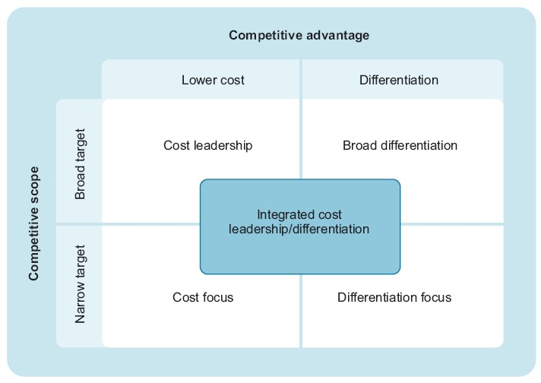
Business Strategies
Hybrid Strategies:
In some cases, companies may combine elements of different competitive strategies.
For example, a company might pursue a differentiation strategy in certain markets while focusing on cost leadership in others.

Slide 23
Ch.
Functional Strategy
02
Finally, functional strategies identify what each department must do in order to help the business accomplish its competitive goals.
As an example, a hotel might want to differentiate itself with exceptional service. Therefore, its human resources department must put in place policies and practices that will enable the hotel to select and train employees who are exceptionally customer oriented.
www.midocean.ae

Slide 24
Ch.
Managers' Roles in Strategic Planning
02
Strategic planning is a collaborative process involving managers at all levels. While top management ultimately makes the final decisions, input from lower-level managers is essential.
Key Roles of Managers:
Provide Competitive Intelligence: Managers, especially HR managers, have valuable insights into industry trends, competitor activities, and employee concerns.
Offer Expertise: Managers contribute their knowledge and experience to inform strategic decision-making.
Facilitate Collaboration: Managers participate in discussions and meetings to develop and refine the strategic plan.
www.midocean.ae

Slide 25
Ch.
Strategic Human Resource Management:
Aligning HR with Business Goals
02
Strategic human resource management (SHRM) is the process of aligning HR policies and practices with a company's overall strategic goals. It ensures that the company has the right people with the right skills and behaviors to achieve its objectives.
Key Elements of SHRM:
Strategic Alignment: HR policies and practices should be consistent with the company's strategic direction.
Employee Competencies: Identify the specific skills and behaviors employees need to contribute to the company's success.
HR Policies and Practices: Develop and implement HR policies and practices that support the development and retention of employees with the required competencies.
www.midocean.ae

Slide 26
Ch.
Strategic Human Resource Management:
Aligning HR with Business Goals- Example
02
A high-end retailer like Neiman Marcus would have different HR policies than a mass retailer like Walmart. Neiman Marcus might focus on attracting and retaining highly skilled employees with exceptional customer service abilities, while Walmart might prioritize efficiency and cost-effectiveness.
The SHRM Process:
Formulate Strategic Plans and Goals: Define the company's overall direction and objectives.
Identify Required Employee Competencies and Behaviors: Determine the skills and behaviors needed to achieve strategic goals.
Develop HR Policies and Practices: Implement HR policies and practices that support the development and retention of employees with the required competencies.
www.midocean.ae

Slide 27
Ch.
Strategic Human Resource Management:
Aligning HR with Business Goals
02
Human resource strategies are the specific HR policies and practices implemented to support a company's strategic goals. These strategies should be aligned with the company's overall direction and business objectives.
Example: A Technology Company
Scenario: A technology company is transitioning from a traditional software development model to a more agile methodology.
www.midocean.ae

Slide 28
Ch.
Strategic Human Resource Management:
Aligning HR with Business Goals
02
HR Strategies Example:
Skill Assessment: Evaluate the current workforce's skills and identify any gaps in agile methodologies and tools.
Training and Development: Implement training programs to equip employees with the necessary agile skills, such as Scrum, Kanban, and continuous integration.
Performance Management: Modify performance metrics to align with agile principles, focusing on outcomes rather than solely on individual tasks.
Cross-Functional Teams: Encourage the formation of cross-functional teams to foster collaboration and knowledge sharing.
Flexible Work Arrangements: Implement flexible work arrangements to support agile methodologies and improve employee satisfaction.
www.midocean.ae

Slide 29
Ch.
Strategic Human Resource Management Tools
02
Three key tools used in strategic human resource management: the strategy map, the HR scorecard, and the digital dashboard.
1. Strategy Map
Visualizes Strategic Alignment: The strategy map illustrates how each department's performance contributes to the overall strategic goals.
Clarity and Understanding: Helps employees understand how their work connects to the company's broader objectives.
Example: Southwest Airlines' strategy map shows the link between employee motivation, on-time flights, and financial performance.
www.midocean.ae

Slide 30
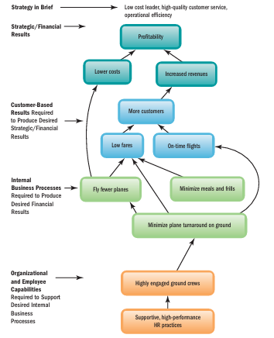
Ch.
Example: Southwest Airlines' strategy map
02
Southwest's strategy map likely outlines a clear connection between its low-cost leader strategy and its operational efficiency.
To achieve its financial goals, the airline must focus on:
Cost reduction: Minimizing expenses through efficient operations and negotiation with suppliers.
Revenue generation: Maximizing load factors (percentage of seats filled) and ancillary revenue (fees for baggage, seat selection, etc.).
Southwest Airlines likely uses a strategy map to visually represent the interconnectedness of its various strategic initiatives
www.midocean.ae

Slide 31
Ch.
Example: Southwest Airlines' strategy map
02
In essence, Southwest's strategy map demonstrates how strong organizational capabilities (e.g., employee engagement) enable efficient internal business processes (e.g., quick turnaround times), which in turn lead to positive customer-based results (e.g., high customer satisfaction and financial performance). This interconnectedness underscores the importance of aligning all aspects of the business to achieve strategic goals.
www.midocean.ae

Slide 32
Ch.
Strategic Human Resource Management Tools
02
2. HR Scorecard
Quantifies Strategic Activities: Assigns financial and non-financial metrics to HR-related activities.
Measures Performance: Tracks progress towards achieving strategic goals.
Example: Southwest Airlines might use metrics like ;
Airplane Turnaround Time:
Definition: The time it takes for an aircraft to disembark passengers, refuel, clean, and reboard passengers for the next flight.
Importance: Faster turnaround times allow airlines to operate more flights per day, increasing revenue and efficiency.
Measurement: Typically measured in minutes, comparing the actual turnaround time to the target or planned time.
www.midocean.ae

Slide 33
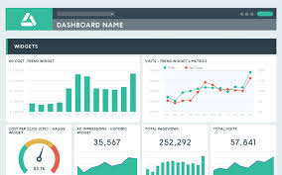
Ch.
Strategic Human Resource Management Tools
02
3. Digital Dashboard
Visualizes Key Performance Indicators (KPIs): Presents real-time data and trends in a visually appealing format.
Enables Proactive Action: Allows managers to identify issues and take corrective measures.
www.midocean.ae

Slide 34
Ch.
Strategic Human Resource Management Tools
02
Digital Dashboard Example
Southwest's digital dashboard would likely display real-time data on various KPIs, including:
On-time performance: Monitors the percentage of flights that arrive and depart on time.
Baggage handling: Tracks the rate of lost or mishandled baggage.
Customer satisfaction: Displays customer satisfaction ratings and feedback.
Employee engagement: Shows employee satisfaction surveys and other metrics related to employee morale and productivity.
www.midocean.ae

Slide 35
Ch.
Evidence-Based HR: A Scientific Approach to Decision Making
02
Evidence-based human resource management (EBHRM) involves making HR decisions based on data, research, and analytics rather than relying solely on intuition or assumptions. It's akin to a scientific approach, where objectivity, experimentation, and evidence are prioritized.
Key Principles of EBHRM:
Objectivity: Gathering data and evidence without bias or preconceived notions.
Experimentation: Conducting controlled experiments to test hypotheses and measure outcomes.
Prediction: Using data and analysis to forecast future trends and outcomes.
www.midocean.ae

Slide 36
Ch.
Evidence-Based HR: A Scientific Approach to Decision Making
02
Benefits of EBHRM:
Improved Decision Making: Data-driven decisions are more likely to be effective and lead to positive outcomes.
Enhanced Credibility: Evidence-based practices enhance the credibility and professionalism of HR functions.
Increased Efficiency: By using data to identify trends and patterns, organizations can streamline processes and allocate resources more effectively.
www.midocean.ae

Slide 37
Ch.
Evidence-Based HR: A Scientific Approach to Decision Making
02
Example: Evaluating the Impact of an Incentive Plan
To assess the effectiveness of a new incentive plan, a company could conduct an experiment by implementing it in a specific department or group of employees (the experimental group) while maintaining the previous incentive plan in a control group.
By comparing the performance outcomes of both groups, the company can determine if the new incentive plan had a significant impact on productivity or other relevant metrics.
www.midocean.ae

Slide 38
Ch.
Conclusion
02
Key Steps in Strategic Management:
Defining the Business and Mission: Organizations must clearly articulate their purpose, values, and core offerings.
Conducting SWOT Analysis: This involves evaluating internal strengths and weaknesses alongside external opportunities and threats to assess the company’s position.
Formulating a New Direction: Establishing a vision statement and translating it into specific, measurable strategic goals.
Developing Action Plans: Creating strategies to achieve these goals with clear action steps.
Implementation: Allocating resources and executing the strategic plan.
Evaluation: Continuously monitoring performance against key metrics to assess effectiveness and make necessary adjustments.
www.midocean.ae

Slide 39
Ch.
Conclusion
02
Types of Strategies discussed include:
Corporate Strategy: Focuses on the overall scope and direction of the company, including concentration, diversification, vertical integration, consolidation, and geographic expansion.
Competitive Strategies: Encompass cost leadership, differentiation, and focus strategies tailored to specific market segments.
Strategic Human Resource Management (SHRM) is presented as a vital component, ensuring that HR policies align with business goals and that the organization has the right talent to succeed. This includes conducting HR audits to assess practices, ensuring compliance, and identifying areas for improvement.
www.midocean.ae

Slide 40
Ch.
Conclusion
02
Through evidence-based HR practices, organizations can make data-driven decisions that enhance credibility and efficiency. The chapter concludes by underscoring the importance of a collaborative approach to strategic planning, involving input from managers at all levels to foster alignment and promote a culture of continuous improvement.
Overall, this chapter serves as a guide for organizations seeking to develop robust strategic management practices that drive success in a competitive landscape.
www.midocean.ae

Slide 41
Week
01
References
Main Reference
Dessler, G. (2011). Human resource management. Thirteenth edition. Pearson International Edition.
Additional Resources for extra reading.
Armstrong, M. (2023). Armstrong's Handbook of Human Resource Management Practice (16th Ed.). Kogan Page.
Noe, R. A., Hollenbeck, J. R., Gerhart, B., & Wright, P. M. (2023). Human Resource Management in Canada (10th Ed.). McGraw-Hill Ryerson.
www.midocean.ae

Slide 42




Thank You

