Slide 1


CPT Coding
Prepared by Dr. Hayat Farag
MHA631
Health Insurance
Lecture 6

Slide 2

Objectives
Understand an Overview of CPT.
Explore CPT Core Components.
Discuss CPT Sections (Evaluation/Management & Surgery).

Slide 3
Chapter
Overview of CPT
06
Current Procedural Terminology (CPT) is published by the American Medical Association (AMA) and includes codes for procedures performed and services provided to patients.
AMA first published CPT in 1966, and subsequent editions expanded its descriptive terms and codes for diagnostic and therapeutic procedures.

Slide 4
Chapter
Overview of CPT
06
CPT is a listing of descriptive terms and identifying codes for reporting medical services and procedures.
It provides a uniform language that describes medical, surgical, and diagnostic services to facilitate communication among providers, patients, and insurers.

Slide 5
Chapter
Overview of CPT
06
Be sure to purchase updated coding manuals to avoid billing delays and claims rejections.
If outdated codes are submitted on claims, providers and healthcare facilities will incur administrative costs associated with resubmitting corrected claims and delayed reimbursement for services provided.

Slide 6
Chapter
Overview of CPT
06
CPT codes are used to report services and procedures performed on patients:
● By providers in offices, clinics, and private homes.
● By providers in institutional settings such as hospitals, nursing facilities, and hospices.
● By a hospital outpatient department (e.g., ambulatory surgery, emergency department, and outpatient laboratory or radiographic procedures).

Slide 7
Chapter
Overview of CPT
06
Procedures and services submitted on a claim must be linked to the ICD-9-CM code that justifies the need for the service or procedure.
That ICD-9-CM code must demonstrate medical necessity for the service or procedure to receive reimbursement consideration by insurance payers.

Slide 8
It is important to remember the familiar phrase “If it wasn’t documented, it wasn’t done.”
It is important to remember the familiar phrase “If it wasn’t documented, it wasn’t done.”
CPT Core Components

Slide 9
Chapter
CPT Guidelines
06
Guidelines are located at the beginning of each CPT section, and should be carefully reviewed before attempting to code.
Guidelines define terms and explain the assignment of codes for procedures and services located in a particular section.

Slide 10
Chapter
Unlisted Procedures/Services
06
An unlisted procedure or unlisted service code is assigned when the provider performs a procedure or service for which there is no CPT code.
When an unlisted procedure or service code is reported, a special report (e.g., copy of procedure report) must accompany the claim to describe the nature, extent, and need for the procedure or service along with the time, effort, and equipment necessary to provide the service.

Slide 11
Chapter
CPT Index
06
The CPT index is organized by alphabetical main terms printed in boldface.
The main terms represent procedures or services, organs, anatomic sites, conditions, eponyms, or abbreviations.
The main term is followed by sub-terms that modify the main term. The sub-terms are followed by additional sub-terms that are indented.

Slide 12
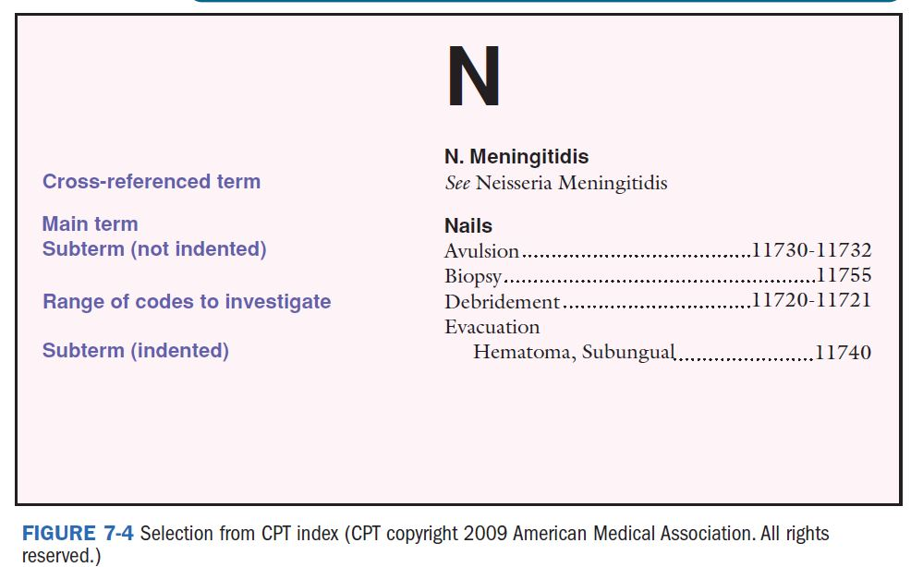
Chapter
CPT Index

Slide 13
Chapter
CPT Modifiers
06
CPT modifiers clarify services and procedures performed by providers.
Although the CPT code and description remain unchanged, modifiers indicate that the description of the service or procedure performed has been altered.
CPT modifiers are reported as two-digit numeric codes added to the five-digit CPT code.

Slide 14
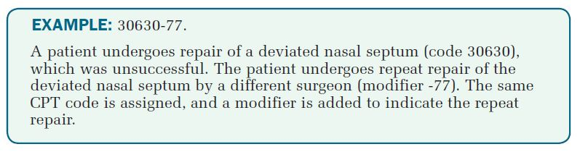
Chapter
CPT Modifiers
06

Slide 15
Chapter
CPT Sections
06
CPT organizes Category I procedures and services within six sections:
● Evaluation and Management (E/M) (99201–99499).
● Anesthesia (00100–01999, 99100–99140).
● Surgery (10021–69990).
● Radiology (70010–79999).
● Pathology and Laboratory (80047–89356).
● Medicine (90281–99199, 99500–99607).

Slide 16
It is important to remember the familiar phrase “If it wasn’t documented, it wasn’t done.”
It is important to remember the familiar phrase “If it wasn’t documented, it wasn’t done.”
Evaluation and Management Section

Slide 17
Chapter
Overview of E/M Section
06
The Evaluation and Management (E/M) section (codes 99201–99499) is located at the beginning of CPT because these codes describe services most frequently provided by physicians.
Accurate assignment of E/M codes is essential to the success of a physician’s practice because most of the revenue generated by the office is based on provision of these services.

Slide 18
Chapter
Overview of E/M Section
06
Most E/M services are cognitive services—this means that the provider must acquire information from the patient, use reasoning skills to process the information, interact with the patient to provide feedback, and respond by creating an appropriate plan of care.
E/M services do not include significant procedural services (e.g., diagnostic tests or surgical procedures), which are coded separately. However, some services that arise directly from the E/M service provided are included (e.g., cleansing traumatic lesions, closing lacerations with adhesive strips, applying dressings, and providing counseling and educational services).

Slide 19
Chapter
Overview of E/M Section
06
Accurate assignment of E/M codes depends on:
(1) identifying the place of service (POS) and/or type of service (TOS) provided to the patient,
(2) determining whether the patient is new or established to the practice,
(3) reviewing the patient’s record for documentation of level of service components,
(4) applying CMS’s Documentation Guidelines for Evaluation and Management Services, and
(5) determining whether E/M guidelines (e.g., unlisted service) apply.

Slide 20
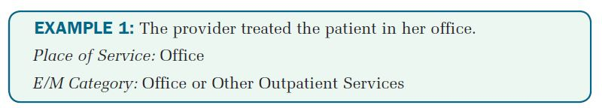
Chapter
Place of Service (POS)
06
Place of service (POS) refers to the physical location where health care is provided to patients (e.g., office or other outpatient settings, hospitals, NFs, home health care, or EDs).

Slide 21
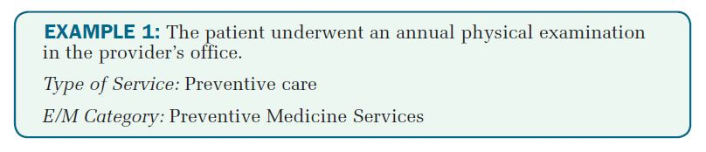
Chapter
Type of Service (TOS)
06
Type of service (TOS) refers to the kind of healthcare services provided to patients. It includes critical care, consultation, initial hospital care, subsequent hospital care, and confirmatory consultation.

Slide 22
Chapter
New and Established Patients
06
A new patient is one who has not received any professional services from the physician, or from another physician of the same specialty who belongs to the same group practice, within the past three years.
An established patient is one who has received professional services from the physician, or from another physician of the same specialty who belongs to the same group practice, within the past three years.

Slide 23
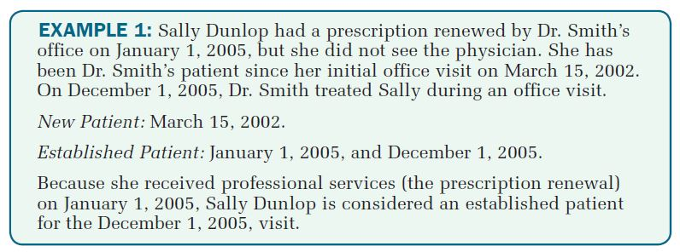
Chapter
New and Established Patients
06

Slide 24
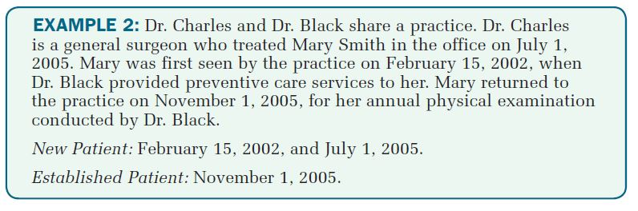
Chapter
New and Established Patients
06

Slide 25
Chapter
Levels of E/M Services
06
Evaluation and management (E/M) categories and subcategories contain codes that are classified according to level of services for reporting to third-party payers.
The levels of E/M services code descriptions include seven components, six of which determine the level of E/M service code to be assigned:
● History
● Examination
● Medical decision making
● Counseling
● Coordination of care
● Nature of presenting problem
● Time

Slide 26
Chapter
Levels of E/M Services
06
The key components of history, examination, and medical decision making are required when selecting an E/M level of service code.
Contributory components include counseling, coordination of care, nature of presenting problem, and time; and they are used to select the appropriate E/M service code when patient record documentation indicates that they were the focus of the visit.

Slide 27
Chapter
Key Components
06
A history is an interview of the patient that includes the following elements: history of present illness (HPI) (including the patient’s chief complaint, CC), a review of systems (ROS), and a past/family/social history (PFSH).
A physical examination is an assessment of the patient’s organ (e.g., extremities) and body systems (e.g., cardiovascular).

Slide 28
Chapter
Key Components
06
Medical decision making refers to the complexity of establishing a diagnosis and/or selecting a management option as measured by the:
● Number of diagnoses or management options.
● Amount and/or complexity of data to be reviewed.
● Risk of complications and/or morbidity or mortality.
The physician is responsible for determining the complexity of medical decision making, and that decision must be supported by documentation in the patient’s chart.

Slide 29
Chapter
Key Components
06
Once the key components for extent of history and examination are determined, the type of medical decision making can be selected as follows:
● Straightforward
● Low complexity
● Moderate complexity
● High complexity
Once the extent of history, extent of examination, and complexity of medical decision making are determined, select the appropriate E/M code.

Slide 30
Chapter
Contributory Components
06
CPT defines counseling as it relates to E/M coding as a discussion with a patient and/or family concerning one or more of the following areas: diagnostic results, and/or recommended diagnostic studies; prognosis; risks and benefits of management (treatment) options; instructions for management (treatment) and/or follow-up; importance of compliance with chosen management (treatment) options; risk factor reduction; patient and family education.

Slide 31
Chapter
Contributory Components
06
Some patients require counseling services (e.g., nutrition instruction, smoking cessation, and weight management) during an E/M visit. If provided, such counseling should be properly documented and the appropriate level of E/M code selected.
Coordination of Care is when the physician makes arrangements with other providers or agencies for services to be provided to a patient.

Slide 32
Chapter
Contributory Components
06
Moderate severity,
High severity.
CPT defines nature of the presenting problem as “a disease, condition, illness, injury, symptom, sign, finding, complaint, or other reason for the encounter, with or without a diagnosis being established at the time of the encounter.”
Five types of presenting problems are recognized:
Minimal,
Self-limited or minor,
Low severity,

Slide 33
Chapter
Contributory Components
06
Time (Face-to-Face versus Unit/Floor)
Face-to-face time is the amount of time the office or outpatient care provider spends with the patient and/or family.
Unit/floor time is the amount of time the provider spends at the patient’s bedside and at management of the patient’s care on the unit or floor (e.g., writing orders for diagnostic tests or reviewing test results). Unit/floor time applies to inpatient hospital care, hospital observation care, initial and follow-up inpatient hospital consultations, and nursing facility services.

Slide 34
Chapter
06
Although the key components of history, examination, and medical decision making usually determine the E/M code, visits consisting predominantly of counseling and/or coordination of care are the exception.
When the physician spends more than 50 percent of the encounter providing counseling and/or coordination of care, it is considered dominant and can be considered a key factor in selecting a particular E/M code. The extent of counseling must be documented in the patient’s chart to support the E/M code selected.

Slide 35
It is important to remember the familiar phrase “If it wasn’t documented, it wasn’t done.”
It is important to remember the familiar phrase “If it wasn’t documented, it wasn’t done.”
Surgery Section

Slide 36
Chapter
Surgery Section
06
Coders must be aware that unbundling is not allowed; unbundling means assigning multiple codes to procedures/services when just one comprehensive code should be reported.
Unbundling occurs when a code for the separate surgical approach (e.g., laparotomy) is reported in addition to a code for the surgical procedure. Procedures performed to gain access to an area or organ system are not separately reported.

Slide 37
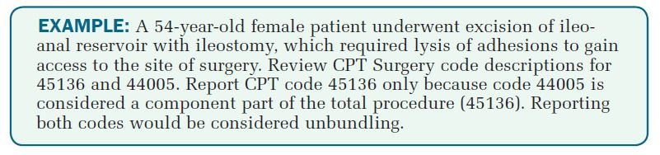
Chapter
Surgery Section
06

Slide 38
Chapter
Multiple Surgical Procedures
06
Great care must be taken when billing multiple surgical procedures (two or more surgeries performed during the same operative session). The major surgical procedure (the procedure reimbursed at the highest level) should be reported first on the claim, and the lesser surgeries listed on the claim in descending order of expense.
The ranking into major and minor procedures is done to accommodate the fact that most insurance companies will reduce the fee for the second surgery by 50 percent of the regular fee and for the third, fourth, and so on, by 50 to 75 percent. If a lesser procedure is listed first, it may be paid at 100 percent and the major or most expensive surgery reduced by 50 to 75 percent, resulting in a lower payment for the combined surgeries.

Slide 39

Chapter
Key Takeaways
06
Current Procedural Terminology (CPT) is published by the American Medical Association (AMA) in 1966 and includes codes for procedures performed and services provided to patients.
CPT codes are used to report services and procedures performed on patients in various settings.
The Evaluation and Management (E/M) section is located at the beginning of CPT because these codes describe services most frequently provided by physicians.
Regarding surgery section: * unbundling is not allowed, * great care must be taken when billing multiple surgical procedures.

Slide 40



Thank You

