Slide 1



Business Data Analysis
MGM509
Lecture 10
Advanced Techniques, Analytical Engineering, and Growing Trends in Data Science
Prepared by
Eng. Ahmed Hussein, MBA, PfMP©, PMP©, CMP APMG

Slide 2

Lecture
What we will cover
10
Other Data Science Tasks and Techniques
Analytical Engineering
Trends in Business Data Analytics
10 – 2

Slide 3


Other Data Science Tasks and Techniques
Lecture
10
10 – 3

Slide 4
Lecture
Overview of Broader DS Tasks
10
Not all data science tasks are classification, clustering or regression.
Many problems focus on understanding structure, group behavior, or novelty.
Other valuable methods:
Co-occurrence grouping
Profiling
Link prediction
Casual Inference
Latent Information Discovery
10 – 4

Slide 5
Lecture
Co-Occurrence Grouping
10
Identifies items or events that tend to appear together in data, revealing meaningful associations or patterns.
When two or more elements (e.g., words, products, events) frequently appear together in the same context (e.g., document, transaction, session).
Classic examples:
  Market basket analysis (e.g., “customers who bought X also bought Y”)
  Text mining (e.g., identifying topic-related word pairs)
  Recommendation systems
Uses association rules (e.g., Apriori algorithm).
Applied in retail, recommendations, and content bundling.
10 – 5

Slide 6
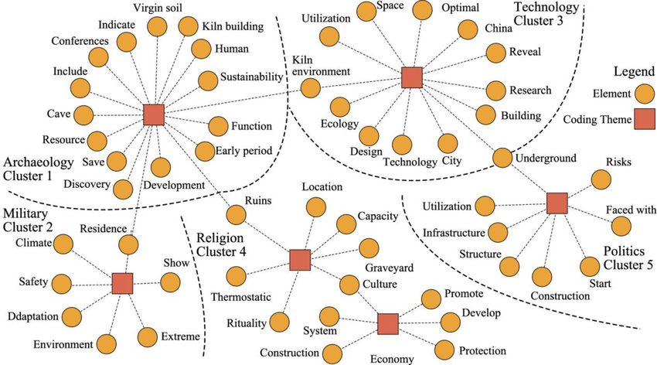
Lecture
Co-Occurrence Grouping
10
Techniques Used:
  Association Rule Mining: e.g., Apriori, FP-Growth
  Pointwise Mutual Information (PMI): for text
  Co-occurrence matrices and heatmaps
Insights Provided:
  Uncover latent relationships or groupings
  Support feature engineering and similarity detection
  Drive personalization and targeting strategies
10 – 6

Slide 7
Lecture
Profiling - Summarizing Behavior
10
Profiling involves creating a summarized representation of an individual, group, or entity’s behavior.
Uses statistical and categorical features to describe users/customers (e.g., average purchase value, churn rate, visit frequency).
Group entities with similar behavior (e.g., “frequent buyers,” “inactive users,” “deal seekers”).
Personalization and Targeting: Profiles inform tailored recommendations, offers, or communications.
10 – 7

Slide 8
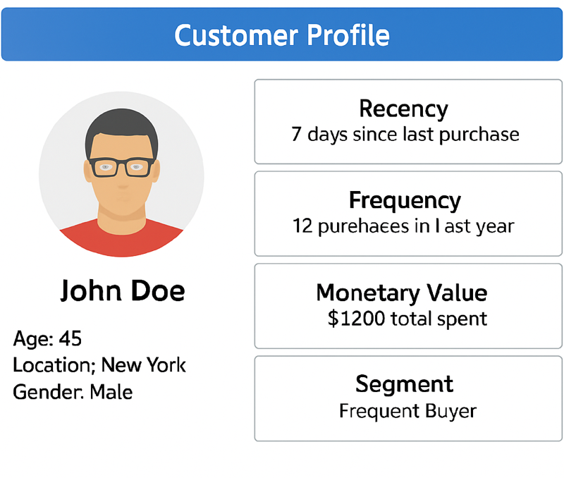
Lecture
Profiling - Summarizing Behavior
10
Use Cases:
  Customer relationship management (CRM)
  Fraud detection
  Risk profiling in finance
  Patient behavior tracking in healthcare
Techniques Involved:
  Aggregation (sums, averages, frequencies)
  Clustering (e.g., K-Means for customer segments)
  Feature extraction (e.g., recency, frequency, monetary value – RFM)
10 – 8

Slide 9
Lecture
Link Prediction
10
Predicts whether a connection (link) between two entities in a network should exist or will exist in the future.
Common in social networks, e-commerce, and citation analysis.
Example: Suggesting new friends on Facebook.
Common Techniques:
Heuristic-Based Common Neighbors, Jaccard Coefficient, Preferential Attachment
Embedding-Based
Node2Vec, DeepWalk, Graph Neural Networks (GNNs)
Matrix Factorization
Decompose adjacency matrix to predict unseen links
10 – 9

Slide 10
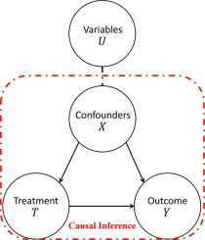
Lecture
Causal Inference
10
Determines whether and how one variable causes a change in another, not just whether they are correlated.
Moves beyond correlation to explain and predict interventions
Helps make strategic business decisions (e.g., “Did the ad campaign cause increased sales?”)
Essential in policy-making, medicine, economics, and A/B testing.
Techniques:
  Randomized Controlled Trials (RCTs):
  Observational Methods: Propensity Score Matching. Difference-in-Differences. Instrumental Variables, Causal Graphs (e.g., DAGs)
10 – 10

Slide 11
Lecture
Latent Information Discovery
10
Process of uncovering hidden patterns, structures, or relationships in data that are not immediately observable.
Reveals underlying drivers of behavior (e.g., user intent, hidden topics)
Supports personalization, clustering, and dimensionality reduction
Useful in NLP, marketing, and content analytics.
10 – 11

Slide 12
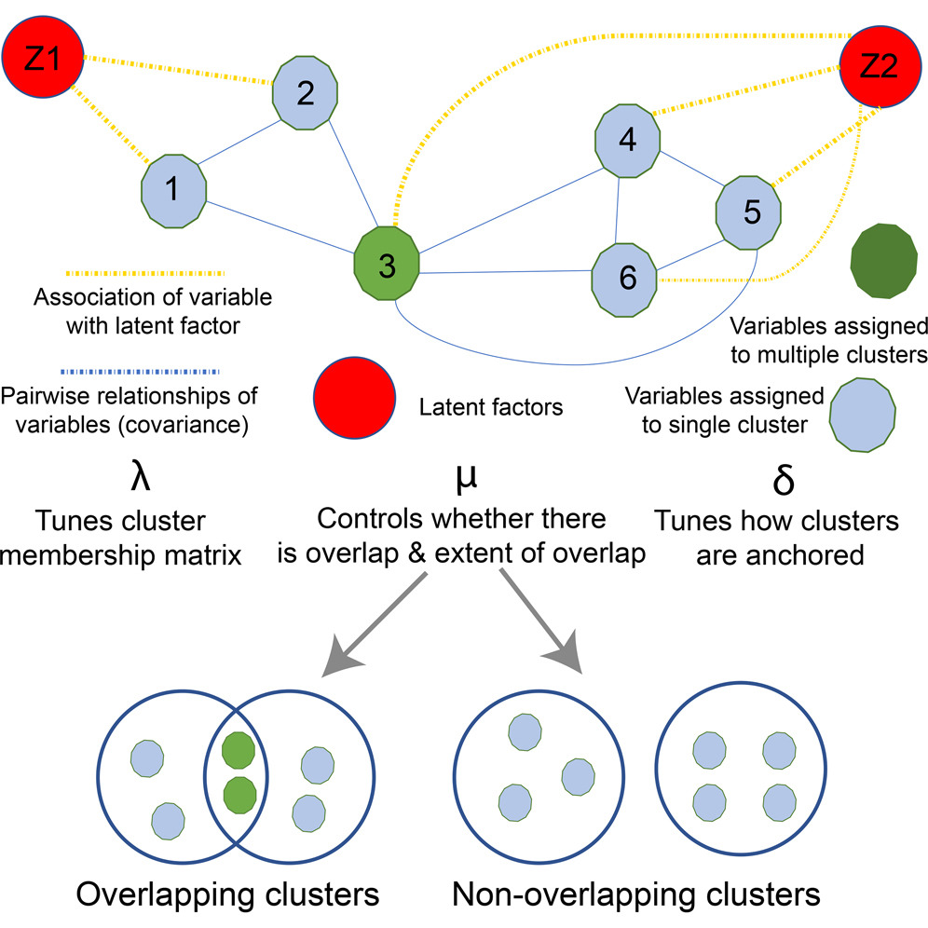
Lecture
Latent Information Discovery Techniques
10
Topic Modeling (e.g., LDA): Discover abstract topics in a collection of documents
Matrix Factorization (e.g., SVD, NMF): Used in recommender systems to uncover user preferences and product features
Embedding Models: Capture latent semantic meanings in text (e.g., Word2Vec, BERT)
Autoencoders / Deep Learning: Reduce dimensions and extract features from images, text, or tabular data
10 – 12

Slide 13
Lecture
Choosing the Right Task
10
Business Goal: What are you trying to improve or predict?
Data Type: Is the data labeled? Structured? Textual?
Desired Output: Category, number, group, pattern?
Interpretability Needs: Will decisions be audited or explained?
Deployment Context: Real-time vs. batch processing?
10 – 13

Slide 14
Lecture
Analytical Engineering
10
10 – 14

Slide 15
Lecture
From Ad Hoc to Engineering
10
Many data science projects are ad hoc, not reusable or scalable.
Analytical engineering aims to make data science solutions systematic and repeatable.
Think in terms of pipelines, standards, and operations.
Move from one-off insights to embedded decision systems.
10 – 15

Slide 16
Lecture
What is Analytical Engineering
10
Definition: Analytical Engineering is the design, implementation, and integration of data-driven solutions into operational systems that support real-world decision-making.
Key Characteristics:
System-Oriented Thinking
Focuses on building end-to-end analytical pipelines that connect data inputs to decision outputs.
Combines Logic + Prediction
Merges business rules with predictive models to automate or enhance decisions.
Operational Integration
Ensures that models and logic are embedded into business workflows, not left on the shelf.
Built for Scale and Sustainability
Prioritizes reliability, maintainability, and performance in real-world conditions (e.g., APIs, dashboards, alerts).
10 – 16

Slide 17
Lecture
Elements of Analytical Engineering
10
Input data pipelines: Clean, structured, timely data.
Decision logic integration: Rule-based + predictive.
Feedback loops: Capture outcomes and retrain.
Evaluation metrics: Tie model performance to business KPIs.
10 – 17

Slide 18
Principles of Decision-Centric
View of Modeling
Lecture
10
Start with the Decision
1
Clearly define the decision the model will inform (e.g., approve loan, target customer with offer).
Align Metrics with Impact
2
Evaluate models based on how they improve decision outcomes, not only accuracy.
Integrate with Business Processes
3
Ensure model outputs are actionable and embedded into workflows.
Balance Complexity vs. Usability
4
A slightly less accurate but easier-to-use model may be more valuable.
Consider Costs and Payoffs
5
Account for the economic or strategic consequences of correct vs. incorrect predictions.
10 – 18

Slide 19
Lecture
Modeling for Business Constraints
10
Designing predictive models that align with operational, financial, legal, and strategic limitations of the business.
Ensures that models are realistic, implementable, and cost-effective
Financial
Optimize for maximum ROI, balancing model accuracy with cost of action.
Operational
Model predictions must fit within available resources (e.g., only 500 customer service calls possible per week).
Regulatory & Ethical
Comply with privacy laws, fairness, and non-discrimination guidelines.
Strategic
Ensure that models align with the organization’s long-term vision, market positioning, and growth priorities,
10 – 19

Slide 20
Lecture
Operationalizing Data Science
10
The process of deploying, integrating, and managing data science models in real-world business environments.
Focuses on turning analytical insights into repeatable, scalable, and actionable outcomes
Key Steps:
Model Deployment
Integrate models into production systems, APIs, or applications for real-time or batch use.
Workflow Integration
Embed predictions into existing business processes and decision-making workflows.
Monitoring & Maintenance
Continuously track model performance, drift, and accuracy over time.
Feedback Loops
Collect outcome data to retrain and improve models for evolving conditions.
Governance & Compliance
Maintain documentation, audit trails, and controls to meet regulatory and business standards.
10 – 20

Slide 21
Lecture
Managing Uncertainty in Practice
10
All predictions and decisions are made with imperfect information.
Key Approaches:
Quantify Uncertainty
Use confidence intervals, probability distributions, or scenario ranges to represent prediction reliability.
Sensitivity Analysis
Test how changes in input variables affect outcomes to identify high-impact factors.
Scenario Planning
Develop “best-case,” “worst-case,” and “most likely” projections for decision-making.
Threshold Adjustment
Adapt decision thresholds based on business risk tolerance (e.g., fraud detection sensitivity).
Continuous Monitoring
Reassess uncertainty as new data arrives or market conditions shift.
10 – 21

Slide 22
Lecture
Managing Uncertainty in Practice
10
Example:
In loan approval modeling, a predicted default probability of 8% ± 3% may require different action than a precise 8%—uncertainty affects risk strategy
10 – 22

Slide 23
Lecture
Feedback Loops & Continuous Learning
10
Data science models degrade over time due to changes in data, behavior, or the market (data drift).
Feedback loops enable models to adapt and improve continuously.
Key Components:
Performance Monitoring
Track KPIs (e.g., accuracy, precision, ROI) in production.
Error Analysis
Identify misclassifications or poor predictions to guide retraining.
Data Refresh
Incorporate new, relevant data into model updates.
Model Retraining
Schedule regular or trigger-based retraining cycles.
Automated Pipelines
Use MLOps tools to automate feedback collection and model updates.
10 – 23

Slide 24
Lecture
Case Example – Targeted Marketing System
10
A telecom company wants to increase customer retention and boost upsell conversions.
Approach:
Data Collection
Customer demographics, purchase history, service usage, support interactions.
Segmentation
Cluster customers into groups (e.g., price-sensitive, high-value, at-risk).
Predictive Modeling
Use machine learning (e.g., logistic regression, random forest) to predict likelihood of purchase or churn.
Campaign Optimization
Match offers to segments (e.g., discounts for price-sensitive, premium features for high-value).
A/B Testing & Feedback
Test campaign versions, measure performance, and refine targeting rules.
10 – 24

Slide 25
Trends in Business Data Analytics
Lecture
10
10 – 25

Slide 26
Why Business Data Analysis Is
Transforming Organizations?
Lecture
10
Data is now a core strategic asset
Decisions increasingly depend on insights, not intuition
Explosion of enterprise data from apps, IoT, and digital systems
Analysts play a critical role in converting raw data → business outcomes
10 – 26

Slide 27
Lecture
1. AI-Driven Analytics & Automation
10
Rapid adoption of machine learning for forecasting and pattern detection
Automated insight generation through AI copilots and agents
Natural language querying (“ask the data”) democratizes data access
Analysts evolve into AI-assisted decision partners
10 – 27

Slide 28
2. Self-Service Analytics for Business Teams
Lecture
10
Growing use of tools like Power BI, Tableau, and Qlik
Non-technical users explore data independently
Analysts shift from report builders → data enablers and governance stewards
Increased focus on data literacy across departments
10 – 28

Slide 29
Lecture
3. Real-Time & Streaming Data
10
Increased demand for real-time dashboards and alerts
Use cases include customer behavior monitoring, fraud detection, operations tracking
Organizations move from monthly reports → instant insights
Technologies: event streaming platforms, APIs, IoT data hubs
10 – 29

Slide 30
Lecture
4. Data Governance, Quality, & Ethics
10
Stronger focus on data ownership, privacy, and lineage
Rise of enterprise data catalogs and governance frameworks
Analysts contribute to ethical data use and model transparency
High-quality data becomes a competitive differentiator
10 – 30

Slide 31
Lecture
5. Predictive & Prescriptive Analytics
10
Shift from “What happened?” → “What will happen?” → “What should we do?”
Adoption of predictive models to forecast risks, demand, churn, and performance
Prescriptive analytics recommends decisions based on optimization models
Expanding need for analysts who understand statistics + business context
10 – 31

Slide 32
Lecture
6. Cloud Analytics & Data Platforms
10
Migration from on-premise systems to cloud platforms (Azure, AWS, Google Cloud)
Use of cloud data warehouses/lakes (Snowflake, BigQuery, Databricks)
Scalable computing enables deeper analysis on massive datasets
Analysts work more closely with data engineers and architects
10 – 32

Slide 33
7. Data Storytelling & Visual Communication
Lecture
10
Insight is useless if not understood
Growing emphasis on:
Analysts become storytellers who influence business decisions
Narrative-driven dashboards
Data visualization best practices
Executive-ready insight summaries
10 – 33

Slide 34
8. Integration of BI with Enterprise Systems
Lecture
10
Connected analytics across ERP, CRM, HRIS, and project systems
Unified data layers for end-to-end visibility
Business analysts leverage cross-system insights to identify:
Rise of “enterprise data fabric” architectures
Revenue leakages
Operational inefficiencies
Customer behavior patterns
10 – 34

Slide 35
9. Low-Code / No-Code Data Applications
Lecture
10
Tools like PowerApps, Alteryx, Knime, AppSheet, and Orange Data Mining enable analysts to build solutions
Faster prototyping of dashboards and workflow automations
Reduces dependency on engineering teams
Analysts act as citizen developers augmenting business processes
10 – 35

Slide 36
10. Data Monetization & Value Realization
Lecture
10
Organizations turning data into revenue streams
Models include:
Analysts quantify business value of data through KPIs and ROI models
Increased focus on data-as-a-product (DaaP)
Selling analytics products
Benchmarking services
API-driven data access
10 – 36

Slide 37
11. Scenario Planning & Simulation Modeling
Lecture
10
Use of “What-if” models for forecasting financial and operational outcomes
Decision modelling to evaluate alternative strategies
Popular in risk management, supply chain, and resource planning
Analysts adopt tools like Power BI parameters, Monte Carlo simulations, and simulation engines
10 – 37

Slide 38
12. Rise of the Analytics Center of Excellence (CoE)
Lecture
10
Organizations centralize analytics talent, processes, and standards
CoEs deliver:
Analysts benefit from structured training, templates, and reusable data assets
Standard dashboards
Data governance frameworks
Technology roadmaps
10 – 38

Slide 39
13. Human + AI Collaboration Becomes the Norm
Lecture
10
Analysts use AI as a partner for:
  Data preparation
  Forecasting
  Insight generation
  Visualization
Human expertise ensures context, ethics, and business relevance
Future analysts are AI-augmented decision makers
10 – 39

Slide 40
Lecture
The Future Business Data Analyst
10
As Business Data Analysis continues to evolve into a strategic, insight-driven discipline essential for competitive advantage, The Key competencies shaping the next-generation analyst are:
  AI and machine learning literacy
  Advanced analytics + business acumen
  Mastery of visualization and insight storytelling
  Ethical and responsible data use
  Ability to translate data into measurable business value
10 – 40

Slide 41
Lecture
Key Points
10
Data science covers diverse tasks beyond basic modeling, such as profiling, link prediction, and causal inference.
Analytical engineering integrates scalable, reliable models into operations.
Decision-centric models deliver actionable outputs, not just predictions.
Data Science is growing and integrating into every business area.
As Human and AI collaboration is growing, Data Analysts need to develop in technicalities, visualization and storytelling, and understand AI governance and ethics.
10 – 41

Slide 42

For Discussion Panel and Next Lecture:
Chapters 11, 12, and 13 in Text Book ”Business Data Analysis”
Lecture
10
For Discussion Panel and Next Lecture
10 – 42

Slide 43



Thank You

