Slide 1


Final Project-1
Orientation Day
MGM 496-PMG496
Introduction
Prepared by
Dr. Mona Moustafa Elashry
www.midocean.ae

Slide 2

Lecture Outline
About The Instructor
Course Description
Course Objectives
Learning Outcomes
Assessment Method
Project Delivery
Delivery Schedule
Project Delivery Rules
Attendance
Student Guide. Pdf.
Interactive Technology
www.midocean.ae

Slide 3

About The Instructor
www.midocean.ae
www.midocean.ae

Slide 4
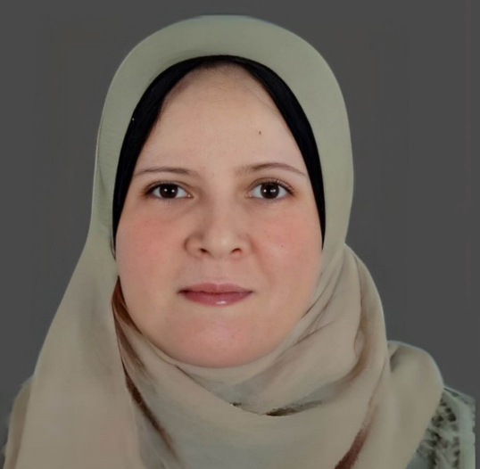
Education:
Doctorate of Business Administration2021
Master of Business Administration 2016
Postgraduate Diploma in Business Administration 2011
Bachelor degree in Economics 1999
Experiences:
Teaching different courses in management
Teaching research methodology & Statistical Analysis
Name: Dr. Mona Mostafa Elashry
Nationality: Egyptian
www.midocean.ae
www.midocean.ae

Slide 5
Course Description
www.midocean.ae
www.midocean.ae

Slide 6
This course is designed for senior-level students pursuing a Bachelor's degree in faculty of Management.
The course focuses on developing the skills necessary to write effective research proposals in their chosen area of study.
Through a series of 10 lectures, students will learn the fundamental elements of a research proposal, including the objectives, methodology, literature review, and ethical considerations.
www.midocean.ae

Slide 7
Course Objectives
www.midocean.ae
www.midocean.ae

Slide 8
By the end of this course, students will be able to:
Understand the purpose and significance of writing a research proposal.
Identify and evaluate appropriate research topics in their field of study.
Conduct a thorough literature review and critically analyze existing research.
Develop a research question and hypothesis.
Create a research methodology and timeline.
Uphold ethical standards in research.
Demonstrate effective academic writing and communication skills in the research proposal.
www.midocean.ae

Slide 9
Course Outcome
www.midocean.ae
www.midocean.ae

Slide 10
Upon completion of this course, students will have the skills and knowledge necessary to write a comprehensive and well-structured research proposal.
They will understand the importance of conducting research in their field of study and demonstrate proficiency in choosing relevant research topics, conducting literature reviews, formulating research objectives and questions, developing a research methodology, and writing effectively.
www.midocean.ae

Slide 11
Assessment Method
www.midocean.ae
www.midocean.ae

Slide 12
Students will be assessed through a certain number of assignments that they will be given during the semester.
The student must submit 3 required assignments during the semester, starting from the 4th week until the 11th week.
www.midocean.ae

Slide 13
Individual Work:
Every student will be required to write and deliver all assignments individually; there will not be group assignments.
www.midocean.ae

Slide 14
Project Delivery
www.midocean.ae
www.midocean.ae

Slide 15
Starting from week 4 student will be asked to submit the required assignments
Students will be asked to deliver 3 submissions for the project.
www.midocean.ae

Slide 16
Delivery Schedule
www.midocean.ae

Slide 18
Assignment 1
Delivered in week 4
Assignment 2
Delivered in week 8
Assignment 3
Delivered in week 11
NF-Failed

Slide 19
Assignment 1
Delivered in week 4
Assignment 2
Delivered in week 8
Assignment 3
Delivered in week 11
NP-Pass

Slide 20
Assignment 1
Delivered in week 4
Assignment 2
Delivered in week 8
Assignment 3
Delivered in week 11
NP-Pass

Slide 21
Assignment 1
Delivered in week 4
Assignment 2
Delivered in week 8
Assignment 3
Delivered in week 11
NP-Pass

Slide 22
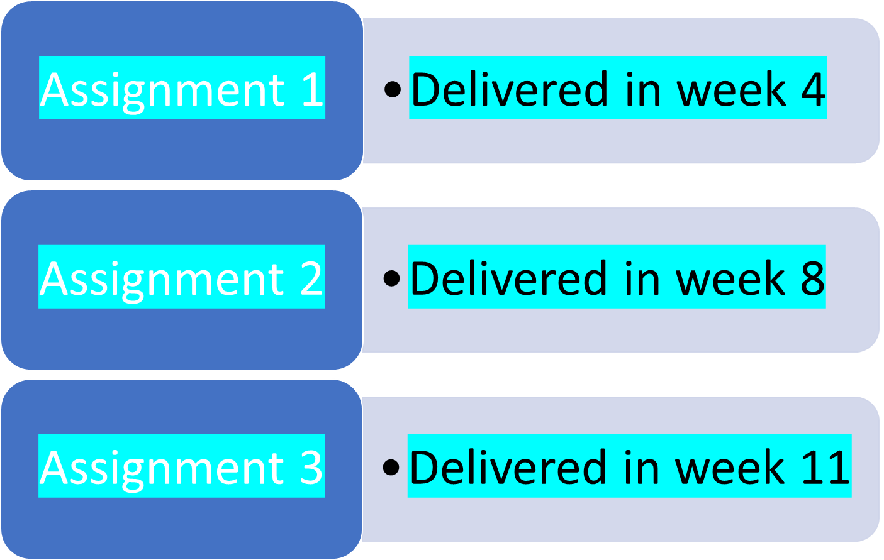
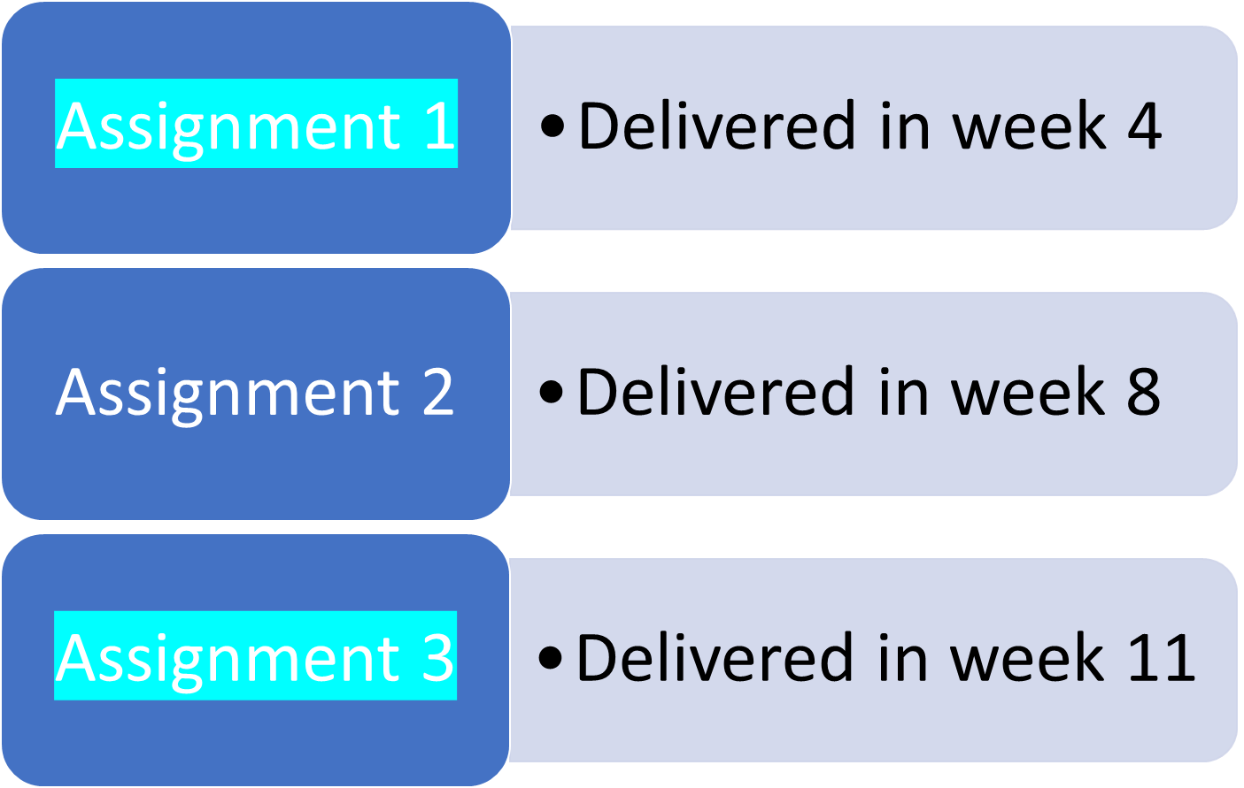
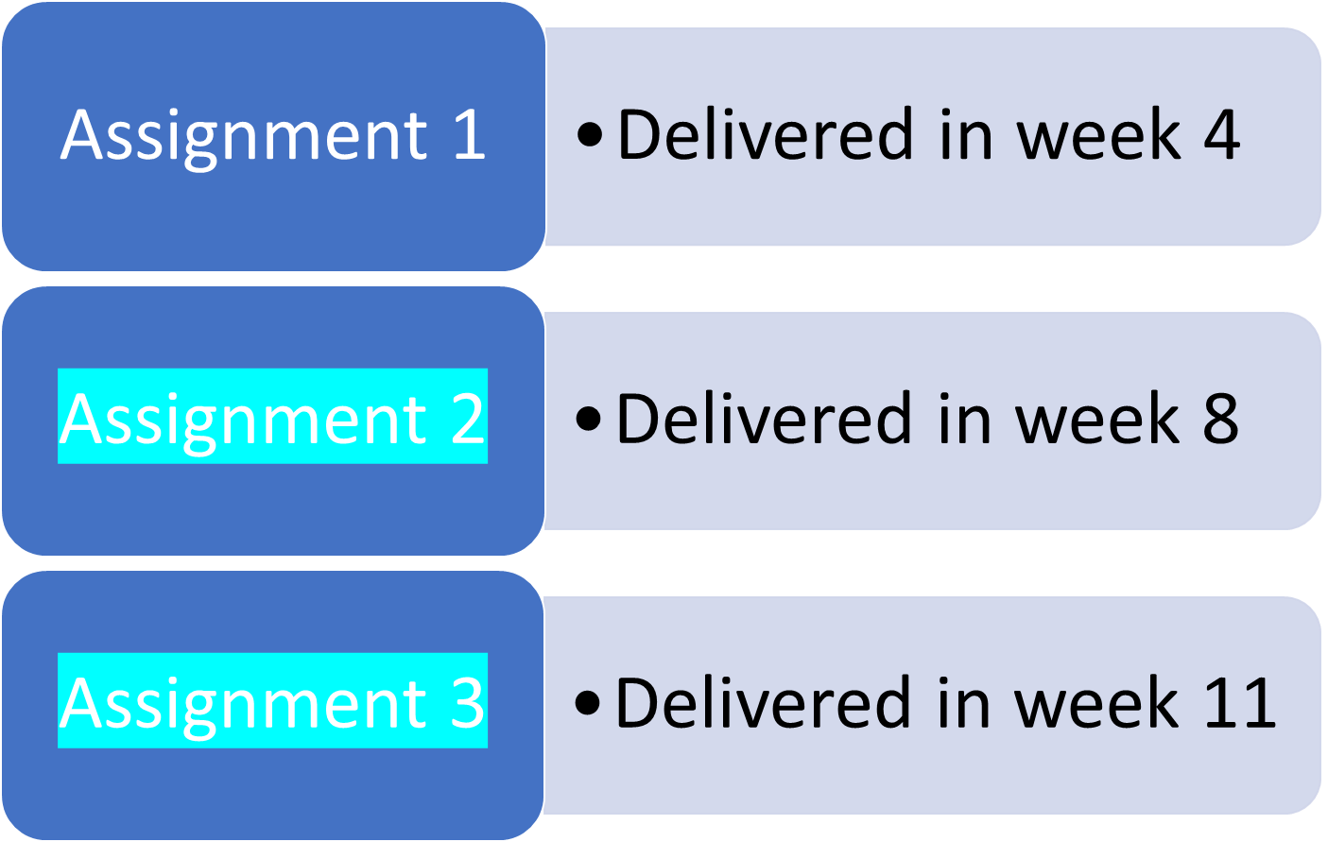
Pass

Slide 23
To ensure the student's success, they should do one of the following:
1. Submit all the three assignments
2. Submit the first and third assignments,
3. Submit the second and third assignments.
It is highly recommended to submit all three assignments
www.midocean.ae

Slide 24
Attendance
www.midocean.ae
www.midocean.ae

Slide 25
Students are required to watch all the recorded lectures.
While it may not be mandatory for students to attend online lectures, it is still extremely important for them to do so in order to gain a complete understanding of the course material and to engage with the learning process.
Attending lectures can help students grasp important concepts, participate in discussions, and receive valuable clarification from the instructors
www.midocean.ae

Slide 26
Project Delivery Rules
www.midocean.ae
www.midocean.ae

Slide 27
All projects should follow the academic writing characteristics which are:
Planned and focused: Delivering research according to the guidance of the scientific research methodologies.
Structured: is coherent, written in scientific research methodologies, and brings together related points and material.
Evidenced: demonstrates knowledge of the scientific research steps, supports opinions and arguments with evidence, and is referenced accurately.
Formal in tone and style: uses appropriate scientific language and tenses and is clear, concise, and balanced.
www.midocean.ae

Slide 28
Interactive Technology
www.midocean.ae

Slide 29

Online Lecture
https://padlet.com/
www.midocean.ae

Slide 30

Online Lecture
https://www.mentimeter.com/
https://www.menti.com/
www.midocean.ae

Slide 31
Student Guide. Pdf.
www.midocean.ae

Slide 32



Thank You

