Slide 1

CCNA - Introduction to Networks v7.0 (ITN)
Prepared by Dr. Abdelrhman Ahmed
Lecture 3
Module 5: Number Systems

Slide 2
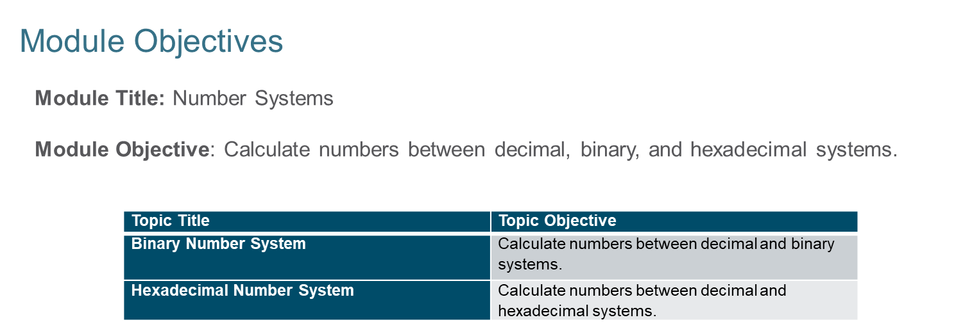

Chapter 3
Number Systems

Slide 3
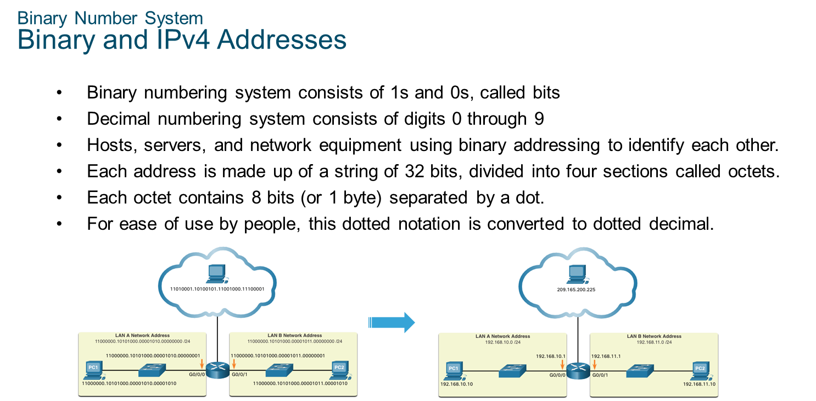
Chapter 3
Binary Number System

Slide 4
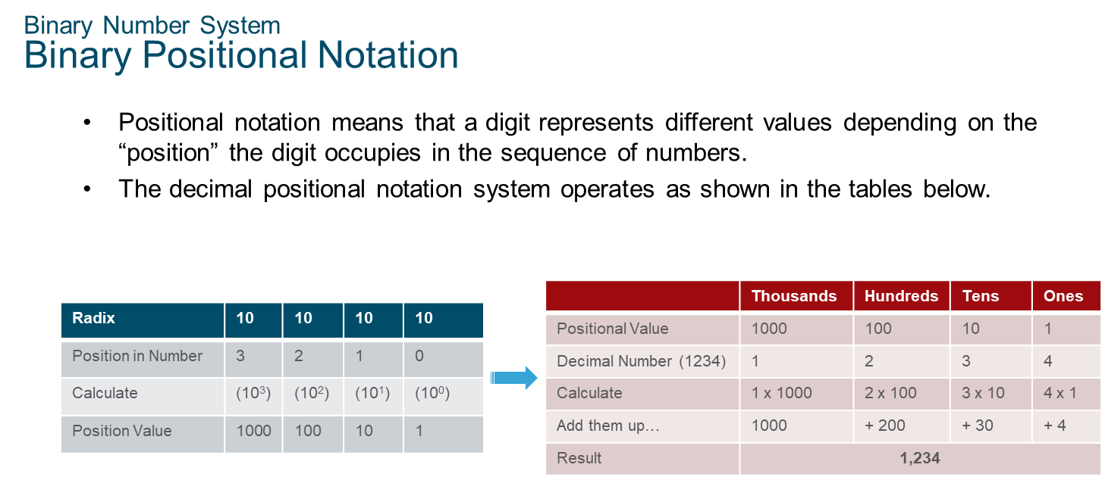
Chapter 3
Binary Number System

Slide 5
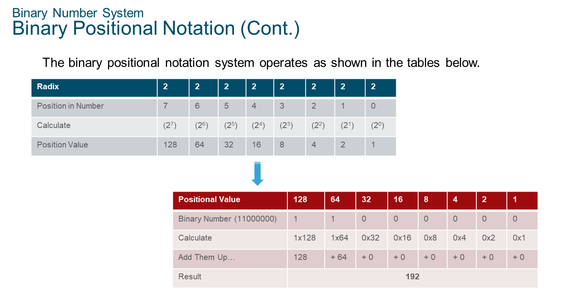
Chapter 3
Binary Number System

Slide 6
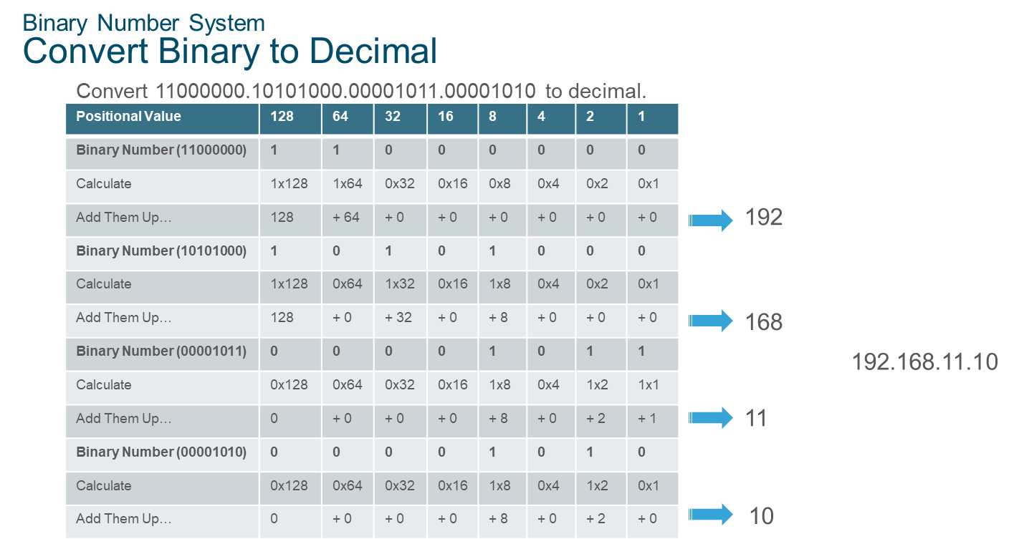
Chapter 3
Binary Number System

Slide 7
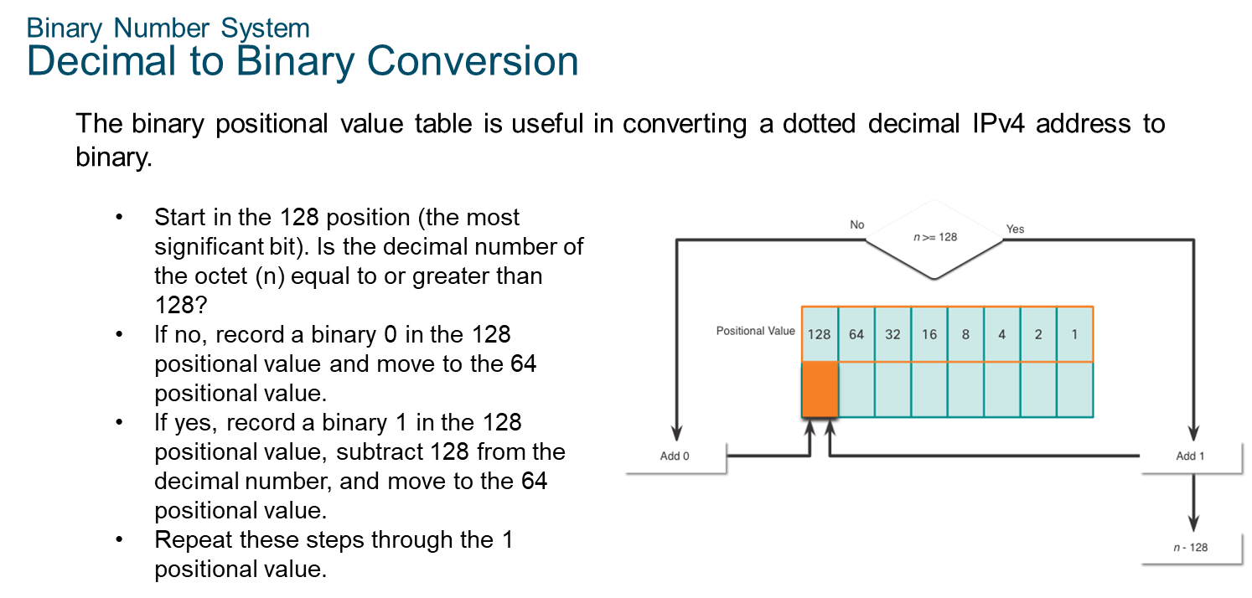
Chapter 3
Binary Number System

Slide 8
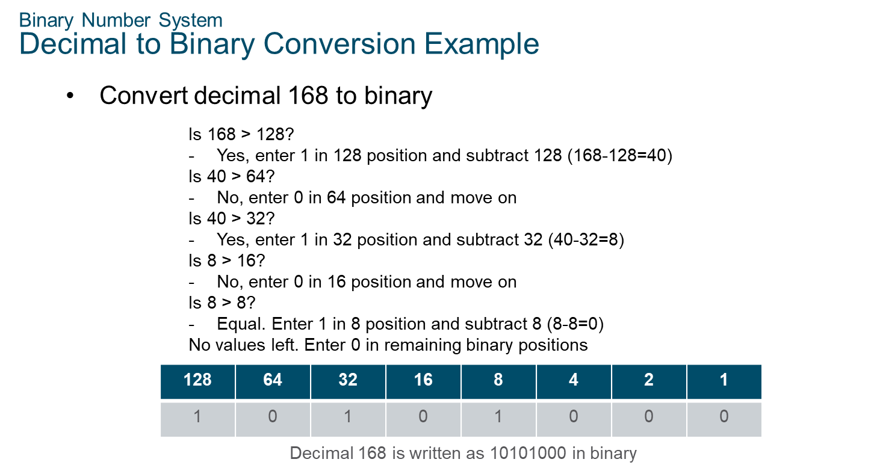
Chapter 3
Binary Number System

Slide 9
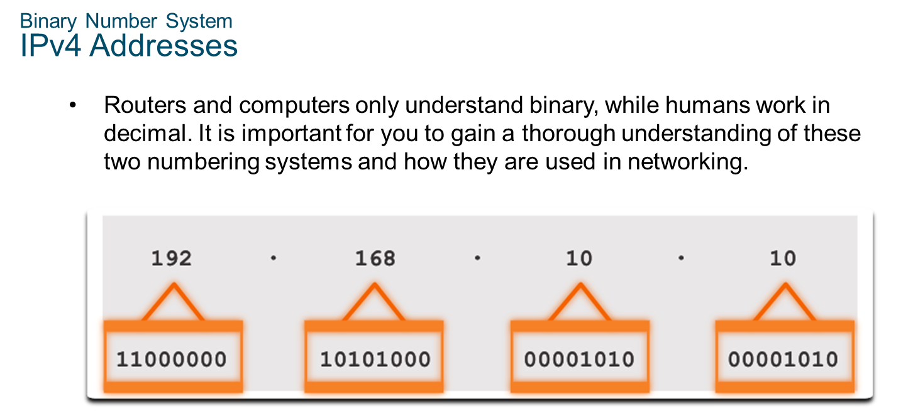
Chapter 3
Binary Number System

Slide 10
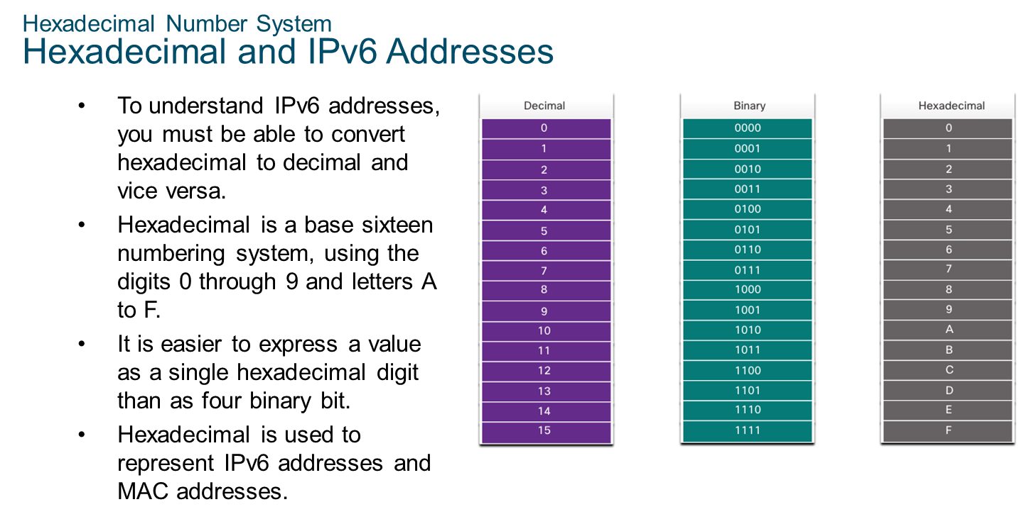
Chapter 3
Hexadecimal Number System

Slide 11
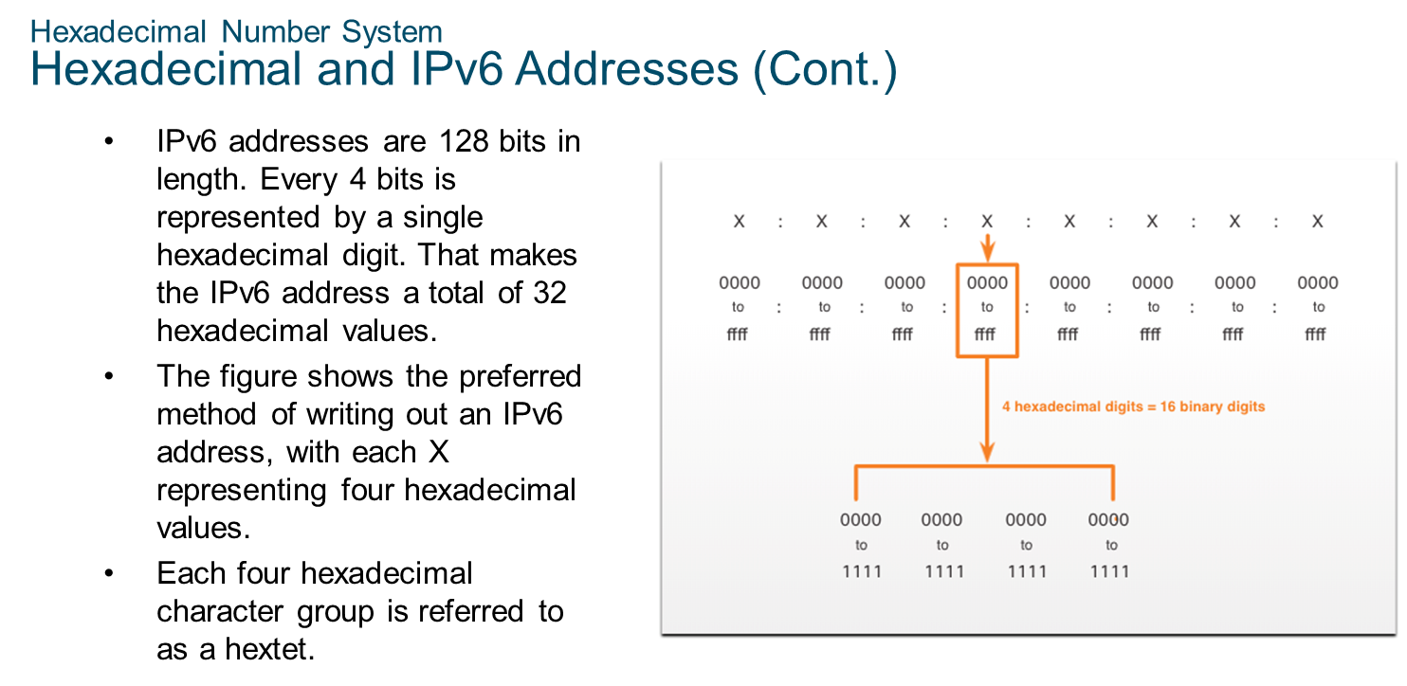
Chapter 3
Hexadecimal Number System

Slide 12
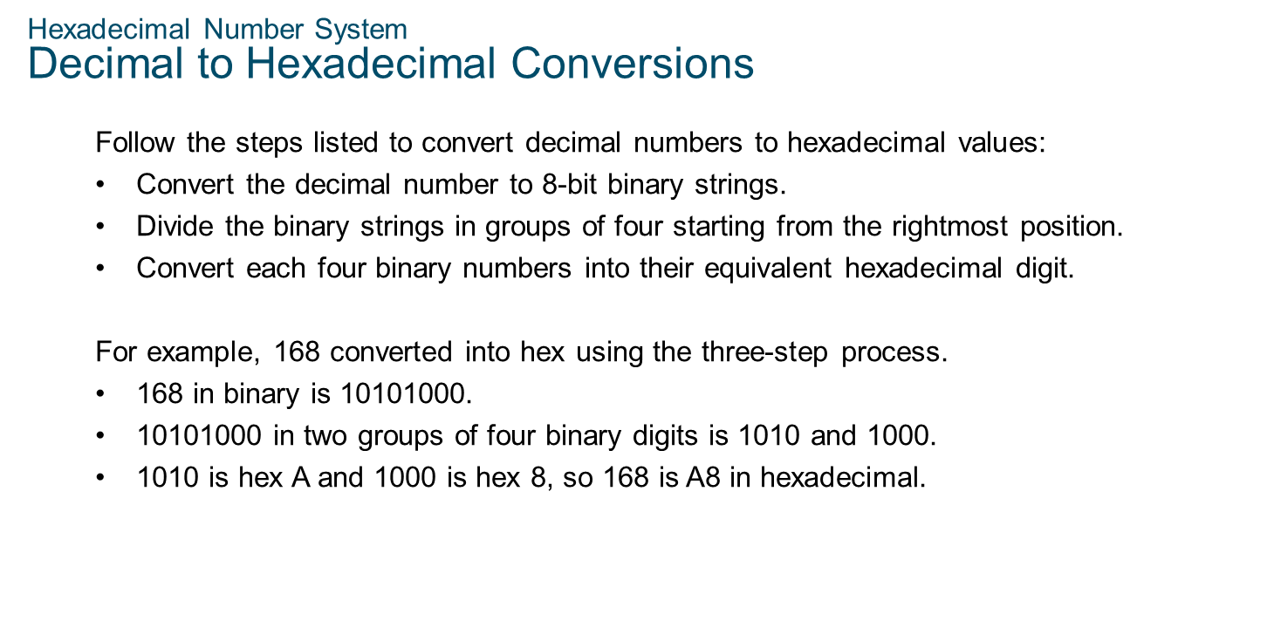
Chapter 3
Hexadecimal Number System

Slide 13
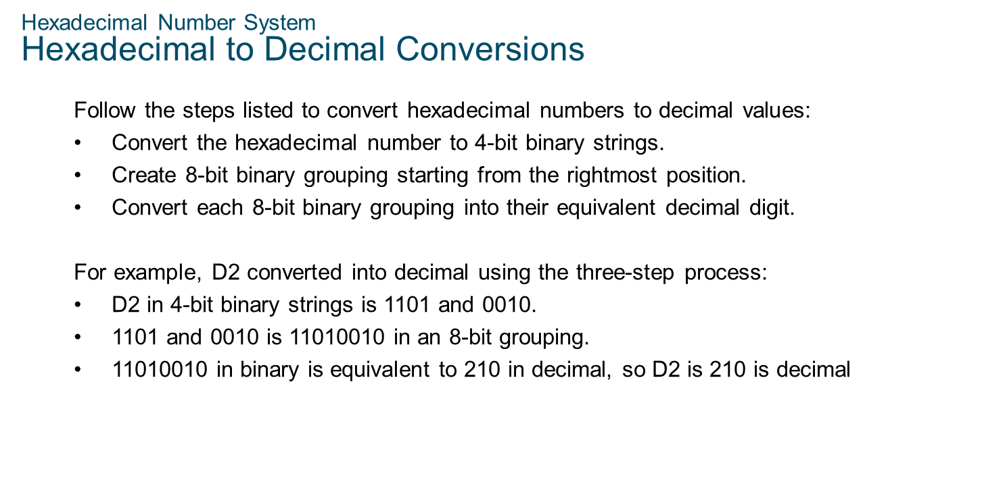
Chapter 3
Hexadecimal Number System

Slide 14


