Slide 1

Hybrid approach to Sales Forecasting Using Prophet and Deep Learning
Othman Omar Alamoudi
Supervisor: Dr. Wesam Ahmed

Slide 2
Agenda
Introduction and Background
Contributions
Related Work
Methodology
Results and Analysis
Conclusion and Future Work
References

Slide 3
INTRODUCTION AND BACKGROUND
Sales forecasting plays a vital role in retail decision-making, inventory control, and supply chain planning
Traditional statistical forecasting models primarily capture linear trends and seasonality
Machine learning models improve accuracy by modeling nonlinear relationships but lack explicit temporal memory
Deep learning models, such as LSTM and GRU, are effective for learning sequential dependencies in time-series data
However, relying on a single modeling approach is often insufficient to fully capture the complexity of real-world sales data
Notes:
Sales forecasting plays a vital role in retail decision-making, inventory management, and supply chain planning. Accurate forecasts help organizations reduce costs and improve operational efficiency.
Traditional statistical models mainly focus on linear trends and seasonality. Machine learning models can capture nonlinear relationships, while deep learning models such as LSTM and GRU are effective at learning temporal dependencies. However, each approach has limitations when used independently, which motivates the use of a hybrid forecasting approach.

Slide 4
INTRODUCTION AND BACKGROUND
Problem Definition: Inaccurate forecasts cause overstocking and loss; traditional models cannot capture complex patterns, need for hybrid intelligent forecasting frameworks
Objectives: Evaluate Statical and DL models for sales forecasting, develop a hybrid prophet + DL framework,
Challenges: Difficulty with nonlinear patterns traditional methods like Prophet performed well for seasonal and linear trends but struggled with more complex, nonlinear patterns.
Notes:
هدفنا الأساسي هو تحسين نتائج التنبوء بالمبيعات المستقبلية باستخدام نماذج الذكاء الصناعي
Difficulty with nonlinear patterns: Traditional methods like Prophet performed well for seasonal and linear trends but struggled with more complex, nonlinear patterns.Need for hybrid models: To address this, we developed a hybrid framework combining Prophet with deep learning models like LSTM and GRU, which helped capture those complex patterns and improve forecasting accuracy.

Slide 5
CONTRIBUTIONS
Proposed a hybrid sales forecasting framework combining prophet and deep learning
Applied residual learning to capture nonlinear patterns not modeled by statistical model
Compared LSTM and GRU architectures within the hybrid framework
Validated the proposed approach using real-world retail sales data

Slide 6
LITERATURE REVIEW
Key Findings | Models Used | Dataset | Year | Study
Achieved (MAPE) of 13.43 For all products and MAPE and 19.51 for 1 product | CNN-LSTM | Public data set from kaggle for retail sales from 2013-2017 | 2024 | de Castro Moraes.
Hybrid approaches achieve lower forecasting error | SARIMA and LSTM and Holt-Winters | Marketplace data - specific | 2025 | Boukrouh et al.
Captures nonlinear and temporal patterns | LSTM | Sales & demand data | 2020 | Sezer et al.
Improved multi-horizon forecasting | Deep learning | Retail time series | 2021 | Lim et al.
GRU offers comparable accuracy with fewer parameters | LSTM, GRU | Sales time series | 2022 | Karim et al.
Notes:
Previous studies have shown that machine learning models outperform traditional statistical methods, and deep learning models further improve forecasting accuracy by capturing nonlinear and temporal patterns. More recent research highlights the effectiveness of hybrid forecasting approaches. However, limited work compares different deep learning architectures within a hybrid framework, which this research aims to address.

Slide 7
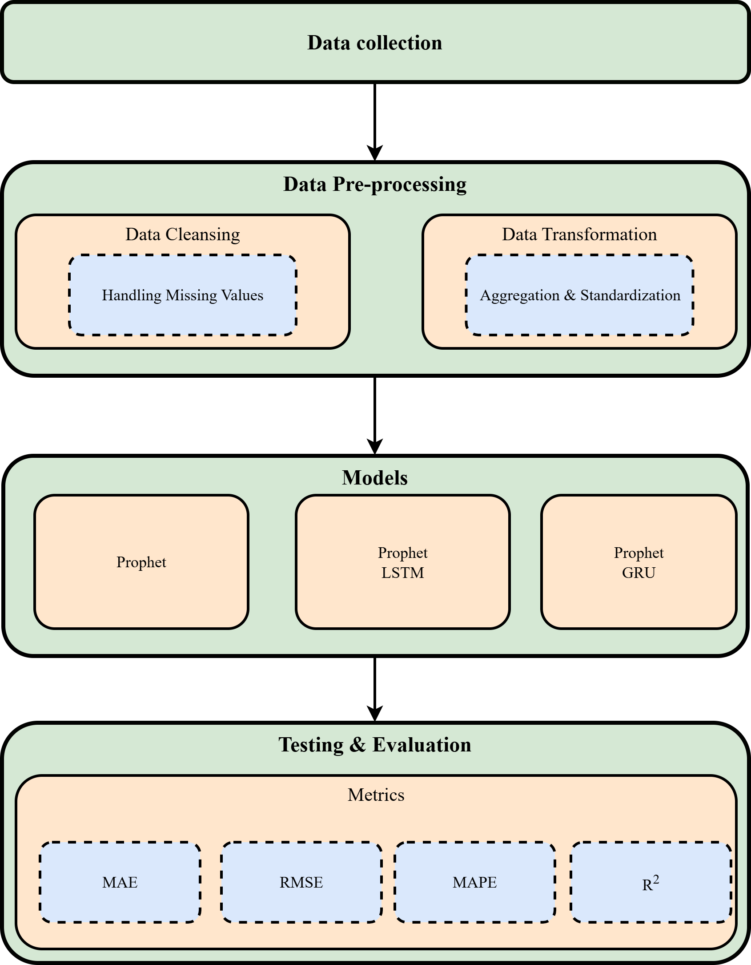
Proposed Framework
Notes:
The proposed framework follows a hybrid residual-learning approach. First, the Prophet model is used to generate baseline forecasts by modeling trend and seasonality. Then, the residuals between actual sales and Prophet predictions are calculated. These residuals are learned using deep learning models, specifically LSTM and GRU. The final forecast is obtained by combining the Prophet forecast with the predicted residuals.

Slide 8
Methodology
Category | Model | Parameter | Value
Baseline | Prophet | Yearly seasonality | Enabled
 |  | Weekly seasonality | Enabled
 |  | Daily seasonality | Disabled
 |  | External regressors | promo, discount, avg_age
 |  | Training data | 70% of time series
 |  | Prediction horizon | Test set (15%)
Hybrid A | Prophet + LSTM | Residual window length | 7 days
 |  | Input features | 1 (Prophet residuals)
 |  | LSTM units | 50
 |  | Activation | ReLU
 |  | Output layer | Dense(1)
 |  | Optimizer | Adam
 |  | Loss function | Mean Squared Error
 |  | Batch size | 16
 |  | Max epochs | 100
 |  | Early stopping | Patience = 5
Hybrid B | Prophet + GRU | Residual window length | 7 days
 |  | Input features | 1 (Prophet residuals)
 |  | Hidden units | 128
 |  | GRU layers | 2
 |  | Dropout | 0.3
 |  | Optimizer | Adam (lr = 0.001)

Slide 9
Methodology
Dataset Information:
Dataset Source:
https://www.kaggle.com/datasets/yashparab/barista-coffee-sales-data-for-eda-csv/data
Barista Sales Forecasting
Key Details:
Total Rows: 100,001 rows
Date Rang: Jan 2020-April 2024
Number of columns: 18
column | Description | Datatype
order_date | Transaction date | Date
order_time | Transaction time | Time
product_category | Category of the product (e.g., Coffee, Tea) | Categorical
qty | Sales qty | Integer
unit_price | unitprice | Float
store_id | Store Id | text
store_location | The location of the store | text
customer_location | Describe the location of the customer | text
customer_id | Customer Id | text
Customer_age | The age of the customer | Integer
Customer_gender | Category of the customer (e.g., Male, Female,Other) | Categorical
loyalty_member | Category of the Loyality (e.g., True, False) | Categorical
is_repeat_customer | Category of the Repeated customer (e.g., True, False) | Categorical
customer_discovery_source | Describe how did the customer find out about the shop | text
payment_method | Describes the payment method | text
discount_applied | Discount Amount | Float
total_amount | Amount of product | Float
promo_applied | Describes if the promo applied | Categorical
promo_type | Describes the promo type | Categorical

Slide 10
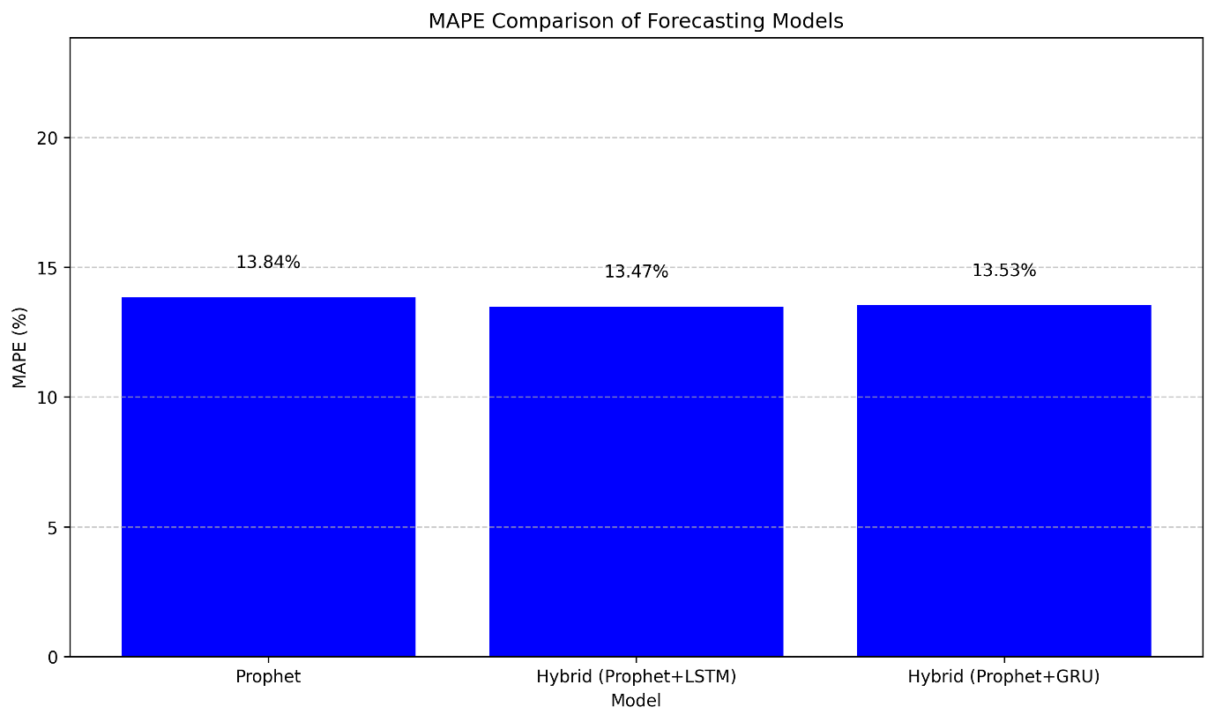
Results
Model | MAE | RMSE | MAPE (%) | R²
Prophet | 131.38 | 160.21 | 9.72 | 0.51
Prophet + LSTM | 118.86 | 147.94 | 8.52 | 0.59
Prophet + GRU | 119.73 | 148.37 | 8.71 | 0.58
Notes:
The experimental results show that both hybrid models outperform the standalone Prophet model across all evaluation metrics. Among the hybrid approaches, the Prophet+LSTM model achieved the best overall performance, while the Prophet+GRU model produced comparable results with lower computational complexity.

Slide 11
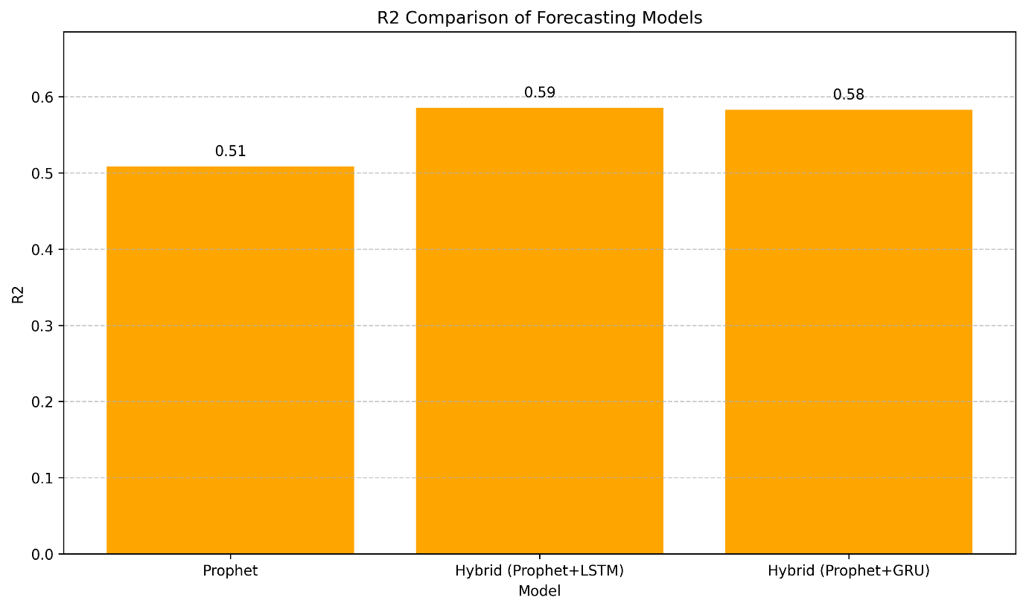
Results

Slide 12
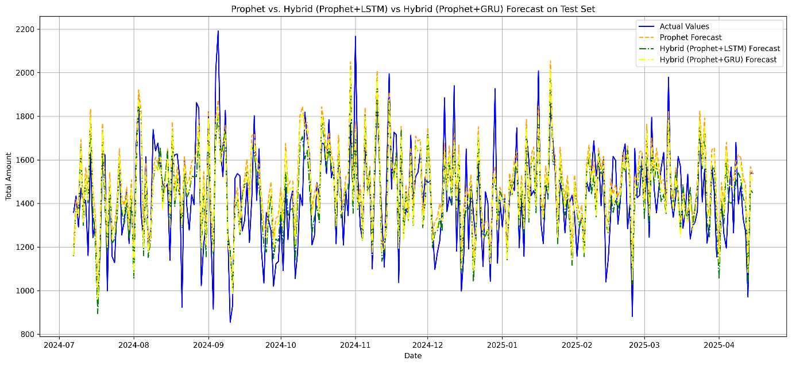
Results

Slide 13
Conclusion
Hybrid forecasting improves accuracy
Residual learning is effective
Applicable to real-world retail forecasting
Notes:
This research demonstrates that combining statistical and deep learning models leads to more accurate and robust sales forecasting. The proposed hybrid framework successfully captures both linear and nonlinear patterns in sales data and is suitable for practical retail applications.

Slide 14
Future Work
Transformers and attention mechanisms
Machine Learning
Notes:
Future work may include incorporating external variables such as promotions and holidays, extending the framework to multivariate forecasting, and exploring more advanced architectures such as transformer-based models.

Slide 15
references
  Li, X., Du, J., Wang, Y., & Cao, Y. (2020, November). Automatic sales forecasting system based on LSTM network. In 2020 International Conference on Computer Science and Management Technology (ICCSMT) (pp. 393-396). IEEE Computer Society.
  Vavliakis, K. N., Siailis, A., & Symeonidis, A. L. (2021). Optimizing Sales Forecasting in e-Commerce with ARIMA and LSTM Models. In WEBIST (pp. 299-306).
  Akande, Y. F., Idowu, J., Misra, A., Misra, S., Akande, O. N., & Ahuja, R. (2021, October). Application of XGBoost algorithm for sales forecasting using Walmart dataset. In International Conference on Advances in Electrical and Computer Technologies (pp. 147-159). Singapore: Springer Nature Singapore.
  Massaro, A., Panarese, A., Giannone, D., & Galiano, A. (2021). Augmented data and xgboost improvement for sales forecasting in the large-scale retail sector. Applied Sciences, 11(17), 7793.
  Brykin, D. (2024). Sales Forecasting Models: Comparison between ARIMA, LSTM and Prophet. Journal of Computer Science, 20(10), 1222-1230.
  Ensafi, Y., Amin, S. H., Zhang, G., & Shah, B. (2022). Time-series forecasting of seasonal items sales using machine learning–A comparative analysis. International Journal of Information Management Data Insights, 2(1), 100058.
  https://www.kaggle.com/datasets/yashparab/barista-coffee-sales-data-for-eda-csv/

Slide 16
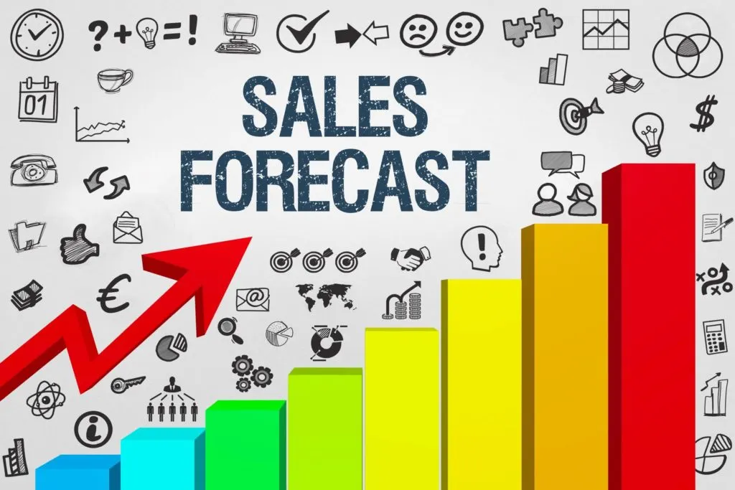
Thank You

