Slide 1
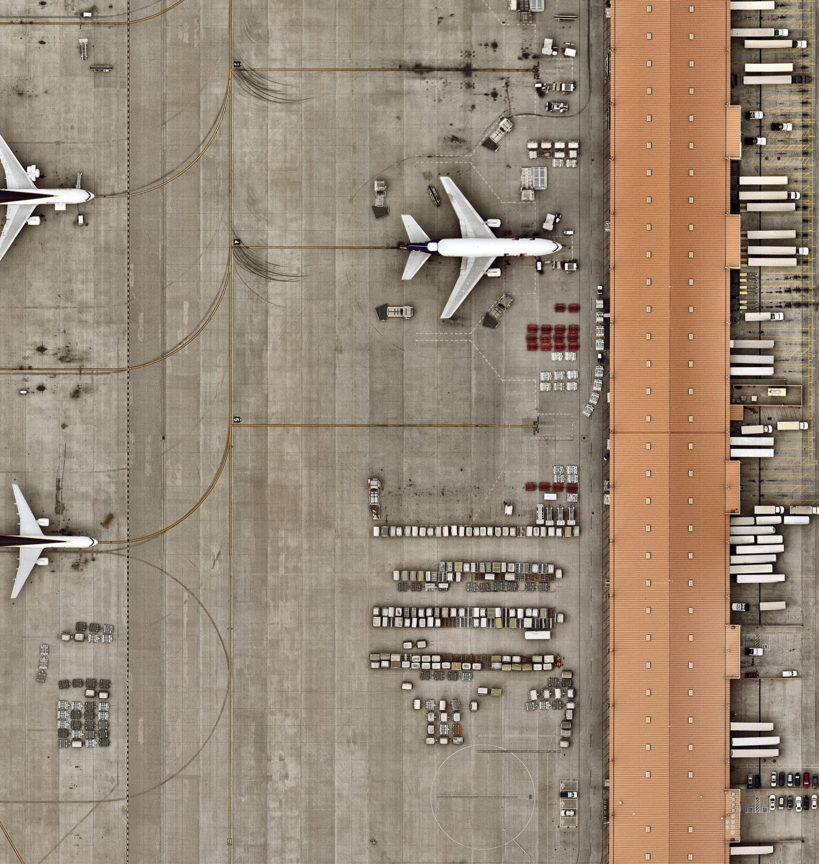
Enhancing Flight Operations with AI-Based Delay Forecasting
Mohammed Hamed Alzahrani Supervisor: Dr. Khaled Eskaf
Midocean University, UAE

Slide 2
Introduction
Flight delays remain one of the most persistent challenges in aviation, impacting both efficiency and passenger satisfaction. In this research, an AI-based forecasting model is used on real-world airline data. By applying a Random Forest Classifier combined with feature selection, the model achieved 98.41% accuracy. Importantly, the analysis revealed that weather conditions and carrier-related delays are the strongest predictors, providing both high predictive performance and actionable insights for improving airline operations.

Slide 3
Problem Definition
1. Operational Inefficiencies
Flight delays create ripple effects: wasted fuel, increased crew costs, missed connections, and disrupted schedules.
2. Limitations of Existing
Models Most rely on linear assumptions, which oversimplify aviation data.
They struggle to adapt to nonlinear and multi-factor causes of delays.
Many are not designed for real-time forecasting, making them less practical for airline operations.
3. The Research Need
Development of intelligent forecasting tools that are adaptable, accurate, and interpretable.
Models that can capture complex interactions (e.g., weather + carrier + seasonal effects) and support proactive decision-making.

Slide 4
Objectives
Data Analysis:
Identify key variables influencing flight delays
Preprocessing:
Develop a robust pipeline: outlier removal (IQR), missing value imputation, and feature
transformation
Model Development:
Build and evaluate a Random Forest Classifier for flight delay prediction
Feature Selection
Apply SelectKBest and RFE to improve efficiency and interpretability
Performance Evaluation
Assess model performance using accuracy, precision, recall, and F1 score
Visualization
Explore and present delay patterns across weather, carriers, and seasonal trends

Slide 5
Contributions
1. High Predictive Performance
Achieved 98.41% accuracy using Random Forest with RFE-selected features.
Balanced precision and recall, ensuring reliable detection of actual delays.
2. Operational Insights
Identified weather conditions and carrier-related delays as the most influential predictors.
Provides actionable guidance for airlines to prioritize resources and improve scheduling.
3. Scalable Framework
Designed a pipeline that is efficient, lightweight.
Can be integrated with real-time data feeds such as live weather and schedules.
4. Academic Value
Bridges the gap between traditional statistical models and modern AI techniques.
Offers an applicable methodology for future research in aviation analytics.

Slide 6
Literature Review
Classical ML (70–90%): Decision Trees, Random Forest, SVM.
Pros: simple, interpretable.
Cons: limited for nonlinear/time-series data.
Deep Learning (94–95%): LSTM, CNN-LSTM, SGDAN.
Pros: capture sequential + spatial patterns.
Cons: data-hungry, less interpretable.
Hybrid Models (>93%): CNN-BiLSTM, DeepONet.
Pros: combine strengths of ML & DL.
Cons: complex, not deployment-friendly.
Gap → Few models are real-time, generalizable, or operationally ready.

Slide 7
Dataset & Preprocessing
Source:
U.S. Bureau of Transportation Statistics (BTS)
Initial size:
171k records → reduced to 51,781 after cleaning
Preprocessing steps:
Outlier removal (IQR method)
Handling missing values (median for numeric, mode for categorical)
One-hot encoding for categorical features
Final dataset:
424 features
Split:
80% training / 20% testing

Slide 8
Feature Engineering
1. Delay Rate
Created a normalized metric: ratio of delayed flights to total arrivals.
Allows fair comparison across airports and carriers of different sizes.
2. Binary Delay Label
Converted the problem into a classification task.
Flights labeled 1 (Delayed) if delay rate > 20%, otherwise 0 (On-time).
Threshold chosen to reflect operational significance.
3. Temporal Features
Included Year and Month variables.
Captures seasonal delay trends, such as winter weather disruptions.

Slide 9
Feature Selection
1. SelectKBest (Filter Method)
Used Mutual Information to rank individual features.
Key variables identified:
  arr_flights (arrival flights)
  carrier_ct (carrier delay counts)
  nas_ct (airspace delays)
  late_aircraft_ct (late aircraft delays).
2. Recursive Feature Elimination (Wrapper Method)
Systematically removed the least important predictors.
Produced a refined input set that significantly improved model performance.
Achieved 98.41% accuracy with better balance between precision and recall.
3. Benefits of Feature Selection
Reduced dimensionality → fewer irrelevant variables.
Improved transparency → easier for stakeholders to understand.
Enhanced efficiency → faster computation, suitable for real-time use.

Slide 10
Model Development
1. Algorithm Selection
Choose Random Forest Classifier:
  Robust for structured tabular data.
  Resistant to overfitting through ensemble learning.
  Provides feature importance, ensuring interpretability.
2. Hyperparameter Tuning
Applied GridSearchCV with cross-validation to optimize performance.
Best parameters identified:
  n_estimators = 100 (number of trees).
  max_depth = None (trees grow until all leaves are pure).
  min_samples_split = 5 (controls split size, avoids overfitting).
3. Evaluation Metrics
Used multiple metrics to capture balanced performance:
  Accuracy → overall correctness.
  Precision → reliability of delay predictions.
  Recall → ability to detect actual delays.
  F1 Score → balance of precision and recall.

Slide 11
Results – Full Feature Model
1. Results – Full Feature Model
Overall Performance
Accuracy: 93.19%
Strong headline number but requires deeper analysis with class-level metrics.
2. On-Time Flights
Precision: 93%
Recall: 99%
Model is very strong at identifying on-time flights, with few false alarms.
3. Delayed Flights
Precision: 96%
Recall: 73%
While precision is high, recall is low → the model failed to detect about 27% of actual delays.
4. Key Issue
High accuracy but imbalanced performance.
Missing delays (false negatives) are risky in aviation, since undetected delays create cascading disruptions for passengers, crews, and operations.

Slide 12
Results – RFE Model
1. Overall Performance
Accuracy: 98.41%
Significant improvement compared to the full-feature model (93.19%).
2. Class-Level Metrics
Precision: ≥98% for both on-time and delayed flights → predictions are highly reliable.
Recall: ≥95% across classes → the model successfully captured almost all actual delays.
F1 Score (Delayed Class): 0.96 → strong balance between precision and recall.
3. Advantages of RFE
Improved Generalization → performed consistently on unseen test data.
Efficiency → reduced feature set led to faster training and prediction.
Interpretability → fewer variables, making results clearer for operational decision-making.

Slide 13
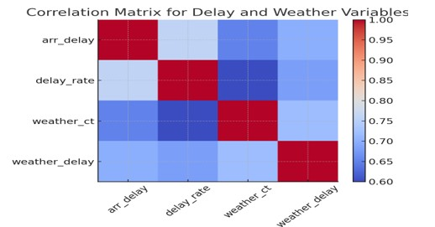
Visual Insights
Correlation Heatmaps
Revealed a strong positive relationship between weather delays and total
delays.
Validates that weather is a dominant factor driving disruptions.

Slide 14
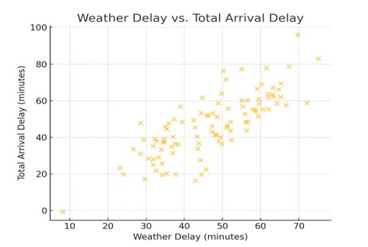
Visual Insights
Scatter Plots
Showed a clear upward trend: as weather-related delays increase, total
delays also rise.
Confirms the model is learning from meaningful operational patterns.

Slide 15
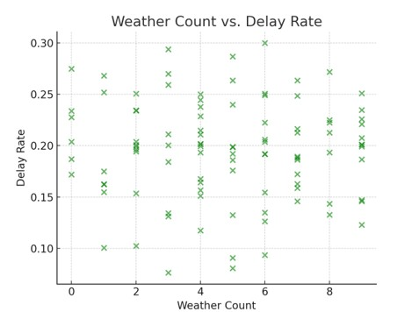
Visual Insights
Time-Series Analysis
Identified seasonal peaks in the winter months, consistent with aviation
reality (snowstorms, low visibility, de-icing).
Demonstrates the importance of including temporal features like the month
and year.

Slide 16
Visual Insights
Value of Visualization
Visual analyses confirmed the logic behind the model’s predictions.
Improves trust and interpretability, making results easier for airlines and
stakeholders to adopt.

Slide 17
Conclusion
Model Effectiveness:
Developed an AI-based Random Forest model that proved highly effective for
predicting light delays.
Feature Selection Impact:
Recursive Feature Elimination (RFE) significantly improved:
  Accuracy → 98.41%
  Interpretability → fewer, more meaningful predictors
  Efficiency → faster execution, suitable for real-time use.
Key Predictors Identified:
Weather-related delays and carrier-specific issues emerged as the most influential
factors affecting flight disruptions.
Operational Insights:
Visual analysis (heatmaps, scatter plots, seasonal trends) validated the model’s logic.
Provided actionable insights that can support airline decision-making and resource
planning.

Slide 18
Future Work
Real-Time Integration:
Connect the model with live weather feeds and real-time flight schedules.
Enable dynamic predictions that update continuously during operations.
Global Expansion:
Apply the pipeline across different airports and countries.
Validate generalization under diverse conditions (e.g., sandstorms in Saudi Arabia, snowstorms
in Europe).
Passenger-Centric Forecasting:
Extend the model to provide personalized delay alerts for passengers.
Improve customer experience by reducing missed connections and uncertainty.
Deployment via APIs:
Develop API-ready tools for direct integration into airline dashboards and decision systems.
Support operational use by airlines, airports, and regulators.
Advanced AI & Explainability:
Use newer models like Transformers, ensemble methods, and hybrid approaches to improve
accuracy.
Apply Explainable AI (XAI) tools such as SHAP and LIME to make predictions clearer
and easier to trust.

Slide 19
Thank you for your attention

