Slide 1



The Negotiation and Influencing Skills
The Negotiating & Influencing Process
Lec.7
ENT623
College of Entrepreneurship and Innovation
Prepared by
Dr. Bothaina Mahmoud Fouad

Slide 2

Upon successful completion of this lecture, you will be able to:
Demonstrate the negotiation types
Describe the stages in the process of negotiation and Influence
Case studies
Our Learning Outcomes

Slide 3
Negotiations types
There are two opposite types or schools of negotiation
Integrative and distributive negotiation are two fundamental approaches to negotiation, differing in their goals, strategies, and outcomes.
Both types are essential to negotiating successfully in business.

Slide 4
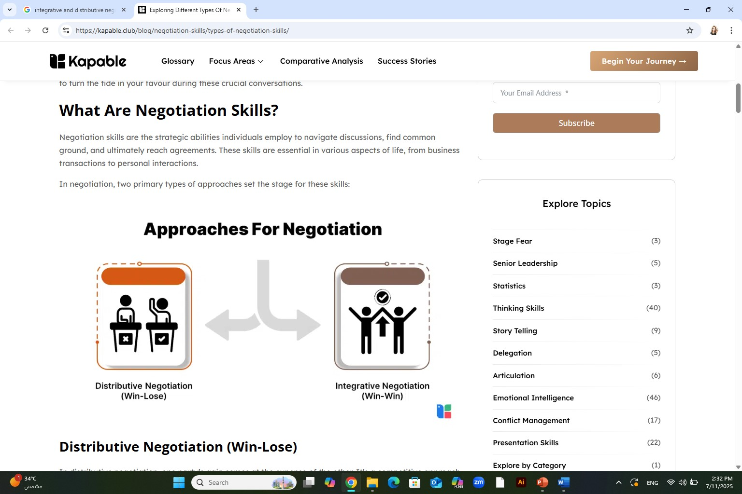
Distributive Negotiation Vs. Integrative Negotiation

Slide 5
Distributive negotiation Definition
is a type of negotiation in which parties' bargain for shares of a fixed resource. Also known as distributive bargaining, it can be used in labor negotiations, sales, and in any problem-solving scenario where people are trying to divvy up things of value

Slide 6
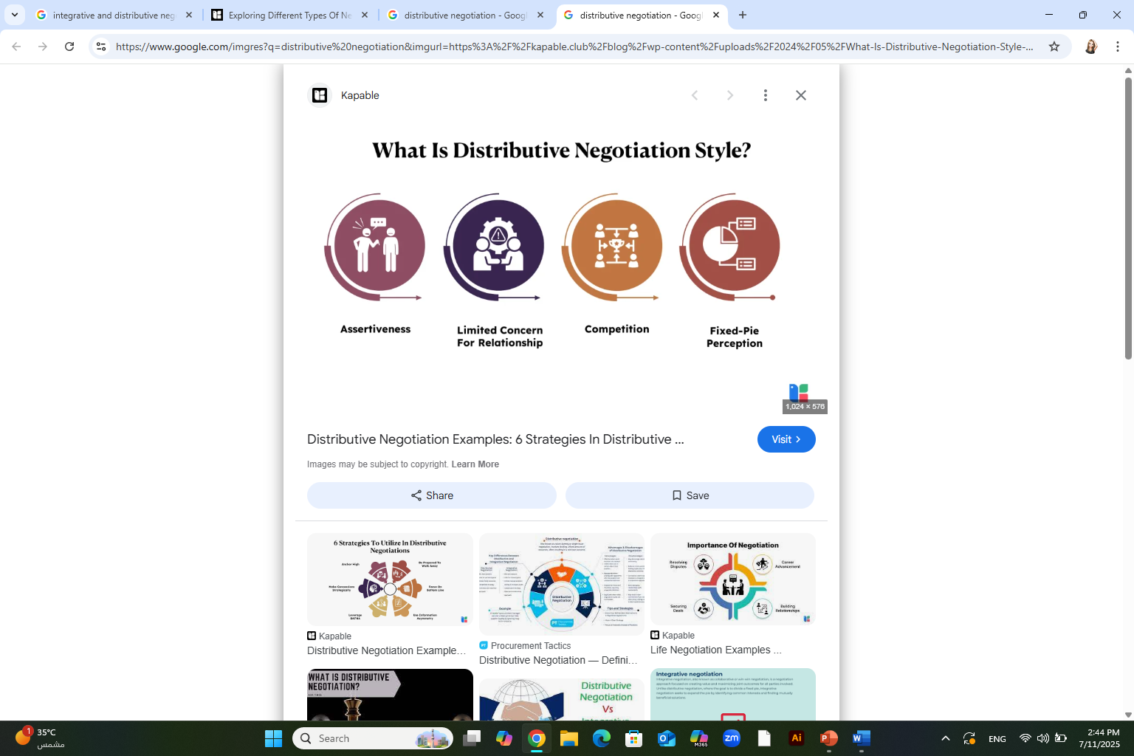
Distributive negotiation
Distributive negotiation, also known as "win-lose" or "zero-sum" negotiation, is a competitive approach where parties aim to divide a fixed amount of value, with one party's gain often corresponding to the other's loss. It's characterized by a focus on maximizing individual outcomes, often through tactics like positional bargaining and making concessions.

Slide 7
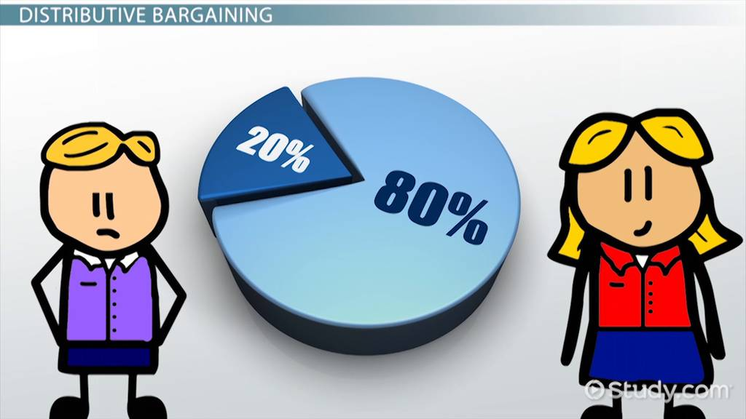
Example about Distributive negotiation
In the real world of negotiations, two teams enter discussions with the goal of claiming as much value as possible. The seller wants to go after the best price they can obtain. The buyer wants to pay the lowest price to achieve the best bargain. It’s good old-fashioned haggling.

Slide 8
Distributive negotiation
Key Characteristics:
Fixed Value: Parties are negotiating over a limited resource or a fixed "pie" that they need to divide.
Competitive: Each party's goal is to maximize their share of the fixed value, leading to a competitive dynamic.
Zero-Sum: One party's gain is directly offset by the other's loss.
Positional Bargaining: Parties often start with extreme positions and make concessions to reach an agreement, focusing on their initial stance

Slide 9

Some of Distributive negotiation basics
Give little or no information to the other side. The less the other negotiator knows about our interests, the better our position. This can include why we want to make the purchase, our preferences, or the point at which we’d decline the deal. Expressing eagerness or need reveals a weakness that could be exploited.
The opposite is equally true – Try to obtain as much information from the other side as you can. Any further information uncovered is potential leverage to negotiate a better deal.
Be realistic – Being too greedy or too stingy will likely result in no agreement. So, keep expectations realistic.
https://www.negotiations.com/articles/negotiation-types/

Slide 10
Some of Distributive negotiation basics
Let the other side know you have options – The only information we should reveal is the fact we have options. This includes other sellers we can purchase from at a competitive price. Reminding the seller of their competition shows our willingness to walk if necessary. It also lets the seller know there will be no negative consequences for us
Make the first offer – Whatever the first offer is will generally act as a negotiation anchor. The anchor becomes the point on which the rest of the negotiation will likely revolve. Try to make the first offer to ensure discussions set off in your favor.
https://www.negotiations.com/articles/negotiation-types/

Slide 11
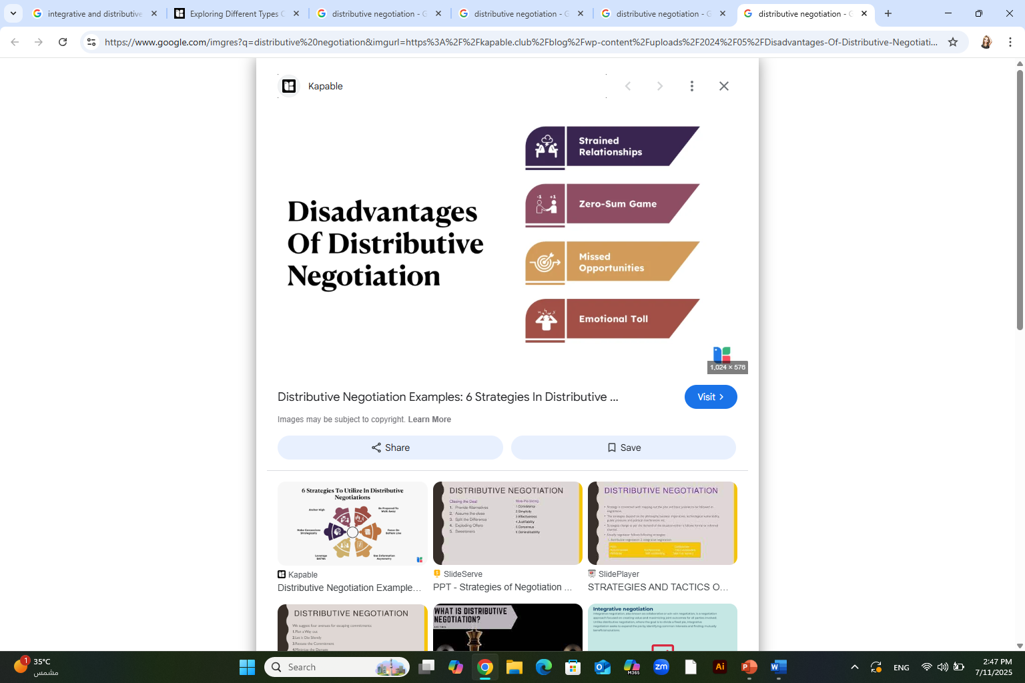
Distributive negotiation
Distributive negotiation, while sometimes necessary, has several significant drawbacks. It often leads to strained relationships, a win-lose outcome, and missed opportunities for mutual benefit. Additionally, it can foster distrust, discourage collaboration, and may even involve deceptive tactics, ultimately hindering long-term success.

Slide 12
Disadvantages of Distributive negotiation
Damaged Relationships: Distributive negotiation focuses on maximizing one's own gains, which can create a competitive and adversarial atmosphere. This can damage trust and make future collaboration more difficult.
Win-Lose Outcomes: The core of distributive negotiation is the idea of a fixed pie, where one party's gain is another's loss. This can leave one party feeling unsatisfied and resentful, even if they achieved a "win".
Missed Opportunities: By prioritizing individual gains, negotiators might overlook potential opportunities for mutually beneficial solutions that could have been discovered through a more collaborative approach (integrative negotiation).
Lack of Trust and Cooperation: The competitive nature of distributive bargaining can breed distrust, making it harder to build a positive working relationship or collaborate effectively on future projects.
Deceptive Tactics: In some cases, distributive negotiation can involve dishonesty, manipulation, and withholding of information to gain an advantage. This can be harmful to the overall negotiation process and relationships.
Time-Consuming: If parties are far apart on their positions, the negotiation can become protracted and time-consuming, especially when each side is focused on maximizing their own outcome.
Focus on Short-Term Gains: Distributive negotiation often prioritizes immediate gains over long-term benefits, potentially sacrificing future opportunities for the sake of a quick win.

Slide 13
When you can use this style and when you avoid using it
Advantages – use this style if: | Disadvantages – avoid using this style if:
You need to act fast | You fear admitting ignorance of uncertainty
You are 100% sure you’re right about the situation | You want to reduce communication and to not give opportunity to explore alternative solutions
You are dealing with an opponent who will abuse you if you show non-competitive behavior | You’ll be surrounded by a ‘yes’ team. Because it’s tough to disagree with a competitive negotiator in your team
The situation is important and an unpopular decision needs to be taken | You might damage the relationship with your opponent
Other negotiation styles are not possible | You’ll receive little commitment from your opponent which adds risks to the implementation phase of your deal

Slide 14
Integrative Negotiation
In the real world of business, the results often tilt in favor of one side over the other. This is because it’s unlikely that both sides will come to the table at equal strength when talks begin.
Nonetheless, there are many advantages when both teams take a cooperative approach. Skillful mutual problem-solving generally involves some form of making value-for-value concessions. This is usually in conjunction with creative problem-solving.

Slide 15
Integrative Negotiation Definition
Integrative negotiation, also known as integrative bargaining, interest-based bargaining, or win-win bargaining, is a negotiation strategy where parties collaborate to find a solution that satisfies the needs and interests of everyone involved. It moves away from the traditional "win-lose" or distributive approach and focuses on finding mutually beneficial outcomes through open communication, creativity, and compromise.
Generally, integrative negotiations are future-focused, with long-term relationships in mind. It aims to create ongoing mutual gains. This mutually beneficial type of negotiation outcome is often described as the Win-Win scenario.

Slide 16

Integrative negotiation
Key Characteristics:
Focus on Interests, not Positions: Instead of focusing on rigid positions, integrative negotiation delves into the underlying interests and needs of all parties involved. This involves understanding why each party wants what they want, not just what they are asking for.
Value Creation: Integrative negotiation aims to expand the pie, creating more value for everyone involved. This can involve brainstorming creative solutions, compromising, and finding mutually beneficial options that satisfy everyone's needs.
Relationship Building: Maintaining a positive and productive relationship is crucial in integrative negotiation. This approach is especially important when parties anticipate future interactions or collaborations.
Open Communication and Transparency: Integrative negotiation relies on open and honest communication to understand each other's perspectives and needs. This transparency builds trust and facilitates the discovery of shared interests.

Slide 17
Integrative negotiation
Key Characteristics:
5. Flexibility and Creativity: Parties in integrative negotiations are willing to be flexible and creative in their approach, exploring different options and considering various solutions to find the best outcome for everyone.
6. Shared Problem Solving: The process is often collaborative, with parties working together to identify and address the problem, rather than viewing it as a win-lose scenario.
7. Win-Win Orientation: The goal is to find a solution that leaves all parties feeling satisfied and having achieved their objectives.
8. Potential for Long-Term Benefits: By building trust and strong relationships, integrative negotiation can lead to more sustainable and mutually beneficial outcomes in the long run.

Slide 18
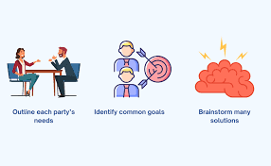
Some of Integrative negotiation basics
Multiple Issues: Integrative negotiations usually involve many issues that are up for discussion. Each side wants to get something of value while trading something of lesser value. In contrast, distributive negotiations generally revolve around the price or a single issue.
Sharing: To understand each other’s situation, both sides should share as much information as possible. This helps each side understand the other’s interests. You can’t solve a problem without knowing the parameters. Cooperation is essential.
https://www.negotiations.com/articles/negotiation-types/

Slide 19
Some of Integrative negotiation basics
Problem Solving: Find solutions to each other’s problems. For example, offer something valuable to the other side that is of lesser value to you. If you can make this trade while realizing your goal, you have integrated your problems into a positive solution.
Bridge Building: More and more businesses are engaging in long-term relationships. Relationships offer greater security and the promise of future success.
https://www.negotiations.com/articles/negotiation-types/

Slide 20

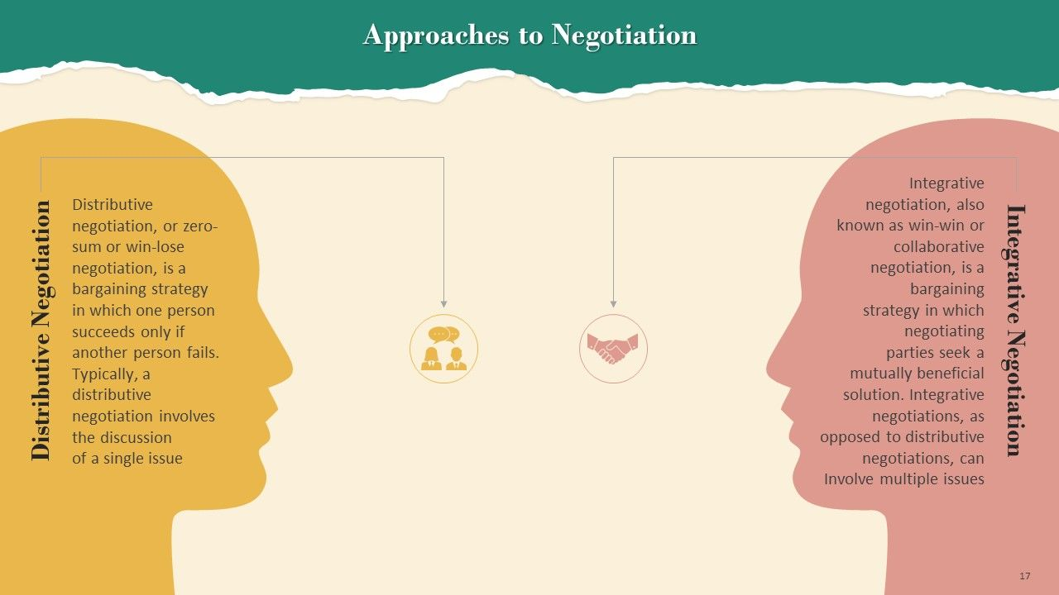

Slide 21
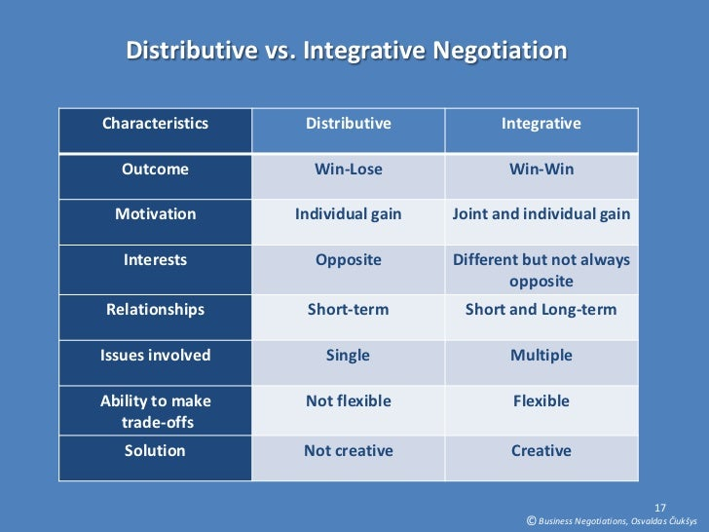

Slide 22
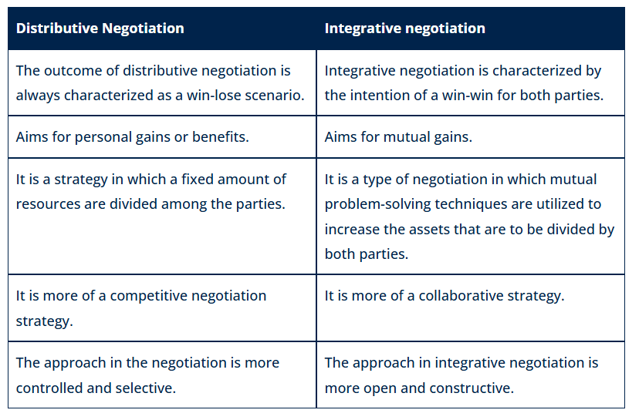

Slide 23
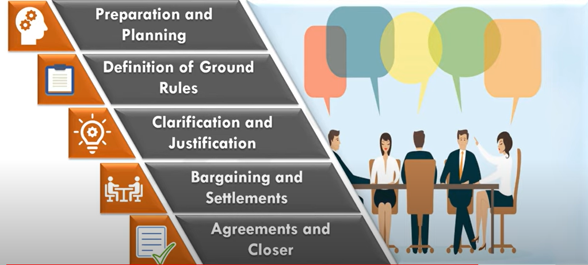
The Negotiation Process

Slide 24
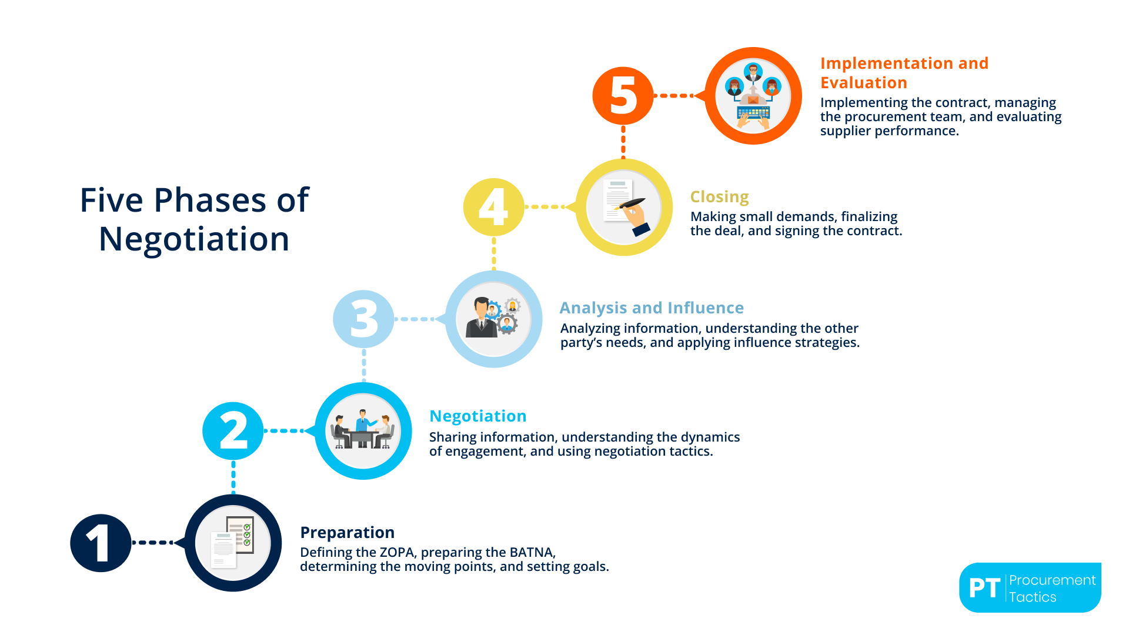
The Negotiation Process
The negotiation process typically involves several key stages: preparation, opening, clarifying goals, bargaining, and agreement/closure. Effective negotiation requires careful planning, understanding the other party's perspective, and clear communication

Slide 25
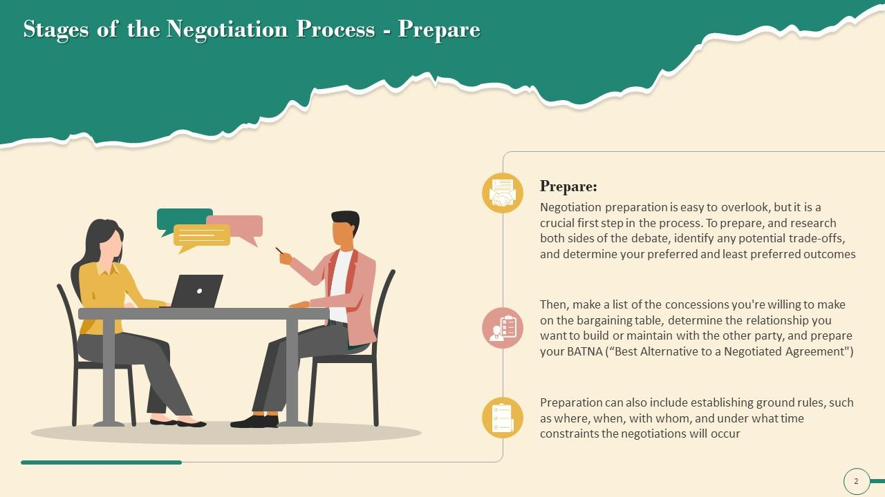
Stage
The Negotiation Process
01
Preparation & Planning
In the preparation and planning stage, you (as a party in the negotiation) need to determine and clarify your own goals in the negotiation. This is a time when you take a moment to define and truly understand the terms and conditions of the exchange and the nature of the conflict. What do you want to walk away with?
You should also take this moment to anticipate the same for the other party. What are their goals in this negotiation? What will they ask for? Do they have any hidden agendas that may come as a surprise to you? What might they settle for, and how does that differ from the outcome you’re hoping for?

Slide 26
Stage
The Negotiation Process
01
Preparation & Planning
To prepare and research both sides of the debate:
Identify any potential trade-offs
Determine your preferred and least preferred outcomes
Make a list of the concessions you’re willing to make on the bargaining table
Determine the relationship you want to build or maintain with the other party.
Prepare your BATNA ( best Alternatives to a Negotiated Agreement)
This stage can include establishing ground rules such as where, when, with whom and under what time constraints the negotiation will occur

Slide 27
Stage
The Negotiation Process
01
Tips & Tricks for Negotiation Preparation Phase
Define your ZOPA: Clearly determine the range within which a deal is possible. Know your minimum and maximum limits so you know when a compromise is acceptable.
Prepare a strong BATNA (Best Alternative To a Negotiated Agreement): Always have a backup plan if the negotiation fails. This gives you confidence and the strength to walk away from a bad deal.
Use anchoring: Start with a higher demand than what you expect. This sets the starting point of the negotiation in your favor and helps you achieve a better outcome.
Practice scenarios: Simulate negotiations with your team to prepare for different tactics the other party might use. This builds confidence and prevents surprises.

Slide 28
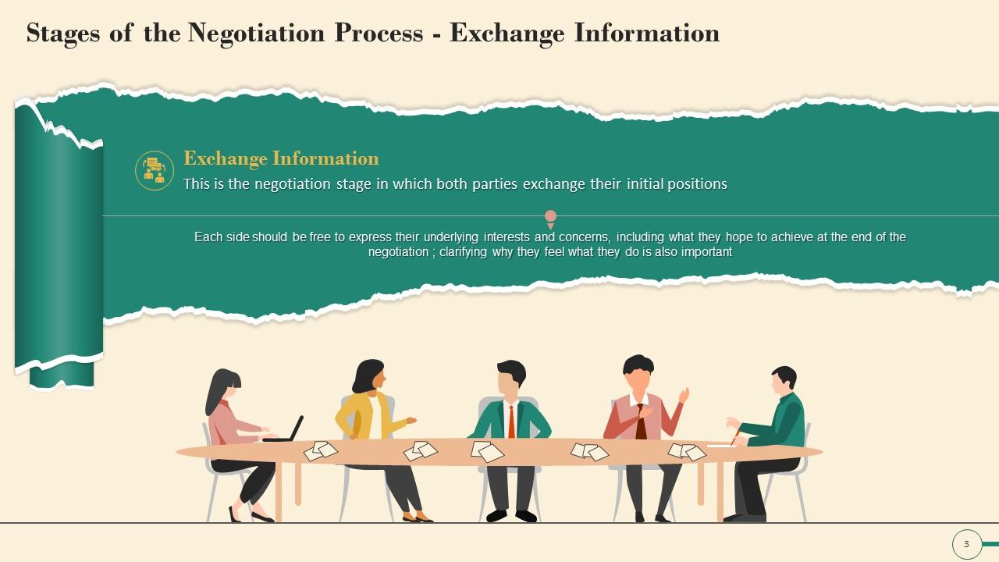
Stage
The Negotiation Process
02
Definition of Ground Rules
After the planning and strategy development stage is complete, it’s time to work with the other party to define the ground rules and procedures for the negotiation.
Each side should be free to express their underlying interests and concerns
Including what they hope to achieve at the end of negotiation
Clarifying why they feel what they do is also important.
Exchange Information stage

Slide 29
Stage
The Negotiation Process
02
Definition of Ground Rules
This is the time when you and the other party will come to agreement on questions like:
Who will do the negotiating—will we do it personally or invite a third party?
Where will the negotiation take place?
Will there be time constraints placed on this negotiation process?
Will there be any limits to the negotiation?
If an agreement can’t be reached, will there be any specific process to handle that?
Exchange Information stage

Slide 30
Stage
The Negotiation Process
02
Tips & Tricks for Negotiation Exchange Information Phase
Share and gather information to better understand the needs, limits, and priorities of the other party.
Manage the dynamics of negotiation: Pay attention to how the negotiation is framed (e.g., as a partnership or a competition) and establish rules for how the process will function.
Use silence as a tactic: Silence can be a powerful tool for creating pressure and encouraging the other party to reveal more information or make concessions.
Offer multiple options (all favorable to you): Present several options that are all acceptable to you, but frame them in a way that gives the other party the illusion of choice.

Slide 31
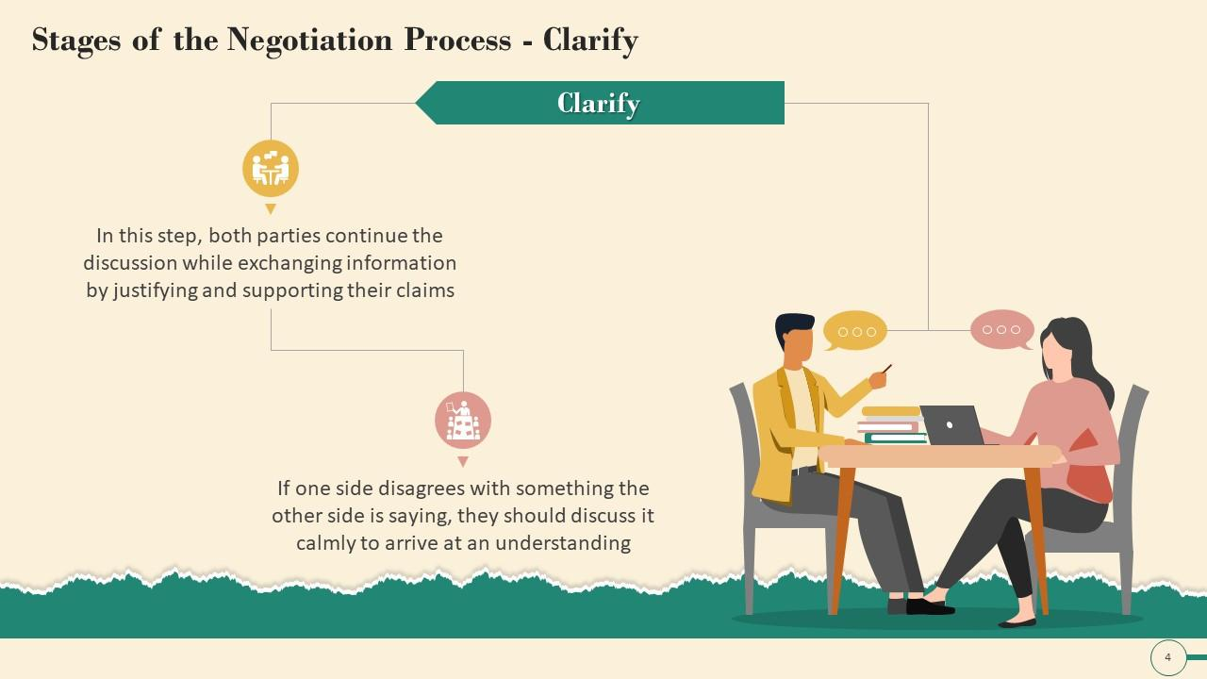
Stage
The Negotiation Process
03
Clarification & Justification
Once initial positions have been exchanged, the clarification and justification stage can begin. Both you and the other party will explain, clarify, bolster and justify your original position or demands. For you, this is an opportunity to educate the other side on your position, and gain further understanding about the other party and how they feel about their side. You might each take the opportunity to explain how you arrived at your current position, and include any supporting documentation. Each party might take this opportunity to review the strategy they planned for the negotiation to determine if it’s still an appropriate approach.

Slide 32
Stage
The Negotiation Process
03
Clarification & Justification
In this phase:
Both parties continue the discussion while exchanging information by justifying and supporting their claims.
If one side disagrees with something the other side is saying, they should discuss it calmly to arrive at an understanding

Slide 33
Stage
The Negotiation Process
03
Tips & Tricks for Negotiation Clarification & Justification Phase
Conduct thorough market research: Understand current trends, customer needs, and the competitive landscape to identify opportunities and risks.
Perform stakeholder analysis: Identify key players, their goals, and their influence in the negotiation process.
Use data to build credibility: Support your arguments with statistical data, research, and case studies to enhance the validity of your proposals.
Leverage emotional connection: Align your proposals with the values and emotions of your audience to increase their receptiveness.
https://procurementtactics.com/negotiation-phase/

Slide 34
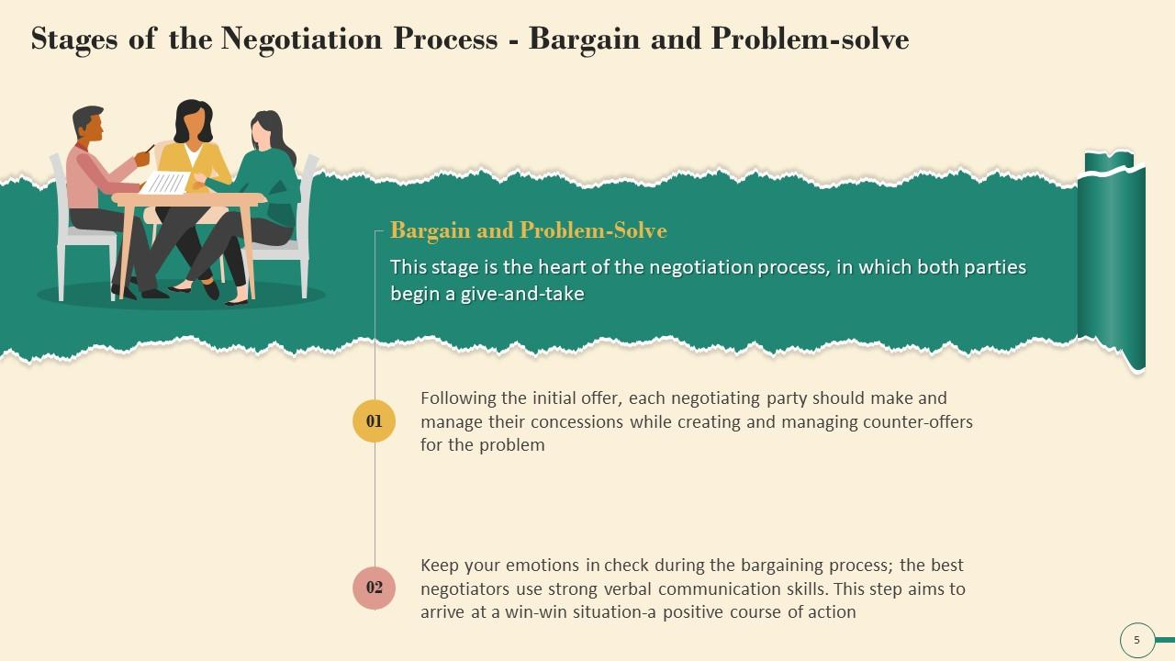
Stage
The Negotiation Process
04
Bargaining and Problem Solving
You and the other party will use various negotiation strategies to achieve the goals established during the preparation and planning process. You will use all the information you gathered during the preparation and planning process to present your argument and strengthen your position, or even change your position if the other party’s argument is sound and makes sense.
This is the essence and the heart of the negotiation process, where the give and take begins

Slide 35
Stage
The Negotiation Process
04
Bargaining and Problem Solving
The communication skills of active listening and feedback serve the parties of a negotiation well. It’s also important to stick to the issues and allow for an objective discussion to occur. Emotions should be kept under control. Eventually, both parties should come to an agreement.
This stage aims to arrive at a win- win situation

Slide 36
Stage
The Negotiation Process
04
Tips & Tricks for Negotiation Bargaining and Problem Solving Phase
Following the initial offers, each negotiating party should make and manage their concessions while creating and managing counter – offers for the problem
Keep your emotions in check during the bargaining process, the best negotiators use strong verbal communication skills
https://procurementtactics.com/negotiation-phase/

Slide 37
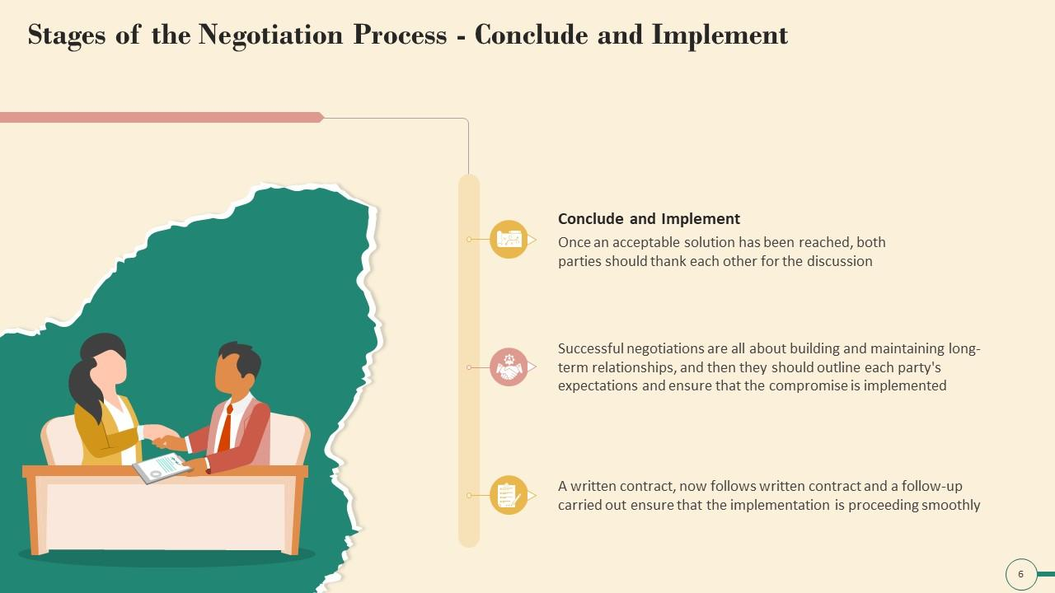
Stage
The Negotiation Process
05
Closure and Implementation
Once an agreement has been met, this is the stage in which procedures need to be developed to implement and monitor the terms of the agreement. They put all of the information into a format that’s acceptable to both parties, and they formalize it
Once an acceptable solution has been reached, both parties should thank each other for the discussion
A written contract now follows written contract and a follow –up carried out ensured that the implementation is proceeding smoothly

Slide 38
Stage
The Negotiation Process
05
Tips & Tricks for Negotiation Closure and Implementation Phase
Document the deal immediately: Write down the agreed terms right after the negotiation and confirm them with the other party to avoid misinterpretations.
Ensure cross-department collaboration: Involve the right people and teams from the start to ensure smooth implementation. Make sure different departments are aligned and working together.
Monitor supplier performance: Regularly evaluate whether suppliers are meeting their obligations and quality standards. Maintain open communication to address any issues promptly.
Map out implementation activities: Create a visual map of all tasks, systems, processes, and people involved in the implementation. Group activities logically to track progress effectively.
Avoid overloading your team: Balance the workload to prevent overwhelming your team, especially if issues arise early in the implementation phase
https://procurementtactics.com/negotiation-phase/

Slide 39
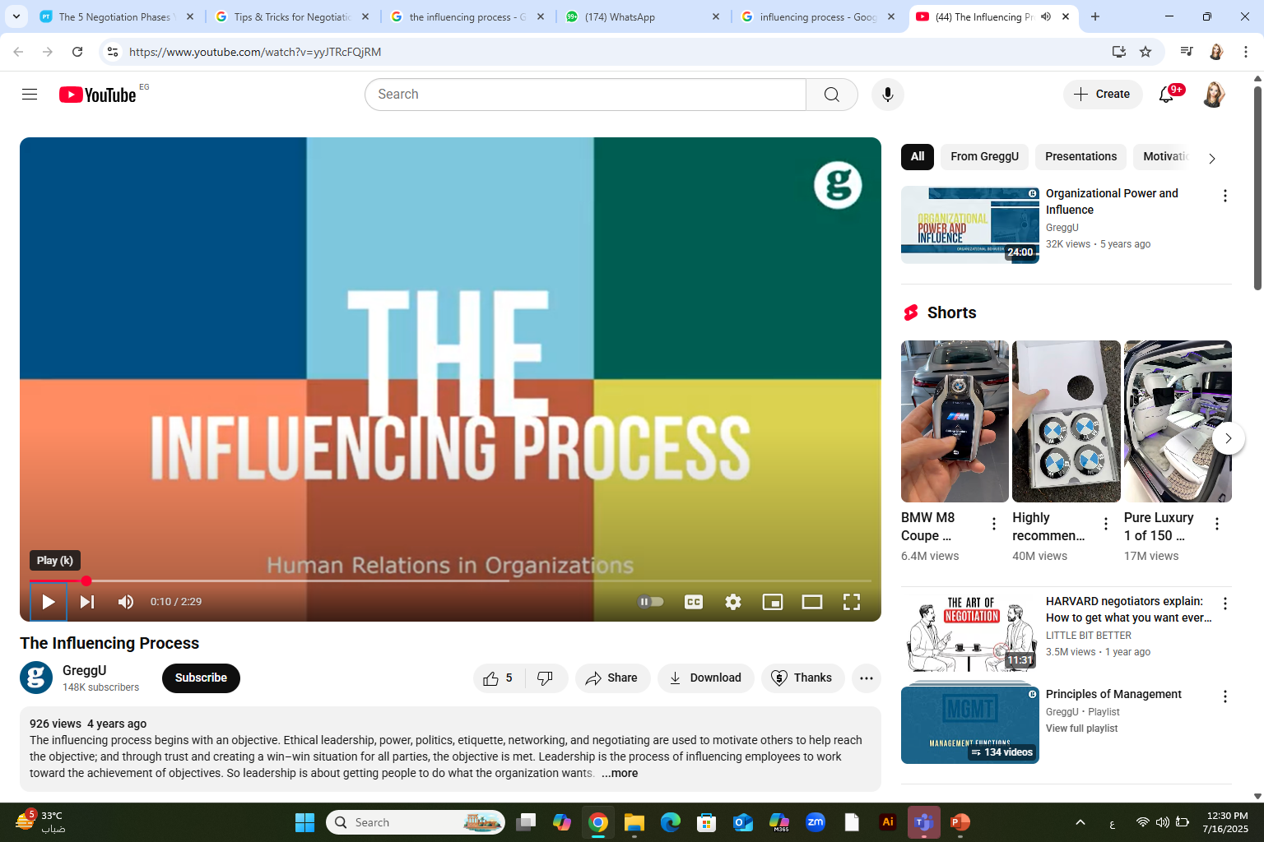
The Influencing Process

Slide 40
The influencing process is a multifaceted approach that aims to guide individuals or groups towards a desired outcome. It involves a range of techniques and strategies designed to inspire, motivate, and persuade others to align with a particular viewpoint, goal, or course of action. Effective influencing relies on understanding the needs and motivations of those being influenced, tailoring communication to resonate with them, and building strong relationships based on trust and mutual respect

Slide 41
Influence processes refer to the five ways leaders shape organizational variables including people and resources. The five influence processes are direct decisions, allocation of resources, reward system, selection and promotion of other leaders and role modeling

Slide 42
1. Direct decisions
Direct decisions provide the leaders the ability to influence the choices of their followers. This ability to influence comes with the control leaders have in formulating mission and vision aspects of an organization. The most important aspect giving power to leader in the organizational structure is their ability to influence the variables affecting their followers through direct decisions. Leaders’ ability to make decisions influencing organizational structure give them the power to dictate decision making in the organization and set overall direction of the organization.

Slide 43
2. Allocation of resources
Leaders make use of their power over various organizational resources such as human, money and technological resources to significantly impact the way work is carried out in an organization. For example, if a department is in serious need of funds a leader has the power to grant additional money to the department in addition to the portion allocated to the department in the annual budget.
3. Reward system
Leader can make use of their power to reward to influence the actions and behaviors of their employees. A leader can offer monetary incentive to followers in case the followers conform to certain behavioral standards and achieve goals necessary for meeting the overall organization objective

Slide 44
4. Selection and promotion of other leaders
Leaders can also influence their followers by making use of their power to promote the leaders who meet individual as well as organizational goals and objectives.
5. Role modeling
Finally, one of the most important ways leaders can mold the behavior and opinion of their followers is by acting as a role model. Followers always follow the path leader is taking. If a leader possesses high moral and ethical standard there are greater chances that their followers will also have high ethical and moral standards.

Slide 45

Avon Corporation Case Study
Direct decisions: The CEO of Avon Corporation, Andrea Jung has taken numerous successful decisions that have changed the image of Avon in the beauty and cosmetics industry. She emphasized the importance of sales force saying that they were at the heart of Avon and that Avon’s future success depends on their efforts. She also strongly emphasized the importance of internet sales. Andrea Jung also worked to change Avon’s traditional focus from the 30–55-years old women to the younger 16-24 years old women citing the reason that this segment of around 17 million women has a purchasing power of over $100. She also eliminated seven layers of management and got rid of 25% of the senior staff.
Allocation of resources: Andrea Jung strongly favors allocation of huge budget for the Research and development function of her organization, believing that it has potential to give off higher benefits in return. Andrea Jung’s decision to invest heavily in R&D paid off when the company’s sales increased by 45% in 2004.

Slide 46
Avon Corporation Case Study
Reward system: Sales representatives making huge profits for the company are rewarded with paid holiday trips to eye-catching tourist attractions like Tenerife, Cyprus and Madeira.
Selection and promotion of other leaders: When Andrea Jung took over Avon Corporation there were no women past middle management. Today 85% of Avon’s top management team in U.S. being composed of females
Role modeling: Andrea Jung with her determination, courage and distinctive managerial style is a wonderful role model for coming generations of female leaders.

Slide 47



Thank You

