Slide 1
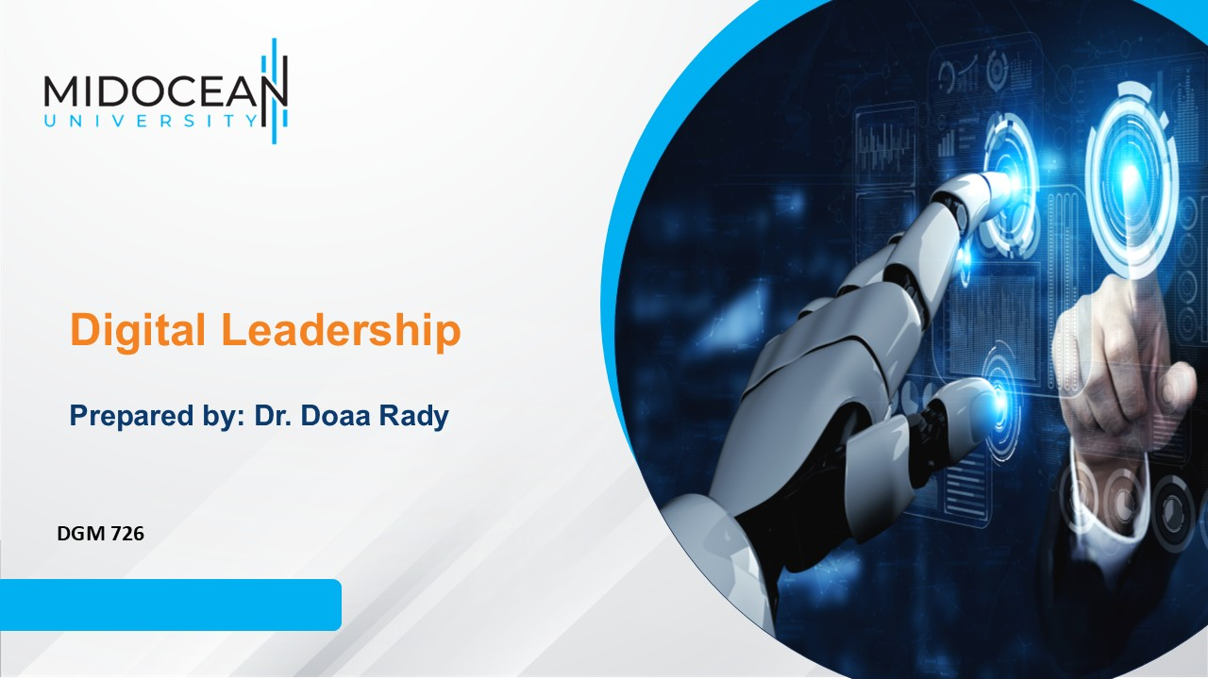
Lecture 5
Digital Transformation &
Digital Leadership

Slide 2

Last Lecture, we leaned about
  Styles of Leadership
    Autocratic
    Managerial
    Democratic
    Collaborative
    How do you determine what is an appropriate style?
    How do you choose and develop a leadership style?
Lec.5

Slide 3
Lecture outline
Lec.5
Today’s Lecture we will Know about
  The Digital Revolution
    Digitization
    Digitalization
    Digital Transformation
    Digital transformation in media
  Digital Leadership
    Definition
    Goals & strategy
  Digital leadership & Digital Transformation
  Importance of Digital Leadership in the Era of Digitalization

Slide 4
Learning Outcomes
Learn about the digital revolution and how it led to digital transformation and what are its tools.
Learn how Digital leadership can effectively achieve successful digital transformation, and what is the importance of digital leadership in the era of digitalization.
Lec.5

Slide 5
Introduction
Accuracy in communication is one of the most critical communication skills.
This applies to both verbal and written communications. Accuracy in communication puts you and your audiences on the same page. Your message is clearly and accurately delivered.
The possibility of misunderstandings, misinterpretations and even poor decisions, is radically reduced. Consistent communications also make future conversations easier, because the definitions are concrete, discussions about misunderstandings and ambiguities are avoided, and trust is built.
Many people have begun to conflate terminology either out of ignorance or for their own benefit, which creates confusion, because suddenly we’re talking about different things but calling them the same.
Some have begun labeling digitalization as digital transformation so, it is important to clarify difference between Digitization, Digitalization, and Digital Transformation.
Lec.5

Slide 6


Lec.5
Digitalization & Digitization

Slide 7
Digitalization & Digitization
Lec.5
Digitization
  The Digitization refers to creating a digital representation of physical objects or attributes. For instance, we scan a paper document and save it as a digital document (e.g., PDF). In other words, digitization is about converting something non-digital into a digital representation or artifact. Computerized systems can then use it for various use cases.
  Digitization is foundational. This is the connection between the physical world and software. This is what we been doing since the 1960s. It is an enabler for all the processes that provide business value because of the need for consumable data.

Slide 8
Digitalization & Digitization
Lec.5
Digitalization
  Digitalization refers to enabling or improving processes by leveraging digital technologies and digitized data. Therefore, digitalization presumes digitization. Digitalization improves an existing business process or processes but doesn’t change or transform them.
  Digitalization is the use of digital technologies to change a business model and provide new revenue and value-producing opportunities; it is the process of moving to a digital business.
  Digitalization affects many aspects of organizations, including information technology, strategy and business models, products and services, internal and external processes, organization, and company culture.

Slide 9
Digitalization & Digitization
Lec.5
Digitalization
  Digitalization has started showing its effect in day to day lives. From reading an e-newspaper to ordering food from an app to be delivered at one’s doorstep, from using a digital toothbrush that tracks the progress and effectiveness on a mobile device to shopping online for groceries and other items, most things are becoming digital. The continuous integration of digital technologies into businesses strategies has led to fundamental changes.

Slide 10
Digitalization & Digitization
Lec.5
The 20th century saw a massive change in the creation and spread of information. Beginning with the radio, moving through television and, eventually, the Internet, new technologies of mass dissemination could supply information directly to large numbers of people with unprecedented speed and efficiency.
Digitalization allowed to connect more than 8 billion devices worldwide, modified information value and management, and started to change the nature of organizations, their boundaries, work processes, and relationships.

Slide 11
Digitalization & Digitization
Lec.5
A Randstad US report, “Workplace 2025: The Post-Digital Frontier,” reveals that just over half (52%) of companies are still in the early stages of digital transformation. To remain competitive, companies must embrace technology and stay ahead of digital disruption and to do so digital leaders play a very important role.

Slide 12
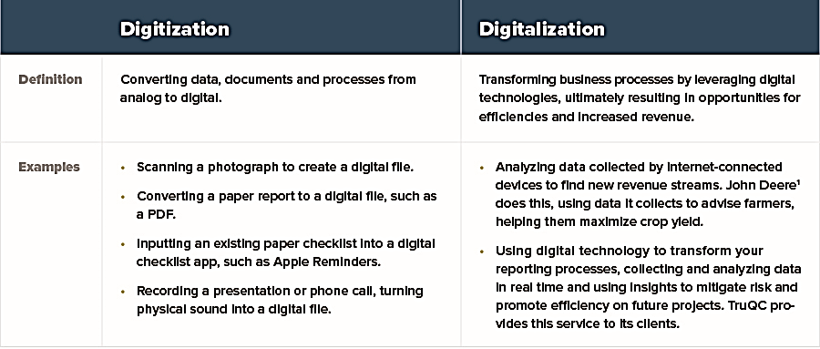


Digitalization & Digitization
Lec.5

Slide 13
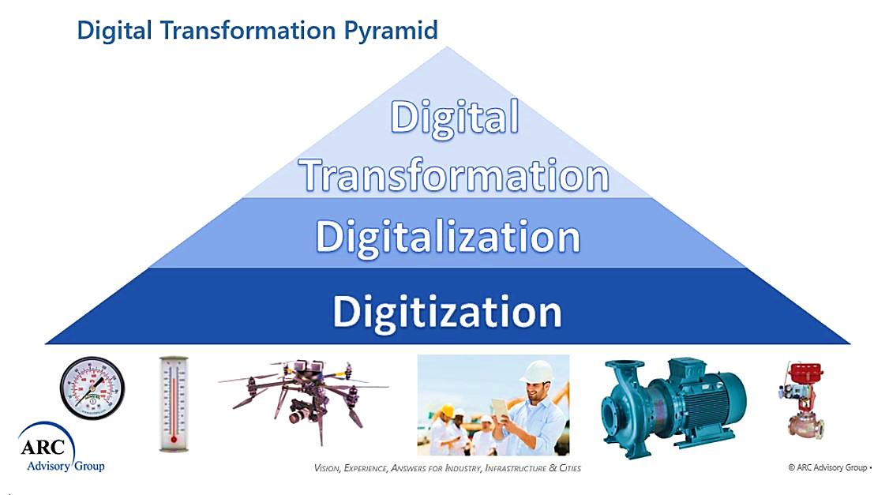
Digitalization & Digitization
Lec.5

Slide 14
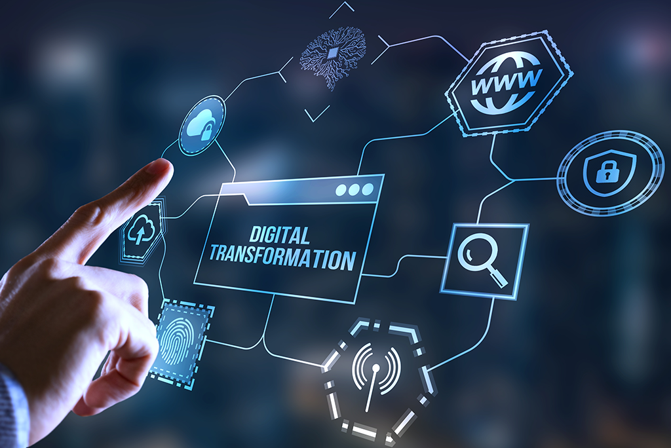
Lec.5
Digital Transformation

Slide 15
Lec.5
Digital Transformation
Digital Transformation is really business transformation enabled by digitalization. The “digital” moniker is a little bit of a misnomer because the essence of digital transformation is the changing of business processes enabled or forced by digitalization technologies.
Industry 4.0 is revolutionizing the way companies manufacture, improve and distribute their products. It focuses on the combination of Digital Transformation and Digitalization.

Slide 16
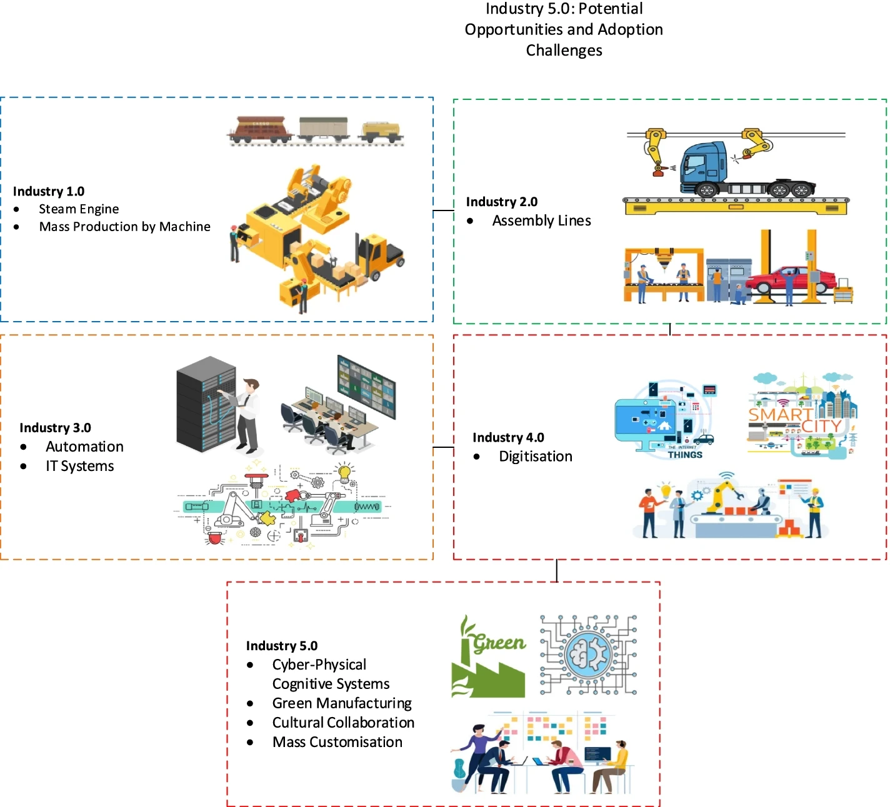
Lec.5
Digital
Transformation

Slide 17
Digital Transformation
Lec.5
The ability to redesign businesses digitally is largely driven by a clear digital strategy that is supported by executives that promote an adaptable and innovative culture.
It encompassed the incorporation of new digital technologies such as social media, artificial intelligence, and big data into business processes, as well as the subsequent development of new business models

Slide 18

Lec.5
Digital Transformation
What is digital transformation in media?
  D2C video streaming:
    One of the most notable trends is the move from traditional broadcasting to Direct-to-consumer (D2C) video streaming. The result is that viewers now have more control than ever over what they watch, when they watch it, and how they access it.

Slide 19
Lec.5
Digital Transformation
What is digital transformation in media?
  The role of artificial intelligence
    AI is being used to create more personalized content, improve audience targeting, and enhance the overall user experience. As a result, AI is becoming an essential tool for media companies looking to stay ahead of the curve. One of the most exciting trends in AI-driven media is the use of creative intelligence. By harnessing the power of AI, media companies are able to create better, more original content that resonates with audiences.

Slide 20
Lec.5
Digital Transformation
What is digital transformation in media?
  Deeper Forays into the Metaverse
    The metaverse is still, at best, an ambiguous concept to most enterprises and consumers alike. This is changing fast, however, as metaverse features and technologies like play-to-earn gaming, online property, non-fungible tokens (NFTs), and cryptocurrencies are becoming all the rage in 2022 and beyond. And despite crypto’s recent downturn, the metaverse and its foundational technologies are continuing to create new opportunities for media and entertainment businesses.

Slide 21
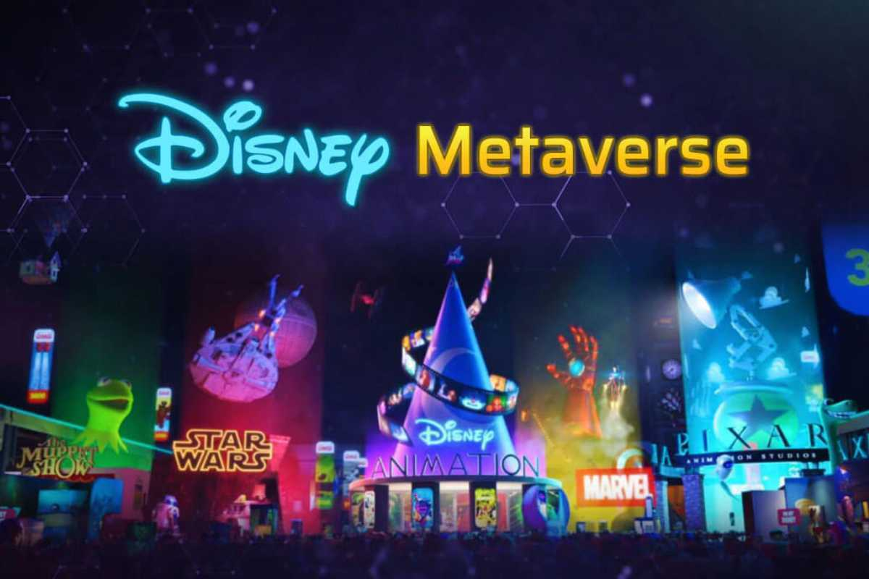

Digital Transformation
Lec.5
What is digital transformation in media?
  Deeper Forays into the Metaverse
    For instance, Disney launched its strategic initiative around the metaverse recently, in what it calls “next-generation storytelling.” And in June 2022, former Disney, Sony, and Lucasfilm creatives announced the kick-off of land sales for its “Notorious Frogs of Frogland” NFT collection and associated metaverse called “NewPangea.” It’s safe to assume that major film development and entertainment studios are looking towards the metaverse for blending physical and digital environments in new entertainment offerings.

Slide 22
Lec.5
Digital Transformation
What is digital transformation in media?
  Personalized content
    By using data about their readers, media companies can deliver tailored content that is more likely to engage and retain readers. This approach has already yielded success for some publishers, and it is expected to become even more widespread in the years to come.
    In conclusion, there are many benefits of embracing digital transformation in media, such as increased audience engagement, new revenue opportunities, and cost savings.

Slide 23

Lec.5
Digital Leadership

Slide 24
Digital Leadership
Lec.5
Digital technology has significant implications for leadership theory, practice, and development.
Leadership practices will face challenges in the future, because geographical and physical presence will be less important. Everything will be on virtual platforms including sharing, learning, and communicating. Workplaces will be more mobile, flexible, adaptable, multilingual, and culturally sensitive.

Slide 25
Digital Leadership
Lec.5
Yet there are practices and skills which are difficult or cannot be computerized: perception and manipulation (physical flexibility, dexterity, and balance); creative intelligence (artistic ability, originality); and social intelligence (persuasion, negotiation, caregiving) .
Leaders in the future would have to learn to keep up with new challenges of the digitalized world to lead their teams with highest efficiency.

Slide 26
Lec.5
Digital Leadership
Digital leadership is a process that is essential to developing and sustaining a culture of innovation by bringing ideas to fruition quickly using an agile IT and business architecture.
Digital leadership is going to be the topic of discussion in the coming years; this leadership style will be more important than ever to face the wave of digitalization. The topic of digital leadership is a perfect combination of management and technology.

Slide 27
Lec.5
Digital Leadership
Digital leadership contributes to business organizations achieving optimal management and optimal team collaboration, which in turn are crucial to the development of the global high-tech economy.
Companies need to invest in training, re-educating, and motivating their employees so that they can manage the steep learning curves and increased cognitive requirements of digitalization.

Slide 28
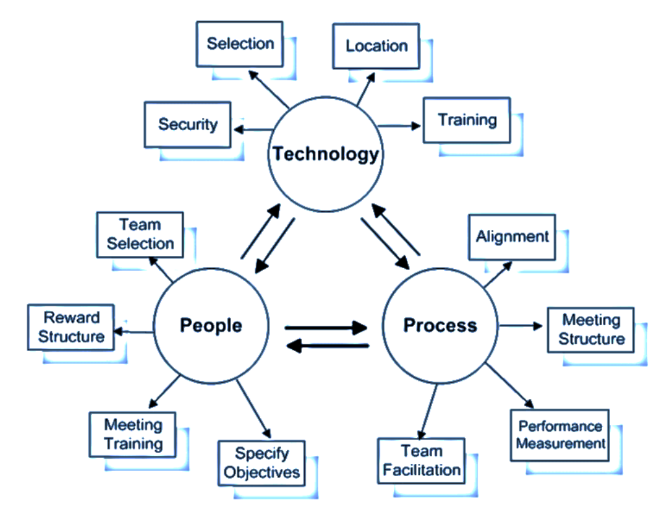
Lec.5
Digital Leadership
In conclusion, the concept of e-leadership is defined as a “social influence process mediated by Advanced Information Technology to produce a change in attitudes, feelings, thinking, behavior, and/or performance with individuals, groups, and/or organizations.”

Slide 29

Lec.5
Digital leadership &
Digital Transformation

Slide 30

Lec.5
Digital leadership & Digital Transformation
Digital disruption refers to a change in expectations and behaviors caused by, or expressed through, digital capabilities, channels, or assets, that radically alters the culture, market, industry, or process.
Innovation management is a combination of the management of innovation processes, and change management. It includes a set of tools that allow managers plus workers or users to cooperate with a common understanding of processes and goals.
The leader will increasingly act as an online influencer and integrator of virtual identities that are aligned around their own ideals and objectives. Digital leadership has been demonstrated to have a bigger impact on digital disruption than innovation management.
The sustainable competitive advantage afforded by technology and digitalization enables businesses to create a digitalization objective and guides organizations in determining how to accomplish this goal.

Slide 31
Lec.5
Digital leadership & Digital Transformation
In firms that have completed their digital transformation, the strategies that must be designed for digital environments have driven employees to seek answers to questions about digital environment orientation.
It has raised the question of how the leaders charged with these responsibilities should tackle the situation.
According to a study, responsive leadership, community leadership, learning and innovative leadership, open leadership, agile leadership, participatory leadership, network leadership, trust leadership, digital leadership, and collaborative leadership are all examples of leadership in the Industry 4.0 era.

Slide 32
Lec.5
Digital leadership & Digital Transformation
The reason for the rising interest in digital leadership during the Industry 4.0 period is that companies and academics are gradually noticing the changes and benefits brought about by digitalization and digital environments for institutions.
Leaders should understand that the transformation brought about by technology has the potential to significantly boost productivity and provide a competitive edge.
The digital leader's important variables are agility, participation, trust, networking, and openness.

Slide 33
Lec.5
Digital leadership & Digital Transformation
Essential tools for
Digital Transformation
Digital adoption platforms (DAPs)
Digital workplace suites
Team collaboration & communication tools
Social intranet tools
Cloud CRMs
HCM platforms
Employee self-service platforms
Cloud storage tools
Project management software
Digital accounting tools
CMS platforms
The digital leadership process leverages four critical platforms to facilitate business transformations:
  • An innovation platform that encourages teams to discover value-creating ideas through digital transformations;
  • An agile system and business platform for rapidly designing and delivering IT applications;
  • A learning platform that fosters reflective discourse and organizational capacity building;
  • They serve as an adoption platform for determining when and how to implement digital transformations.

Slide 34
Lec.5
Digital leadership & Digital Transformation
Digital leadership is founded on the systematic interaction and interdependence of three functional areas (strategic leadership, entrepreneurialism, and digital technology).
Employee identification with the organization should be enabled or encouraged through digital leadership. It entails considering online self-awareness and harmony, navigating the debate surrounding cyber kindness, and figuring out how to be a digital citizen capable of inspiring positive social change.

Slide 35
Lec.5
Digital leadership & Digital Transformation
Governance is the process of establishing a digital organization, including its vision, values, structure, culture, and decision-making procedures, as well as adjusting personnel management, virtual teams, knowledge management, and communication and cooperation on an individual basis.
The most successful digital transformations begin with a change in the mentality of leaders, who need to develop for this challenge.

Slide 36
Lec.5
Digital leadership & Digital Transformation
Just as digital transformation is more about people rather than technology, the key technological skills are soft skills rather than hard skills.
The best way to make an organization more data-centric and digital is to selectively invest in those who are most adaptable, curious, and flexible in the first place.

Slide 37

Lec.5
Importance of Digital Leadership
in the Era of Digitalization

Slide 38
Importance of Digital Leadership
in the Era of Digitalization
Lec.5
“Why digital leadership is important in the era of digitalization?”
  Every industry had to go through some level of digitalization to sustain.
  Digital Leadership plays a very important role during crises. (e.g., COVID-19)
  Empowers the company’s agility, efficiencies, and differentiation
  Significantly enables sensing market changes, seizing opportunities, and reconfiguring organizations.

Slide 39
Conclusion
Lec.5
We learned about
  The Digital Revolution
    Digitization
    Digitalization
    Digital Transformation
    Digital transformation in media
  Digital Leadership
    Definition
    Goals & strategy
  Digital leadership & Digital Transformation
  Importance of Digital Leadership in the Era of Digitalization

Slide 40


References
Lec.5
Sağbaş, Murat & Erdoğan, Fahri. (2022). Digital Leadership: A Systematic Conceptual Literature Review. 3. 17-35. Retrieved February 26, 2023, https://www.researchgate.net/publication/358729671
TruQC. (2022, August 17). Digitization vs. digitalization: Differences, definitions and examples. truqc.com. Retrieved February 26, 2023, from https://www.truqcapp.com/digitization-vs-digitalization-differences-definitions-and-examples/
Sen Gupta, M. (2020, March 24). What is digitization, digitalization, and digital transformation? ARC Advisory Group. Retrieved February 26, 2023, from https://www.arcweb.com/blog/what-digitization-digitalization-digital-transformation
Magenest. (2022, July 18). Digital Transformation in media: Definition, examples, and tips. Magenest. Retrieved February 26, 2023, from https://magenest.com/en/digital-transformation-in-media/
PDG Consulting. (2022, July 18). Top digital transformation trends for Media & Entertainment Enterprises in 2022. PDG. Retrieved February 26, 2023, from https://pdgc.com/top-digital-transformation-trends-for-media-entertainment-enterprises-in-2022/
Adel, A. Future of industry 5.0 in society: human-centric solutions, challenges and prospective research areas. J Cloud Comp 11, 40 (2022). https://doi.org/10.1186/s13677-022-00314-5
Karpenkova, A. (2022, April 1). 11 must-have tools to support Digital Transformation (2023). The Whatfix Blog | Drive Digital Adoption. Retrieved February 26, 2023, from https://whatfix.com/blog/digital-transformation-tools/

Slide 41



Thank You

