Slide 1



Critical Thinking
Prepared by Dr. Ahmed Alqarni
MGM 115
Lecture 5

Slide 2

Lecture 5
Analyzing Arguments
Mostly from Critical Thinking, Bassham and others
www.midocean.ae

Slide 3
Lecture 5
ANALYZING ARGUMENTS
This lecture includes:
Analyzing short arguments
Analyzing longer arguments
www.midocean.ae

Slide 4
Lecture 5
Introduction
To analyze an argument means to break it down into its various parts to see clearly what conclusion is defended and on what grounds. Analyzing arguments is an important critical reasoning skill because, we can’t think critically about what we don’t understand. In this chapter we discuss two methods for analyzing arguments, one for short arguments and one for longer arguments.
www.midocean.ae

Slide 5
Lecture 5
DIAGRAMMING SHORT ARGUMENTS
Diagramming is a quick and easy way to analyze relatively short arguments
(i.e., arguments that are roughly a paragraph in length or shorter). This section explains how the diagramming method works.
First, read through the argument and circle any premise or conclusion indicators you see.
For example: The death penalty should be abolished because it’s racially discriminatory, there’s no evidence that it’s a more effective deterrent than life imprisonment, and innocent people may be executed by mistake.
www.midocean.ae

Slide 6
Lecture 5
DIAGRAMMING SHORT ARGUMENTS
Second, number the statements consecutively as they appear in the argument:
➀ The death penalty should be abolished because ➁ it’s racially discriminatory, ➂ there’s no evidence that it’s a more effective deterrent than life imprisonment, and ➃ innocent people may be executed by mistake.
www.midocean.ae

Slide 7
Lecture 5
DIAGRAMMING SHORT ARGUMENTS
Third, arrange the numbers on a page with premises placed above the conclusions(s) they are claimed to support:
➁ ➂ ➃
➀
www.midocean.ae

Slide 8
Lecture 5
DIAGRAMMING SHORT ARGUMENTS
Fourth, omit any logically irrelevant statements—that is, statements that don’t function as either premises or conclusions in the argument. In this particular example, there are no logically irrelevant statements. Finally, using arrows to mean “is offered as evidence for,” create a kind of flowchart that indicates relationships of argumentative support:
➁ ➂ ➃
➀
www.midocean.ae

Slide 9
Lecture 5
DIAGRAMMING SHORT ARGUMENTS
In this argument each of the three premises provides independent support for the conclusion. A premise provides independent support for a conclusion when it provides a separate, freestanding reason for accepting the conclusion. More precisely, a premise provides independent support for a conclusion when the amount of support it provides would not be weakened or destroyed by the removal of any other premise in the argument. We symbolize this relationship of independent support by drawing arrows from each of the three premises to the conclusion.
www.midocean.ae

Slide 10
Lecture 5
DIAGRAMMING SHORT ARGUMENTS
In some arguments the premises work cooperatively, rather than independently, to support the argument’s conclusion.
For example:
➀ Every member of the Applewood Association is more than fifty years old.
➁ Bob is a member of the Applewood Association. So, ➂ Bob is more than
fifty years old.
Here the argument’s premises provide linked support for the conclusion. A premise provides linked support when it works conjointly with another premise to support the conclusion.
www.midocean.ae

Slide 11
Lecture 5
DIAGRAMMING SHORT ARGUMENTS
a premise provides linked support for a conclusion when the amount of support it provides would be weakened or destroyed by the removal of some other premise in the argument. We symbolize relationships of linked support by underlining the linked premises and putting a plus sign (+) between them. Thus, the argument above can be diagrammed as follows:
➀ + ➁
➂
www.midocean.ae

Slide 12
Lecture 5
DIAGRAMMING SHORT ARGUMENTS
The basic distinction between linked and independent premises isn’t hard
to understand. Two premises are linked if the omission of one of the premises would reduce the amount of support provided by the other. For example:
➀ No members of the Mill City High School marching band are Yankee
fans. ➁ Allan is a member of the Mill City High School marching band. So,
➂ Allan isn’t a Yankee fan.
In this example neither premise provides any support for the conclusion without the other. Taken together, however, the linked premises validly imply the conclusion.
www.midocean.ae

Slide 13
Lecture 5
Independent & Linked Premises
Linked premises
Independent premises
Two premises are linked when the omission of one of the premises would cancel or reduce the amount of support provided by the other.
Example
➀ No student at Wexford College is a
Rhodes Scholar.
➁ Melissa is a Rhodes Scholar.
➂ So, Melissa is not a student at Wexford College.
Two premises are independent when neither premise would provide less support for the conclusion if the other premise were omitted.
Example
➀ Nick doesn’t own a car.
➁ Nick is legally blind.
➂ So, Nick probably won’t drive a car to the game.
www.midocean.ae

Slide 14
Lecture 5
Example of independent premises
Example one:
➀ Ten witnesses say they saw Blotto rob the bank. ➁ The stolen bank
money was found in Blotto’s apartment. ➂ Blotto’s fingerprints were
found on the note the robber handed to the bank teller. Therefore, ➃
probably Blotto robbed the bank.
Example two:
➀ Agatha is a mother. ➁ Agatha is an aunt. Therefore, ➂ Agatha is a female.
www.midocean.ae

Slide 15
Lecture 5
Example of linked premises
If Amy runs marathons, she’s probably very fit. Amy does run marathons.
She’s also a B student. So, Amy probably is very fit.
First we circle all the premise and conclusion indicators:
If Amy runs marathons, she’s probably very fit. Amy does run marathons.
She’s also a B student. So , Amy probably is very fit.
Next we number the statements in the argument consecutively:
➀ If Amy runs marathons, she’s probably very fit. ➁ Amy does run marathons.
➂ She’s also a B student. So , ➃ Amy probably is very fit.
www.midocean.ae

Slide 16
Lecture 5
Example of linked premises
Then we check to see if there are any logically irrelevant statements in the
argument. In this case, statement ➂ is clearly irrelevant. It is simply an aside that provides no support whatsoever for the conclusion. Thus, we will omit it from our diagram.
Finally, we diagram the argument by arranging the numbers on a page
with premises placed above the conclusion(s) they are claimed to support. In this argument the conclusion indicator so indicates that ➃ is the conclusion.
Because ➀ supports ➃ only if it is conjoined with ➁, ➀ and ➁ provide linked support for ➃. Thus, the argument can be diagrammed as follows:
www.midocean.ae

Slide 17
Lecture 5
Example of linked premises
➀ + ➁
➃
www.midocean.ae

Slide 18
Lecture 5
Example of linked premises
Another example:
Most Democrats are liberals, and Senator Dumdiddle is a Democrat. Thus,
Senator Dumdiddle is probably a liberal. Therefore, Senator Dumdiddle
probably supports affirmative action in higher education, because most
liberals support affirmative action in higher education.
www.midocean.ae

Slide 19
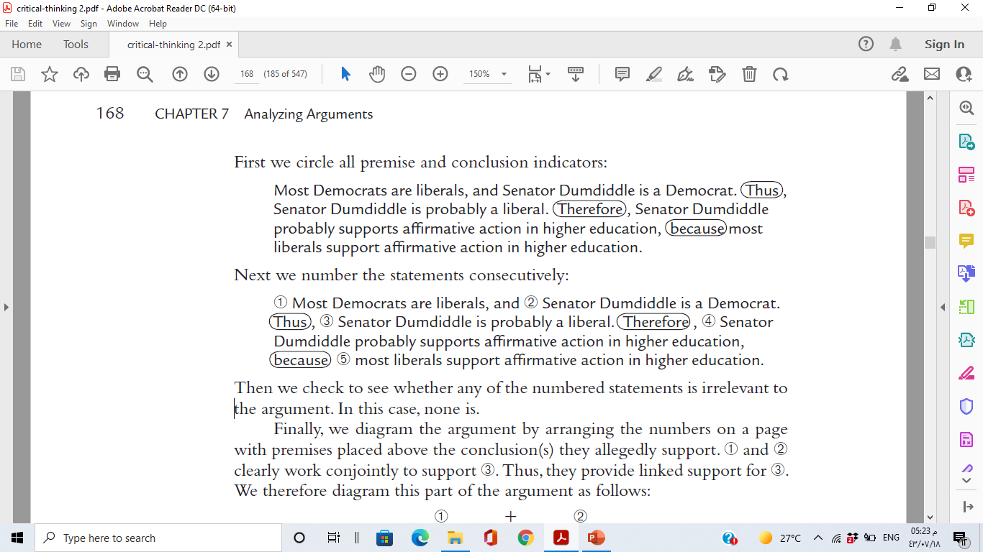
Lecture 5
Example of linked premises
www.midocean.ae

Slide 20
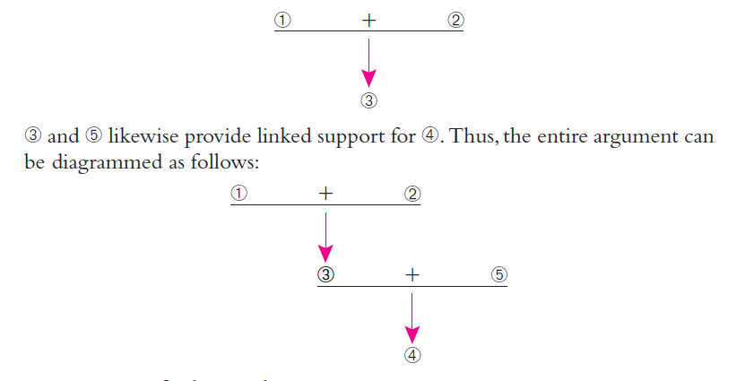
Lecture 5
Example of linked premises
www.midocean.ae

Slide 21
Lecture 5
Example of linked premises
A third example:
Cheating is wrong for several reasons. First, it will ultimately lower your
self-respect because you can never be proud of anything you got by cheating.
Second, cheating is a lie because it deceives other people into thinking
you know more than you do. Third, cheating violates the teacher’s trust
that you will do your own work. Fourth, cheating is unfair to all the people who aren’t cheating. Finally, if you cheat in school now, you’ll find it easier to cheat in other situations later in life—perhaps even in your closest personal relationships.
www.midocean.ae

Slide 22
Lecture 5
Example of linked premises
First we circle the premise and conclusion indicators:
Cheating is wrong for several reasons. First, it will ultimately lower your self respect because you can never be proud of anything you got by cheating.
Second, cheating is a lie because it deceives other people into thinking you know more than you do. Third, cheating violates the teacher’s trust that you will do your own work. Fourth, cheating is unfair to all the people who aren’t cheating. Finally, if you cheat in school now, you’ll find it easier to cheat in other situations later in life—perhaps even in your closest personal relationships.
www.midocean.ae

Slide 23
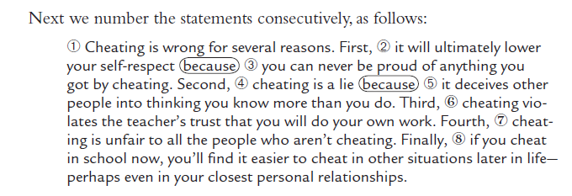
Lecture 5
Example of linked premises
www.midocean.ae

Slide 24
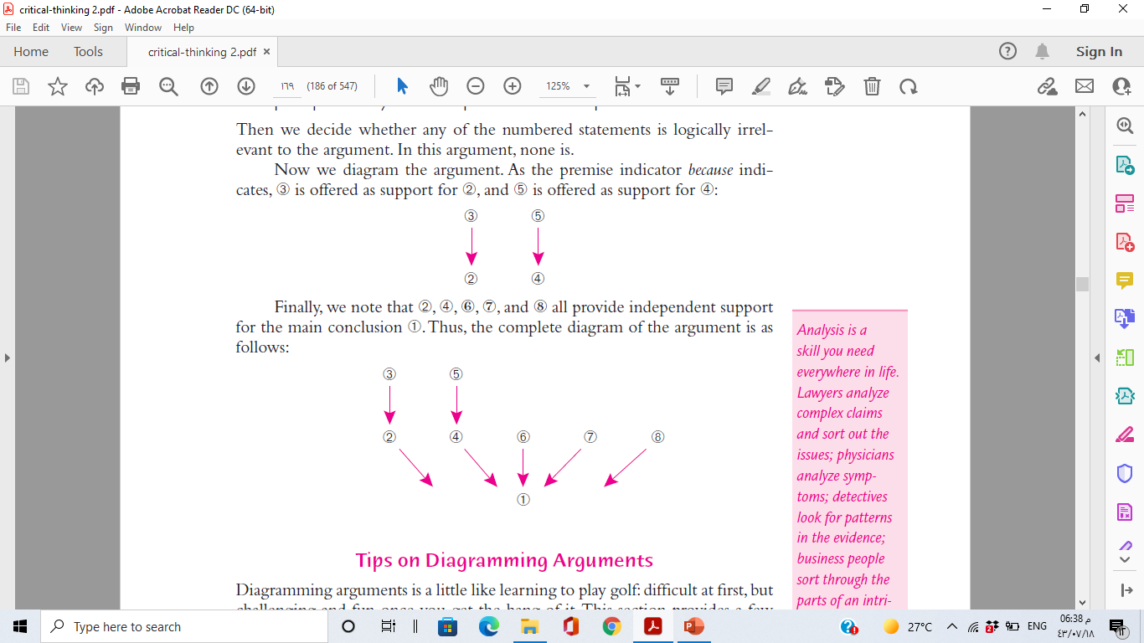
Lecture 5
Example of linked premises
www.midocean.ae

Slide 25
Lecture 5
Tips on Diagramming Arguments
Find the main conclusion first. It is easy to get lost if you don’t have a clear idea where you are going. For that reason it is often a good idea, especially when diagramming complex arguments, to start by locating the main conclusion and then working back through the passage to see how the argument as a whole works together to support the conclusion.
2. Pay close attention to premise and conclusion indicators. One common mistake students make in diagramming arguments is to overlook premise and conclusion indicators such as since, as, so, and because.
www.midocean.ae

Slide 26
Lecture 5
Tips on Diagramming Arguments
3- Remember that sentences containing the word and often contain two or more separate statements. We have seen that a single sentence frequently expresses two or more distinct statements. Sometimes these statements are separated by the word and. For example:
Never fly Cattle Car Airlines. They’re never on time, and the food tastes like warmed-over cardboard.
Here the second sentence is a compound sentence that expresses two logically distinct premises separated by the word and. These distinct premises should be diagrammed separately.
www.midocean.ae

Slide 27
Lecture 5
Tips on Diagramming Arguments
4. Treat conditional statements (if-then statements ) and disjunctive statements (either-or statements ) as single statements.
5. Don’t number or diagram any sentence that is not a statement. Arguments,
by definition, consist entirely of statements—that is, sentences that it makes sense to regard as either true or false. Consequently, questions, suggestions, exclamations, and other non statements should be omitted from argument diagrams.
www.midocean.ae

Slide 28
Lecture 5
Tips on Diagramming Arguments
6. Don’t diagram irrelevant statements. In real life most lengthy and complex arguments contain logically irrelevant statements—that is, statements that don’t support the conclusion in any way. Because the purpose of an argument diagram is simply to map the logical structure of an argument, such statements should be omitted.
7. Don’t diagram redundant statements. Many arguments contain redundant statements—that is, statements that basically repeat what’s already been said. Such statements are often useful for rhetorical purposes, but they should be omitted in argument diagrams because they merely clutter the argument.
www.midocean.ae

Slide 29
Lecture 5
SUMMARIZING LONGER ARGUMENTS
Diagramming works well with relatively short arguments, but with longer arguments it quickly becomes tedious and confusing. Consequently, it is usually better to summarize lengthy arguments rather than diagram them. In summarizing we don’t try to identify every single step in an argument. Instead, the goal of an argument summary is to provide a synopsis of the argument that accurately restates the main points in the summarizer’s own words. In this section we introduce a method for summarizing longer arguments called standardization.
www.midocean.ae

Slide 30
Lecture 5
SUMMARIZING LONGER ARGUMENTS
Summarizing involves two skills of argument analysis that are not generally used in argument diagramming, namely, paraphrasing and finding missing premises and conclusions. Let’s look at these two skills before we introduce our technique for summarizing arguments.
www.midocean.ae

Slide 31
Lecture 5
Paraphrasing
A paraphrase is a detailed restatement of a passage using different words and phrases. A good paraphrase is accurate, clear, concise, and charitable. Let’s look at each of these four qualities.
www.midocean.ae

Slide 32
Lecture 5
Paraphrasing
A Good Paraphrase Is Accurate The first virtue of a good paraphrase is that it is accurate. An accurate paraphrase is faithful to an author’s intended meaning; it reproduces that meaning fairly and without bias or distortion.
A Good Paraphrase Is Clear Arguments are often expressed in language
that is needlessly wordy or confusing. Because one of the basic aims of an argument summary is to clarify what an argument is saying, it’s often necessary to translate (i.e., paraphrase) complex or confusing language into language that’s easier to understand.
www.midocean.ae

Slide 33
Lecture 5
Paraphrasing
A Good Paraphrase Is Concise. A good summary captures the essence of an argument. It strips away all the irrelevant or unimportant details and puts the key points of the argument in a nutshell. To lay bare the essence of an argument, it is often necessary to paraphrase portions that can be stated more briefly than they are by the author.
A Good Paraphrase is Charitable. It is often possible to interpret a passage
in more than one way. In such cases, the principle of charity requires that
we interpret the passage as charitably as the evidence reasonably permits
www.midocean.ae

Slide 34
Lecture 5
Finding Missing Premises and Conclusions
In real life, people often leave parts of their arguments unstated. Sometimes a premise is left unstated: Example:
Store clerk: I’m sorry, I can’t sell you any beer; you’re under twenty-one.
Implied here is the premise, “I can’t sell beer to anyone under twenty-one.”
In other cases, a conclusion is left unstated:
Advertisement: The bigger the burger, the better the burger. Burgers are
bigger at Burger King.
Implied here is the conclusion, “Burgers are better at Burger King.”
www.midocean.ae

Slide 35
Finding Missing Premises and Conclusions
Lecture 5
There are many reasons why a premise or conclusion might be implied rather than stated. Sometimes the missing statement is something so obvious and familiar that it would be tedious to state it explicitly.
For example: Sally can’t drive because she doesn’t have a driver’s license.
Understood here is the premise, “No one can drive without a driver’s license.” This is something so widely known that in most contexts it can simply be assumed.
At other times an arguer may leave a premise or conclusion unstated because he wishes to conceal a weak or questionable step in his argument. For example: She’s Cuban, so she’s probably hot-tempered.
Here the unstated premise is “Most Cubans are hot-tempered.”
www.midocean.ae

Slide 36
Finding Missing Premises and Conclusions
Lecture 5
An argument with a missing premise or conclusion is called an enthymeme.
There are two basic rules in filling in missing steps in enthymemes:
1. Faithfully interpret the arguer’s intentions. The most important rule in filling in missing premises and conclusions is to be as accurate as possible in interpreting an arguer’s intent. A missing premise or conclusion is a
genuine part of an argument only if it was implicitly understood to be
part of the argument by the arguer himself. Consequently, we should
always try to fill in a missing step in an argument in a way that the
arguer himself would recognize as expressing his own thought.
www.midocean.ae

Slide 37
Finding Missing Premises and Conclusions
Lecture 5
2. Be charitable. Sometimes it is difficult or impossible to know what
unstated premise or conclusion an arguer had implicitly in mind.
In such cases, the principle of charity requires that we interpret the
argument as generously as possible.
Be as generous in interpreting other people’s incompletely stated arguments as you would like them to be in interpreting your own.
www.midocean.ae

Slide 38
Lecture 5
Summarizing Extended Arguments
The method for summarizing longer arguments is called standardization because it consists of restating an argument in standard logical form. An argument is said to be in standard logical form when each step in the argument is numbered consecutively, premises are stated above the conclusions they are claimed to support, and justifications are provided for each conclusion in the argument.
www.midocean.ae

Slide 39
How to Standardize an Extended Argument
Lecture 5
1. Read through the argument carefully and try to identify its main conclusion (it may be only implied). Once you have identified the main conclusion, go back through the argument to identify major premises and subconclusions offered in support of the main conclusion. Paraphrase as needed to clarify meaning.
2. Omit any unnecessary or irrelevant material. Focus only on the key
points in the argument. Omit any statements that provide little or no
direct support for the main conclusion.
www.midocean.ae

Slide 40
How to Standardize an Extended Argument
Lecture 5
3. Number the steps in the argument and stack them in correct logical order (i.e., with the premises placed above the conclusions they are intended to support). State the main conclusion last.
4. Fill in any key missing premises or conclusions. Don’t worry about filling in all missing steps in the argument. Include only those missing premises or conclusions that are important in understanding and evaluating the central argument. Place brackets around implied statements to indicate that they have been added to the argument.
www.midocean.ae

Slide 41
How to Standardize an Extended Argument
Lecture 5
5. Add parenthetical justifications for each conclusion in the argument. In other words, for each conclusion or subconclusion, indicate in parentheses from which previous lines in the argument the conclusion or subconclusion is claimed to directly follow.
www.midocean.ae

Slide 42
Lecture 5
Example of Standardizing an Extended Argument
Regarding your editorial (Sept. 7), “Give us better SAT scores,” that’s the last thing we need! It is common knowledge that many successful entrepreneurs and inventors were not high honor students. In fact, many were high school and college drop-outs, and many did not get outstanding SAT scores.
Professional speaker Jim Rohn states: “Formal education will earn you a living. Self-education will earn you a fortune. You determine how much of a fortune you will earn by how much self education you decide to get.”
So, there must be better predictors of success than grades and standardized tests. As a business owner, I want to hire people who have excellent people skills and positive attitudes and are committed to doing quality work. These skills are a million times more important to me, as well as to other employers in the long run, than perfect SAT scores.
In my opinion, our country is in the shape it’s in because of our illiteracy in human relations. Memorization-based education does not teach our children how to find answers, solve problems, deal with difficulties in their personal or professional lives, take responsibility for their actions, or develop their skills and talents. It does encourage people to seek the easy way out. And it destroys our children’s ability to use their common sense.
www.midocean.ae

Slide 43
Lecture 5
Example of Standardizing an Extended Argument
The United States has more people in prison, in terms of percentage of population, than any other nation. They’re not there because they didn’t memorize easily looked-up information.
The political and power structures of the medical community as well as our legal system damage our country with their lack of common sense. Throughout history, mainstream organizations have always resisted change. The most educated people believed the earth was flat. It was the so-called dumbbell who proved them wrong.
If we want high scores, let’s get them in kindness. In the words of Theodore Roosevelt, “The most important single ingredient in the formula of success is knowing how to get along with people.”
So tell me about the schools where our kids get great grades in kindness and consideration. You can build a life on those traits. We can build bombs and prisons when we focus on the opposite.
www.midocean.ae

Slide 44
Lecture 5
Example of Standardizing an Extended Argument
This argument is neither as clear nor as well organized as the previous argument we examined. Here is one reader’s attempt to summarize the writer’s central argument:
www.midocean.ae

Slide 45
Lecture 5
Example of Standardizing an Extended Argument
1. Memorization-based education does not teach our children how to find answers, solve problems, deal with difficulties in their personal or professional lives, take responsibility for their actions, or develop their skills and talents.
2. Memorization-based education encourages people to take the easy way out and destroys our children’s ability to use their common sense.
3. Memorization-based education is largely responsible for the bad shape this country is in today, including the high prison population and the lack of basic common sense in our medical and legal communities.
4. [Thus, memorization-based education is a mistake. (from 1–3)]
5. [The SAT is mainly a test of memorized information.]
6. Many successful entrepreneurs and inventors were high school or college drop-outs who did not get outstanding SAT scores.
7. Good people skills are a million times more important to employers than perfect SAT scores.
8. Thus, success in life depends much more on good people skills than it does on good grades or high SAT scores. (from 6–7)
9. [Therefore, contrary to the September 7 editorial, it is much more important for schools to teach good people skills than it is for them to teach the kinds of memorized information tested on the SAT. (from 4–5, 8)]
www.midocean.ae

Slide 46
Lecture 5
SUMMARY
1. In this chapter we learned how to analyze arguments. To analyze an argument means to break it up into its various parts to see clearly what conclusion is being defended and on what grounds.
2. To analyze short arguments we use a method called diagramming, which involves six basic steps:
a. Read through the argument carefully, circling any premise or conclusion
indicators you see.
b. Number the statements consecutively as they appear in the argument.
(Don’t number any sentences that are not statements.)
www.midocean.ae

Slide 47
Lecture 5
SUMMARY
c. Arrange the numbers spatially on a page with the premises placed above the conclusion(s) they are alleged to support. Omit any irrelevant or redundant statements.
d. Using arrows to mean “is evidence for,” create a kind of flowchart that
shows which premises are intended to support which conclusions.
e. Indicate independent premises by drawing arrows directly from the
premises to the conclusions they are claimed to support. Indicate linked
premises by placing a plus sign between each of the linked premises,
underlining the premises, and drawing an arrow from the underlined
premises to the conclusions they are claimed to support.
f. Put the argument’s main conclusion last.
www.midocean.ae

Slide 48
Lecture 5
SUMMARY
(Two premises are independent if neither premise would provide less support for the conclusion if the other premise were removed. Two premises are linked if at least one of the premises would provide less support for the conclusion if the other premise were removed.)
f. Put the argument’s main conclusion last.
www.midocean.ae

Slide 49
Lecture 5
SUMMARY
3. To analyze longer arguments, we use a method called standardizing. There are five basic steps in standardizing arguments:
a. Read through the argument carefully. Identify the main conclusion (it may be only implied) and any major premises and subconclusions. Paraphrase as needed to clarify meaning. (A paraphrase is a restatement of a passage using different words and phrases. A good paraphrase is clear, concise, accurate, and charitable.)
b. Omit any unnecessary or irrelevant material.
www.midocean.ae

Slide 50
Lecture 5
SUMMARY
c. Number the steps in the argument and list them in correct logical order (i.e., with the premises placed above the conclusions they are intended to support).
d. Fill in any key missing premises and conclusions.
e. Add justifications for each conclusion in the argument. In other words,
for each conclusion or subconclusion, indicate in parentheses from which previous lines in the argument the conclusion or subconclusion is claimed to directly follow.
www.midocean.ae

Slide 51




Thank You

