Slide 1

Research Methods
Prepared by
Dr. Mahitab ELrafii
Lecture No.5
Research Methods

Slide 2

Sources of Knowledge
Research Methods
Dr. Mahitab ELrafii
Research questions and objectives

Slide 3

Content of lecture
Lecture 5
The Content of lecture 5 Includes the following:
What is an academic research question?
Importance of the research question.
Types of Research Questions
Steps to Developing a Good Research Question
Examples of Good and Bad Research Questions
Important Points to Keep in Mind in Creating a Research Question
Research Objectives
Why are research objectives important?
How to write research objectives?

Slide 4

Lecture 5
What is an academic research question?
A research question is a question that a study or research project aims to answer. This question often addresses an issue or a problem, which, through analysis and interpretation of data, is answered in the study's conclusion.

Slide 5


Lecture 5
What is a Research Question?
In most studies, the research question is written so that it outlines various aspects of the study, including the population and variables to be studied and the problem the study addresses.

Slide 6

Lecture 5
What is a Research Question?
As their name implies, a research question is often grounded on research. As a result, these questions are dynamic; this means researchers can change or refine the research question as they review related literature and develop a framework for the study. While many research projects will focus on a single research question, larger studies often use more than one research question.

Slide 7
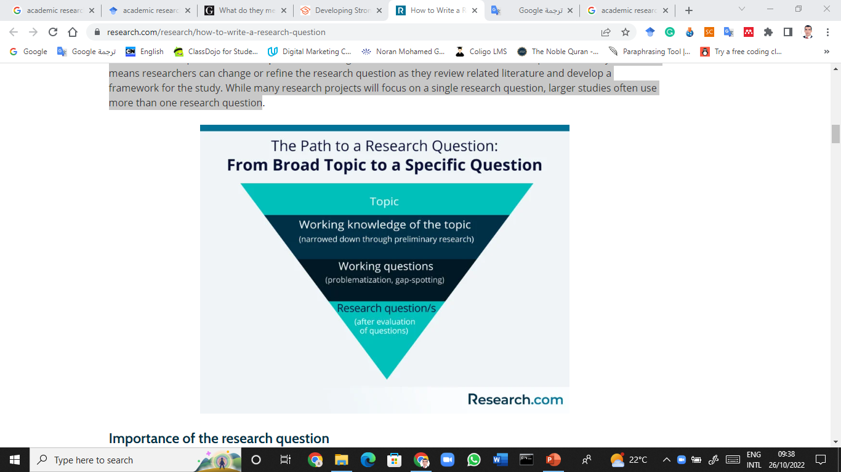
Lecture 5
What is a Research Question?

Slide 8

Lecture 5
Importance of the research question
The primary importance of framing the research question is that it narrows down a broad topic of interest into a specific area of study. Research questions, along with hypotheses, also serve as a guiding framework for research. These questions also specifically reveal the boundaries of the study, setting its limits, and ensuring cohesion.

Slide 9

Lecture 5
Importance of the research question
Moreover, the main research question has an effect on the rest of the study questions. These questions influence factors, such as the Research Methodology, sample size, data collection, and data analysis.

Slide 10

Lecture 5
Types of Research Questions
Research questions can be classified into different categories, depending on the type of research to be done. Knowing what type of research, one wants to do—quantitative, qualitative, or mixed-methods studies—can help in determining the best type of research question to use.
Doody and Bailey (2016) suggest a number of common types of research questions, as outlined below.

Slide 11

Lecture 5
Quantitative research questions
Quantitative research questions are precise. These questions typically include the population to be studied, dependent and independent variables, and the research design to be used. They are usually framed and finalized at the start of the study .
Quantitative research questions also establish a link between the research question and the research design.

Slide 12
Lecture 5
Quantitative research questions
Moreover, these questions are not answerable with “yes” or “no” responses. As a result, quantitative research questions don’t use words such as “is,” “are,” “do,” or “does.”
Quantitative research questions usually seek to understand particular social, familial, or educational experiences or processes that occur in a particular context and/or location (Marshall & Rossman, 2011). They can be further categorized into three types: descriptive, comparative, and relationship.

Slide 13

Lecture 5
Quantitative research questions
Descriptive research questions aim to measure the responses of a study’s population to one or more variables or describe variables that the research will measure. These questions typically begin with “what.”
Comparative research questions aim to discover the differences between two or more groups for an outcome variable.

Slide 14
Lecture 5
Quantitative research questions
These questions can be causal, as well. For instance, the researcher may compare a group where a certain variable is involved and another group where that variable is not present.
Relationship research questions seek to explore and define trends and interactions between two or more variables. These questions often include both dependent and independent variables and use words such as “association” or “trends.

Slide 15

Lecture 5
Qualitative research questions
Qualitative research questions may concern broad areas of research or more specific areas of study. Similar to quantitative research questions, qualitative research questions are linked to research design. Unlike their quantitative counterparts, though, qualitative research questions are usually adaptable, non-directional, and more flexible (Creswell, 2013). As a result, studies using these questions generally aim to “discover,” “explain,” or “explore.”

Slide 16
Lecture 5
Qualitative research questions
Ritchie et al. (2014) and Marshall and Rossman (2011) have also further categorized qualitative research questions into a number of types, as listed below:
Contextual research questions seek to describe the nature of what already exists.
Descriptive research questions attempt to describe a phenomenon.
Emancipatory research questions aim to produce knowledge that allows for engagement in social action, especially for the benefit of disadvantaged people.

Slide 17
Lecture 5
Qualitative research questions
Evaluative research questions assess the effectiveness of existing methods or paradigms.
Explanatory research questions seek to expound on a phenomenon or examine reasons for and associations between what exists.
Exploratory research questions investigate little-known areas of a particular topic.
Generative research questions aim to provide new ideas for the development of theories and actions.
Ideological research questions are used in research that aims to advance specific ideologies of a position.

Slide 18

Lecture 5
Mixed-methods studies
Mixed-methods studies typically require a set of both quantitative and qualitative research questions. Separate questions are appropriate when the mixed-methods study focuses on the significance and differences in quantitative and qualitative methods and not on the study’s integrative component.
Researchers also have the option to develop a single mixed-methods research question. According to Tashakkori and Teddlie (2010), this suggests an integrative process or component between the study’s quantitative and qualitative research methods. :

Slide 19

Lecture 5
Steps to Developing a Good Research Question
Before learning how to write a research paper, you must first learn how to create a research question. In general, a good research question should be relevant, determinative and meaningful (Stone, 2002). Creating a research question can be a difficult process, but there is a specific method you can take to make the process easier. The steps of this method as follow:

Slide 20
Lecture 5
1. Start with a broad topic.
When researching a topic, it is wise to choose the field of study you are really interested in, as your interest in a topic will affect your motivation levels during your research. It is also wise to take into account the interests that the research community has taken up recently, as this may affect the chances of your paper being published.

Slide 21
Lecture 5
2. Do preliminary research
to learn about topical issues.
Once you have chosen a topic, you can begin to do preliminary research. This initial phase of research accomplishes two goals. First, a preliminary review of the relevant literature allows you to discover issues that are currently being discussed by scientists and fellow researchers. In this way, you get up-to-date and relevant knowledge of your topic.
Second, a preliminary review of the relevant literature allows you to identify gaps or limitations in existing knowledge of your topic. With a certain amount of fine tuning, you can later use these gaps as the focus of your research question.

Slide 22
Lecture 5
3. Narrow down your topic and determine potential research questions.
Once you have gathered enough knowledge about the subject you want to pursue, you can begin to focus on a more specific field of study. One option is to focus on gaps in existing knowledge or recent literature. Referred to by Sandberg and Alvesson (2011) as 'gap finding', this method involves creating research questions from limitations identified in the literature and areas of study that have been overlooked. Likewise, researchers can choose research questions that expand or complement the findings of the existing literature.

Slide 23
Lecture 5
4. Evaluate the soundness
of your research question.
Your initial research and review of related literature will have produced some interesting questions that seem like they’re worth pursuing. However, not all interesting questions make for sound research questions. Keep in mind that a research question draws its answer or conclusion through an analysis of evidence

Slide 24
Lecture 5
4. Evaluate the soundness
of your research question.
Hulley et al. (2007) suggest using a set of criteria- known as the “FINER” criteria-to find out if you have a good research question. The FINER criteria are outlined below::
1– Feasible:
A good research question is feasible, which means that the question is well within the researcher’s ability to investigate. Researchers should be realistic about the scale of their research as well as their ability to collect data and complete the research with their skills and the resources available to them. It’s also wise to have a contingency plan in place in case problems arise

Slide 25
Lecture 5
4. Evaluate the soundness
of your research question
2 – Interesting
The ideal research question is interesting not only to the researcher but also to their peers and community. This interest boosts the researcher’s motivation to see the question answered.
3– Novel
Your research question should be developed to bring new insights to the field of study you are investigating. The question may confirm or extend previous findings on the topic you are researching, for instance.

Slide 26
Lecture 5
4. Evaluate the soundness of your research question
4 – Ethical
This is one of the more important considerations of making a research question. Your research question and your subsequent study must be something that review boards and the appropriate authorities will approve.
5 – Relevant
Aside from being interesting and novel, the research question should be relevant to the scientific community and people involved in your area of study. If possible, your research question should also be relevant to the public’s interest.

Slide 27

Lecture 5
Examples of Good and Bad Research Questions
The following examples of research questions can further guide researchers in forming a research question correctly.
example no. 1
Bad: How does social media affect people's behavior?
Good: What is the effect of daily use of YouTube on the attention span of children under 16?
The first research question is considered bad because of the ambiguity of "social media" as a concept and the question's lack of specificity. A good research question should be specific and focused, and its answer should be discovered through data collection and analysis. You can also hone your ability to form well-formed and specific research questions by improving your reading skills.

Slide 28
Lecture 5
Examples of Good and Bad Research Questions
Example no. 2
Bad: Has there been an increase in childhood obesity in the US in the past 10 years?
Good: How have school intervention programs and parental education levels affected the rate of childhood obesity among 1st to 6th-grade students?
In the second example, the first research question is not ideal because it’s too simple, and it’s easily answerable by a “yes” or “no.” The second research question is more complicated; to answer it, the researcher must collect data, perform in-depth data analysis, and form an argument that leads to further discussion.

Slide 29
Lecture 5
Important Points to Keep
in Mind in Creating a Research Question
Developing the right research question is an important first step in the research process. The main points outlined below should assist researchers in their pursuit:
The development of a research question is an iterative process that involves constantly updating one's knowledge on the topic and refining ideas at all stages (Maxwell, 2013).
Stay up-to-date with current trends, recent research studies, and technological advancements in the field of study you are pursuing.
Make your research question as specific and concise as possible to ensure clarity. Avoid using words or terms that do not add to the meaning of the research question.
Aside from conducting a literature review, seek input from experts in the field, mentors, and colleagues. This input can be useful not only for the research question but also for creating the rest of the study.

Slide 30
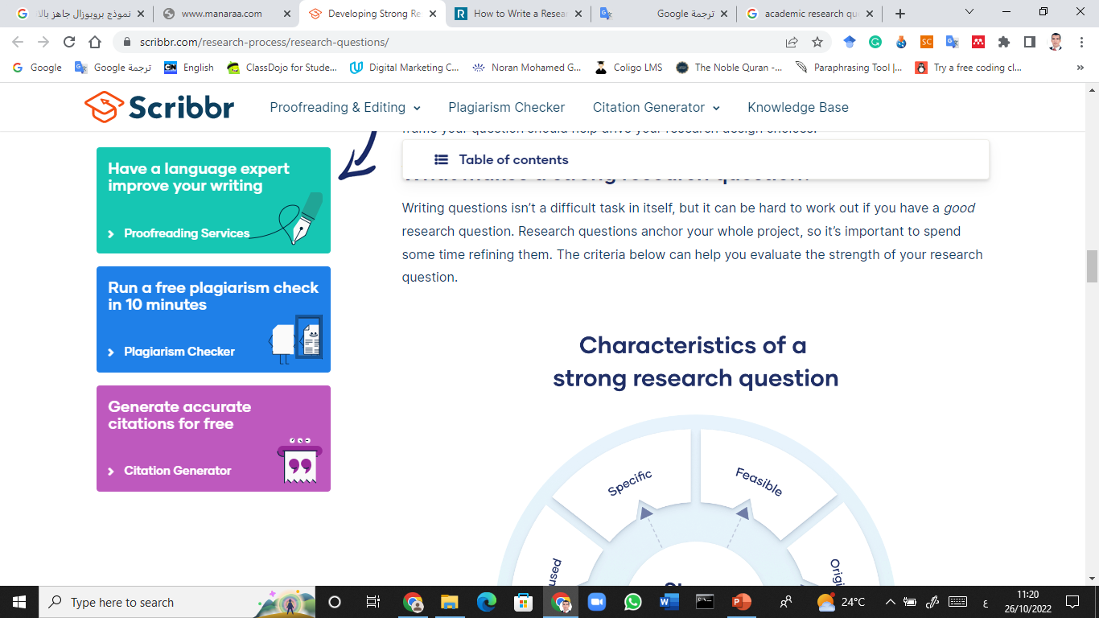
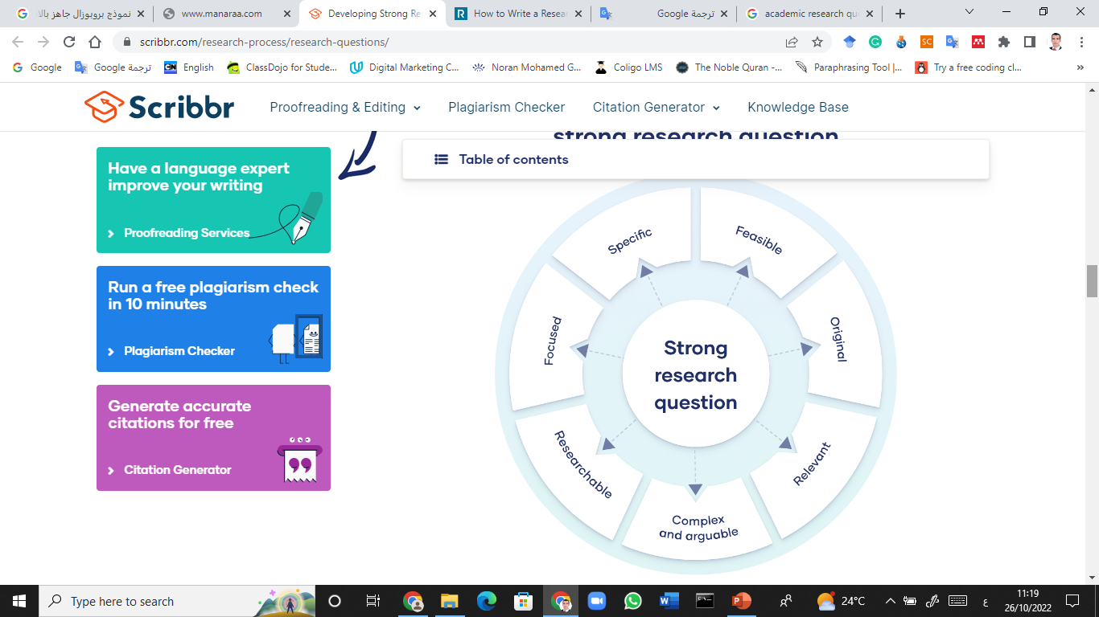
Lecture 5

Slide 31

Research Objectives
Research objectives describe what your research is trying to achieve and explain why you are pursuing it. They summarize the approach and purpose of your project and help to focus your research.

Slide 32
Lecture 5
What is a research objective?
Research objectives describe what your research project intends to achieve. They should guide every step of the research process, including how to collect data, build your argument, and develop your conclusions.
Your research objectives may evolve slightly as your research progresses, but they should always align with the research conducted and the actual content of your research paper.

Slide 33
Lecture 5
Why are research objectives important?
Research objectives are important because:
Determine the scope and depth of your project: This helps you avoid unnecessary searching. This also means that research methods and conclusions can easily be evaluated.

Slide 34
Lecture 5
Why are research objectives important?
Contribute to the design of your research: When you know what your goals are, you have a clearer idea of which methods are most appropriate for your research.
Explain how your project will contribute to current research: it allows you to showcase your knowledge of the latest research, employ or build on existing research methods, and attempt to contribute to recent discussions.

Slide 35
Lecture 5
How to write research objectives
Once you've created a research problem that you want to tackle, you need to decide how you're going to tackle it. This is where the research objective and objectives come in.

Slide 36
Lecture 5
How to write research objectives
Step 1: Decide on a general aim
Your research aim should reflect your research problem and should be relatively broad.
Step 2: Decide on specific objectives
Break down your aim into a limited number of steps that will help you resolve your research problem. What specific aspects of the problem do you want to examine or understand?
.

Slide 37
Lecture 5
How to write research objectives
Step 3: Formulate your aims and objectives
Once you’ve established your research aim and objectives, you need to explain them clearly and concisely to the reader.
You’ll lay out your aims and objectives at the end of your problem statement, which appears in your introduction. Frame them as clear declarative statements and use appropriate verbs to accurately characterize the work that you will carry out.

Slide 38
Lecture 5
SMART research objectives
Specific: Make sure your objectives aren’t overly vague. Your research needs to be clearly defined in order to get useful results.
Measurable: Know how you’ll measure whether your objectives have been achieved.
Achievable: Your objectives may be challenging, but they should be feasible. Make sure that relevant groundwork has been done on your topic

Slide 39
Lecture 5
SMART research objectives
Relevant: Make sure that they directly address the research problem you want to work on and that they contribute to the current state of research in your field.
Time-based: Set clear deadlines for objectives to ensure that the project stays on track.

Slide 40
Lecture 5
Thank you

