Slide 1

Interaction Design (DGM 729)
Prepared by
Dr. Mohamed Owies
Lecture_Intro
Interaction Design (DGM 719)

Slide 2
Course Description
Interaction Design

Slide 3
Intro lecture
Content
This Lecture will include the following points:
Course Description
Learning Outcomes
Topics
Recommended Reference
User Experience Team of One
What is a user experience team of one?
Introduction.

Slide 4
Intro lecture
Course Description
This course equips students with the mindset, methods, and practical tools necessary to thrive as independent UX practitioners within organizations that have limited or no dedicated UX teams. Moreover, It offers a hybrid learning experience that combines foundational theory with hands-on practice, empowering learners to lead UX initiatives single-handedly and drive user-centered innovation in challenging environments.

Slide 5


Intro lecture
Course Description
The course will encourage you to be self-reflexive of the concepts, decisions and assumptions involved in your digital design practice or scholarly work.
Central design debates and topics will be explored, including:
Software/internet design history.
User interface design.
Collaborative or participatory design.
Considerations of intellectual property
Creative commons.

Slide 6



Intro lecture
Learning Outcomes
After completing this course, students should be able to:
User Experience Design introduces the fundamentals of user experience (UX) and user interface (UI) design.
Develop an understanding of core UX principles and definitions.
Explore the psychological foundations that influence human behavior and decision-making in digital environments.
Identify and explain the key components that shape the overall user experience.
Gain a comprehensive view of the entire UX design process and its life cycle.

Slide 7

Intro lecture
Learning Outcomes
After completing this course, students should be able to:
Learn how to design and execute both qualitative and quantitative user research to uncover user needs and pain points.
Apply foundational concepts in human-computer interaction (HCI) and cognitive psychology to inform design decisions.
Get hands-on experience with industry-standard UX/UI tools and deliverables used in professional practice.
Critically analyze existing literature to identify gaps and formulate a concept note for future research projects.

Slide 8

Intro lecture
Topics
The following is the main content of this course:
Chapter 1: UX 101
Chapter 2: Getting Started
Chapter 3: Advocating for UX Within Organizations
Chapter 4: Professional Growth and Career Development in UX
Chapter 5: Project Planning and Discovery Methods

Slide 9
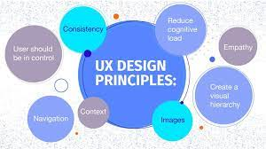
Intro lecture
Topics
The following is the main content of this course:
Chapter 6: UX Research Methods
Chapter 7: UX Design Methods
Chapter 8: Testing and Design Validation Methods
Chapter 9: Evangelism Methods
Chapter 10: The Future of UX: Trends and Personal Vision

Slide 10

Intro lecture
Recommended Reference
The User Experience Team of One A Research and Design Survival Guide By Leah Buley.

Slide 11
Intro
lecture
User Experience Team of One
The user experience team of one ethos is equal parts philosophy and practice (see Figure 1). It focuses on having the right attitude, seeking out opportunities, being patient and inclusive, and doing the best work you can.
Between philosophy and practice, this book covers not just guiding principles, but also the nuts and bolts of how to successfully run a UX project as a team of one.

Slide 12
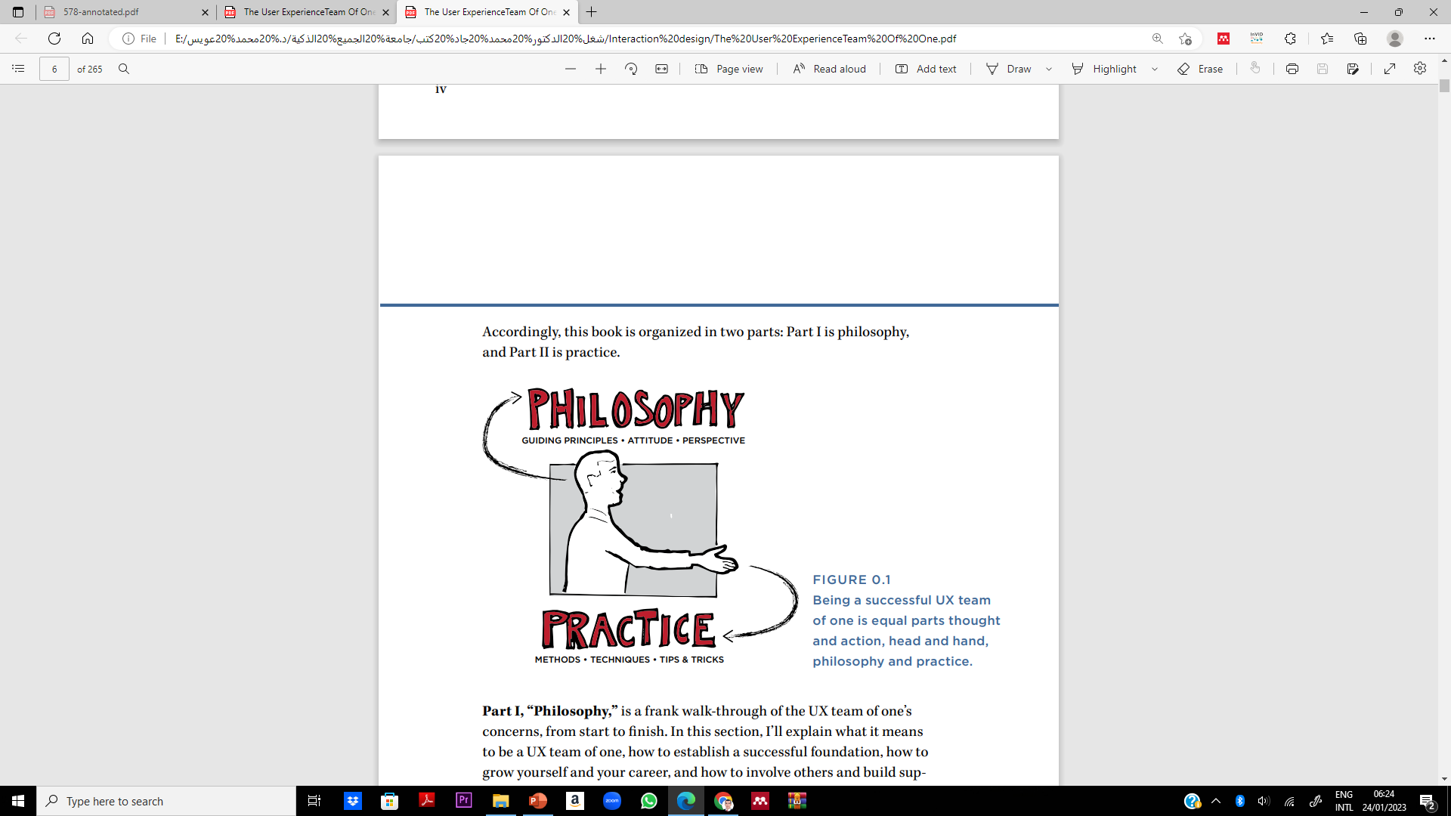
Intro
lecture
User Experience Team of One

Slide 13
Intro lecture
Philosophy
Part I, “Philosophy,” is a frank walk-through of the UX team of one’s concerns, from start to finish. In this section, I’ll explain what it means to be a UX team of one, how to establish a successful foundation, how to grow yourself and your career, and how to involve others and build support for UX along the way.
Chapter 1, “UX 101,” gives an overview of what UX is, how it came to be, and what it takes to be a UX practitioner.
Chapter 2, “Getting Started,” focuses on how to begin, including the fundamentals of user research and design for the new and aspiring UX team of one.

Slide 14
Intro lecture
Philosophy
Chapter 3, “Building Support for Your Work,” addresses some of the most challenging parts of life as a team of one: how to build support and do great work in spite of real-world organizational and interpersonal constraints.
Chapter 4, “Growing Yourself and Your Career,” is a blueprint for thriving and flourishing as you grow yourself and your career in user experience.

Slide 15
Intro lecture
Practice
In Part II, “Practice,” I’ll focus on the nuts and bolts of user experience work. This half of the book is intended to function as a ready reference, full of practical methods that have been selected and, in some cases, adapted to fit the realities of a UX team- of -one’s situation. What is this reality? Most importantly, teams of one must rely heavily on their non-UX colleagues to help them get work done.
That means there is a preference here for methods that can be done in a quick-and-dirty fashion, and an even greater bias toward methods that invite collaboration and cross-functional participation. In some cases, these methods may already be familiar to you, but the approach and tips are adapted for the work of a team of one

Slide 16
Intro lecture
Practice
Chapter 5, “Planning and Discovery Methods,” helps you set up a UX project for success. It includes planning and discovery of the team’s requirements and expectations. It also covers techniques for establishing a shared UX strategy with the team.
Chapter 6, “Research Methods,” is all about research. This includes research with users, the centerpiece of a UX practice, as well as research into competitors and best practices.
Chapter 7, “Design Methods,” covers methods and techniques for inclusive and participatory user experience design.

Slide 17
Intro lecture
Practice
Chapter 8, “Testing and Validation Methods,” provides methods for validating that your strategy, research, and design work has led you in the right direction.
Chapter 9, “Evangelism Methods,” brings our discussion of philosophy and practice full circle, and finishes up with approaches for building support and awareness of UX throughout your organization.
Chapter 10, “What’s Next,” closes with a personal challenge for you to think critically about where you’re taking your work in UX and how it aligns with the growth of the field overall.

Slide 18
Intro lecture
What is a user experience team of one?
A UX team of one is someone who works in a situation where they are the key person driving a user-centered design philosophy. Certainly, if you are the only person in your company practicing (or aspiring to practice) user-centered design, you are a user experience team of one.
However, even in organizations with multiple UX professionals, if you regularly work on a team where you are the only UX person, you are a UX team of one. Chapter 3 explains the kinds of challenges that UX teams of one commonly face, and explains what to do about them

Slide 19

Intro lecture
Introduction
in June 2011, this message appeared on the Interaction Designers Association (IXDA) discussion list:
I am at a point in my life where I know I want to do UX design after doing Web design for so long and then reading about usability testing, etc., 6 years ago. But my issue is I’m tired of working for orgs who say they care about their customer but don’t do testing to even know what their customers want from them… I’m kind of fed up with working for people who don’t get it.

Slide 20
Intro lecture
Introduction
It’s also an important avenue for doing good in the world. The UX team of one is as much a professional circumstance as a constructive philosophy. And here are its founding principles:
UX is a force for good. In an increasingly technological world, designing products with real people in mind helps us make sure that technology integrates in our lives in a human way. It’s a voice of reason, arguing that products and technology can support and even enrich our fundamental humanity.

Slide 21
Intro lecture
Introduction
The world needs more of it. As the boundaries continue to blur between the technological world and the analog world, everything that we buy, use, and do will need this user-centered perspective. Companies that never thought of themselves as being in the user experience business before will realize that they are now. We all are. This field can only grow.
Whatever your job title, whatever your career aspirations, you have it in your power to spark an awareness of the “user’s perspective” in the work that you do and with the people that you work with.

Slide 22

Intro lecture
Thank You

