Slide 1



Machine Learning
Prepared by Dr. Yasser Abdelhamid
DS 620
Machine Learning
Lecture 8

Slide 2

Outline
Logistic regression
Bias
Variance
Overfitting
Under-fitting
Regularization
  Lasso Regularization
  Didge Regularization
Lasso regression
Ridge regression

Slide 3
Binary classification
Binary classification is a type of classification where the target variable is a variable having (usually) the 0 value to represent negative result and 1 for positive result.
target variable y ∈ {0,1}

Slide 4
Multiclass classification
Is a type of classification where the target variable may have more than two categories.
Example:
  Election :
    Democratic.
    Republican.
    Independent.

Slide 5
Example: Insurance prediction
Age | Bought insurance
22 | 0
25 | 0
47 | 1
52 | 0
46 | 1
56 | 1
55 | 0
60 | 1
62 | 1
61 | 1

Slide 6
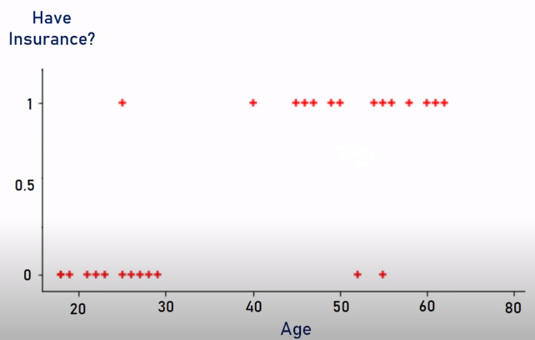
Example: Insurance prediction
Age | Bought insurance
22 | 0
25 | 0
47 | 1
52 | 0
46 | 1
56 | 1
55 | 0
60 | 1
62 | 1
61 | 1

Slide 7
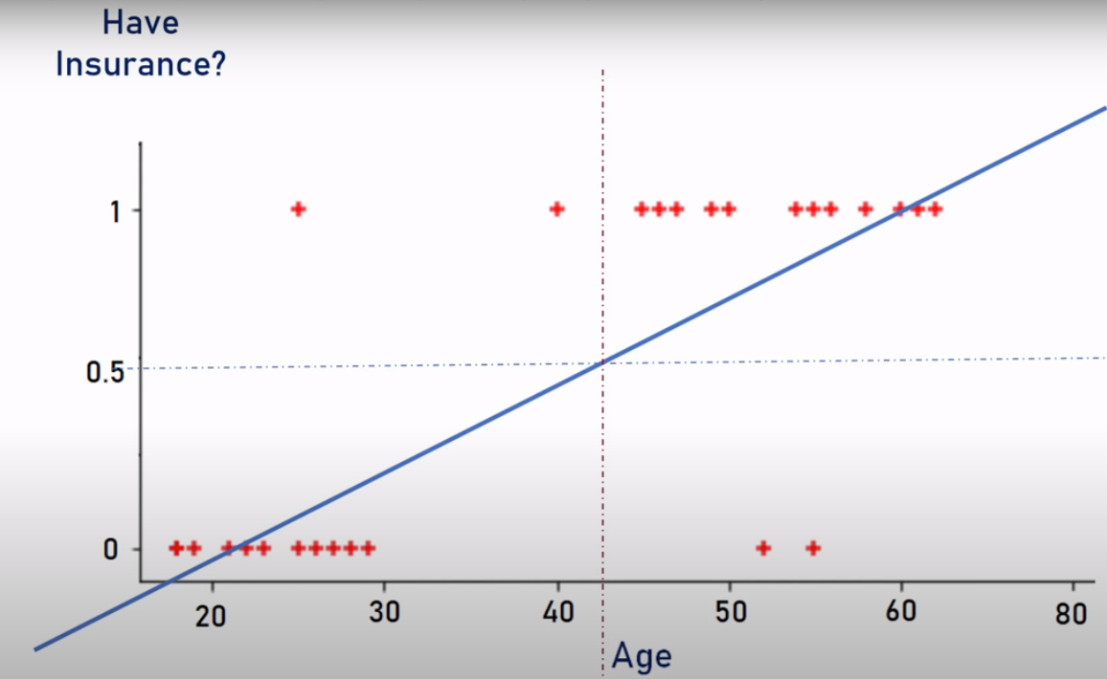
Using linear regression
It looks that people with age >= 42 are likely to buy the insurance,
while people with age < 42 will not buy the insurance.

Slide 8
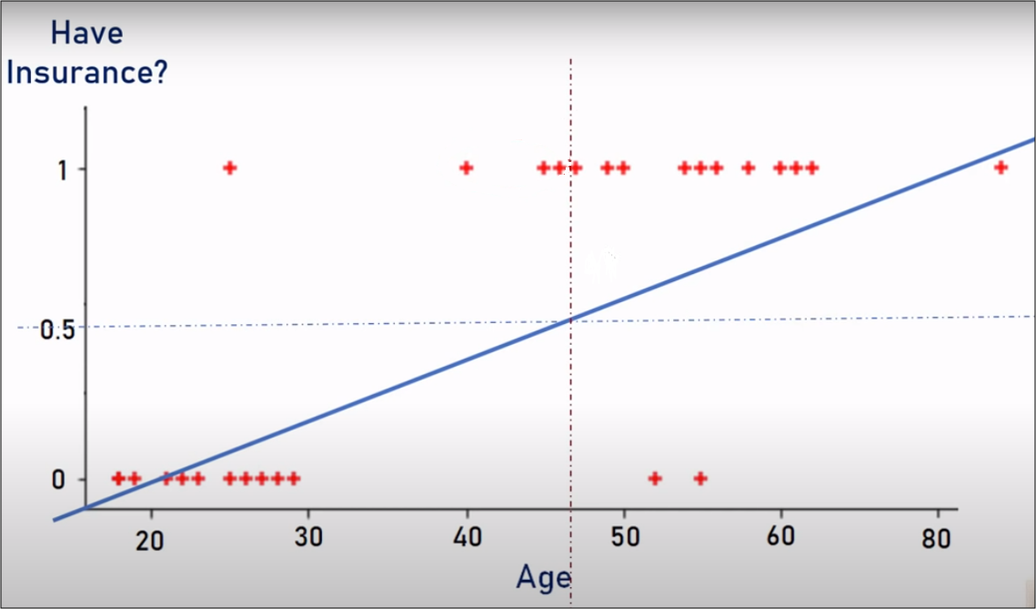
Using linear regression
By adding a new instance, and running linear regression, the threshold changes, giving worse hypothesis, and misclassifies more instances that were correctly classified without adding that new instance.
y is either 0 or 1, but h(x) may be <0 or >1
we need 0 <= h(x) <= 1

Slide 9
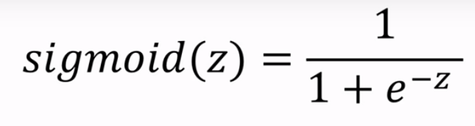
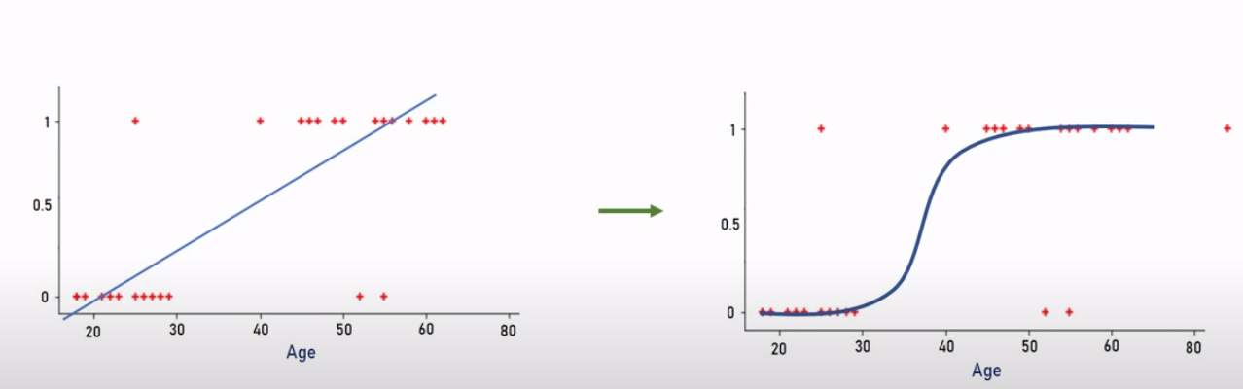
Sigmoid function
Sigmoid function converts its input to a range between 0 and 1.

Slide 10
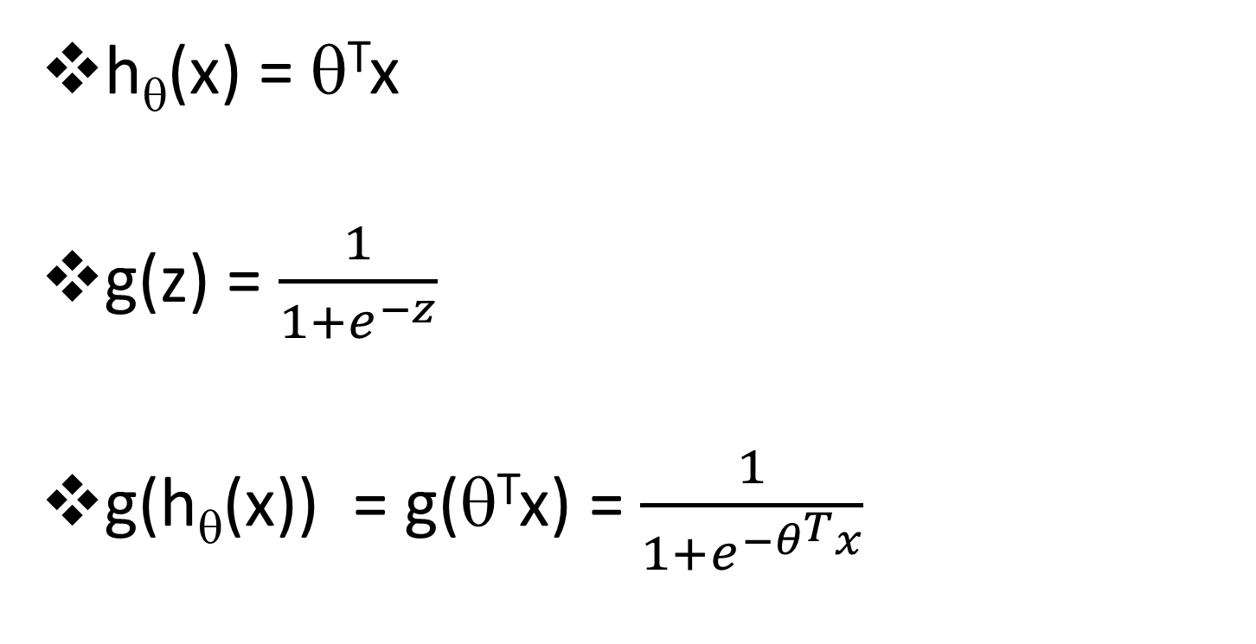
Logistic regression model
h_{θ}(x) = θ^{T}x
g(z) = $\frac{1}{1+e^{−z}}$
g(h_{θ}(x)) = g(θ^{T}x) = $\frac{1}{1+e^{−θ^{T}x}}$

Slide 11
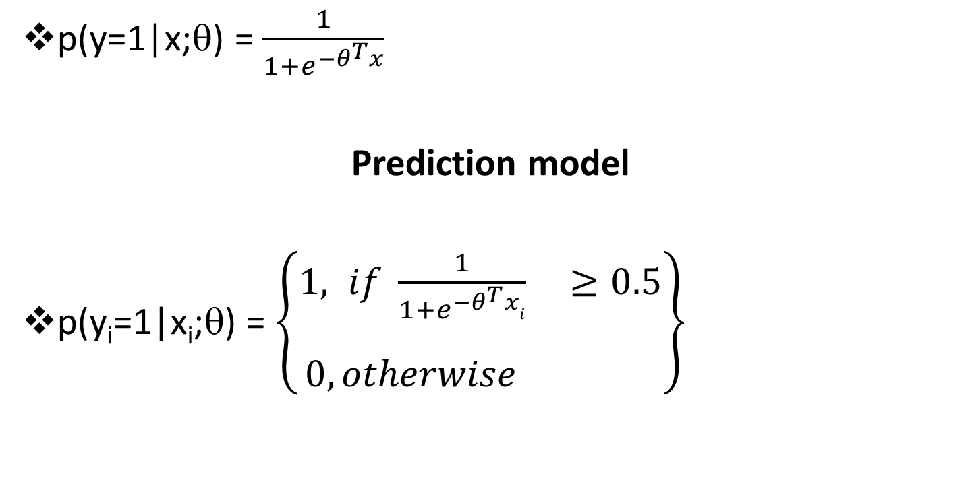
Sigmoid function
p(y=1|x;θ) = $\frac{1}{1+e^{−θ^{T}x}}$
Prediction model
p(y_{i}=1|x_{i};θ) = $\left\{\begin{aligned}1, if \frac{1}{1+e^{−θ^{T}xi}} ≥0.5 \\ \\ 0, otherwise \end{aligned}\right\}$

Slide 12
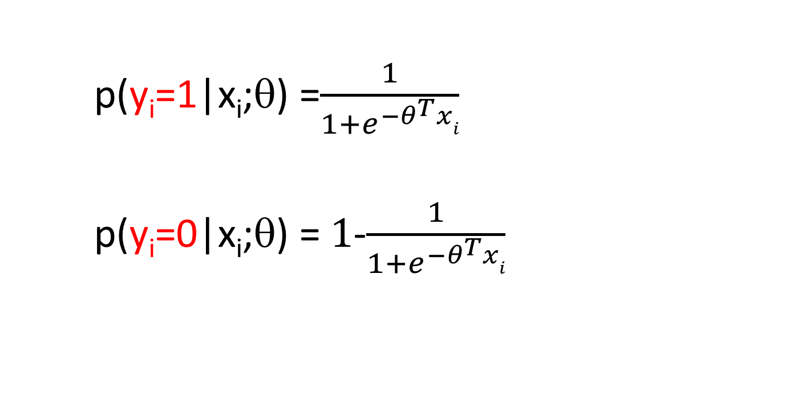
logistic regression model
p(y_{i}=1|x_{i};θ) =$\frac{1}{1+e^{−θ^{T}xi}}$
p(y_{i}=0|x_{i};θ) = $1$-$\frac{1}{1+e^{−θ^{T}xi}}$

Slide 13
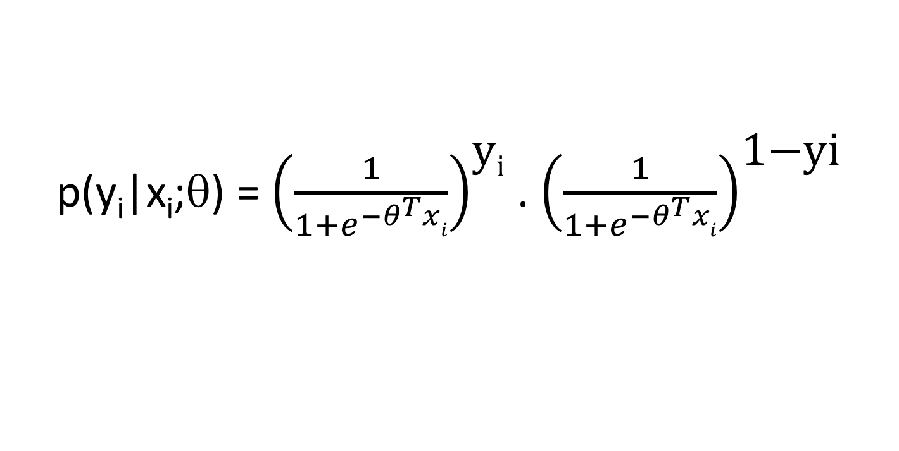
The general form of the model
p(y_{i}|x_{i};θ) = ${\left(\frac{1}{1+e^{−θ^{T}xi}}\right)}^{\text{y}\text{i}}$ . ${\left(\frac{1}{1+e^{−θ^{T}xi}}\right)}^{\text{1−}\text{yi}}$

Slide 14
Example:
Default on loan
A bank is building a prediction model for default customers depending on customer’s credit score.
( a customer defaults on his loan when he fails to pay back a debt according to the initial arrangement).

Slide 15
Example:
Default on loan
The bank is using the regression model:
h_{θ}(x)=θ₀ + θ₁x
using the regression model parameters:
θ₀=0 .73257 , θ₁=−9 . 9238*10⁻⁵

Slide 16
Example:
Default on loan
To estimate the probability of default for a customer who has a credit score = 8000
h_{θ}(x) = θ₀ + θ₁x
With θ₀=0 .73257, and θ₁=−9 . 9238*10⁻⁵
h_{θ}(8000) = 0 .73257+ (−9 . 9238*10⁻⁵ * 8000 ) =−0.06134

Slide 17
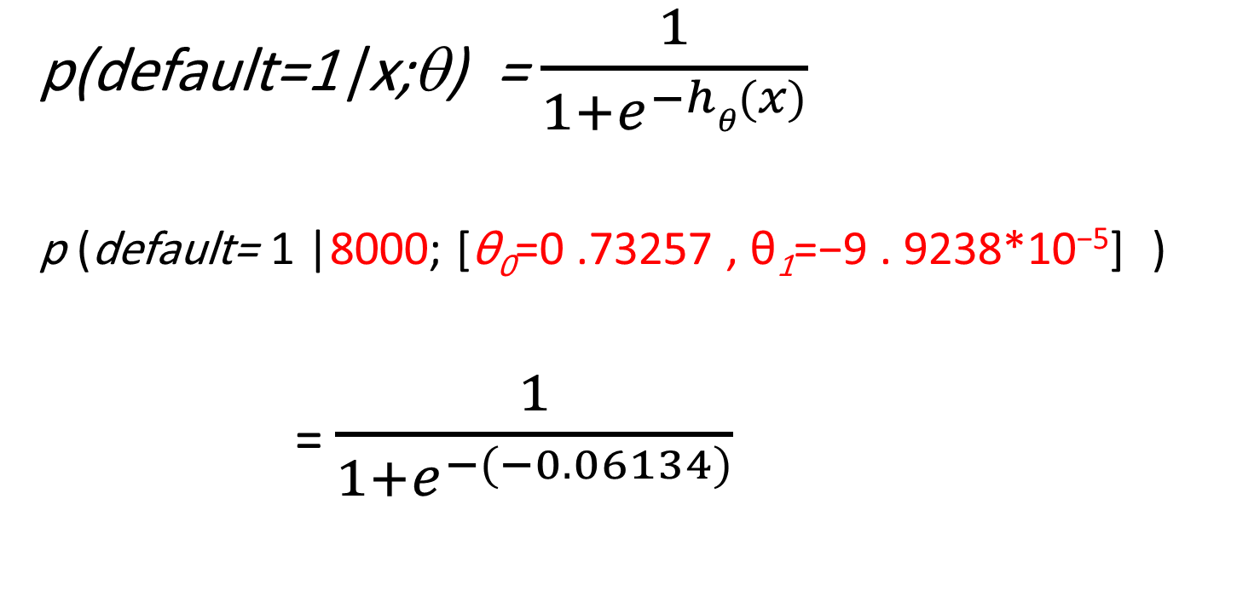
Example:
Default on loan
p(default=1|x;θ) = $\frac{1}{1+e^{−hθ(x)}}$
p (default= 1 |8000; [θ₀=0 .73257 , θ₁=−9 . 9238*10⁻⁵] )
= $\frac{1}{1+e^{−(−0.06134)}}$

Slide 18
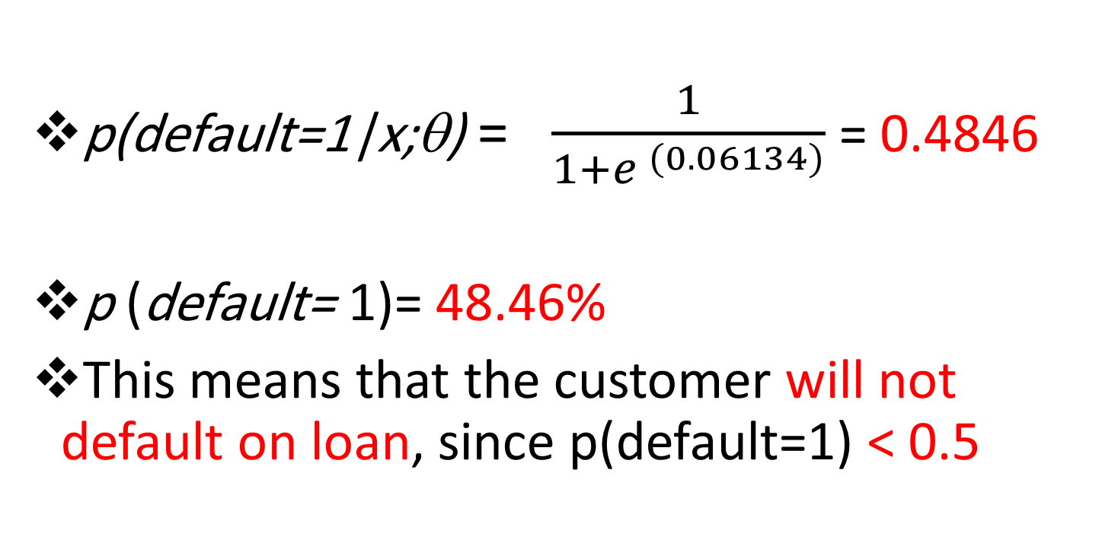
Example:
Default on loan
p(default=1|x;θ) = $\frac{1}{1+e^{ (0.06134)}}$ = 0.4846
p (default= 1)= 48.46%
This means that the customer will not default on loan, since p(default=1) < 0.5

Slide 19
Linear vs Logistic Regression
Linear regression
Logistic regression
Data is modeled using a linear function.
Predicts a continuous value of y
Output is interpreted as the value of predicted variable.
Maps the continuous values of input to the categorical values (classes) of y.
Predicts the class of y.
Output is interpreted as the probability of occurrence of event.

Slide 20
Bias, variance, overfitting, and underfitting

Slide 21
Bias
Bias refers to the error introduced by approximating a real-world problem with a simplified model.
It represents the model's tendency to consistently make certain assumptions or errors when predicting outcomes.

Slide 22
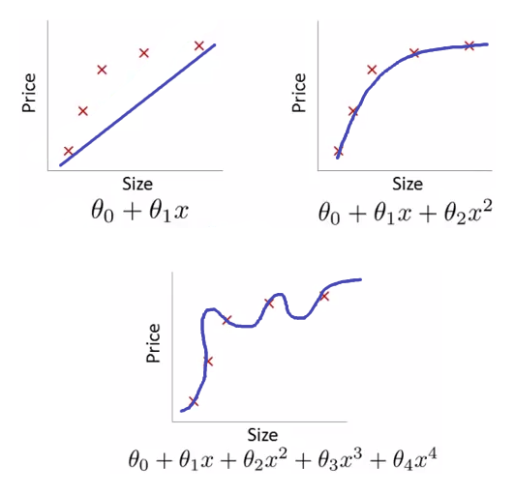
Example
A high bias model oversimplifies the problem and makes strong assumptions, leading to Underfitting.
It may struggle to capture complex patterns and generalize well to unseen data.

Slide 23
How to detect bias
Common characteristics of a high bias model include:
  High training error and
  High testing error.
It may exhibit systematic errors and have difficulty learning from the training data.

Slide 24
Variance
Variance refers to the variability or sensitivity of a model's predictions to fluctuations in the training data.
It measures how much the model's predictions vary across different training sets.

Slide 25
example
A high variance model is overly complex and captures noise or random fluctuations in the training data.
It tends to memorize the training examples and performs poorly on unseen data, leading to overfitting.

Slide 26
How to detect variance
Common characteristics of a high variance model include:
  low training error
  high testing error
It may exhibit high sensitivity to the training data and struggle to generalize to new instances.

Slide 27
Bias-Variance Tradeoff
The bias-variance tradeoff is a fundamental concept in machine learning.
It refers to the delicate balance between a model's ability to capture the underlying patterns (low bias) and its ability to generalize to new data (low variance).

Slide 28
Bias-Variance Tradeoff
Ideally, we aim to find a model that minimizes both bias and variance, striking the right balance.
However, reducing one often increases the other, making it a tradeoff.

Slide 29
How to get the right balance
There are many techniques like:
  Cross-validation,
  Regularization, and
  Model selection
These techniques help manage the bias-variance tradeoff.

Slide 30
How to get the right balance
Polynomial degree=1
Polynomial degree=2
Polynomial degree=4
Under-fitting
High bias
High variance
Training accuracy low
Test accuracy low
Most generalizing
low bias
low variance
Training accuracy high
Test accuracy high
Over-fitting
low bias
High variance
Training accuracy high
Test accuracy low

Slide 31
regularization
Regularization is a technique used in machine learning to prevent overfitting and improve the generalization performance of models.
It involves adding a penalty term to the loss function during training, which encourages the model to avoid overly complex or extreme parameter values.

Slide 32
regularization
The main idea behind regularization is to find a balance between fitting the training data well and avoiding excessive complexity.
Overfitting occurs when a model becomes too complex and captures noise or random fluctuations in the training data, leading to poor performance on unseen data.
Regularization helps in addressing this issue by imposing constraints on the model's parameters.

Slide 33
Lasso regularization
L1 Regularization (Lasso): L1 regularization adds a penalty term proportional to the absolute values of the model's parameters.
It encourages sparsity by driving some of the parameters to zero, effectively performing feature selection.
L1 regularization can be useful when dealing with datasets with many irrelevant or redundant features.

Slide 34
Ridge regularization
L2 Regularization (Ridge): L2 regularization adds a penalty term proportional to the squared magnitudes of the model's parameters.
It discourages large parameter values and encourages the model to distribute the importance of features more evenly.
.

Slide 35
Example
Assume we have a dataset with two features, X1 and X2, and we want to perform linear regression model.
Assume the model equation
h_{Ɵ}(x) = Ɵ₀ + Ɵ₁x₁+Ɵ₂x₂
The objective function for Lasso regression can be represented as:
Loss = Sum of squared errors + λ * (|Ɵ₁| + |Ɵ₂|)
The regularization parameter, λ , controls the strength of the regularization. A higher λ value will result in more aggressive shrinking of the coefficients towards zero.

Slide 36
Example
During the training process, the model will adjust the coefficients (Ɵ₁ and Ɵ₂) to minimize this loss function.
However, Lasso regularization encourages sparsity in the coefficients, meaning it tends to drive some of the coefficients to exactly zero.

Slide 37
Example
For example, let's say the Lasso regression model finds the following coefficients:
  Ɵ₀ = 1.0
  Ɵ₁ = 0.9
  Ɵ₂ = 0.0
In this case, the coefficient of X2 (Ɵ₂) becomes exactly zero, indicating that the feature X2 is not contributing to the prediction.
Lasso regression performs feature selection by automatically identifying and eliminating less relevant features.
The resulting model equation would be:
h_{Ɵ}(x) = 1.0 + 0.9*X1

Slide 38
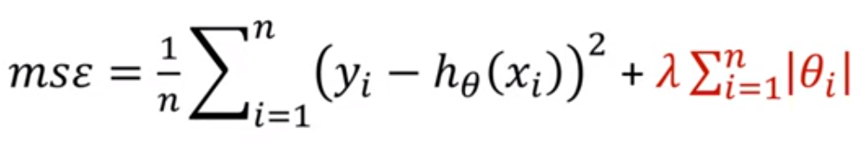
Lasso regression cost function

Slide 39
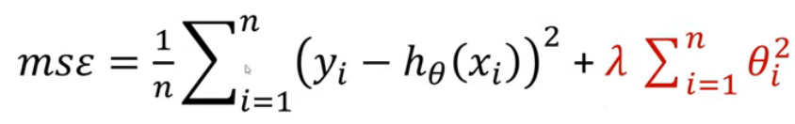
Ridge regression cost function

Slide 40
SUmmary
Logistic regression
Bias
Variance
Overfitting
Under-fitting
Regularization
  Lasso Regularization
  Didge Regularization
Lasso regression
Ridge regression

Slide 41


Thank You

