Slide 1


Decision Trees
Prepared by Dr. Sami Alzahrani
PMG 621
Risk and Decision Analysis
Lecture 6

Slide 2



Decision Trees
Lecture 6
PMG 621
Risk and Decision Analysis
Prepared by
Dr. Sami Alzahrani
www.midocean.ae

Slide 3

Chapter
Introduction
06
A decision model represents our understanding of an evaluation situation. This chapter de- scribes what many consider the most powerful modeling and calculation technique in decision analysis.
www.midocean.ae

Slide 4
Chapter
Introduction
06
Decision Trees
A decision tree is a graphical representation of expected value (EV) calculations. The tree consists of decision, chance, and terminal nodes connected by branches. This acts as a blackboard to develop and document our understanding of the problem, and facilitates team collaboration and communication.
www.midocean.ae

Slide 5
Chapter
06
Conceptually, any decision, no matter how complex, can be analyzed with a decision tree analysis. Other alternatives, especially Monte Carlo circulation, have advantages and disadvantages for certain problems. Decision tree analysis is especially suited for everyday problems when one wants to pick the best alternative quickly and proceed.
www.midocean.ae

Slide 6
Chapter
06
Node Types:
There are three types of nodes in a decision tree:
Decision nodes, represented by squares, are variables or actions that the decision maker controls. Chance event nodes, represented by circles, are variables or events that cannot be controlled by the decision maker. Terminal or end nodes, represented in a decision tree diagram by un- connected branches, are endpoints where outcome values are attached.
www.midocean.ae

Slide 7
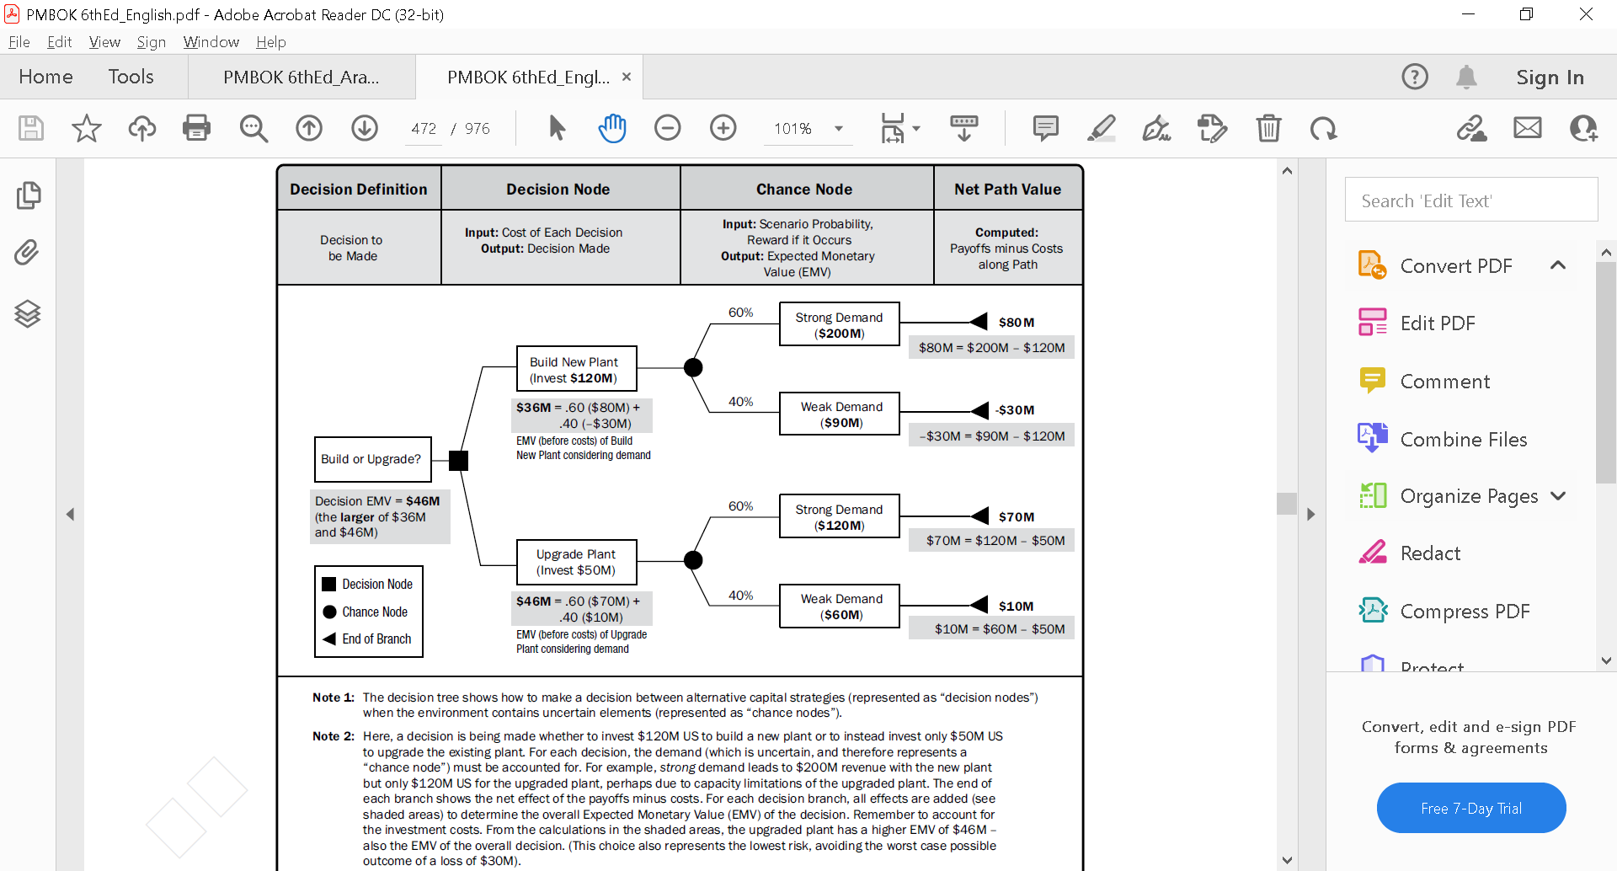
www.midocean.ae

Slide 8
By convention, the tree is drawn chronologically from left to right and branches out, like a tree lying on its side. Decision tree analysis language includes colorful biological analogies. The starting (usually) decision nodes called the root, and the radial lines are called branches (sometimes twigs). The terminal nodes are sometimes called leaves, and an overly complex tree bears the label, a bushy mess.
www.midocean.ae

Slide 9
Tree Annotations:
We label the decision tree diagram with these numbers:
Probabilities for each outcome branch emanating from chance nodes. Outcome values, representing present values (PVs) of the resulting cash- flow stream, discounted to the date of the root decision. Sometimes, we may choose to place benefits and costs along branches as they are realized.
www.midocean.ae

Slide 10
More commonly, terminal node values represent the entire outcome.
Node expected values, calculated during the process of solving the tree. When solving with a utility function as risk policy, I like to show expected monetary value (EMV), expected (value) utility (EU), and certainty equivalent (CE) for each node.
.
www.midocean.ae

Slide 11
Tree Calculations:
Solving a decision tree is a simple back-calculation process. This is sometimes called back-solving or folding back the tree. Starting from the terminal nodes at the right, moving left, we solve for the value of each node and label it with its EV. These EVs are EMVs or EV costs when we measure value in dollars or other currency.
www.midocean.ae

Slide 12
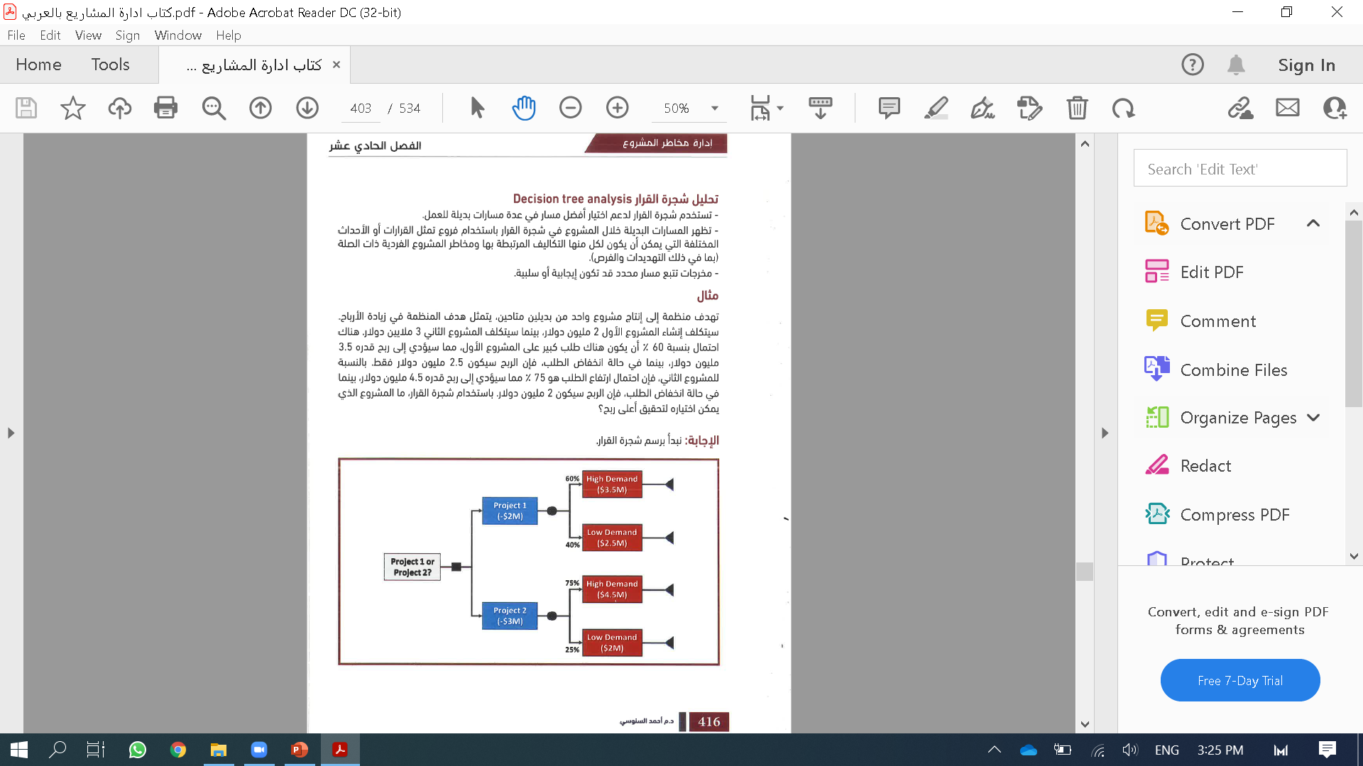
Chapter
Example for decision analysis: Tree Analysis
06
www.midocean.ae

Slide 13
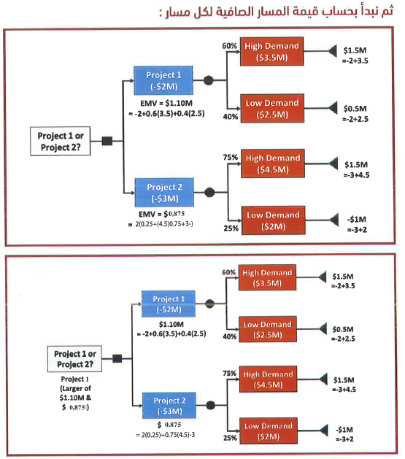
Chapter
06
www.midocean.ae

Slide 14
Here are the three simple rules for solving a tree:
- At a chance node, calculate its EMV (or EV cost) from the probabilities
and values of its branches. This becomes the value of the node and the
branch leading to it.
- Replace a decision node with the value of its best alternative. We are applying the EMV decision rule..
www.midocean.ae

Slide 15
If a cost value lies along a branch, recognize that cost in passing from right to left. That is, subtract a cost when solving a tree to maximize EMV. Treat the rest of the cost as a "toll" to be paid when traversing the tree. (Sometimes a tree is designed to solve for EV costs, in which case, a cost along a branch is added.)
www.midocean.ae

Slide 16
Wastewater Plant Example:
In this case, we assume that your company is developing a new gold mine that will be operated by another company.
Development is nearing completion when your team discovers that water discharge contaminant levels are above those seen in the original survey samples. A regulatory agency now mandates an improved treatment facility to recover heavy metals from the mine discharge.
www.midocean.ae

Slide 17
This extended pollutant- recovery capability was not designed into the nearly completed mine facility. The best general solution is to construct or bring in a wastewater treatment module (referred to as the Plant in the following tables and figures).
In addition to the investment and operating costs of the Plant, adding this capability has the potential to delay mine start-up.
www.midocean.ae

Slide 18
Data Assumptions:
There are uncertainties affecting the mine project completion time. For all other activities except the wastewater system, the engineers judge the completion time in three scenarios, as shown in Table 5.1.
Assume that: extending construction activities to meet a later start-up date will not affect costs. Further, completion times are independent of the wastewater treatment system.
www.midocean.ae

Slide 19
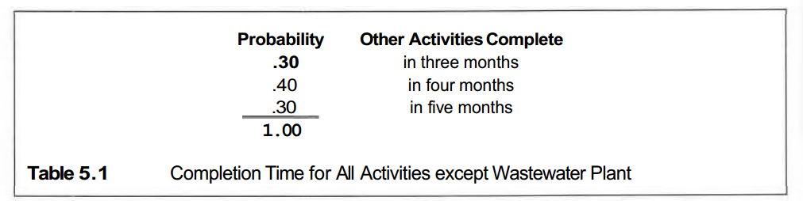
www.midocean.ae

Slide 20
Three plant alternatives are being considered:
- Used: Buy a used, skid-mounted wastewater plant.
- Skid: Buy a new, skid-mounted plant.
- Fixed: Buy a new, fixed plant.
Figure 5.1 shows how the root decision node will appear, adding a branch for another alternative to be evaluated later. The square in the figure represents the decision point, and branches coming out of the right side are alternatives. For illustration in this chapter, the nodes have reference numbers inside, though this is not customary.
www.midocean.ae

Slide 21
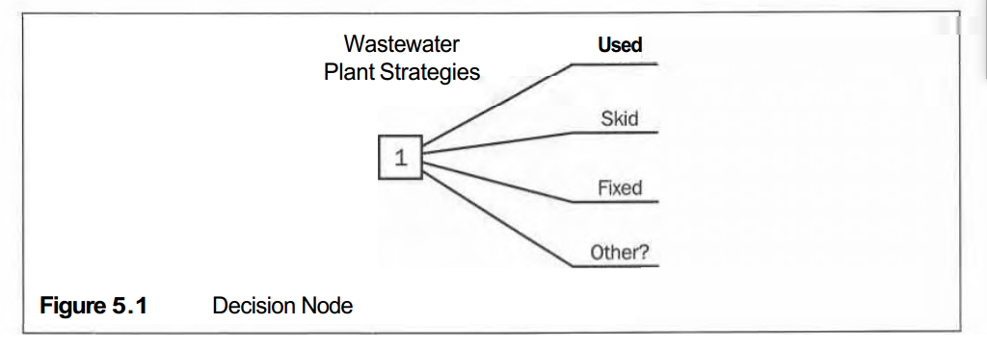
www.midocean.ae

Slide 22
Although costing more initially, the Skid plant costs less to operate and is faster to install, plus it is likely to have greater salvage value at mine abandonment than a Used plant. A Fixed plant costs less to buy and operate than a skid-mounted plant, but requires more time to install. Clearly, trade- offs will be necessary in making the decision.
www.midocean.ae

Slide 23
The engineers use three weighted scenarios in each case as the form to judge times to implement each plant-acquisition option. Engineers for the plant vendors and the project team jointly make these assessments, as three-level discrete distributions, as shown in Table 5.2.
www.midocean.ae

Slide 24
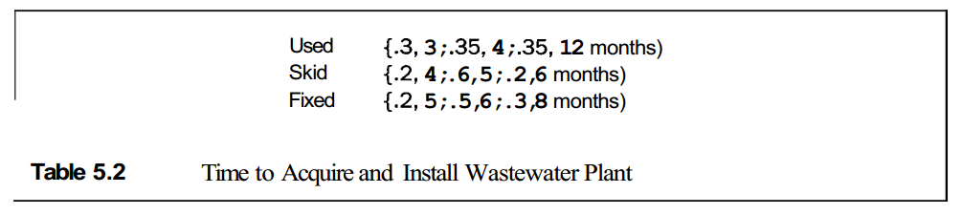
www.midocean.ae

Slide 25
These pairs of numbers represent outcome values (second in each pair) with their associated probabilities (first value, a decimal, in each pair). This lottery notation is a way of expressing a discrete chance. Event. The other mine activities are independent of the wastewater plant. Figure 5.2 illustrates what I a Time Plant Operational chance node looks like for the Skid option. The branches coming off at the right at the node represent the possible outcomes. I Note that the branch probabilities at any chance node always sum to 1.
www.midocean.ae

Slide 26
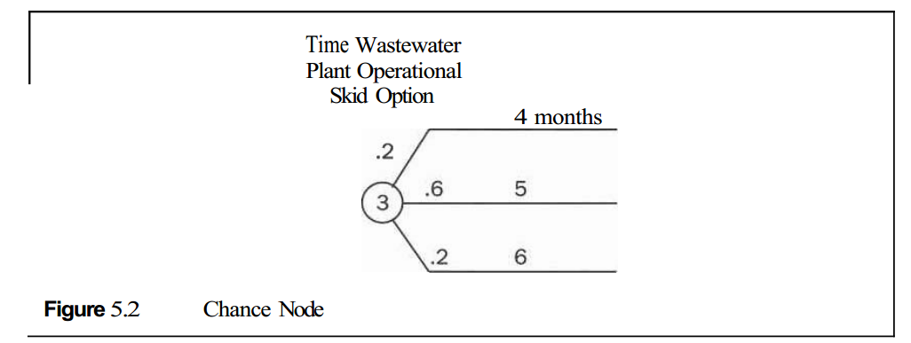
www.midocean.ae

Slide 27
Chapter
06
An important consideration is the cost of delaying the mine start-up. In this case, the opportunity loss is the foregone asset value, due to increased development costs and delaying mine production. Assume that, from the project feasibility model, the project team determines that delays to mine start-up are valued at $150,000 per month (pretax) cost. Early completions have the opposite effect. The mine is projected to operate for six years. Other information about the options is shown in Table 5.3. These values are known well enough that single-point estimates can be used.
www.midocean.ae

Slide 28
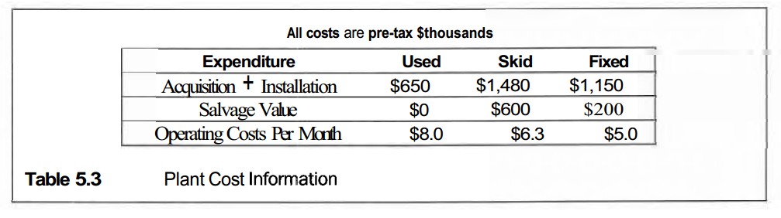
Chapter
06
www.midocean.ae

Slide 29
Chapter
06
Over half the work of a typical custom evaluation involves developing a project casMow model. The model provides the outcome value for each scenario: combination of decisions and chance-event outcomes. The model underlying the outcome values shown in Figure 5.3 includes, in addition to the assumptions in Tables 5.1-5.3, such items as inflation, cost of capital, depreciation, and taxes.
www.midocean.ae

Slide 30
Chapter
06
Try Your Intuition
Now you have seen all of the input data. Can you judge the best alternative by intuition? Try estimating EV cost for each option. What is the difference in EV cost between the first choice and the next best alternative?
For most of us, even this small problem is much too complex to
internalize in our heads. The plant choice is not obvious because each alternative has advantages:
www.midocean.ae

Slide 31
Chapter
06
Used: Lowest: initial cost.
Skid: Fastest and lowest-risk acquisition time, medium operating costs,
highest salvage value.
Fixed: Lowest operating costs, medium investment.
No single alternative dominates across all attributes. Most of us need an analytic tool to have confidence in our selection.
www.midocean.ae

Slide 32
Chapter
06
Evaluating Options:
The appraisal approach of decision analysis is a logical way to evaluate the three plant-acquisition alternatives. Figure 5.3 shows the complete decision tree model: terminal nodes (right column) show outcomes if the respective tree path is realized; the outcome value is PV costs. Again, these terminal values are from a casMow projection model. Since all monetary values are costs, one may work with EV costs instead of EMVs; minimizing EV cost is exactly equivalent to maximizing EMV.
www.midocean.ae

Slide 33
Chapter
06
The root node is the Type Plant Decision. There are two chance events affecting outcome value: Time Plant Operational and Time Other Activities Complete. The latest event controls when the mine development project is complete. In labeling the tree, we annotate these chance-event outcomes with labels (months to complete) and the probability of the respective outcome. When solving the tree, we label each chance and decision node with its EV cost.
www.midocean.ae

Slide 34
Chapter
06
We back-solve the decision tree to evaluate the three alternatives. Normally, the nodes do not have numbers, though I numbered them here to illustrate the calculations. Table 5.4 shows the sequence and components of node EV cost calculations.
www.midocean.ae

Slide 35
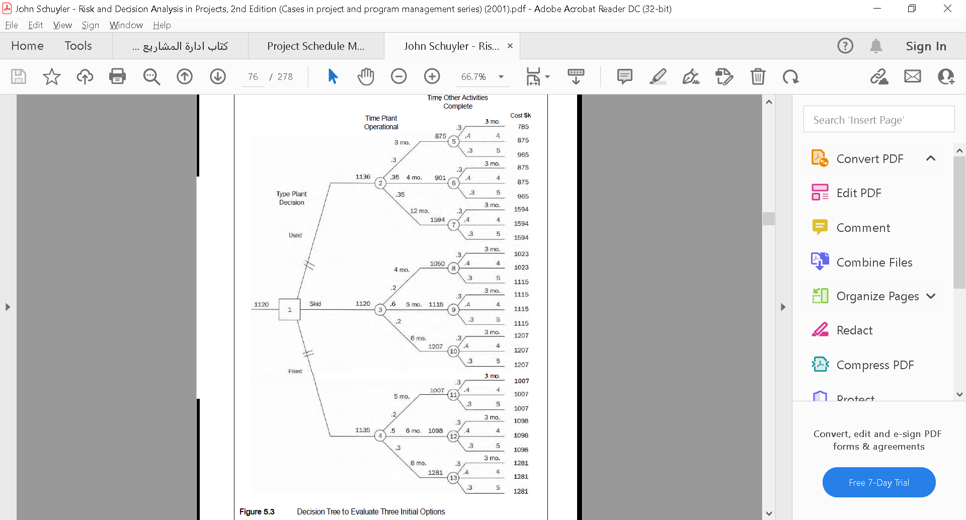
Chapter
06
www.midocean.ae

Slide 36
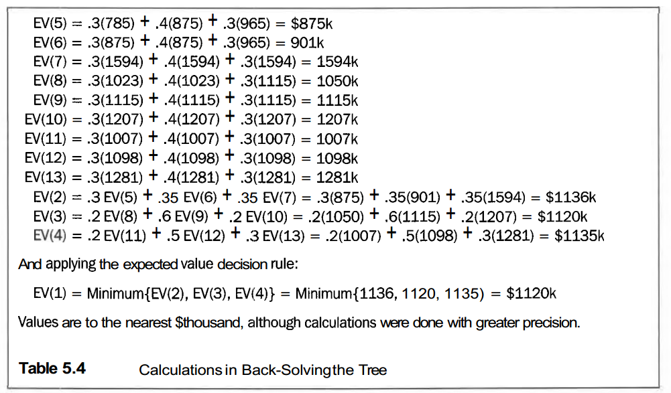
Chapter
06
www.midocean.ae

Slide 37
Chapter
06
Note that there are fewer calculations at each column of nodes in progressing from right to left through the tree. For large trees, the progressive thinning of branches provides considerable calculation efficiency (as compared to a payoff-table approach). Acquiring a Skid plant ($1,120,000) appears the best of the three alternatives, although its superiority is slight ($16,000). The "cut" marks on branches indicate inferior alternatives that have been "pruned."
www.midocean.ae

Slide 38
Chapter
06
Tree Software:
We can draw small decision trees on the back of an envelope and solve them with a hand calculator. A mostly manual solution is practical for trees of up to, say, 100 branches. By "manual," I include the use of a hand calculator. If we will be solving a tree more than once, including revisions to the numbers, a computer will help. I often build a Microsoft@ Excel template for small- and medium-sized trees. One can even use Excel's Draw functions to illustrate the tree structure.
www.midocean.ae

Slide 39
Chapter
06
For people who frequently develop decision trees and for someone needing to develop a large tree, I recommend obtaining and learning decision tree software. The two programs that I use and teach with are DATATM by Tree Age Software, Inc., and Precision Tree TM by Palisade Corporation. More information is in Appendix B, Decision Analysis Software.
www.midocean.ae

Slide 40
Chapter
06
Decision Tree Summary:
Decision tree analysis is a convenient way to analyze project decisions having one or several important uncertainties. We use probability distributions to encode judgments about risk and uncertainty. For all but the simplest of problems, decision tree models greatly bolster our intuition.
A single value measure, gauging benefits or progress toward the organization's objective, is a central idea in decision analysis. Money is a convenient measurement scale for most purposes.
www.midocean.ae

Slide 41
Chapter
06
The Wastewater Plant example combines cost, schedule, and performance criteria into a single monetary value measure, EV cost:
Schedule was translated into cost equivalents by recognizing the asset
value lost due to project delay.
Performance was recognized by different plant operating costs during
the mine life.
www.midocean.ae

Slide 42
Chapter
06
Many practitioners believe that insights gained into decision problems are more important than the numerical results. Further comfort comes from credible quantitative-analysis results.
www.midocean.ae

Slide 43
Chapter
06
Recourse:
RISK and DECISION ANALYSIS in Projects
Second Edition
By: John Schuyler
Chapter 5
www.midocean.ae

Slide 44


Thank You

