Slide 1



Address Resolution
Lecture 5
CCNA – Introduction to Networks V7.0 (ITN)
Prepared by
Dr. Abdelrhman Ahmed

Slide 2
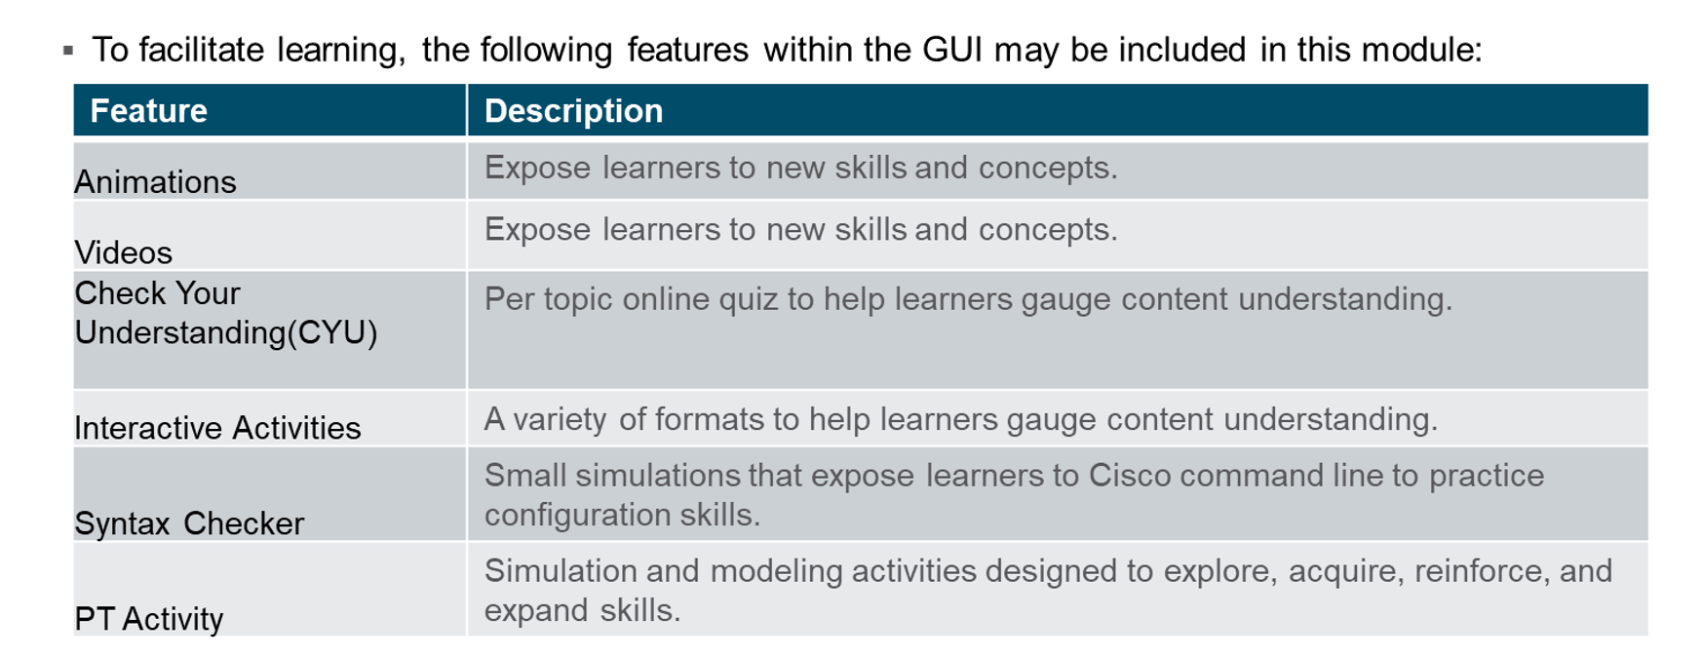
Chapter
What to Expect in this Module
05

Slide 3
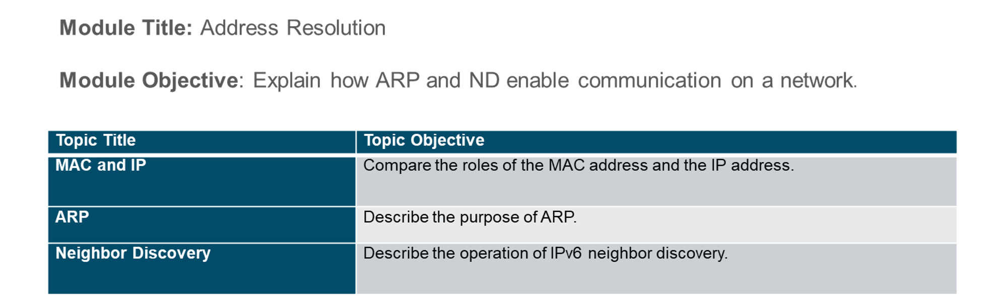
Chapter
Module Objectives
05

Slide 4
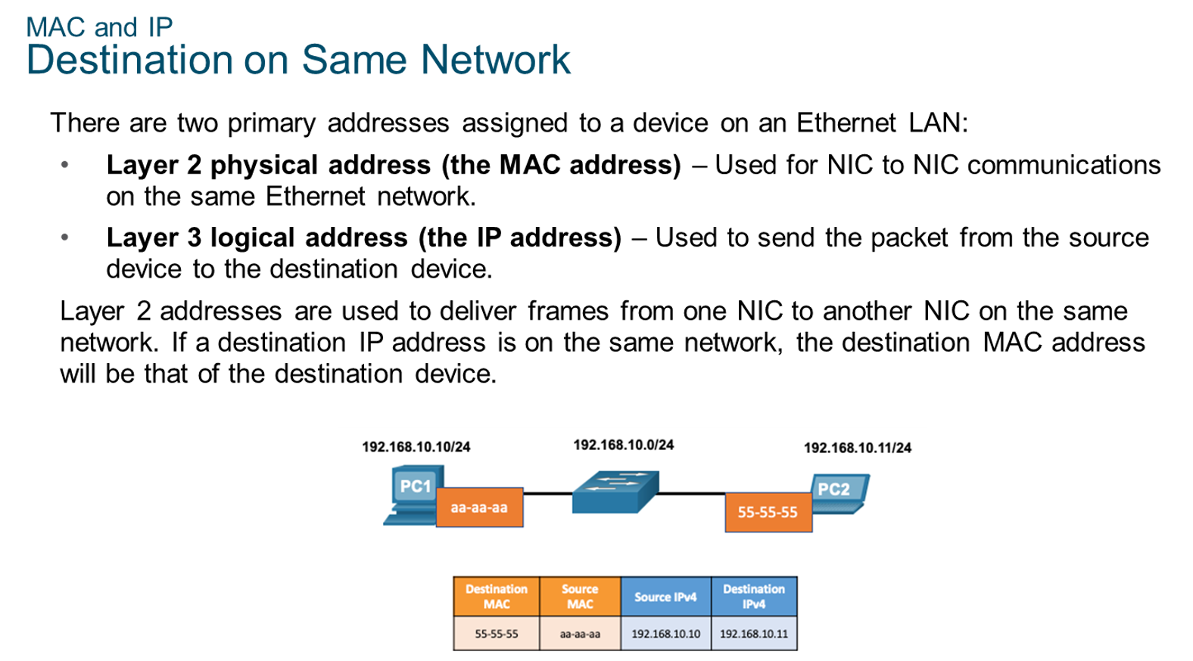
Chapter
MAC and IP
05

Slide 5
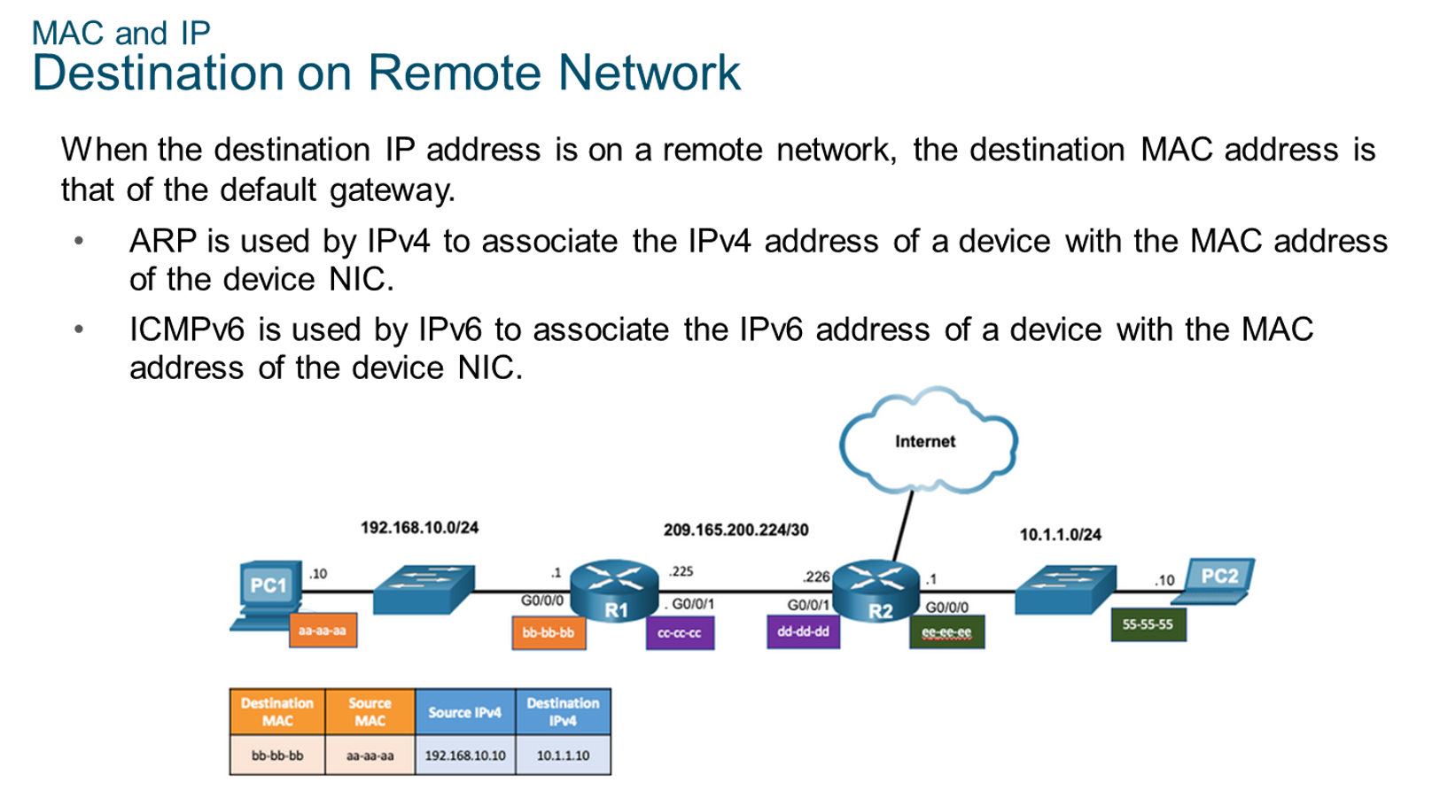
Chapter
MAC and IP
05

Slide 6
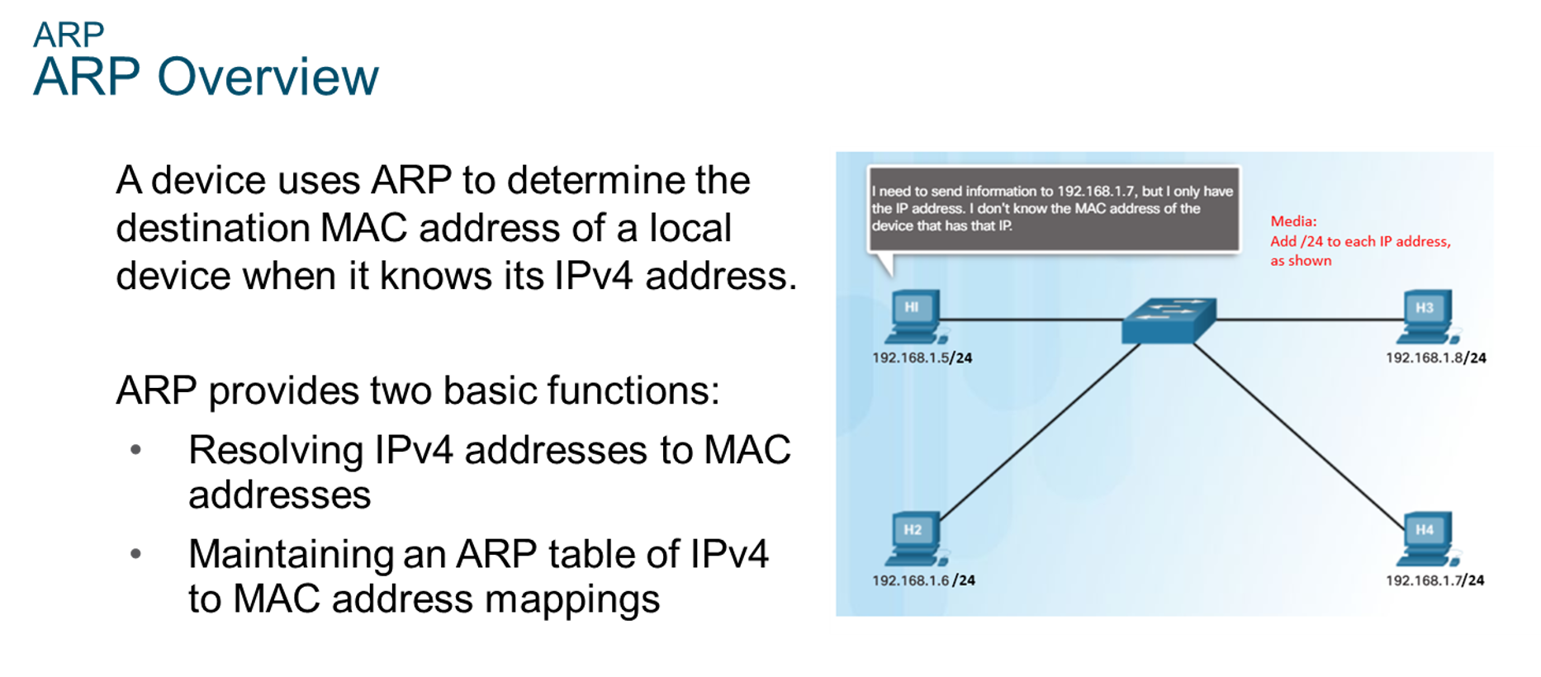
Chapter
ARP
05

Slide 7
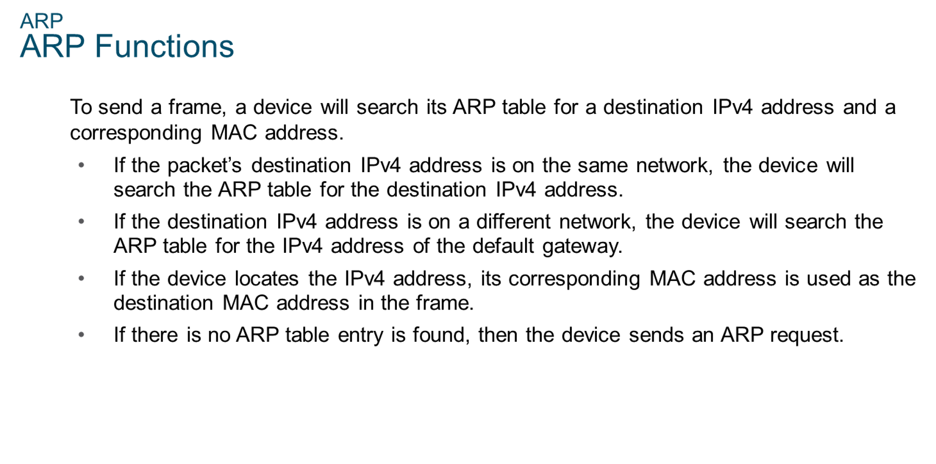
Chapter
ARP
05

Slide 8
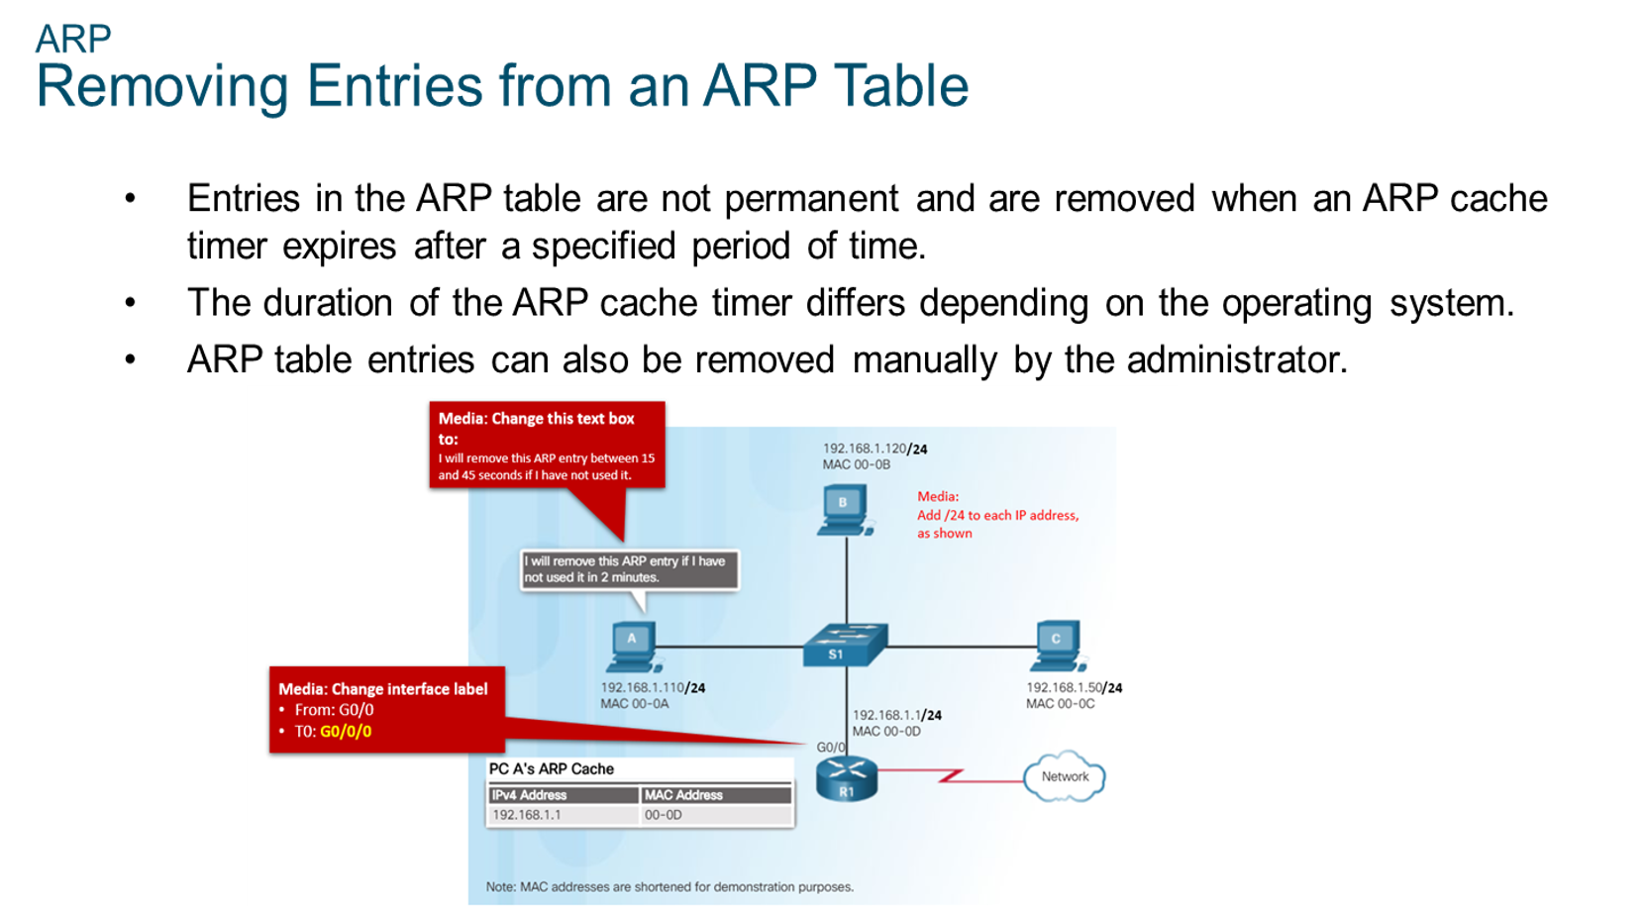
Chapter
ARP
05

Slide 9
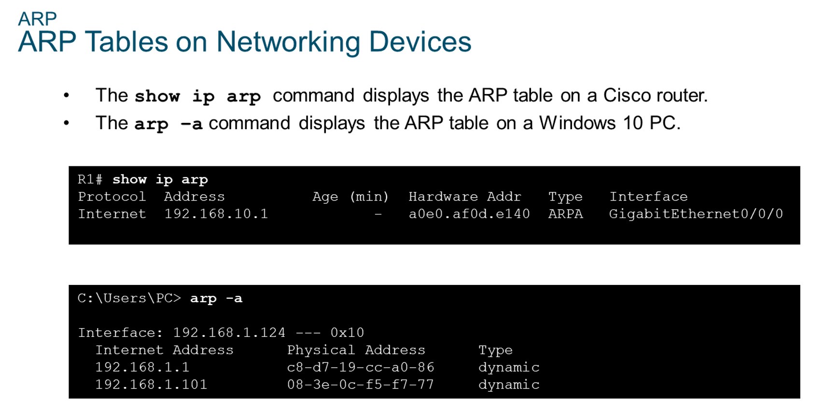
Chapter
ARP
05

Slide 10
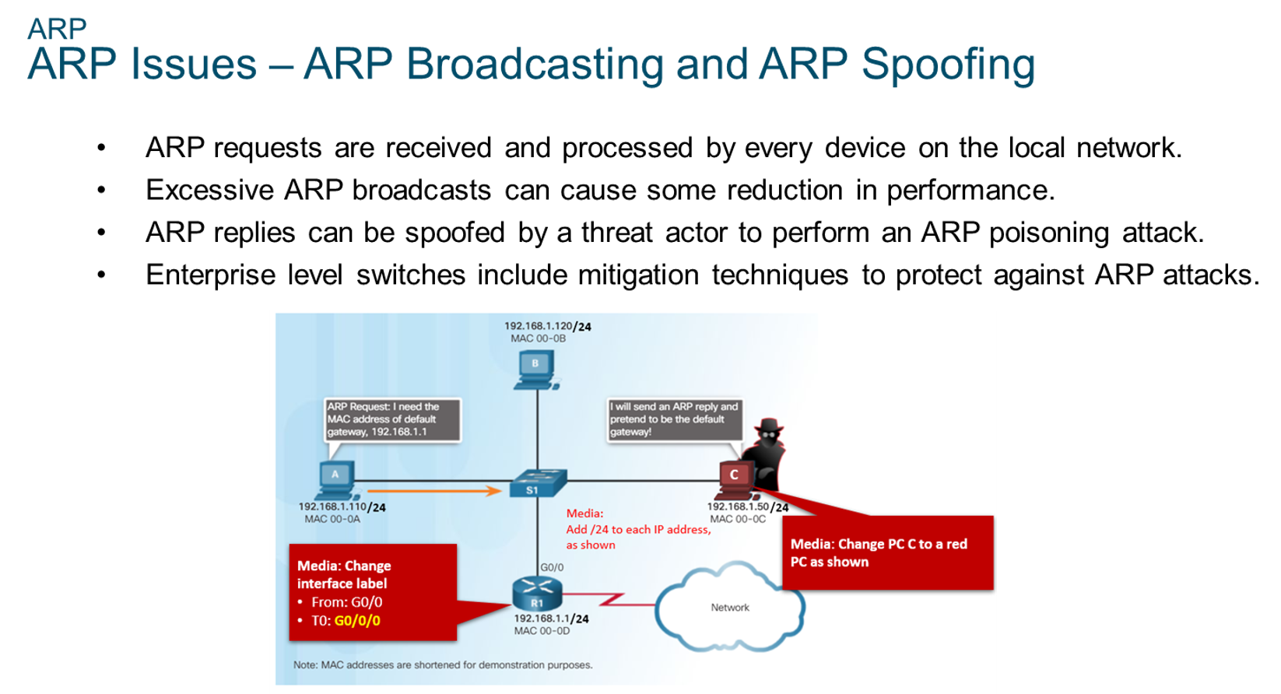
Chapter
ARP
05

Slide 11
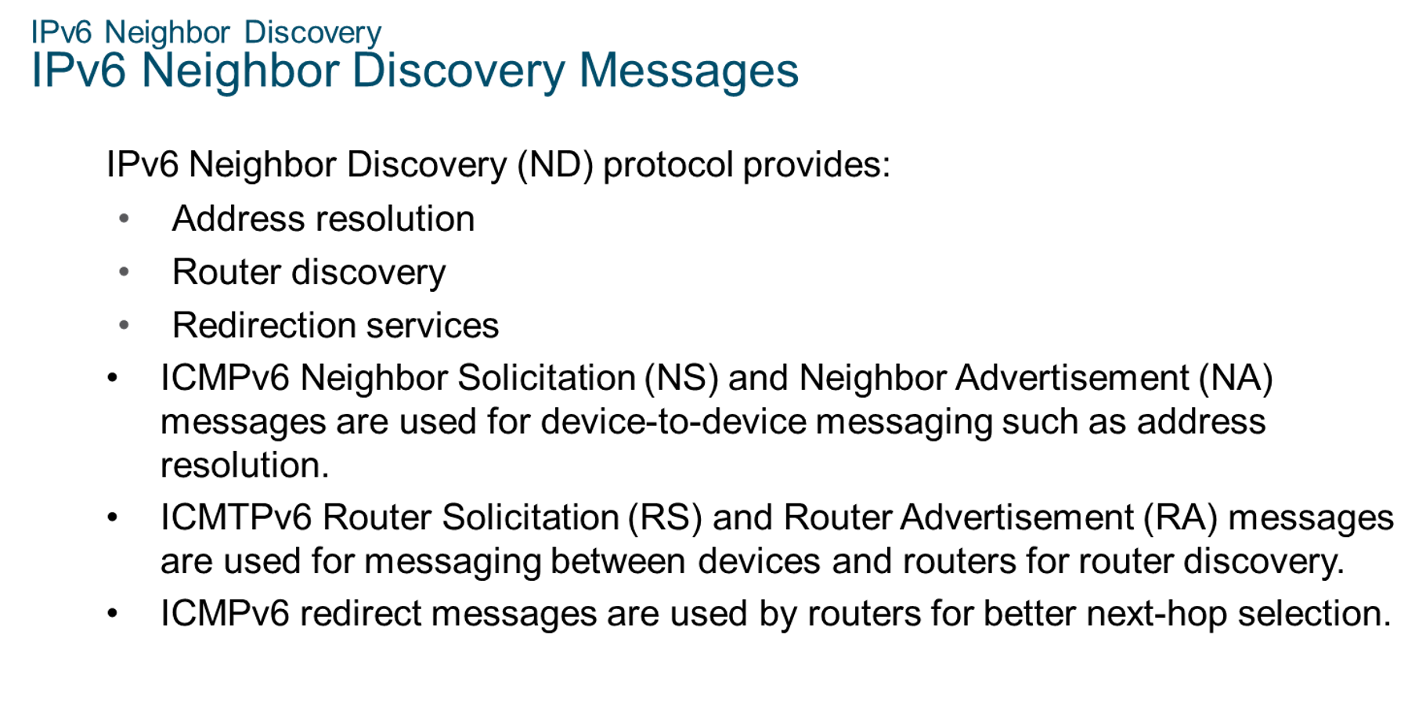
Chapter
IPv6 Neighbor Discovery
05

Slide 12
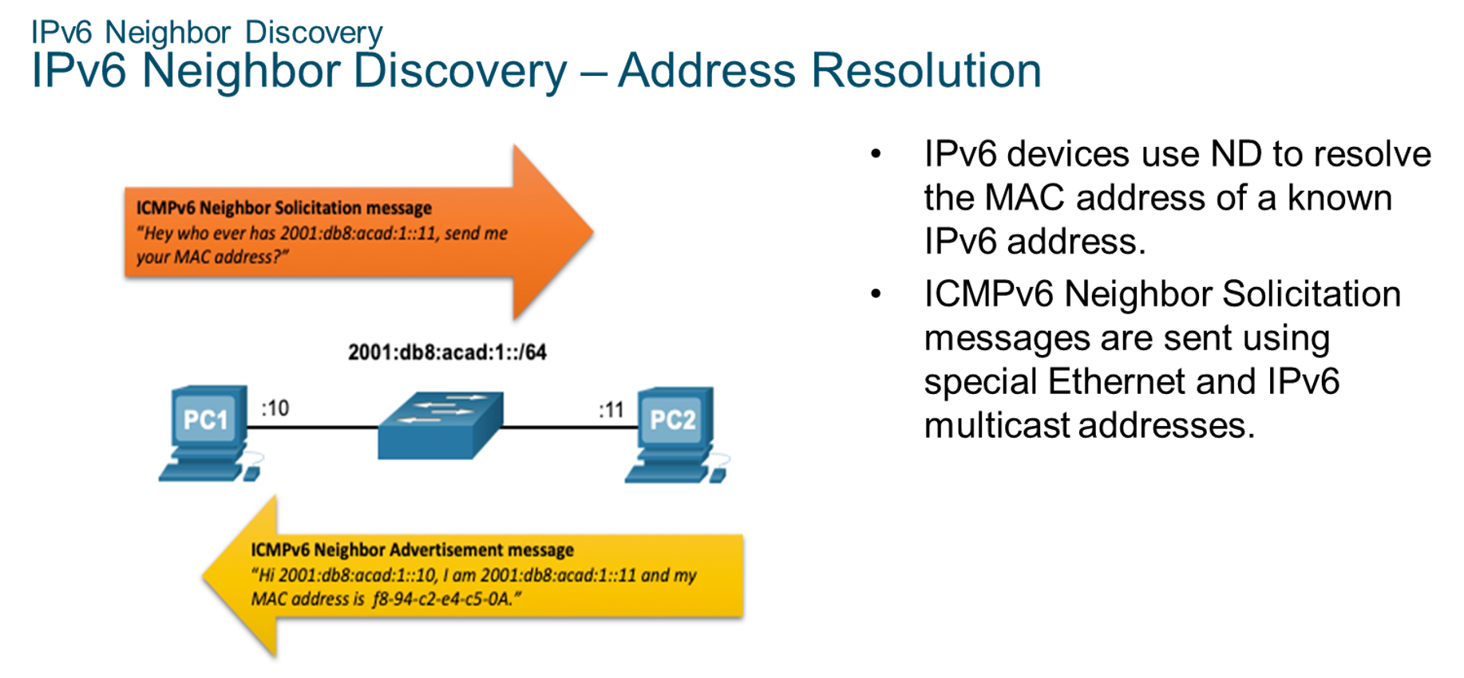
Chapter
05
IPv6 Neighbor Discovery

Slide 13



Thank You

