Slide 1





MGM603
Managing People and Organizations
Prepared by Dr. Salahaldin Abuabdou
Lecture 9
Chapter 7. Groups and Teams

Slide 2


CHAPTER 7
Groups and Teams
Learning Outcomes
Define groups and teams and identify and describe several types of each.
Identify the five core group performance factors and relate them to groups and teams in organizations.
Discuss the stages of group and team development, other team performance factors, and the implementation process in the context of creating new teams.
Identify the primary benefits and costs of teams, how managers can promote effective team performance, and important team competencies.
Describe emerging team opportunities and challenges related to virtual teams and diversity and multicultural teams.

Slide 3
CHAPTER 7
Groups and Teams
Types of Groups and Teams:
Types of Groups and Teams | A group is Two or more people who interact with one another such that each person influences and is influenced by each other person. Two people who are physically near each other are not a group unless they interact and have some influence on each other. Coworkers may work side by side on related tasks—but if they do not interact, they are not a group. A team is An interdependent collection of at least two individuals who share a common goal and share accountability for the team’s as well as their own outcomes. A key part of this definition is that team members are interdependent with respect to information, resources, and skills. As tasks become more complex, they require greater coordination among team members.

Slide 4
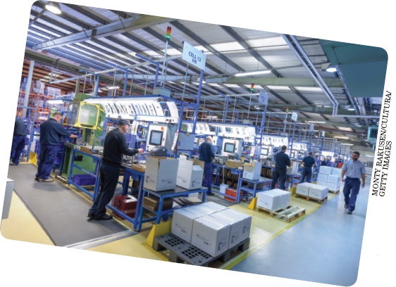
CHAPTER 7
Groups and Teams
Types of Groups and Teams:
Groups are prevalent throughout most organizations. A variety of different kinds of workgroups and teams like this one perform many different kinds of functions and play a number of different roles.

Slide 5
CHAPTER 7
Groups and Teams
Workgroups
Workgroups | Workgroups are formal groups established by the organization to do its work Workgroups include command (or functional) groups and affinity groups (as well as teams). A command group is relatively permanent and is characterized by functional reporting relationships such as having both a group manager and those who report to the manager. Affinity groups are relatively permanent collections of employees from the same level in the organization who meet on a regular basis to share information, capture emerging opportunities, and solve problems

Slide 6
CHAPTER 7
Groups and Teams
Workgroups
Workgroups- command groups | In business organizations, most employees work in command groups, as typically specified on an official organization chart. The size, shape, and organization of a company’s command group can vary considerably. Typical command groups in organizations include the quality-assurance department, the customer service department, the cost-accounting department, and the human resource department. Other types of command groups include work teams organized as in the Japanese style of management, in which subsections of manufacturing and assembly processes are each assigned to a team of workers. The team members decide among themselves who will perform each task.

Slide 7

CHAPTER 7
Groups and Teams
Teams
Groups composition plays a big role in how a group functions and performs. For example, the group on the left includes people who, on the surface at least, seem very different from one another along several obvious dimensions. The group on the right, though, is comprised of people who appear to be very similar to one another. These differences and similarities will affect how the groups members interact and the outcomes they are able to achieve.

Slide 8
CHAPTER 7
Groups and Teams
Teams
Teams | Organizations also use a wide variety of different types of teams Each type of team is composed of different members and responsible for different types of tasks. The functional teams come from the same department or functional area. A team of marketing employees and a team of finance employees are examples of functional teams. Cross-functional teams have members from different departments or functional areas. This is one of the most common types of work teams. An example of a cross-functional team is a top-management team with members representing different functions or units of the organization.

Slide 9
CHAPTER 7
Groups and Teams
Teams
Teams | 3. Problem-solving teams are teams established to solve problems and make improvements at work. The core strength of problem-solving teams is that because employees are the ones actually doing the work, they usually know the job best. For example, Colgate and JM Huber, a raw material supplier, jointly assembled a multidisciplinary team to identify ways to reduce costs. The team ultimately realized savings of hundreds of thousands of dollars 4. Self-directed teams set their own goals and pursue them in ways decided by the team. Team members are responsible for tasks typically reserved for team leaders or managers, including scheduling work and vacations, ordering supplies, and evaluating their performance. for example, At 3M (makers of Post-It Notes, Scotch Tape, and myriad other products), self-directed work teams have made improvements in products, services, and processes while increasing customer responsiveness, lowering operating costs, increasing productivity, and decreasing cycle times.

Slide 10
CHAPTER 7
Groups and Teams
Teams
Teams | 5- Venture teams are teams that operate semi-autonomously to create and develop new products (product development teams), processes (process design teams), or businesses (venture teams). 6- Virtual teams are teams of geographically and/or organizationally dispersed coworkers who communicate using the Internet and other information technologies For example, PricewaterhouseCoopers, one of the world’s largest accounting firms, with more than 236,000 employees in 158 countries, uses virtual teams to bring employees from around the globe “together” for a week or two to prepare work for a particular client. The Whirlpool Corporation used a virtual team composed of experts from the United States, Brazil, and Italy during a two-year project to develop a chlorofluorocarbon-free refrigerator 7- Global teams have members from different countries. Global teams can be virtual or meet face-to-face. Procter & Gamble, a multinational manufacturer of family, personal, and household care products, uses global teams to allow employees at its Cincinnati headquarters to collaborate with employees and suppliers all over the world.

Slide 11
CHAPTER 7
Groups and Teams
Teams
Functional teams | members come from the same department or functional area
Cross-functional teams | members come from different departments or functional areas
Problem-solving teams | teams created to solve problems and make improvements
Self-directed teams | set their own goals and pursue them in ways defined by the team
Venture teams | teams that operate semi-autonomously to create and develop new products, processes, or businesses
Virtual teams | teams of geographically and/or organizationally dispersed coworkers who communicate using telecommunications and information technologies
Global teams | face-to-face or virtual teams whose members are from different countries
Table7.1.Types of Teams

Slide 12

CHAPTER 7
Groups and Teams
Teams
Virtual teams are becoming increasingly common in organizations. New forms of technology, coupled with pressures to reduce travel costs, make it easy for colleagues who are geographically dispersed to interact in ways that mirror face-to-face interactions. Of course, they may also have a reduced personal connection with their colleagues when meeting this way.

Slide 13
CHAPTER 7
Groups and Teams
Informal Groups
Informal Groups | informal groups are formed by their members and consist of friendship groups, which are relatively permanent, and interest groups, which may be shorter-lived. Friendship groups arise out of cordial personal relationships among members and the enjoyment they get from being together. Interest groups are organized around a common activity or interest, although friendships may also develop among members. Good examples: of interest groups are the networks of working women that have developed over the last several years. Many of these groups began as informal social gatherings of women who wanted to meet with other women working in male-dominated organizations, but they soon developed into interest groups whose benefits went far beyond their initial social purposes.

Slide 14
CHAPTER 7
Groups and Teams
Group Performance Factors
Group Performance Factors | The performance of any group is affected by several factors (in addition to its reasons for forming and the stages of its development, discussed later). In a high-performing group, a group synergy often develops in which the group’s performance is more than the sum of the individual contributions of its members. Several additional factors may account for this accelerated performance. The five basic group performance factors are composition, size, norms, cohesiveness, and informal leadership. If you are part of a group or team that is not performing effectively, the Improve Your Skills feature might be a useful diagnostic tool.

Slide 15
CHAPTER 7
Groups and Teams
Group Performance Factors
Group Performance Factors | Diagnosing Team Problems Here are some questions you can ask in diagnosing team issues. 1. Clear direction Can each of the team members articulate the purpose that the team exists to achieve? 2. A real team task Is the team assigned collective responsibility for all of its customers and major outputs? Does the team make collective decisions about work strategies (rather than leaving it to individuals)? Are team members willing and able to help one another? Does the team get team-level feedback about its performance? 3. Team rewards Are more than 80 percent of all rewards available to teams only, and not to individuals?

Slide 16
CHAPTER 7
Groups and Teams
Group Performance Factors
Group Performance Factors | 4. Basic material resources Does the team have its own meeting space? Can the team easily get the basic materials it needs to do its work? 5. Authority to manage the work How to meet client demands Which actions to take, and when Whether to change their work strategies when they deem necessary Do team members have the authority to decide the following without first receiving special authorization?

Slide 17
CHAPTER 7
Groups and Teams
Group Performance Factors
Group Performance Factors | 6. Team goals Can team members articulate specific and shared team goals? 7. Improvement norms Do team members encourage one another to detect and solve problems? Do members openly discuss differences in what members have to contribute to the team? Do members encourage experimentation with new ways of operating? Does the team actively seek to learn from other teams?

Slide 18
CHAPTER 7
Groups and Teams
Group Composition
Group Composition | Group Composition: The degree of similarity or difference among group members on factors important to the group’s work Group composition is most often described in terms of the homogeneity or heterogeneity of the members A group is homogeneous if the members are similar in one or several ways that are critical to the work of the group, such as in age, work experience, education, technical specialty, or cultural background. In heterogeneous groups, the members differ in one or more ways that are critical to the work of the group. A substantial amount of research has explored the relationship between a group’s composition and its productivity.

Slide 19
CHAPTER 7
Groups and Teams
Group Composition
Group Composition | A homogeneous group is likely to be more productive when the group task is simple, cooperation is necessary, the group tasks are sequential, or quick action is required. A heterogeneous group is more likely to be productive when the task is complex, requires a collective effort (that is, each member does a different task, and the sum of these efforts constitutes the group output), and demands creativity, and when speed is less important than thorough deliberations. For example, a group asked to generate ideas for marketing a new product probably needs to be heterogeneous to develop as many different ideas as possible. A homogeneous group tends to have less conflict, fewer differences of opinion, smoother communication, and more interactions.

Slide 20
CHAPTER 7
Groups and Teams
Group Composition
Group Composition | When a task requires cooperation and speed, a homogeneous group is therefore more desirable. If, however, the task requires complex analysis of information and creativity to arrive at the best possible solution, a heterogeneous group may be more appropriate because it generates a wide range of viewpoints. More discussion and more conflict are likely, both of which can enhance the group’s decision making. Group composition becomes especially important as organizations become increasingly more culturally diverse. Cultures differ in the importance they place on group membership and in how they view authority, uncertainty, and other important factors.

Slide 21

CHAPTER 7
Groups and Teams
Group Composition
Groups composition plays a big role in how a group functions and performs. For example, the group on the left includes people who, on the surface at least, seem very different from one another along several obvious dimensions. The group on the right, though, is comprised of people who appear to be very similar to one another. These differences and similarities will affect how the groups members interact and the outcomes they are able to achieve.

Slide 22
CHAPTER 7
Groups and Teams
Group Size
Group Size | A group—the number of people in the group—can have as few as two members or as many members as can interact and influence one another. Group size can have an important effect on performance. A group with many members has more resources available and may be able to complete a large number of relatively independent tasks. In groups established to generate ideas, those with more members tend to produce more ideas, although the rate of increase in the number of ideas diminishes rapidly as the group grows. Beyond a certain point, the greater complexity of interactions and communication may make it more difficult for a large group to achieve agreement.

Slide 23
CHAPTER 7
Groups and Teams
Group Size
Group Size | Social loafing is the tendency of some members of groups not to put forth as much effort in a group situation as they would working alone. Social loafing often results from the assumption by some members that if they do not work hard, other members will pick up the slack. How much of a problem this becomes depends on the nature of the task, the characteristics of the people involved, and the ability of the group leadership to be aware of the potential problem and do something about it. The most effective size of a group, therefore, is determined by the group members’ ability to interact and influence one another effectively.

Slide 24

CHAPTER 7
Groups and Teams
Group Size
Social loafing occurs when one or more members of a group put forth less effort than others and let other members of the group pick up the slack. This man, for example, is distracted and not paying attention to what his team members are doing. But he may end up getting just as much credit as they do when their project is completed.

Slide 25
CHAPTER 7
Groups and Teams
Group Norms
Group Size | A norm is a standard against which the appropriateness of a behavior is judged. Thus, norms determine the behavior expected in a certain situation. Group norms usually are established during the second stage of group development (communication and decision making) and are carried forward into the maturity stage. By providing a basis for predicting others’ behaviors, norms enable people to behave in a manner consistent with and acceptable to the group. Without norms, the activities in a group would be chaotic. Norms result from the combination of members’ personality characteristics, the situation, the task, and the historical traditions of the group.

Slide 26
CHAPTER 7
Groups and Teams
Group Cohesiveness
Group cohesiveness | Group cohesiveness is the extent to which a group is committed to remaining together; it results from forces acting on the members to remain in the group. The forces that create cohesiveness are attraction to the group, resistance to leaving the group, and motivation to remain a member of the group. group cohesiveness is related to many aspects of group dynamics: maturity, homogeneity, manageable size, and frequency of interactions. The following figure shows that group cohesiveness can be increased by competition or by the presence of an external threat. Finally, successfully reaching goals often increases the cohesiveness of a group because people are proud to be identified with a winner and to be thought of as competent and successful.

Slide 27
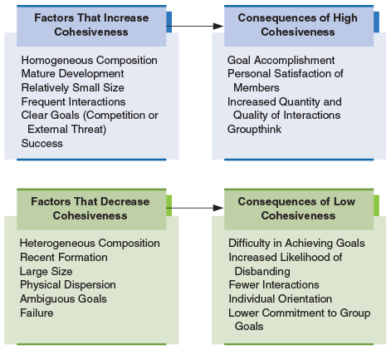
CHAPTER 7
Groups and Teams
Group Cohesiveness
Figure 7.1. Factors That Affect Group Cohesiveness and Consequences of Group Cohesiveness
The factors that increase and decrease cohesiveness and the consequences of high and low cohesiveness indicate that although it is often preferable to have a highly cohesive group, in some situations the effects of a highly cohesive group can be negative for the organization.

Slide 28
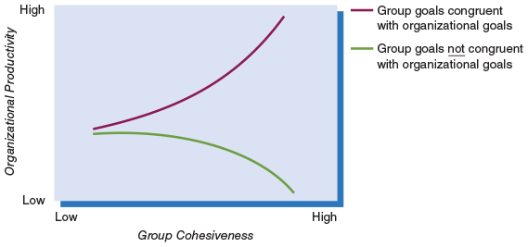
CHAPTER 7
Groups and Teams
Group Cohesiveness
Figure7.2. Group Cohesiveness, Goals, and Productivity
This figure shows that the best combination is for the group to be cohesive and for the group’s goals to be congruent with the organization’s goals. The lowest potential group performance also occurs with highly cohesive groups when the group’s goals are not consistent with the organization’s goals.

Slide 29
CHAPTER 7
Groups and Teams
Group Cohesiveness
Group cohesiveness | Cohesiveness may also be a primary factor in the development of certain problems for some decision-making groups. An example is groupthink, which occurs when a group’s overriding concern is a unanimous decision rather than critical analysis of alternatives. These problems, together with the evidence regarding group cohesiveness and productivity, mean that a manager must carefully weigh the pros and cons of fostering highly cohesive groups. Finally, there is emerging evidence that the emotional intelligence of group members can promote cohesiveness. In this context, emotional intelligence refers to interpersonal capability that includes the ability to perceive and express emotions, to understand and use them, and to manage emotions in oneself and other people.

Slide 30
CHAPTER 7
Groups and Teams
Informal Leadership
Informal Leadership | informal leader is a person who engages in leadership activities but whose right to do so has not been formally recognized. The formal and the informal leader in any group or team may be the same person, or they may be different people. For example, most groups and teams need people to play both task and socioemotional roles. An informal leader is likely to be a person capable of carrying out both roles effectively. If the formal leader can fulfill one role but not the other, an informal leader often emerges to supplement the formal leader’s functions. If the formal leader can fill neither role, one or more informal leaders may emerge to carry out both sets of functions.

Slide 31

CHAPTER 7
Groups and Teams
Informal Leadership
An informal leader is someone who engages in leadership activities without the formal authority to do so. Take these construction supervisors, for instance. The project manager may be away handling other responsibilities and one of the two supervisors in the center is taking charge during the manager’s absence. This supervisor, then, is emerging as an informal leader by taking on a larger role than has been actually granted to them by the company.

Slide 32
CHAPTER 7
Groups and Teams
Creating New Groups and Teams
 | Managers frequently have the opportunity to create new groups and teams. Given the significant roles that groups and teams can play in organizational effectiveness, it is clearly important that this process be approached logically and rationally. In general, if a new group or team is being created, managers should be aware of the stages that groups and teams go through, understand how various performance factors should be considered, and be aware of the formal process experts suggest for implementing teams.

Slide 33
CHAPTER 7
Groups and Teams
Stages of Group and Team Development
 | Groups are not static, and when a new group or team is created it generally goes through some “growing pains” before it becomes fully functional. Traditional research on small groups per se (as opposed to teams) has focused on a four-stage development process: mutual acceptance, communication and decision making, motivation and productivity, and control and organization. The stages and the activities that typify them are shown in Figure 7.3. We will discuss the stages as separate and distinct. It is difficult to pinpoint exactly when a group moves from one stage to another, however, because the activities in the phases tend to overlap.

Slide 34
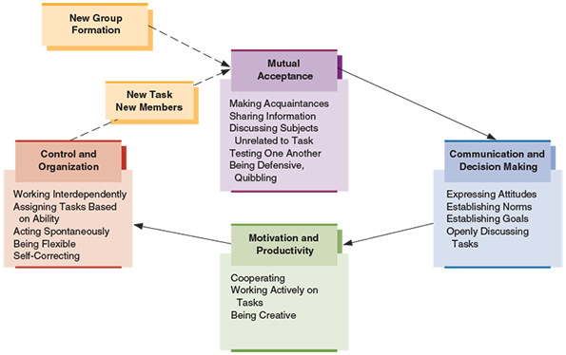
CHAPTER 7
Groups and Teams
Stages of Group and Team Development
This figure shows the stages of evolution from a newly formed group to a mature group. Note that as new members are added or an existing group gets a new task, the group needs to go through the stages again.

Slide 35
CHAPTER 7
Groups and Teams
Stages of Group and Team Development
Mutual Acceptance | Mutual Acceptance In the mutual acceptance stage of group development (also called the forming stage), the group forms, and members get to know one another by sharing information about themselves. They often test one another’s opinions by discussing subjects that have little to do with the group, such as the weather, politics, sports, or recent events within the organization. Some aspects of the group’s task, such as its formal objectives, may also be discussed at this stage. However, such discussion probably will not be very productive because the members are unfamiliar with one another and do not know how to evaluate one another’s comments.

Slide 36
CHAPTER 7
Groups and Teams
Stages of Group and Team Development
Communication and Decision Making | 2- Communication and Decision Making The group progresses to the communication and decision-making stage (also called storming stage) once group members have begun to accept one another. In this stage, members discuss their feelings and opinions more openly, which can increase conflict; they may show more tolerance for opposing viewpoints and explore different ideas to bring about a reasonable solution or decision. The membership usually begins to develop norms of behavior during this stage. Members discuss and eventually agree on the group’s goals. Then they are assigned roles and tasks to accomplish the goals.

Slide 37
CHAPTER 7
Groups and Teams
Stages of Group and Team Development
Motivation and Productivity | 3- Motivation and Productivity In the next stage, motivation and productivity stage (also called the norming stage), the emphasis shifts away from personal concerns and viewpoints to activities that will benefit the group. Members perform their assigned tasks, cooperate with one another, and help one another accomplish their goals. The members are highly motivated and may carry out their tasks creatively. In this stage, the group is accomplishing its work and moving toward the final stage of development.

Slide 38
CHAPTER 7
Groups and Teams
Stages of Group and Team Development
Control and Organization | 4- Control and Organization In the final stage, control and organization stage (also called the performing stage), the group works effectively toward accomplishing its goals. Tasks are assigned by mutual agreement and according to ability. In a mature group, the members’ activities are relatively spontaneous and flexible rather than subject to rigid structural restraints. Mature groups evaluate their activities and potential outcomes and take corrective actions if necessary. The characteristics of flexibility, spontaneity, and self-correction are very important if the group is to remain productive over an extended period.

Slide 39
CHAPTER 7
Groups and Teams
Stages of Group and Team Development
 | Finally, as working conditions and relationships change, either through a change in membership or when a task is completed and a new task is begun, groups may need to re-experience one or more of the stages of development to maintain the cohesiveness and productivity characteristic of a well-developed group. The San Francisco Forty-Niners, for example, once returned from an NFL players strike to an uncomfortable and apprehension-filled period. Their coach conducted rigorous practices but also allowed time for players to get together to air their feelings. Slowly, team unity returned, and players began joking and socializing again as they prepared for the rest of the season. Their redevelopment as a mature group resulted in two subsequent Super Bowl victories.

Slide 40
CHAPTER 7
Groups and Teams
Understanding Team Performance Factors
Understanding Team Performance Factors | People working together in teams have the potential to produce more or higher-quality outputs than would have resulted if the individual efforts of team members were later combined Process gain refers to the performance improvements that occur because people work together rather than independently. Process gain is the goal of working in teams—people working together doing more and doing it better than would be possible working alone. Process loss occurs when a team of people working in a group or team together performs worse than the individual members would have if they had worked alone. One useful technique for promoting process gain is to develop and promote team efficacy. Team efficacy is a team’s shared belief that it can organize and execute the behaviors necessary to reach its goals.

Slide 41
CHAPTER 7
Groups and Teams
Understanding Team Performance Factors
Understanding Team Performance Factors | Managers should also try to build trust among team members. Trust is our confidence that other people will honor their commitments, especially when it is difficult to monitor or observe the other people’s behavior An opposite behavior occurs when people actually work harder and are more motivated when others are present than when they are working alone. Social facilitation happens when people are motivated to look good to others and want to maintain a positive self-image. It happens when people are working alone, but in the presence of an audience. People sometimes increase their effort when working in a group simply because others are present or because of evaluation apprehension

Slide 42
CHAPTER 7
Groups and Teams
Understanding Team Performance Factors
Understanding Team Performance Factors | In addition, managers should establish clear roles. Roles define the behaviors and tasks each team member is expected to perform because of the position they hold. One of the primary outcomes of the process of group and team development is the establishment of clear roles in the team. Understanding what your teammates expect you to do and what you can expect your teammates to do reduces conflict and enables smooth team performance. Making team roles and expectations clear helps to reduce process loss.

Slide 43
CHAPTER 7
Groups and Teams
Understanding Team Performance Factors
Understanding Team Performance Factors | It is also important to establish positive norms. By helping team members know what to expect from one another, norms help to ensure high performance. An example of a positive team norm is arriving to meetings prepared and on time, and participating fully. Team members comply with team norms to avoid punishments and receive rewards; to imitate team members whom they like and admire; and because they have internalized the norm and believe it is the appropriate way to behave.

Slide 44
CHAPTER 7
Groups and Teams
The Implementation Process
The Implementation Process | Implementing teams across an organization is not easy; it takes a lot of hard work, time, training, and patience. Indeed, changing from a traditional organizational structure to a team-based structure is a major organizational change and calls for a complete cultural change for the organization. Typically, the organization is hierarchically designed to provide clear direction and control. However, many organizations need to be able to react quickly to a dynamic environment. Team procedures artificially imposed on existing processes are a recipe for disaster. In this section, we present several essential elements peculiar to an organizational change to a team-based situation. .

Slide 45
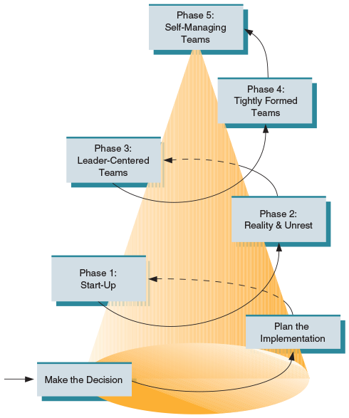
CHAPTER 7
Groups and Teams
The Implementation Process
Figure 7.4. Phases of Team Implementations
Implementation of teams in organizations is a long and arduous process. After the decision is made to initiate teams, the steering committee develops the plans for the design team, which plans the entire process. The goal is for teams to become self-managing. The time it takes for each stage varies with the organization.

Slide 46
CHAPTER 7
Groups and Teams
The Implementation Process
The Implementation Process | Phase 1: Start-Up: In phase 1, team members are selected and prepared to work in teams so that the teams have the best possible chance of success. Much of the initial training is informational or “awareness” training that sends the message that top management is firmly committed to teams and that teams are not experimental. Phase 2: Reality and Unrest: After perhaps six to nine months, team members and managers report frustration and confusion about the ambiguities of the new situation. For employees, unfamiliar tasks, more responsibility, and worry about job security replace hope for the opportunities presented by the new approach. All of the training and preparation, as important as it is, is never enough to prepare for the storm and backlash.

Slide 47
CHAPTER 7
Groups and Teams
The Implementation Process
The Implementation Process | Phase 3: Leader-Centered Teams As the discomfort and frustrations of the previous phase peak, teams usually long for a system that resembles the old manager-center organizational structure. However, members are learning about self-direction and leadership from within the team and usually start to focus on a single leader in the team Phase 4: Tightly Formed Teams In the fourth phase of team implementation, teams become tightly formed to the point that their internal focus can become detrimental to other teams and to the organization as a whole. Such teams are usually extremely confident of their ability to do everything. Phase 5: Self-Managing Teams Phase 5 is the end result of the months or years of planning and implementation. Mature teams are meeting or exceeding their performance goals. Team members are taking responsibility for team-related leadership functions.

Slide 48
CHAPTER 7
Groups and Teams
Teamwork Competencies
Managing Teams | 1. Conflict resolution abilities The ability to recognize and encourage desirable and discourage undesirable team conflict The ability to recognize the type and source of conflict confronting the team The ability to employ an integrative (win–win) negotiation strategy, rather than the traditional distributive (win–lose) strategy 2. Collaborative problem-solving abilities The ability to identify situations requiring participative group problem solving and to utilize the proper degree and type of participation The ability to recognize the obstacles to collaborative group problem solving and implement appropriate corrective actions 3. Communication abilities The ability to communicate openly and supportively The ability to listen objectively and to appropriately use active listening techniques The ability to maximize the congruence between nonverbal and verbal messages and to recognize and interpret the nonverbal messages of others

Slide 49
CHAPTER 7
Groups and Teams
Teamwork Competencies
Managing Teams | 4. Goal-setting and self-management abilities The ability to help establish specific, challenging, and accepted team goals The ability to provide constructive feedback 5. Planning and task coordination abilities The ability to coordinate and synchronize activities, information, and tasks among team members The ability to help establish task and role assignments for individual team members and ensure proper balancing of workload

Slide 50
CHAPTER 7
Groups and Teams
Emerging Team Opportunities and Challenges
Emerging Team Opportunities and Challenges | As teams become increasingly common in organizations, two additional sets of opportunities and challenges must be addressed. These involve virtual teams and diversity and multicultural teams. Virtual Teams Managing virtual teams can be difficult. Virtual team members are frequently separated by both geographic space and time, increasing the challenges of working together effectively. In such environments, team members are often isolated from one another and find it difficult to feel connected to their team. Virtual Team Leadership Skills The effective leadership of teams whose members are linked by technology and whose members often do not see each other requires unique skills and behaviors compared to managing and leading teams located in the same place

Slide 51
CHAPTER 7
Groups and Teams
Emerging Team Opportunities and Challenges
Emerging Team Opportunities and Challenges | Leader Behaviors The lack of face-to-face contact with virtual team members makes it difficult for leaders to monitor team member performance and to implement solutions to work problems. It is also difficult for virtual team leaders to perform typical mentoring, coaching, and development functions. Groupware and Group Decision Support Systems Synchronous and asynchronous information technologies support members of virtual teams. Synchronous technologies such as videoconferencing, instant messaging, electronic meetings, and even conference calls allow real-time communication and interaction.

Slide 52
CHAPTER 7
Groups and Teams
Diversity and Multicultural Teams
Emerging Team Opportunities and Challenges | Diversity can both help and hinder team effectiveness. Diversity can be a source of creativity and innovation that can create a competitive advantage and improve a team’s decision making Innovative companies intentionally use heterogeneous teams to solve problems. Despite its potential for improving team performance, diversity can be a two-edged sword. Diversity can create misunderstandings and conflict that can lead to absenteeism, poor quality, low morale, and loss of competitiveness as well as lowered workgroup cohesiveness. Diverse groups are less able to provide for all of their members’ needs and tend to have less integration and communication and more conflict than do homogeneous groups.

Slide 53
CHAPTER 7
Groups and Teams
Diversity and Multicultural Teams
Emerging Team Opportunities and Challenges | Increasing the Effectiveness of Multicultural Teams What should you do to increase the effectiveness of multicultural teams? The best solution seems to be to make minor concessions on process—learn to adjust to and even respect another approach to decision making. For example, global American managers have learned to keep impatient bosses away from team meetings and give them frequent updates. A comparable lesson for managers from other cultures is to be explicit about what they need—saying, for example, “We have to see the big picture before we will be ready to talk about details.”

Slide 54
CHAPTER 7
Groups and Teams
Diversity and Multicultural Teams
Emerging Team Opportunities and Challenges | Four strategies for dealing with the challenges of multicultural teams are: Adaptation: seeing a problem as a cultural difference and not a personality issue. This works when team members are willing and able to identify and acknowledge their cultural differences and to assume responsibility for figuring out how to live with them. Structural intervention: changing the shape of the team. Social interaction and working can be structured to engage everyone on the team. Managerial intervention: setting norms early or bringing in a higher-level manager. This usually works best early in a team’s life. In one case, a manager set norms of respect by telling his new team that no one had been chosen for English skills; each member was chosen because he or she was technically the best person for the job, so get over the accents. Exit: removing a team member when other options have failed. If emotions get too high and too much face has been lost, it can be almost impossible to get a team to work together effectively again.*

Slide 55

CHAPTER 7
Groups and Teams
Diversity and Multicultural Teams
Just as diversity is becoming more common in organizations, so too are groups and teams also becoming more diverse. This group, for instance, reflects several different forms of diversity. Group and team diversity can promote creativity and innovation. Unfortunately it can also be a source of conflict.

Slide 56
CHAPTER 7
Groups and Teams
Summary and Application
A group is two or more persons who interact with one another such that each person influences and is influenced by each other person.
Teams are an interdependent collection of at least two individuals who share a common goal and share accountability for the team’s as well as their own outcomes.
Groups and teams are not necessarily the same thing. All teams are groups, but not all groups are teams. Common kinds of groups in organizations include workgroups, teams, and informal groups.
The performance of any group is affected by several factors other than its reasons for forming and the stages of its development.
The five basic group performance factors are composition, size, norms, cohesiveness, and informal leadership. Group composition is most often described in terms of the homogeneity or heterogeneity of the members. Group size can also have an important effect on performance.

Slide 57
CHAPTER 7
Groups and Teams
Summary and Application
A norm is a standard against which the appropriateness of a behavior is judged and determines the behavior expected in a certain situation.
Group cohesiveness is the extent to which a group is committed to remaining together; it results from forces acting on the members to remain in the group.
The final group performance factor is informal leadership: the emergence of an individual who engages in leadership activities but whose right to do so has not been formally recognized.
When a new group or team is formed, it typically goes through several stages of development. Traditional research on small groups per se (as opposed to teams) has focused on a four-stage development process:
mutual acceptance,
communication and decision making,
motivation and productivity, and
control and organization.

Slide 58
CHAPTER 7
Groups and Teams
Summary and Application
In terms of teamwork, other factors that contribute to performance include process gain or loss, team efficacy, trust, social facilitation, and roles.
The process of implementation of teams should be approached as would be the case for any major organizational change.
Managers need to have a clear understanding of the potential benefits and costs of using teams. They should also know what they need to do to promote effective team performance, including providing top-management support, understanding time frames, and planning for the likely need to change rewards. Working to develop teamwork competencies is also important.
Virtual teams and multicultural teams are important emerging areas of teamwork that are relevant to most organizations today.
Managers should strive to understand how to most effectively use these two kinds of teams.

Slide 59
Thanks

