Slide 1



Project Leadership
PMG 511
Lecture 2
Ch2 - Project Fundamentals
Prepared by
Dr Hakem Sharari
www.midocean.ae

Slide 2
Learning Outcomes
What is a Project?
Project Life Cycle and the project Phases.
Organizational Structure.
Process Models.
Quality Project.
Project Outcomes.
Summary and Conclusions.
Self Assessment.

Slide 3
What is a Project?

Slide 4
What is a Project?
Project based on a business need or opportunity.
Often explored and initiated by the project sponsor(s), who writes or approves the project charter.
Has the following features:
A defined beginning and end.
Unique goals and outcomes.
Typically requires team members with varied skills.
Contrasts with operational work, which is repetitive ‘business as usual’.

Slide 5
Project Life Cycle

Slide 6

Project Life Cycle
Most projects need to be broken down into a logical sequence of ‘phases’, known as the project life cycle.
A project life cycle is a collection of project phases that defines:
What work will be performed in each phase?
What deliverables will be produced and when?
Who is involved in each phase?
How will management control and approve work produced in each phase?
A deliverable is a product or service produced or provided as part of a project.

Slide 7

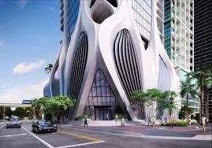

Project Life Cycle
Different project managers or leaders choose different PLC’s, depending on the nature of the task i.e., engineering, software development etc.

Slide 8
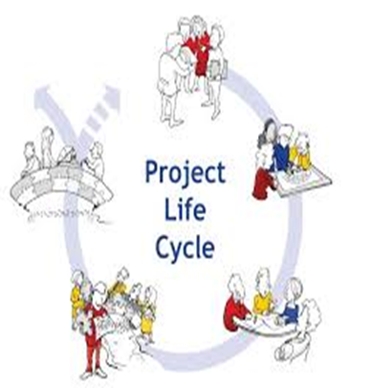
Project Phases
In the early phases of a project life cycle:
Resource needs are usually lowest.
The level of uncertainty (risk) is highest.
Project stakeholders have the greatest opportunity to influence the project.
In the middle phases of a project life cycle:
The certainty of completing a project increases.
More resources are needed.
In the final phase of a project life cycle:
The focus is on ensuring that project requirements were met.
The sponsor approves completion of the project.

Slide 9
Project Phases
Conception/Initiation: research conducted, leadership chosen, goals and requirements established.
Planning: detailed plans drafted and documented.
Execution: plans are implemented, intended result of project takes shape.
Closing: results handed off, lessons learned collected.

Slide 10
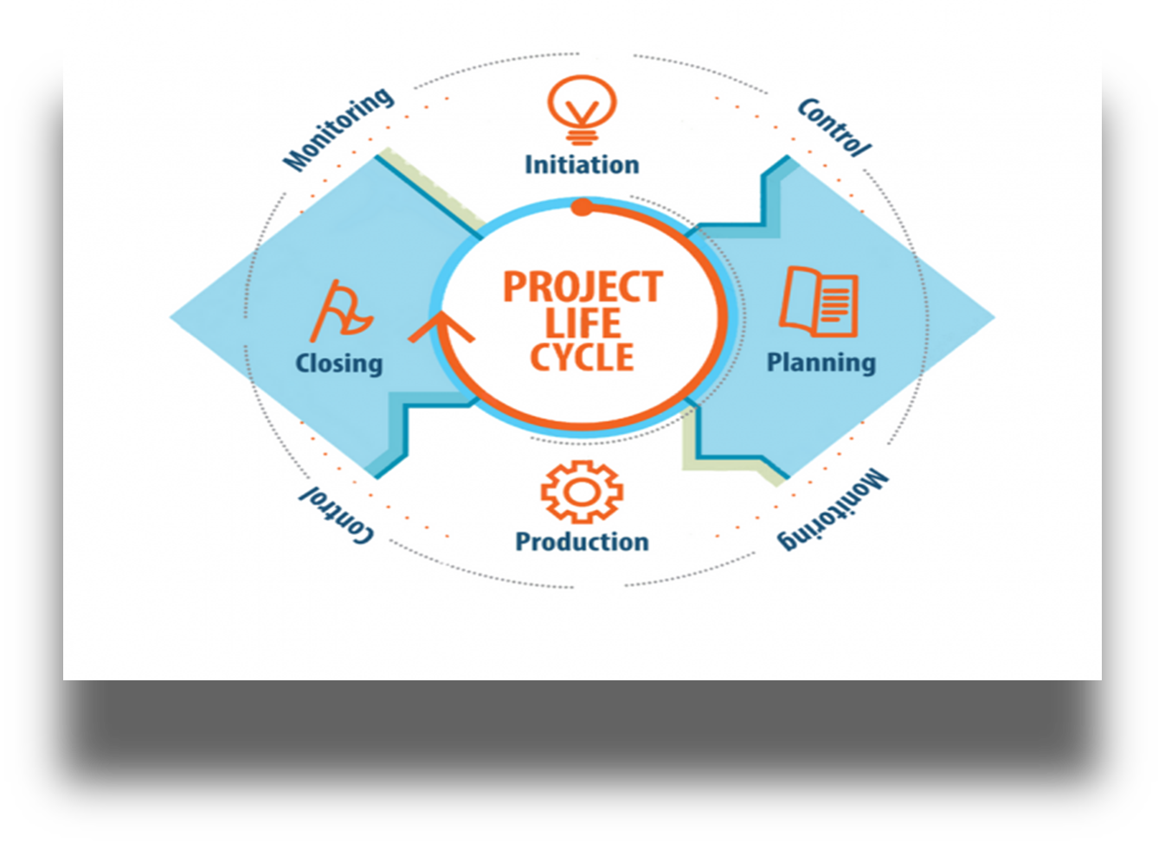

Slide 11
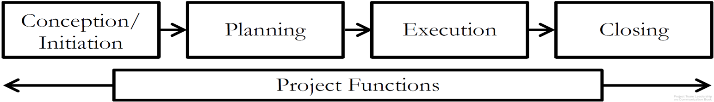
Project Functions
Unlike individual phases, project functions don’t occur at one point in time – they require continuous attention and/or action:
Risk and Issue Management.
Quality Management.
Communications Management.
Managing the Project Itself.

Slide 12
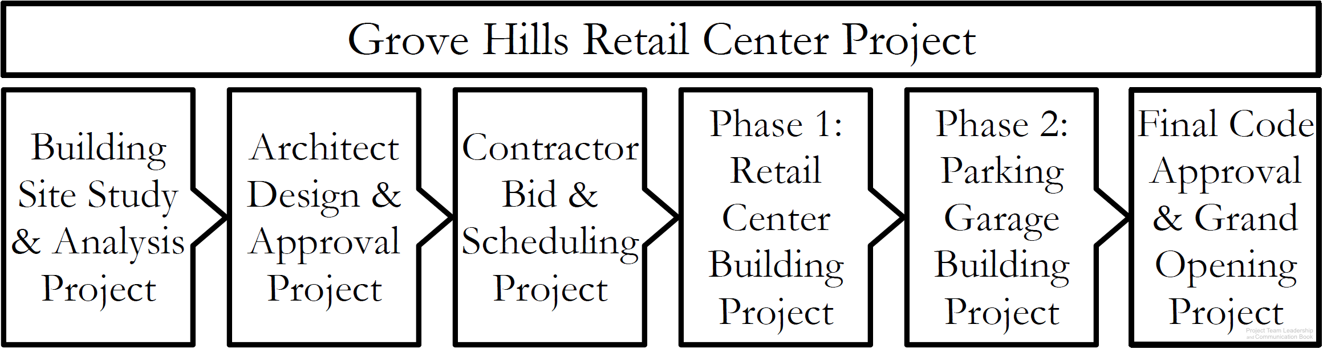
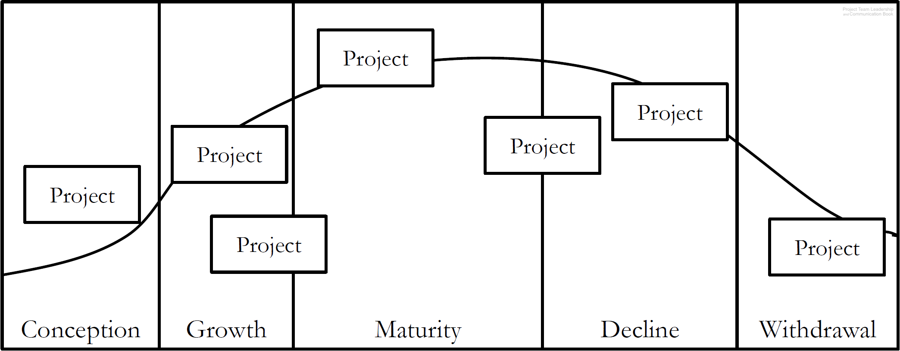
Projects Size and Scale
Projects can vary in size and scale.
A large project can have multiple sub-projects
A project life cycle includes projects in every phase

Slide 13
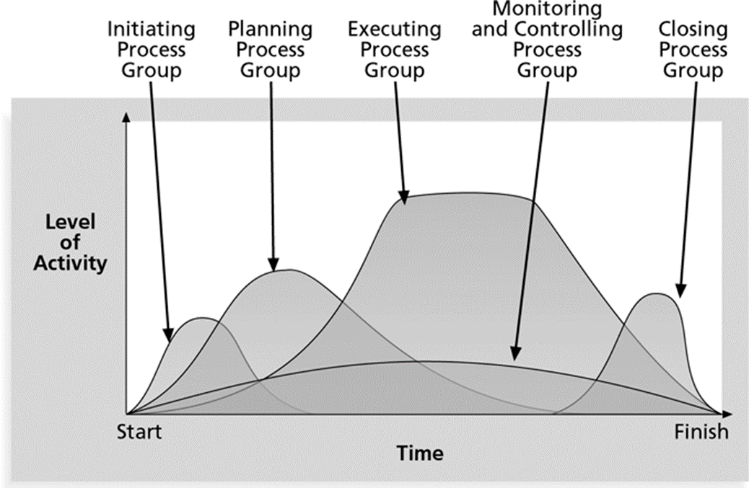
Activity and Groups
Level of activity and overlap of process groups over time during the project lifecycle.

Slide 14
Project Life Cycle (PLC)

Slide 15
Initiation Process

Slide 16

Project Initiation
Determine the nature and scope of the project. If this stage is not performed well, it is unlikely that the project will be successful in meeting the business’ needs.
The key project controls needed here are an understanding of the business environment and making sure that all necessary controls are incorporated into the project. Any deficiencies should be reported and a recommendation should be made to fix them.
Every organization has its own variations of what documents are required to initiate a project. It’s important to identify the project need, stakeholders, and main goals.

Slide 17
Initiation Breakdown Process
Select project manager
Determine company culture and existing systems
Collect processes, procedures and historical information
Divide large projects into phases
Identify stakeholders
Document business need
Determine project objectives
Document assumptions and constraints
Develop project charter
Develop preliminary project scope statement

Slide 18
Planning Process

Slide 19

Project Planning
The main purpose of project planning is to guide execution.
To plan time, cost and resources adequately to estimate the work needed and to effectively manage risk during project execution. As with the Initiation process group, a failure to adequately plan greatly reduces the project's chances of successfully accomplishing its goals.
Every knowledge area includes planning information.
Key outputs included in the project include:
A team contract.
A scope statement.
A work breakdown structure (WBS).
A project schedule, in the form of a Gantt chart with all dependencies and resources entered.
A list of risks (part of a risk register).

Slide 20
Planning Breakdown process
Determine how you will do planning – part of management plans.
Create project scope statement.
Determine team.
Create activity list.
Create network diagram.
Estimate resource requirements.
Estimate time and cost.
Determine critical path.
Develop Schedule.
Developer budget.
Determine quality standards, processes and metrics.
Determine roles and responsibilities.
Determine communications requirements.
Risk identification, qualitative and quantitative risk analysis and response planning.
Determine what to purchase.
Prepare procurement documents.
Finalize the “how to execute and control” aspects of all management plans.
Create process improvement plan.
Gain formal approval.
Hold kick-off meeting.

Slide 21
Execution Process

Slide 22
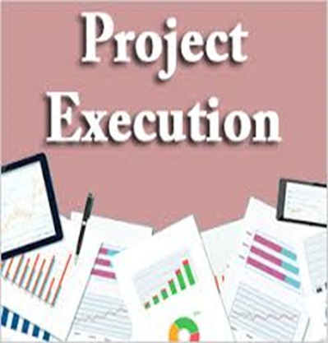
Project Executing
Project execution usually takes the most time and resources.
Executing consists of the processes used to complete the work defined in the project management plan to accomplish the project's requirements.
Execution process involves coordinating people and resources, as well as integrating and performing the activities of the project in accordance with the project management plan.
The deliverables are produced as outputs from the processes performed as defined in the project management plan.
Project managers must use their leadership skills to handle the many challenges that occur during project execution.
The executing processes and outputs. Many project sponsors and customers focus on deliverables related to providing the products, services, or results desired from the project.

Slide 23
Execution Breakdown processes
Acquire final team.
Select Sellers.
Request seller responses.
Use work authorization system.
Hold progress meetings.
Give recognition and rewards.
Team building.
Follow processes.
Continuous improvement.
Implement approved changes, defect repair, preventive and corrective actions.
Send and receive information.
Recommend changes and corrective actions.
Complete product scope.
Execute the PM plan.

Slide 24
Monitoring and Controlling Process

Slide 25

Monitoring and Controlling Processes
Involves measuring progress toward project objectives, monitoring deviation from the plan, and taking corrective action to match progress with the plan.
Monitoring and controlling consists of those processes performed to observe project execution so that potential problems can be identified in a timely manner and corrective action can be taken, when necessary, to control the execution of the project.
The key benefit is that project performance which observed and measured regularly to identify variances from the project management plan.
Affects all other process groups and occurs during all phases of the project life cycle.
Outputs include performance reports, requested changes, and updates to various plans.

Slide 26
Monitoring and Controlling Breakdown
Measure against the performance measurement baselines.
Measure according to the management plans.
Determine variances and if they warrant corrective action or a change.
Scope verification.
Configuration management.
Recommend changes, defect repair, preventive and corrective actions.
Integrated change control.
Approve changes, defect repair, preventive and corrective actions.
Risk audits.
Use issue logs.
Facilitate conflict resolution.
Measure team member performance.
Report on performance.
Create forecasts.
Administer contracts.

Slide 27
Closing Process

Slide 28

Project Closing
Closing includes the formal acceptance of the project and the ending. And also it include the administrative activities like archiving of the files and documenting lessons learned.
Involves gaining stakeholder and customer acceptance of the final products and services.
Even if projects are not completed, they should be formally closed in order to reflect on what can be learned to improve future projects
Outputs include project archives and lessons learned, which are part of organizational process assets.
Most projects also include a final report and presentation to the sponsor or senior management.

Slide 29
Closing Breakdown Processes
Develop closure procedures.
Complete contract closure.
Confirm work is done to requirement.
Gain formal acceptance of the product.
Final performance reporting.
Index and archive records.
Update, lessons learned and knowledge base.
Release resources.

Slide 30
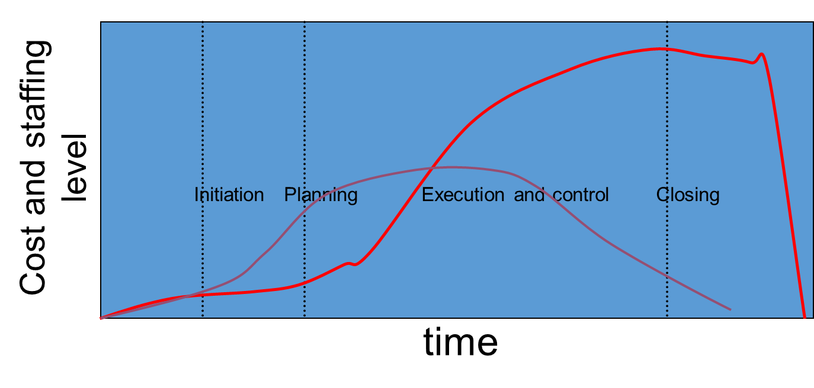
Project Life Cycle - Ideal vs Typical

Slide 31
Project Life Cycle - Ideal v Typical
The Red Curve shows that the project is delayed in finishing.
The area under the curve represents the spend on the project – the red curve spent much more.
If the project is rushed, do you think that the quality if the outputs or deliverables will be good?

Slide 32

Example of a Delayed Project
Planned
1959 to 1963 (4 years)
$7 million
Actual
1959 to 1973 (14 years)
$100 million
The Opera House under construction in 1965.

Slide 33
Organizational Structure

Slide 34

What is organization?
Organization is the structural framework of duties and responsibilities required through a social unit of people, systematically structured and managed to meet a need or to pursue a common and collective goals on a continuing basis.

Slide 35
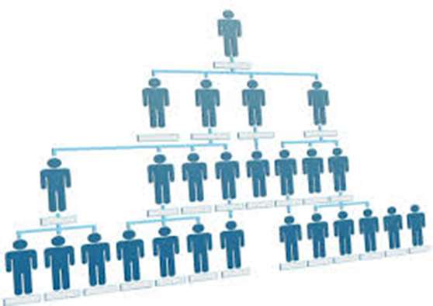
What is An Organizational Structure?
Is a system that outlines how certain activities are directed in order to achieve the goals of an organization. These activities can include rules, roles, and responsibilities

Slide 36

Organizational Structures and Projects
Why do we need organizational structure in a project?
To determines the relationships, functions and positions and subdivides and delegates roles, responsibilities and authority to carry out any defined tasks. It determines how information flows between levels within the company

Slide 37
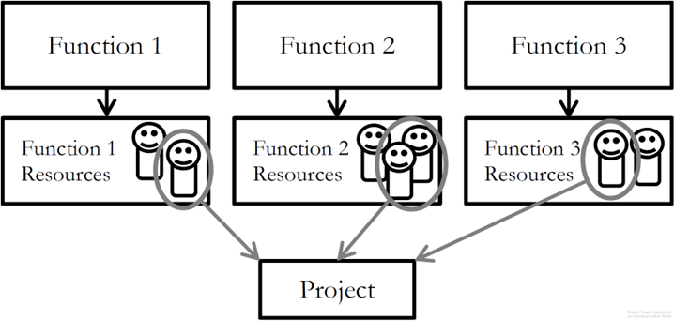
Functional Organizational Structure
‘Classic’ organizational structure.
Organization made up of functional ‘silos’ (HR, Sales, Marketing, etc.).
Project teams consist of resources from multiple departments.
Strengths: resource redundancy.
Weaknesses: resources don’t report to project leader, functional managers may not be supportive of project.

Slide 38
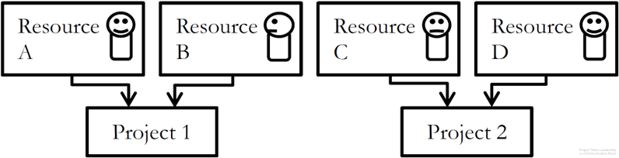
Project-focused Organizational Structure
‘Flat’ organizational structure.
Organization made of project. leads and resources, with few ‘layers’ (few management level).
Project teams consist of resources specifically recruited/assigned to that project.
Strengths: Autonomy/freedom/self-direction, no functional managers.
Weaknesses: Resources are tempted to join other projects ‘jump ship’ to retain employment, projects must ‘stand on their own’, competition between projects for resources.

Slide 39
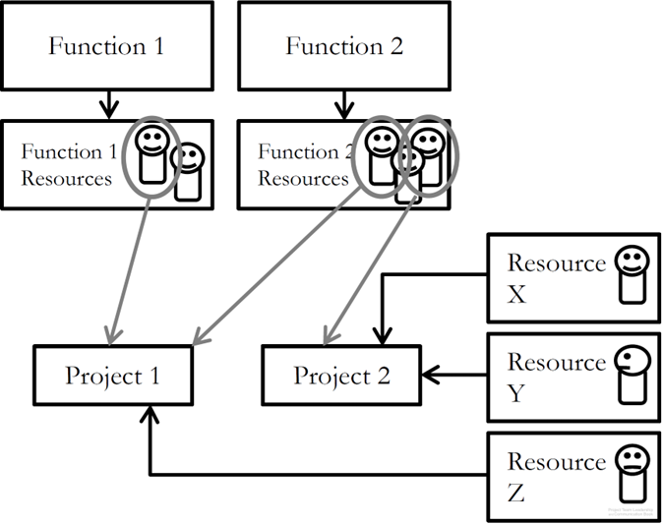
Matrix Organizational Structure
‘Strong’ or ‘weak’ matrix depending on ratio of Functional to Project-Focused aspects
Resources are often external contractors
Strengths: compatible with older, ‘classic’ orgs, can be adjusted as needed.
Weaknesses: some resources may feel more detached from project than others, significant increase in number of stakeholders.

Slide 40
Organizational Values and Needs

Slide 41

Organizational Values and Needs
Similar to the concept of culture, organizations have defining characteristics:
How customers are treated (input, visibility into inner workings)
Risk tolerance and preferred schedule certainty
Experience level of personnel and management
These can highlight certain needs. For example:
The need for extremely clear requirements/specifications vs. the need for stakeholder input .
The need for a clear schedule vs. the need for a responsive project.
The need for many or few project artifacts (documentation).

Slide 42
Process Models

Slide 43

Process in Organizations
Process are actually much less abstract (they’re more exact) in organizations
It is the “The project life cycle”.

Slide 44
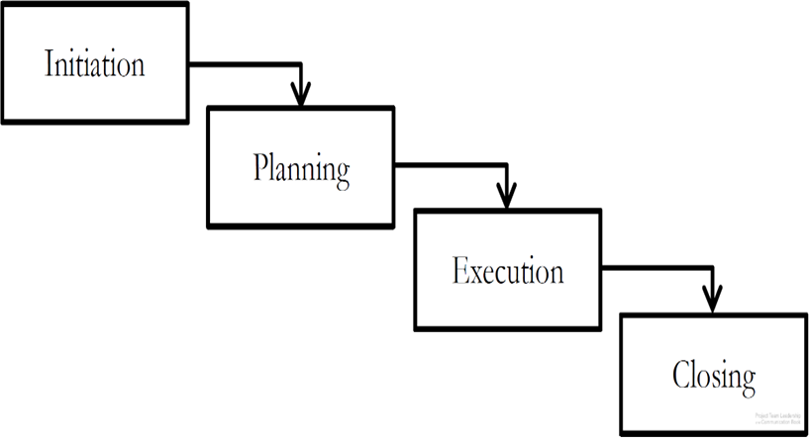
Plan-focused Process Models
Each step must be completely done before
the next can be begun.
Plans are made for each step, then executed ‘waterfall’ style.
Strengths: high, schedule certainty, easy to understand, straightforward, time-tested.
Weaknesses: does not handle uncertainty/change well, stakeholder visibility can be poor (only changes of phase).

Slide 45
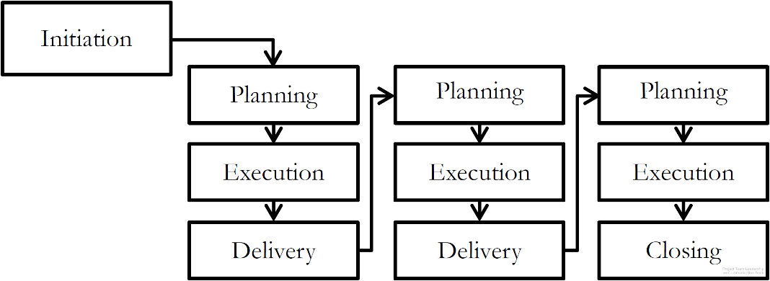
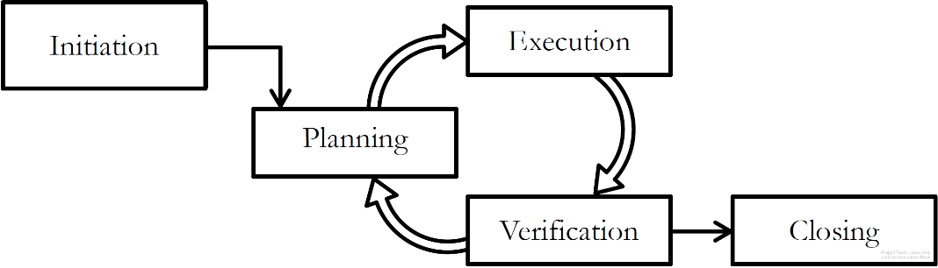
Cyclical Process Models
Projects cycle through delivery or feedback phases.
Plans are made a little-at-a-time.
Strengths: stakeholder visibility is often higher than plan-focused.
Weaknesses: can be difficulty to know when to stop, requires strong disciplined leadership or can get out of control.
Incremental Process Model
Iterative Process Model

Slide 46
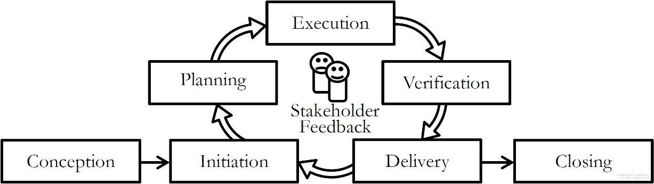
Change-focused Process Models
Responsiveness to change and stakeholder input is the most
important aspect.
Similar to Cyclical process models.
Requires experienced, disciplined leaders and team members
Strengths: stakeholder visibility is high (they’re consulted frequently), responds well to changing market conditions or circumstances.
Weaknesses: can ‘go on forever’ if stakeholders are uncertain or conditions keep changing, requires frequent customer interactions.

Slide 47
Project Quality

Slide 48
Project Quality
Quality is hard to define; most agree there are three main aspects:
Standards defined by the industry, organization, or team.
Conformance to the requirements, specifications, and commitments inherent to the project.
Excellence, the need to go beyond strictly meeting basic requirements/specifications. Thinking about elements such as the user’s perspective, maintenance, long-term cost, etc.
A fourth element can’t be ignored, though:
Perception – do stakeholders have an appropriate, well-informed view of the project? Are communications appropriate? Is the team acting professionally?

Slide 49
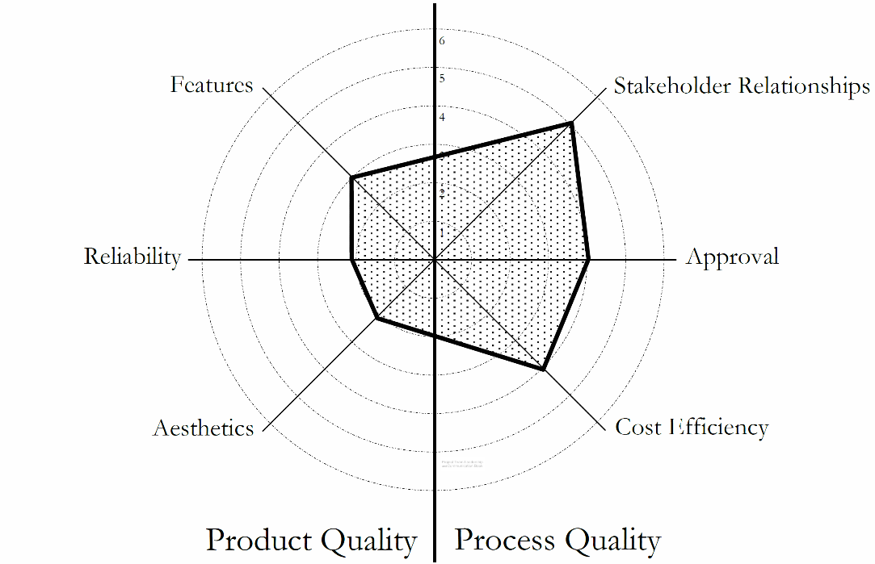
Product and Process Quality
Product Quality relates to what the project is trying to produce.
Examples include features, performance, durability, reliability, resources consumed.
Process Quality relates to the team’s planning and execution of the project.
Examples include timeliness, safety, compliance, responsiveness to customer.
Both must be addressed, and balance must be achieved.
‘Radar Chart’ Showing Balance/Prioritization of Quality in a Project

Slide 50
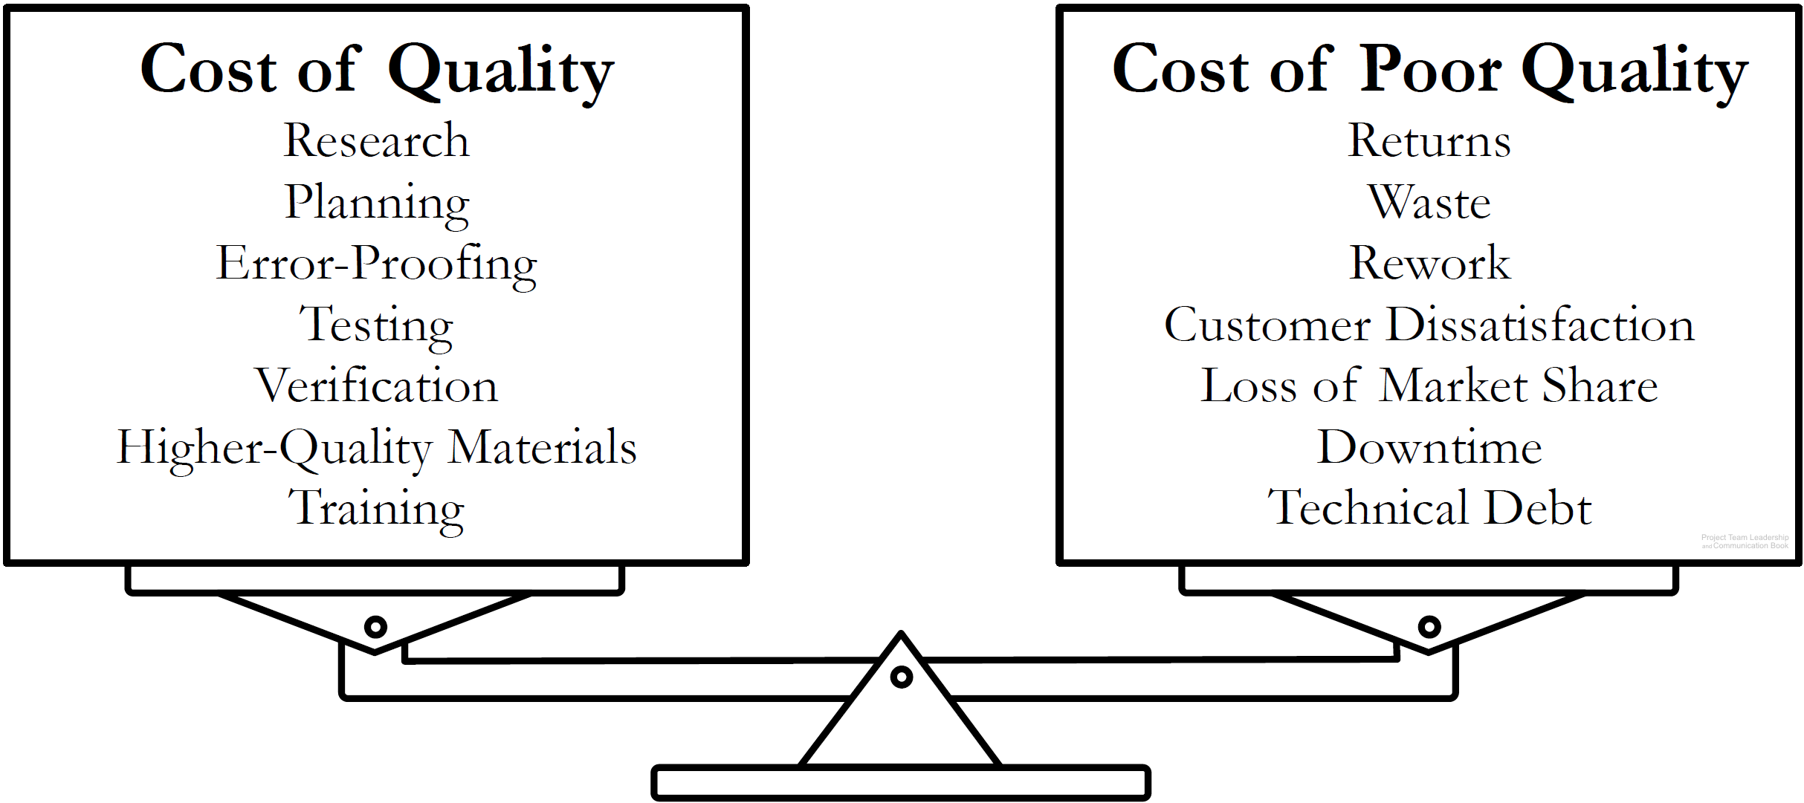
Quality As a Balancing Act
Projects must balance the cost of quality with the cost of poor quality.
Determining where that balance lies requires teams to think about future implications of their actions.

Slide 51
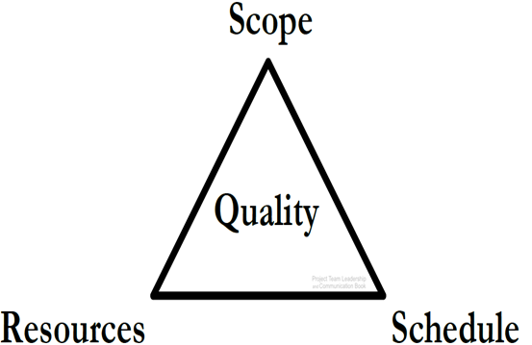
The Project Triangle
Resources: the budget, materials, wages, etc.
Schedule: the time expended.
Scope: What is and isn’t included in the project outcomes.
Quality: can relate to any or all of the three.
Balance: more scope requires more resources, more schedule, or both. Faster project means less scope/more resources, etc.

Slide 52
Project Outcomes

Slide 53
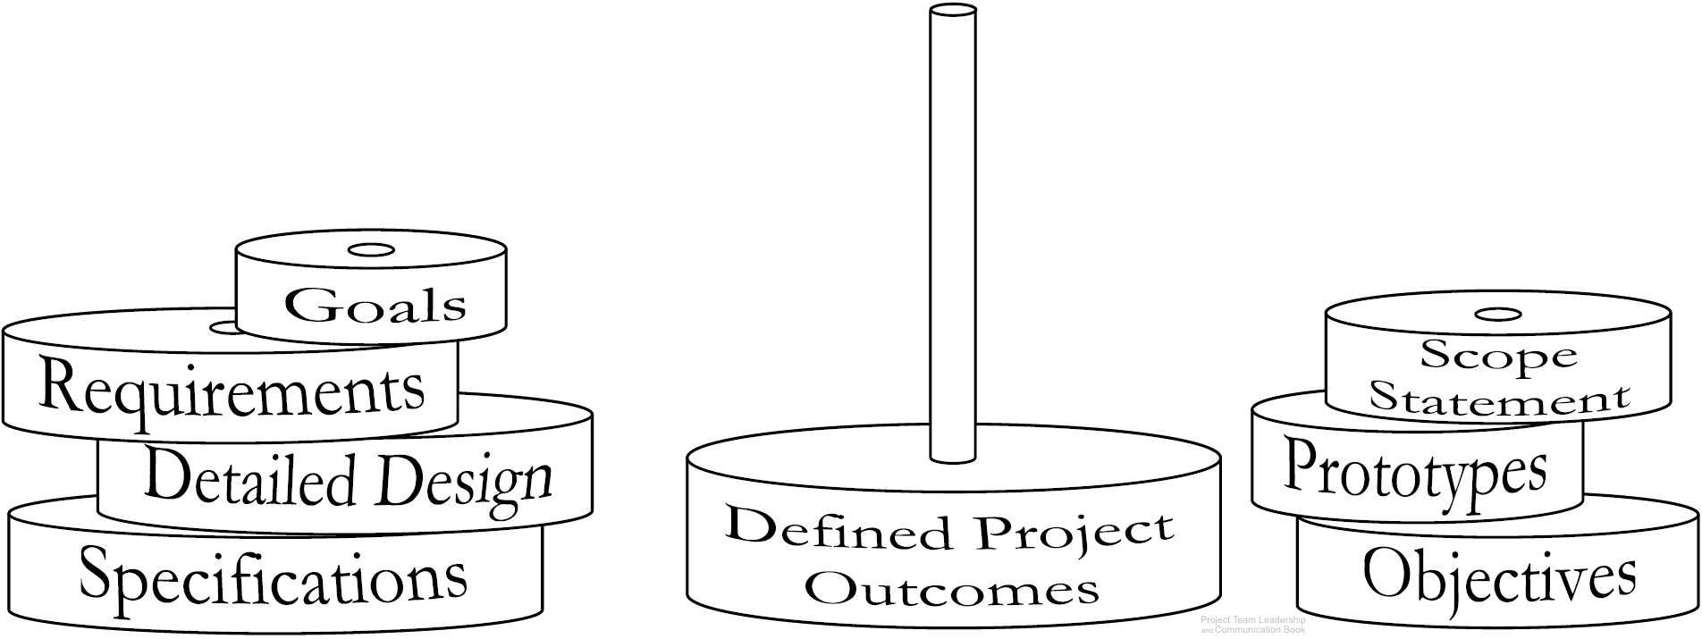
Defining Project Outcomes
Defining the projects outcomes, or deliverables often requires multiple artifacts (documents).
Specific artifacts can vary by industry, organization, or team.

Slide 54

Project Goal Statements
Goals are the overarching outcomes of the project.
High-level: what the project is trying to achieve.
Measurable: it should be clear when the goal is or isn’t met.
Achievable: within the capability of the resources/time available.

Slide 55

Project Scope Statements
Scope Statements – what is and isn’t included in the project?
A list of major deliverables.
A basic strategy.
Constraints, assumptions, and external dependencies.
Often in the form of paragraphs with ‘bullets’.

Slide 56

Project Requirements/Specifications
Requirements and/or specifications:
Details for what’s expected.
Non-ambiguous.
Reader should know exactly what’s needed.
Functional (the outcomes) and non-functional (limits such as schedule, safety, etc.)

Slide 57
Project Kick-off Meeting
The ‘Project Kick-off Meeting’ is designed to:
Establish the project and begin the work.
Introduce team members and stakeholders to each other, and define roles/responsibilities.
Share clear goals and objectives, define what success means to the team.
Choose/share tools, meeting times, etc.
Begin foundational work on the project plans.

Slide 58
Summary and Conclusions

Slide 59
Summary and Conclusions
Projects are unique and time limited, and vary from organization to organization (size, length, etc.).
What is the project phases and project lifecycle?
Organizational structures, values, and needs have very significant effects on projects and how they’re carried out.
Quality (the cost of quality and the cost of poor quality) and the Project Triangle represent a constant give-and-take balancing act.
Project outcomes are defined in layers, which can include goals, objective, requirements/ specifications.
Project kickoff meetings and creating the project plan are often the initial steps in any project.

Slide 60
Self Assessment

Slide 61
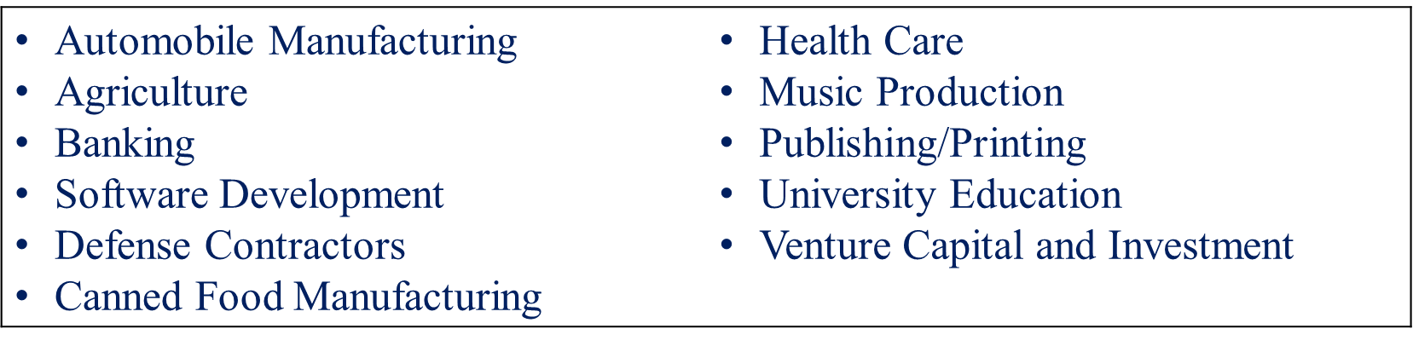
Self Assessment
List 10 successful projects around you from any of the following industries:

Slide 62
Self Assessment
Think about your own project, organize a teams of 3-4 and consider the following:
Your project phases, structure of organization, the values and needs, goals/objectives, basic scope statement, specifications/requirements and the project quality.

Slide 63
Thank You For Listening

Slide 64


Reference

