Slide 1




Mathematics 3 – MAT132
Mathematics 3
Lecture 8
MAT 132
Calculus Applications in real life
Prepared by
Dr. Israa Lewaa

Slide 2
Lecture
05
Lecture Objective
Chapter Objectives
1- Show several uses of Calculus in Real Life
2- Explain Different Applications using Differential
3- Explain Different Applications using Integration
4- Obtain Marginal cost
5- Obtain Marginal Revenue
6- Obtain Demand Function

Slide 3
Lecture
09
Lecture Outline
Lecture Outline
1- Uses of Calculus in Real Life
2- Different Applications using Differential
3- Different Applications using Integration
4- Marginal cost
5- Marginal Revenue
6- Demand Function

Slide 4

Lecture
08
Uses of Calculus in real Life
1- Integration by parts

Slide 5
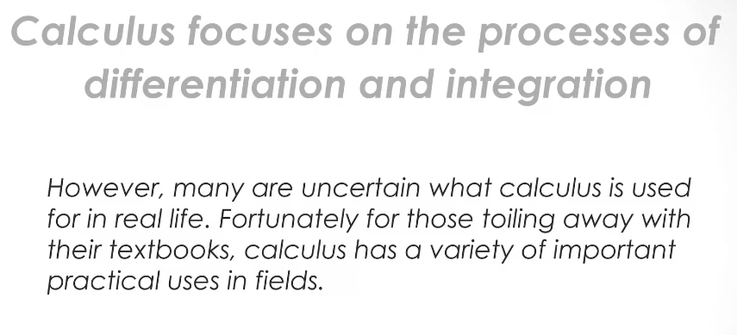
Lecture
08
Lecture
08
Process of differentiation and Integration
Example

Slide 6
Lecture
08
Various Fields of using Calculus
Example
Uses of Calculus in Economics
Uses of Calculus in Biology
Uses of Calculus in Engineering
Uses of Calculus in Architect
Uses of Calculus in Finance

Slide 7
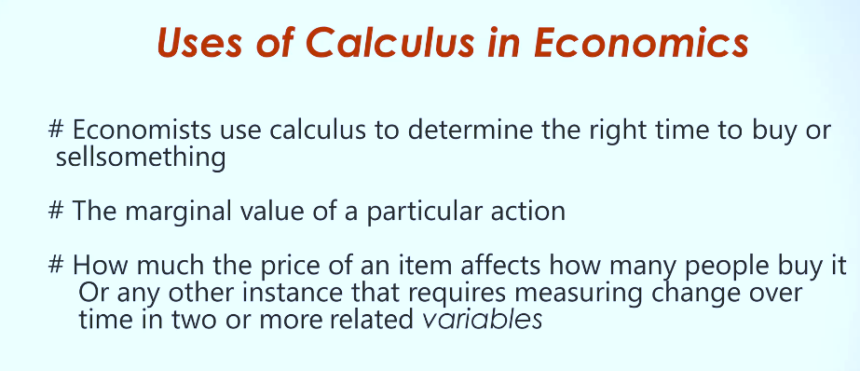
Lecture
08
Lecture
05
Uses of Calculus in Economics
** Revision – Fundamentals
Lecture 8 Dr. Israa Lewaa Mathematics 3

Slide 8
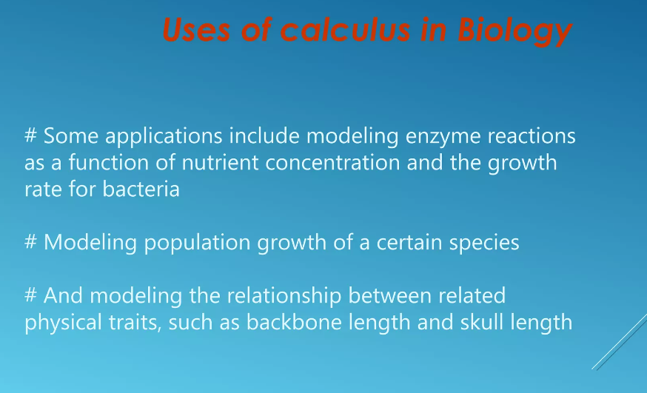
Lecture
08
Uses of Calculus in Biology
Example

Slide 9
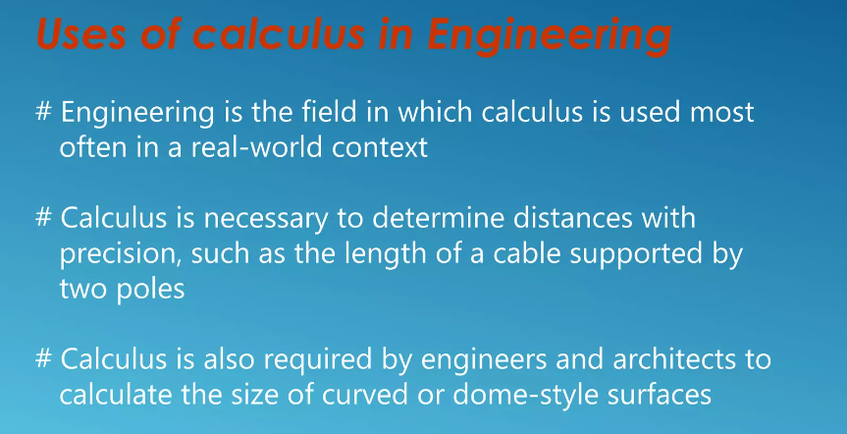
Lecture
08
Uses of Calculus in Engineering
Example

Slide 10
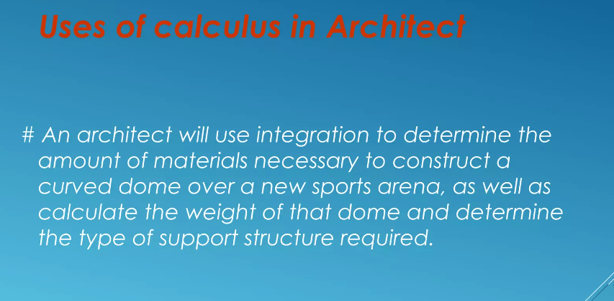
Lecture
08
Uses of Calculus in Architect
Example

Slide 11
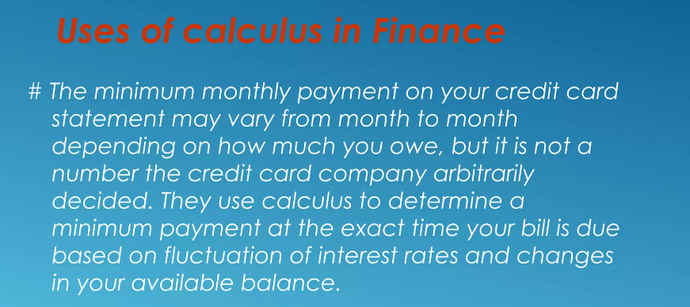
Lecture
07
Uses of Calculus in Finance
** EXTRA PRACTISE

Slide 12
Lecture
08
Applications of Calculus
Example
Applications for Calculus

Slide 13
Lecture
08
Applications for Calculus
Example
Marginal cost
Marginal Revenue
Demand Function
Lecture 8 Dr. Israa Lewaa Mathematics 3

Slide 14
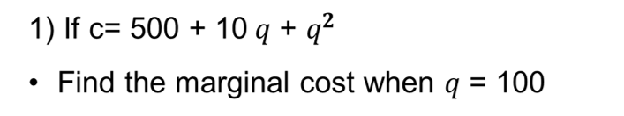
Lecture
08
Lecture
08
Extra Practice – Example 1
The Definite Integral
Lecture 8 Dr. Israa Lewaa Mathematics 3

Slide 15
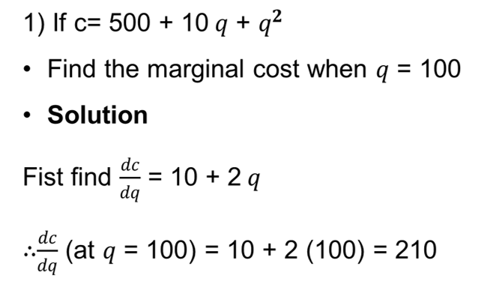
Lecture
08
Lecture
08
Extra Practice – Example 1 Solution
Example 1 - Definite Integration

Slide 16
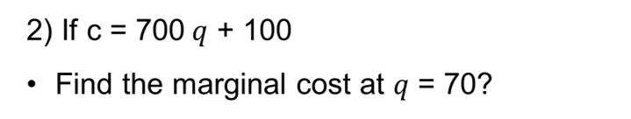
Lecture
08
Extra Practice – Example 2
Example

Slide 17
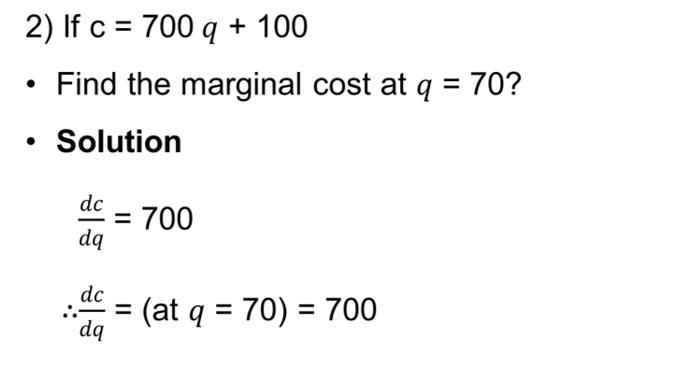
Lecture
08
Extra Practice – Example 2 Solution
Example

Slide 18
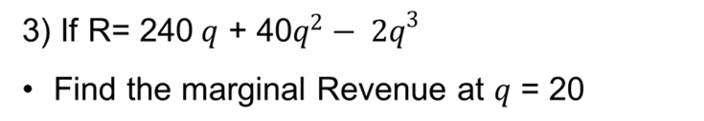
Lecture
08
Extra Practice – Example 3
** EXTRA PRACTISE

Slide 19
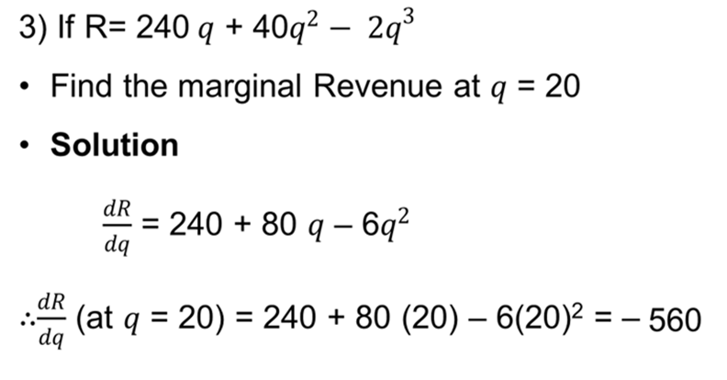
Lecture
08
Extra Practice – Example 3 Solution
** EXTRA PRACTISE

Slide 20
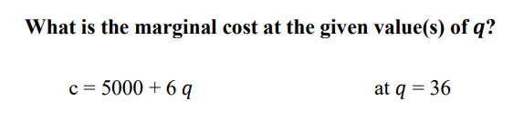
Lecture
08
Extra Practice – Example 4
** EXTRA PRACTISE
Lecture 8 Dr. Israa Lewaa Mathematics 3

Slide 21
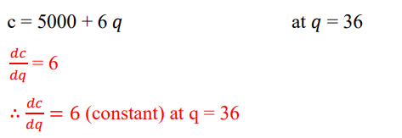
Lecture
08
Extra Practice – Example 4 Solution
** EXTRA PRACTISE

Slide 22


Lecture
08
Extra Practice – Example 5
** EXTRA PRACTISE

Slide 23
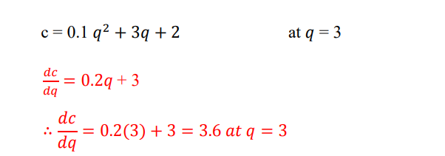
Lecture
08
Extra Practice – Example 5 Solution
** EXTRA PRACTISE

Slide 24

Lecture
08
Extra Practice – Example 6
** EXTRA PRACTISE

Slide 25
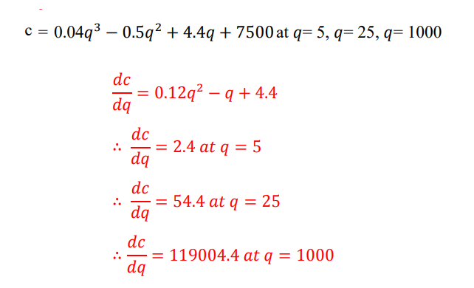
Lecture
08
Extra Practice – Example 6 Solution
** EXTRA PRACTISE

Slide 26
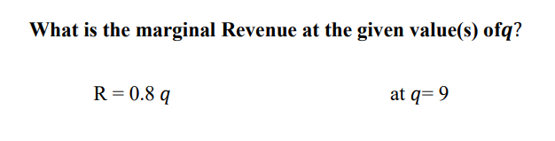
Lecture
07
Extra Practice – Example 7
** EXTRA PRACTISE
Lecture 8 Dr. Israa Lewaa Mathematics 3

Slide 27
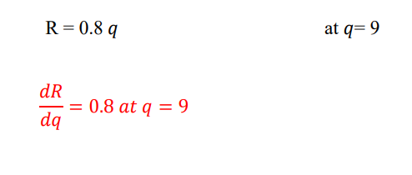
Lecture
07
Extra Practice – Example 7 Solution
** EXTRA PRACTISE

Slide 28


Lecture
07
Extra Practice – Example 8
** EXTRA PRACTISE

Slide 29
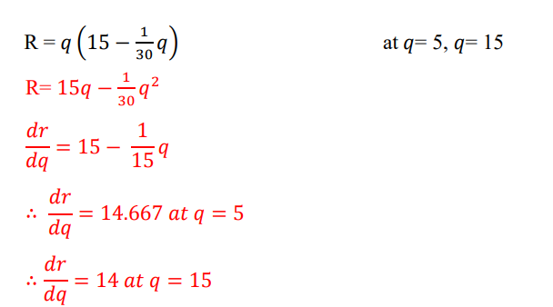
Lecture
07
Extra Practice – Example 8 Solution
** EXTRA PRACTISE

Slide 30
Lecture
07
Extra Practice – Example 9
** EXTRA PRACTISE

Slide 31
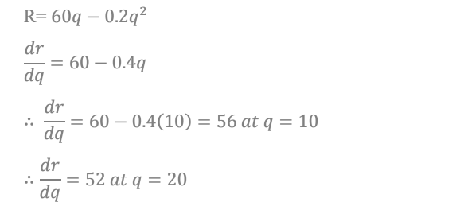
Lecture
07
Extra Practice – Example 9 Solution
** EXTRA PRACTISE

Slide 32
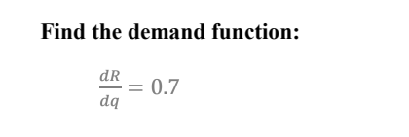
Lecture
07
Extra Practice – Example 10
** EXTRA PRACTISE

Slide 33
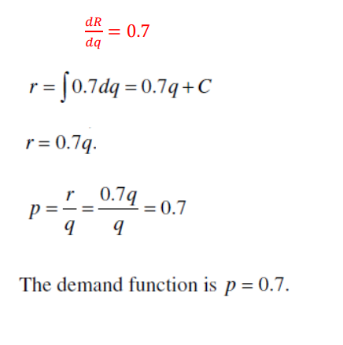
Lecture
07
Extra Practice – Example 10 Solution
** EXTRA PRACTISE

Slide 34


Lecture
07
Extra Practice – Example 11
** EXTRA PRACTISE

Slide 35
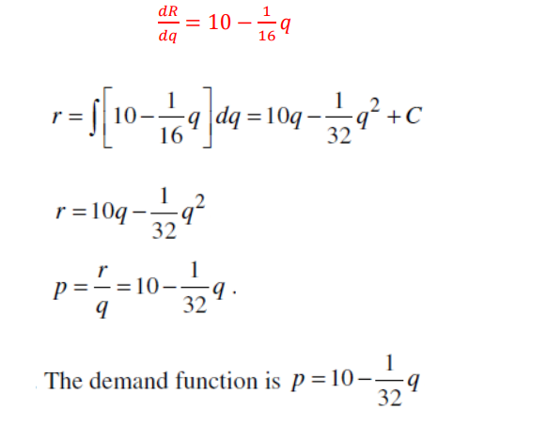
Lecture
07
Extra Practice – Example 11 Solution
** EXTRA PRACTISE

Slide 36

Lecture
07
Extra Practice – Example 12
** EXTRA PRACTISE

Slide 37
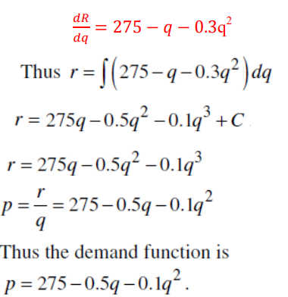
Lecture
07
Extra Practice – Example 12 Solution
** EXTRA PRACTISE

Slide 38

Lecture
07
Extra Practice – Example 13
** EXTRA PRACTISE

Slide 39
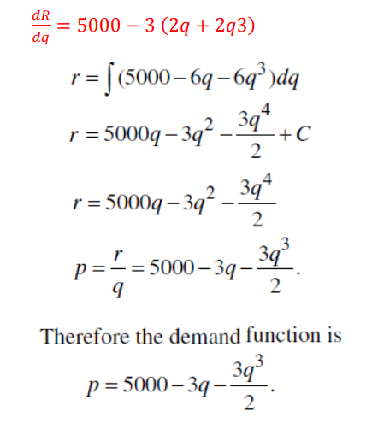
Lecture
07
Extra Practice – Example 13 Solution
** EXTRA PRACTISE

Slide 40
Lecture
09
Lecture Summary
Lecture Summary
1- Uses of Calculus in Real Life
2- Different Applications using Differential
3- Different Applications using Integration
4- Marginal cost
5- Marginal Revenue
6- Demand Function

Slide 41



Thank You

