Slide 1





Introductory lecture
Prepared by Dr. Walaa Mohamed
PMG 615
Project Financial management

Slide 2
Financial management
Financial management is the planning, organization, direction and control of the activities and financial resources within an organization.
The importance of financial management:
• Financial Planning
• Achieving economic stability
• Improved profitability rates
• Make financial decisions

Slide 3
Financial Management functions
• Providing the necessary capital for investment
• Ensure that sufficient liquidity is available on an ongoing basis
• cash flow management
• Control of financial resources

Slide 4
Financial management objectives
• Ensure that financial resources are available on a regular basis
• Ensure optimal use of available financial resources
• Ensure that investments are secured
• Maximize profits
• Creating financial reserves for the company

Slide 5
Project finance
Project finance is non-recourse financing of a single asset or portfolio of assets where the lenders can look only to those specific assets to generate the flow needed to service its fixed obligations, chief of which are interest payments and repayments of principal. Lenders’ security and collateral is usually solely the project’s contracts and physical assets.

Slide 6
Corporate finance
In corporate finance, loans have access to the whole cash flow from the spread of the borrower’s business as security, instead of the limited cash flow from a specific project thus even if an individual project fails, corporate lenders can still reasonably expect to be repaid.

Slide 7
Net present value (NPV)
It is the difference between the present value of cash inflows and the present value of cash outflows over a period of time. NPV is used in capital budgeting and investment planning to analyze the profitability of a projected investment or project.

Slide 8
Payback period
It is defined as the number of years required to recover the original cash investment. In other words, it is the period of time at the end of which a machine, facility, or other investment has produced sufficient net revenue to recover its investment costs.

Slide 9
What is a Coverage Ratio?
A Coverage Ratio is any one of a group of financial ratios used to measure a company’s ability to pay its financial obligations. A higher ratio indicates a greater ability of the company to meet its financial obligations while a lower ratio indicates a lesser ability. Coverage ratios are commonly used by creditors and lenders to determine the financial standing of a prospective borrower.

Slide 10
Risk periods
There are three main risk periods in a project financing:
engineering and construction.
start-up.
operational.

Slide 11

صيغ التمويل في المصارف الإسلامية
تقوم المصارف التجارية بعمليات القروض والسلفيات لعملائها مقابل فائدة ربوية محددة مقدماً. أما في المصارف الإسلامية فيتم استخدام الأموال عن طريق صيغ التمويل المتعددة والمشروعة والتي تناسب كافة الأنشطة سواء أكانت تجارية، صناعية، زراعية، عقارية، مهنية، حرفية. ويعد نشاط التمويل من أهم الأنشطة بالمصارف الإسلامية حيث تمثل عوائده أهم مصدر للأرباح.
وهناك العديد من صيغ التمويل الإسلامية، منها: التمويل بالمرابحة، والتمويل بالمشاركة، والتمويل بالمضاربة، والتمويل بالاستصناع، والتمويل بالسَلَم، والتمويل بالإجارة والتمويل بالبيع الآجل.

Slide 12
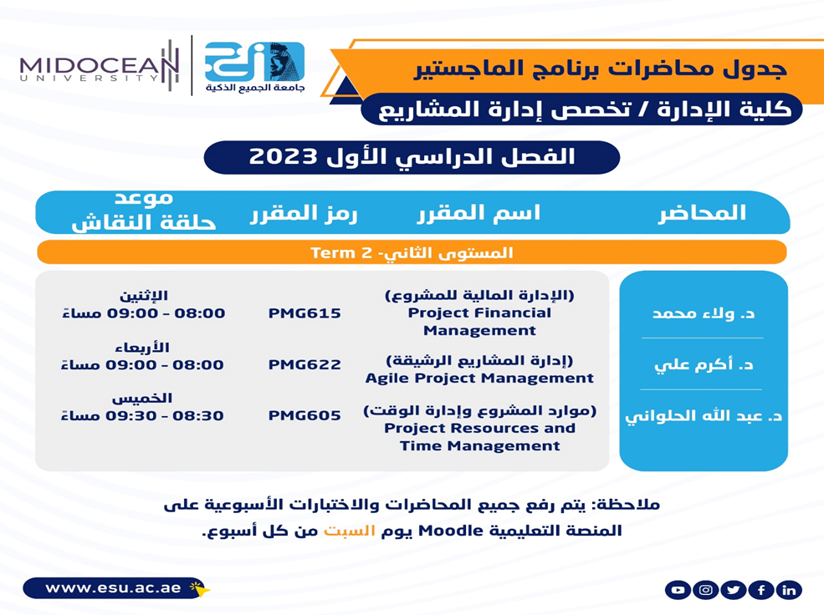


حساب اللينك ان الخاص بي
https://www.linkedin.com/in/walaa-mohamed-95a402122/

