Slide 1


Penetration Test and Ethical Hacking
Master of Science in Cybersecurity
Orientation show
عرض توجيهي
Dr. Nermin Hamza Ewais
Everyone Smart University
Faculty of IT
2023

Slide 2
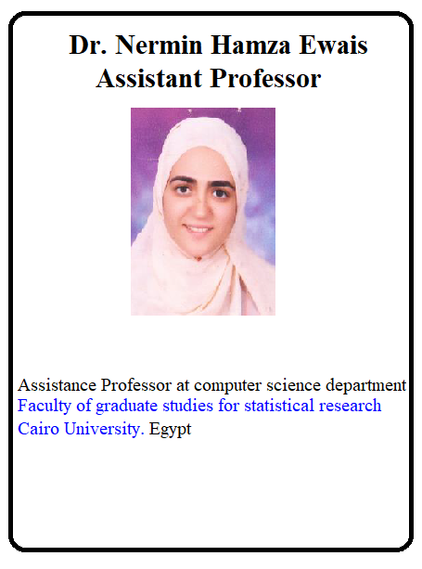

Who Am I?
Dr. Nermin Hamza Ewais
  Assistant Professor in computer science
    Ph.D from Cairo University 2010
    PHD Thesis: “A novel security system for computer networks”
    M.Sc from Cairo University, 2005
    B.Sc from Cairo University , 2000

Slide 3
Who Am I?
  How to reach me
    By email at hamza@esu.ac.ae
    ( please include “Penetration Test and Ethical Hacking” in subject line)
  Office hours
  Discussion Time (Tuesday at 9:00 PM) every day
  Work.
    Cairo University – King Abdulaziz University
  Training.
    CEH – CHFI- Academic Courses

Slide 4

The course that will be taught
Penetration Test and Ethical Hacking

Slide 5
Penetration Test and Ethical Hacking
The Penetration testing and Ethical Hacking course provide the skills required for a student to learn how to test the system.
A penetration test or pen-test is a test evaluating the strengths of all security controls on the computer system. Penetration tests evaluate procedural and operational controls as well as technological controls.

Slide 6
Primary Goal of This Course
Learning Outcomes:
  • Demonstrate knowledge of various vulnerabilities in network applications.
  Practice awareness of various malicious content and guiding ways for protection against the same.
  Demonstrate knowledge of various forms of attacks.
  Recall judicious and ethical use of various tools.
  Expertise in the techniques of system hacking and hacking over a wireless network.
  •

Slide 7
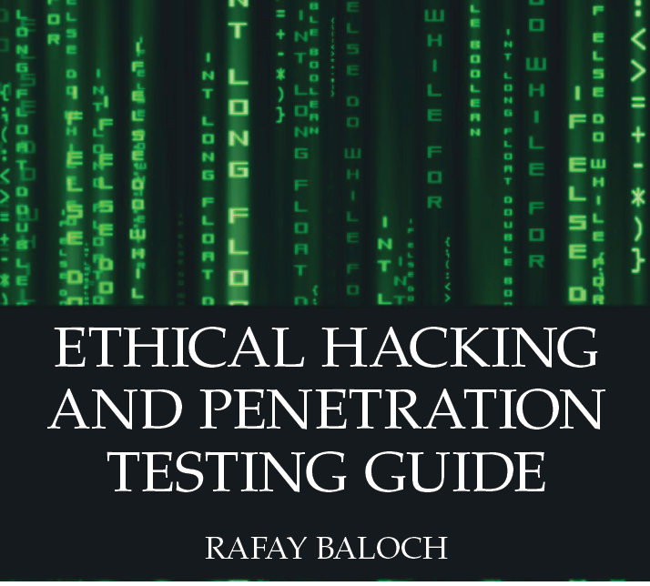
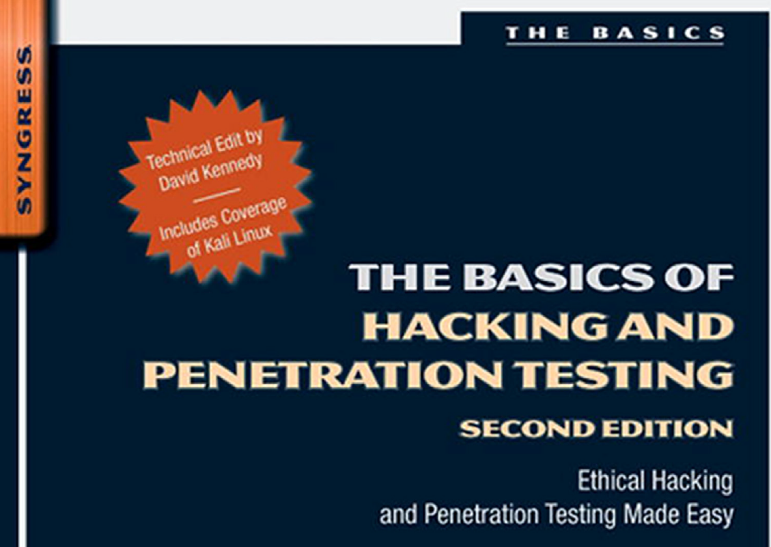
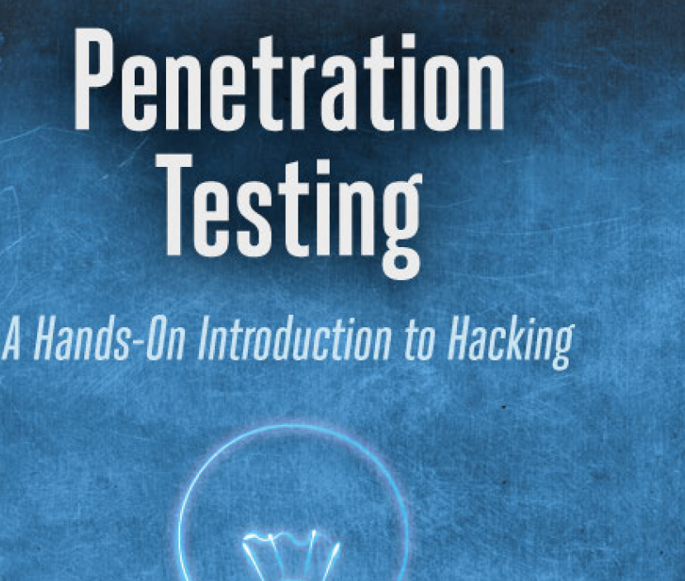
Learning Resources:
Credit Hours:
3 credit hours.
  Required Textbook:
  ETHICAL HACKING AND PENETRATION TESTING GUIDE, RAFAY BALOCH, 2015 by Taylor & Francis Group, LLC
  The Basics of Hacking and Penetration Testing, Ethical Hacking and Penetration Testing Made Easy, Second Edition, Dr. Patrick Engebretson, David Kenned Technical Editor, 2013 Elsevier Inc. All rights reserved
  Penetration testing A Hands-On Introduction to Hacking, Georgia Weidman, 2014 by Georgia Weidman.

Slide 8
Units of Course Contents
  Lecture Structure:
Module | Course Unit | No.of. Weeks | Contact Hours
1 | Lecture1 Introduction to Penetration test | 1st | 3
2 | Lecture2 Information Gathering | 2nd | 3
3 | Lecture3 Target Enumeration and Port Scanning Techniques | 3 | 3
4 | Lecture4 Vulnerability Assessment | 4 | 3
5 | Lecture5 Network Sniffing | 5 | 3
6 | Lecture6 Web-Based Exploitation | 6 | 3
7 | Lecture7 Social Engineering | 7 | 3
8 | Lecture8 Post-exploitation | 8 | 3
9 | Lecture9 web hacking | 9 | 3
10 | Lecture10 attacks and wireless hacking | 10 | 3

Slide 9

Course Information
  Assessment Method:
Short Exam
  80% marks
    Count of short Exam 10 (Weekly)
    8 Marks for each of short Exam.
  20% Final Examination

Slide 10


Academic Calendar
-- اللغة الأساسية في المحاضرات هي:
اللغة الإنجليزية
-- الاختبارات باللغة الإنجليزية مع وجود
ترجمة للسؤال.

Slide 11


