Slide 1
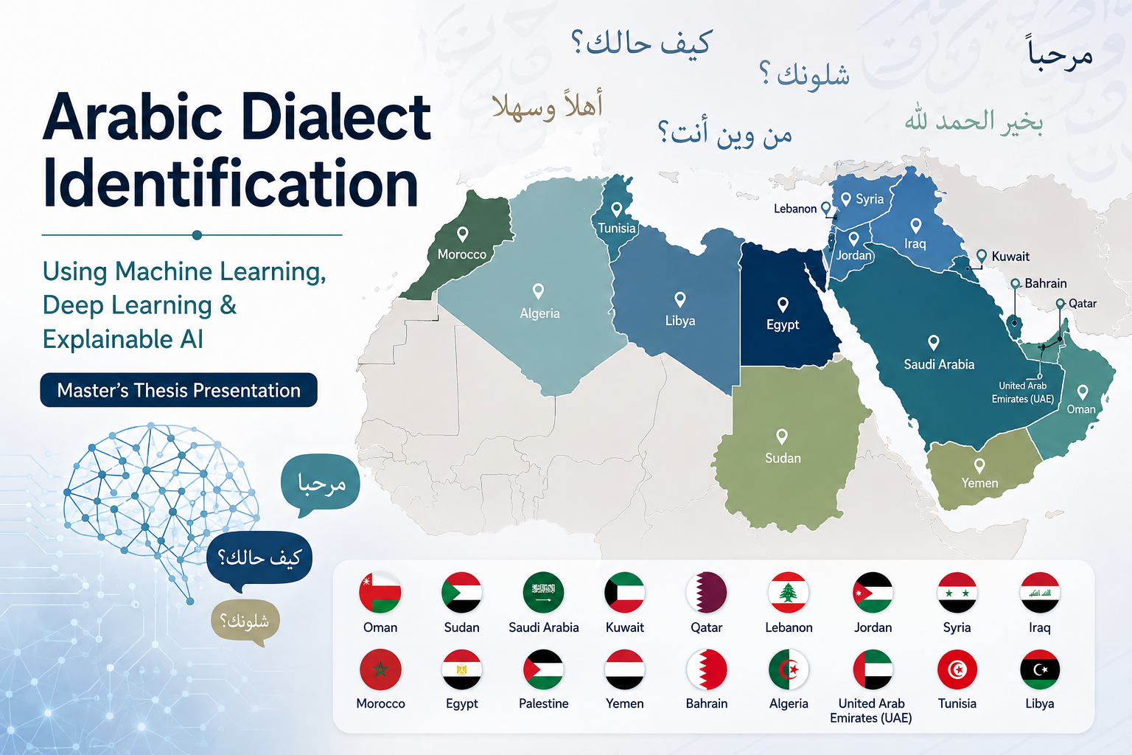

Prepared by :
Marwa AlMahmoud
Norah Alharbi
Nouf Alalkabi
Supervised by :
DR. Hager Saleh
1

Slide 2
1. Introduction
Arabic is a widely spoken language with many regional dialects that differ in vocabulary, expressions, and pronunciation.
The rapid growth of social media has generated a large amount of informal Arabic text representing different dialects.
Identifying Arabic dialects is challenging because of spelling variations, slang, code-switching, and dialect-specific words and expressions.
Therefore, automatic Arabic dialect identification is important for developing more accurate and effective Arabic Natural Language Processing (NLP) applications.
2

Slide 3
2. Problem Statement, Motivation & Objectives
Problem Statement & Motivation
Arabic dialects vary significantly across countries and regions, making automatic regional identification challenging.
Social media text is often informal and contains spelling variations, slang, abbreviations, and code-switching.
AI models may provide predictions without clearly explaining the reasons behind their decisions.
This creates a need for an accurate and explainable approach to Arabic regional dialect identification.
Aim
To develop an AI-based system that classifies Arabic text according to its regional dialect or country and explains the model’s predictions.
Objectives
Collect and preprocess Arabic dialect data.
Develop and compare Machine Learning and Deep Learning models.
Evaluate model performance using appropriate metrics.
Apply Explainable AI techniques, such as SHAP and LIME, to interpret predictions.
3

Slide 4
3. Related Work
Summary of selected studies related to Arabic dialect classification
Paper
Models
Dataset
Link
Limitation
Base Model
Result
Abdelminaam et al.
(2021)
ML + DL
(mLSTM)
TEAD,
ATSAD,
ASTD
IEEE Access
2021
DOI: 10.1109/
ACCESS.2021.3094173
No Transformer
models;
imbalance affects
performance
AraVec
(Word2Vec)
99.75%
TEAD
Brihi et al.
(2025)
ML + DL
+ Hybrid
45,862
Yemeni
Facebook
comments
IEEE Access
2025
DOI: 10.1109/
ACCESS.2025.3593204
Yemeni dialect
only;
no Transformer
models
Word2Vec +
TF-IDF +
Lexicon
94.71%
accuracy
Al-Anzi et al.
(2025)
ANN + CNN
(1D-CNN)
4,071
Arabic
speech
clips
Applied Sciences
2025
DOI: 10.3390/
app15126516
Speech-based;
limited dialect
coverage
Klaam
Pre-trained
Model
94.28%
test
Research Gap: Text-based regional dialect identification + Transformer models + Explainable AI
4

Slide 5
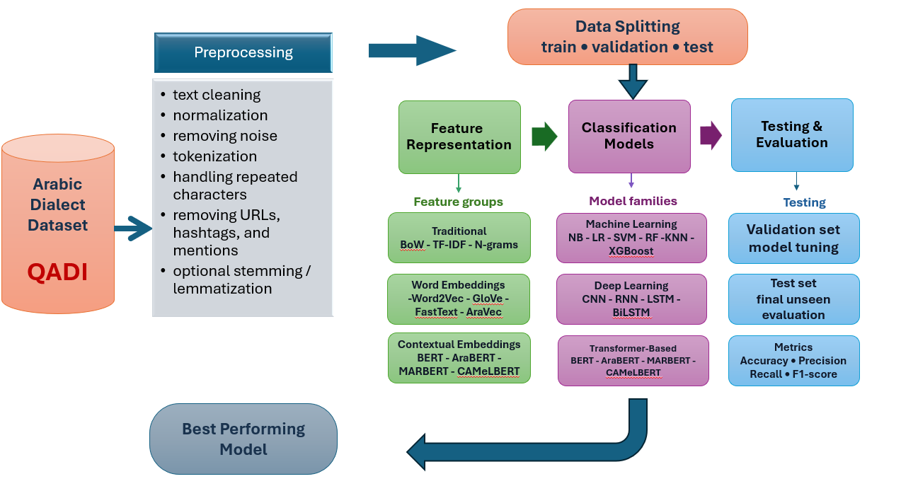
4. Proposed Methodology
1
3
5

Slide 6
4. Dataset
QADI – Arabic Dialect Identification Dataset
458,197
18
3
Arabic Tweets
Dialect Classes
Data Splits
Dataset Overview
Dataset Split
Source
Twitter
Training
440,052
Data Type
Informal Arabic social-media text
Validation
9,164
Coverage
18 Arab countries / dialect classes
Test
8,981
Quality
No missing values detected
Dialect coverage: Saudi Arabia • Egypt • Lebanon • Jordan • Syria • Iraq • Morocco • Palestine • Yemen • UAE • Kuwait • Qatar • Bahrain • Oman • Sudan • Algeria • Tunisia • Libya
6

Slide 7
Data Preparation
Preparing QADI Arabic tweets for reliable model training and evaluation
01
02
03
04
05
Remove URLs
& Mentions
Clean Social
Media Noise
Arabic Normalization
Tokenization
Model Preparation
Remove hyperlinks
and @usernames.
Remove emojis,
special symbols,
and unnecessary punctuation.
Standardize Arabic text
and reduce
spelling variations.
Convert text into tokens using
the appropriate
Arabic tokenizer.
Prepare tokenized data
for ML, DL, AraBERT
and MARBERT models.
Output: Clean, normalized, and tokenized Arabic text ready for model training and evaluation.
Goal: reduce noise while preserving meaningful dialectal information.
7

Slide 8
Thank You
Questions & Discussion
Arabic Dialect Identification
9

