Slide 1



Accounting for Managers
Prepared by Dr. Emad Zaher
Assistant Professor of Accounting
MGM341
Lecture 1
(Introduction to Managerial Accounting)

Slide 2

Learning outcomes
Chapter (1) Introduction to Financial Accounting
LO 1 Identify the origins Accounting.
LO 2 Explain the different forms of business ownership.
LO 3 State the main reasons for studying Accounting .
LO 4 Describe Activities & different users of Accounting information.
LO 5 Explain the GAAP & the role of standards-setters bodies.
LO 6 Comparing Managerial Accounting with Financial Accounting.
LO 7 Identify the Managerial cost concepts.

Slide 3
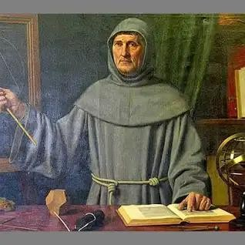
The Origins of Accounting
The Origins of Accounting is generally attributed to the Italian mathematician “Luka Pacioli” in 1494.
Luka developed the Double entry system which includes:
Debit
Credit
Borrower
lender

Slide 4
Forms of Business Ownership
Proprietorship |  | Partnership |  | Corporation
Owned by one person Owner is often manager/operator Owner receives any profits, • suffers any losses, and is personally liable for all debts |  | Owned by two or more persons Often retail and service- type businesses Generally unlimited personal liability |  | Owned by shareholders Separate legal entity organized under state corporation law Limited liability
Prepared by Dr. Emad Zaher

Slide 5


Why do we study Accounting ?
To Know the Business profit & loss.
To know the Business financial position.
To Know the changes in owner’s capital.
To Know the business cash Position.
Prepared by Dr. Emad Zaher

Slide 6


Users of Accounting Information
External Users
Internal Users
Competitors
External Auditors
Managers
Shareholders
Employees
Budget Officers
Lenders (Banks)
Tax Authorities
Internal Auditors

Slide 7







QUESTIONS ASKED BY EXTERNAL USERS
How does the company compare in size
and profitability with its competitors?
Is the company earning satisfactory income?
What do we do if they catch us?
Will the company be able to pay its debts as they come due?

Slide 8









QUESTIONS ASKED BY INTERNAL USERS
What is the cost of manufacturing each unit of product?
Is cash sufficient to pay bills?
Which product line is the most
profitable?
Can we afford to give employees pay raises this year?

Slide 9
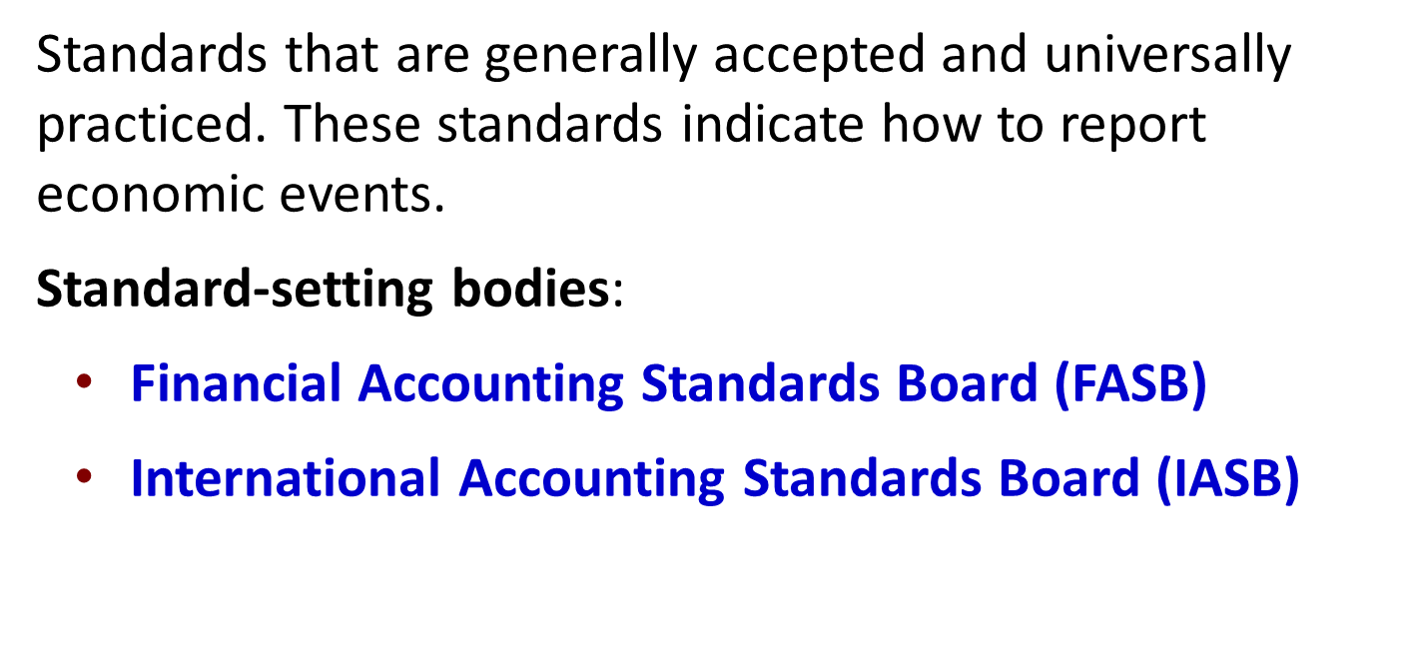


Generally Accepted Accounting Principles
Prepared by Dr. Emad Zaher

Slide 10

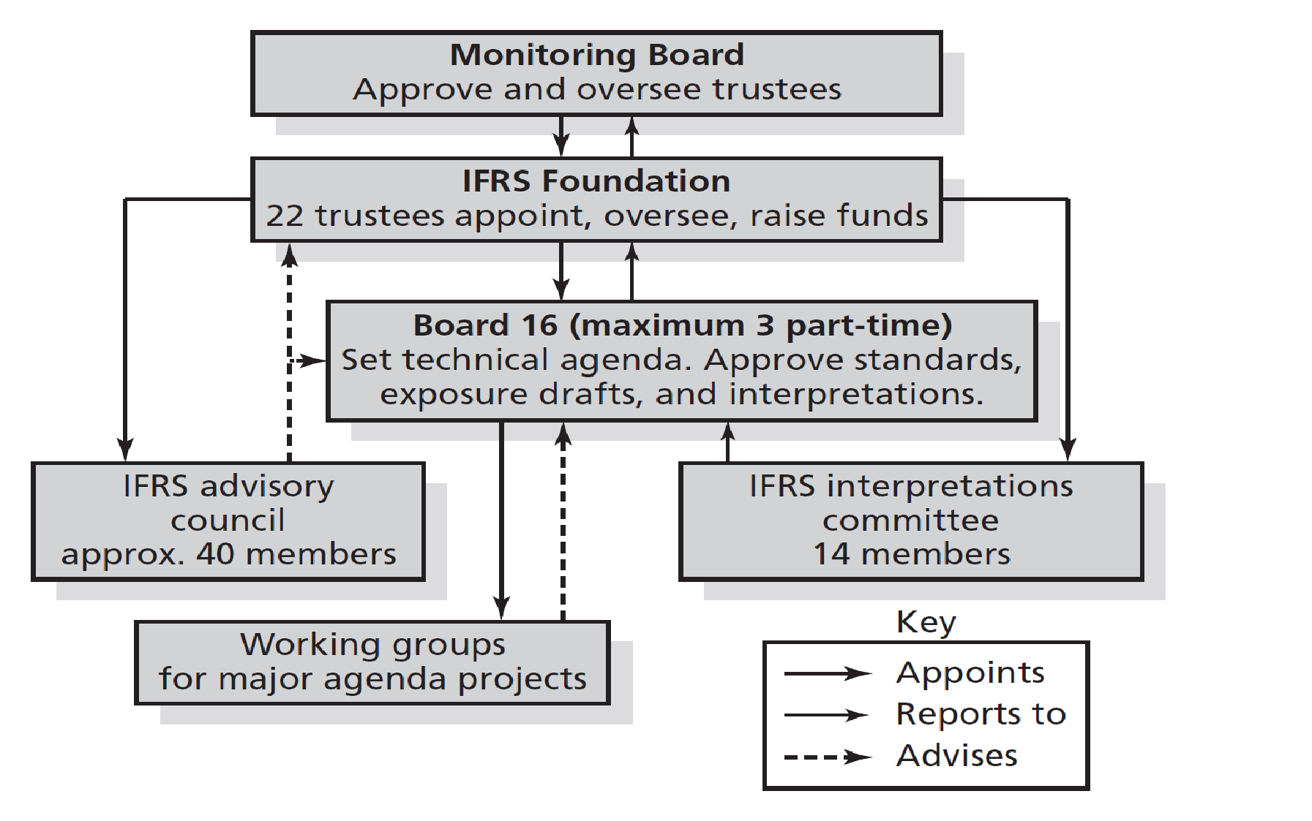
The Structure of the IASB

Slide 11
Managerial Accounting concept
Provides both financial and non financial information for managers and other internal users for the purpose of:
Planning.
Control.
Decision Making
Prepared by Dr. Emad Zaher

Slide 12
Comparing Financial and Managerial Accounting
Feature |  | Financial Accounting |  | Managerial Accounting
Primary Users |  | External users: shareholders, creditors, and regulators. |  | Internal users: officers and managers.
Frequency of Reports |  | Financial statements. Quarterly and annually. |  | Internal reports. As frequently as needed.
Purpose of Reports |  | Financial statements for General-purpose. |  | Decision Making
Focus/Emphasis |  | Past-Oriented |  | Future-Oriented
Verification Process |  | Audited by accountants According IFRS &US.GAAP. |  | No independent audits.
Prepared by Dr. Emad Zaher

Slide 13



Management Functions
Planning
Directing
Controlling
Maximize profit and
market share
Commit to environmental protection and social programs
Add value to the business
Implement planned
objectives
Provide incentives to motivate employees
Hire and train
employees
Keeping activities on
track
Determine whether goals are met
Decide changes needed to get back on track
Performance Evaluation
Prepared by Dr. Emad Zaher
13

Slide 14
Organizational
Shareholders
Organization charts show the interrelationships of
Structure
Board of Directors
activities and the delegation of authority and responsibility within the
Chief Executive Officer and President
company.
General Counsel/ Secretary
Vice President Marketing
Vice President
Vice President Operations
Vice President Human Resources
Finance/Chief
Financial Officer
Treasurer
Controller
14

Slide 15
Chief Financial Officer (CFO)
Controller Functions
Treasurer Functions
Investor relations
Short-term financing
Banking
Credits and collections
Investments
Risk management
(insurance)
Planning for control
Evaluating and consulting
Tax administration
Government reporting
Protection of assets
Prepared by Dr. Emad Zaher

Slide 16

DO IT
Indicate whether the following statements are true or false.
False 1.
Managerial accountants have a single role within an
organization: collecting and reporting costs to management.
^{True} 2. Financial accounting reports are general-purpose and intended for external users.
True
3. Managerial accounting reports are special-purpose
and issued as frequently as needed.

Slide 17
DO IT
Indicate whether the following statements are true or false.
False
4. Managerial accounting information is reported to
those outside users budgeting, and internal control.
False
5. Managerial accounting reports must now comply
with accounting standards.

Slide 18
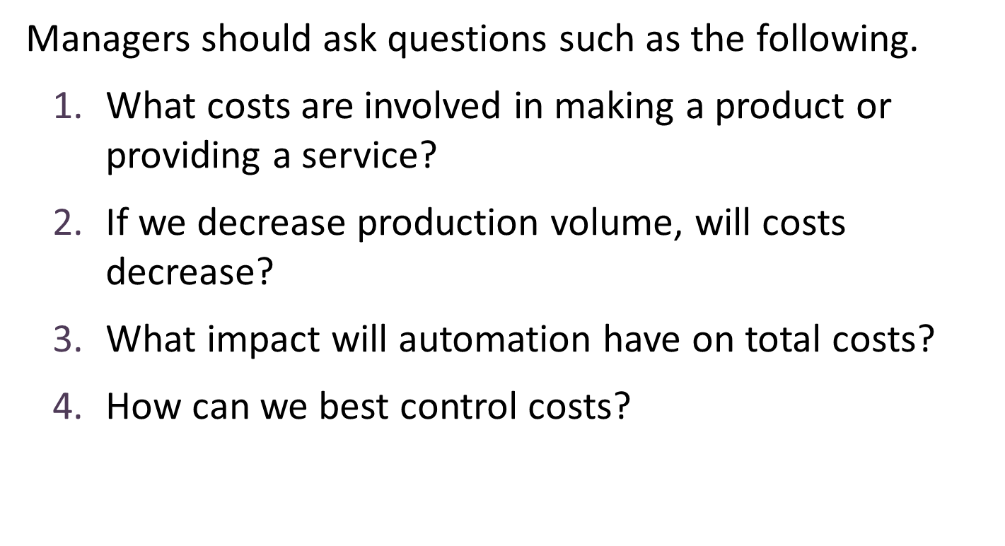
Managerial Cost Concepts

Slide 19
Required Textbook:
Managerial Accounting (3rd Custom Ed. for Athabasca University). (2021).
Topics:
Cost Behavior and Analysis
Cost Management Systems
Relevant Information and Special Decision Making
Basic Principles of Financial Accounting
Interpreting Financial Statements
The Budgeting Process and Standard Cost System
Capital Investments and Capital Budgeting
Performance Evaluation and the Balanced Scorecard

Slide 20
Module Learning Outcomes:
Demonstrate understanding of the roles, responsibilities and ethical considerations of management accountants within an organization.
Identify and appropriately use management accounting terminology and concepts, especially regarding costs in business organizations.
Perform a variety of financial and non-financial calculations in order to prepare schedules, statements and reports used in management accounting.

Slide 21





Thank You

