Slide 1



Strategic Management
Prepared by Dr. Amira Elfekky
MGM414
Welcoming Lecture

Slide 2



Strategic Management
Welcoming Lecture
MGM414
Prepared by
Dr. Amira Elfekky
www.midocean.ae

Slide 3

    الخبــــرات:
    حاصلة درجة الدكتوراة في الذكاء الصناعي وتطبيقته في ادارة الجودة الشاملة – جامعه القاهره
    ، مديرة ادارة الجودة, شهادة الأيزو IATF 16949:2016 & ISO TS 16949و مدربة معتمدة.
    10 عاماً من الخبرة في إدارة المشاريع/ تقييم الاداء
    حاصلة علي جائزه افضل اداء تطويري في قطاع السيارات(2022) علي مستوي الشرق الأوسط وشمال أفريقيا
    استشاري تحليلات اقتصادية وساسية –المجلس المصري للشئون الخارجية و وزارة الخارجية المصرية
    محاضرة ومدربة معتمدة بهيئه الأمم المتحدة واليونسكو منذ 2016
    نشر 5 ورقة بحثية في المؤتمرات الدولية/ المجلات العلمية
    شاركت بالعديد من المؤتمرات الدوليه بدبي – السعودية – المانيا

Slide 4

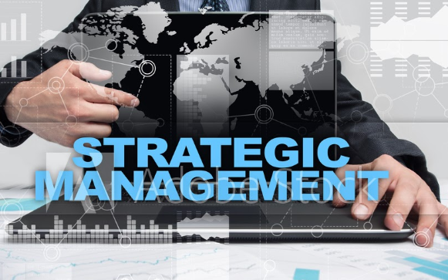
Strategic Management
Strategic management involves developing and implementing plans to help an organization achieve its goals and objectives. This process can include formulating strategy, planning organizational structure and resource allocation, leading change initiatives, and controlling processes and resources.
www.midocean.ae

Slide 5


Strategic Management
Question
IN 2017, TESLA INC.— an American manufacturer of all-electric cars—boasted a market capitalization of over $60 billion, an appreciation of more than 1,400 per cent over its initial public offering price in 2010. How can a California startup achieve a market valuation that exceeds that of GM, the largest car manufacturer in the world, making some 10 million vehicles a year?
www.midocean.ae

Slide 6

Strategic Management
The answer:
Tesla’s Secret Strategy. In a blog entry on Tesla’s website in the summer of 2006, Elon Musk, Tesla’s co-founder and CEO, explained the startup’s master plan:
1. Build sports car.
2. Use that money to build an affordable car.
3. Use that money to build an even more affordable car.
4. While doing above, also provide zero-emission electric power generation options.
5. Don’t tell anyone.
www.midocean.ae

Slide 7
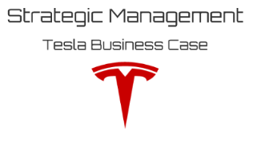
Tesla’s Secret Strategy
Let’s see if Tesla stuck to its strategy. In 2008, Tesla introduced its first car: the Roadster, a $110,000 sports coupe with faster acceleration than a Porsche or a Ferrari. Tesla’s first vehicle served as a prototype to demonstrate that electric vehicles can be more than mere golf carts. Tesla thus successfully completed Step 1 of the master plan.
Build sports car
Let’s see if Tesla stuck to its strategy. In 2008, Tesla introduced its first car: the Roadster, a $110,000 sports coupe with faster acceleration than a Porsche or a Ferrari. Tesla’s first vehicle served as a prototype to demonstrate that electric vehicles can be more than mere golf carts. Tesla thus successfully completed Step 1 of the master plan.
www.midocean.ae

Slide 8
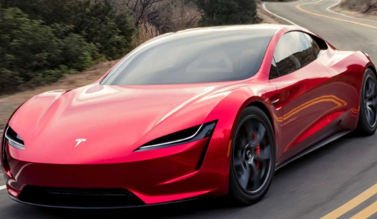
Tesla’s Secret Strategy
Let’s see if Tesla stuck to its strategy. In 2008, Tesla introduced its first car: the Roadster, a $110,000 sports coupe with faster acceleration than a Porsche or a Ferrari. Tesla’s first vehicle served as a prototype to demonstrate that electric vehicles can be more than mere golf carts. Tesla thus successfully completed Step 1 of the master plan.
2. Use that money to build an affordable car
In Step 2, after selling some 2,500 Roadsters, Tesla discontinued its production in 2012 to focus on its next car: the Model S, a four-door family sedan, with a base price of $73,500 before tax credits. The line appeals to a somewhat larger market and thus allows for larger production runs to drive down unit costs. The Model S received an outstanding market reception. It was awarded not only the 2013 Motor Trend Car of the Year but also received the highest score of any car ever tested by Consumer Reports (99/100).
www.midocean.ae

Slide 9
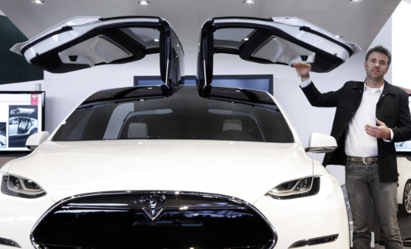
Tesla’s Secret Strategy
Let’s see if Tesla stuck to its strategy. In 2008, Tesla introduced its first car: the Roadster, a $110,000 sports coupe with faster acceleration than a Porsche or a Ferrari. Tesla’s first vehicle served as a prototype to demonstrate that electric vehicles can be more than mere golf carts. Tesla thus successfully completed Step 1 of the master plan.
3. Use that money to build an even more affordable car
Tesla has now reached Step 3 of its master plan. In 2017, Tesla delivered the company’s newest car: the Model 3, an all-electric compact luxury sedan, with a starting price of $35,000. Tesla received some 375,000 preorders within three months of unveiling its model. Many of the want-to-be Tesla owners stood in line overnight, eagerly awaiting the opening of the Tesla stores to put down a $1,000 deposit to secure a spot on the waiting list for the Model 3, a car they had never even seen, let alone taken for a test drive.
www.midocean.ae

Slide 10
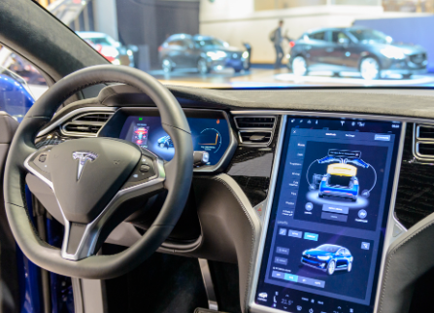
Tesla’s Secret Strategy
Let’s see if Tesla stuck to its strategy. In 2008, Tesla introduced its first car: the Roadster, a $110,000 sports coupe with faster acceleration than a Porsche or a Ferrari. Tesla’s first vehicle served as a prototype to demonstrate that electric vehicles can be more than mere golf carts. Tesla thus successfully completed Step 1 of the master plan.
4. While doing above, also provide zero-emission electric power generation options
Step 4 of Musk’s master plan for Tesla aims to provide zero-emission electric power generation options. To achieve this goal, Tesla acquired SolarCity, a solar energy company, for more than $2 billion in the fall of 2016. This joining creates the world’s first fully integrated clean-tech energy company by combining solar power, power storage, and transportation.
www.midocean.ae

Slide 11
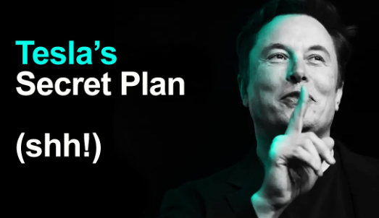
Tesla’s Secret Strategy
Let’s see if Tesla stuck to its strategy. In 2008, Tesla introduced its first car: the Roadster, a $110,000 sports coupe with faster acceleration than a Porsche or a Ferrari. Tesla’s first vehicle served as a prototype to demonstrate that electric vehicles can be more than mere golf carts. Tesla thus successfully completed Step 1 of the master plan.
5. Don’t tell anyone
www.midocean.ae

Slide 12

Content
Part One / Analysis
Chapter 1 What Is Strategy?
Chapter 2 Strategic Leadership: Managing the Strategy Process
Chapter 3 External Analysis: Industry Structure, Competitive Forces, and Strategic Groups
Chapter 4 Internal Analysis: Resources, Capabilities, and Core Competencies
Chapter 5 Competitive Advantage, Firm Performance, and Business Models

Slide 13
Content
Part Two/ Formulation
Chapter 6 Business Strategy: Differentiation, Cost Leadership, and Blue Oceans
Chapter 7 Business Strategy: Innovation, Entrepreneurship, and Platforms
Chapter 8 Corporate Strategy: Strategic Alliances, Mergers, and Acquisitions
Chapter 9 Global Strategy: Competing Around the World
Part Three/ Implementation
Chapter 10 Organizational Design: Structure, Culture, and Control

Slide 14
Orientation
الفترة الزمنية التعليمية في الفصل الدراسي الصيف تكون مدة ١٣أسبوع ( منهم أسبوعين للاختبار النهائي)

Slide 15

Orientation

Slide 16
Orientation
-- تعتمد أوقات المحاضرات وحلقات النقاش علي توقيت مكة المكرمة لجميع البرامج.
-- مدة المحاضرة المسجلة ٧٠- ٩٠ دقيقة ترفع علي منصة
Moodle

Slide 17
Orientation
-- ترفع المحاضرة الأسبوعية علي المنصة التعليمية Moodle يوم السبت من كل أسبوع.
-- حلقات النقاش و هي حلقات أسبوعية اختيارية للطالب وغرضها مناقشة ما تم طرحه في المحاضرة المسجلة لهذا الاسبوع. (يرجي مراجعة الموعد والمدة الزمنية لكل مقرر حسب الجدول)
-- حلقات النقاش اختيارية.

Slide 18
Orientation
-- الأسبوع الأول هو أسبوع توجيهي
-- ويتم رفع كل ما يخص الفصل الدراسي علي صفحة المودل.
-- يرفع إختبار قصير به أسئلة عامة للطلاب من السهل حلها ويكون هذا الاختبار القصير بمثابة تدريب للطلاب علي التوقيت وعدد الأسئلة.

Slide 19

Orientation Day

Slide 20
Short Exam
-- يرفع الاختبار القصير إسبوعياً في نفس موعد رفع المحاضرة يوم السبت من كل أسبوع في تمام الساعة العاشرة مساءً و يترك لمدة أسبوع ، ثم يغلق في يوم السبت الذي يليه تمام الساعة التاسعة مساءً.
-- أسئلة الاختبار القصير MCQ /Matching / true & false / أسئلة صوتية
-- تعد الإجابة علي الاختبار القصير بمثابة الحضور للطالب.
-- الإختبار القصير من ٨ درجة / ٨ اسئلة. (بمجموع ٨٠درجة)
-- فترة السماحية للإختبار القصير ٢٤ دقيقة.
بنك الأسئلة للإختبار القصير ٢٤ سؤال. عدد الأسئلة الصوتية في البنك حوالي ٦أسئلة.

Slide 21
FINAL EXAMS
-- الإختبار النهائي سيكون من خلال المودل.
-- أسئلة الإختبار النهائي /Matching / true & false MCQ / أسئلة صوتية
-- الإختبار النهائي من ٢٠ درجة.

Slide 22
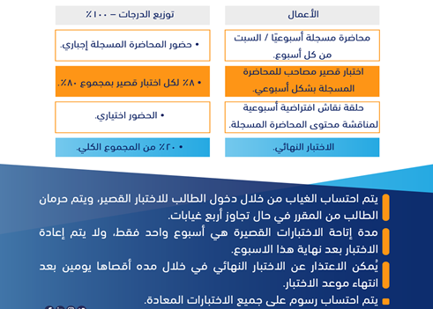
Orientation

Slide 23

Orientation

Slide 24
Orientation
-- اللغة الأساسية في المحاضرات هي اللغة الإنجليزية
-- الاختبارات باللغة الإنجليزية مع وجود ترجمة للسؤال.

Slide 25
Orientation Day
We are AWESOME.
We can do it!

Slide 26


Slide 27

Thank You

