Slide 1


Correlation & Regression
Part I
Prepared by Dr. Hesham Mousli
MHA 613
Statistics in Healthcare
Lecture 9

Slide 2

Chapter
Intended Objectives
09
Distinguish between correlation and regression, their purposes, and their differences in analyzing relationships between variables.
Learn how to interpret correlation coefficients (e.g., Spearman’s r).
Understand the steps and best practices for performing correlation and regression analyses.

Slide 3
Chapter
Correlation vs Regression
09
Correlation: Measures the strength of the relationship between variables.
Regression: Describes the relationship and provides predictive equations.

Slide 4

Chapter
Definition of Correlation
09
Correlation measures how strongly two variables are associated.
It does not imply causation.

Slide 5
Chapter
Correlation Coefficient
09
The Correlation Coefficient (r):
  Measures linear relationships.
  Ranges from -1 to +1.
  Positive: Variables increase together.
  Negative: One variable increases as the other decreases.

Slide 6
Chapter
Interpreting r Values
09
r = 1 or -1: Perfect linear relationship.
r = 0: No linear relationship.
Intermediate values: Degree of association.

Slide 7
Chapter
Testing Significance of r
09
Even independent variables may show small r values due to random fluctuations.
Significance testing (p-value) determines if r differs from zero.

Slide 8
Chapter
Visualization of Correlation
09
Scatter plots to observe relationships.
Linearity and clustering of points provide insights into strength and direction.

Slide 9
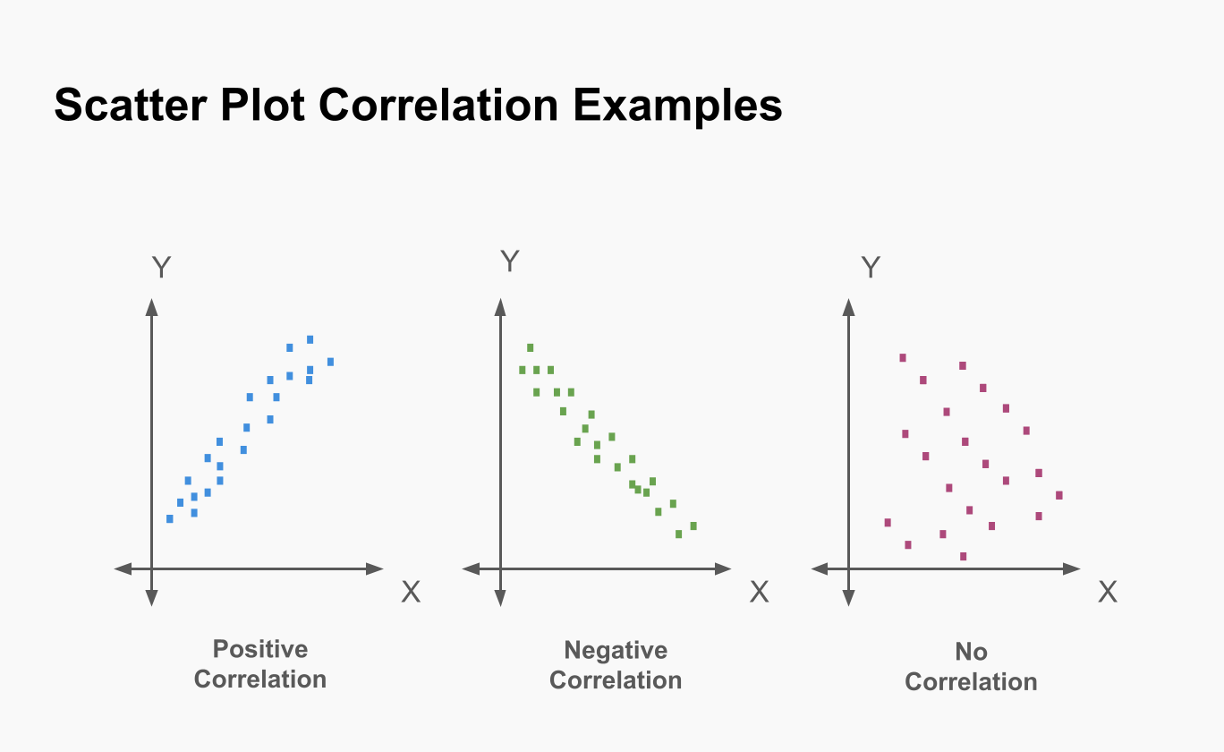

Slide 10
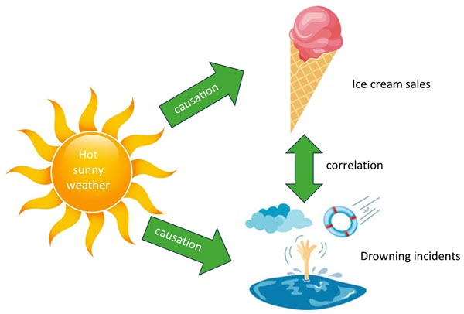
Chapter
Limitations of Correlation
09
Does not imply causation.
Sensitive to outliers.
Limited to linear relationships.

Slide 11
Applications of Correlation in Healthcare
Chapter
09
Hospital Bed Occupancy and Infection Rates:
Correlation: There is often a positive correlation between high hospital bed occupancy rates and the incidence of hospital-acquired infections (HAIs). Overcrowding can strain hygiene protocols and increase the risk of cross-infections among patients.
Implication: Monitoring and managing bed occupancy can help reduce the risk of HAIs and improve patient safety.

Slide 12
Case Scenario (1)
Chapter
09
A healthcare administrator wants to examine whether the frequency of staff training sessions (measured in hours per month) is correlated with the rate of medication errors in a hospital ward.
Objective:
  To identify whether increasing training hours is associated with a reduction in medication errors.

Slide 13
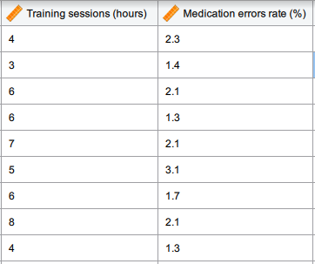

Slide 14
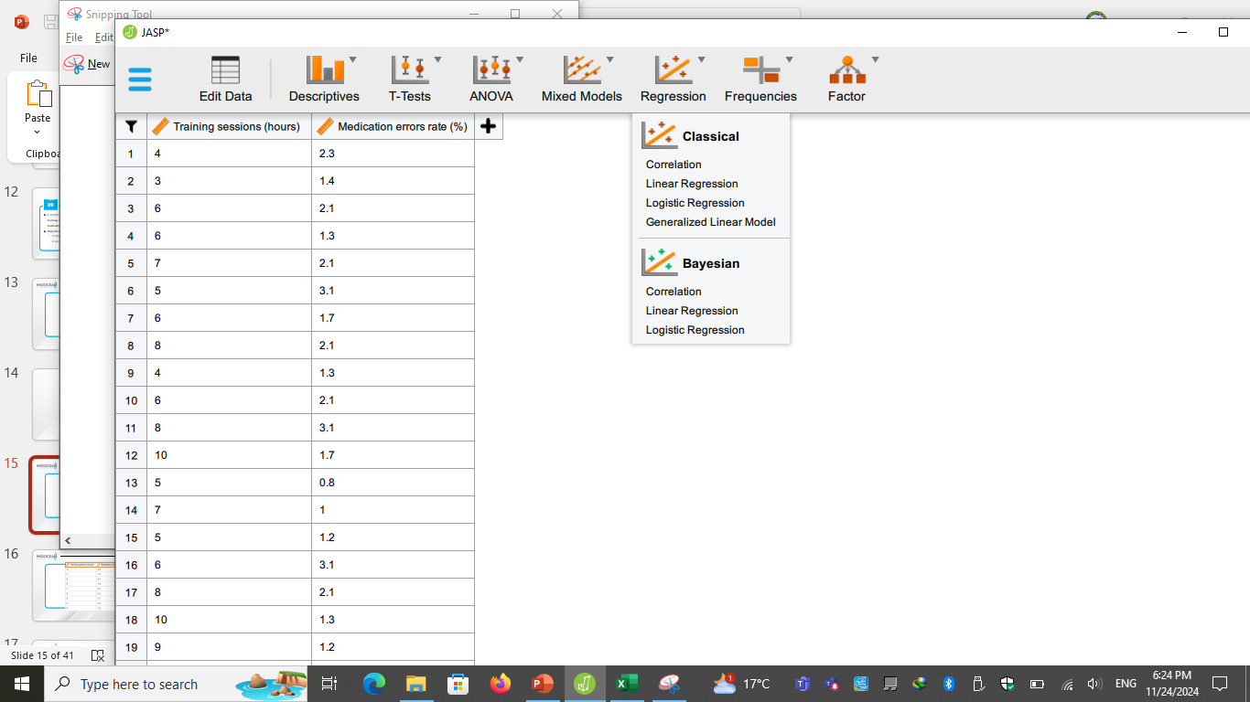

Slide 15
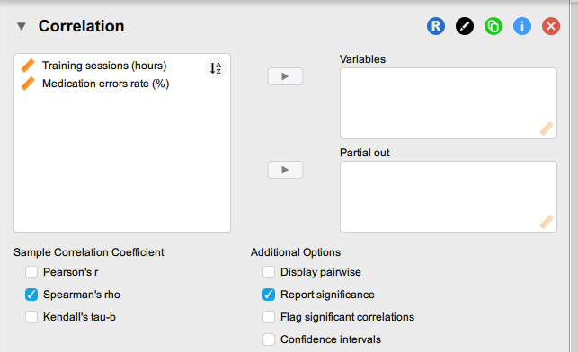

Slide 16
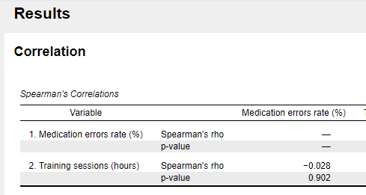

Slide 17
Case Scenario (1)
Chapter
09
Correlation coefficient (r) = -0.028: This indicates a very weak negative correlation between the frequency of staff training sessions and the rate of medication errors. The magnitude of the correlation is so small that it is practically negligible.
p-value = 0.902: This is far greater than the common significance level (e.g., 0.05), meaning the result is not statistically significant.

Slide 18
Case Scenario (2)
Chapter
09
A public health department wants to study the relationship between healthcare spending per capita and life expectancy in different regions.
Objective:
  To determine if higher healthcare expenditure is correlated with improved life expectancy.

Slide 19
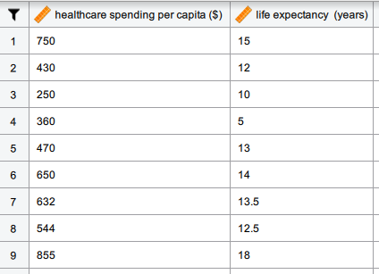

Slide 20
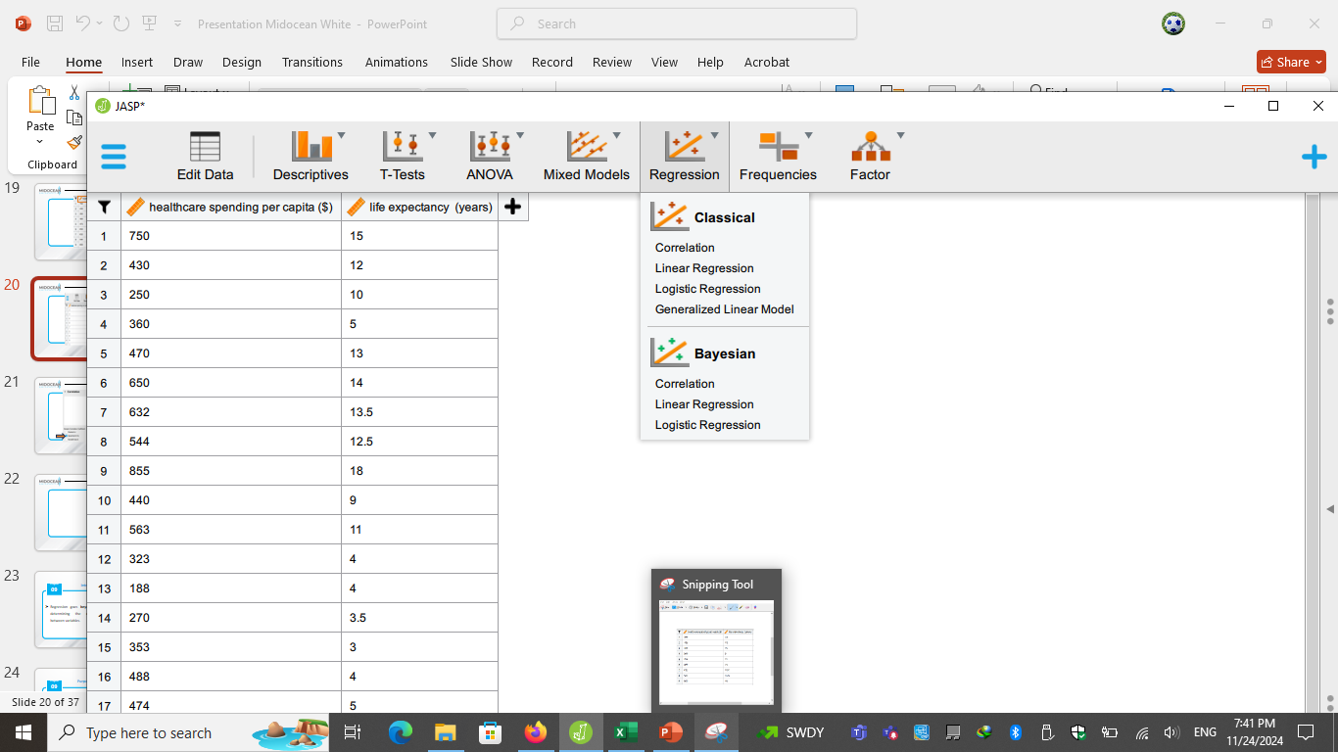

Slide 21
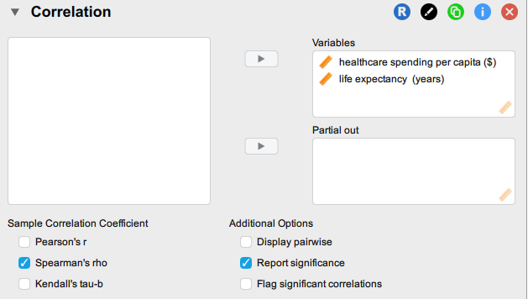

Slide 22
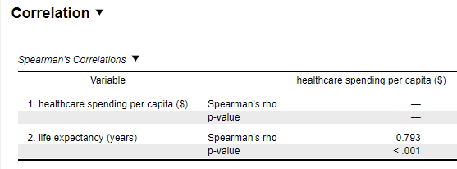

Slide 23
Case Scenario (2)
Chapter
09
The p-value (< 0.001) indicates that the observed correlation between healthcare spending per capita and life expectancy is statistically significant.
This means there is strong evidence to reject the null hypothesis, which assumes no correlation between these variables.

Slide 24
Case Scenario (2)
Chapter
09
The correlation coefficient (r = 0.793) suggests a strong positive relationship between healthcare spending per capita and life expectancy.
This means that regions with higher healthcare spending per capita tend to have higher life expectancy, and vice versa.

Slide 25

Chapter
Introduction to Regression
09
Regression goes beyond correlation by determining the exact relationship between variables.

Slide 26
Purpose of Regression Analysis
Chapter
09
Test for significant associations.
Provide a compact representation of data.
Make predictions and interpolations.

Slide 27
Chapter
Key Terms in Regression
09
Independent variables (predictors).
Dependent variable (outcome).
Parameters (e.g., slope, intercept).

Slide 28
Simple Linear Regression
Chapter
09
It models the relationship between one predictor and one outcome.
Formula: Y = a + bX.

Slide 29
A healthcare administrator wants to determine whether the number of available hospital beds in a facility can predict the patient occupancy rate.
Dataset Variables:
  Independent Variable (X): Number of hospital beds (e.g., 20, 30, 40, etc.).
  Dependent Variable (Y): Patient occupancy rate (percentage of beds occupied).

Slide 30
Hypothesis:
  Null Hypothesis (H₀): The number of hospital beds does not significantly predict the patient occupancy rate.
  Alternative Hypothesis (H₁): The number of hospital beds significantly predicts the patient occupancy rate.

Slide 31
Multiple Linear Regression
Chapter
09
It models the relationship with multiple predictors.
Formula: Y = b0 + b1X1 + b2X2 + ...

Slide 32
Title: Predicting Hospital Length of Stay (LOS):
Objective:
To understand how various factors influence the length of stay (LOS) in a hospital and develop a model to predict it.
Dependent Variable (Y):
  Length of Stay (in days).

Slide 33
Independent Variables (X1, X2, X3, etc.):
  Age of the patient (X1):
    Older patients may have longer stays due to complications or comorbidities.
  Severity of the condition (X2):
    Categorized by diagnostic scores or emergency admission status.
  Type of procedure or treatment (X3):
    Major surgeries may require extended recovery periods.
  Insurance coverage status (X4):
    Patients with insurance may receive more comprehensive care.
  Hospital capacity and staffing levels (X5):
    Understaffed facilities may influence LOS due to delayed treatments.

Slide 34
Logistic Regression
Chapter
09
Used when the outcome is categorical (e.g., disease/no disease).
Outputs probabilities.

Slide 35
A hospital's administration wants to predict whether patients admitted to the emergency department (ED) are likely to be readmitted within 30 days after discharge.
This helps the hospital allocate resources effectively and improve patient outcomes.

Slide 36
Data Used:
Dependent Variable (Outcome): Readmission status (1 = Readmitted within 30 days, 0 = Not readmitted).
Independent Variables (Predictors):
  Patient age, Length of stay, Number of comorbidities, Previous hospitalizations, Insurance type, Discharge condition, Medication adherence, Socioeconomic status.

Slide 37
Steps in Regression Analysis
Chapter
09
1. Define the research question.
2. Collect and clean data.
3. Select the appropriate regression model.
4. Evaluate model performance.

Slide 38
Wrap Up
Correlation measures the strength and direction of variable relationships without implying causation.
Regression explains relationships and predicts outcomes between dependent and independent variables.
Types of Regression: Includes simple, multiple, and logistic regression for continuous and categorical outcomes.
Applications: Useful in healthcare for predicting outcomes, analyzing risk factors, and resource allocation.

Slide 39



Thank You

