Slide 1


College of Management
Project Communications
Instructure: Dr. Raef Baraka
PMG 112
Lecture 03

Slide 2

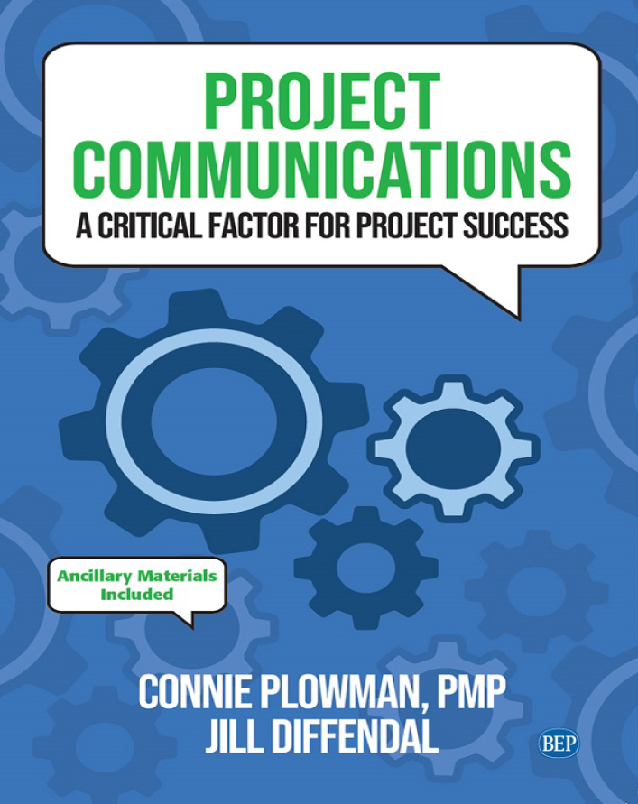
Reference Book:
Ch1: Introduction.
Ch2: Exploring Communication Theories.
Ch3: Knowing Your Audience.
Ch4: Starting with the Basics.
Ch5: Planning Project Communications.
Ch6: Managing and Monitoring Project Communications.
Ch7: Using Project Communication Tools.
Ch8: Communicating Change.
Ch9: Managing Conflict through Communication.
Ch10: Closing.

Slide 3

Chapter 3: Knowing Your Audience
The purpose of this chapter is to help you:
Explore various recommendations for identifying the audience in your project, including their role, their level of power and influence over the project, and their level of support for the project•
See the value of understanding what is important to the members of your audience—the WIIFM (what’s in it for me).

Slide 4
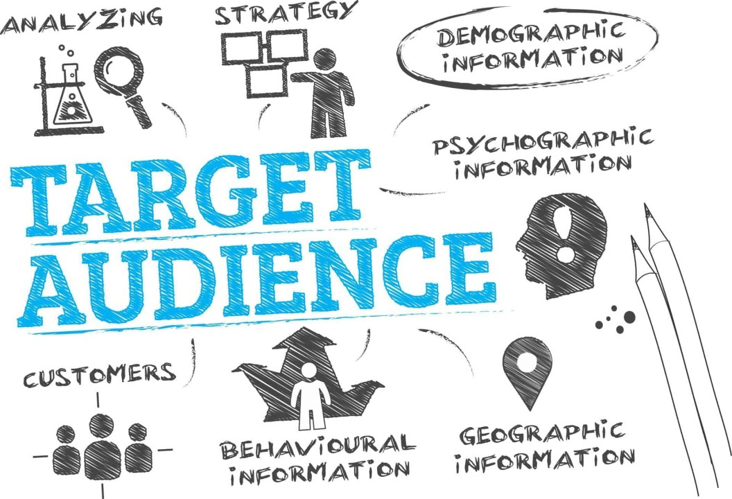
Knowing Your Audience
Knowing Your Audience
Seek first to understand, then to be understood.
—Steven R. Covey, American educator, author, and business leader

Slide 5
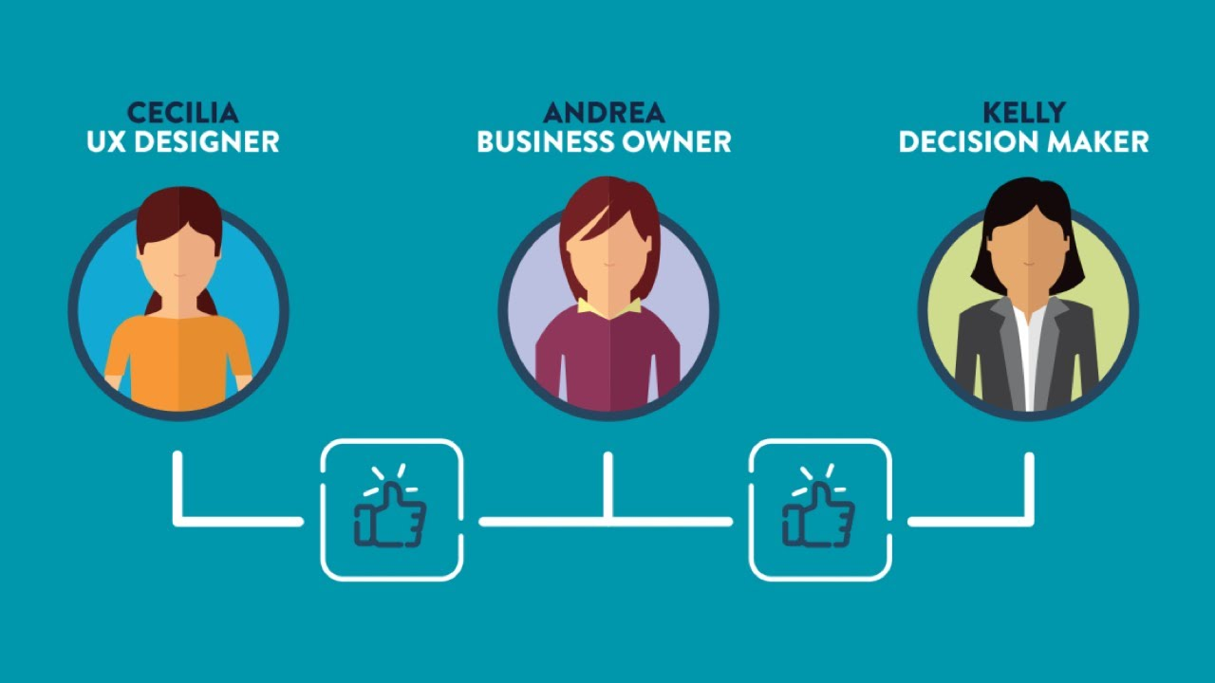
Knowing Your Audience
Knowing Your Audience
One of the most critical pieces of information, you need in order to prepare your speech is to know your audience—who you are delivering it to.
Consider how differently you would deliver your message to a group of 10-year-olds at a school career day; students in a college graduate program; the executive leadership team of your project; or a neighborhood group looking to build a new community center.
Dr. Raef Baraka

Slide 6

Knowing Your Audience
Knowing Your Audience
No matter what the method of communication—presentation, e-mail, phone call, status report—it’s important to know who will be receiving your message.
When you tailor your communication to your audience, they are more likely to understand and respond appropriately.
This concept is called audience design—altering the way you are delivering your message to suit the communication needs and expectations of those to whom you are communicating.
Dr. Raef Baraka

Slide 7
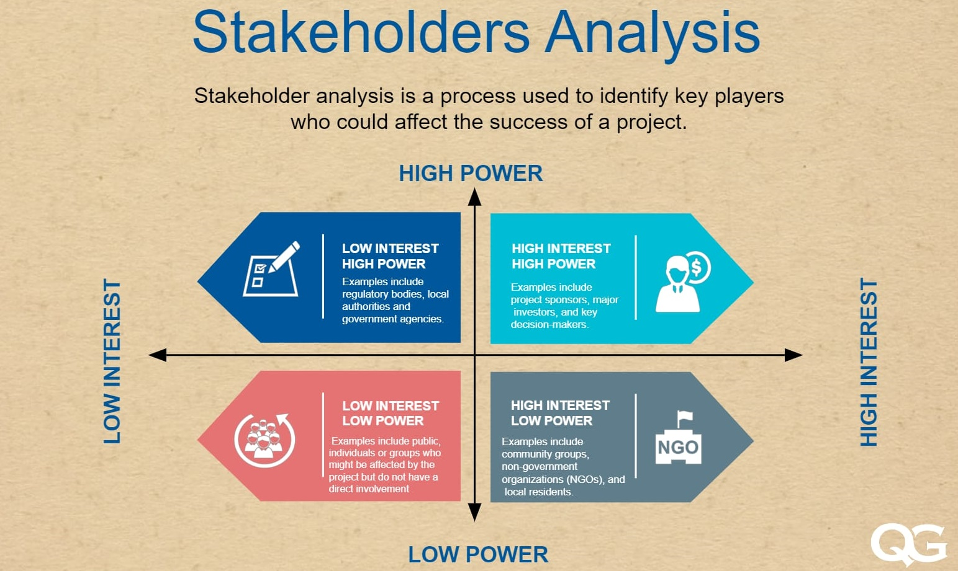
Knowing Your Audience
Knowing Your Audience
Dr. Raef Baraka

Slide 8
Knowing Your Audience
Knowing Your Audience
A clear understanding of the audience and what matters to them will result in more effective communication, more active stakeholder engagement, and, ultimately, a more successful project
Dr. Raef Baraka

Slide 9
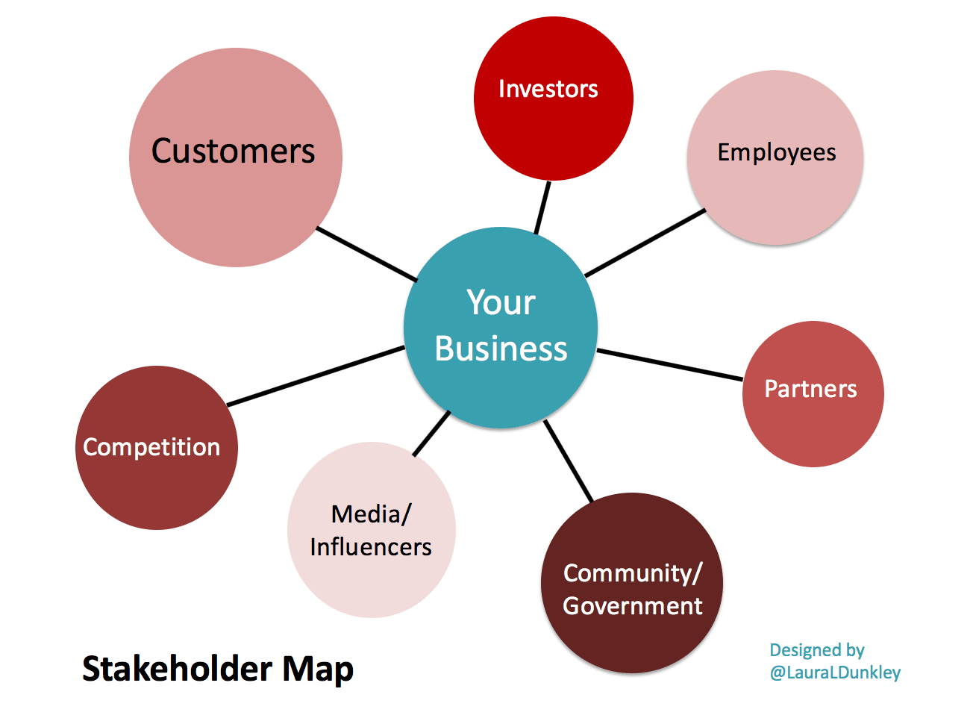
Knowing Your Audience
Audience = Stakeholders
In a project, the audience is the stakeholders

Slide 10

Knowing Your Audience
Audience = Stakeholders
In a project, the audience defined as “an individual, group, or organization that may affect, be affected by, or perceive itself to be affected by a decision, activity, or outcome of a project, program, or portfolio.”
Why is it important to take a thorough look at your project’s stakeholders? Because in many ways, stakeholders are the project.
Dr. Raef Baraka

Slide 11
Knowing Your Audience
Why is it important to take a thorough look at your project’s stakeholders
The project cannot be completed without those who initiate it, execute it, and live with the results once the project is complete.”
You can have a project without a charter, or a risk management plan, or a work breakdown structure. But you cannot have a project without stakeholders.
Dr. Raef Baraka

Slide 12
Knowing Your Audience
Why is it important to take a thorough look at your project’s stakeholders
Stakeholders can also be the barometer by which project success is measured.
stakeholder satisfaction is one of the criteria for assessing project success.
If stakeholders are not satisfied with the project outcomes, it may not matter whether you have fully achieved the project’s objectives.
Dr. Raef Baraka

Slide 13
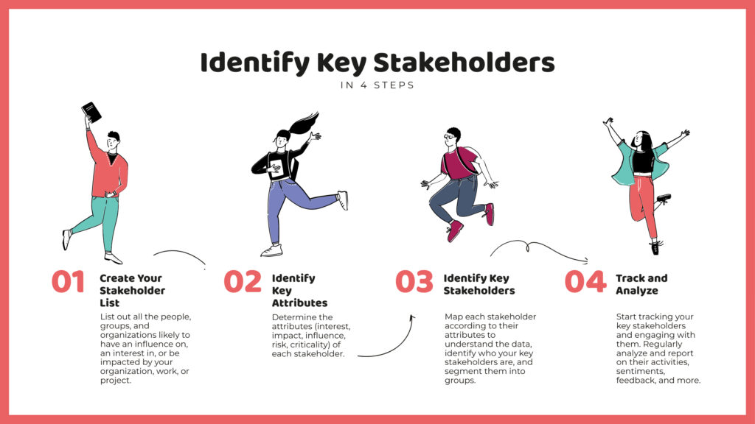
Knowing Your Audience
Identifying Stakeholders

Slide 14
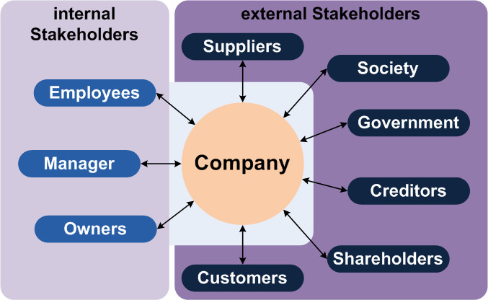
Knowing Your Audience
Identifying Stakeholders
Many of a project’s stakeholders can be discerned by reviewing project documents, including the charter, business case, and agreements.
Another tool for identifying stakeholders in a project is expert judgment, which includes seeking input from those who understand the organization and the industry.
Dr. Raef Baraka

Slide 15
Knowing Your Audience
Identifying Stakeholders
Expert judgment include:
Those who have a thorough understanding of the organization’s functions, culture, and power structures. These people can help identify stakeholders who may have interest in or influence over the project.
Those with thorough knowledge of the industry, customers, or wider environment. They can help identify stakeholders and stakeholder concerns that derive from the external environment in which the project will exist.
Dr. Raef Baraka

Slide 16
Knowing Your Audience
Identifying Stakeholders
Remember that some stakeholders will be easy to identify, such as the sponsor and the team. It may be more difficult, however, to identify everyone who will be impacted by the project.
The information presented here is intended to give you a starting point for identifying stakeholders and their characteristics to help you communicate with them more effectively.
As you identify your project stakeholders, keep track of them using a tool such as a stakeholder register.
Dr. Raef Baraka

Slide 17
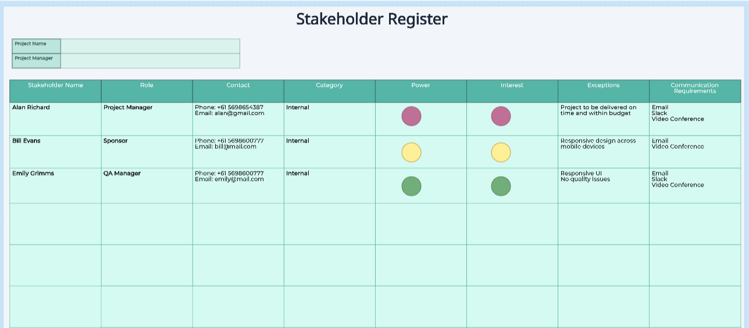
Knowing Your Audience
Identifying Stakeholders
Dr. Raef Baraka

Slide 18
Knowing Your Audience
Identifying Stakeholders
Some of the information you will want to track includes the role(s) the stakeholder plays in the project and the organization; the stakeholder’s power and influence; and the stakeholder’s level of support for the project.
Roles:
Roles include the person or group’s position within the organization as well as their relationship to the project. Roles include titles or descriptors like project manager, business partner, sponsor, subject matter expert, business analyst, etc.
Roles are an excellent starting point for building your stakeholder register, and for understanding how you can best communicate with each individual or group.
Dr. Raef Baraka

Slide 19
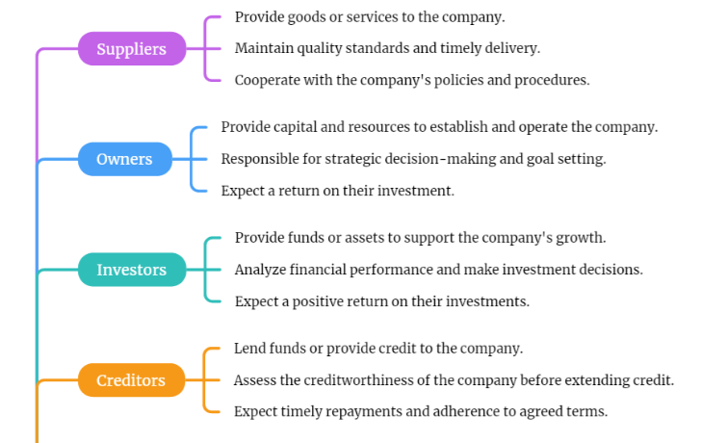
Roles of Stakeholders
Dr. Raef Baraka

Slide 20
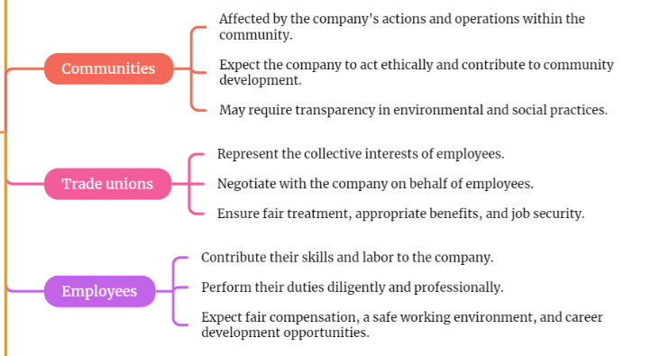
Roles of Stakeholders
Dr. Raef Baraka

Slide 21
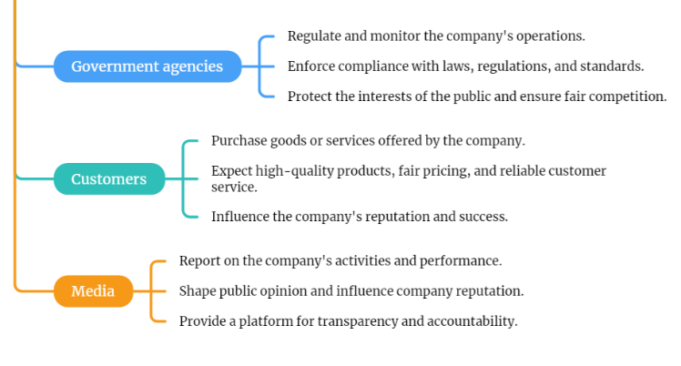
Roles of Stakeholders
Dr. Raef Baraka

Slide 22
Knowing Your Audience
Identifying Stakeholders
Power and Influence:
Two key factors to understand about each of your stakeholder groups are their level of power and their influence.
Power is a representation of the stakeholder’s level of authority as it relates to the project. For example, a project sponsor has the ability to stop or completely shut down the project, so they have a very high level of power with regard to the project. An end user who will be using the new product or software generated by the project, for example, may have a relatively low level of power.
Dr. Raef Baraka

Slide 23
Knowing Your Audience
Identifying Stakeholders
Power and Influence:
Two key factors to understand about each of your stakeholder groups are their level of power and their influence.
Influence which is often related to power, is an indicator of how much the stakeholder can affect others involved with the project. Who can they influence, and how strongly? The software’s end users may not have a high level of power, but they still have the ability to spread negative views about the project, which can influence others’ support for the project, as well as the long-term adoption and integration of the project outcomes into the organization..
Dr. Raef Baraka

Slide 24
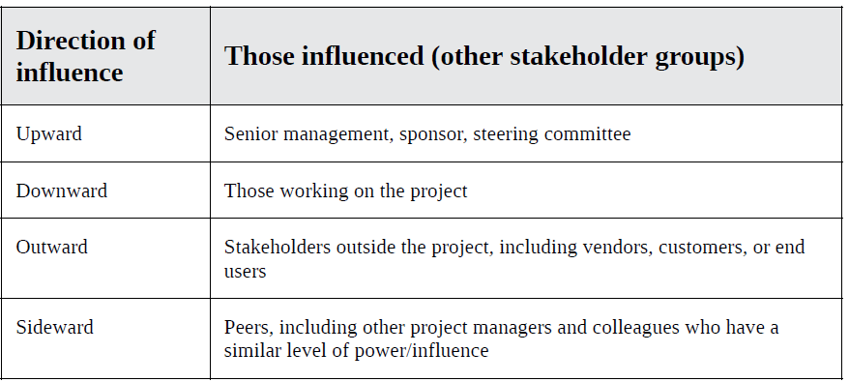
Knowing Your Audience
Identifying Stakeholders
Power and Influence:
One way to categorize stakeholder influence is by defining their “direction” of influence.
Dr. Raef Baraka

Slide 25
Knowing Your Audience
Identifying Stakeholders
Support:
Stakeholder support can make or break a project.
Five classifications of stakeholder engagement:
  Unaware: Stakeholders who are unaware do not know of the project’s existence. They do not have the basic knowledge required to move to a different classification of engagement.
  Resistant: Resistant stakeholders know about the project but do not support it. They may actively work to stop the project in whole or in part.
  Neutral: Stakeholders who are neutral do not act in ways that either promote or detract from the project. Often these stakeholders are not highly impacted by the project.
  Supportive: Supportive stakeholders take steps to support the project in words and/or actions.
  Leading: These stakeholders take a leadership role in ensuring the project succeeds.
Dr. Raef Baraka

Slide 26
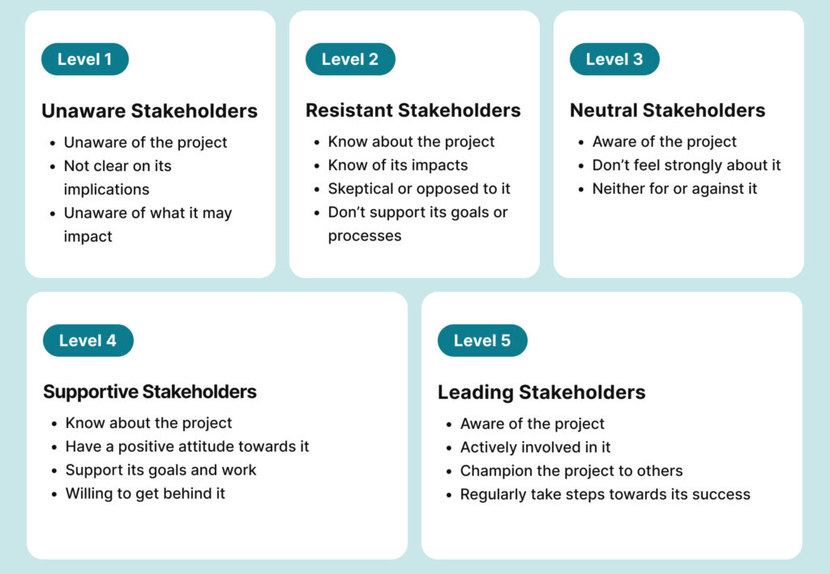
Classifications of stakeholder engagement
Dr. Raef Baraka

Slide 27
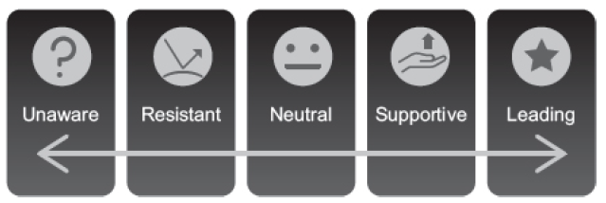
Knowing Your Audience
Identifying Stakeholders
Support:
Five classifications of stakeholder engagement:
One way to look at these classifications is on a spectrum.
Keep in mind that stakeholders can move in either direction on this spectrum.
A resistant stakeholder can move toward being more supportive; likewise, a supportive stakeholder can move toward being resistant. Communication (or lack thereof) is a powerful tool in moving stakeholders along the spectrum.
Dr. Raef Baraka

Slide 28
Knowing Your Audience
Identifying Stakeholders
Support:
In your stakeholder engagement planning, you should attempt to identify where each of your stakeholders are on this spectrum, and where they need to be in order for the project to progress smoothly and achieve its goals.
Why is this important? Because knowing where your stakeholders sit on this spectrum can help you and the project team develop and implement communication strategies that align with stakeholders’ expectations and interests.
Dr. Raef Baraka

Slide 29
Knowing Your Audience
Identifying Stakeholders
A good stakeholder engagement plan starts with identifying who your stakeholders are, their role, power and influence in the project, and their current and desired levels of support for the project.
The next step is understanding how to engage your stakeholders in order to keep them informed and move them toward the level of support needed for the project to succeed.
Dr. Raef Baraka

Slide 30
Knowing Your Audience
Stakeholder Engagement Assessment Matrix
Stakeholder Engagement Assessment Matrix
The stakeholder engagement assessment matrix is a project-management tool.
It can help project teams understand and track stakeholders until the project is completed.
The matrix lists stakeholders and categorizes their current and desired engagement levels.
Common categories include “Unaware,” “Resistant,” “Neutral,” “Supportive,” and “Leading.”
This tool lets you visually manage relationships and ensure all stakeholders are appropriately engaged. Regularly updating it throughout the project lifecycle ensures stakeholders stay informed and supportive.
Dr. Raef Baraka

Slide 31
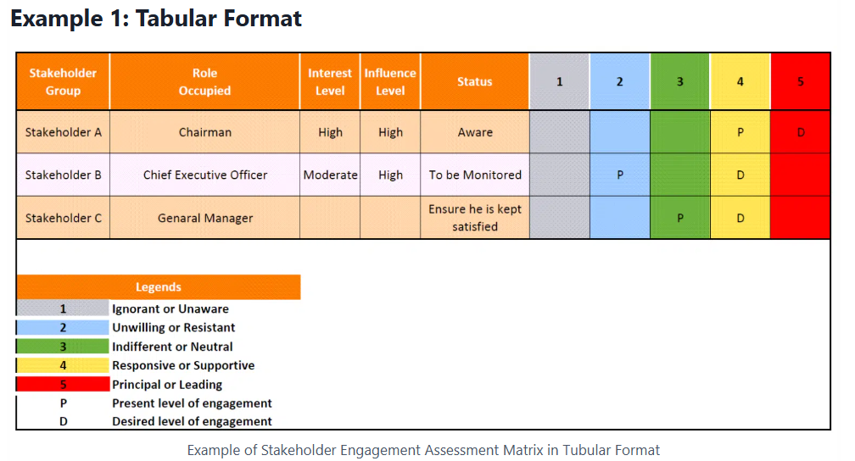
Knowing Your Audience
Stakeholder Engagement Assessment Matrix
Dr. Raef Baraka

Slide 32
Knowing Your Audience
Stakeholder Engagement Assessment Matrix
Stakeholder Engagement Assessment Matrix
Stakeholder A (Organization Chairman): This stakeholder greatly influenced the project’s success. Initially, this stakeholder was in the “Responsive/Supportive” category but was moved to the “Leading/Principal” category after effective communication.
Stakeholder B (Project CEO): This stakeholder exhibited moderate interest but high influence. This stakeholder is currently categorized as “Unwilling/Resistant to Change” but must be brought to at least a “Supportive” level to ensure active and constructive input, which is vital for project success.
Stakeholder C (General Manager): This stakeholder had low interest but moderate project influence. Although they were initially in a “Neutral” position, the project manager aims to elevate their engagement to at least a “Supportive” role.
Dr. Raef Baraka

Slide 33
Knowing Your Audience
Stakeholder Engagement Assessment Matrix
Benefits of a Stakeholder Engagement Assessment Matrix:
Creates Awareness: You will get an understanding of stakeholder skills, influence, and interests. This insight allows alignment between high-level stakeholders and project objectives, thus ensuring that everyone understands their role and the project’s goals.
Encourages Stakeholder Participation: Involving stakeholders increase their engagement, accountability, and commitment, thus leading to a higher level of responsibility to perform their roles effectively..
Dr. Raef Baraka

Slide 34
Knowing Your Audience
Stakeholder Engagement Assessment Matrix
Benefits of a Stakeholder Engagement Assessment Matrix:
Improves Project Performance: Regular stakeholder feedback highlights areas for improvement, thus fostering a sense of ownership and increasing stakeholder contributions to the project.
Keeps the Project on Track: Engaged stakeholders promote collaboration, unity, and productivity, which can help keep the project on schedule.
Dr. Raef Baraka

Slide 35
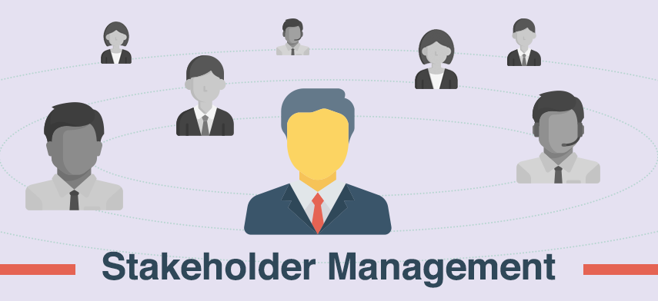
Knowing Your Audience
Effective Stakeholder Engagement
Dr. Raef Baraka

Slide 36
Knowing Your Audience
Effective Stakeholder Engagement
Engaging with stakeholders is not a one-time event but an ongoing process throughout the project lifecycle. Key strategies for effective stakeholder engagement:
Identify and Prioritize Stakeholders:
Conduct a thorough stakeholder analysis to identify all relevant individuals and groups, assess their interests and influence, and prioritize them based on their impact on the project
Communicate Openly and Transparently:
Establish clear channels of communication to keep stakeholders informed about project developments, milestones, and any potential issues or concerns. Encourage feedback and address any questions or grievances promptly.
Dr. Raef Baraka

Slide 37
Knowing Your Audience
Effective Stakeholder Engagement
Engaging with stakeholders is not a one-time event but an ongoing process throughout the project lifecycle. Key strategies for effective stakeholder engagement:
Involve Stakeholders in Decision-Making:
Actively involve stakeholders in key decision-making processes to ensure their perspectives are considered and their concerns are addressed. This promotes ownership and commitment to the project's success.
Regularly Review and Adapt:
Continuously monitor and evaluate stakeholder engagement efforts, soliciting feedback and making adjustments as necessary to meet evolving needs and expectations.
Dr. Raef Baraka

Slide 38
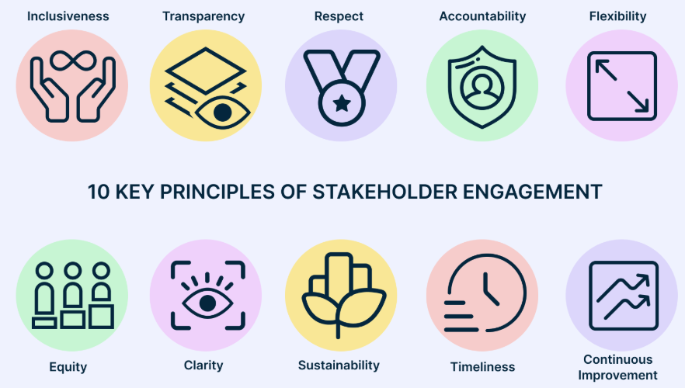
Knowing Your Audience
Effective Stakeholder Engagement
Dr. Raef Baraka

Slide 39
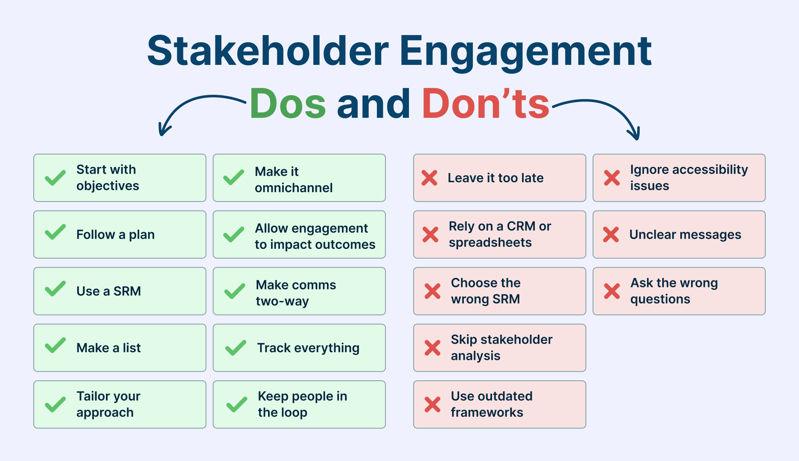
Knowing Your Audience
Effective Stakeholder Engagement
Dr. Raef Baraka

Slide 40
Exploring Communication Theories
Lecture Summary
In essence, stakeholders are the lifeblood of any project, wielding the power to shape its trajectory and determine its success.
By recognizing the diverse interests and perspectives of stakeholders and actively engaging with them throughout the project lifecycle, organizations can foster collaboration, mitigate risks, and ultimately achieve their goals in a manner that is inclusive and sustainable.

Slide 41



Thank You

