Slide 2
Contents
Digital Vs Analog
Numbering Systems [binary, octal and hexadecimal]
Base Conversion
Information Representation
Binary Additions
Complement

Slide 3
Digital versus Analog signal
We live in an Analog world.
We use the word Analog to express phenomena that have smooth gradual and continuous change or movement.
Everything in the physical world is an analog signal Sound, light, temperature, pressure
Need to convert into electrical signals
  Transducers: converts one type of energy to another
    Electro-mechanical, Photonic, Electrical, …
  Examples, Microphone
  speaker
    Thermocouples (measure temperature)

Slide 4
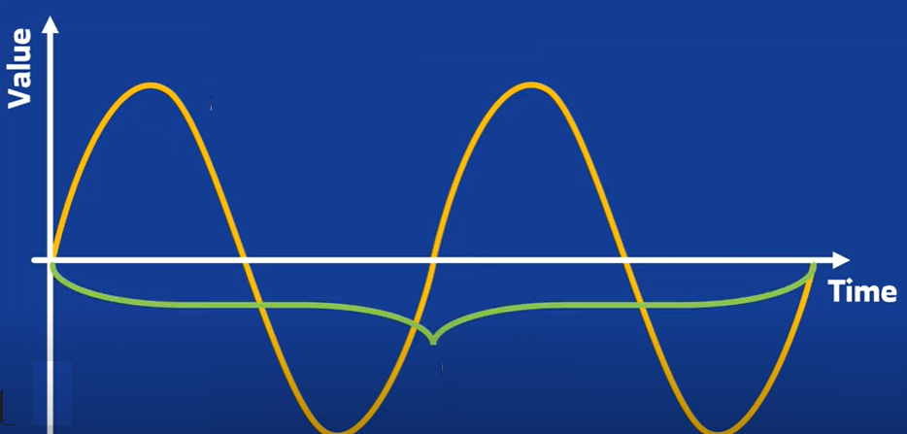
Analog

Slide 5
Digital versus Analog
The word Digital, however, means just the opposite.
In Digital Systems, parameters have a limited set of Discrete Values that they can assume.
In Other words, digital parameters don’t have a Continuous range.
This means that, digital parameters change their values by Jumping from one allowed value to another.
As an example, the day of the month is a parameter that may only assume one value out of a set of limited discrete values {1, 2, 3, …., 31}.

Slide 6
Digital versus Analog
To convert an Analog signal into a digital one, some loss of accuracy is inevitable since digital systems can only represent a finite discrete set of values.
The process of conversion is known as Digitization or Quantization.
Analog-to-digital-converters (ADC) are used to produce a digitized version of analog signals.
Digital-to-analog-converters (DAC) are used to regenerate analog signals from their digitized form.

Slide 7
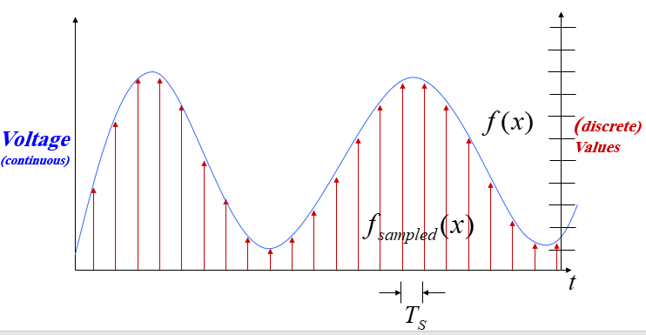
Physical
Phenomena
Voltage or
Current
ADC Discrete Values
Sensor
ADC
Software

Slide 8
Digital versus Analog
Why digital?
  digital systems are easier to design since dealing with a limited set of values rather than an infinite (or very large) continuous range of values is significantly simpler
  information storage is easy
  accuracy and precision is better
  operation can be programmed
  digital circuits are less affected by noise

Slide 9
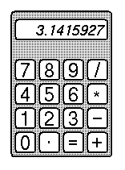
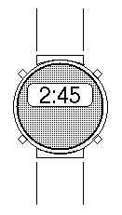
Example of Digital Systems
Digital Computer
  Usually design to maximize performance (speed).
Handheld Calculator
  Usually designed to minimize cost.
Digital Watch
  Usually designed to minimize power.

Slide 10
Numbering Systems
Computers only deal with binary data (0s and 1s), hence all data manipulated by computers must be represented in binary format.
Machine instructions manipulate many different forms of data:
  Numbers:
    Integers: 33, +128, -2827
    Real numbers: 1.33, +9.55609, -6.76E12, +4.33E-03
  Alphanumeric characters (letters, numbers, signs, control characters): examples: A, a, c, 1 ,3, ", +, Ctrl, Shift, etc.

Slide 11
Numbering Systems
  Images (still or moving): Usually represented by numbers representing the Red, Green and Blue (RGB) colors of each pixel in an image,
  Sounds: Numbers representing sound amplitudes sampled at a certain rate.
So in general we have two major data types that need to be represented in computers; numbers and characters.

Slide 12
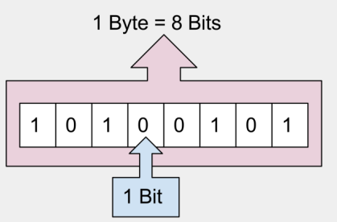
Binary Numbers
In binary, we have bytes and bits which are major components in writing binary.
Bit: a single 0 or 1 in a binary number
  For Example: 10100000
Byte: eight bits put together
  For Example: 10100000

Slide 13
Converting Binary to Decimal
The Process : Weighted Multiplication
  Multiply each bit of the Binary Number by it corresponding bit-weighting factor (i.e. Bit-0→2⁰=1; Bit-1→2¹=2; Bit-2→2²=4; etc).
  Sum up all the products in step (a) to get the Decimal Number.
Example:
  Convert the binary number 0111₂ into its decimal equivalent
  (0111)₂ = 0x2³ + 1x 2² + 1x 2¹ + 1x 2⁰ = 7₁₀
  (10101001)₂ = (169_{)10:}
(1 × 2⁷) + (1 × 2⁵) + (1 × 2³) + (1 × 2⁰) = 128+32+8+1=169

Slide 14
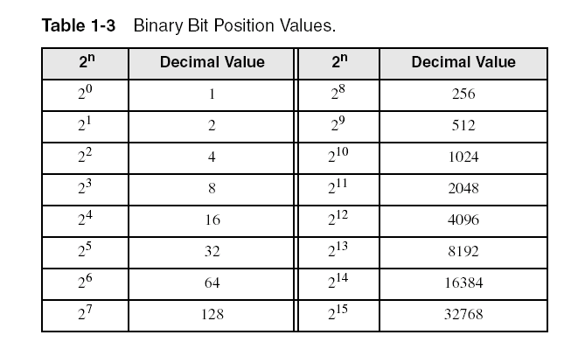
Binary Numbers

Slide 15
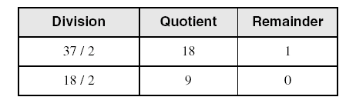
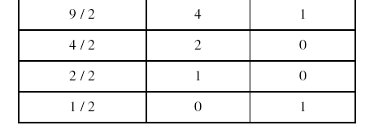
Convert Decimal to Binary
Repeatedly divide the decimal integer by 2. Each remainder is a binary digit in the translated value:
least significant bit
most significant bit
(37)₁₀ = (100101)₂
stop when quotient is zero

Slide 16
Another Procedure for Converting from Decimal to Binary
Start with a binary representation of all 0’s
Determine the highest possible power of two that is less or equal to the number.
Put a 1 in the bit position corresponding to the highest power of two found above.
Subtract the highest power of two found above from the number.
Repeat the process for the remaining number

Slide 17
Another Procedure for Converting from Decimal to Binary
Example: Converting (76)₁₀ to Binary
  The highest power of 2 less or equal to 76 is 64, hence the seventh (MSB) bit is 1
  Subtracting 64 from 76 we get 12.
  The highest power of 2 less or equal to 12 is 8, hence the fourth bit position is 1
  We subtract 8 from 12 and get 4.
  The highest power of 2 less or equal to 4 is 4, hence the third bit position is 1
  Subtracting 4 from 4 yield a zero, hence all the left bits are set to 0 to yield the final answer

Slide 18
Exercises:
Convert (10110)₂ = ??
Solution:
(10110)₂ =16 + 4 + 2 = (22)₁₀
What are the weights of the digits with value 1?
Solution,
the weights of the digits with value 1 is: 16 , 4 , 2
What is the largest binary number that can be expressed with 5 bits?
5-bit binary: 11111

Slide 19
Convert the decimal number 35 to binary
Results of repeated division by 2 (quotients are followed by remainders):
35₁₀ = 17(1); 8(1); 4(0); 2(0); 1(0); 0(1)
Answer: (100011)₂
What is the value of the third quotient ?
The value of the third quotient = 4

Slide 20
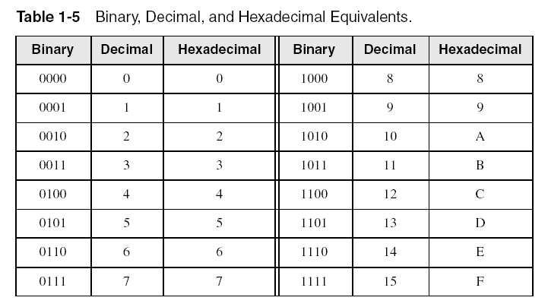
Hexadecimal Integers
Binary values are represented in hexadecimal.

Slide 21

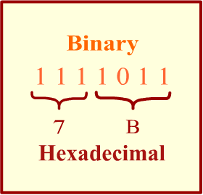
Converting Binary to Hexadecimal
Each hexadecimal digit corresponds to 4 binary bits.
Example: Translate the binary integer 0001 0110 1010 0111 1001 0100 to hexadecimal
21

Slide 22
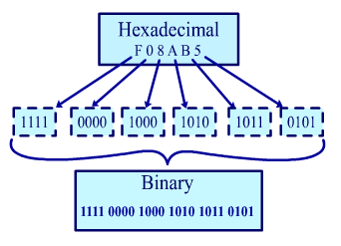
Converting Hexadecimal to Binary
Each Hexadecimal digit can be replaced by its 4-bit binary number to form the binary equivalent.

Slide 23
Conversion from Binary to Octal
Partition binary number into groups of 3 digits starting from the radix point
When it’s not a multiple of 3, you can add 0s to the left or right as you want depending on radix point
Replace each group of 3 binary digits by the correspondent octal digit
Example
  (11101010)₂ = (011 101 010 )₂
  = (352)₈

Slide 24
Conversion from Octal to Binary
Replace each octal digit by the 3 corresponding binary digits. You can suppress Leading 0s
Example
  (352)₈ = (011 101 010)₂ = (11101010)₂
For conversion from octal to hexadecimal, convert first to binary, then from binary to hexadecimal
Example
  (352)₈ = (011 101 010)₂ = (11101010)₂
  (11101010)₂ = (1110 1010)₂ = (EA)₁₆
  (352)₈ = (EA)₁₆

Slide 25
Exercise
Convert the number (10110)₂ to Octal?
(10110)₂ = 10 110 = (2 6)₈
Convert the number (10110)₂ to Hexadecimal?
(1001110)₂ = 100 1110 = (4 E)₁₆

Slide 26
Exercise
Convert the number (372)₈ to Binary?
(372)₈ = (011 111 010 )₂
Convert the number (10110)₂ to Hexadecimal?
(372)₁₆ = (0011 0111 0010 )₂

Slide 27
Converting Hexadecimal to Decimal
Multiply each digit by its corresponding power of 16:
Decimal = (d3 × 16³) + (d2 × 16²) + (d1 × 16¹) + (d0 × 16⁰)
d = hexadecimal digit
Examples:
  (1234)₁₆ = (1 × 16³) + (2 × 16²) + (3 × 16¹) + (4 × 16⁰) = (4,660 )₁₀
  (3BA4)₁₆ = (3 × 16³) + (11 * 16²) + (10 × 16¹) + (4 × 16⁰) = (15,268)₁₀

Slide 28
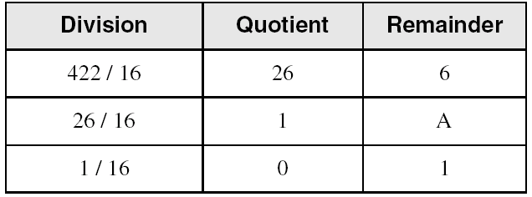
Converting Decimal to Hexadecimal
Repeatedly divide the decimal integer by 16. Each remainder is a hex digit in the translated value:
least significant digit
most significant digit
(422)₁₀ = (1A6)₁₆
stop when quotient is zero

Slide 29
Exercise:
Convert the number (735)₈ to decimal number.
  (735)₈ = 7 * 8² + 3 * 8¹ + 5 * 8⁰ =
  = 7 * 64 + 3 * 8 + 5 * 1 =
  = 448 + 24 + 5 = 477₁₀
What is the value of the third term in conversion equation from right?
the value of the send term in conversion equation from right = 448

Slide 30
Exercise:
Convert the number (FAFA)₁₆ to decimal number.
FAFA₁₆ = 15*16³ + 10*16² + 15*16¹ + 10*16⁰ =
= 15*4096 + 10*256 + 15 * 16 + 10*1 =
= 61,440 + 2560 + 240 + 160 = 64,250
What is the value of the second term in conversion equation from right?
the value of the send term in conversion equation from right = 240

Slide 31
Convert the following numbers with the indicated bases to decimal:
  (4310)₅ = ??
  (4310)₅ = 4 * 5³ + 3 * 5² + 1 * 5¹ = (580)₁₀
  b. (198)₁₂ = ??
  (198)₁₂ = 1 * 12² + 9 * 12¹ + 8 * 12⁰ = 260₁₀

Slide 32
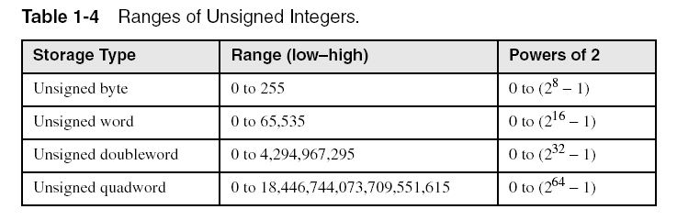
Integer Storage Sizes
Standard sizes:
What is the largest unsigned integer that may be stored in 20 bits?

Slide 33
Binary Addition
Start with the least significant bit (rightmost bit)
Add each pair of bits
Include the carry in the addition, if present
carry:
1
Sum Rules
0+0 = sum 0 carry 0
0+1 = sum 1 carry 0
1+0 = sum 1 carry 0 1+ 1 = sum 0 carry 1
0
0
0
0
0
1
0
0
(4)
+
0
0
0
0
0
1
1
1
(7)
0
0
0
0
1
0
1
1
(11)
bit position:
7
6
5
4
3
2
1
0

Slide 34
Binary Addition Example
Extending this to two multiple bit examples:
Carries 0 0
Augend 01100 10110
Addend +10001 +10111
Sum
Note: The 0 is the default Carry-In to the least significant bit.
Carries 00000 01100
Augend 01100 10110
Addend +10001 +10111
Sum 11101 101101

Slide 35
Exercise:
Add the following numbers without converting them to decimal.
  Binary numbers 1011 and 101.
  1011
  0101
  ---------
  10000

Slide 36
Complements in binary systems
Complements are used for simplifying the subtraction operation and for easy manipulation of certain logical rules and events.
Two types of complements for each base-r system:
  (1’s complements) and 2’s complements).
1’s complement is obtained by value obtained by inverting all the bits in the binary representation of the number (swapping 0s and 1s)
  For example: 1’s complement of 1011000 = 0100111

Slide 37
2’s complement is obtained by starting at the LSB, leaving all the 0s unchanged, look for the first occurrence of a 1. Leave this 1 unchanged and replace each 1 by 0 and each 0 by 1 for all the bits after it.
Another method is to add 1 to the 1’s complement of the bits in the binary representation of the number.
    For example: 2’s Complement of 11010010 = (00101110)2
    1’s of 11010010 = 00101101
    Then add 1 to it, 00101101 + 1 = (00101110)2

Slide 38
Exercise:
Obtain the 1 's and 2's complements of the following binary numbers:
  00000000 → 1’s complement = 11111111
  2’s complement = 00000000
  11011010 → 1’s complement = 00100101
  2’s complement = 00100110
  10000101 -> 1’s complement = 01111010 → 2’s complement = 01111011

Slide 39
Exercise:
Find the 2's complement of (B2FA)₁₆.
B2FA =(1011 0010 1111 1010)₂ ➔ 2’s complement = (0100110100000110)₂
Find the 2's complement of (23)₁₀.
(23)₁₀ =(10111)₂ ➔ 2’s complement = (01001)₂

Slide 40
END OF Lecture 01

