Slide 1



Master of Science in Artificial intelligent
Lecture 10
AI511
Foundations of Artificial Intelligence
Prepared by
Prof. Lamiaa Fattouh Ibrahim
www.midocean.ae

Slide 2
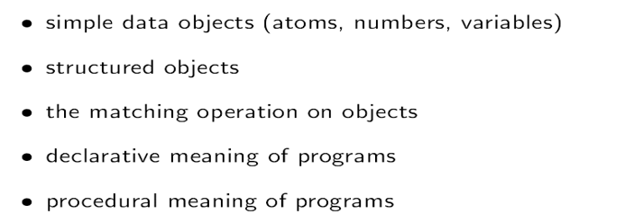
outlines

Slide 3
outlines
Lists
The Syntax of lists
Write procedures involving lists
Built in operators for arithmetic and comparison
Simple debugging

Slide 4
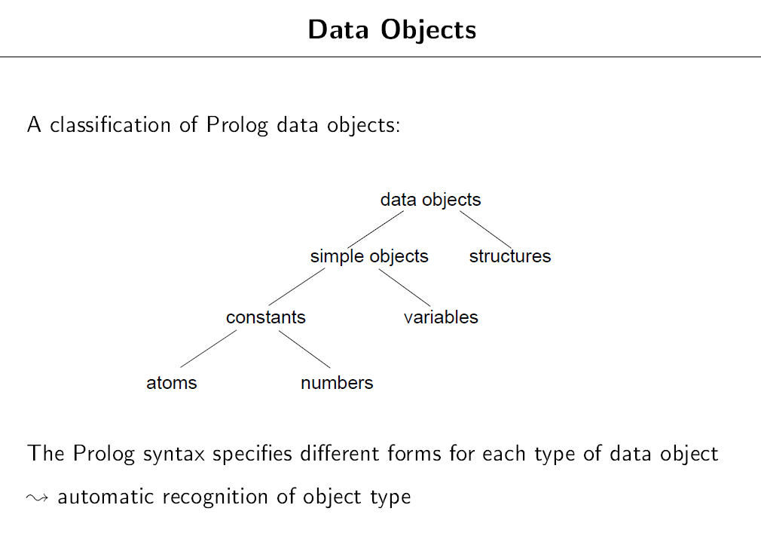

Slide 5

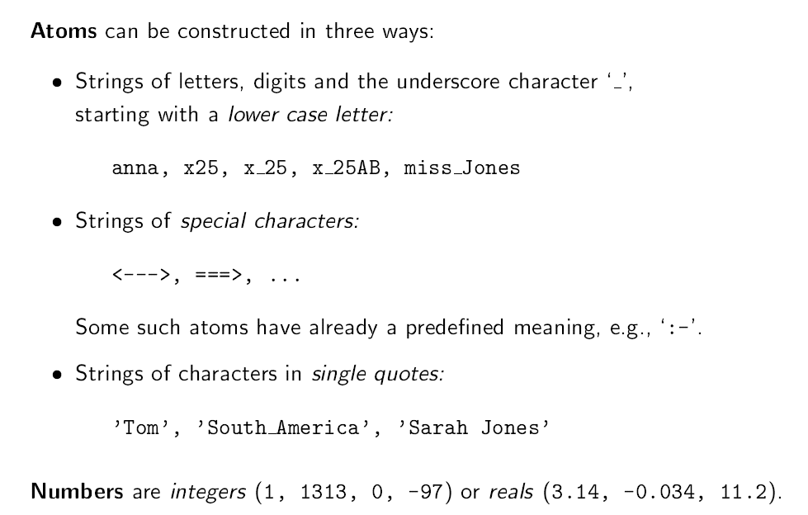

Slide 6

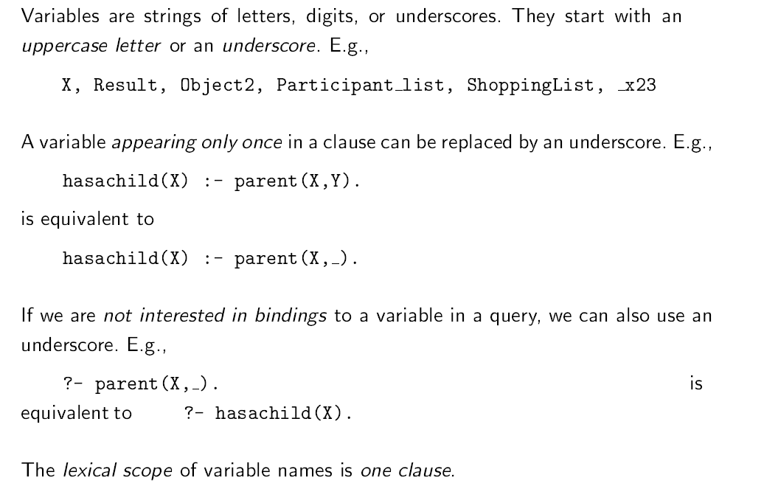

Slide 7

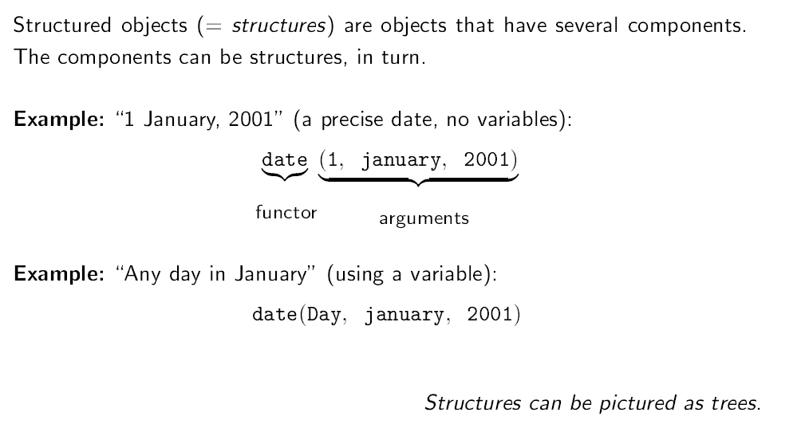

Slide 8
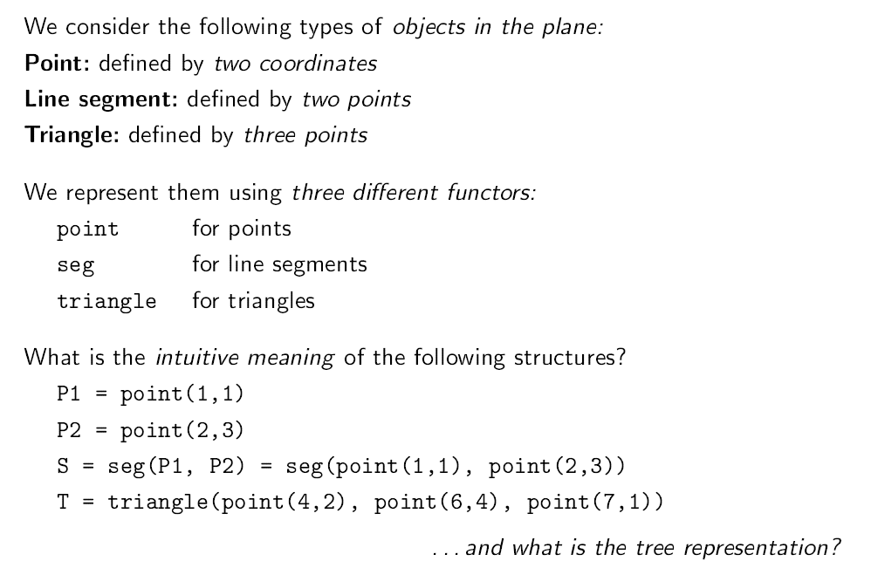

Slide 9
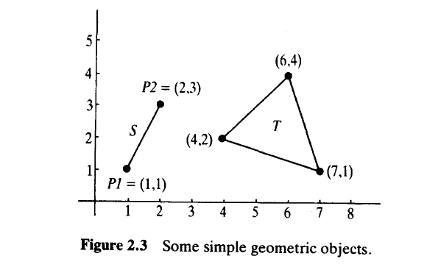

Slide 10
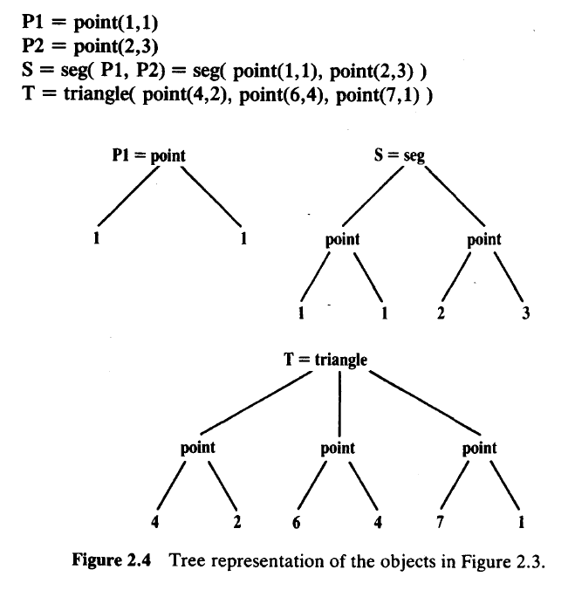

Slide 11

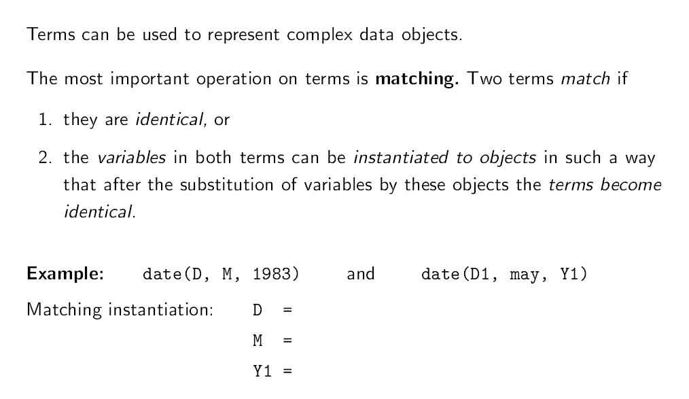

Slide 12

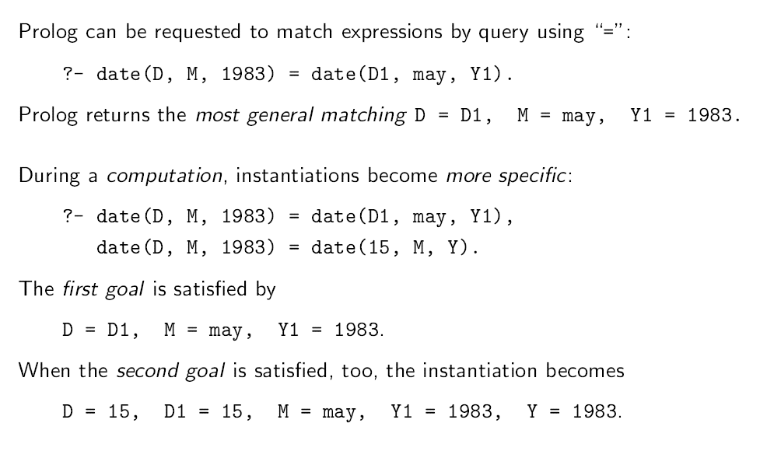

Slide 13

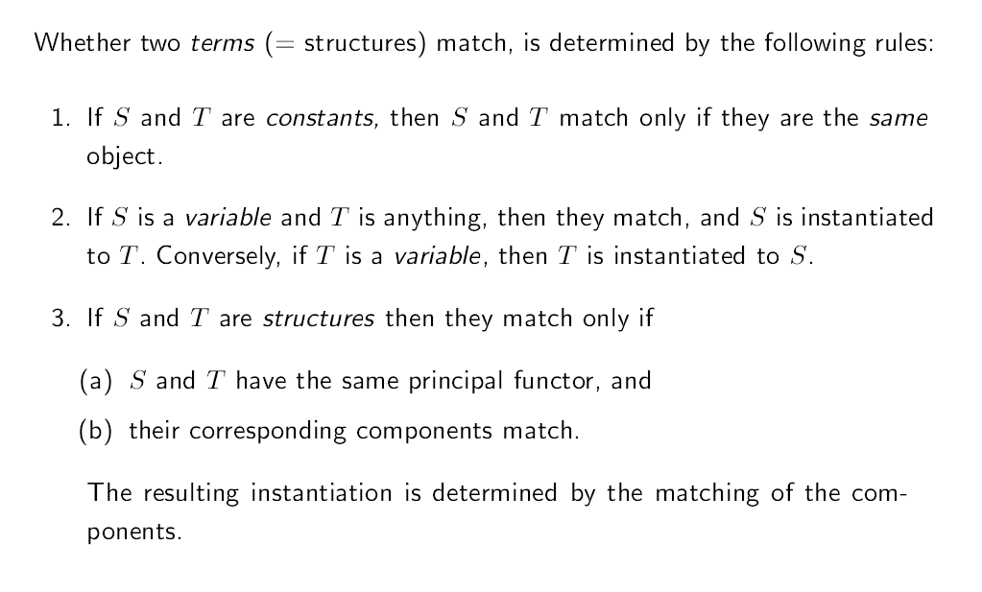

Slide 14

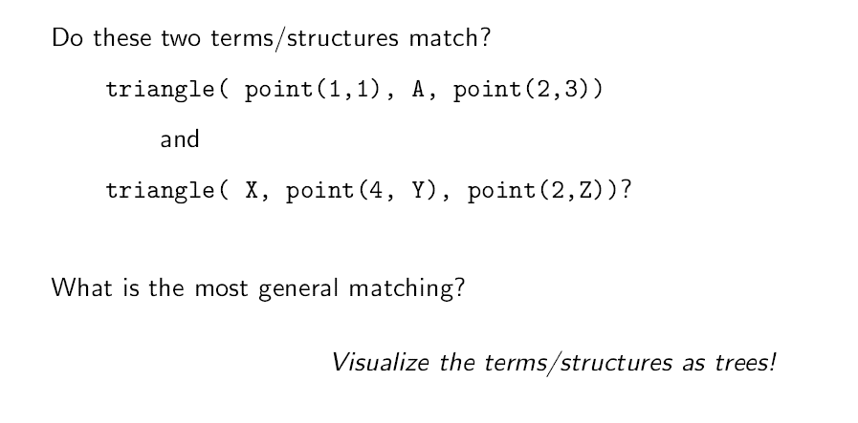

Slide 15
The terms date(D, M, 1983) and date(D1, M1,1444) do not match
The terms date(X, Y, Z) and point(X, Y, Z) do not match

Slide 16

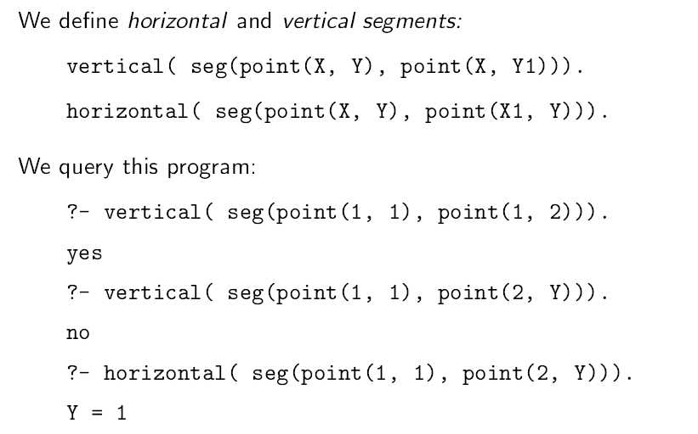

Slide 17

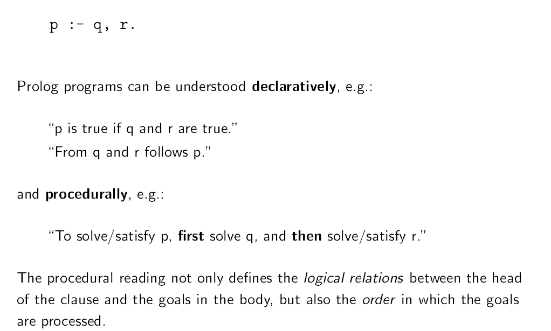

Slide 18

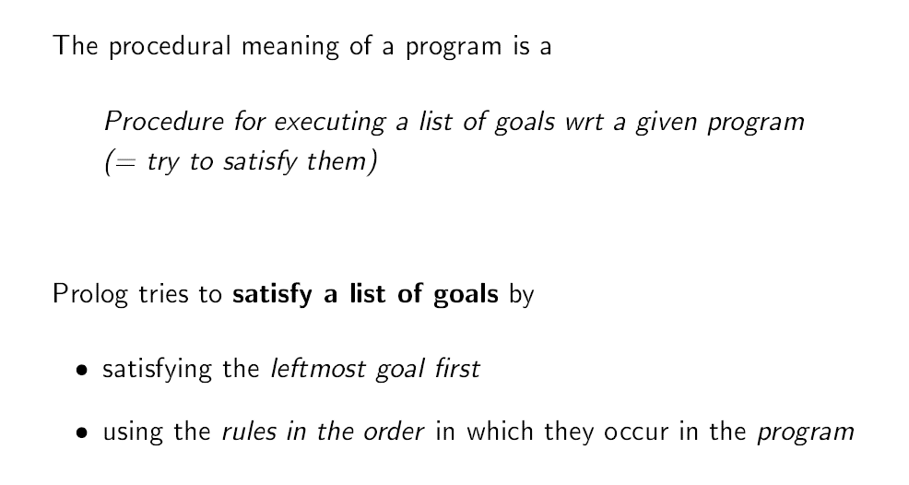

Slide 19
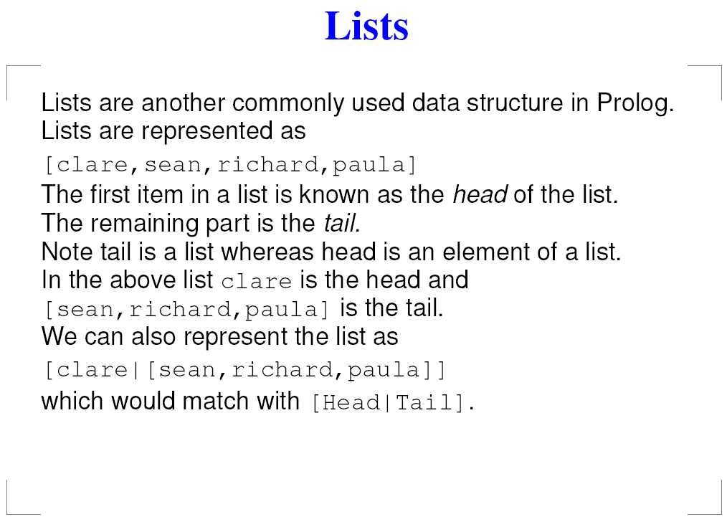

Slide 20
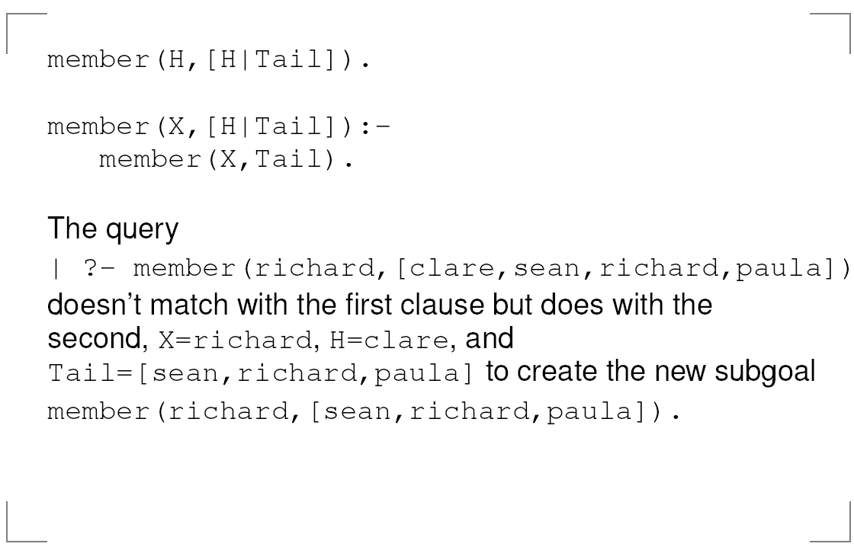

Slide 21
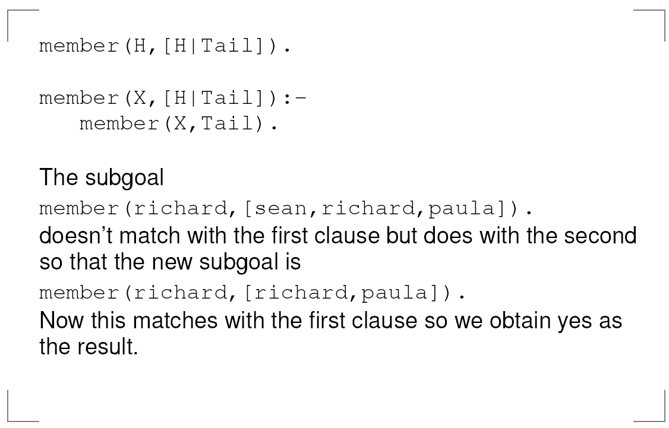

Slide 22
The rules for member are
member(M, [M |_]).
Member(M, [_ |T]) :- member(M, T).
The first rule says that M is a member of a list with head
M. The second rule says that M is a member of a list if M is a member of its tail T.

Slide 23
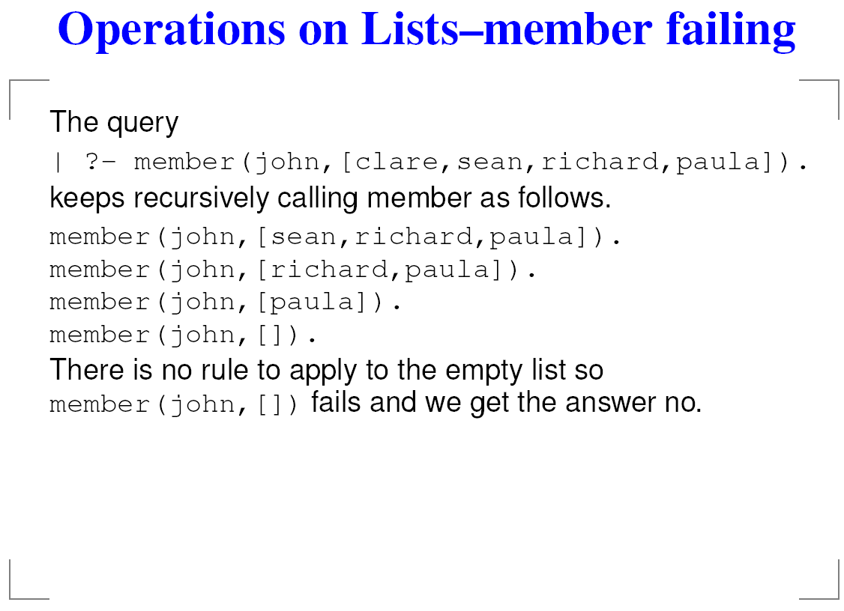

Slide 24
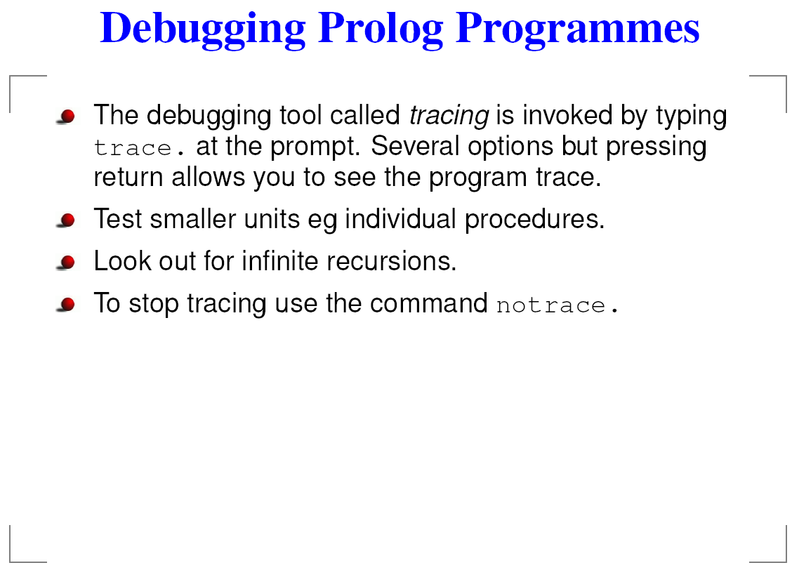

Slide 25
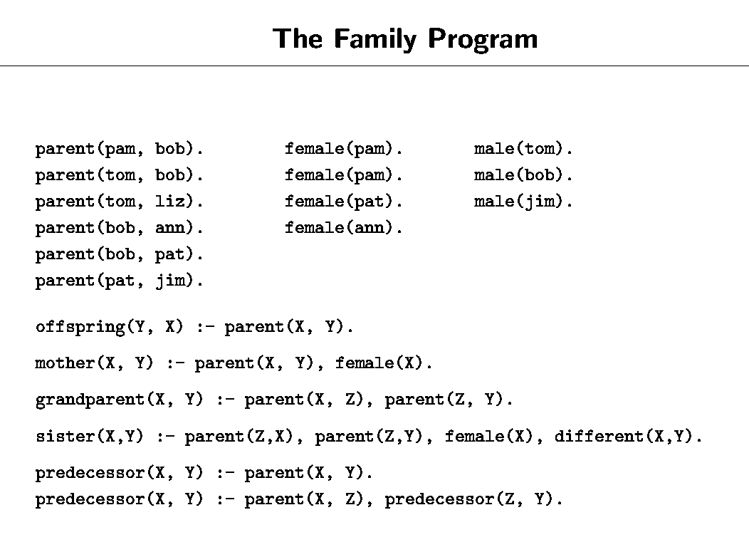
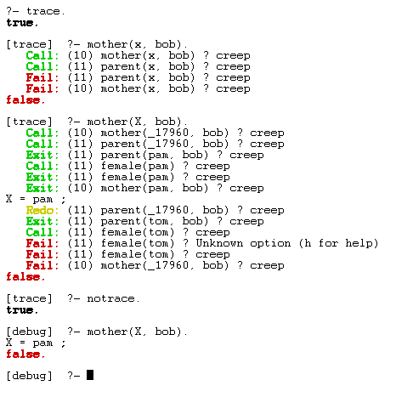

Slide 26
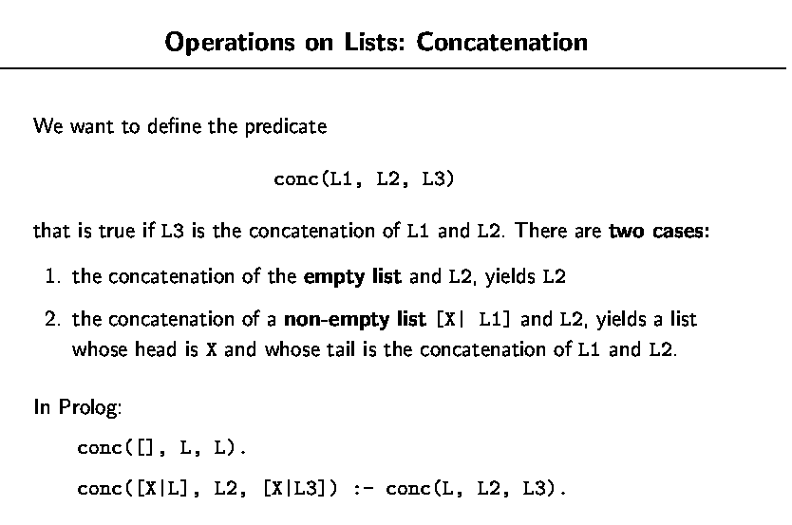
In words,
The result of conc the empty list [ ] and a list L is L.
If the result of conc L and L2 is L3, then
the result of conc [X | L] and L2 is [X | L3]

Slide 27
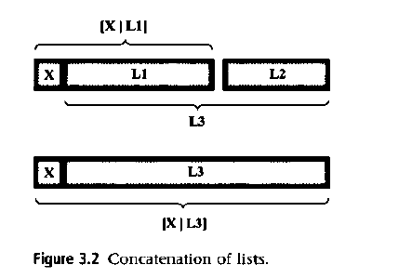

Slide 28
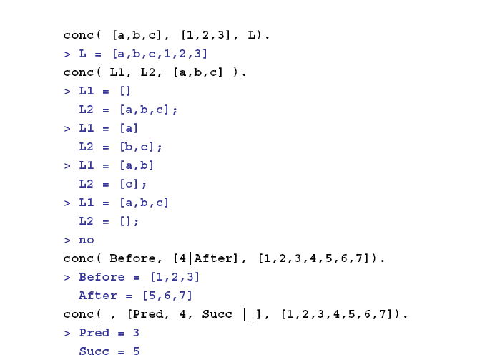

Slide 29
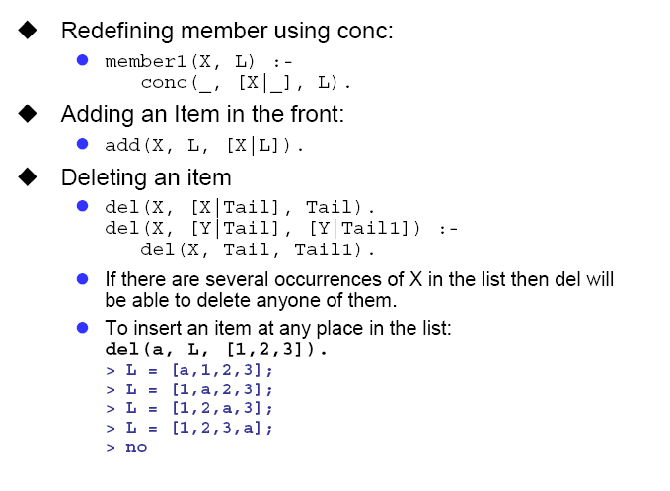

Slide 30
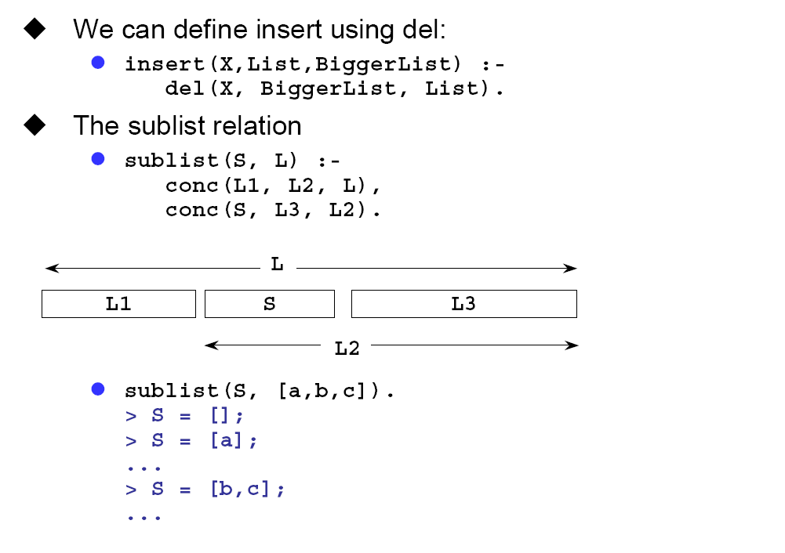

Slide 31
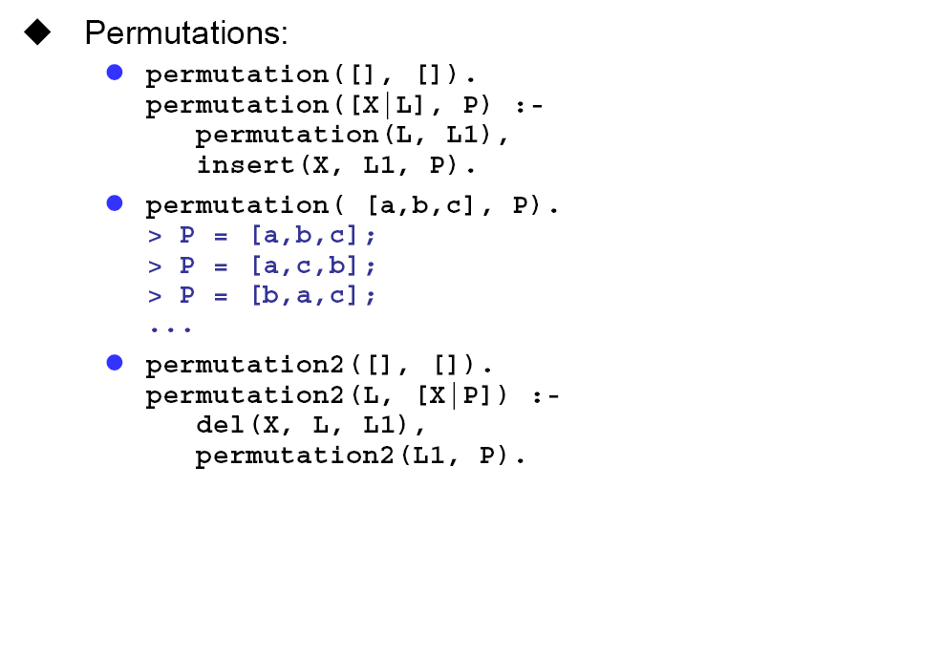
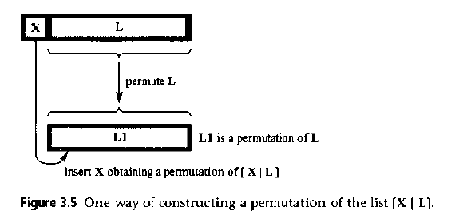

Slide 32
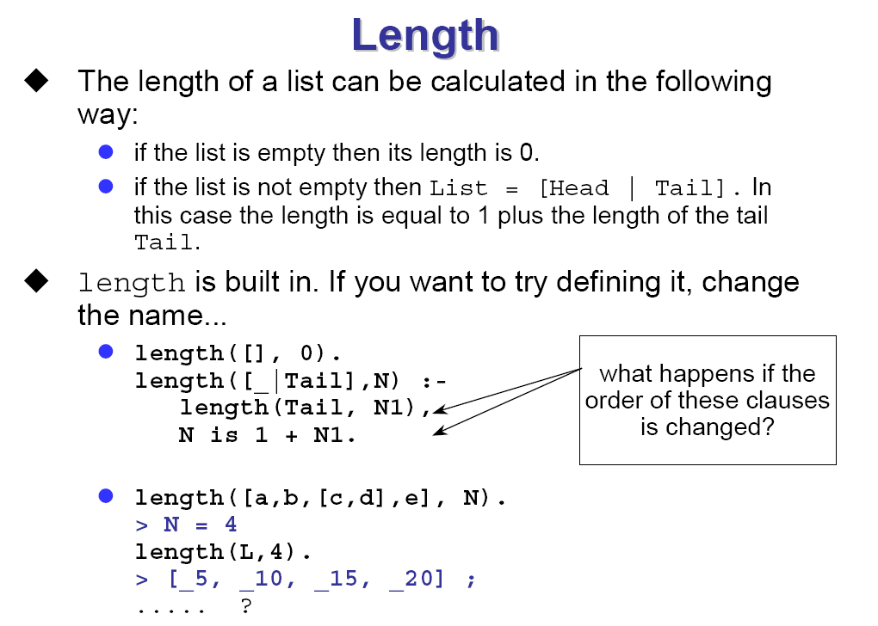

Slide 33
length/2
  length(L, N) returns the length N, i.e. the number of elements, in the list L.
    ?- L = [a, b, c, d, e], length(L, N).
    N = 5
remove/3
  remove(X, L, RemainderList) removes X from L to leave RemainderList.
    ?- remove(b, [a, b, c], X).
    X = [a, c]
  remove/3 can be used to add an element to a list.
    ?- remove(nice, L, [have, a day]).
    L = [nice, have, a, day];
    L = [have, nice, a day];
    L = [have, a, nice, day];
    L = [have, a, day, nice]

Slide 34
reverse/2
reverse(L, RevL) returns RevL in which the order of elements in L is reversed.
  ?- reverse([apple, seasplash, holly, leaf], RevL).
  RevL = [leaf, holly, seasplash, apple]
sort/2
  sort(List, SortedList) returns SortedList as the sorted elements of List and removes duplicates.
  For atoms it is just alphabetical.
  For numbers it is just increasing.
    ?- sort([apple, seasplash, holly, leaf], S).
    S = [apple, holly, leaf, seasplash]
    ?- sort([3.45, 10, 4.75, 10, 1], S).
    S = [1, 3.45, 4.75, 10]

Slide 35
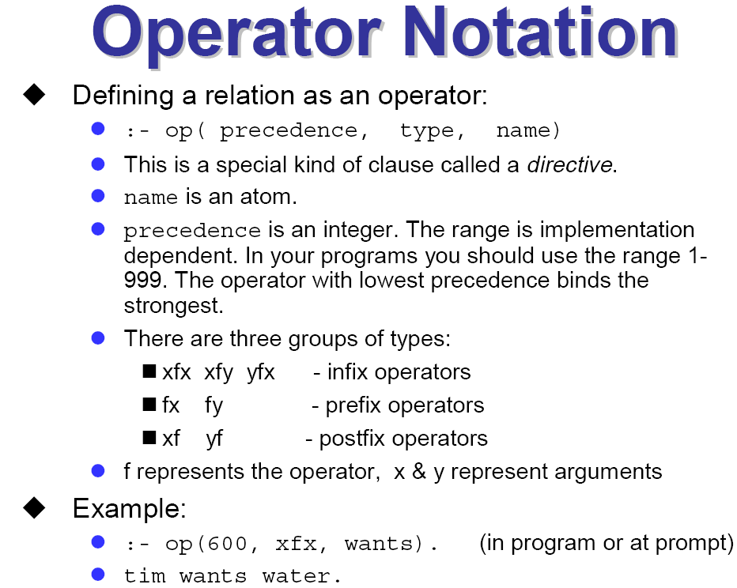

Slide 36
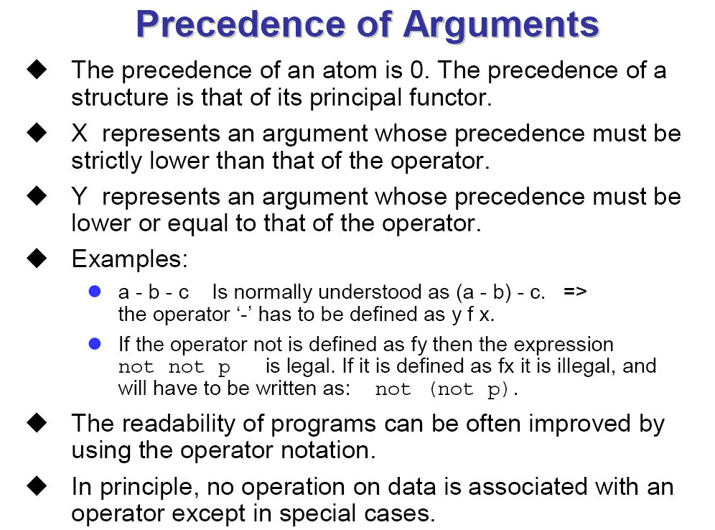

Slide 37
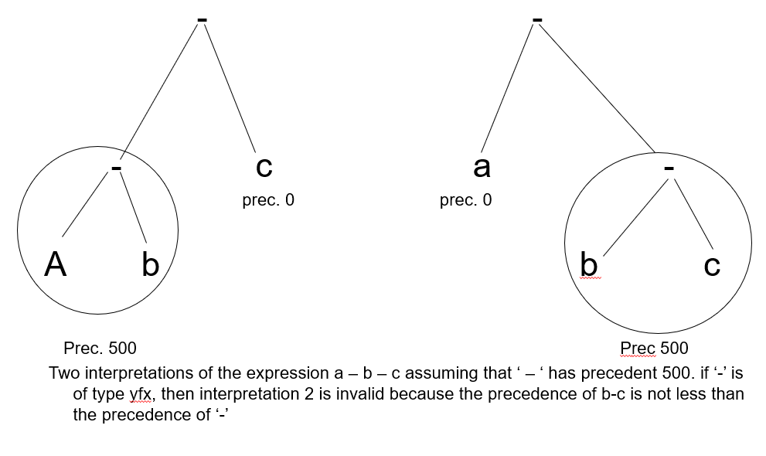

Slide 38
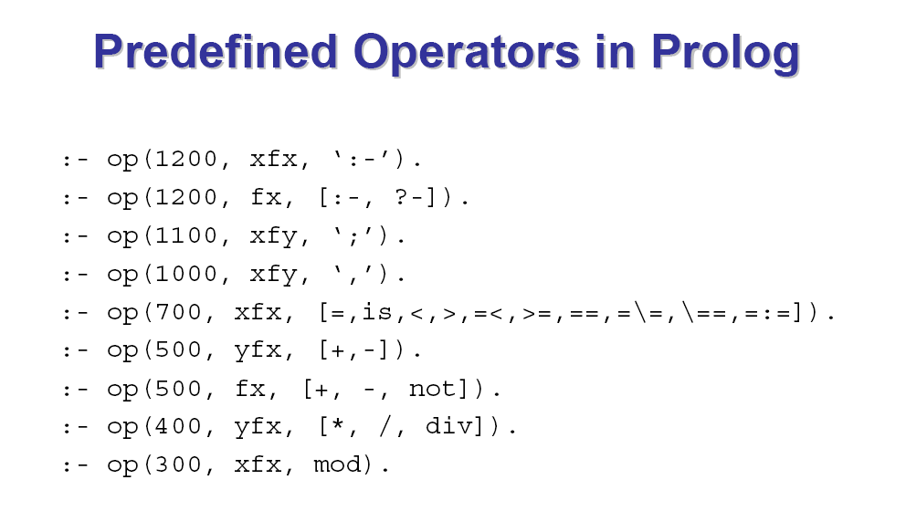

Slide 39
Arithmetic and Comparative Operators
Position.
  infix operators: +, -, *, /.
  prefix operator: -.
  postfix operator: !.
Precedence.
  Each operator has a precedence value associated with it.
  Precedence values are used to decide which operator is carried out first.
  In Prolog, multiplication and division have higher precedence values than addition and subtraction.
Associativity.
  An operator is either left associative or right associative.
  In Prolog, arithmetic operations are left associative.
  Round brackets can be used to enforce precedence and associativity.

Slide 40
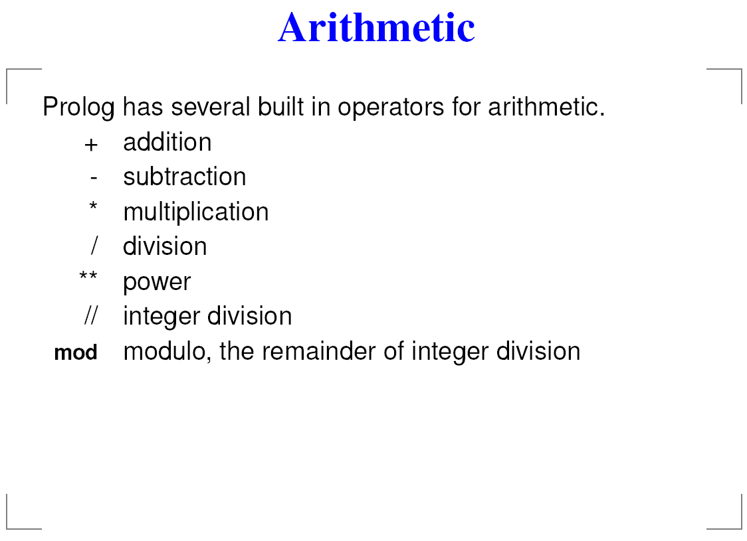

Slide 41
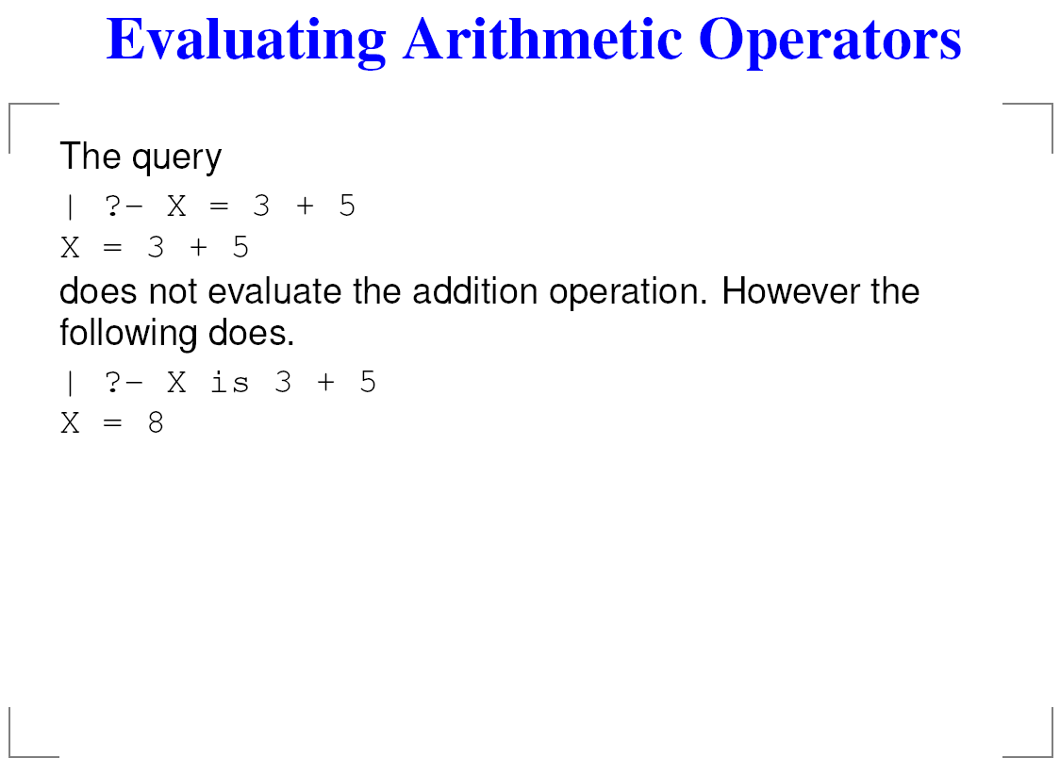

Slide 42
Arithmetic and Comparative Operators
Arithmetic expression: involving arithmetic operators
A built-in operator (predicate) is can be used in an evaluation goal for evaluating an arithmetic expression (i.e., carrying out an arithmetic calculation).
  The left hand side is usually a variable.
  The right hand side is an arithmetical expression.
Built-in predicates for making comparison between two arithmetic expressions in a goal.
    X =:= Y the values of X and Y are equal.
    X =\= Y the values of X and Y are not equal.
    X < Y X is less than Y.
    X > Y X is greater than Y.
    X =< Y X is less than or equal to Y.
    X >= Y X is greater than or equal to Y.

Slide 43
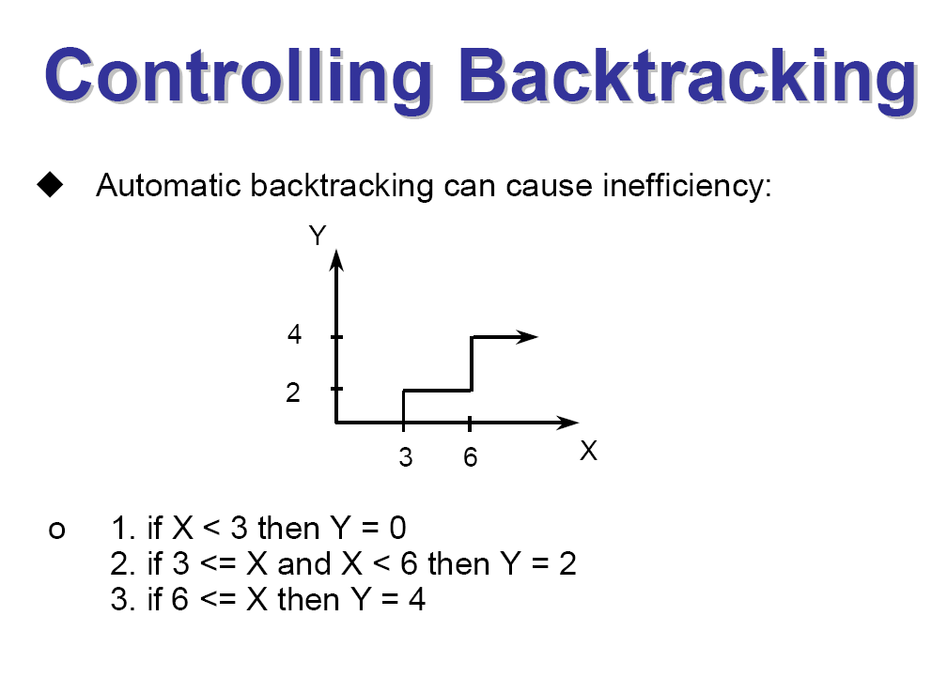

Slide 44
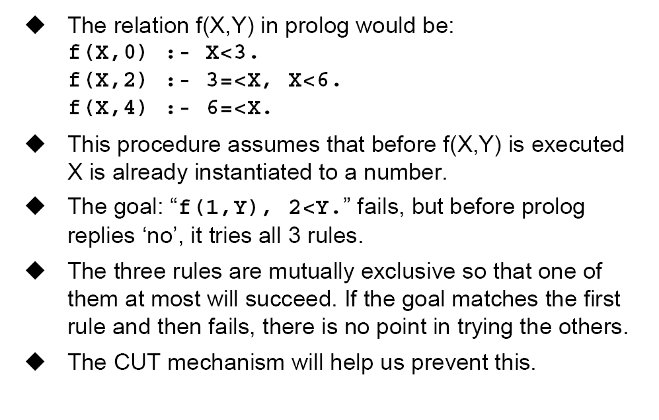

Slide 45
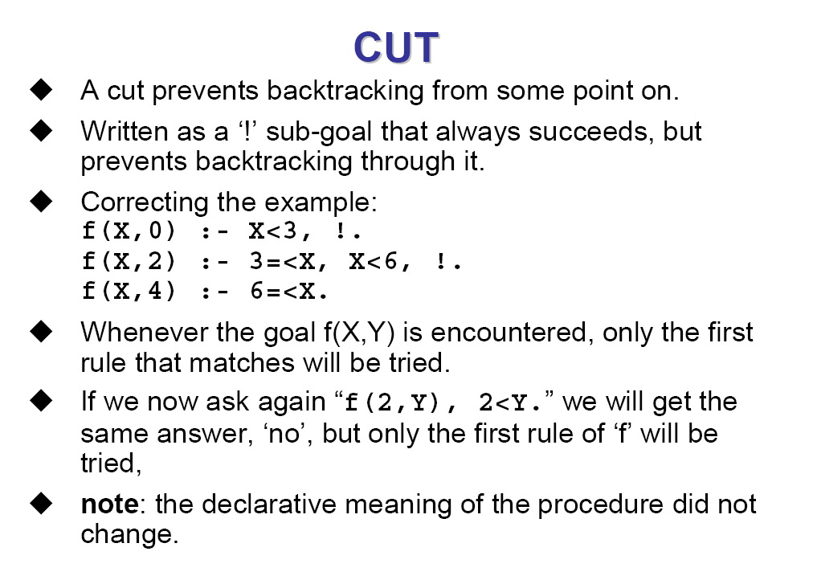

Slide 46
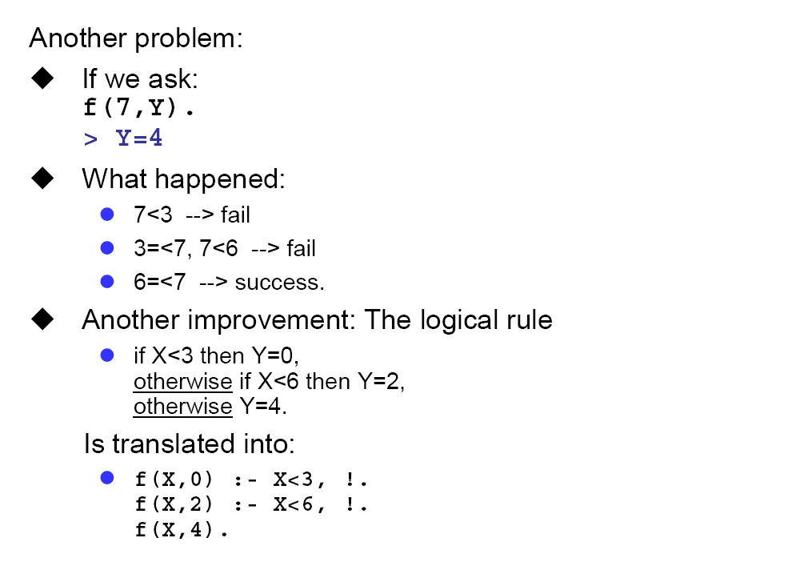

Slide 47
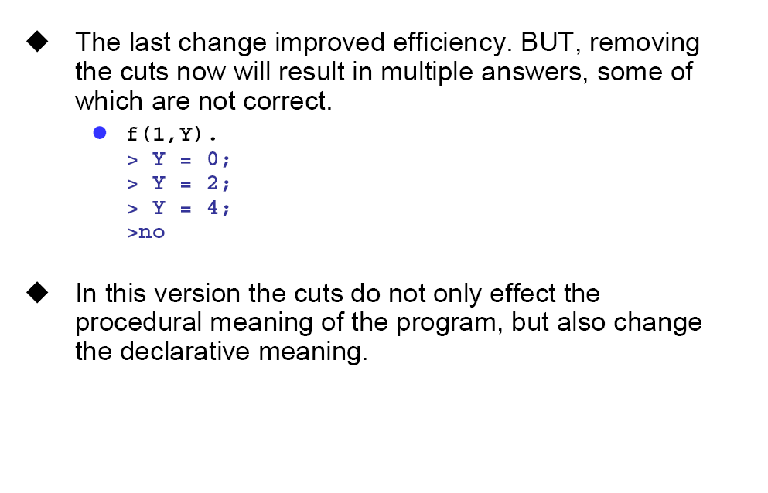


Slide 48
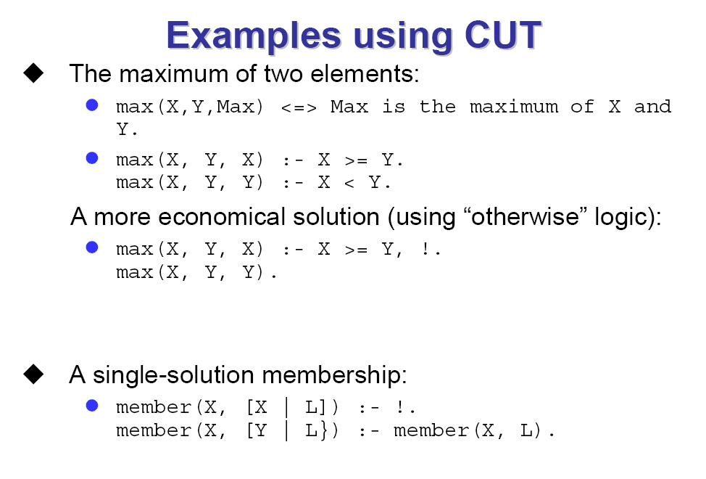

Slide 49
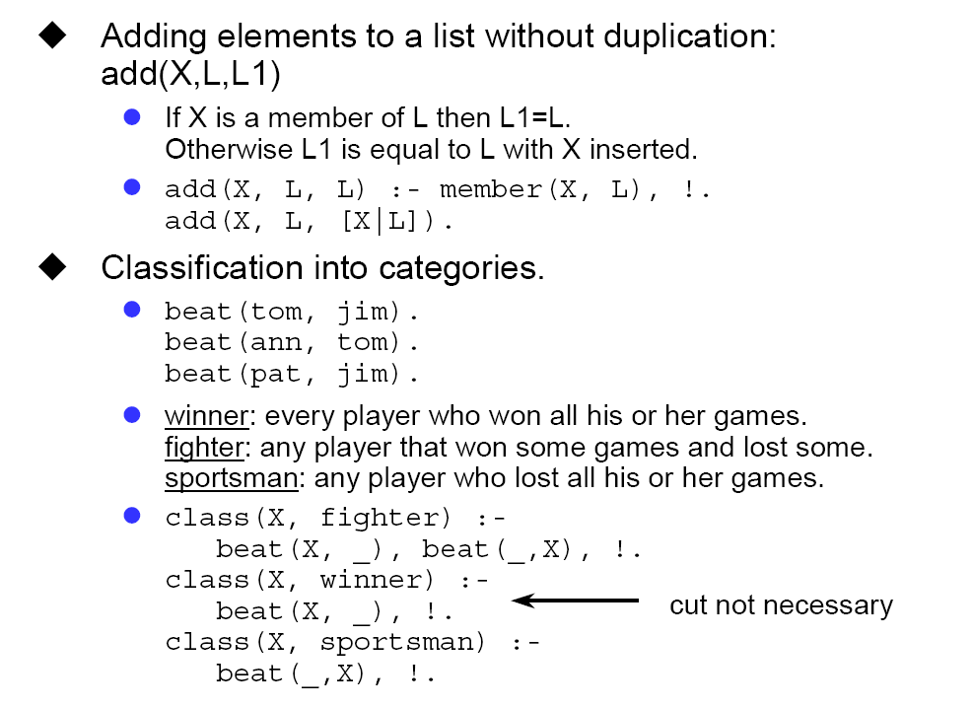

Slide 50
Summary
The list is a frequently used structure. It is either empty or consists of a head and a tail which is list as well. Prolog provides a special notation for lists.
Common operations on lists, programmed in this lecture, are: list membership, concatenation, adding an item, deleting an item, sublist.
The operator notation allows the programmer to tailor the syntax of programs toward particular needs. Using operators the readability of programs can be greatly improved.

Slide 51
Summary
New operator are defined by the directive op, starting the name of an operator, its type and precedence.
In principle, there is no operation associated with an operator; operators are merely a syntactic device providing an alternative syntax for terms.
Arithmetic is done by built-in procedures. Evaluation of an arithmetic expression is forced by the procedure is and by the comparison predicates <, =<, etc.

Slide 52



Thank You

