Slide 1
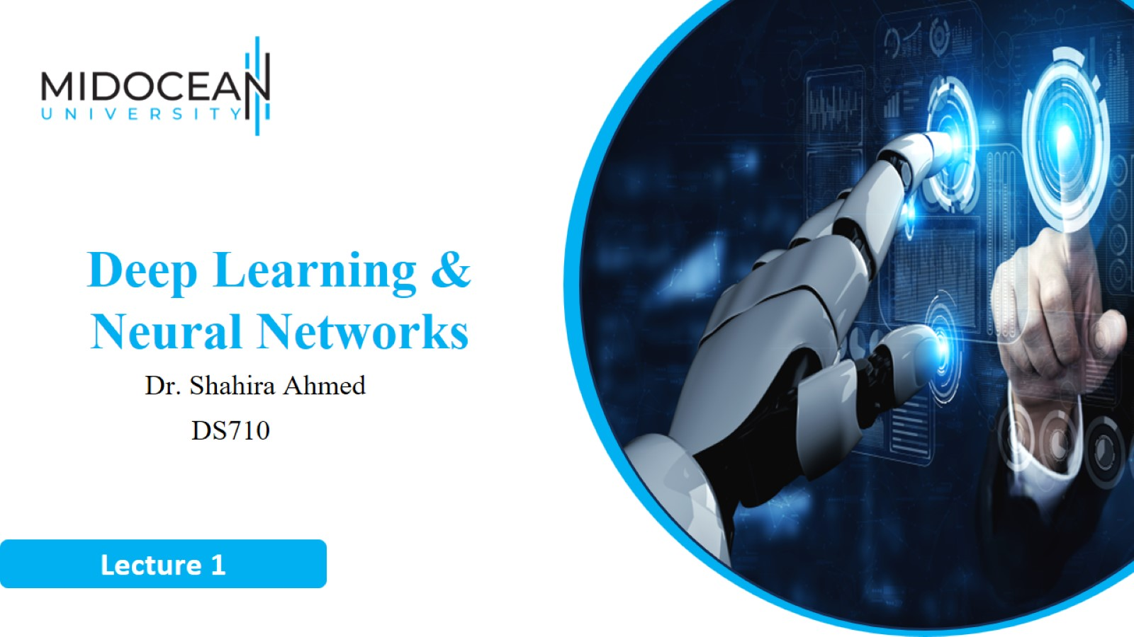

Slide 2
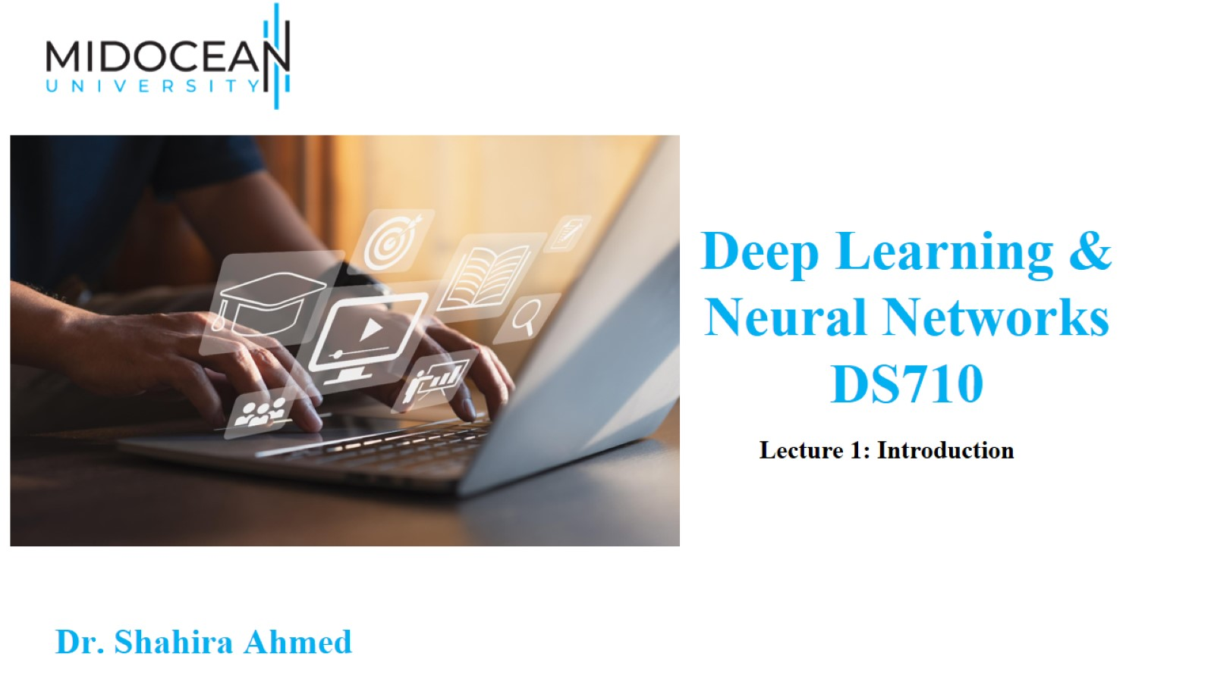

Slide 3
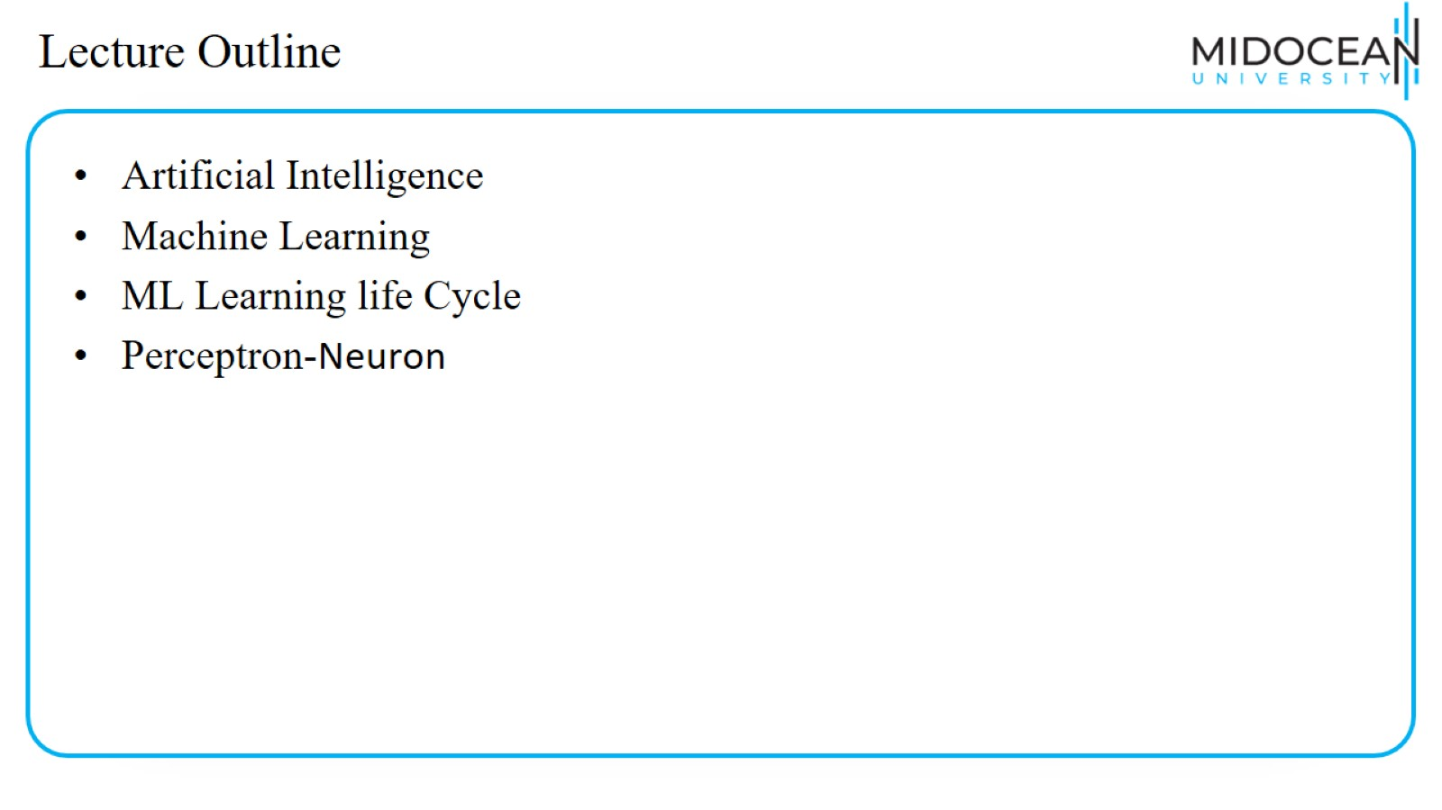
Lecture Outline

Slide 4
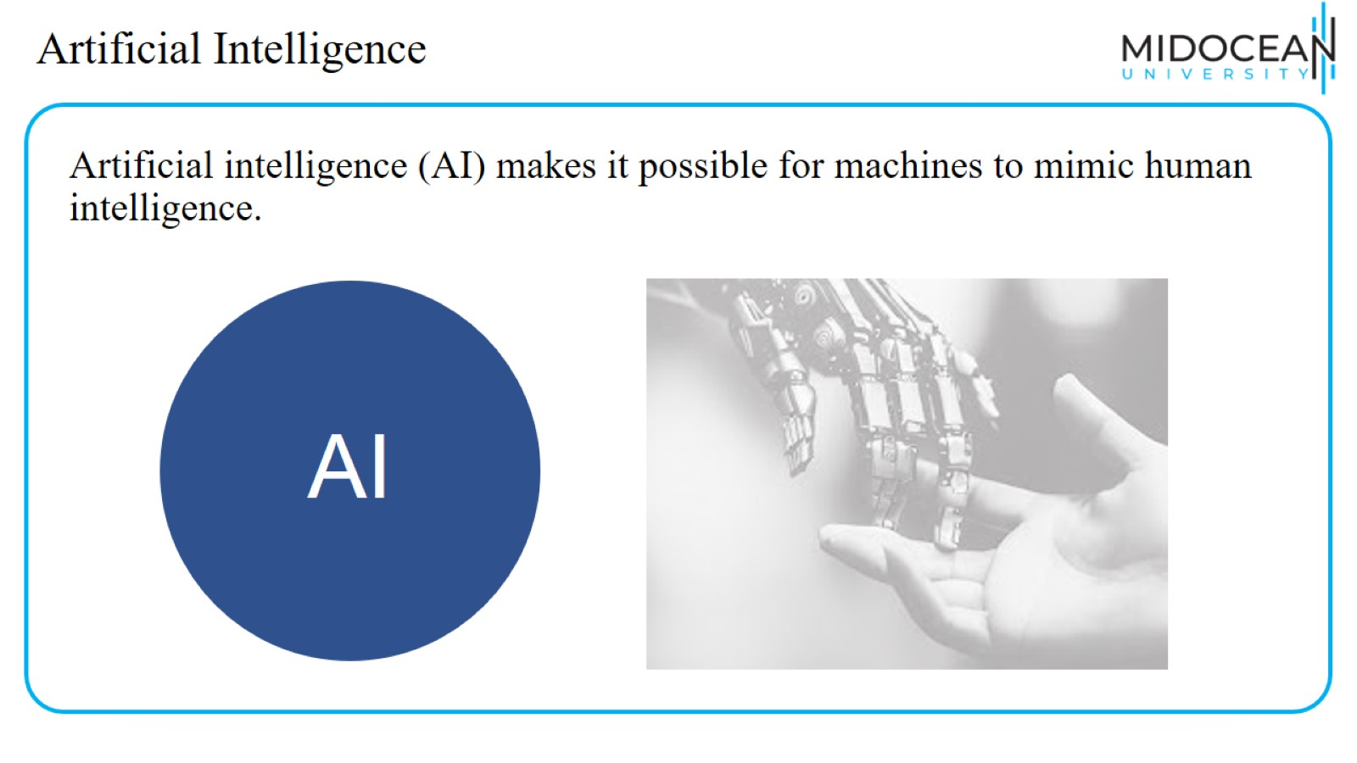
Artificial Intelligence

Slide 5
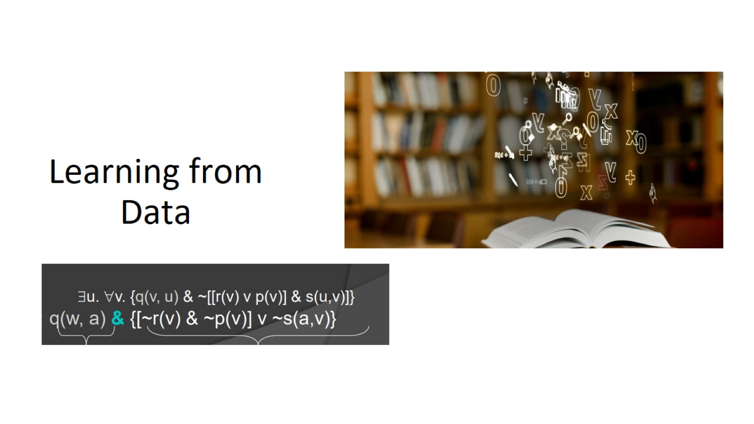
Learning from Data

Slide 6
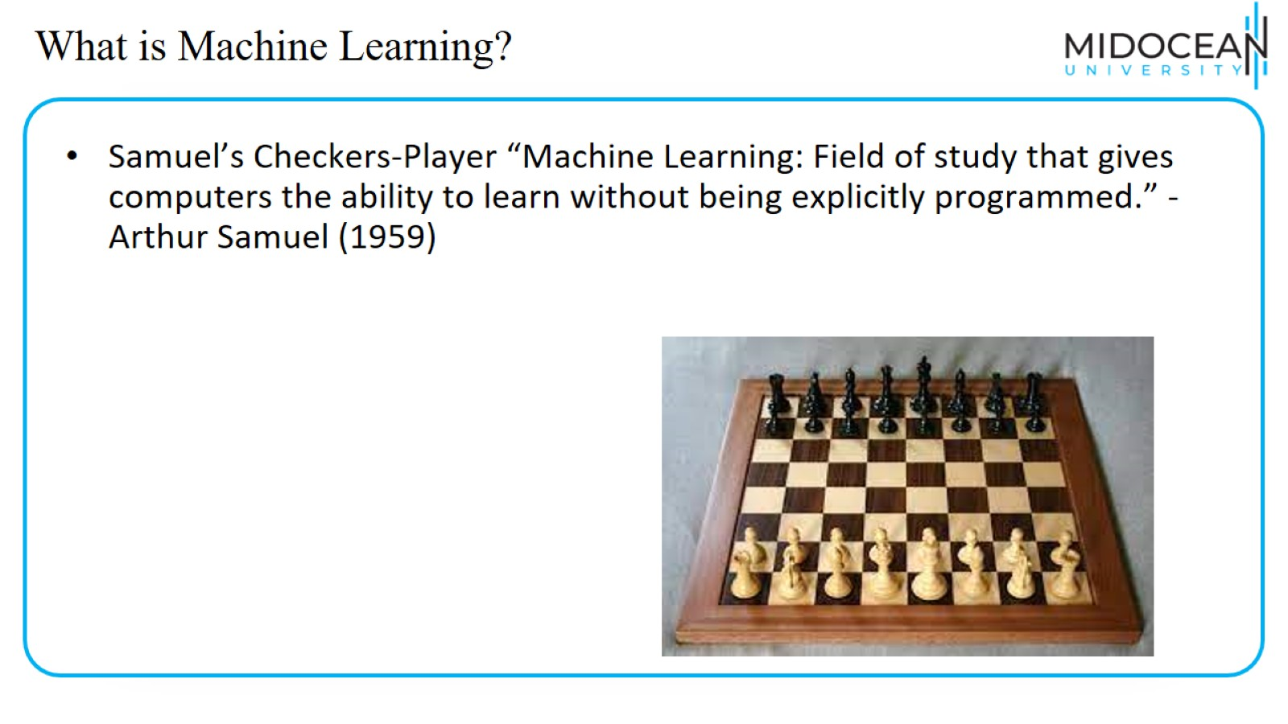
What is Machine Learning?

Slide 7
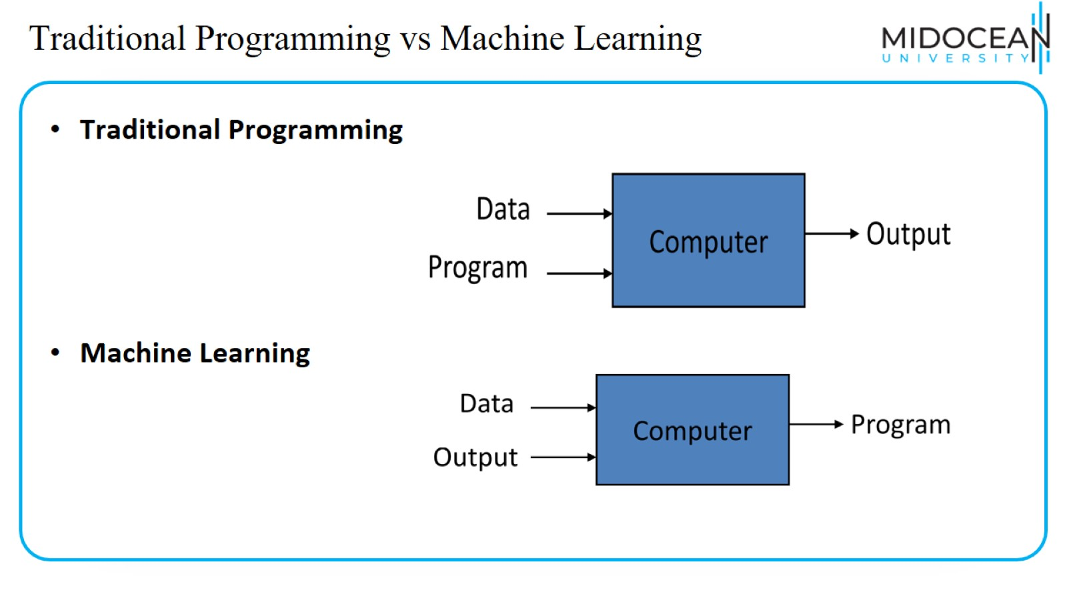
Traditional Programming vs Machine Learning

Slide 8
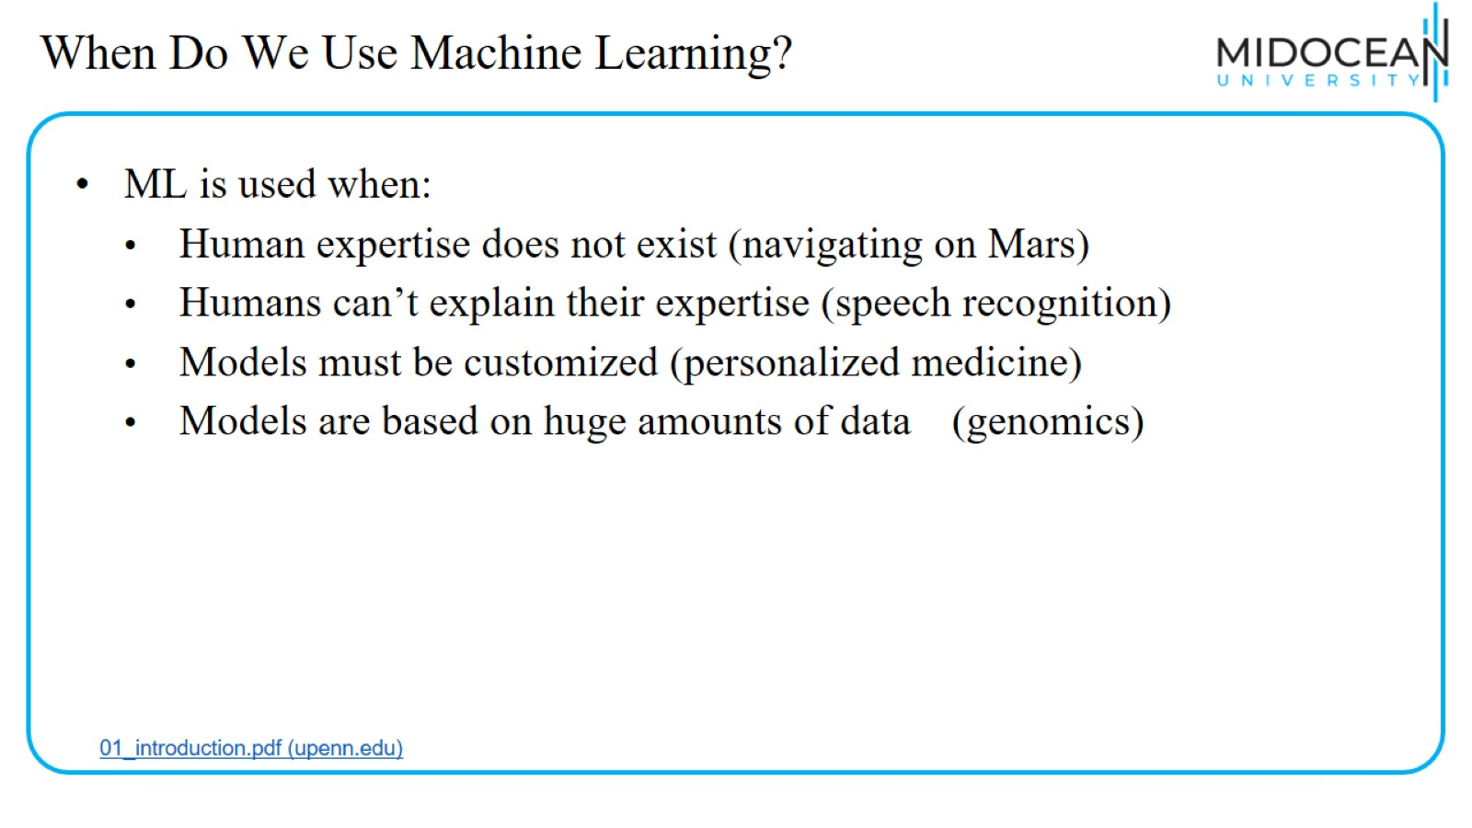
When Do We Use Machine Learning?

Slide 9
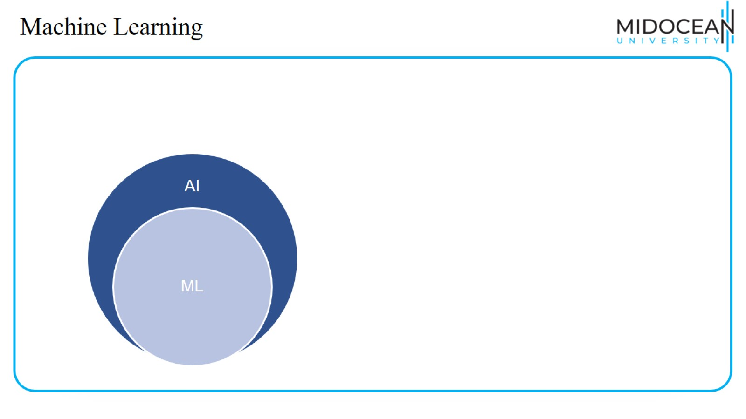
Machine Learning

Slide 10
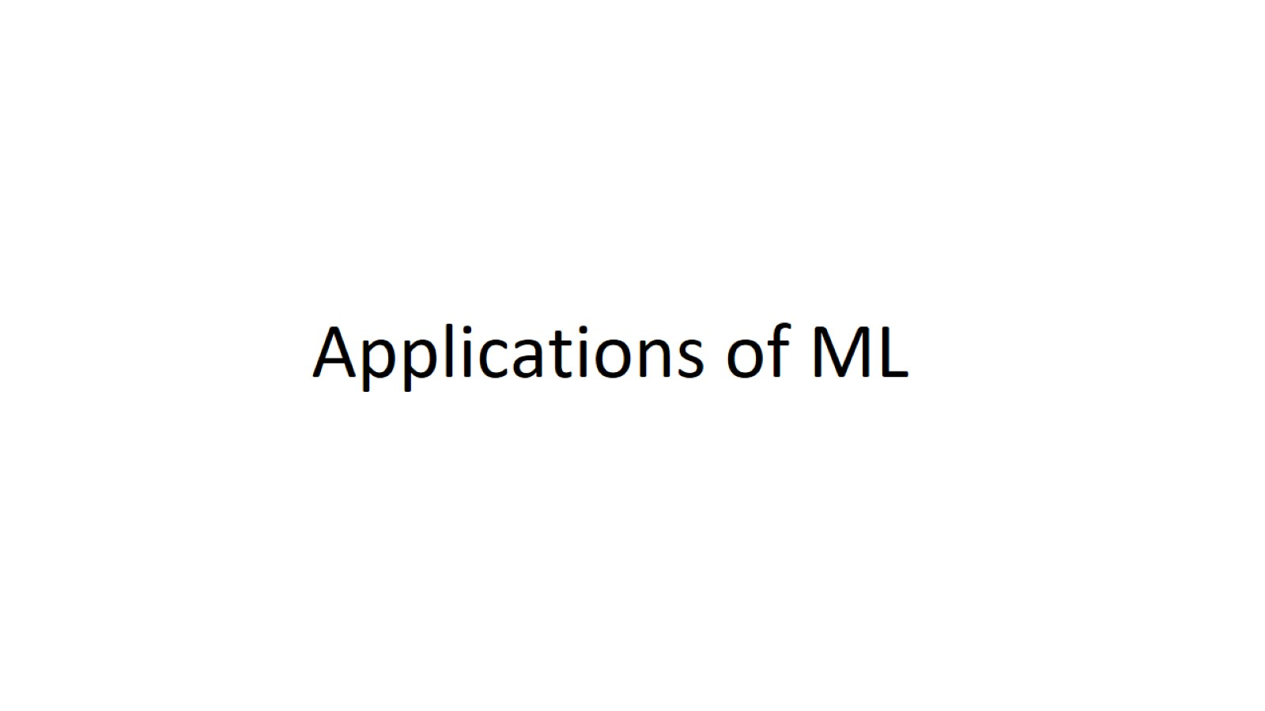
Applications of ML

Slide 11
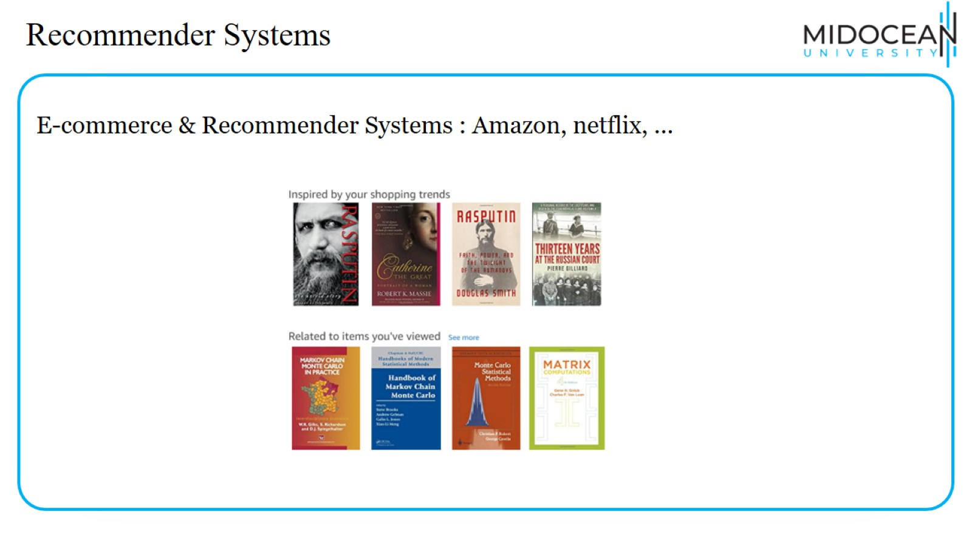
Recommender Systems

Slide 12
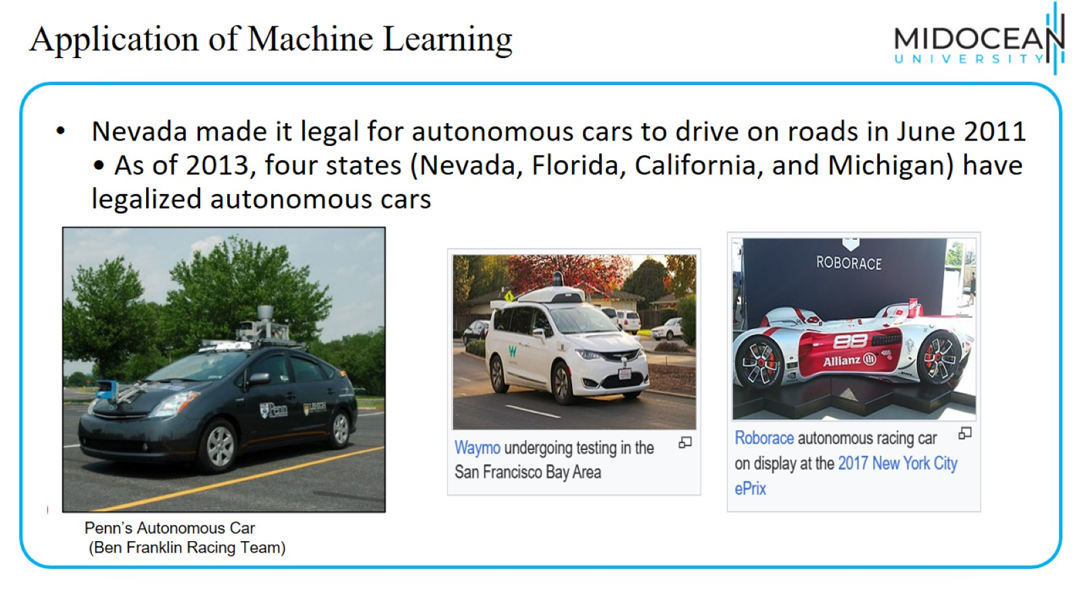
Application of Machine Learning

Slide 13
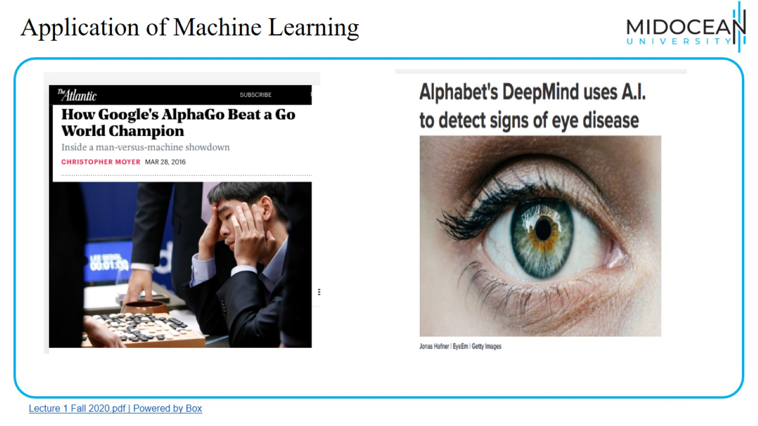
Application of Machine Learning

Slide 14

Application of Machine Learning

Slide 15
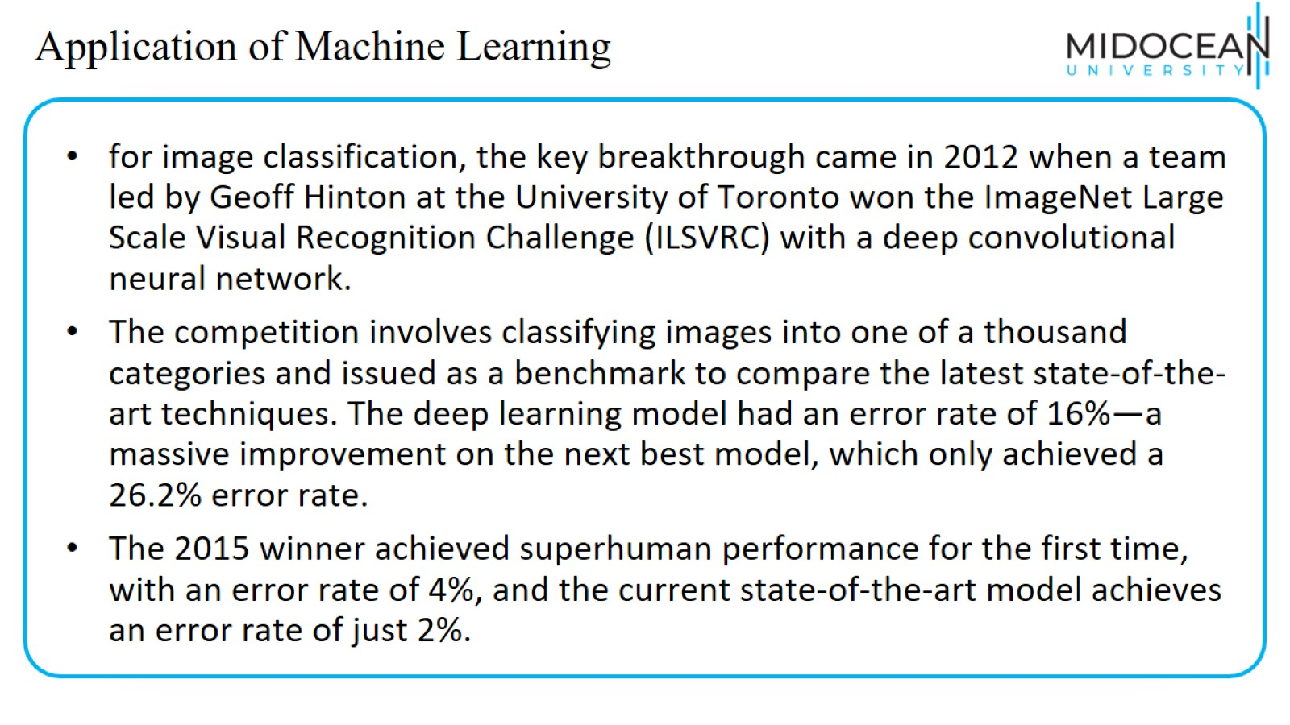
Application of Machine Learning

Slide 16
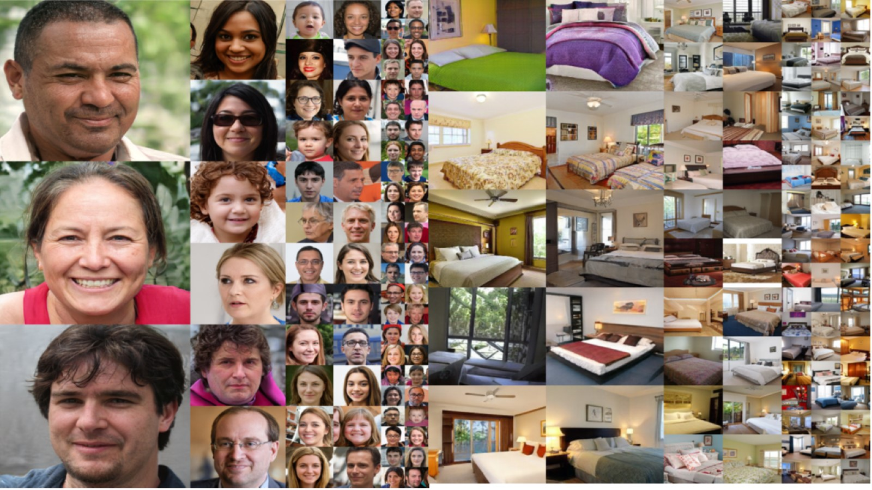

Slide 17
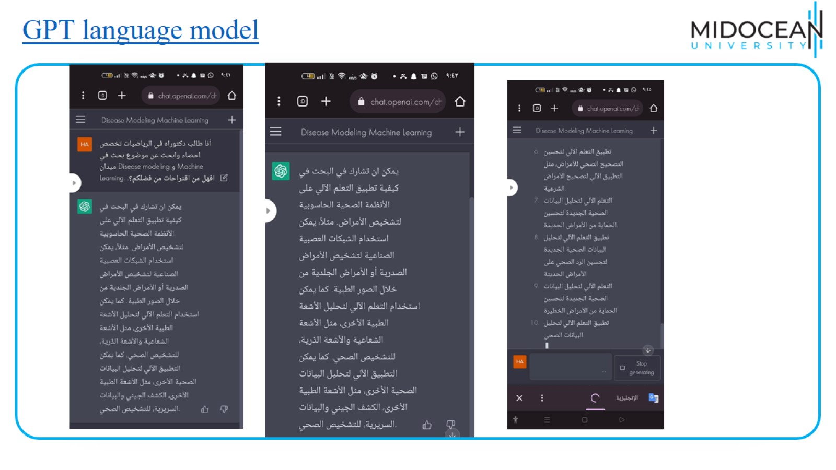
GPT language model

Slide 18
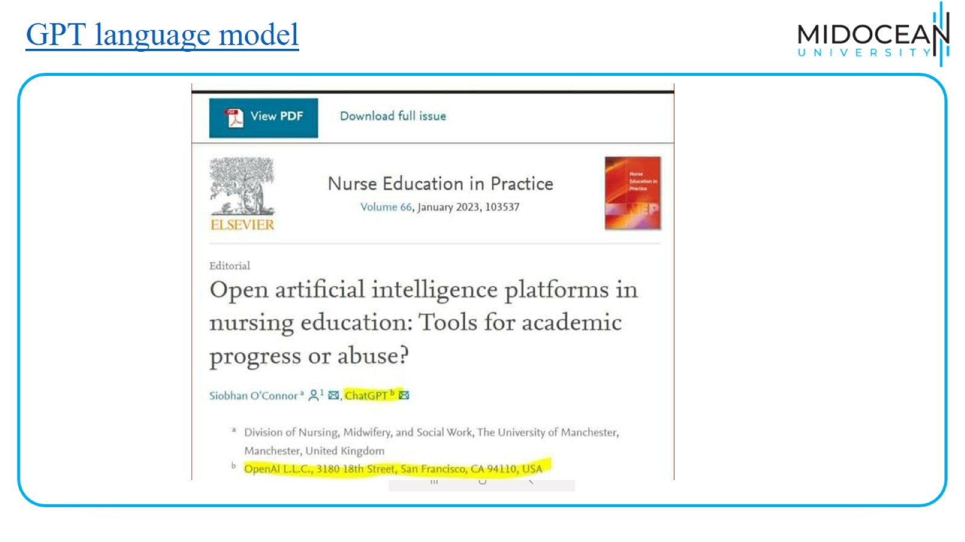
GPT language model

Slide 19
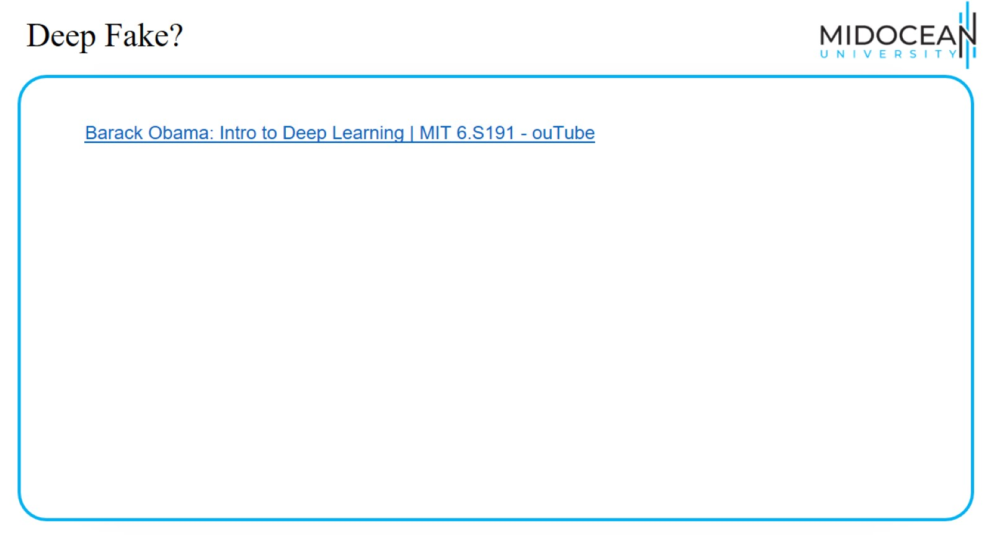
Deep Fake?

Slide 20
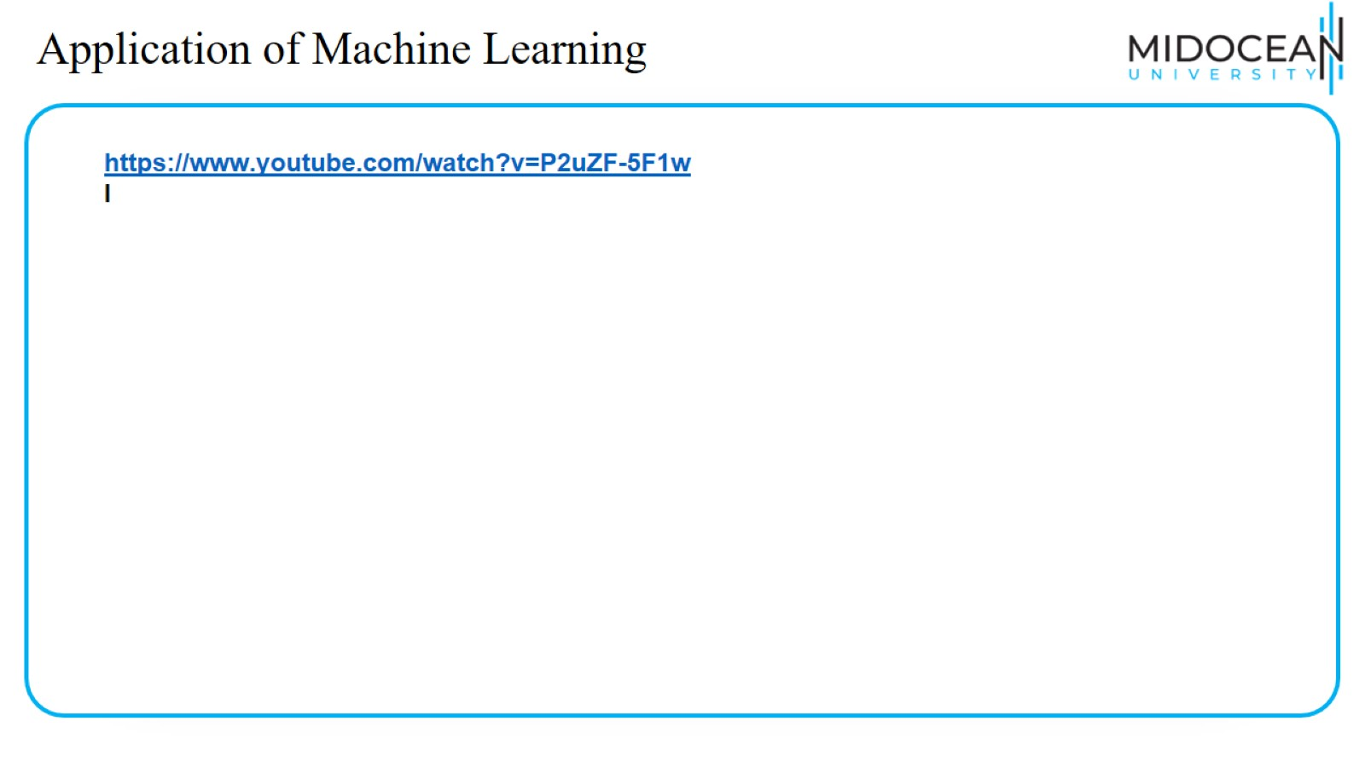
Application of Machine Learning

Slide 21
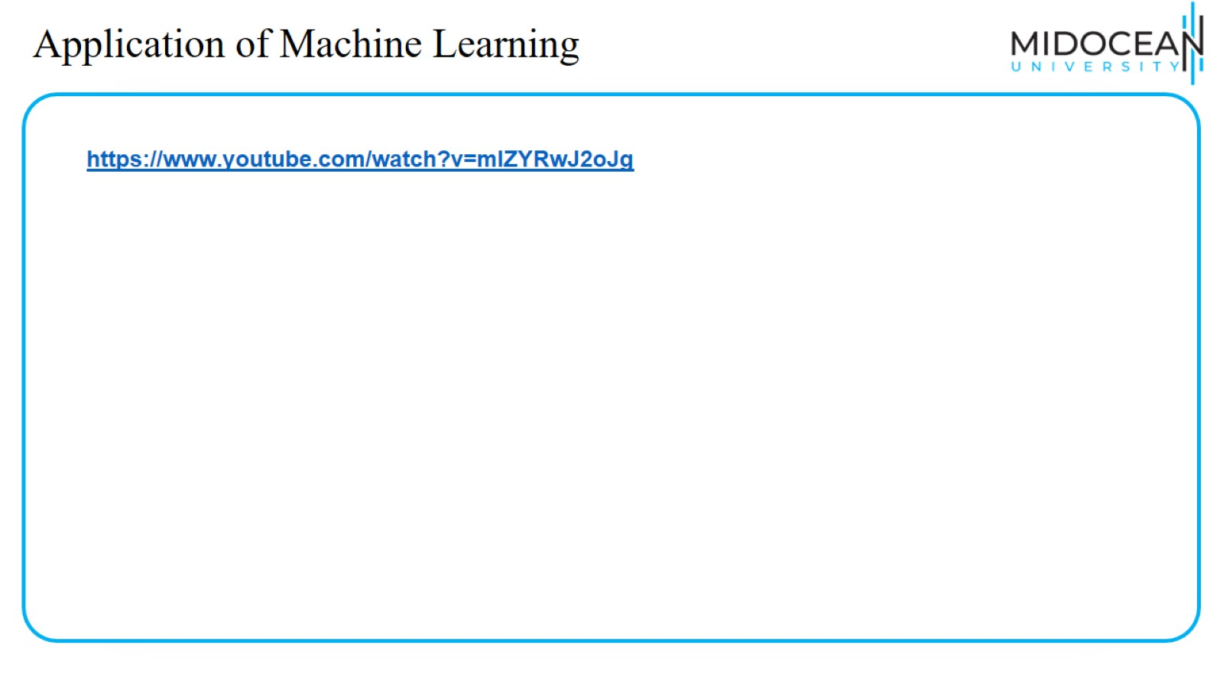
Application of Machine Learning

Slide 22
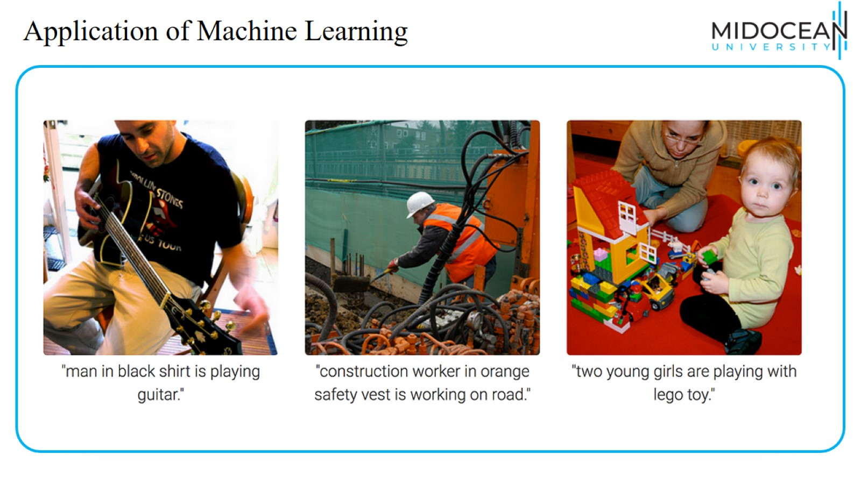
Application of Machine Learning

Slide 23
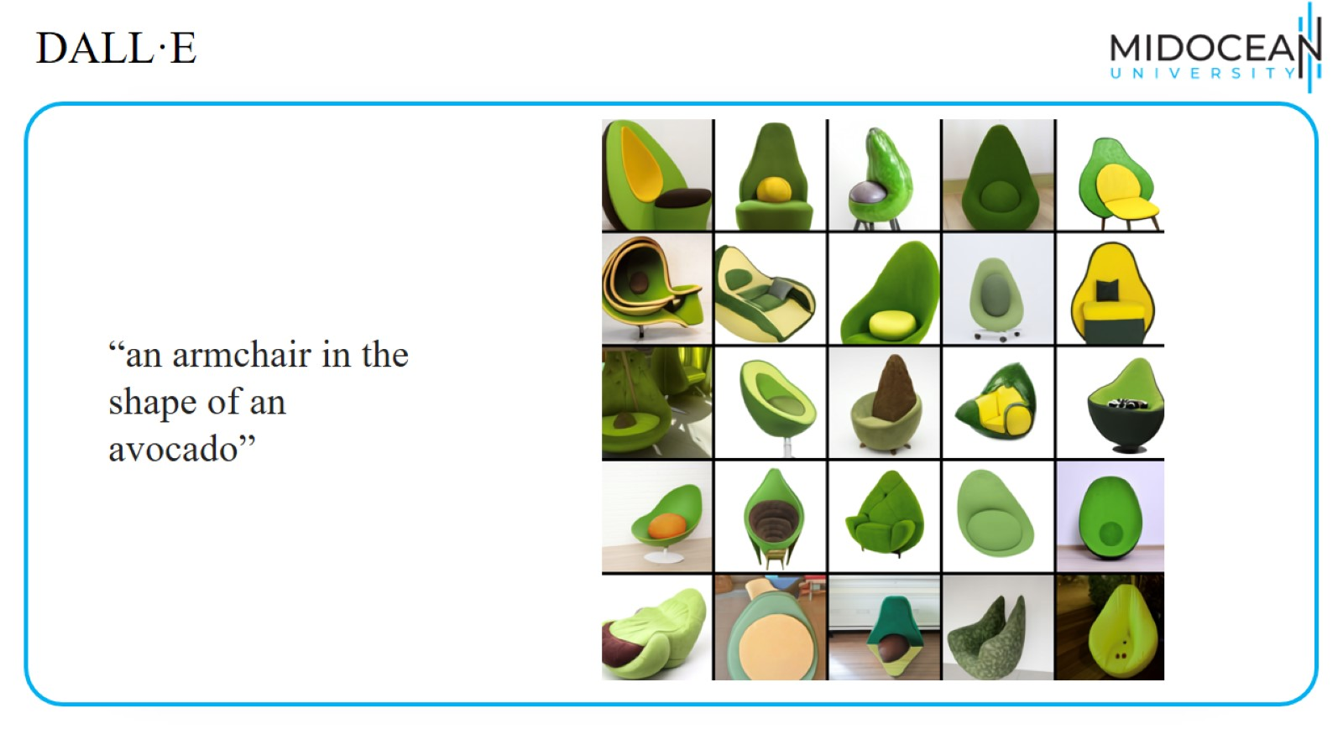
DALL·E

Slide 24
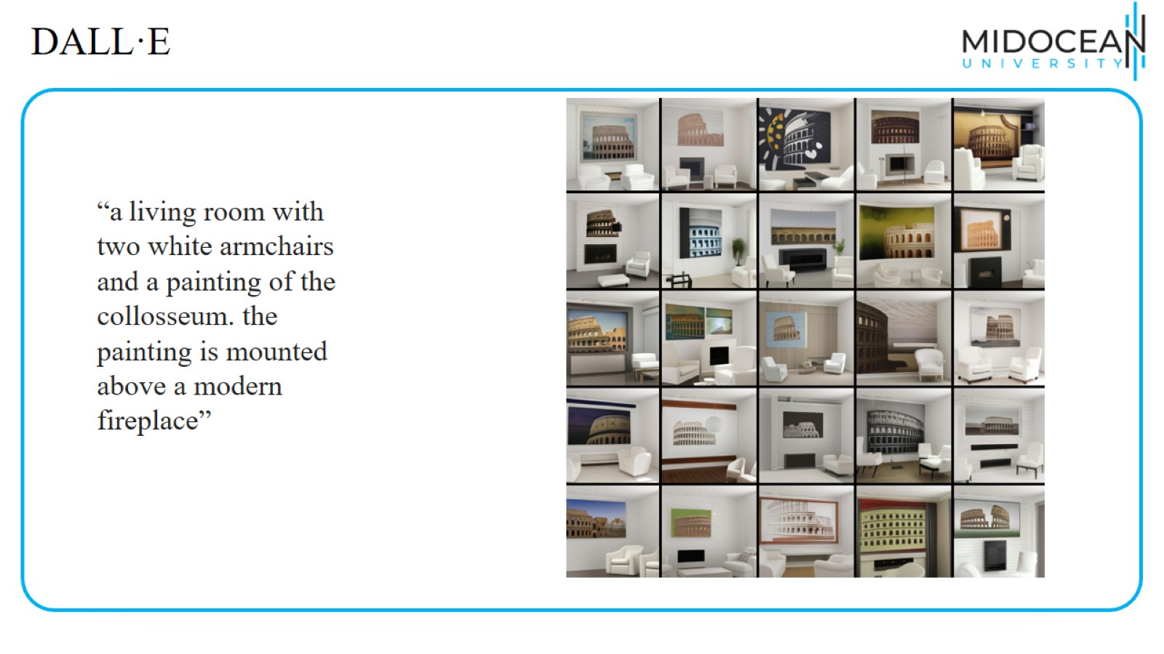
DALL·E

Slide 25
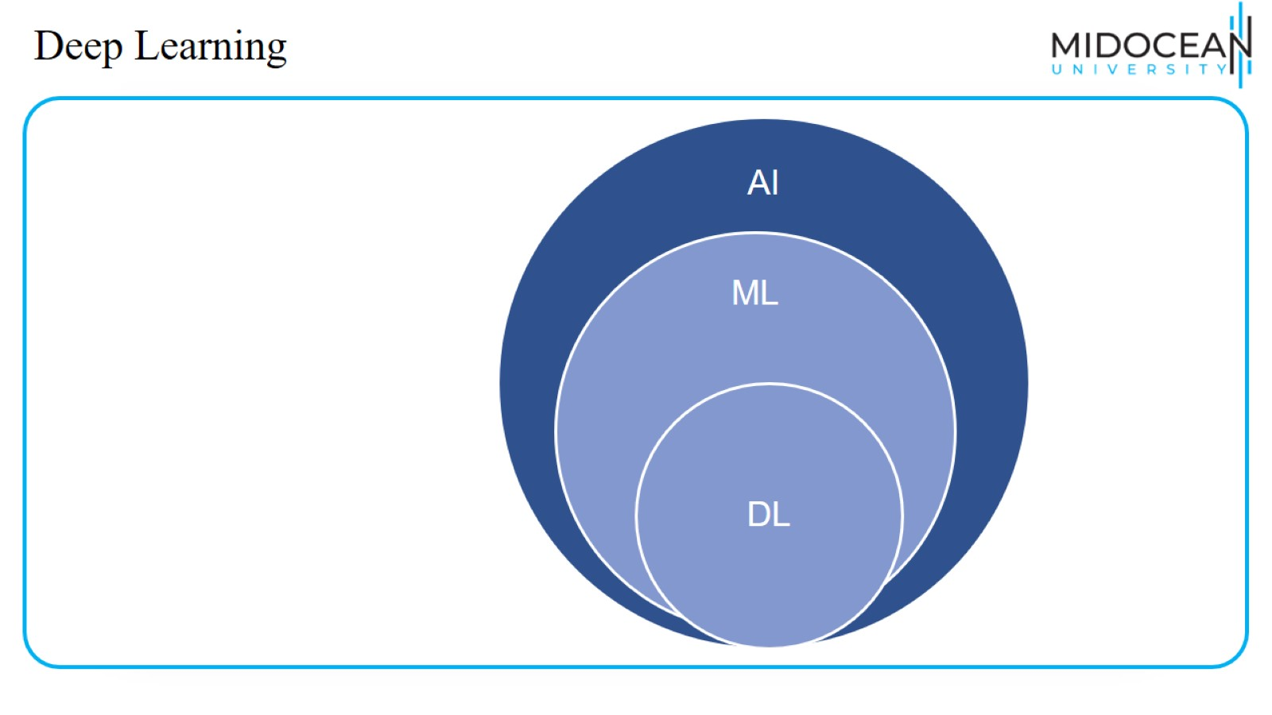
Deep Learning

Slide 26
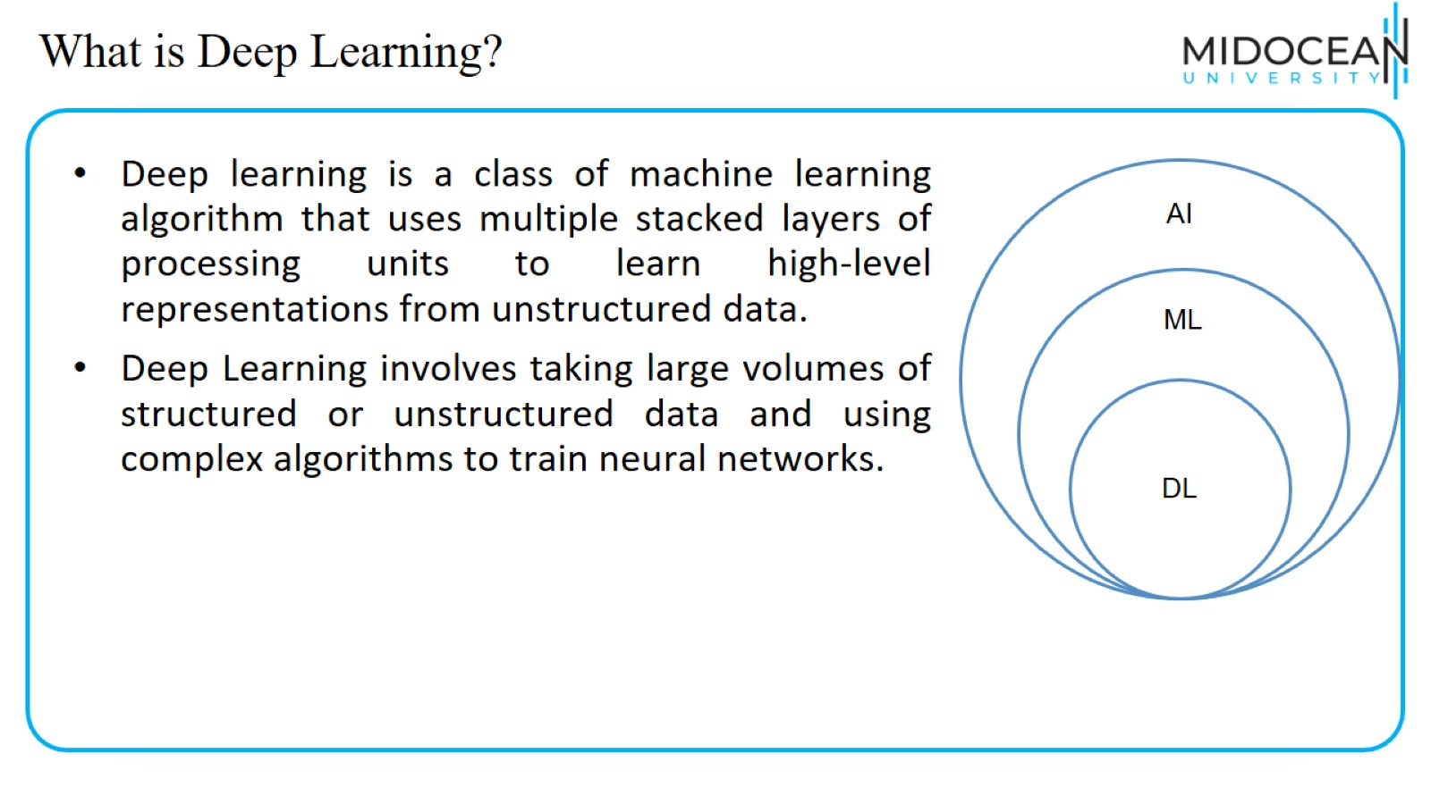
What is Deep Learning?

Slide 27
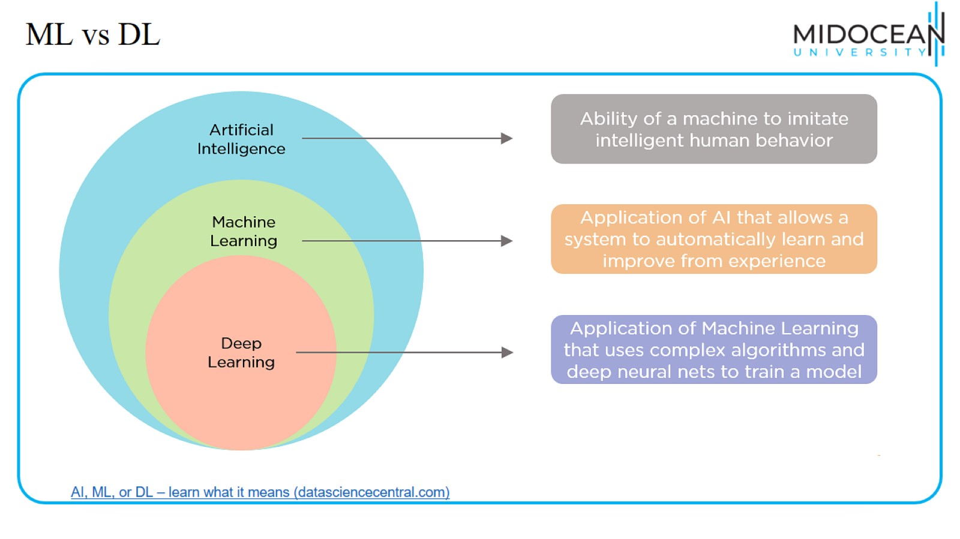
ML vs DL

Slide 28
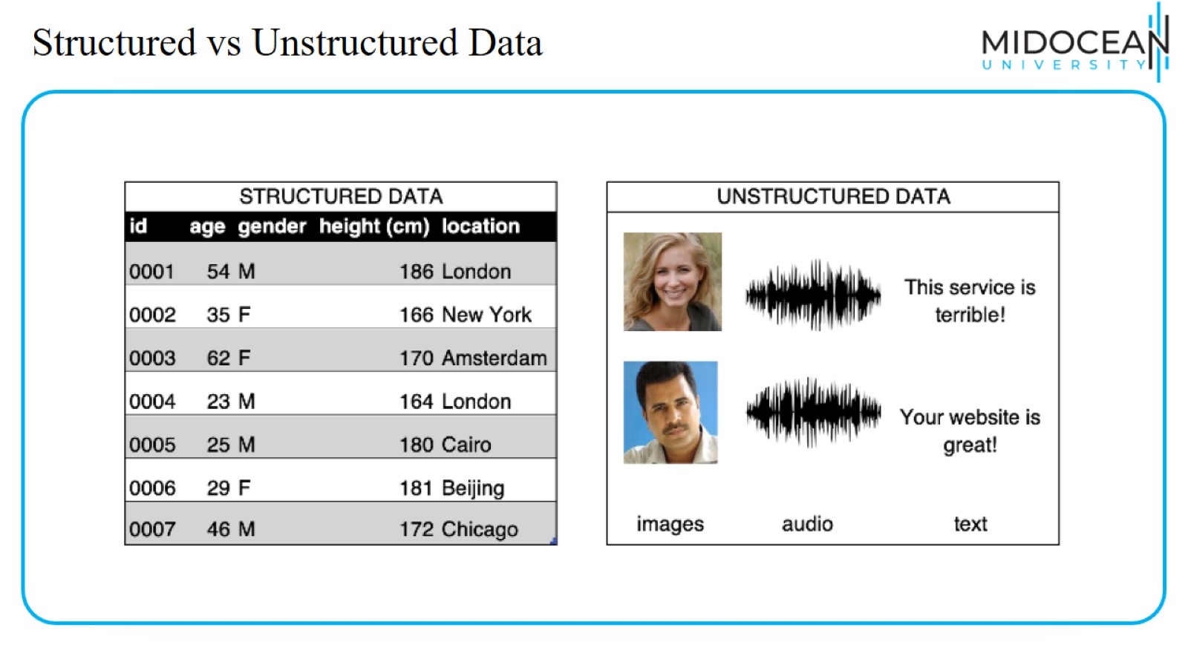
Structured vs Unstructured Data

Slide 29
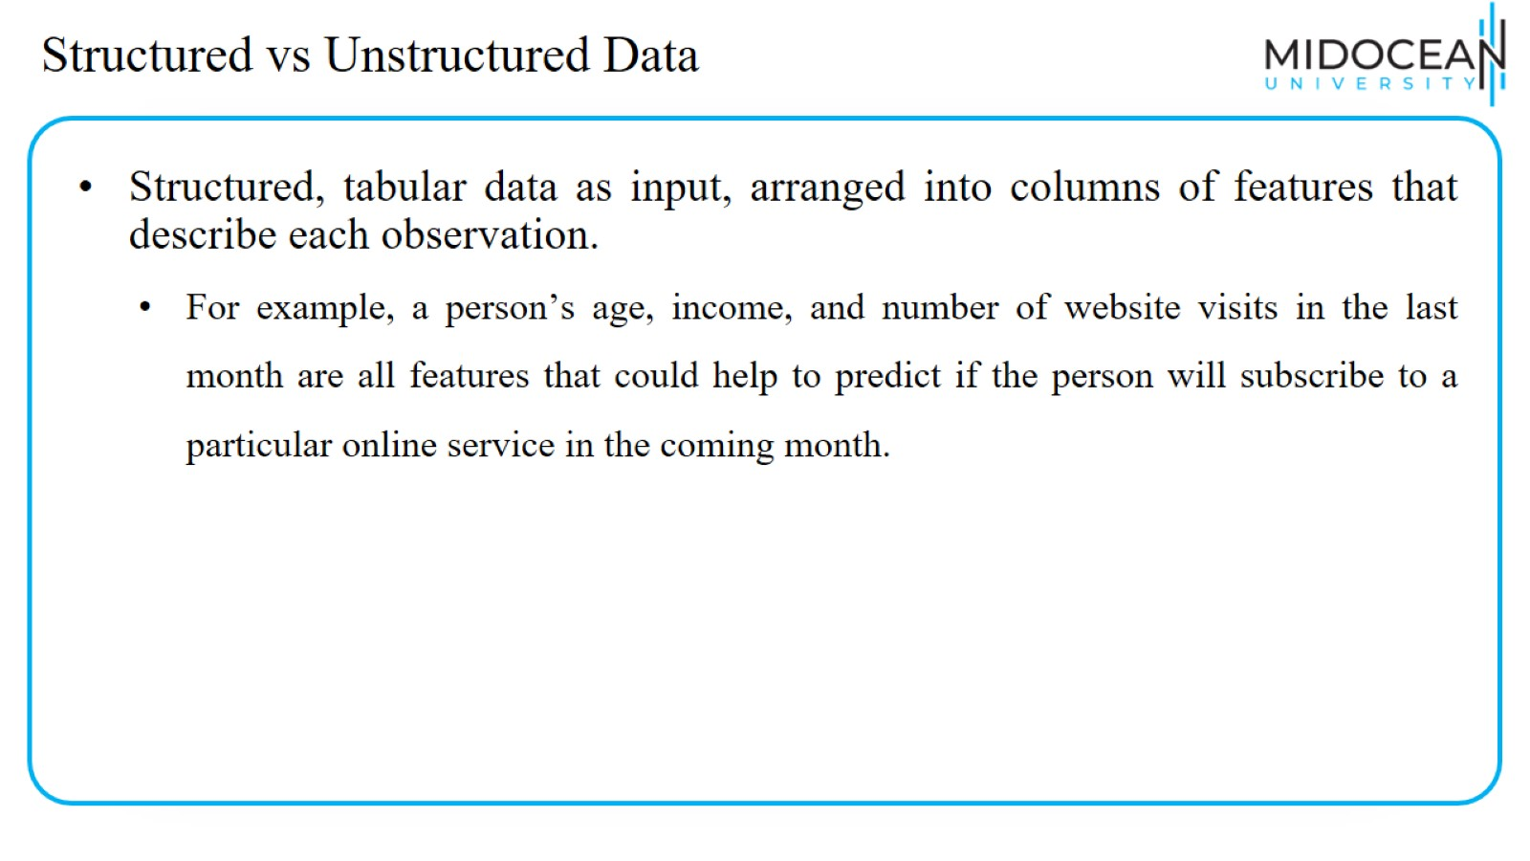
Structured vs Unstructured Data

Slide 30
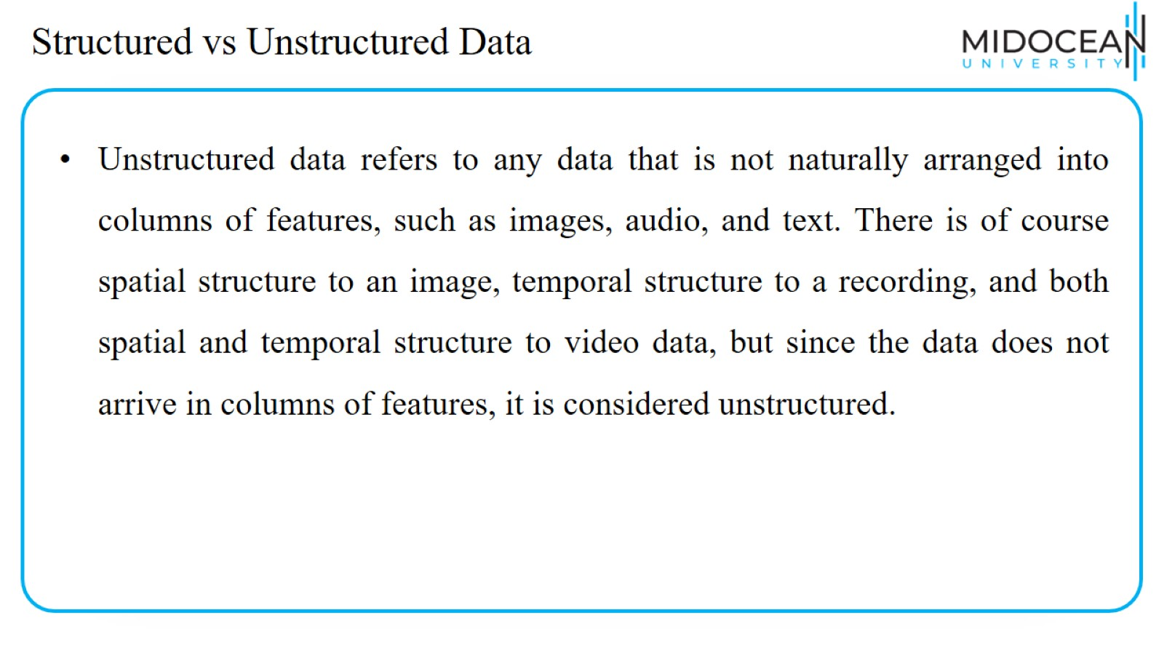
Structured vs Unstructured Data

Slide 31
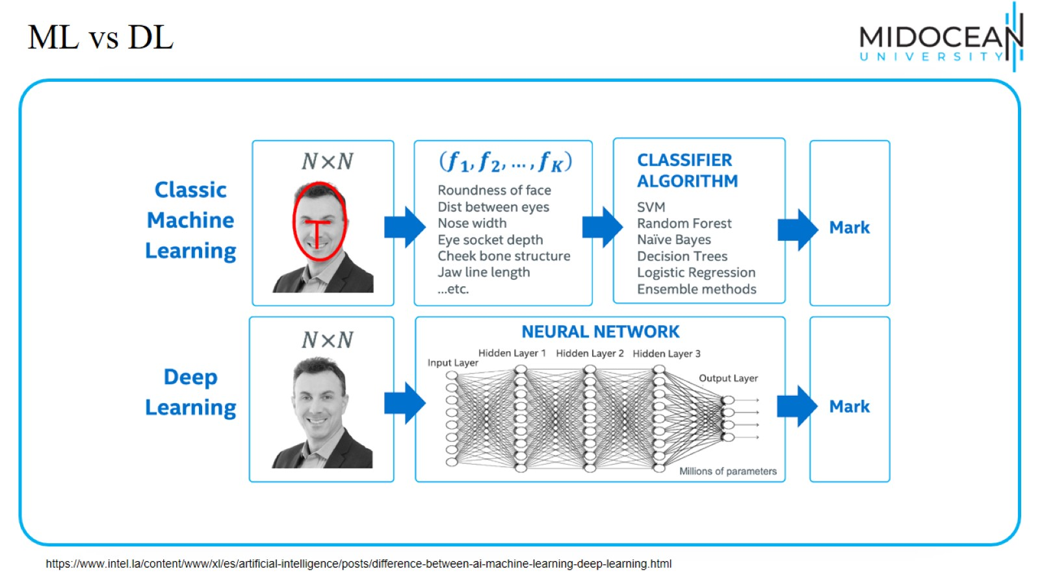
ML vs DL

Slide 32
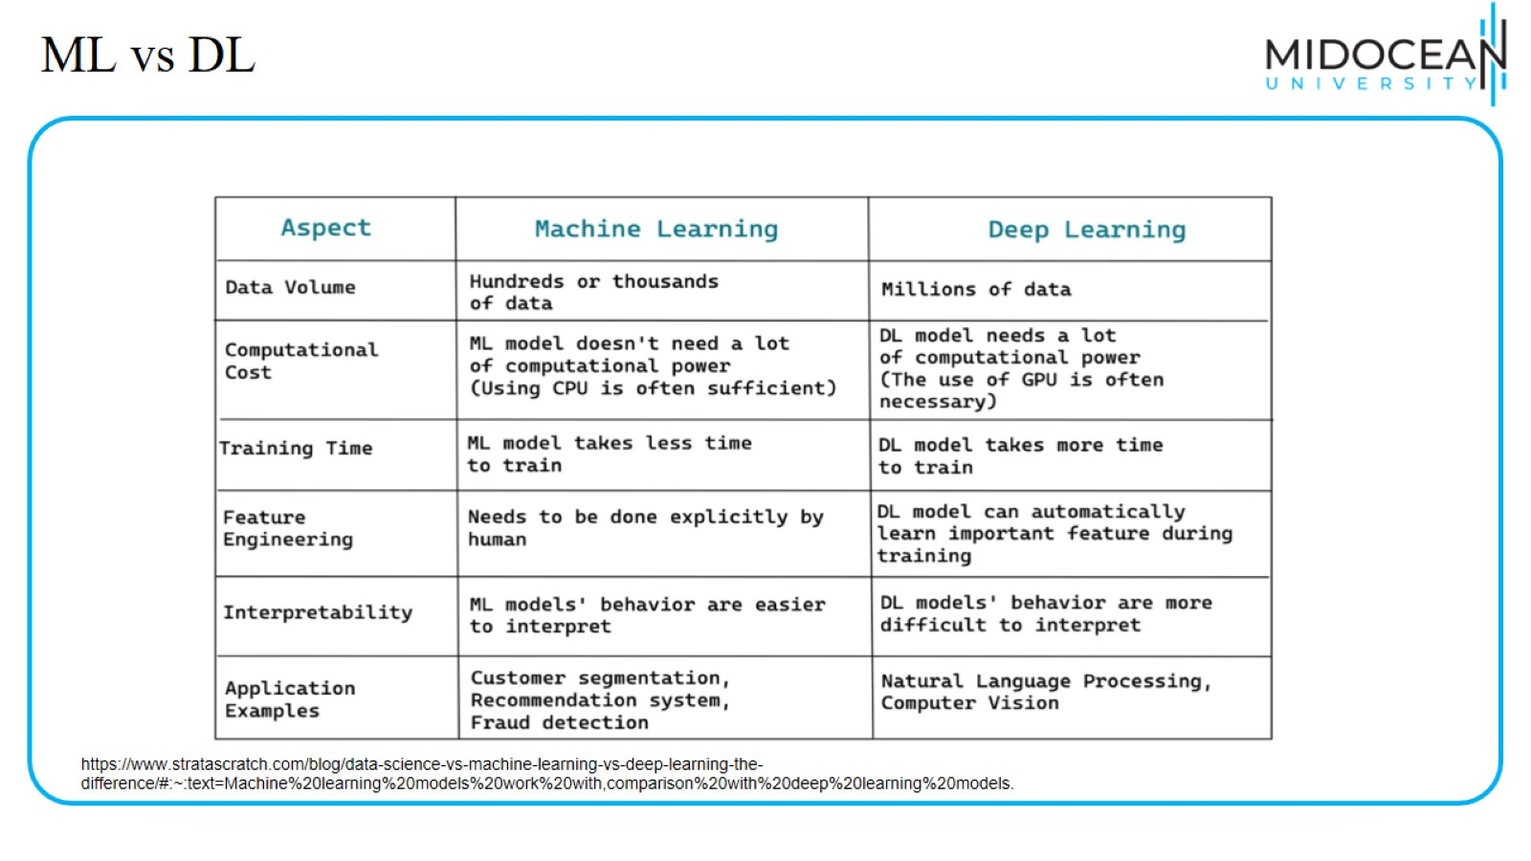
ML vs DL

Slide 33
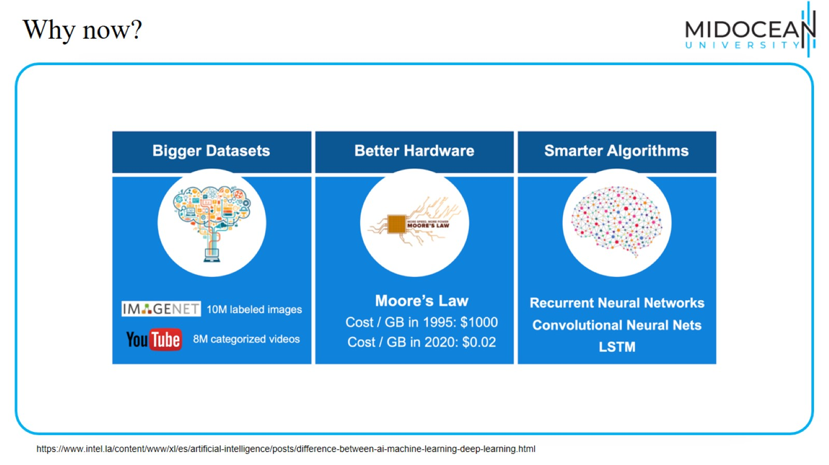
Why now?

Slide 34
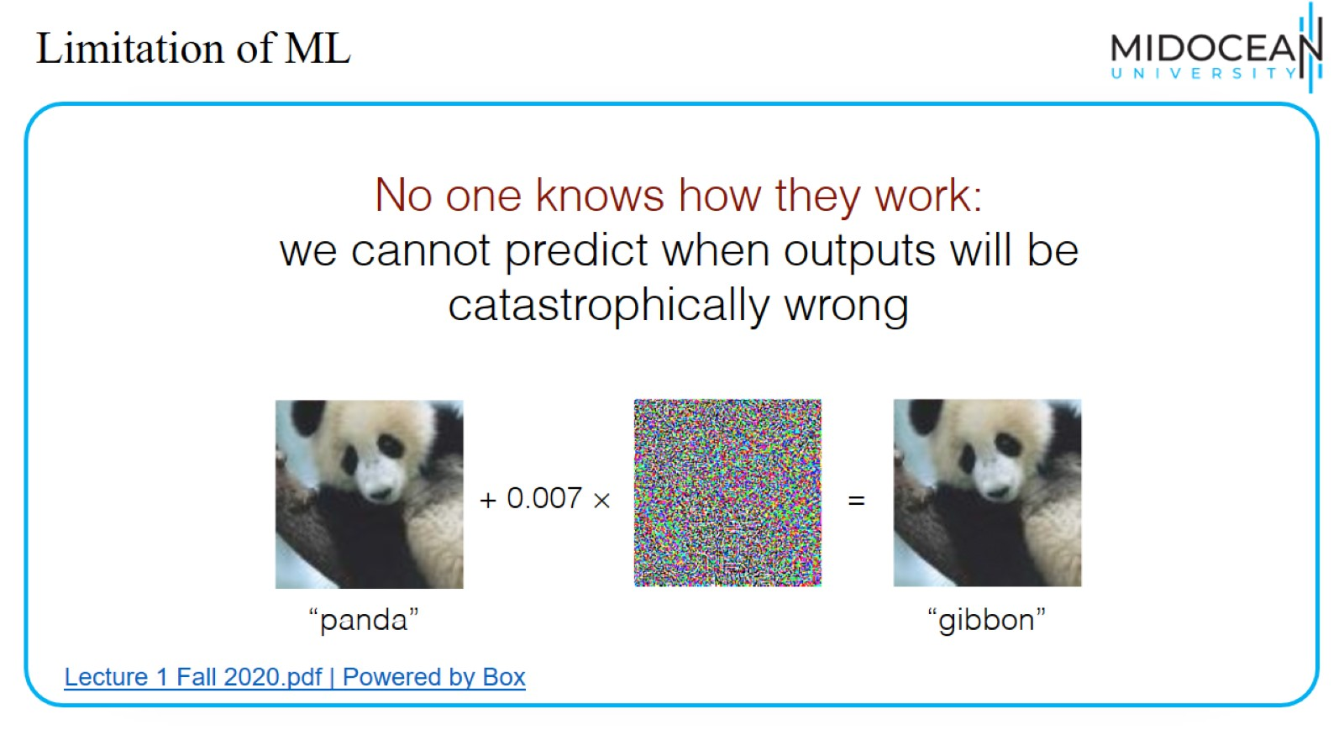
Limitation of ML

Slide 35
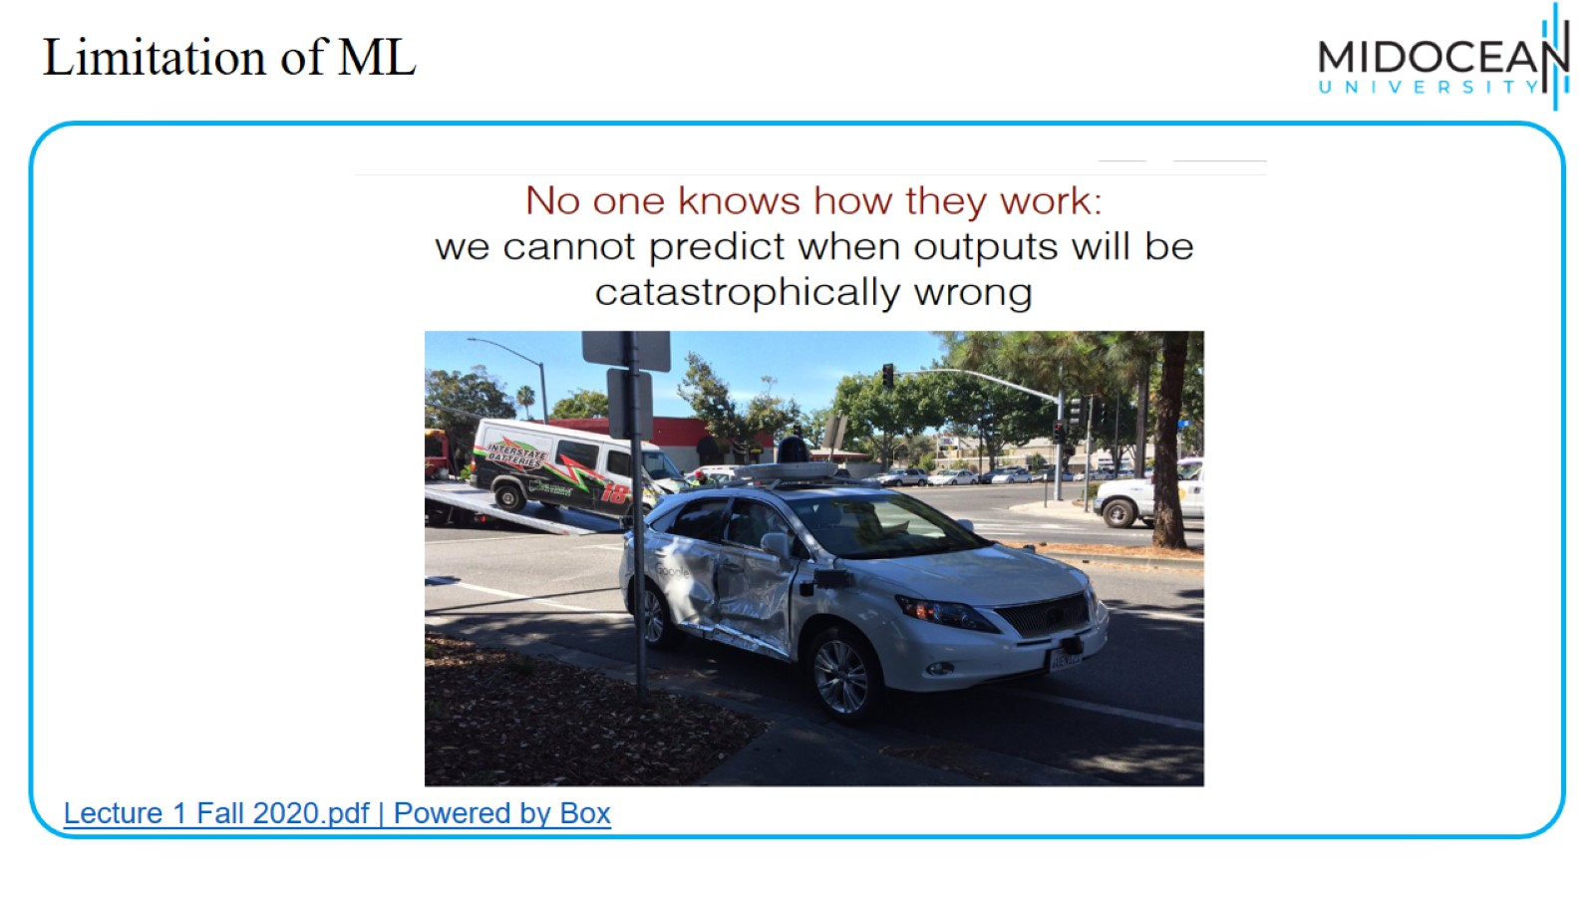
Limitation of ML

Slide 36
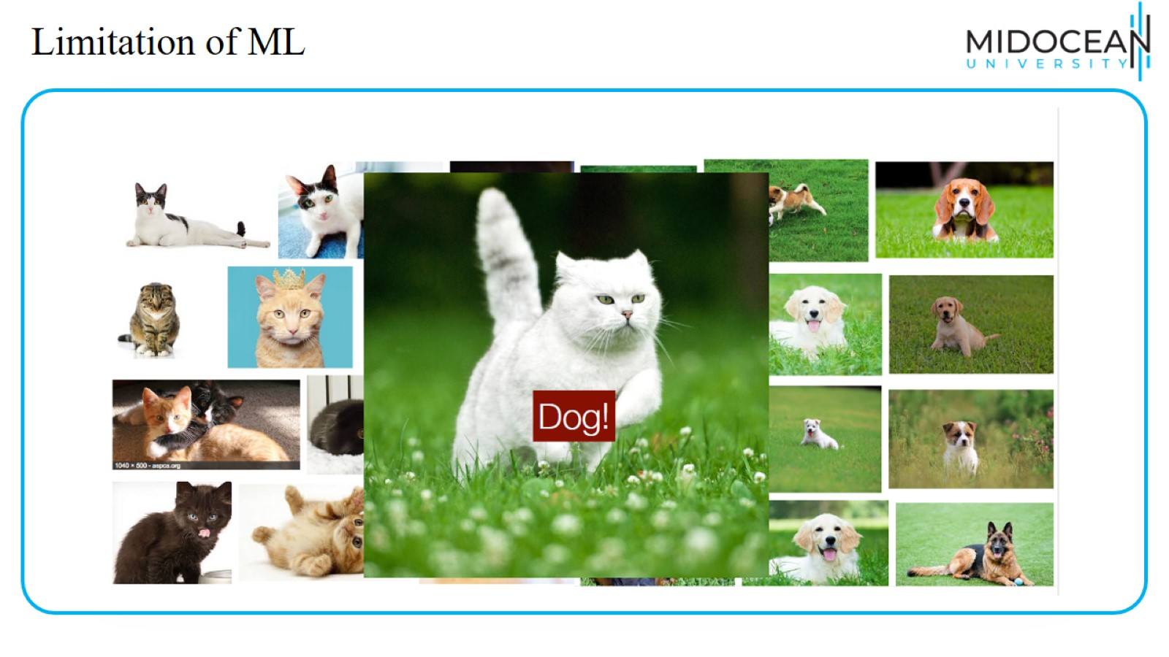
Limitation of ML

Slide 37
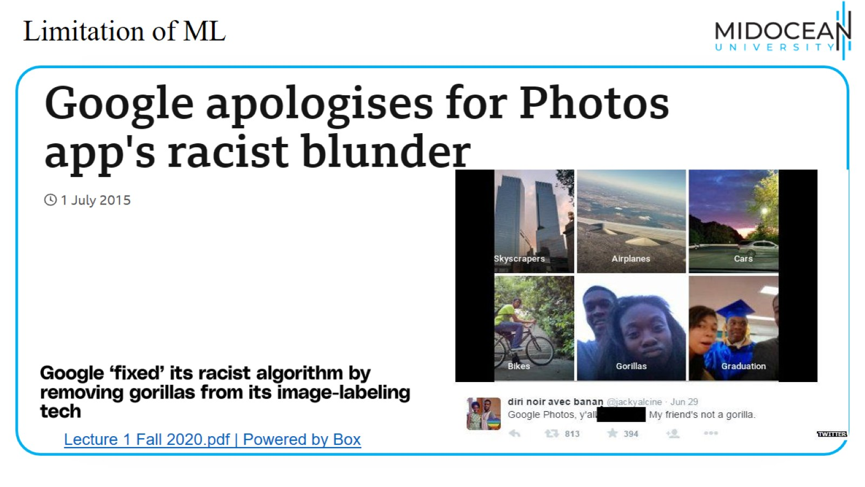
Limitation of ML

Slide 38
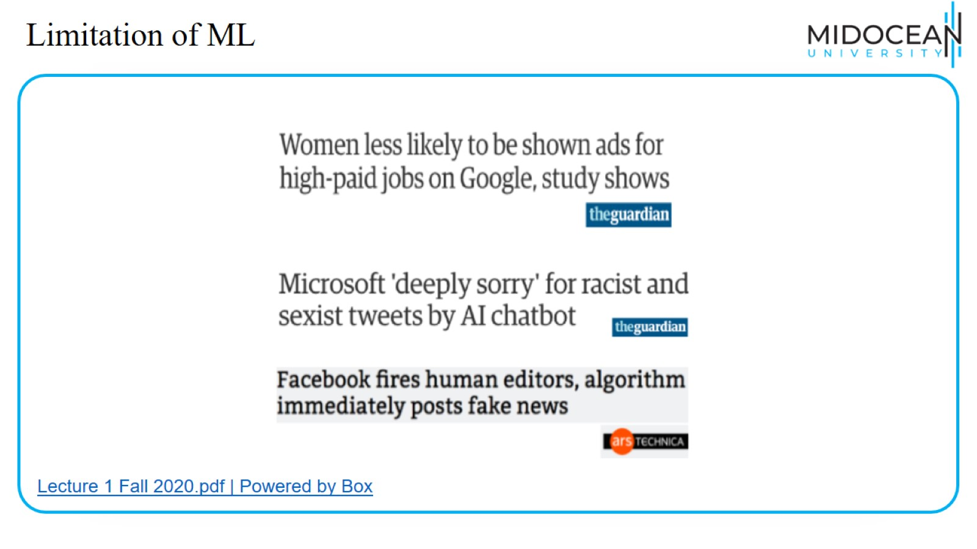
Limitation of ML

Slide 39
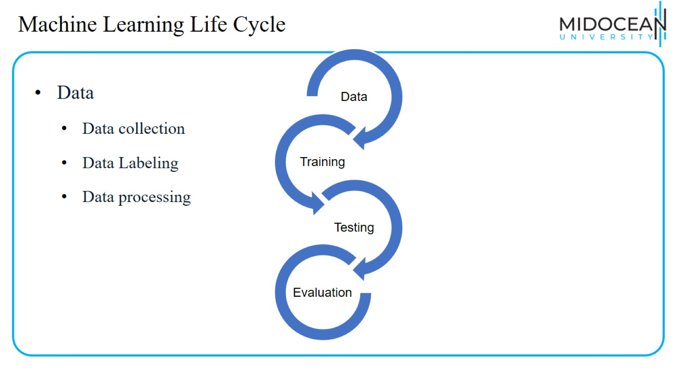
Machine Learning Life Cycle

Slide 40
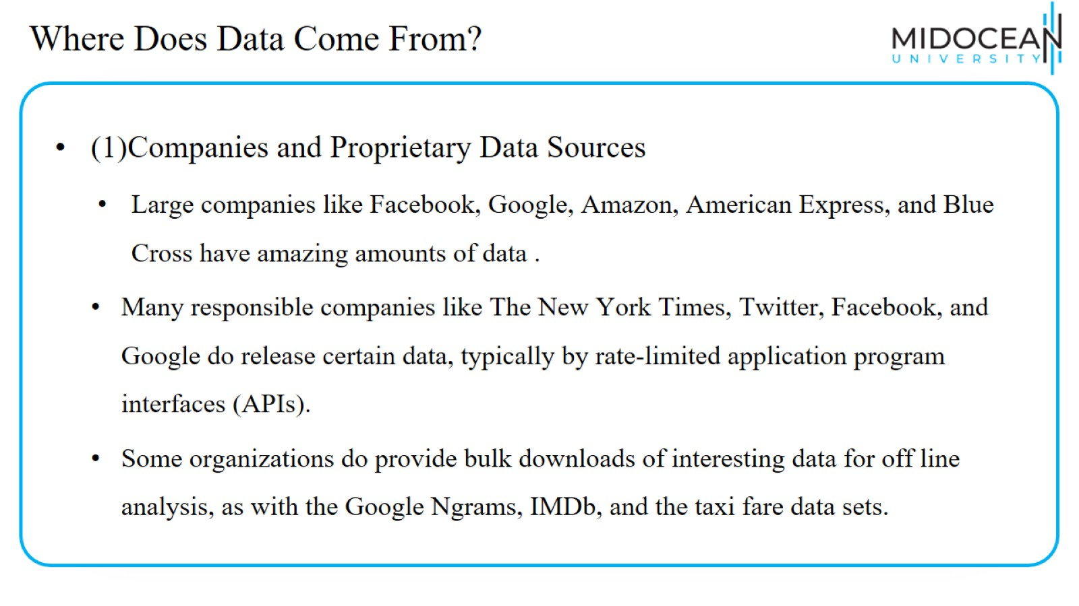
Where Does Data Come From?

Slide 41
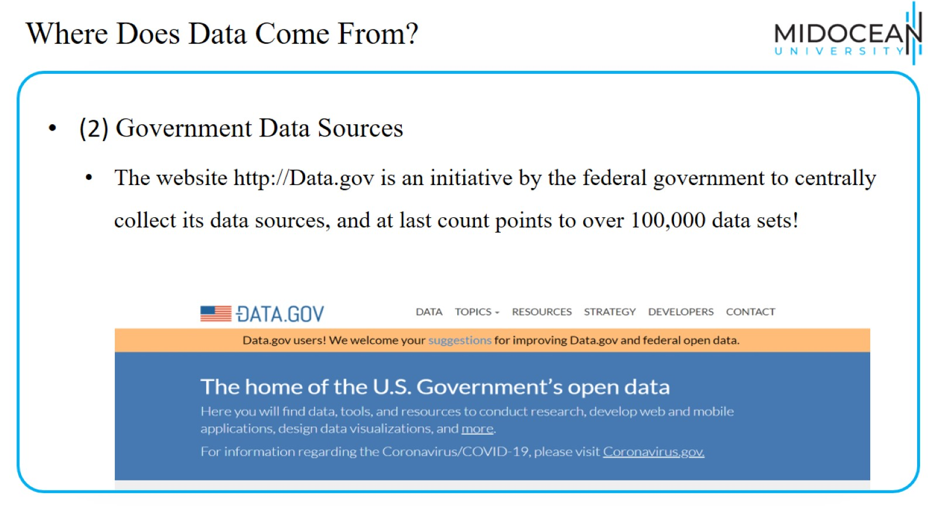
Where Does Data Come From?

Slide 42
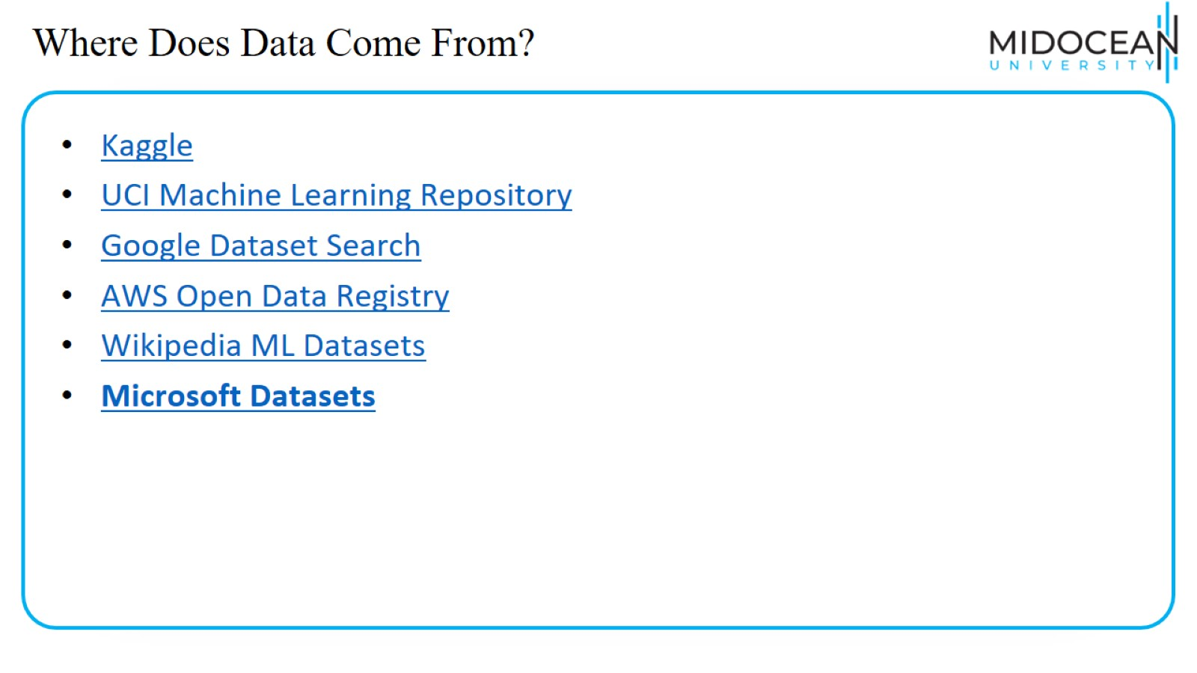
Where Does Data Come From?

Slide 43
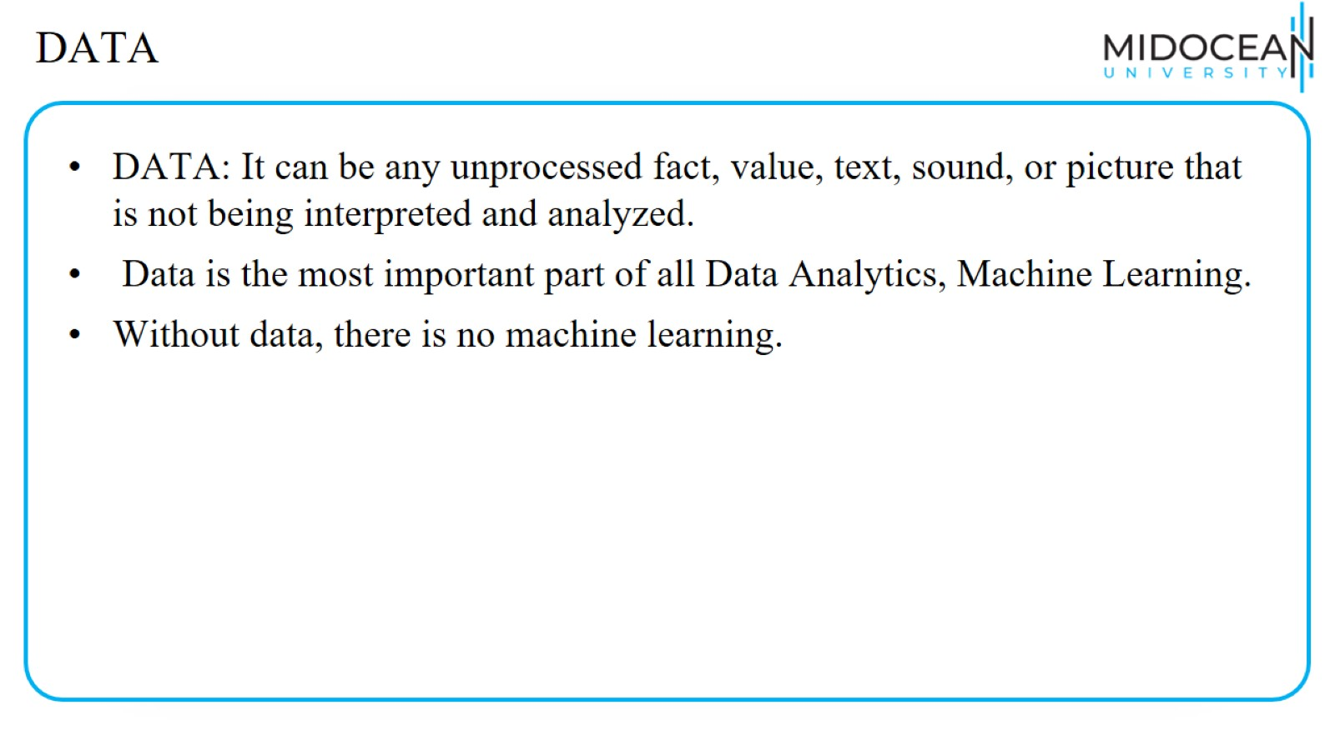
DATA

Slide 44
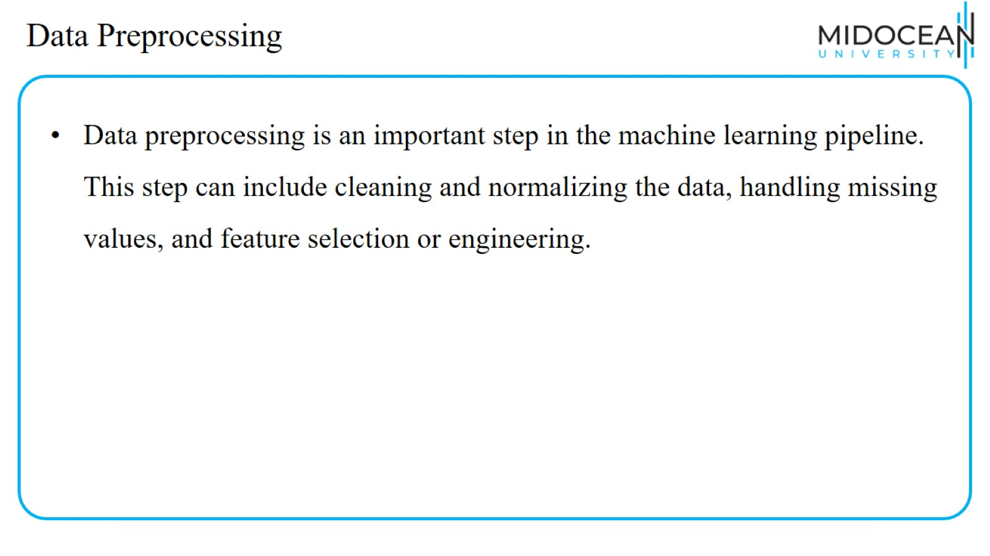
Data Preprocessing

Slide 45
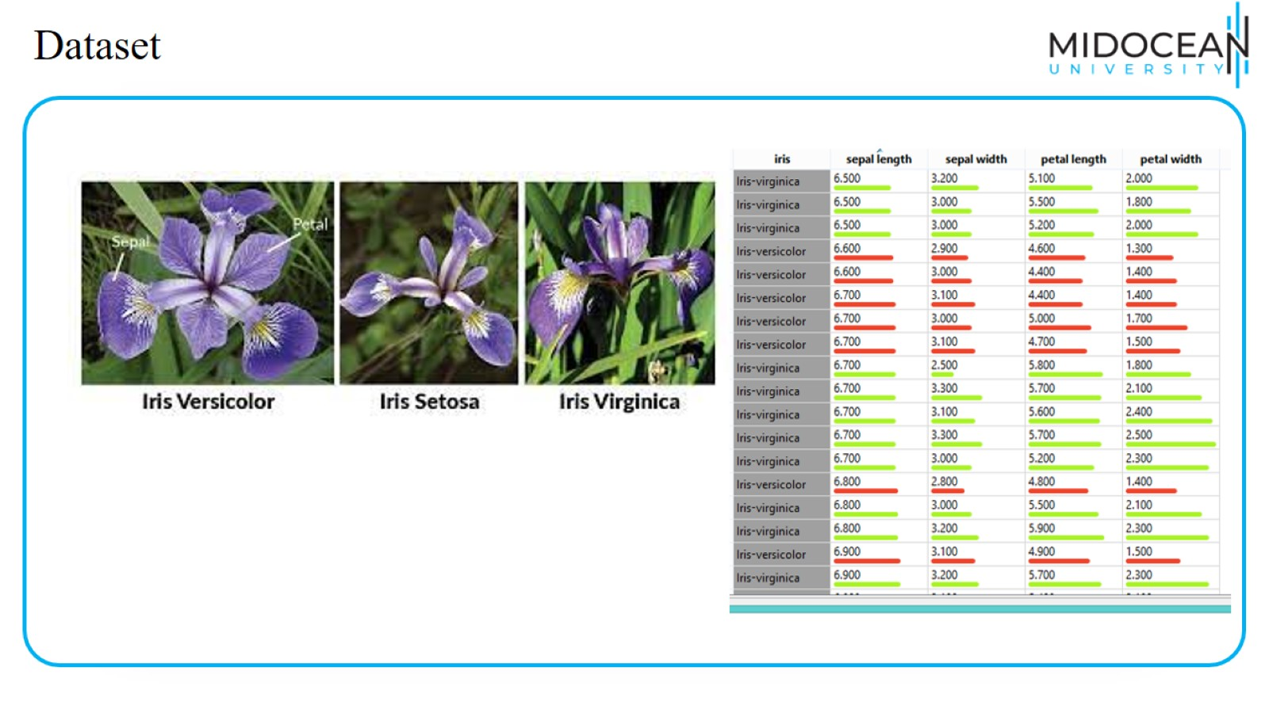
Dataset

Slide 46
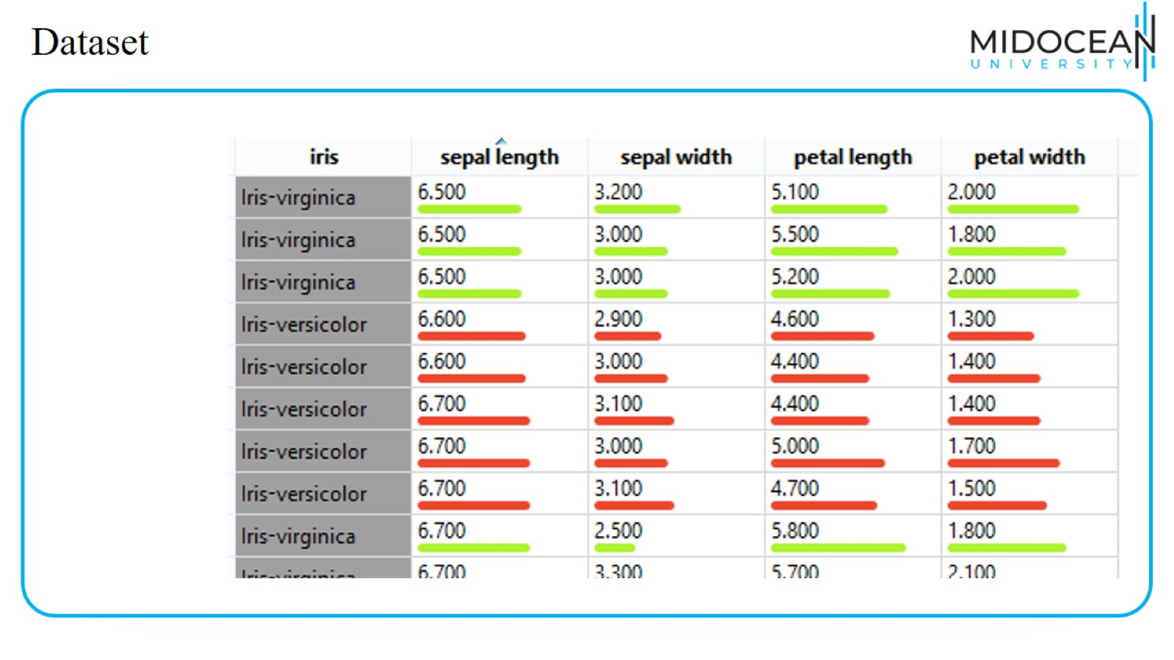
Dataset

Slide 47
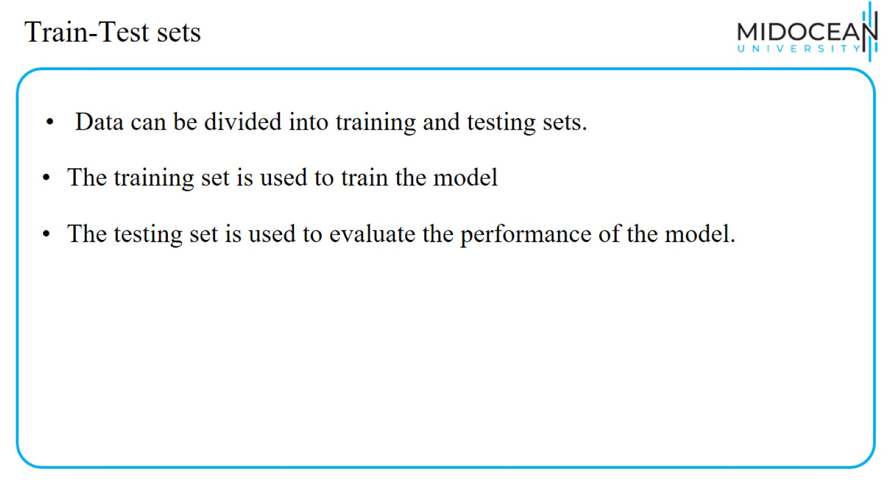
Train-Test sets

Slide 48
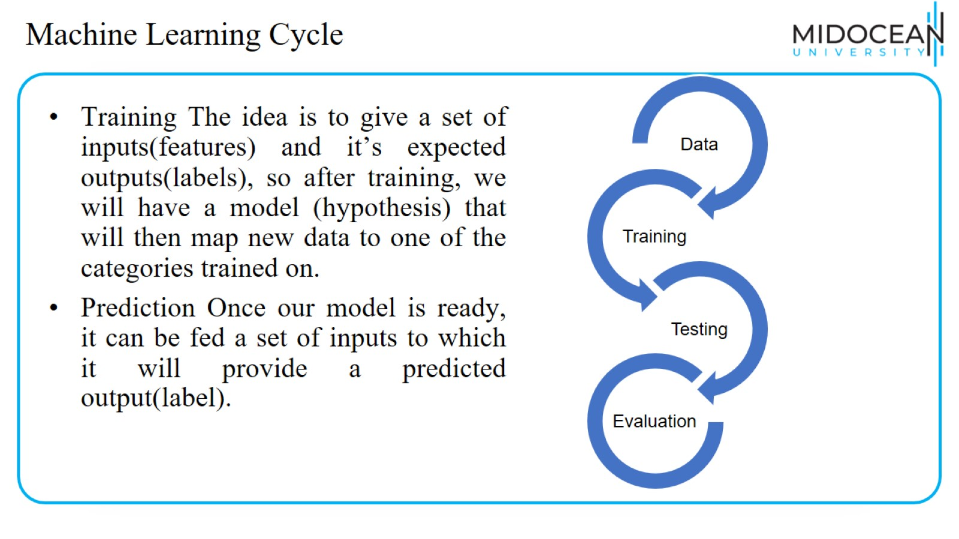
Machine Learning Cycle

Slide 49
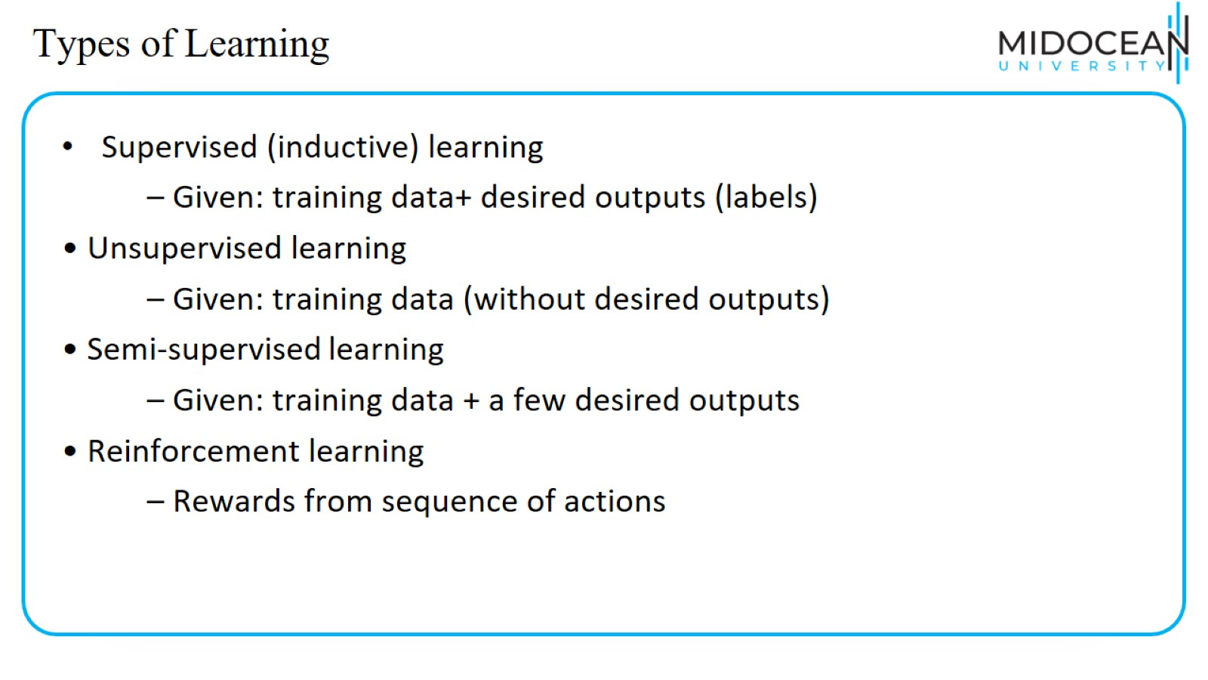
Types of Learning

Slide 50
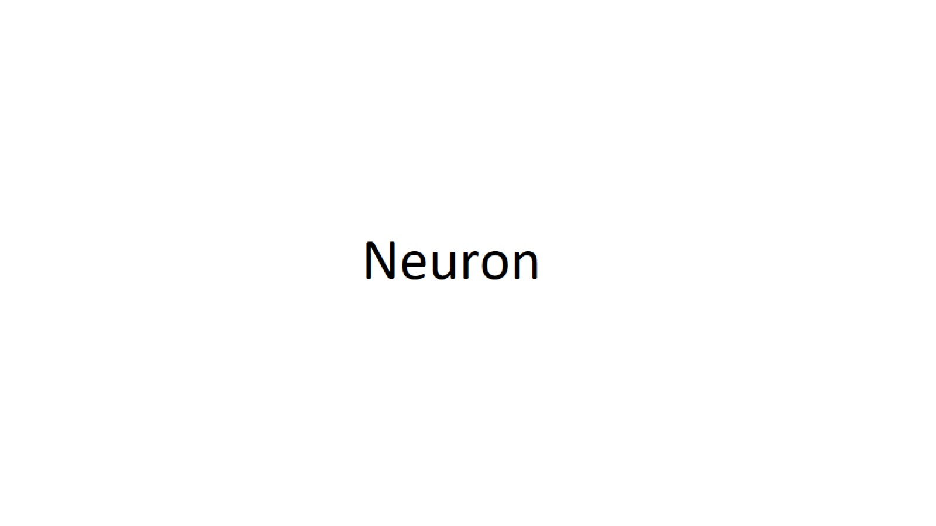
Neuron

Slide 51
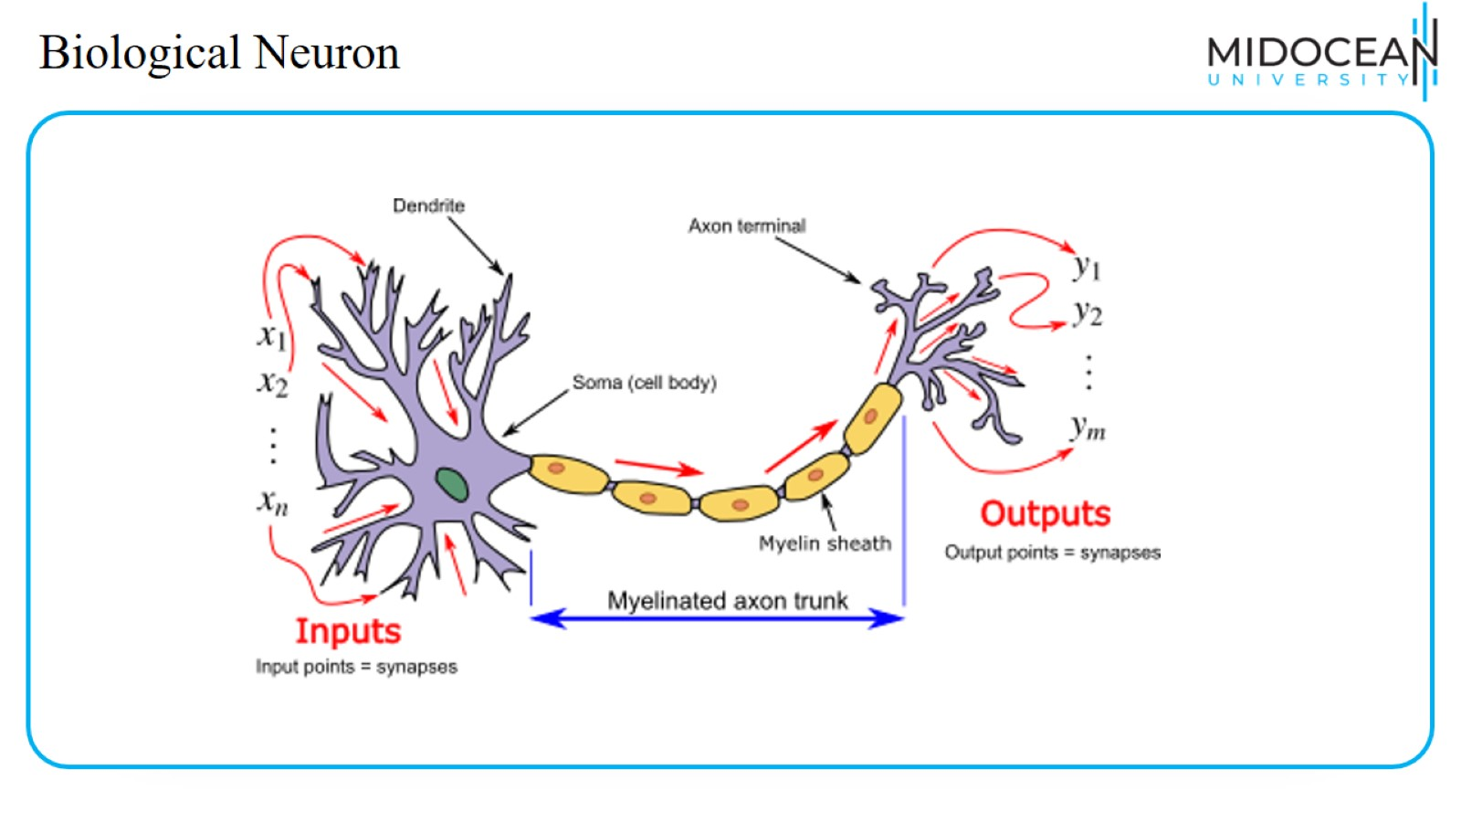
Biological Neuron

Slide 52

Artificial Neuron

Slide 53

Recap : Nnets and the brain

Slide 54

So what are neural networks??

Slide 55

The human perspective

Slide 56

Example

Slide 57

Summary

Slide 58

Teachable Machine

Slide 59


Slide 60


