Slide 1


Flutter & Dart Complete Guide
Prepared by Eng. Yousef Salah Kassem
DAFL 2
Firebase
Lecture 8

Slide 2

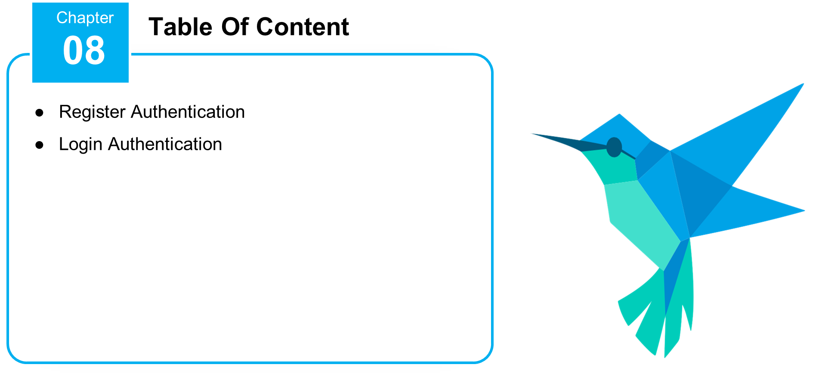

Slide 3
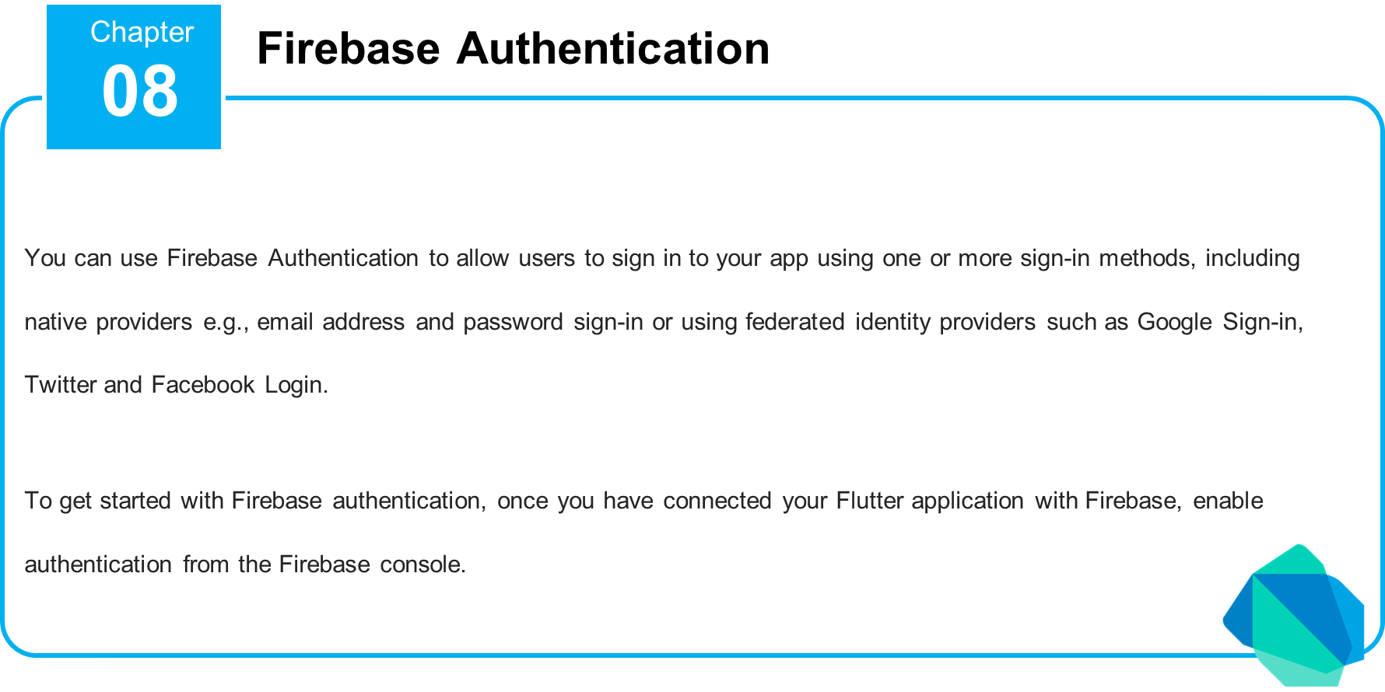

Slide 4
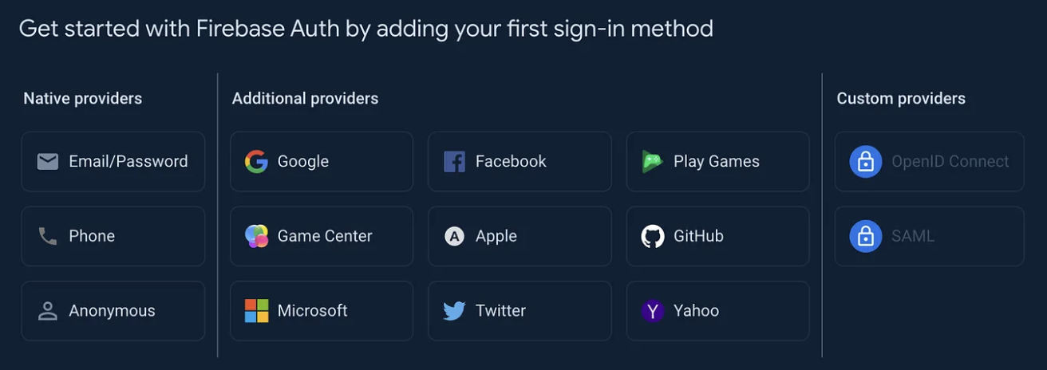

Slide 5
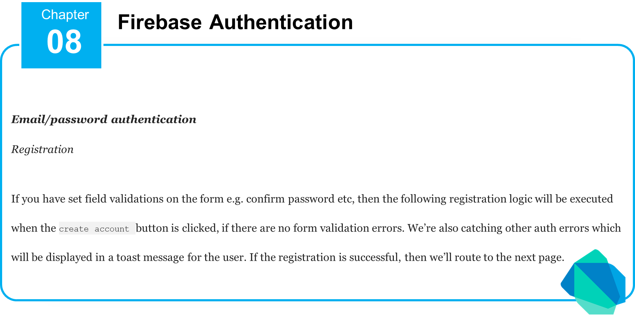

Slide 6
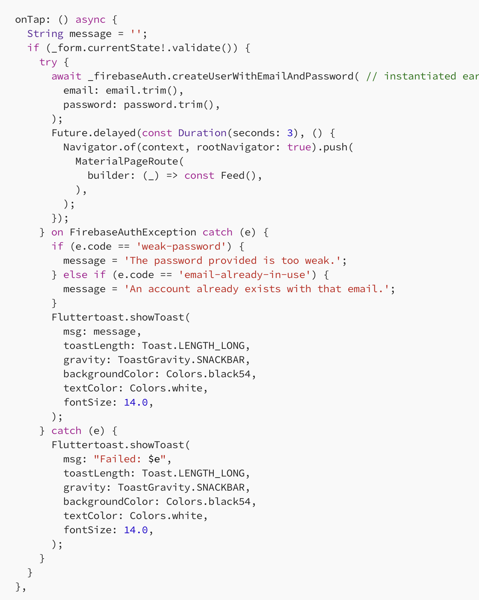

Slide 7
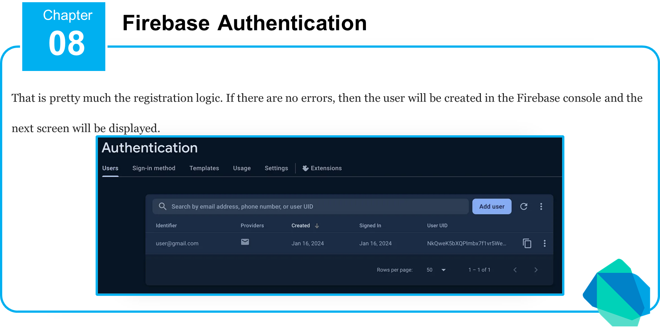

Slide 8
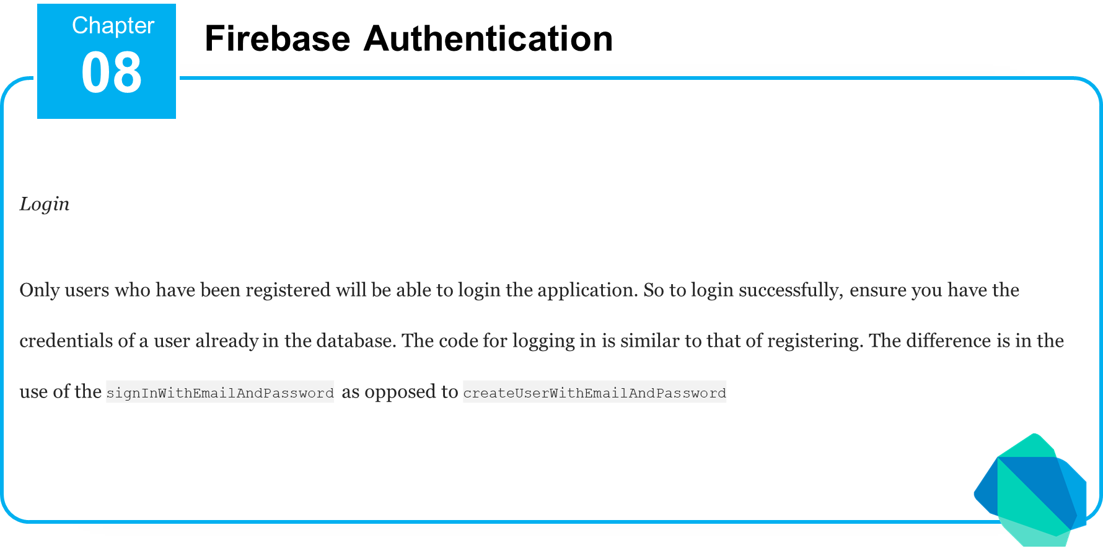

Slide 9
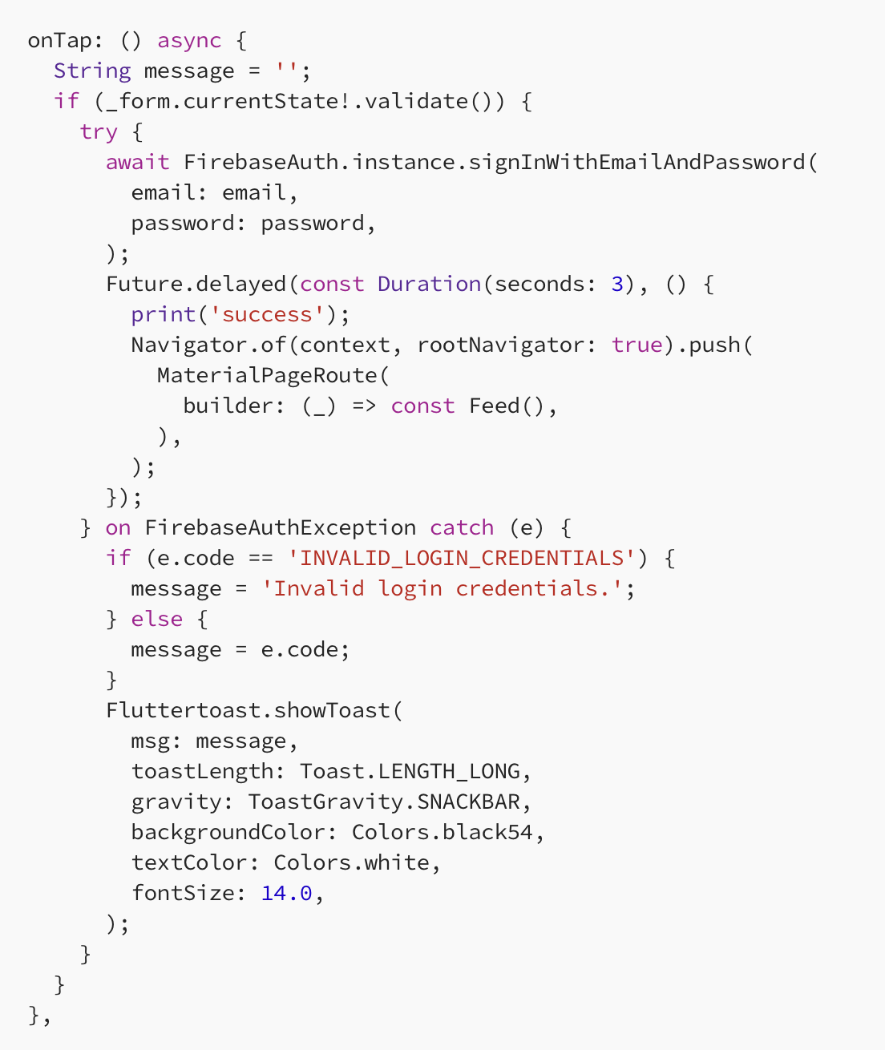

Slide 10
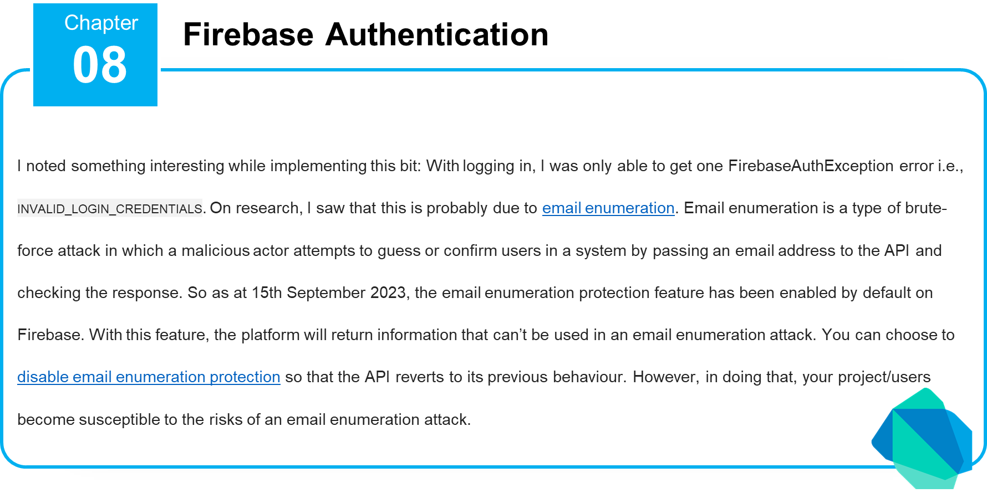

Slide 11
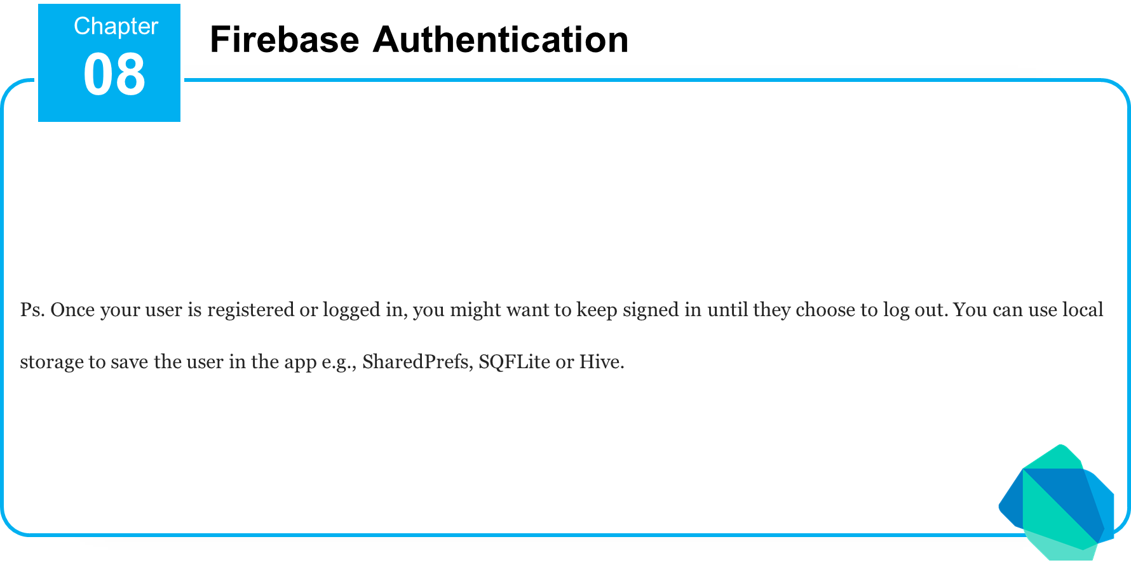

Slide 12


Slide 13
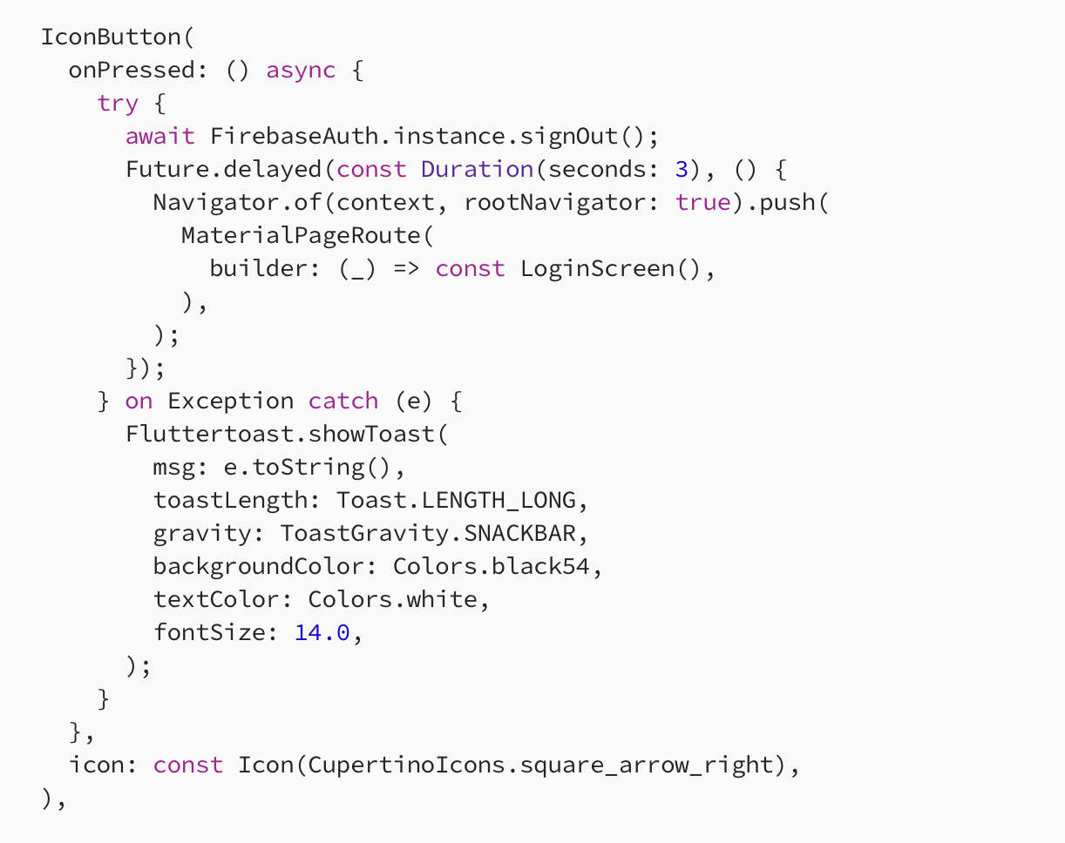

Slide 14
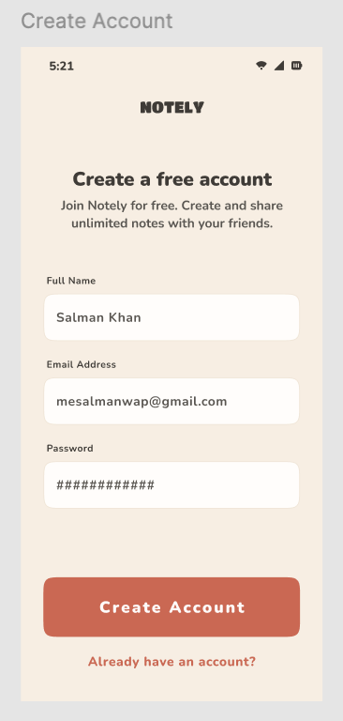

Slide 15
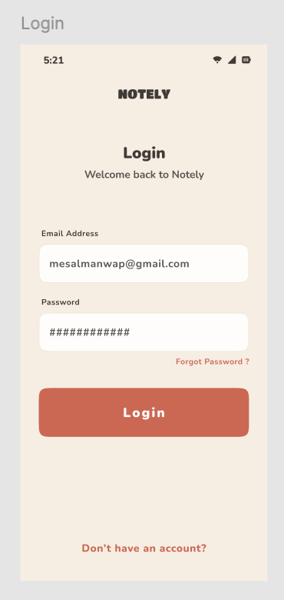

Slide 16
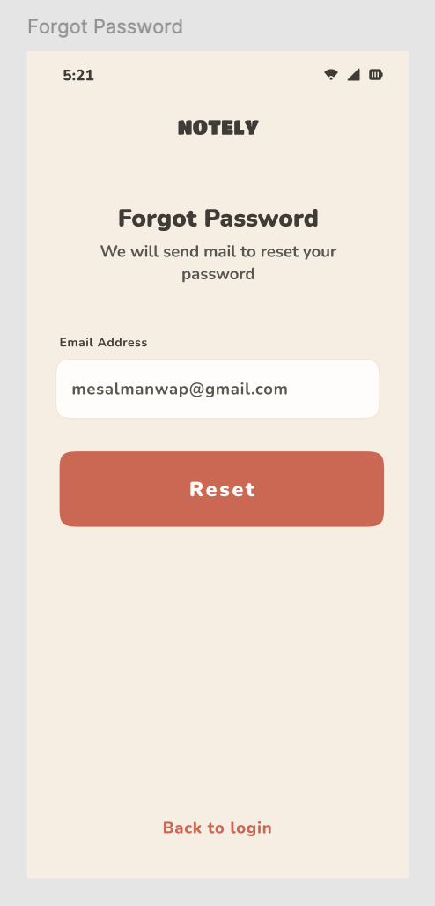

Slide 17
https://www.figma.com/design/VYJ3Mk36c8C7SjN076yoc3/Note-Taking-Mobile-App-(Community)?node-id=343-116&p=f&t=dAOt1bOa93mbgoeW-0

Slide 18


Slide 19


Slide 20



Thank You

