Slide 1


Prepared by Dr. Rana Maya
REA 621
Real Estate market analysis
Lecture 5

Slide 2



Market Segmentation and Target Market Analysis
Lecture 5
REA621
Real Estate market analysis
Prepared by
Dr. Rana Maya

Slide 3

lecture
Abstract
05
This lecture presents a comprehensive and applied treatment of real estate market segmentation and target market analysis. it integrates theory with practice, quantitative and qualitative tools, and global case studies from residential, commercial, hospitality, and mixed-use developments.

Slide 4

lecture
05
Contents
1. introduction
2. Conceptual Foundations of Market Segmentation
3. Bases of Real Estate Market Segmentation
4. Segmentation by Property Type
5. Data Sources for Market Segmentation
6. market segmentation tools
7.Case Studies in Target Market Analysis
8. Translating Target Market Analysis into Development Decisions
9.Risks and Common Mistakes

Slide 5
lecture
05
  Learning outcomes
By the end of the lecture, you will be able to:
Explain the concept and importance of real estate market segmentation.
Identify key segmentation bases relevant to real estate markets.
Analyze real estate market data to define meaningful segments.
Evaluate the attractiveness of different real estate market segments.
Select and justify appropriate target markets for real estate projects.
Assess the impact of target market selection on project design, pricing, and marketing strategy.

Slide 6

Real estate markets are inherently heterogeneous. Properties differ by location, use, quality, price, tenure, legal framework, and user preferences. Likewise, demand is not uniform: households, firms, investors, and institutions seek different attributes, face different constraints, and make decisions based on different motivations.
Treating the real estate market as a single, undifferentiated entity leads to weak analysis, misallocation of capital, and failed projects.
Why?

Slide 7
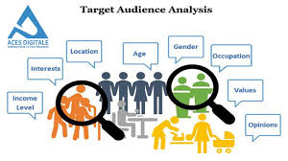
1. introduction
Local conditions may not precisely mirror national trends. Not every metropolitan area benefits from a national economic boom, and some communities will survive a national recession relatively unscathed. As a result, real estate market studies usually give greater weight to metropolitan area economic indicators than to nationwide statistics.
Market segmentation and target market analysis provide a structured framework to understand diversity.
Segmentation divides the overall market into relatively homogeneous groups with similar needs, behaviors, or characteristics.
Target market analysis then evaluates these segments and selects those that offer the best strategic fit and financial potential for a specific real estate product or investment.

Slide 8
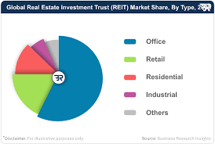
2. Conceptual Foundations of Market Segmentation
Definition of Market Segmentation
Market segmentation is the process of dividing a broad market into smaller, identifiable groups of consumers or users who share similar characteristics, needs, or decision-making behaviors and who are likely to respond similarly to a given real estate product or marketing strategy.
In real estate, segmentation applies to:
Users (residents, tenants, visitors)
Buyers (owner-occupiers, investors)
Intermediaries (brokers, corporate tenants)

Slide 9

2. Conceptual Foundations of Market Segmentation
Why Segmentation Is Critical in Real Estate?
Real estate projects are:
Capital intensive
Location fixed
Long-lived
Highly regulated
Errors in understanding demand are costly and often irreversible. Effective segmentation allows developers and investors to:
Align product design with real demand
Optimize pricing and unit mix
Reduce vacancy and absorption risk
Improve marketing efficiency
Enhance long-term asset performance

Slide 10

2. Conceptual Foundations of Market Segmentation
Segmentation vs. Targeting vs. Positioning
These three concepts are closely related but distinct:
Segmentation: Identifying distinct market groups
Targeting: Selecting which segment(s) to serve
Positioning: Designing the product and value proposition to appeal to the chosen target segment
In real estate feasibility studies, segmentation and targeting precede design, financial modeling, and risk analysis.

Slide 11

3. Bases of Real Estate Market Segmentation
Real estate markets can be segmented using multiple bases. In practice, effective analysis often combines several approaches.
3.1 Geographic Segmentation
Geographic segmentation divides the market based on location-related criteria.
Common Variables
Country, region, city
Metropolitan vs. secondary cities
District or neighborhood
Accessibility (CBD, transit-oriented, peripheral)
Urban, suburban, rural

Slide 12
3. Bases of Real Estate Market Segmentation
Real Estate Example
In residential development, demand for high-rise apartments in a CBD differs fundamentally from demand for villas in suburban areas, even within the same city.
Case Illustration: London Residential Market
London’s residential market is often segmented into:
Prime Central London (PCL)
Inner London
Outer London
Each zone exhibits different buyer profiles, price sensitivities, and investment dynamics.

Slide 13

3. Bases of Real Estate Market Segmentation
3.2 Demographic Segmentation
Demographic segmentation is widely used in residential and retail real estate.
Key Variables
Age
Household size
Income level
Education
Occupation
Family life cycle

Slide 14
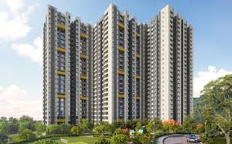
3. Bases of Real Estate Market Segmentation
Application in Residential Projects
Young professionals : studios and 1-bedroom units near employment centers
Families :larger units near schools and amenities
Seniors : accessible, low-maintenance housing
Example
A housing project targeting households with monthly income between USD 3,000–5,000 will differ significantly in size, finishes, and amenities from a project targeting households earning above USD 10,000.

Slide 15

3. Bases of Real Estate Market Segmentation
3.3 Socioeconomic Segmentation
Socioeconomic segmentation focuses on social class, lifestyle, and consumption patterns.
Variables
Social class
Lifestyle preferences
Work-life balance
Consumption behavior
This approach is particularly relevant in:
Mixed-use developments
Gated communities
Lifestyle-oriented projects

Slide 16

3. Bases of Real Estate Market Segmentation
3.4 Psychographic Segmentation
Psychographic segmentation examines psychological traits and values.
Variables
Values and attitudes
Aspirations
Risk tolerance
Environmental awareness
Prestige orientation
Example
Two buyers with identical incomes may choose very different properties: one prioritizes sustainability and green buildings, while the other prioritizes luxury and status.

Slide 17
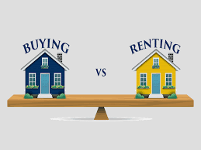
3. Bases of Real Estate Market Segmentation
3.5 Behavioral Segmentation
Behavioral segmentation focuses on how users interact with real estate products.
Variables
Ownership vs. renting
Length of stay
Usage patterns
Price sensitivity
Brand or developer loyalty
Application
In hospitality real estate, business travelers and leisure tourists represent distinct behavioral segments, even if they share demographic characteristics.

Slide 18

4. Segmentation by Property Type
4.1 Residential Market Segmentation
Residential real estate can be segmented by:
Tenure (ownership vs. rental)
Housing type (apartments, villas, townhouses)
Price bands (affordable, mid-market, luxury)
Density (low, medium, high)
A complete market study report should include a map that shows where the property sits within the metropolitan area or a major city. At a smaller scale, a map should show the boundaries of the primary and secondary market areas, location of the site, nearby interstate highways, and key
What are housing product types?
Master-Planned Communities
True MPCs are developed from a comprehensive plan by a master developer, and they incorporate a variety of housing types, sizes, and prices along with shared common space, amenities, and a vital public realm.
MPCs differentiate themselves from typical suburban subdivisions in that they provide a means for interaction among neighbors in the sense of the word “community”

Slide 19

4. Segmentation by Property Type
4.2 Office Market Segmentation
Office markets are commonly segmented by:
Location (CBD, decentralized, suburban)
Building grade (A, B, C)
Tenant type (corporate, SMEs, co-working)
.
Case Study: Grade A Offices in Dubai
Multinational corporations concentrate demand in Grade A offices in DIFC and Downtown Dubai, while SMEs target lower-grade buildings in secondary locations.

Slide 20

4. Segmentation by Property Type
4.3 Retail Market Segmentation
Retail real estate segmentation considers:
Catchment area
Consumer spending power
Retail format (mall, strip retail, convenience)
.
Example
Neighborhood convenience centers serve daily needs, while regional malls target discretionary spending and entertainment.

Slide 21

4. Segmentation by Property Type
4.4 Hospitality Market Segmentation
Hospitality segmentation is highly sophisticated and includes:
Business vs. leisure travelers
Budget, mid-scale, luxury
Length of stay
Seasonality
Case Study: Marriott International
Marriott segments the hospitality market through multiple brands (e.g., Courtyard, Ritz-Carlton, Residence Inn), each targeting a specific traveler profile.
.

Slide 22

4. Segmentation by Property Type
4.5 Industrial and Logistics Segmentation
Segmentation variables include:
Proximity to ports and highways
Warehouse size and specifications
Industry type
Last-mile vs. regional distribution

Slide 23
5. Data Sources for Market Segmentation
5.1 Secondary Data
National statistics offices
Census data
Housing surveys
Brokerage reports (CBRE, JLL, Savills)
Planning authorities
5.2 Primary Data
Household surveys
Tenant interviews
Focus groups
Broker consultations
5.3 Big Data and Technology
Mobile location data
Credit card spending data
Online property platforms
GIS and spatial analysis

Slide 24
6. market segmentation tools
These tools help you analyze user behavior (web/app usage, purchase paths, engagement) and create segments based on patterns.
Google Analytics (GA4) – tracks user interactions, events, and traffic sources; supports audience segmentation and integration with ad platforms.
House Canary: Provides accurate analysis and property price forecasts using big data.
Mashvisor: Specializes in residential property analysis, ROI calculation, and long-term and short-term rental comparisons.
Power BI (Microsoft): one of the best tools transforming data into interactive dashboards.
Tableau: Used for analyzing complex data and predicting patterns.
Saudi Arabia Suhail App: Provides analysis of real estate transaction data, neighborhood indices, and automated property valuation.
Salesforce (CRM Platform): analyze customer behavior and predict market trends.

Slide 25
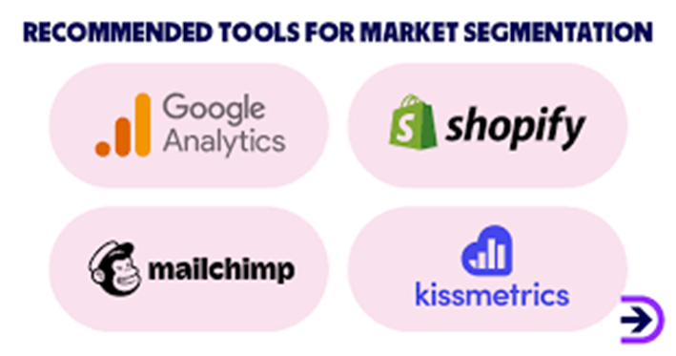
6. market segmentation tools
Create, send and manage newsletters and manage subscriptions
Understanding user behavior across digital platform

Slide 26
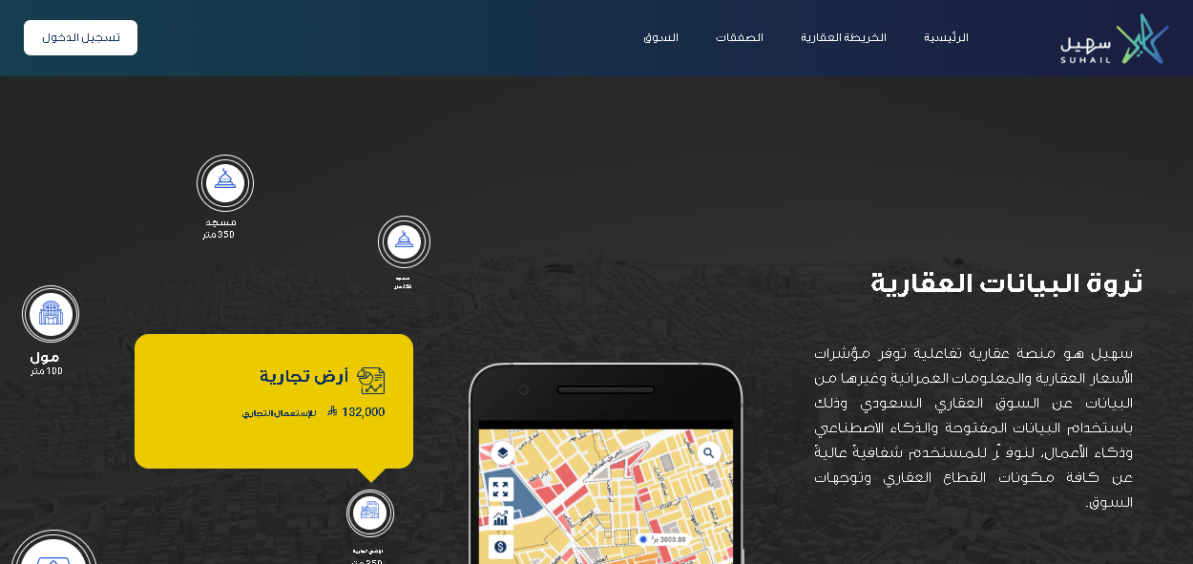
6. market segmentation tools

Slide 27
6. market segmentation tools -Example
Example: Google Analytics Report
Residential Project: Green Valley Residences
Location: Suburban city area
Report Period: 1 January – 31 March 2026
Tool: Google Analytics 4 (GA4)
1. Executive Summary
During the reporting period, Green Valley Residences attracted 42,600 users, indicating strong digital interest in the project. Engagement metrics show high interaction with unit detail pages and pricing information, suggesting a market segment actively evaluating purchase or rental decisions. Lead conversion performance highlights contact forms and WhatsApp inquiries as the most effective channels.

Slide 28
6. market segmentation tools - Example
2. Audience Overview (Market Reach)
Metric | Value | Interpretation
Total Users | 42.600 | Overall demand awareness
New Users | 68% | Strong inflow of new prospects
Returning Users | 32% | Repeated interest (consideration stage)
Avg. Engagement Time | 2 min 45 sec | High content relevance
Engaged Sessions | 61% | Quality traffic
Insight:
A high proportion of returning users suggests that potential buyers/renters revisit the website multiple times before making a decision—typical behavior in residential real estate markets.

Slide 29
6. market segmentation tools - Example
Given that all 8 billion people on the planet must live somewhere, how do we organize ourselves?
3. Geographic Segmentation (Location Analysis)
Top user locations:
Country / City | % of Users
City A (Local) | 48%
City B (Nearby Region) | 22%
GCC Countries | 18%
Other | 12%
Insight:
Nearly 40% of interest originates outside the immediate city, indicating potential demand from investors, expatriates, or relocating households.

Slide 30
6. market segmentation tools - Example
4. Demographic Insights (Target Market Profile)
Age Distribution
25–34 years: 34%
35–44 years: 29%
45–54 years: 21%
Other: 16%
Gender
Male: 58%
Female: 42%
Interpretation:
The dominant segment (25–44 years) aligns with first-time buyers, young families, and mid-career professionals, confirming suitability of unit sizes and pricing strategy.

Slide 31
lecture
6. market segmentation tools - Example
Numerous areas of contemporary economics are connected to urban economics. My early professional goal was to become a | Source | % of Sessions |
| --------------------- | ------------- |
| Organic Search | 41% |
| Paid Ads (Google Ads) | 27% |
| Social Media | 18% |
| Direct | 14% |
macroeconomist. Understanding the causes and effects of booms and recessions is the goal of macroeconomists. Additionally, they aim to comprehend the
5. Traffic Sources (Demand Drivers)
Source | % of Sessions
Organic Search | 41 %
Paid Ads (Google Ads) | 27 %
Social Media | 18%
Direct | 14%
Insight: Organic search dominance indicates strong interest in keywords such as “apartments for sale,” “residential compound,” and “family housing”. Paid ads are effective but secondary

Slide 32
6. market segmentation tools - Example
6. Content Performance (Unit & Feature Interest)
Page | Avg. Engagement Time
2-Bedroom Apartments | 3:40 min
Pricing & Payment Plans | 3:15 min
Amenities (Pool, Gym, Parking) | 2:55 min
Location & Accessibility | 2:30 min
Insight :High engagement with pricing and unit configuration pages indicates users are beyond awareness and actively comparing options.

Slide 33
6. market segmentation tools - Example
7. Conversion & Lead Analysis (Sales Funnel)
Conversion Event | Conversion Rate
Contact Form Submission | 4.6%
WhatsApp Click | 3.9%
Phone Call Click | 2.1%
Brochure Download | 5.2%
Total Leads Generated: 1,920
Interpretation:
Digital channels generate measurable leads, supporting the feasibility of online-driven sales and leasing strategies.

Slide 34
6. market segmentation tools - Example
| Priority Factor | % Selecting as “Very Important” |
| ----------------------- | ------------------------------- |
| Proximity to work | 72% |
| Parking availability | 65% |
| Public transport access | 58% |
| Security | 76% |
| Retail/services nearby | 49% |
8. Device Usage (Design & UX Implications)
Device | % of Users
Mobile | 63%
Desktop | 31%
Tablet | 6 %
Insight:
The website must remain mobile-first, especially for inquiry forms and quick contact options

Slide 35
6. market segmentation tools - Example
| Priority Factor | % Selecting as “Very Important” |
| ----------------------- | ------------------------------- |
| Proximity to work | 72% |
| Parking availability | 65% |
| Public transport access | 58% |
| Security | 76% |
| Retail/services nearby | 49% |
9. Key Market Insights for Decision-Makers
Strong interest from young families and professionals
Significant demand from outside the immediate city
Pricing and unit layout are primary decision drivers
Digital channels are effective for lead generation
Mobile users dominate the demand funnel

Slide 36
6. market segmentation tools - Example
Given that all 8 billion people on the planet must live somewhere, how do we organize ourselves?
10. Conclusion for Market Analysis Report
Google Analytics data confirms that Green Valley Residences targets a clearly defined and digitally active residential market segment. User behavior patterns indicate a strong conversion potential, supporting the project’s pricing strategy, unit mix, and marketing approach.

Slide 37

6. Target Market Analysis
Using Qualitative Research
6.1 Definition of Target Market
A target market is the specific segment or segments that a real estate project intentionally seeks to serve based on strategic, financial, and operational considerations.

Slide 38

6. Target Market Analysis
6.2 Criteria for Selecting Target Markets
Common evaluation criteria include:
•Market size and growth
•Purchasing power
•Accessibility
•Competitive intensity
•Regulatory constraints
•Risk profile

Slide 39
6. Target Market Analysis
6.3 Targeting Strategies
Undifferentiated targeting: Rare in real estate
Differentiated targeting: Multiple products for multiple segments
Concentrated targeting: Focus on one niche segment

Slide 40

7.Case Studies in Target Market Analysis
7.1 Case Study 1: Mixed-Use Development in Singapore
Context: High land costs and dense urban environment
Segmentation:
Office tenants: multinational firms
Residential buyers: high-income professionals
Retail users: daily convenience
Target Market Decision:
Focus on premium office and compact luxury residential units
Outcome:
High pre-commitment rates
Stable long-term rental income

Slide 41

7.Case Studies in Target Market Analysis
Case Study 2: Suburban Housing Project in Germany
Context: Aging population and strong rental culture
Segmentation:
Seniors (65+)
Young families
Target Market:
Seniors seeking accessible rental housing
Design Implications:
Barrier-free units
Proximity to healthcare and transit

Slide 42

7.Case Studies in Target Market Analysis
Case Study 3: Retail Center in a Secondary City (MENA Region)
Segmentation:
Low- to middle-income households
High sensitivity to price
Target Market:
Convenience-oriented shoppers
Result:
High footfall
Stable occupancy despite limited luxury brands

Slide 43
8. Translating Target Market Analysis into Development Decisions
8.1 Product Design
•Unit mix and sizes
•Quality of finishes
•Amenities and services
8.2 Pricing Strategy
•Affordability thresholds
•Rent-to-income ratios
•Competitive benchmarking
8.3 Marketing and Sales Strategy
•Channel selection
•Messaging and branding
•Sales phasing

Slide 44

9. Risks and Common Mistakes
•Over-segmentation with insufficient data
•Copying successful projects without local validation
•Ignoring informal or underserved segments
•Misalignment between target market and pricing

Slide 45

Conclusion
Market segmentation and target market analysis are central to successful real estate development and investment. They provide the analytical bridge between macroeconomic indicators and project-level decisions. Real estate professionals can reduce uncertainty, enhance value creation, and deliver projects that genuinely meet market needs
lecture
05
Exercise
Do market segmentation report for real estate market project?

Slide 46



Thank You

