Slide 1

RHSA (Admin 1) Red Hat Enterprise Linux 8 Essentials
Prepared by Eng. Taghreed Elsayed
Lecture 2
Managing Files from the Command Line

Slide 2
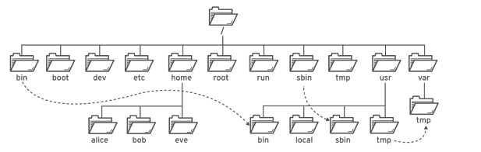

Chapter
03
Managing Files from the Command Line
THE FILE SYSTEM HIERARCHY:
All files on a Linux system are stored on file systems which are organized into a single inverted tree of directories, known as a file system hierarchy.
This tree is inverted because the root of the tree is said to be at the top of the hierarchy, and the branches of directories and subdirectories stretch below the root.
Significant file system directories in Red Hat

Slide 3
Chapter
03
Managing Files from the Command Line
The directory / is the root directory at the top of the file system hierarchy.
The / character is also used as a directory separator in file names. For example, if etc is a subdirectory of the / directory, we could call that directory /etc.
Likewise, if the / etc directory contained a file named issue, we could refer to that file as / etc/issue.
Subdirectories of / are used for standardized purposes to organize files by type and purpose. This makes it easier to find files. For example, in the root directory, the subdirectory /boot is used for storing files needed to boot the system.

Slide 4
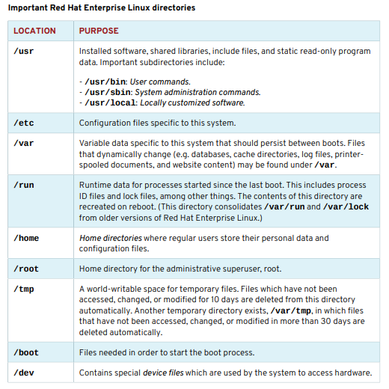
Chapter
03
Managing Files from the Command Line

Slide 5
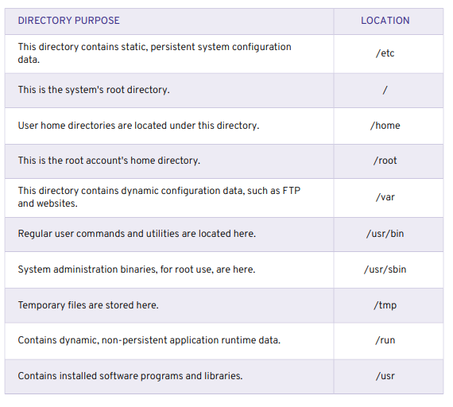
Chapter
03
FILE SYSTEM HIERARCHY

Slide 6
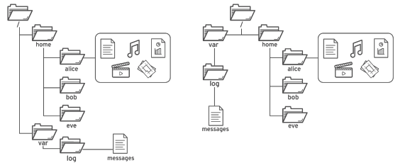
Chapter
03
LOCATING FILES BY NAME
ABSOLUTE PATHS AND RELATIVE PATHS
The path of a file or directory specifies its unique file system location.
Following a file path traverses one or more named subdirectories, delimited by a forward slash (/), until the destination is reached.
Standard file behavior definitions apply to directories (also called folders) the same as other file types.
The common file browser view (left) is equivalent to the top-down view (right)

Slide 7
Chapter
03
Managing Files from the Command Line
Absolute paths : An absolute path is a fully qualified name, beginning at the root (/) directory and specifying each subdirectory traversed to reach and uniquely represent a single file.
Every file in a file system has a unique absolute path name, recognized with a simple rule: A path name with a forward slash (/) as the first character is an absolute path name.
For example, the absolute path name for the system message log file is /var/log/messages. Absolute path names can be long to type, so files may also be located relatively.
When a user logs in and opens a command window, the initial location is normally the user's home directory. System processes also have an initial directory.
Users and processes navigate to other directories as needed; the terms working directory or current working directory refer to their current location.

Slide 8
Chapter
03
Managing Files from the Command Line
Relative paths Like an absolute path, a relative path identifies a unique file, specifying only the path necessary to reach the file from the working directory.
Recognizing relative path names follows a simple rule: A path name with anything other than a forward slash (/) as a first character is a relative path name.
A user in the /var directory could refer to the message log file relatively as log/messages. For standard Linux file systems, the path name of a file, including all / characters, may be no more than 4095 bytes long.
Each component of the path name separated by / characters may be no more than 255 bytes long. File names can use any UTF-8 encoded Unicode character except / and the NUL character.

Slide 9
Chapter
03
Managing Files from the Command Line
(ASCII characters require one byte; other Latin, Greek, Hebrew, or Cyrillic characters take two bytes; remaining characters in the Unicode Basic Multilingual Plane take three; and no character will take more than four bytes.) Linux file systems—including, but not limited to, ext4, XFS, BTRFS, GFS2, and Gluster FS—are case-sensitive.
Creating FileCase.txt and filecase.txt in the same directory results in two unique files. Although many non-Linux file systems are supported in Linux, each has unique file naming rules. For example, the ubiquitous VFAT file system is not case-sensitive and allows only one of the two example files to be created.
However, VFAT, along with Microsoft's NTFS and Apple's HFS+, has case preserving behavior. Although these file systems are not case-sensitive (enforced primarily to support backward compatibility), they do display file names with the original capitalization used when the file was created.

Slide 10

Chapter
03
NAVIGATING PATHS
NAVIGATING PATHS The pwd command displays the full path name of the current location, which helps determine appropriate syntax for reaching files using relative path names.
The ls command lists directory contents for the specified directory or, if no directory is given, for the current directory.
Use the cd command to change directories.
With a working directory of /home/student, relative path syntax is shortest to reach the Videos subdirectory. The Documents subdirectory is then reached using absolute path syntax.

Slide 11
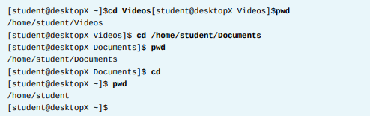
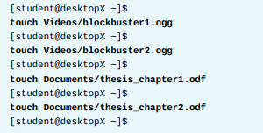
Chapter
03
Managing Files from the Command Line
The touch command normally updates a file's timestamp to the current date and time without otherwise modifying it. This is useful for creating empty files, which can be used for practice, since "touching" a file name that does not exist causes the file to be created. Using touch, practice files are created in the Documents and Videos subdirectories.

Slide 12
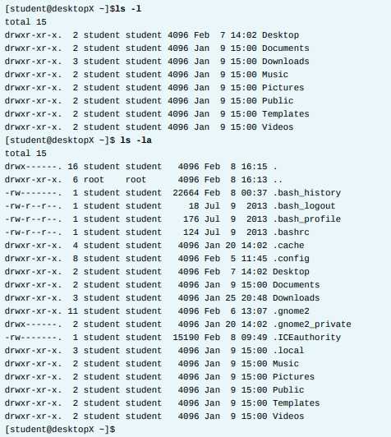
Chapter
03
Managing Files from the Command Line
The ls command has multiple options for displaying attributes on files.
The most common and useful are -l (long listing format), -a (all files, includes hidden files), and -R (recursive, to include the contents of all subdirectories).

Slide 13
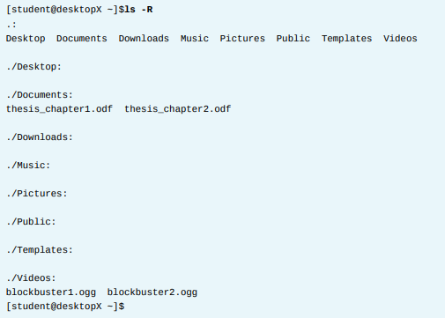
Chapter
03
Managing Files from the Command Line

Slide 14
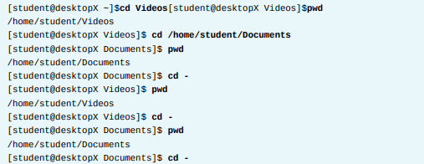

Chapter
03
Managing Files from the Command Line
The cd command has many options.
A few are so useful as to be worth practicing early and using often. The command cd - changes directory to the directory where the user was previous to the current directory. Watch as this user takes advantage of this behavior to alternate between two directories, useful when processing a series of similar tasks.

Slide 15
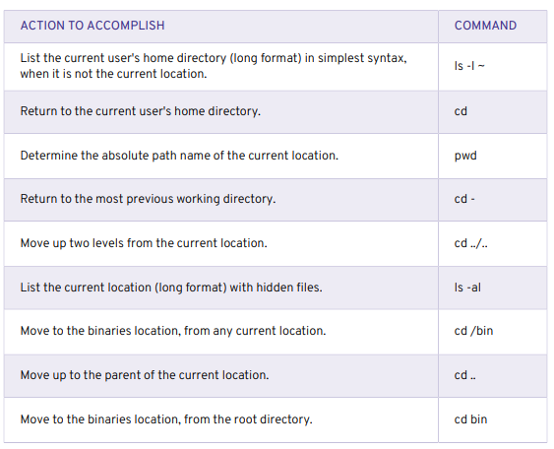
Chapter
03
LOCATING FILES AND DIRECTORIES

Slide 16
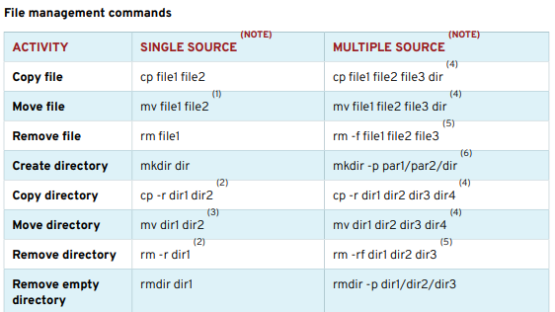
Chapter
03
MANAGING FILES USING COMMAND-LINE TOOLS

Slide 17
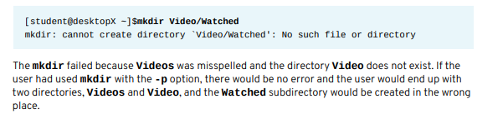
Chapter
03
Managing Files from the Command Line
Create directories The mkdir command
creates one or more directories or subdirectories, generating errors if the file name already exists or when attempting to create a directory in a parent directory that doesn't exist.
The -p parent option creates missing parent directories for the requested destination. Be cautious when using mkdir -p, since accidental spelling mistakes create unintended directories without generating error messages.
In the following example, a user attempts to use mkdir to create a subdirectory named Watched in the existing Videos directory, but mistypes the directory name.

Slide 18
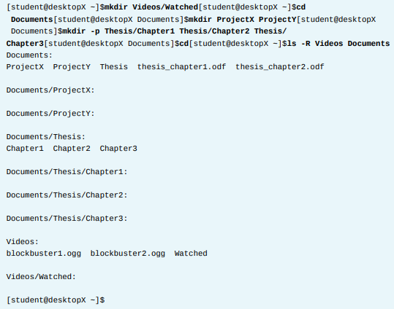
Chapter
03
Managing Files from the Command Line

Slide 19
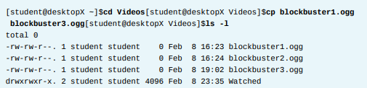

Chapter
03
Managing Files from the Command Line
Copy files The cp command copies one or more files to become new, independent files. Syntax allows copying an existing file to a new file in the current or another directory, or copying multiple files into another directory.
In any destination, new file names must be unique. If the new file name is not unique, the copy command will overwrite the existing file.

Slide 20
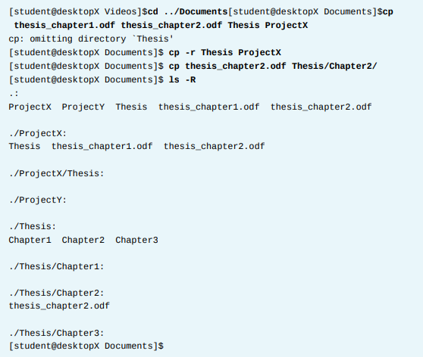
Chapter
03
Managing Files from the Command Line
To protect users from accidentally overwriting directories with contents, multiple file cp commands ignore directories specified as a source.
Copying non-empty directories, with contents, requires the -r recursive option.

Slide 21
Chapter
03
Managing Files from the Command Line
Copy files The cp command copies one or more files to become new, independent files. Syntax allows copying an existing file to a new file in the current or another directory, or copying multiple files into another directory.
In any destination, new file names must be unique. If the new file name is not unique, the copy command will overwrite the existing file.

Slide 22
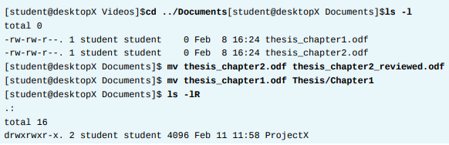
Chapter
03
Managing Files from the Command Line
Move files The mv command renames files in the same directory, or relocates files to a new directory.
File contents remain unchanged. Files moved to a different file system require creating a new file by copying the source file, then deleting the source file. Although normally transparent to the user, large files may take noticeably longer to move.

Slide 23
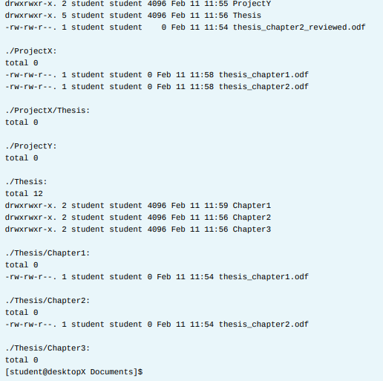
Chapter
03
Managing Files from the Command Line

Slide 24
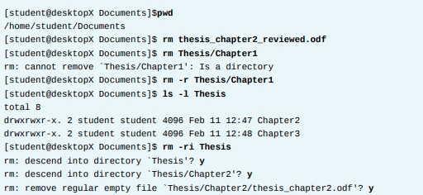

Chapter
03
Managing Files from the Command Line
Remove files and directories Default syntax for rm deletes files, but not directories. Deleting a directory, and potentially many subdirectories and files below it, requires the -r recursive option. There is no command-line undelete feature, nor a trash bin from which to restore.

Slide 25
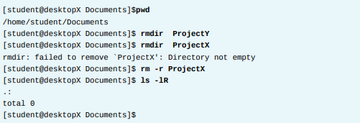
Chapter
03
Managing Files from the Command Line
After rm failed to delete directory, the -r recursive option succeeded. The last rm command parsed into each subdirectory first, individually deleting contained files before removing each now-empty directory. Using -i will interactively prompt for each deletion.
This is essentially the opposite of -f which will force the deletion without prompting the user. The rmdir command deletes directories only if empty. Removed directories cannot be undeleted.

