Slide 1

Entrepreneurship & Innovation
Prepared by Dr. Amany Ramadan
ENT 611
Entrepreneurship & Innovation
Lecture 3

Slide 2


Feasibility Analysis and Crafting a
Winning Business Plan
Chapter
3
www.midocean.ae

Slide 3


Chapter
Conducting a Feasibility Analysis and Crafting a
Winning Business Plan
3
www.midocean.ae

Slide 4
Entrepreneurship
Lecture 3:Conducting a Feasibility Analysis and Crafting a
Winning Business Plan
www.midocean.ae

Slide 5
Feasibility Analysis
Entrepreneurs do not lack creative ideas, but …
Is a particular idea a viable foundation for creating a successful business?
Feasibility study addresses the question: “Should we proceed with this business idea?”
www.midocean.ae

Slide 6
Feasibility Analysis
A feasibility analysis is the process of determining if the idea is a viable foundation for creating a successful business. If the idea meets the necessary criteria, the entrepreneur’s next step is to build a solid business plan for capitalizing on the idea.
www.midocean.ae

Slide 7
Feasibility Analysis
A feasibility study:
Is not the same as a business plan.
Serves as a filter, screening out ideas that lack the potential for building a successful business before an entrepreneur commits the necessary resources to building a business plan.
Is an investigative tool.
www.midocean.ae

Slide 8
Business Plan
A business plan is a planning tool for transforming an idea into reality.
It builds on the foundation of the feasibility study but provides a more comprehensive analysis than a feasibility study.
www.midocean.ae

Slide 9
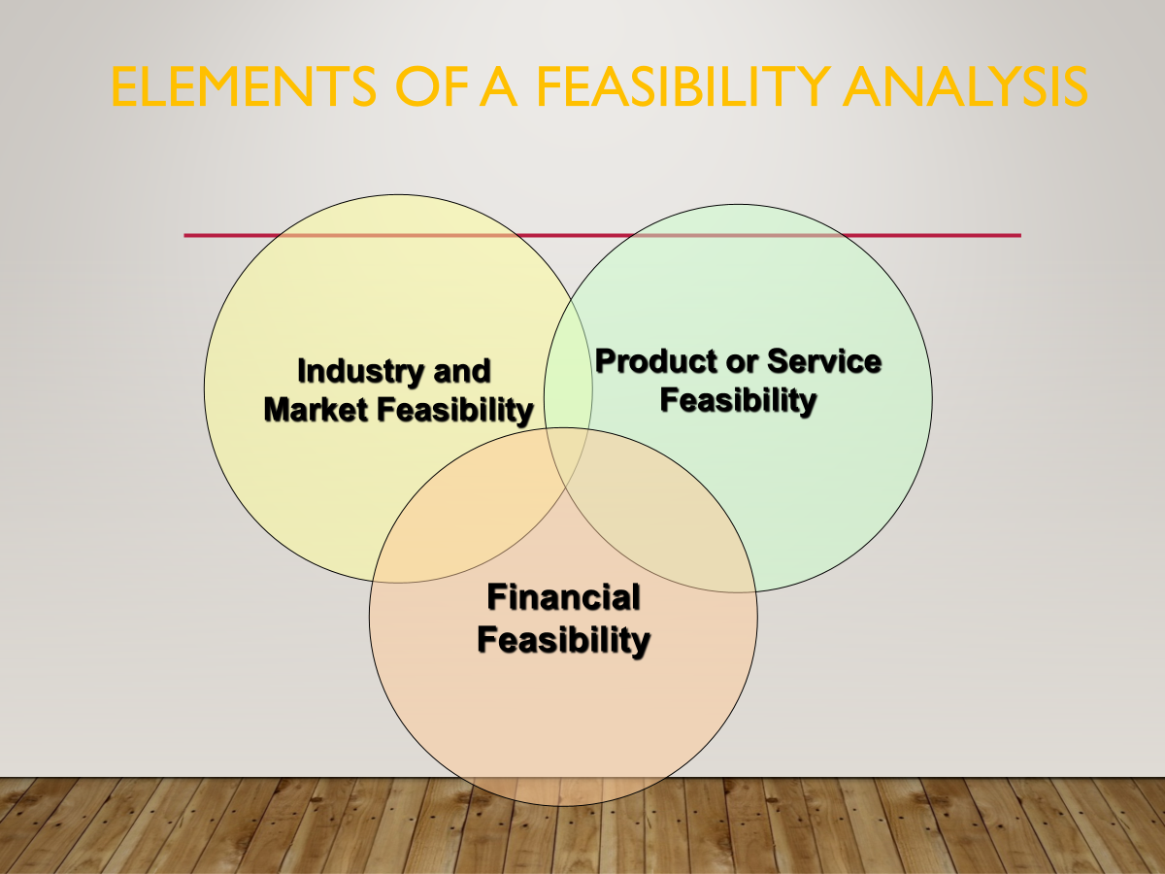
www.midocean.ae

Slide 10
Industry and Market Feasibility Analysis
Two areas of focus:
Determining how attractive an industry is overall as a “home” for a new business.
Identifying possible niches a small business can occupy profitably.
www.midocean.ae

Slide 11
Five Forces Model
Five forces interact with one another to determine the setting in which companies compete and, hence, the attractiveness of the industry:
  Rivalry among companies in the industry
  Bargaining power of suppliers
  Bargaining power of buyers
  Threat of new entrants
  Threat of substitute products or services
www.midocean.ae

Slide 12
Five Forces Model
Potential
Entrants
Threat of
New Entrants
Bargaining Power
of Suppliers
Industry Competitors
Rivalry among existing firms
Bargaining Power
of Buyers
Suppliers
Buyers
Threat of Substitute
Products or Services
Substitutes

Slide 13
Rivalry Among Companies
Strongest of the five forces
Industry is more attractive when:
  Number of competitors is large, or, at the other extreme, quite small.
  Competitors are not similar in size or capacity.
  Industry is growing fast.
  Opportunity to sell a differentiated product or service exists.
www.midocean.ae

Slide 14
Bargaining Power of Suppliers
The greater the leverage of suppliers, the less attractive the industry.
Industry is more attractive when:
  Many suppliers sell a commodity product.
  Substitutes are available.
  Switching costs are low.
www.midocean.ae

Slide 15
Bargaining Power of Buyers
Buyers’ influence is high when number of customers is small and cost of switching to a competitor’s product is low.
Industry is more attractive when:
  Customers’ switching costs are high.
  Number of buyers is large.
  Customers want differentiated products.
  Customers find it difficult to collect information for comparing suppliers.
www.midocean.ae

Slide 16
Threat of New Entrants
The larger the pool of potential new entrants, the less attractive an industry is.
Industry is more attractive to new entrants when:
  Advantages of economies of scale are absent.
  Capital requirements to enter are low
  Buyers are not loyal to existing brands
  Government does not restrict the entrance of new companies
www.midocean.ae

Slide 17
Threat of Substitutes
Substitute products or services can turn an industry on its head.
Industry is more attractive to new entrants when:
  Quality substitutes are not readily available.
  Prices of substitute products are not significantly lower than those of the industry’s products.
  Buyers’ switching costs are high.
www.midocean.ae

Slide 18
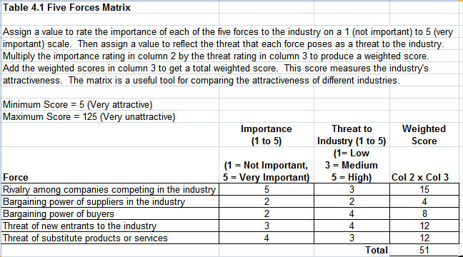
Five Forces Matrix

Slide 19
Business Prototyping
Entrepreneurs test their business models on a small scale before committing serious resources to launch a business that might not work.
Recognizes that a business idea is a hypothesis that needs to be tested before taking it full scale.
www.midocean.ae

Slide 20




Thank You

