Slide 1



Cybersecurity Emergency Response
Lecture 10
HCIA-Security
Prepared by
Dr. Abdelrhman Ahmed

Slide 2
Chapter
10
Forward
• The Internet of Things (loT), mobile Internet, cloud computing, and big data are booming. Emerging technologies are reshaping the world. However, cyber security incidents are still on the rise, increasing people's concerns about cyber safety.
• In 2017, global cyber attacks, such as WannaCry ransomware, occurred at a high rate. It is difficult to effectively monitor and provide alerts for unexpected global security incidents. Furthermore, nations tend to be reactive instead of proactive when it comes to security incidents. This slide provides references for security incident responses.

Slide 3
Chapter
10
Objectives
• Upon completion of this course, you will be able to:
□ Understand the background of cyber security emergency response.
□ Describe the handling process of cyber security emergency response.
□ Understand new trends in cyber security emergency response.

Slide 4

Chapter
10
Background of Information Security Emergency Response
• The Morris Worm Incident, which occurred in November 1988, forced over 10% of Internet systems to stop working. This incident shocked the world and deeply concerned computer science professionals.
• A Computer Emergency Response Team (CERT) and the CERT Coordination Center (CERT/CC) for Internet security was founded in 1989 following the Morris worm incident. At that time, the Defense Advanced Research Projects Agency (DARPA) tasked Carnegie Mellon University's Software Engineering Institute (SEI) with developing a communication coordination center to connect experts during security emergencies and to help prevent future intrusion

Slide 5
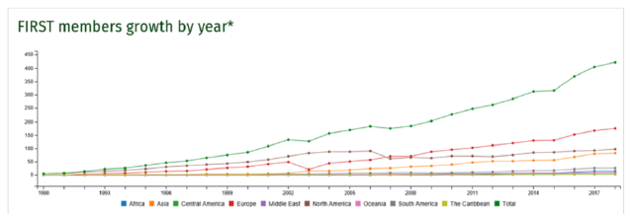
Chapter
10
FIRST Background
• Security emergency response organizations in different countries face communication and cooperation difficulties because they use different languages and time zones and serve different user groups.
• The Forum of Incident Response and Security Teams (FIRST), founded in 1990, was initially formed by 11 security emergency response organizations, and currently has more than 400 members worldwide.

Slide 6

Chapter
10
CNCERT/CC
• Founded in September 2002, CNCERT/CC is a non-governmental and non-profit cyber security technical center. It is a core organization that helps to coordinate the cyber security emergency system in China.
• CNCERT has actively established international cooperation on cyber security. As of 2017, CNCERT had established "CNCERT International Cooperation Partnership" with 211 organizations in 72 nations and regions.

Slide 7
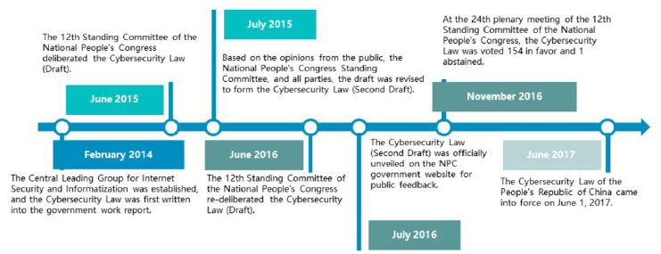
Chapter
10
Cyber Security Laws & Regulations in China
• The Cybersecurity Law of the People's Republic of China was adopted by the Standing Committee of the National People's Congress (NPC) in November, 2016 and came into force on June 1, 2017. The Cybersecurity Law is China's first to provide guidelines on cyber security.
• The Cybersecurity Law underwent three years of deliberation before its final release.

Slide 8
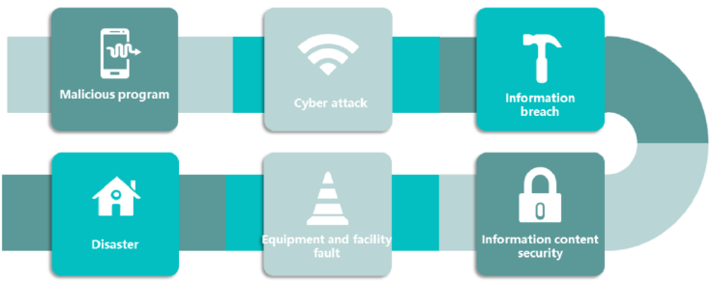
Chapter
10
Cyber Security Incident Classification
• Cyber security incidents are classified as follows in the National Emergency Plan for Cyber Security Incidents:

Slide 9
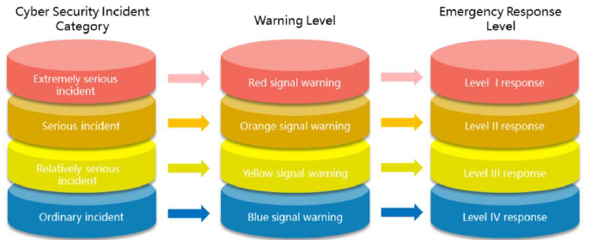
Chapter
10
National Cyber Security Incident Categories
• The National Emergency Plan for Cyber Security Incidents clarifies the enforcement solution for Chapter V "Monitoring, Early Warnings, and Emergency Responses" of the PRC Cybersecurity Law. The Plan divides incidents into four categories, which correspond to four warning levels and emergency response levels.

Slide 10

Chapter
10
Concept of Incident Response/Emergency Response
• Incident response/emergency response refers to the preparations made by an organization to respond to emergencies and major information security incidents and the measures taken after the incident occurs.
• — GB/T 24363-2009 Information Security Emergency Response Plan Specifications
• The emergency response object of an information system security incident refers to the security incident of the information stored, transmitted, and processed by the information system. The incident subject may be caused by natural events, system faults, or manual attacks from internal or external personnel.
• —GA/T 708-2007 Architecture framework of security classification protection for information system

Slide 11
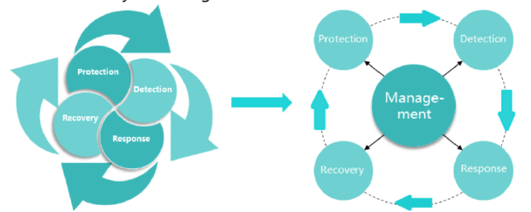
Chapter
10
Cyber Security Emergency Response Model
• MPDRR is an acronym for management, protection, detection, reaction, and recovery. The MPDRR model is a common cyber security model with an in-depth defense system.
• The MPDRR model is developed based on the PDRR (protection, detection, recovery, response) model. It inherits the advantages of the PDRR model and adds security management to security technologies.

Slide 12

Chapter
10
Regulations & Standards for Digital Forensics
• Emergency response types:
□ Remote emergency response (preferred): Emergency response teams handle security incidents by Telephone, email, or fax after receiving incident reports from customers.
□ Local emergency response: Emergency response teams shortly arrive at the sites where cyber security incidents occur, locate the causes, resolve the issues, and create detailed emergency response reports.

Slide 13
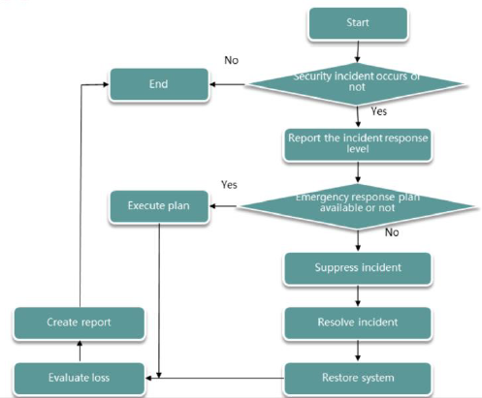
Chapter
10
Handling Process of Cyber Security Emergency Response

Slide 14
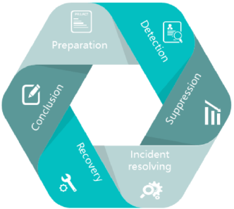
Chapter
10
Cyber Security Emergency Response
• Cyber security emergency response plays an important role in tracing, handling, and preventing emerging cyber security incidents to ensure network information security. Currently, emergency response includes:

Slide 15
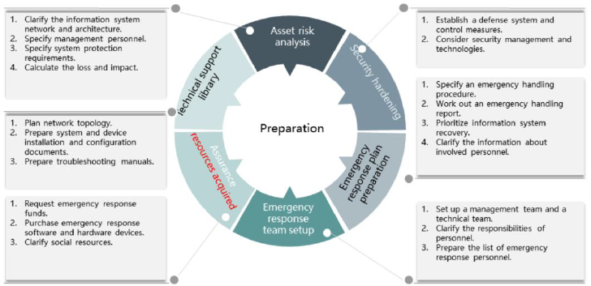
Chapter
10
Preparation
Assess potential security incidents and formulate corresponding policies and assurance measures to suppress and resolve security incidents.

Slide 16
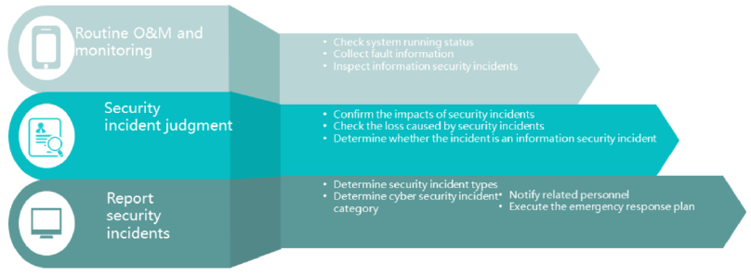
Chapter
10
Detection
• Perform routine monitoring and collect system information. If a network security incident occurs, determine its impact and category, and report the incident

Slide 17
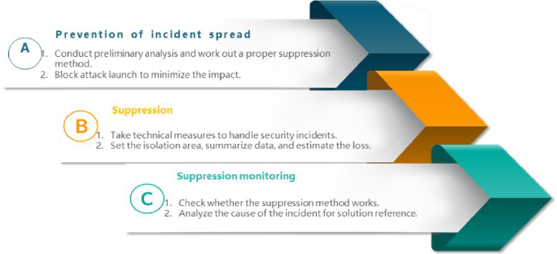
Chapter
10
Suppression
• Restrict the scope of attacks and limit potential loss and damage. If an emergency incident is detected, start the emergency response process to minimize the impact of the incident.

Slide 18
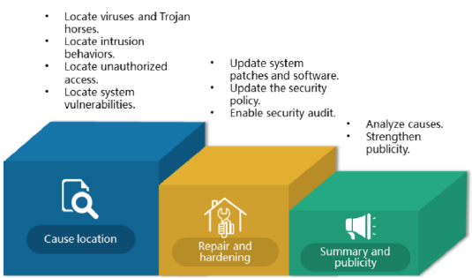
Chapter
10
Incident Resolving
• After the security incident is suppressed, locate the root cause to resolve the incident.

Slide 19

Chapter
10
Recovery
• Restore all the compromised systems, applications, databases, and network devices to normal status.
□ Restore network device configurations.
□ Restore data or systems.
□ Back up all changes.
□ Check running status of the devices that recover.
□ Check whether the isolation measures work. Remove isolation measures or short-term suppression defense measures if site situation improves.

Slide 20
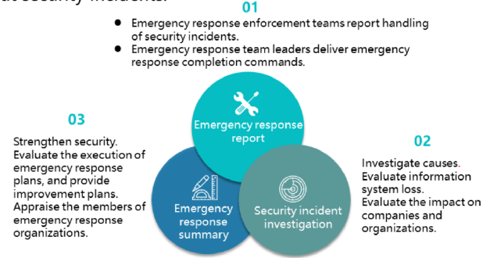
Chapter
10
Conclusion
• Learn lessons from security incident responses, and summarize information about security incidents.

Slide 21
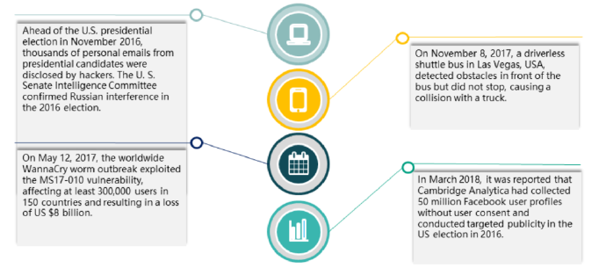
Chapter
10
Global Major Security Incidents
• The loT, mobile Internet, cloud computing, and big data are booming. Emerging technologies are reshaping the world. However, cyber security incidents are still on the rise, increasing people's concerns about cyber safety.

Slide 22
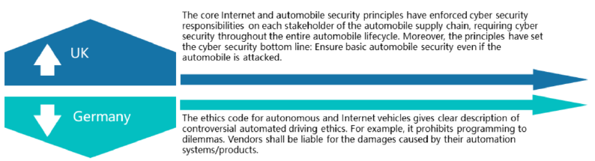
Chapter
10
Cyber Security Laws/Regulations
• In 2017, global pilot projects focusing on cyber security laws and regulations were initiated in critical infrastructure, personal data security, and cyber emergency response. As a result, some countries have introduced trial security assurance regulations on autonomous driving.

Slide 23
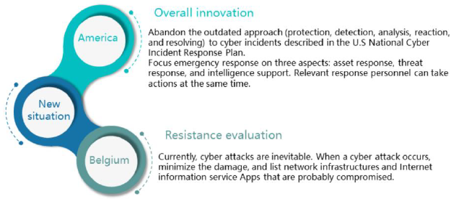
Chapter
10
New Trend in Cyber Security Emergency Response
• In 2017, global cyber attacks, such as WannaCry ransomware, occurred at a high rate. It is difficult to effectively monitor and provide alerts for unexpected global security incidents. Furthermore, nations tend to be reactive instead of proactive when it comes to security incidents. The United States and Belgium, among others, have departed from the existing emergency response mechanism.

Slide 24
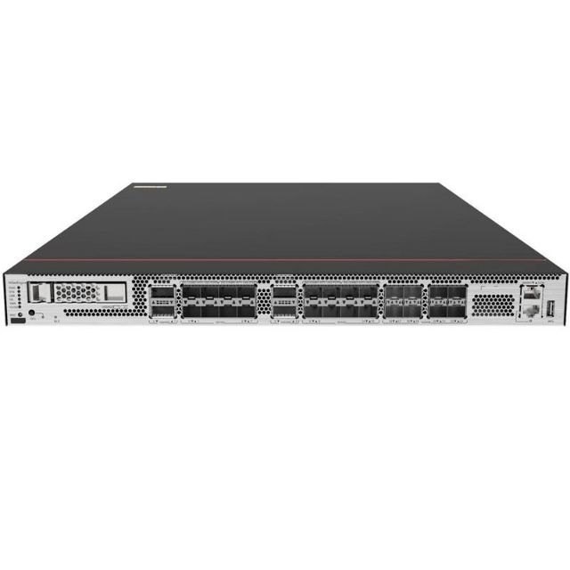
Chapter
Huawei USG6725F Firewall
10
This device recently earned the “Recommended” rating in the 2025 public evaluation by Wuhan Huanghe Laboratory, one of China’s important national security testing bodies.
This ranking means the firewall demonstrated:
High threat detection accuracy
High performance under stress
Strong zero-day attack resistance
Very low false positives
This makes it an excellent model for enterprises and SOC operations.

Slide 25
Chapter
10
Positioning of USG6725F in Huawei’s Security Portfolio
Huawei’s firewall product line:
USG6300 → SME
USG6500 → Mid-Enterprise
USG6700 Series → Data Center / Enterprise
USG6700E → High-performance data center
USG6725F sits between 6700E and 6500, giving:
  Data-center level features
  But affordable for large campus & enterprise edge
This model is often used at:
Internet boundary (north-south traffic)
Core campus firewall
Cloud edge security
Branch-to-HQ secure gateway

Slide 26
Chapter
Hardware Architecture of USG6725F
10
The USG6725F is built on Huawei’s latest UniSecurity hardware architecture:
3.1 Multi-core CPU + Security ASIC
Multi-core general-purpose processor for control plane + management
Dedicated security acceleration chip (ASIC) for:
  VPN encryption/decryption
  DPI (Deep Packet Inspection)
  Session management
  IPS pattern matching
  This achieves high throughput with low latency.

Slide 27
Chapter
Hardware Architecture of USG6725F
10
3.2 Hardware Bypass & Redundancy
Hot-swappable power supplies
Intelligent fan control
Hardware-bypass ports to avoid outages if the device fails
3.3 Interface Flexibility
Depending on model variant:
GE RJ45 / GE SFP
10GE ports
Some models support 40GE/100GE via module

Slide 28
Chapter
Software Architecture: Security Engines
10
The USG6725F runs Huawei’s unified security operating system, and inside it are many security engines.
4.1 Application Awareness Engine
Identifies 6000+ applications
Even if they use non-standard ports
Uses machine learning & payload analysis
Enables policy like:
“Block TikTok but allow Teams”,
“Allow Facebook browsing but block Facebook video streaming”,
“Allow SSH but only to specific servers”

Slide 29
Chapter
Software Architecture: Security Engines
10
4.2 Intrusion Prevention System (IPS)
Signature-based detection
Protocol anomaly detection
Zero-day exploit detection
Virtual patching:
  Firewall blocks exploitation attempts before a system is patched
IPS has:
Decoding engine → Understands protocols like HTTP/2, DNS, SMB, TLS
Attack detection engine → signature and behavior
Correlation engine → combines events to reduce false positives

Slide 30
Chapter
Huawei USG6725F Firewall
10
4.3 Anti-Malware Engine
Uses:
File hash reputation
Sandboxing integration (sending suspicious files to cloud sandbox)
Static file scanning
Heuristic behavior detection
Stops:
Ransomware
Worm propagation
Backdoors
Spyware command/control communications

Slide 31
Chapter
Huawei USG6725F Firewall
10
4.4 VPN Engine
Supports:
IPsec VPN
SSL VPN
GRE
L2TP
DVPN (dynamic mesh VPN for large enterprises)
VPN acceleration runs on ASIC → very high throughput.

Slide 32
Chapter
Conclusion
10
Huawei USG6725F is a high-performance NGFW with:
Deep packet inspection
AI-driven threat detection
Advanced IPS and malware defense
Zero-trust support
High VPN performance
SOC-ready visibility

Slide 33



Thank You

