Slide 1

Research Methods (RSC 701)
Prepared by
Dr. Mahitab ELrafii
Lecture No.9
Research Methods (RSC 701)

Slide 2

Sources of Knowledge
Research Methods
Dr. Mahitab ELrafii

Slide 3
Content of lecture
Lecture 9
The Content of lecture 9 Includes the following:
What is the conclusion of the research paper?
Research conclusion
Sum up the paper
Summarize your findings
Effective strategies in writing the conclusion
Writing an effective conclusion for your research paper can be achieved using any of the following strategies:
What to avoid in conclusion?
How should you write your recommendations?
Frequently asked questions about recommendations

Slide 4

Lecture 9
What is the conclusion of the research paper?
The conclusion is the part of the research paper that brings everything together in a logical manner. As the final part of a research paper, the conclusion provides a clear explanation of your research findings in a way that emphasizes the importance of your study. The conclusion should be broader and more comprehensive compared to a particular outcome, and in the same vein, different findings can be combined into a single conclusion (Barron, 2008).

Slide 5
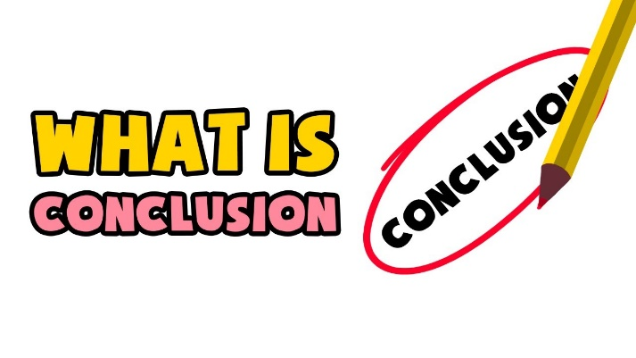
Lecture 9
What is the conclusion of the research paper?
Unlike an introduction where you open a dialogue with the readers about the problem and/or present your research questions, arguments, and knowledge gaps you aim to fill, an epilogue provides a clear and concise picture of how you can achieve all of these.

Slide 6
Lecture 9
What is the conclusion of the research paper?
Conclusion is where you describe the consequences of your arguments by justifying to your readers why your arguments are important (Hamilton College, 2014).
Derntl (2014) also describes conclusion as the counterpart to introduction. Using the hourglass model (Swales, 1993) as a visual reference, Derntl describes the conclusion as part of a research paper that leads readers from narrow or specific findings to a broader, more general conclusion.

Slide 7
Lecture 9
Research conclusion
The conclusion of the paper is where you wrap up your ideas and leave the reader with a strong final impression. It has several main goals:
Paraphrase the problem statement addressed in the paper
Summarize your general arguments or findings

Slide 8
Lecture 9
Research conclusion
Suggest the main points from your paper The content of the conclusion varies depending on whether your research paper presents the results of original empirical research or builds an argument through interaction with sources.

Slide 9
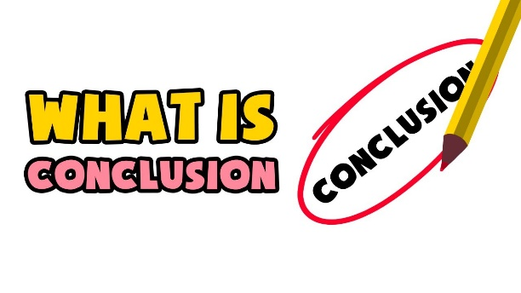
Lecture 9
Restate the problem
The first task of your conclusion is to remind the reader of your research problem. You will have discussed this issue in depth throughout the body, but the point now is to zoom out from the details to the bigger picture.
While you are paraphrasing an issue you have previously submitted, you should avoid phrasing it like the way you presented it in the introduction. Ideally, you will find a new way to revisit the problem through the more detailed ideas discussed in the flesh.

Slide 10

Lecture 9
Restate the problem
For example: Research examining the relationship of Instagram usage to photo issues might present their problem as follows:
As social media becomes increasingly central to young people's daily lives, it is important to understand how different platforms influence their concept of self-development.
“Finally…”
Avoid beginning your conclusion with phrases like "in conclusion" or "in conclusion," as this can sound too obvious and make your writing seem uncomplicated. The content and placement of the conclusion should explain its function without the need for additional references.

Slide 11
Lecture 9
Sum up the paper
Having revisited the problem, it is time to summarize how the text of the paper began to address it, and what conclusions this approach led to.
Depending on the nature of your research paper, this may mean restating your thesis and arguments or summarizing your overall findings.

Slide 12
Lecture 9
Sum up the paper
Briefly summarize the main arguments presented in the body, showing how each contributes to the proof of your thesis. You can also list any counter-arguments you have taken up, emphasizing why your thesis is contested, especially if your argument is controversial.

Slide 13
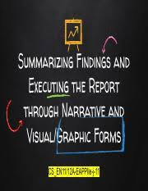
Lecture 9
Summarize your findings
.
In an experimental paper, this is the time to summarize your main findings. Don't go into detail here (you'll have provided your in-depth findings and discussions already), but clearly articulate the answers to the research questions you've investigated.
Describe your main results, even if they are not necessarily the ones you expected or hoped for and explain the general conclusion to which they led you.

Slide 14

Discuss the implications
Lecture 9
After summarizing your main arguments or findings, conclude by looking at the broader implications of your research. This means expressing the main points, practical or theoretical, from your research paper - often in the form of a call to action or suggestions for future research.

Slide 15

Lecture 9
future research directions
In a more empirical paper, you can close it by either making recommendations for practice or suggesting directions for future research.
Whatever the scope of your research, there will always be room for further investigation of relevant topics, and you will often discover new questions and problems during the research process.
End your paper on a forward-looking note by suggesting how you or other researchers can build on this topic in the future and address any limitations of the current paper.

Slide 16
Lecture 9
future research directions
.
If you are unsure of your conclusion, it may be helpful to ask a friend or fellow student to read your conclusion and summarize the main points.
Do they understand from your conclusion what your research is about?
Are they able to summarize the implications of your findings?
Can they answer your research question based on your conclusion?

Slide 17
Lecture 9
Why Is Conclusion Necessary in a Research Paper?
Just like the final chord in a song, a conclusion is essential to making a research paper complete and concise (CRLS Research Guide, 2018). While your introduction sets expectations and your research paper presents your detailed methodology and analyses, the epilogue is where you state the importance of your findings, ideas, and observations. The conclusion creates a larger picture of your research work that helps readers see your subject matter as a whole and in a new light.

Slide 18

Lecture 9
Why Is Conclusion Necessary in a Research Paper?
As the author of your research paper, the conclusion plays an important role in giving you the opportunity to have the last word, make a good impression, and end your paper on a positive note. In order to achieve this, your conclusion must possess the key characteristics of an effective closing section. An effective concluding section is also one of the most important characteristics of good research.

Slide 19
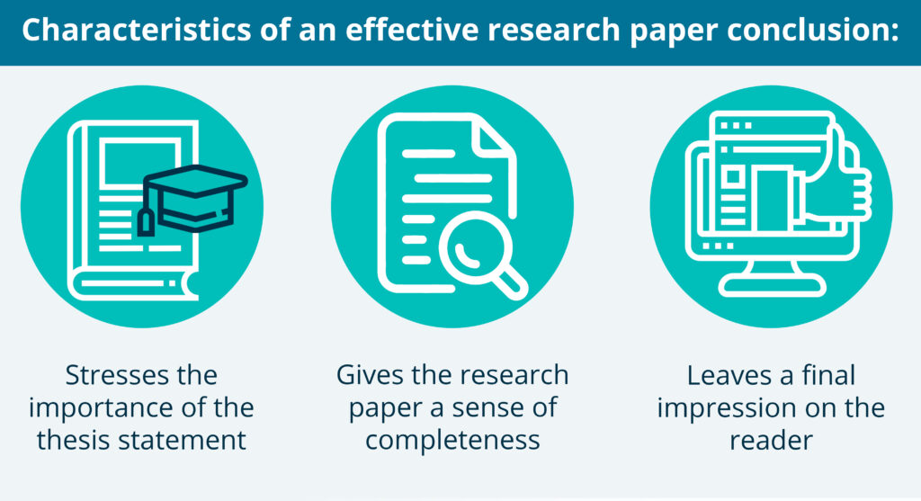
Lecture 9
.

Slide 20

Lecture 9
Effective strategies in writing the conclusion
In terms of length, conclusions of professional empirical research articles usually contain five to six paragraphs, while student/junior papers usually contain conclusions of two to three paragraphs (Powner, 2017).
The conclusion of your research paper is the opposite of the introduction not only in placement but also in structure. The introduction generally follows an inverted triangle format with the general statement element at the top, narrowing down to the main point of the research. The conclusion, on the other hand, follows the structure of a flipped introduction by opening with the highlights of your research and ending with a general but relevant statement that encourages readers to think, as well as challenging them to act based on the new pieces of knowledge, they gained from your research paper.

Slide 21
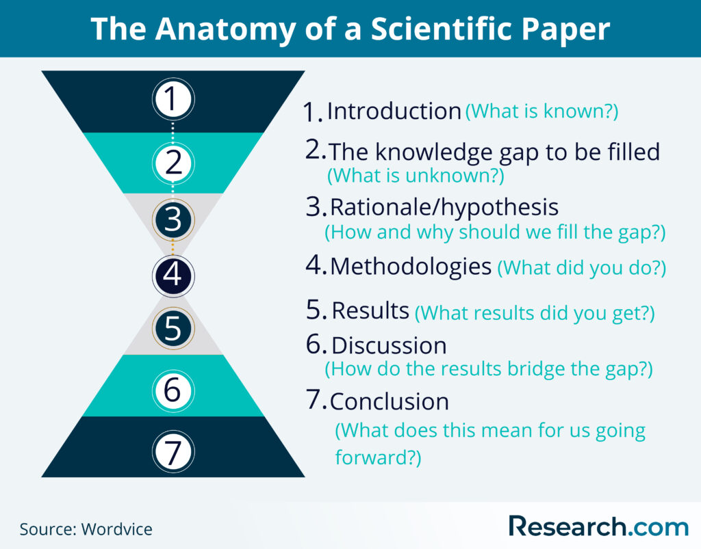
Lecture 9
.

Slide 22
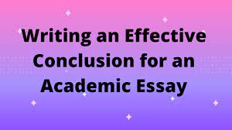
Writing an effective conclusion for your research paper can be achieved using any of the following strategies:
Lecture 9
Synthesize rather than summarize
As mentioned earlier, the conclusion is not a summary of your research paper. While the summary can be an element of this section, the conclusion goes beyond simply restating your thoughts and analyses. Rather than repeating what you've already said in the abstract, introduction, and body of your monograph, show the reader how coherently the key elements of your research paper fit together.

Slide 23
Writing an effective conclusion for your research paper can be achieved using any of the following strategies:
Lecture 9
echo foreground
This approach to conclusion writing leads the reader full circle by using or referring to the same elements you used in your introduction or by drawing parallels. An example would be retelling the scenario you described in the introduction, but this time while creating a new understanding of the topic based on the results of your study that reinforce your arguments and/or hypotheses.

Slide 24
Writing an effective conclusion for your research paper can be achieved using any of the following strategies:
Lecture 9
Redirect the reader
Your conclusion plays the role of being a bridge for your readers to return to the real world after welcoming them to your study through your introduction and engaging them in your methodologies, analyzes, and findings. Redirecting your readers is a way to challenge them to take the information they get from your research study and apply it to real life. This strategy can also be approached by suggesting a course of action for further studies or solutions to an existing issue.
Challenge your conclusion
Also called the "so what" game, this strategy requires you to challenge your thoughts by asking yourself "so what?" While you are developing your conclusion. Once you have your conclusion on paper, review it with someone who will challenge what you have written (The Writing Center UNC, n.d.). You can ask a friend to read your conclusion with you and ask, "So what?" after each statement. This strategy can help you find gaps in your conclusion and refine them in the process.

Slide 25
Writing an effective conclusion for your research paper can be achieved using any of the following strategies:
Lecture 9
Addressing restrictions
This strategy asks you, the researcher, to identify weaknesses in your research paper, which include aspects in which your argument is lacking, or if there are cases in which your conclusion may be incorrect. This strategy is useful for writing conclusions for scientific papers as well as for experiments .
Show ideas to create a new image or meaning
All relevant data should be interpreted at the appropriate depth. Explain how the methodologies or mechanisms used, as well as your observations, helped to reach the conclusions of your study. There are times when your studies may not yield the results you expected. In such cases, explain to the readers why this is happening. If the results are consistent with your expectations, go on to describe your theory that is supported by your evidence (Caprette, 1995).
ask questions
Research studies are driven by questions. Asking research questions, either of your readers or in general, may help your readers gain a new perspective on the topic, which they may not have held before reading your conclusion. It may also bring your main points together to generate or develop a new idea from your research study.

Slide 26
Lecture 9
What to avoid in conclusion?
Coming to an effective conclusion involves avoiding techniques that can hold you back from developing a compelling concluding section of your research paper. Here are some strategies to avoid when writing a search result:
General and clear opening statements
Don't begin your conclusion with broad terms, such as "conclusion," "summary," "conclusion," etc. While this may be an effective transition during an oral presentation, it doesn't work the same way on actual paper where readers can tell which part of Your paper they read exactly.
Add new information
The Conclusion portion of your research paper should contain space for any information that is relevant to your study but is not referenced elsewhere in your research paper. All important information must be in the body. The abstract is not the appropriate section to introduce new information as you are supposed to communicate to readers about the value of your research study.

Slide 27
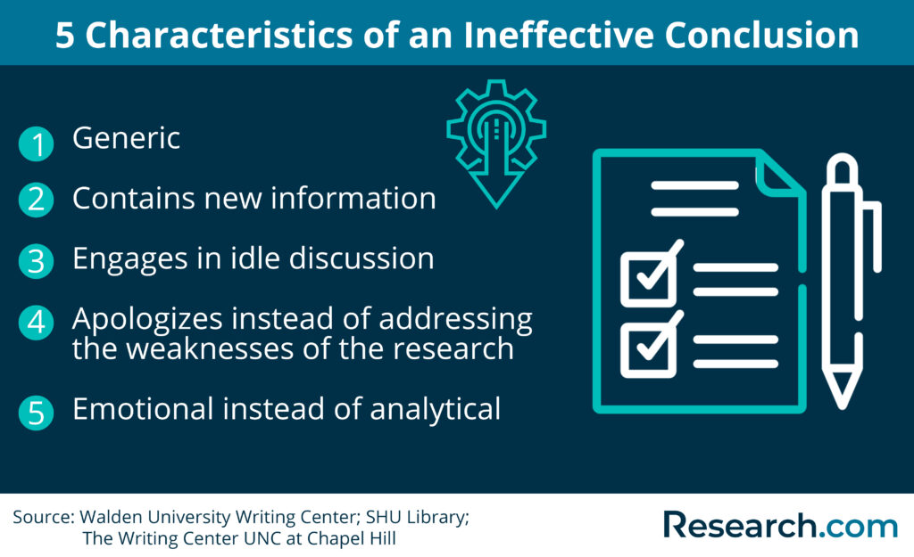
Lecture 9
What to avoid in conclusion?
apologies
When you get to the concluding part of your research paper, you may have doubts about your research paper. You may ask yourself if you've done enough, and you may feel obligated to apologize. Do not undermine your authority over your research by expressing doubts about your approach and apologizing for your inability to include other methodologies that you may consider better than your own. You understand that you have immersed yourself in your research and have covered all the bases to produce a sound and well-supported research study.
Appeal to the feelings of the readers
Your conclusion, just like the rest of your research paper, is supposed to be analytical, not emotional. Avoid making emotional statements to appeal to your readers' feelings as this tends to get out of character with what should be a logical and scientific research study (The Writing Center UNC, n.d.).

Slide 28
Lecture 9
Choose the right strategy to use in writing your paper's conclusion
Writing a research paper may follow the same general structure, but the way the concluding section is written may differ depending on the area of ​​specialization and conventions of your research paper. The tone of your research paper, be it analytical, argumentative, expository, etc. also plays a role in choosing the best approach.
For example, if you want to invite your readers to look and explore a new idea that developed from your argument, asking a new question might be the right strategy to use. If you want to delve into potential weaknesses in your research, addressing limitations may be the best way to go. Whatever strategy or approach you will use, make sure it keeps the flow and tone of your research paper consistent, as well as clearly communicating your final message and the impact you wish to have on your readers. Once you have your well-written conclusion, the next step is to learn how to write an abstract for a research paper.

Slide 29

Lecture 9
Recommendations in research
Recommendations in research are an important component of your discussion section and conclusion of your dissertation, dissertation, or research paper.
As you conduct your research and analyze the data you have collected, there may be ideas or findings that do not quite fit the scope of your research topic. Or your results may indicate that there are other implications for your conclusions or causal relationships between previously studied variables that were addressed in the current research.

Slide 30
Lecture 9
Recommendations in research
Recommendations are generally included both in the conclusion (in brief) and in your discussion section. However, if your research is more business-oriented or practical in nature, you may also present it in a separate chapter or consulting report.

Slide 31
Lecture 9
What should recommendations look like?
Research recommendations should be:
concrete and specific
Backed by a clear rationale
directly related to your researching
general, provide ways in which other researchers can reproduce or replicate your findings to draw further conclusions, and suggest different directions that future research could take, if applicable.

Slide 32
Lecture 9
What should recommendations look like?
Likewise, when making these recommendations, avoid:
Undercut your own work, but instead make suggestions about how future studies can build on it Suggesting recommendations is necessary to complete your argument, but instead make sure that your research stands on its own on its own merits. Use the recommendations as a place for self-criticism, but as a natural extension of your work

Slide 33

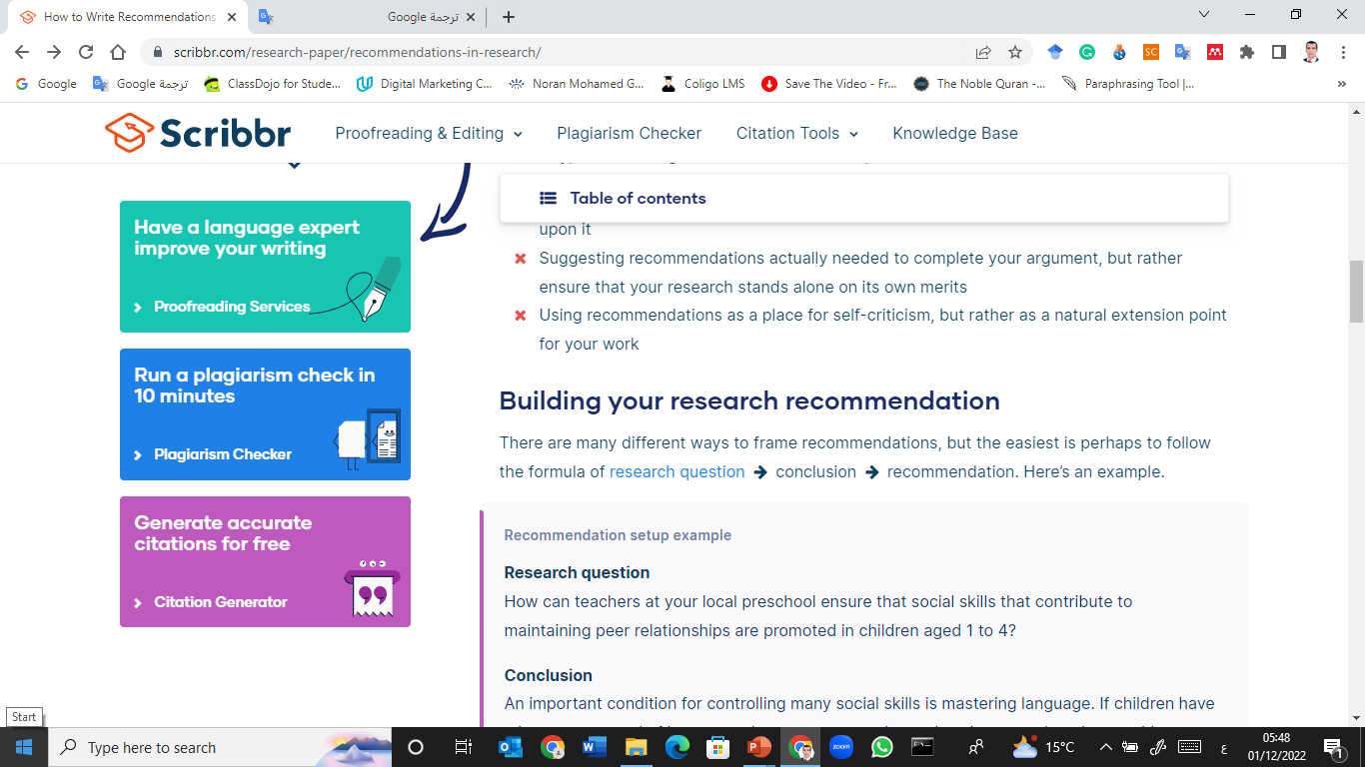
Building your research recommendation
Lecture 9

Slide 34
Lecture 9
How should you write your recommendations?
As a rule of thumb, try to limit yourself to only the most relevant future recommendations: ones that stem directly from your work. While you can have multiple recommendations for each research conclusion, it is also acceptable to have one recommendation that is connected to more than one conclusion.
These recommendations should be targeted at your audience, specifically toward peers or colleagues in your field that work on similar subjects to your paper. They can flow directly from any limitations you found while conducting your work, offering concrete and actionable possibilities for how future research can build on anything that your own work was unable to address at the time of your writing.

Slide 35

Lecture 9
Frequently asked questions about recommendations
May I present new arguments in the conclusion of my dissertation?
While it may be tempting to present new arguments or evidence in your thesis or dissertation conclusion, especially if you have a particularly striking argument that you want to end your analysis with, you shouldn't. Theses and dissertations follow a more formal structure than this.
All of your findings and arguments should be presented in the body of the text (more specifically in the Discussion section and the Results section.) The conclusion is intended to summarize and reflect on the evidence and arguments you have already presented, not to present new arguments
.

Slide 36
Lecture 9
Frequently asked questions about recommendations
What should I include in a dissertation or dissertation conclusion?
The conclusion of your dissertation or dissertation should include the following:
Rephrase your research question
A summary of your main arguments and/or findings
A short discussion of the implications of your research

Slide 37
Lecture 9
Frequently asked questions about recommendations
What is not included in the conclusion of the thesis?
For a stronger thesis result, avoid including:
Important evidence or analysis that is not mentioned in the discussion section and results section
General closing phrases ("In conclusion...")
Weak statements that undermine your argument ("There are good points on both sides of this issue").
Your conclusion should leave the reader with a strong and decisive impression of your work.

Slide 38
Lecture 9
Frequently asked questions about recommendations
What is the difference between discussion and conclusion?
In a dissertation or dissertation, the discussion is an in-depth exploration of the findings, going into detail about the meaning of your findings and citing relevant sources to put them into context.
The conclusion is shorter and more general: it succinctly answers the main research question and makes recommendations based on the overall findings.

Slide 39
Indications or recommendations in research: what is the difference?
Lecture 9
High-quality research articles that get many citations contain implications and recommendations. Implications are the impact your research has, while recommendations are specific actions that can be taken based on your findings, such as further research or policy making.
This seems obvious enough, but the two are generally confused.
This confusion is especially true if you come from a so-called higher context culture where information is often embedded based on situation, as it is in many Asian cultures. High-context cultures differ from low-context cultures in which information is more direct and clearer (as in North American and many European cultures).

Slide 40
Lecture 9
Thank you

