Slide 1


AWS Cloud Security Foundations
(AWS-CSF)
Lecture 3
AWS Foundational Services - Compute
Prepared by
Dr. Ibrahim Gomaa

Slide 2

Lecture
Course Outline
3
Lecture 3: AWS Foundational Services - Compute
Topics
Compute services overview
Amazon EC2
Amazon EC2 cost optimization
Container services
Introduction to AWS Lambda
Introduction to AWS Elastic Beanstalk
AWS Cloud Security Foundations– AWS-CSF
Lecture 3 – AWS Foundational Services - Compute
Dr. Ibrahim Gomaa

Slide 3
Lecture
AWS Foundational Services - Compute
3
Compute services overview
AWS Cloud Security Foundations– AWS-CSF
Lecture 3 – AWS Foundational Services - Compute
Dr. Ibrahim Gomaa

Slide 4
Lecture
Compute services overview
3
Services | Key Concepts | Characteristics | Ease of Use
Amazon EC2 | Infrastructure as a service (IaaS) Instance-based Virtual machines | Provision virtual machines that you can manage as you choose | A familiar concept to many IT professionals.
AWS Lambda | Serverless computing Function-based Low-cost | Write and deploy code that runs on a schedule or that can be triggered by events Use when possible (architect for the cloud) | A relatively new concept for many IT staff members, but easy to use after you learn how.
Amazon ECS Amazon EKS AWS Fargate Amazon ECR | Container-based computing Instance-based | Spin up and run jobs more quickly | AWS Fargate reduces administrative overhead, but you can use options that give you more control.
AWS Elastic Beanstalk | Platform as a service (PaaS) For web applications | Focus on your code (building your application) Can easily tie into other services—databases, Domain Name System (DNS), etc. | Fast and easy to get started.
AWS Cloud Security Foundations– AWS-CSF
Lecture 3 – AWS Foundational Services - Compute
Dr. Ibrahim Gomaa

Slide 5
Lecture
Compute services overview
3
Choosing the optimal compute service
The optimal compute service or services that you use will depend on your use case
Some aspects to consider –
  What is your application design?
  What are your usage patterns?
  Which configuration settings will you want to manage?
Selecting the wrong compute solution for an architecture can lead to lower performance efficiency
  A good starting place—Understand the available compute options
AWS Cloud Security Foundations– AWS-CSF
Lecture 3 – AWS Foundational Services - Compute
Dr. Ibrahim Gomaa

Slide 6
Lecture
AWS Foundational Services - Compute
3
Amazon EC2
AWS Cloud Security Foundations– AWS-CSF
Lecture 3 – AWS Foundational Services - Compute
Dr. Ibrahim Gomaa

Slide 7



Lecture
3
Amazon EC2
Amazon Elastic Compute Cloud (Amazon EC2)
Amazon Elastic Compute Cloud (Amazon EC2) provides virtual machines where you can host the same kinds of applications that you might run on a traditional on-premises server
Example uses of Amazon EC2 instances
Application server
Web server
Database server
Game server
Mail server
Media server
Catalog server
File server
Computing server
Proxy server
On-premises servers
AWS Cloud Security Foundations– AWS-CSF
Lecture 3 – AWS Foundational Services - Compute
Dr. Ibrahim Gomaa

Slide 8

Lecture
3
Amazon EC2
Amazon EC2 overview
Amazon Elastic Compute Cloud (Amazon EC2)
  Provides virtual machines—referred to as EC2 instances—in the cloud.
  Gives you full control over the guest operating system (Windows or Linux) on each instance.
You can launch instances of any size into an Availability Zone anywhere in the world.
  Launch instances from Amazon Machine Images (AMIs).
  Launch instances with a few clicks or a line of code, and they are ready in minutes.
You can control traffic to and from instances.
Amazon EC2
AWS Cloud Security Foundations– AWS-CSF
Lecture 3 – AWS Foundational Services - Compute
Dr. Ibrahim Gomaa

Slide 9
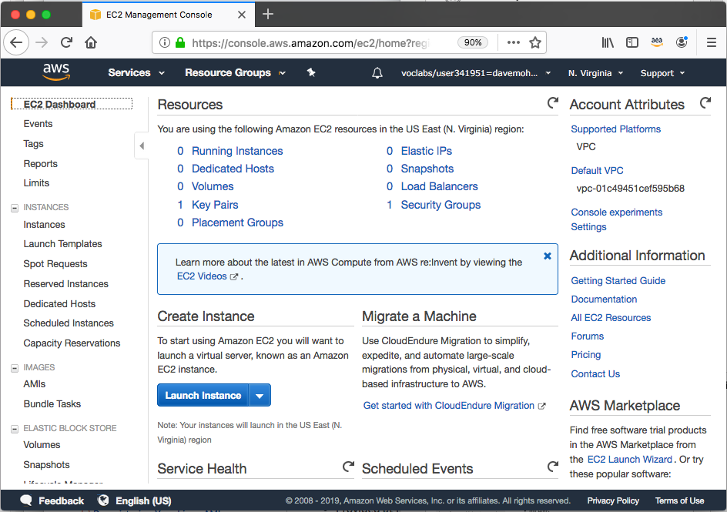
Lecture
3
Amazon EC2
Launching an Amazon EC2 instance
This section of the module walks through nine key decisions to make when you create an EC2 instance by using the AWS Management Console Launch Instance Wizard.
Along the way, essential Amazon EC2 concepts will be explored.
AWS Cloud Security Foundations– AWS-CSF
Lecture 3 – AWS Foundational Services - Compute
Dr. Ibrahim Gomaa

Slide 10


Lecture
3
Amazon EC2
1. Select an AMI
Launch
instance
AMI
Instance
Choices made using the
Launch Instance Wizard:
AMI
Instance Type
Network settings
IAM role
User data
Storage options
Tags
Security group
Key pair
Amazon Machine Image (AMI)
  Is a template that is used to create an EC2 instance (which is a virtual machine, or VM, that runs in the AWS Cloud)
  Contains a Windows or Linux operating system
  Often also has some software pre-installed
AMI choices:
  Quick Start – Linux and Windows AMIs that are provided by AWS
  My AMIs – Any AMIs that you created
  AWS Marketplace – Pre-configured templates from third parties
  Community AMIs – AMIs shared by others; use at your own risk
AWS Cloud Security Foundations– AWS-CSF
Lecture 3 – AWS Foundational Services - Compute
Dr. Ibrahim Gomaa

Slide 11


Lecture
3
Amazon EC2
Creating a new AMI: Example
AWS Cloud
AMI details
Region A
Connect to the instance and manually modify it or run a script that modifies the instance (for example, upgrade installed software)
Quick Start or other
existing AMI
Launch an instance
Capture as
a new AMI
Starter
AMI
1
2
Modified
Instance
3
Unmodified
Instance
New
AMI
(Optional) Import
a virtual machine
MyAMI
Region B
Copy the AMI to any other Regions
where you want to use it
New
AMI
4
AWS Cloud Security Foundations– AWS-CSF
Lecture 3 – AWS Foundational Services - Compute
Dr. Ibrahim Gomaa

Slide 12


Lecture
3
Amazon EC2
2. Select an instance type
Choices made using the
Launch Instance Wizard:
AMI
Instance Type
Network settings
IAM role
User data
Storage options
Tags
Security group
Key pair
Consider your use case
  How will the EC2 instance you create be used?
The instance type that you choose determines –
  Memory (RAM)
  Processing power (CPU)
  Disk space and disk type (Storage)
  Network performance
Instance type categories –
  General purpose
  Compute optimized
  Memory optimized
  Storage optimized
  Accelerated computing
Instance types offer family, generation, and size
AWS Cloud Security Foundations– AWS-CSF
Lecture 3 – AWS Foundational Services - Compute
Dr. Ibrahim Gomaa

Slide 13
Lecture
3
Amazon EC2
EC2 instance type naming and sizes
Example instance sizes
Instance Name | vCPU | Memory (GB) | Storage
t3.nano | 2 | 0.5 | EBS-Only
t3.micro | 2 | 1 | EBS-Only
t3.small | 2 | 2 | EBS-Only
t3.medium | 2 | 4 | EBS-Only
t3.large | 2 | 8 | EBS-Only
t3.xlarge | 4 | 16 | EBS-Only
t3.2xlarge | 8 | 32 | EBS-Only
Instance type details
Instance type naming
Example: t3.large
  T is the family name
  3 is the generation number
  Large is the size
AWS Cloud Security Foundations– AWS-CSF
Lecture 3 – AWS Foundational Services - Compute
Dr. Ibrahim Gomaa

Slide 14




Lecture
3
Amazon EC2
Select instance type: Based on use case
Instance type details
 | General Purpose | Compute Optimized | Memory Optimized | Accelerated Computing | Storage Optimized
Instance Types | a1, m4, m5, t2, t3 | c4, c5 | r4, r5, x1, z1 | f1, g3, g4, p2, p3 | d2, h1, i3
Use Case | Broad | High performance | In-memory databases | Machine learning | Distributed file systems
AWS Cloud Security Foundations– AWS-CSF
Lecture 3 – AWS Foundational Services - Compute
Dr. Ibrahim Gomaa

Slide 15
Lecture
3
Amazon EC2
Instance types: Networking features
The network bandwidth (Gbps) varies by instance type.
  See Amazon EC2 Instance Types to compare.
To maximize networking and bandwidth performance of your instance type:
  If you have interdependent instances, launch them into a cluster placement group.
  Enable enhanced networking.
Enhanced networking types are supported on most instance types.
  See the Networking and Storage Features documentation for details.
Enhanced networking types –
  Elastic Network Adapter (ENA): Supports network speeds of up to 100 Gbps.
  Intel 82599 Virtual Function interface: Supports network speeds of up to 10 Gbps.
AWS Cloud Security Foundations– AWS-CSF
Lecture 3 – AWS Foundational Services - Compute
Dr. Ibrahim Gomaa

Slide 16




Lecture
3
Amazon EC2
3. Specify network settings
Where should the instance be deployed?
  Identify the VPC and optionally the subnet
Should a public IP address be automatically assigned?
  To make it internet-accessible
Choices made by using the
Launch Instance Wizard:
AMI
Instance Type
Network settings
IAM role
User data
Storage options
Tags
Security group
Key pair
AWS Cloud
Region
Availability Zone 1
Availability Zone 2
VPC
Example: specify to deploy the instance here
Public subnet
Instance
Private subnet
AWS Cloud Security Foundations– AWS-CSF
Lecture 3 – AWS Foundational Services - Compute
Dr. Ibrahim Gomaa

Slide 17


Lecture
3
Amazon EC2
4. Attach IAM role (optional)
Choices made by using the
Launch Instance Wizard:
AMI
Instance Type
Network settings
IAM role
User data
Storage options
Tags
Security group
Key pair
Will software on the EC2 instance need to interact with other AWS services?
  If yes, attach an appropriate IAM Role.
An AWS Identity and Access Management (IAM) role that is attached to an EC2 instance is kept in an instance profile.
You are not restricted to attaching a role only at instance launch.
  You can also attach a role to an instance that already exists.
Application on instance can access
attached to
Role that grants Amazon Simple Storage Service (Amazon S3) bucket access permissions
S3 bucket with objects
Instance
AWS Cloud Security Foundations– AWS-CSF
Lecture 3 – AWS Foundational Services - Compute
Dr. Ibrahim Gomaa

Slide 18
Lecture
3
Amazon EC2
4. Attach IAM role (optional)
User data
Choices made by using the
Launch Instance Wizard:
AMI
Instance Type
Network settings
IAM role
User data
Storage options
Tags
Security group
Key pair
#!/bin/bash
yum update –y
yum install -y wget
AMI
Running
EC2 instance
Optionally specify a user data script at instance launch
Use user data scripts to customize the runtime environment of your instance
  Script runs the first time the instance starts
Can be used strategically
  For example, reduce the number of custom AMIs that you build and maintain
AWS Cloud Security Foundations– AWS-CSF
Lecture 3 – AWS Foundational Services - Compute
Dr. Ibrahim Gomaa

Slide 19


Lecture
3
Amazon EC2
6. Specify storage
Configure the root volume
  Where the guest operating system is installed
Attach additional storage volumes (optional)
  AMI might already include more than one volume
For each volume, specify:
  The size of the disk (in GB)
  The volume type
    Different types of solid state drives (SSDs) and hard disk drives (HDDs) are available
  If the volume will be deleted when the instance is terminated
  If encryption should be used
Choices made by using the
Launch Instance Wizard:
AMI
Instance Type
Network settings
IAM role
User data
Storage options
Tags
Security group
Key pair
AWS Cloud Security Foundations– AWS-CSF
Lecture 3 – AWS Foundational Services - Compute
Dr. Ibrahim Gomaa

Slide 20
Lecture
3
Amazon EC2
Amazon EC2 storage options
Amazon Elastic Block Store (Amazon EBS) –
  Durable, block-level storage volumes.
  You can stop the instance and start it again, and the data will still be there.
Amazon EC2 Instance Store –
  Ephemeral storage is provided on disks that are attached to the host computer where the EC2 instance is running.
  If the instance stops, data stored here is deleted.
Other options for storage (not for the root volume) –
  Mount an Amazon Elastic File System (Amazon EFS) file system.
  Connect to Amazon Simple Storage Service (Amazon S3).
AWS Cloud Security Foundations– AWS-CSF
Lecture 3 – AWS Foundational Services - Compute
Dr. Ibrahim Gomaa

Slide 21




Lecture
3
Amazon EC2
Example storage options
Host computer
Instance 1 characteristics –
  It has an Amazon EBS root volume type for the operating system.
  What will happen if the instance is stopped and then started again?
Instance 2 characteristics –
  It has an Instance Store root volume type for the operating system.
  What will happen if the instance stops (because of user error or a system malfunction)?
Amazon Elastic Block Store (Amazon EBS)
Instance Store
Attached as
Root volume
Attached as
Storage volume
20-GB volume
Instance 1
Ephemeral
volume 1
Attached as
Storage volume
Attached as
Root volume
500-GB volume
Instance 2
Ephemeral volume 2
AWS Cloud Security Foundations– AWS-CSF
Lecture 3 – AWS Foundational Services - Compute
Dr. Ibrahim Gomaa

Slide 22
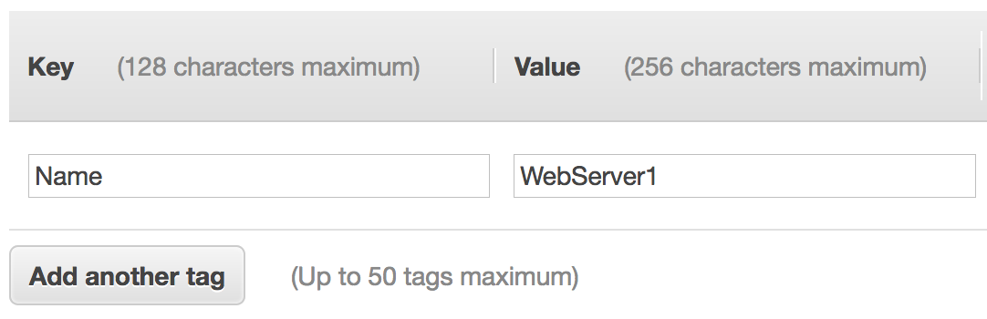
Lecture
3
Amazon EC2
7. Add tags
A tag is a label that you can assign to an AWS resource.
  Consists of a key and an optional value.
Tagging is how you can attach metadata to an EC2 instance.
Potential benefits of tagging—Filtering, automation, cost allocation, and access control.
Example:
Choices made by using the
Launch Instance Wizard:
AMI
Instance Type
Network settings
IAM role
User data
Storage options
Tags
Security group
Key pair
AWS Cloud Security Foundations– AWS-CSF
Lecture 3 – AWS Foundational Services - Compute
Dr. Ibrahim Gomaa

Slide 23
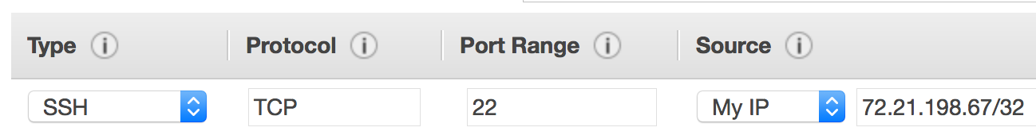
Lecture
3
Amazon EC2
8. Security group settings
Choices made by using the
Launch Instance Wizard:
AMI
Instance Type
Network settings
IAM role
User data
Storage options
Tags
Security group
Key pair
A security group is a set of firewall rules that control traffic to the instance.
  It exists outside of the instance's guest OS.
Create rules that specify the source and which ports that network communications can use.
  Specify the port number and the protocol, such as Transmission Control Protocol (TCP), User Datagram Protocol (UDP), or Internet Control Message Protocol (ICMP).
  Specify the source (for example, an IP address or another security group) that is allowed to use the rule.
Example rule:
AWS Cloud Security Foundations– AWS-CSF
Lecture 3 – AWS Foundational Services - Compute
Dr. Ibrahim Gomaa

Slide 24


Lecture
3
Amazon EC2
9. Identify or create the key pair
Choices made by using the
Launch Instance Wizard:
AMI
Instance Type
Network settings
IAM role
User data
Storage options
Tags
Security group
Key pair
At instance launch, you specify an existing key pair or create a new key pair.
A key pair consists of –
  A public key that AWS stores.
  A private key file that you store.
It enables secure connections to the instance.
For Windows AMIs –
  Use the private key to obtain the administrator password that you need to log in to your instance.
For Linux AMIs –
  Use the private key to use SSH to securely connect to your instance.
AWS Cloud Security Foundations– AWS-CSF
Lecture 3 – AWS Foundational Services - Compute
Dr. Ibrahim Gomaa

Slide 25
Lecture
AWS Foundational Services - Compute
3
Activity: Amazon EC2
AWS Cloud Security Foundations– AWS-CSF
Lecture 3 – AWS Foundational Services - Compute
Dr. Ibrahim Gomaa

Slide 26

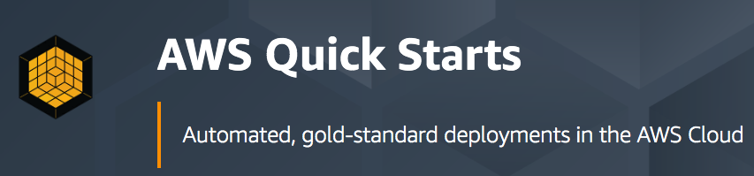
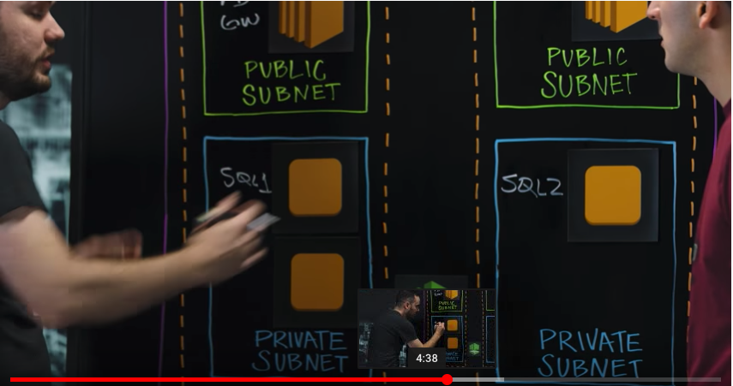

Lecture
Activity: Amazon EC2
3
Amazon EC2
Amazon RDS
AWS Cloud
Availability Zone 1
Availability Zone 2
MS SQL Server primary DB instance
MS SQL Server secondary
DB instance
Always-on
mirroring
Volume
Volume
replica
Volume
Volume replica
AWS Cloud Security Foundations– AWS-CSF
Lecture 3 – AWS Foundational Services - Compute
Dr. Ibrahim Gomaa

Slide 27
Lecture
Activity: Amazon EC2
3
Between Amazon EC2 or Amazon RDS, which provides a managed service? What does managed service mean?
  ANSWER: ???
Name at least one advantage of deploying Microsoft SQL Server on Amazon EC2 instead of Amazon RDS.
  ANSWER: ???
What advantage does the Quick Start provide over a manual installation on Amazon EC2?
  ANSWER: ???
Which deployment option offers the best approach for all use cases?
  ANSWER: ???
Which approach costs more: using Amazon EC2 or using Amazon RDS?
  ANSWER: ???
AWS Cloud Security Foundations– AWS-CSF
Lecture 3 – AWS Foundational Services - Compute
Dr. Ibrahim Gomaa

Slide 28
Lecture
Activity: Amazon EC2
3
Between Amazon EC2 or Amazon RDS, which provides a managed service? What does managed service mean?
  ANSWER: Amazon RDS provides a managed service. Amazon RDS handles provisioning, installation and patching, automated backups, restoring snapshots from points in time, high availability, and monitoring.
Name at least one advantage of deploying Microsoft SQL Server on Amazon EC2 instead of Amazon RDS.
  ANSWER: Amazon EC2 offers complete control over every configuration, the OS, and the software stack.
What advantage does the Quick Start provide over a manual installation on Amazon EC2?
  ANSWER: The Quick Start is a reference architecture with proven best practices built into the design.
Which deployment option offers the best approach for all use cases?
  ANSWER: Neither. The correct deployment option depends on your specific needs.
Which approach costs more: using Amazon EC2 or using Amazon RDS?
  ANSWER: It depends. Managing the database deployment on Amazon EC2 requires more customer oversight and time. If time is your priority, then Amazon RDS might be less expensive. If you have in-house expertise, Amazon EC2 might be more cost-effective.
AWS Cloud Security Foundations– AWS-CSF
Lecture 3 – AWS Foundational Services - Compute
Dr. Ibrahim Gomaa

Slide 29
Lecture
AWS Foundational Services - Compute
3
Amazon EC2 Cost Optimization
AWS Cloud Security Foundations– AWS-CSF
Lecture 3 – AWS Foundational Services - Compute
Dr. Ibrahim Gomaa

Slide 30
Lecture
Amazon EC2 Cost Optimization
3
Amazon EC2 pricing models
On-Demand Instances
Pay by the hour
No long-term commitments.
Eligible for the AWS Free Tier.
Dedicated Hosts
A physical server with EC2 instance capacity fully dedicated to your use.
Dedicated Instances
Instances that run in a VPC on hardware that is dedicated to a single customer.
Reserved Instances
Full, partial, or no upfront payment for instance you reserve.
Discount on hourly charge for that instance.
1-year or 3-year term.
Scheduled Reserved Instances
Purchase a capacity reservation that is always available on a recurring schedule you specify.
1-year term.
Spot Instances
Instances run as long as they are available and your bid is above the Spot Instance price.
They can be interrupted by AWS with a 2-minute notification.
Interruption options include terminated, stopped or hibernated.
Prices can be significantly less expensive compared to On-Demand Instances
Good choice when you have flexibility in when your applications can run.
AWS Cloud Security Foundations– AWS-CSF
Lecture 3 – AWS Foundational Services - Compute
Dr. Ibrahim Gomaa

Slide 31

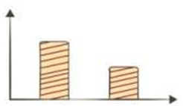
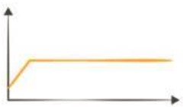

Lecture
Amazon EC2 Cost Optimization
3
Amazon EC2 pricing models: Benefits
On-Demand Instances | Spot Instances | Reserved Instances | Dedicated Hosts
Low cost and flexibility | Large scale, dynamic workload | Predictability ensures compute capacity is available when needed | Save money on licensing costs Help meet compliance and regulatory requirements
AWS Cloud Security Foundations– AWS-CSF
Lecture 3 – AWS Foundational Services - Compute
Dr. Ibrahim Gomaa

Slide 32
Lecture
Amazon EC2 Cost Optimization
3
Amazon EC2 pricing models: Use cases
Spiky Workloads
Time-Insensitive Workloads
Steady-State Workloads
Highly Sensitive Workloads
On-Demand Instances | Spot Instances | Reserved Instances | Dedicated Hosts
Short-term, spiky, or unpredictable workloads Application development or testing | Applications with flexible start and end times Applications only feasible at very low compute prices Users with urgent computing needs for large amounts of additional capacity | Steady state or predictable usage workloads Applications that require reserved capacity, including disaster recovery Users able to make upfront payments to reduce total computing costs even further | Bring your own license (BYOL) Compliance and regulatory restrictions Usage and licensing tracking Control instance placement
AWS Cloud Security Foundations– AWS-CSF
Lecture 3 – AWS Foundational Services - Compute
Dr. Ibrahim Gomaa

Slide 33





Lecture
Amazon EC2 Cost Optimization
3
The four pillars of cost optimization
Cost Optimization
Right size
Increase elasticity
Optimal pricing model
Optimize storage choices
AWS Cloud Security Foundations– AWS-CSF
Lecture 3 – AWS Foundational Services - Compute
Dr. Ibrahim Gomaa

Slide 34
Lecture
Amazon EC2 Cost Optimization
3
Pillar 1: Right size
Provision instances to match the need
  CPU, memory, storage, and network throughput
  Select appropriate instance types for your use
Use Amazon CloudWatch metrics
  How idle are instances? When?
  Downsize instances
Best practice: Right size, then reserve
Pillars:

1. Right size
2. Increase elasticity
3. Optimal pricing model
4. Optimize storage choices

AWS Cloud Security Foundations– AWS-CSF
Lecture 3 – AWS Foundational Services - Compute
Dr. Ibrahim Gomaa

Slide 35
Lecture
Amazon EC2 Cost Optimization
3
Pillar 2: Increase elasticity
Stop or hibernate Amazon EBS-backed instances that are not actively in use
  Example: non-production development or test instances
Use automatic scaling to match needs based on usage
  Automated and time-based elasticity
Pillars:
1. Right-Size
2. Increase Elasticity
3. Optimal pricing model
4. Optimize storage choices


AWS Cloud Security Foundations– AWS-CSF
Lecture 3 – AWS Foundational Services - Compute
Dr. Ibrahim Gomaa

Slide 36
Lecture
Amazon EC2 Cost Optimization
3
Pillar 3: Optimal pricing model
Leverage the right pricing model for your use case
  Consider your usage patterns
Optimize and combine purchase types
Examples:
  Use On-Demand Instance and Spot Instances for variable workloads
  Use Reserved Instances for predictable workloads
Consider serverless solutions (AWS Lambda)
Pillars:
1. Right-Size
2. Increase Elasticity
3. Optimal pricing model
4. Optimize storage choices


AWS Cloud Security Foundations– AWS-CSF
Lecture 3 – AWS Foundational Services - Compute
Dr. Ibrahim Gomaa

Slide 37
Lecture
Amazon EC2 Cost Optimization
3
Pillar 4: Optimize storage choices
Reduce costs while maintaining storage performance and availability
Resize EBS volumes
Change EBS volume types
  Can you meet performance requirements with less expensive storage?
  Example: Amazon EBS Throughput Optimized HDD (st1) storage typically costs half as much as the default General Purpose SSD (gp2) storage option.
Delete EBS snapshots that are no longer needed
Identify the most appropriate destination for specific types of data
  Does the application need the instance to reside on Amazon EBS?
  Amazon S3 storage options with lifecycle policies can reduce costs
Pillars:
1. Right-Size
2. Increase Elasticity
3. Optimal pricing model
4. Optimize storage choices


AWS Cloud Security Foundations– AWS-CSF
Lecture 3 – AWS Foundational Services - Compute
Dr. Ibrahim Gomaa

Slide 38
Lecture
AWS Foundational Services - Compute
3
Container services
AWS Cloud Security Foundations– AWS-CSF
Lecture 3 – AWS Foundational Services - Compute
Dr. Ibrahim Gomaa

Slide 39



Lecture
Container services
3
Container basics
Your Container
Containers are a method of operating system virtualization.
Benefits –
  Repeatable.
  Self-contained environments.
  Software runs the same in different environments.
    Developer's laptop, test, production.
  Faster to launch and stop or terminate than virtual machines
Your application
Dependencies
Configurations
Hooks into OS
AWS Cloud Security Foundations– AWS-CSF
Lecture 3 – AWS Foundational Services - Compute
Dr. Ibrahim Gomaa

Slide 40

Lecture
Container services
3
What is Docker?
Docker is a software platform that enables you to build, test, and deploy applications quickly.
You run containers on Docker.
  Containers are created from a template called an image.
A container has everything a software application needs to run.
Container
Containers have everything the software needs to run:
Libraries
System tools
Code
Runtime
AWS Cloud Security Foundations– AWS-CSF
Lecture 3 – AWS Foundational Services - Compute
Dr. Ibrahim Gomaa

Slide 41
Lecture
Container services
3
Containers versus virtual machines
Example
VM 1
VM 2
VM 3
Three containers on one EC2 instance
Container
App 1
App 2
App 3
Container instance 1
Container
instance 2
Container
instance 3
Bins/Libs
Bins/Libs
Bins/Libs
Docker engine
App 1
App 2
App 3
EC2 instance guest OS
EC2 instance guest OS
EC2 instance guest OS
Bins/Libs
Bins/Libs
Bins/Libs
EC2 instance guest OS
Hypervisor
Part of
AWS Global Infrastructure
Host operating system
Physical server
AWS Cloud Security Foundations– AWS-CSF
Lecture 3 – AWS Foundational Services - Compute
Dr. Ibrahim Gomaa

Slide 42

Lecture
Container services
3
Amazon Elastic Container Service (Amazon ECS)
Amazon Elastic Container Service (Amazon ECS) –
  A highly scalable, fast, container management service
Key benefits –
  Orchestrates the running of Docker containers
  Maintains and scales the fleet of nodes that run your containers
  Removes the complexity of standing up the infrastructure
Integrated with features that are familiar to Amazon EC2 service users –
  Elastic Load Balancing
  Amazon EC2 security groups
  Amazon EBS volumes
  IAM roles
Amazon Elastic Container Service
AWS Cloud Security Foundations– AWS-CSF
Lecture 3 – AWS Foundational Services - Compute
Dr. Ibrahim Gomaa

Slide 43

Lecture
Container services
3
Amazon Elastic Container Service (Amazon ECS)
To prepare your application to run on Amazon ECS, you create a task definition which is a text file that describes one or more containers, up to a maximum of ten, that form your application. The Amazon ECS task scheduler is responsible for placing tasks within your cluster. A task will run anywhere from one to ten containers, depending on the task definition you defined. When Amazon ECS runs the containers that make up your task, it places them on an ECS cluster, The cluster consists of a group of EC2 instances each of which is running an Amazon ECS container agent.
EC2 instance
Requests to run containers
x3
x2
Container A
EC2 instance
Container B
Amazon Elastic Container Service (Amazon ECS)
ECS cluster
AWS Cloud Security Foundations– AWS-CSF
Lecture 3 – AWS Foundational Services - Compute
Dr. Ibrahim Gomaa

Slide 44
Lecture
Container services
3
Amazon ECS cluster options
Key question: Do you want to manage the Amazon ECS cluster that runs the containers?
  If yes, create an Amazon ECS cluster backed by Amazon EC2 (provides more granular control over infrastructure)
  If no, create an Amazon ECS cluster backed by AWS Fargate (easier to maintain, focus on your applications)
Containers
Amazon ECS cluster backed by Amazon EC2
Amazon ECS cluster backed by Fargate
Container instance 1
Container instance 2
Container instance 3
App 1
App 2
App 3
You manage
Bins/Libs
Bins/Libs
Bins/Libs
You manage
Docker engines (one per OS in the cluster)
AWS manages
VM guest operating systems in the Amazon ECS cluster
AWS Cloud Security Foundations– AWS-CSF
Lecture 3 – AWS Foundational Services - Compute
Dr. Ibrahim Gomaa

Slide 45
Lecture
Container services
3
What is Kubernetes?
Kubernetes is open source software for container orchestration.
  Deploy and manage containerized applications at scale.
  The same toolset can be used on premises and in the cloud.
Complements Docker.
  Docker enables you to run multiple containers on a single OS host.
  Kubernetes orchestrates multiple Docker hosts (nodes).
Automates –
  Container provisioning.
  Networking.
  Load distribution.
  Scaling.
AWS Cloud Security Foundations– AWS-CSF
Lecture 3 – AWS Foundational Services - Compute
Dr. Ibrahim Gomaa

Slide 46

Lecture
Container services
3
Amazon Elastic Kubernetes Service (Amazon EKS)
Amazon Elastic Kubernetes Service (Amazon EKS)
  Enables you to run Kubernetes on AWS
  Certified Kubernetes conformant (supports easy migration)
  Supports Linux and Windows containers
  Compatible with Kubernetes community tools and supports popular Kubernetes add-ons
Use Amazon EKS to –
  Manage clusters of Amazon EC2 compute instances
  Run containers that are orchestrated by Kubernetes on those instances
Amazon Elastic Kubernetes Service
AWS Cloud Security Foundations– AWS-CSF
Lecture 3 – AWS Foundational Services - Compute
Dr. Ibrahim Gomaa

Slide 47



Lecture
Container services
3
Amazon Elastic Container Registry (Amazon ECR)
Amazon ECS integration
Docker support
Team collaboration
Access control
Third-party integrations
Amazon ECR is a fully managed Docker container registry that makes it easy for developers to store, manage, and deploy Docker container images.
Amazon Elastic Container Registry
Image
Registry
AWS Cloud Security Foundations– AWS-CSF
Lecture 3 – AWS Foundational Services - Compute
Dr. Ibrahim Gomaa

Slide 48
Lecture
AWS Foundational Services - Compute
3
Introduction to AWS Lambda
AWS Cloud Security Foundations– AWS-CSF
Lecture 3 – AWS Foundational Services - Compute
Dr. Ibrahim Gomaa

Slide 49
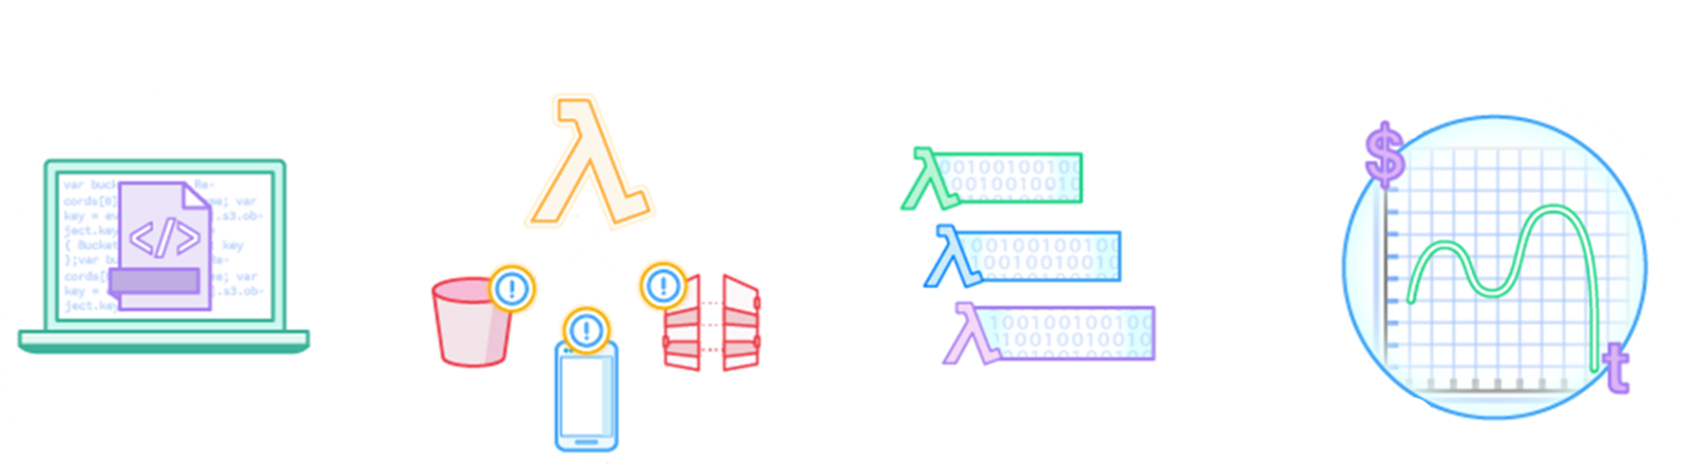

Lecture
Introduction to AWS Lambda
3
AWS Lambda: Run code without servers
AWS Lambda is a serverless compute service.
The code you run
is a Lambda function
Upload your code
AWS
services
HTTP endpoints
Your code
runs only when it is
triggered
Pay only for the
compute time that
you use
Mobile apps
Run your code on a schedule
or in response to events
AWS Cloud Security Foundations– AWS-CSF
Lecture 3 – AWS Foundational Services - Compute
Dr. Ibrahim Gomaa

Slide 50





Lecture
Introduction to AWS Lambda
3
Benefits of Lambda
It supports multiple programming languages
Completely automated administration
Built-in fault tolerance
It supports the orchestration of multiple functions
Pay-per-use pricing
AWS
Lambda
AWS Cloud Security Foundations– AWS-CSF
Lecture 3 – AWS Foundational Services - Compute
Dr. Ibrahim Gomaa

Slide 51








Lecture
Introduction to AWS Lambda
3
AWS Lambda event sources
Event sources
Configure other AWS services as event sources to invoke your function as shown here.
Alternatively, invoke a Lambda function from the Lambda console, AWS SDK, or AWS CLI.
Amazon S3
Amazon DynamoDB
Amazon Simple Notification Service (Amazon SNS)
Lambda function
Running of your code (only when triggered)
Amazon Simple Queue Service (Amazon SQS)
AWS Lambda
Amazon API Gateway
Logging, monitoring, and metrics
Application Load Balancer
Amazon
CloudWatch
Many more…
AWS Cloud Security Foundations– AWS-CSF
Lecture 3 – AWS Foundational Services - Compute
Dr. Ibrahim Gomaa

Slide 52



Lecture
Introduction to AWS Lambda
3
AWS Lambda function configuration
Lambda function configuration
Function code
Running of your code (only when it is triggered)
AWS Lambda function
Dependencies
(code libraries, etc.)
AWS Lambda
Logging, monitoring, and metrics
Amazon
CloudWatch
Execution role
AWS Cloud Security Foundations– AWS-CSF
Lecture 3 – AWS Foundational Services - Compute
Dr. Ibrahim Gomaa

Slide 53

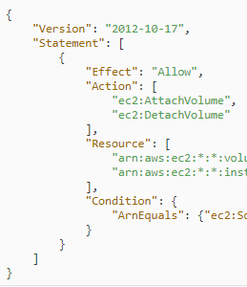

Lecture
Introduction to AWS Lambda
3
Schedule-based Lambda function example:
Start and stop EC2 instances
Stop instances example
Stop
IAM role
Start instances example
Time-based CloudWatch
event
1
2
Lambda function triggered
3
EC2 instances stopped
Start
IAM role
4
Time-based CloudWatch
event
5
Lambda function triggered
6
EC2 instances started
AWS Cloud Security Foundations– AWS-CSF
Lecture 3 – AWS Foundational Services - Compute
Dr. Ibrahim Gomaa

Slide 54


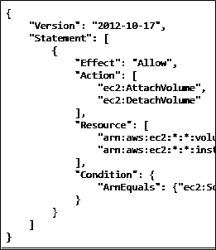
Lecture
Introduction to AWS Lambda
3
Event-based Lambda function example:
Create thumbnail images
AWS Cloud
1
2
3
User
Source
bucket
Lambda
4
5
Execution
role
Access
policy
Target
bucket
Lambda
function
AWS Cloud Security Foundations– AWS-CSF
Lecture 3 – AWS Foundational Services - Compute
Dr. Ibrahim Gomaa

Slide 55
Lecture
Introduction to AWS Lambda
3
AWS Lambda quotas
Soft limits per Region:
Concurrent executions = 1,000
Function and layer storage = 75 GB
Hard limits for individual functions:
Maximum function memory allocation = 3,008 MB
Function timeout = 15 minutes
Deployment package size = 250 MB unzipped, including layers
Additional limits also exist. Details are in the AWS Lambda quotas documentation.
AWS Cloud Security Foundations– AWS-CSF
Lecture 3 – AWS Foundational Services - Compute
Dr. Ibrahim Gomaa

Slide 56
Lecture
AWS Foundational Services - Compute
3
Introduction to AWS Elastic Beanstalk
AWS Cloud Security Foundations– AWS-CSF
Lecture 3 – AWS Foundational Services - Compute
Dr. Ibrahim Gomaa

Slide 57

Lecture
Introduction to AWS Elastic Beanstalk
3
AWS Elastic Beanstalk
An easy way to get web applications up and running
A managed service that automatically handles –
  Infrastructure provisioning and configuration
  Deployment
  Load balancing
  Automatic scaling
  Health monitoring
  Analysis and debugging
  Logging
No additional charge for Elastic Beanstalk
  Pay only for the underlying resources that are used
AWS Elastic
Beanstalk
AWS Cloud Security Foundations– AWS-CSF
Lecture 3 – AWS Foundational Services - Compute
Dr. Ibrahim Gomaa

Slide 58
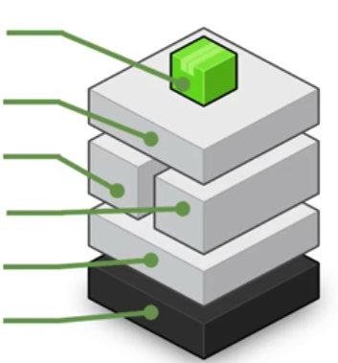
Lecture
Introduction to AWS Elastic Beanstalk
3
AWS Elastic Beanstalk deployments
It supports web applications written for common platforms
  Java, .NET, PHP, Node.js, Python, Ruby, Go, and Docker
You upload your code
  Elastic Beanstalk automatically handles the deployment
  Deploys on servers such as Apache, NGINX, Passenger, Puma, and Microsoft Internet Information Services (IIS)
You
manage
Your code
HTTP server
Application server
AWS
manages
Language interpreter
Operating system
Host
AWS Cloud Security Foundations– AWS-CSF
Lecture 3 – AWS Foundational Services - Compute
Dr. Ibrahim Gomaa

Slide 59




Lecture
Introduction to AWS Elastic Beanstalk
3
Benefits of Elastic Beanstalk
Fast and simple to start using
Developer productivity
Difficult to outgrow
Complete resource control
Use the AWS Management Console, a Git repository, or an integrated development environment (IDE) such as Eclipse or Visual Studio to upload your application
With Elastic Beanstalk, your application can handle peaks in workload or traffic while minimizing your costs
by focusing on writing code instead of managing and configuring servers, databases, load balancers, firewalls, and networks
—such as Amazon EC2 instance type—that are optimal for your application.
AWS Cloud Security Foundations– AWS-CSF
Lecture 3 – AWS Foundational Services - Compute
Dr. Ibrahim Gomaa

Slide 60
Lecture
AWS Foundational Services - Compute
3
Thanks
AWS Cloud Security Foundations– AWS-CSF
Lecture 3 – AWS Foundational Services - Compute
Dr. Ibrahim Gomaa

