Slide 1


Accounting for Managers
Prepared by Dr. Emad Zaher
Assistant Professor of Accounting
MGM341
Lecture (3)
Cash Flow Statement
Chapter
17-1

Slide 2
















Learning outcomes
1. Explain the difference between net income & net cash flow
Indicate the usefulness of the statement of cash flows.
Distinguish among operating, investing, and financing activities.
Prepare a statement of cash flows using the indirect method.
Analyze the statement of cash flows.
Chapter
17-2

Slide 3

STATEMENT OF CASH FLOWS
Income statement
Cash flow
statement
Net income
Net cash flow
Accrual Basis
Cash Basis
Chapter
17-3
Prepared by Dr. Emad Zaher

Slide 4
Usefulness of the Statement of Cash Flows
Provides information about:
Entity’s ability to generate future cash flows.
Entity’s ability to pay dividends and obligations.
Reasons for difference between net income and net cash provided (used) by operating activities.
Chapter
17-4

Slide 5


Classification of Cash Flows
Operating
Activities
Investing
Activities
Financing
Activities
Income Statement
Items
Generally Long- Term Asset Items
And investments
Generally Long-Term Liability and Equity Items
Chapter
17-5

Slide 6



Format of the Statement of Cash Flows
Order of Presentation:
Operating activities.
Investing activities.
Financing activities.
Direct Method
Indirect Method
Chapter
17-6

Slide 7


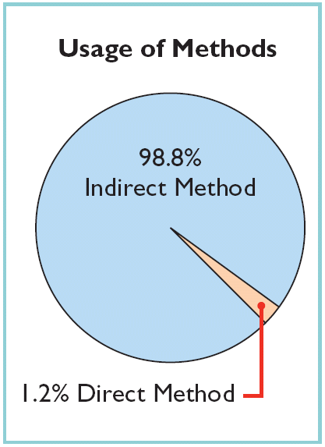
Preparing the Statement of Cash Flows
Indirect and Direct Methods
Companies favor the indirect method for two reasons:
It is easier and less costly to prepare, and
It focuses on the differences between net income and net cash flow from operating activities.
Chapter
17-7

Slide 8
Operating Activities (Indirect method)
Net income | ××
Adjustments to reconcile net income to net cash flow
Depreciation& Amortization expense | × | Add
Loss on sale of fixed assets …… | × | Add
Gain on sale of fixed assets ………. | )×( | Deduct
Changes in current assets and current liabilities
increase in current assets | )×( | Deduct
Decrease in current assets. | × | Add
Increase in current liabilities | × | Add
Decrease in current liabilities Net cash flow provided by operating activity | )×( ×× | Deduct
Chapter
17-8
Prepared by Dr. Emad Zaher

Slide 9
Current Assets | Current liabilities
Accounts Receivable | Accounts Payable
Note Receivable | Note Payable
Inventory | Expense payable
Prepaid Expense | Unearned Revenue
Chapter
17-9

Slide 10


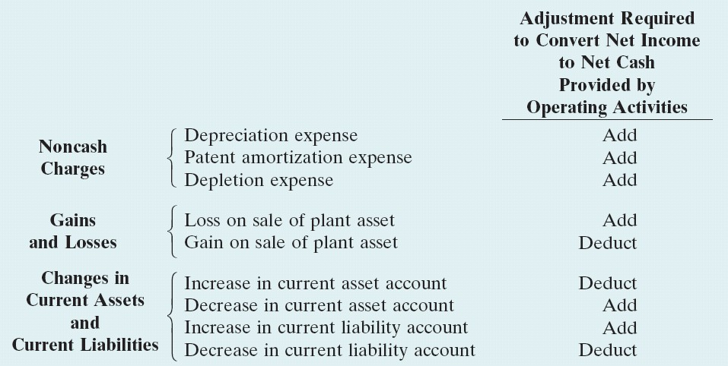
Operating Activities
Summary of Conversion to Net
Cash Provided by Operating Activities—Indirect Method
Chapter
17-10

Slide 11
Mayer company reported net income of $ 50000 for the year. During the year accounts receivable increased by 7000, accounts payable decreases by 3000 and Depreciation Expense of 5000 was recorded, Net cash provided by operating Activities for the year is…
A- $45000 B- 65000 C- $49000 D- $50000
Chapter
17-11

Slide 12
 | Cash flow From operating Activities:
 | Net income |  | 50000
 | Adjustment to reconcile Net income to Net Cash
 | Increase in accounts receivable | (7000)
 | Decrease in Accounts Payable | (3000)
 | Depreciation Expense |  | 5000
 | Net Cash flow provided by operating Activities. |  | 45000
The correct Answer is (A)
Chapter
17-12

Slide 13

A company had Net income of $ 180000. depreciation exp. is $26000. During The year Accounts receivable and inventory increases $ 15000 and 40000 Respectively. Prepaid expense . and Accounts payable decreased $2000 $ 4000 respectively. There was also a loss on the sale of equipment of $3000 . How much cash was provided by operating Activities .
A) $146000 B) 152000 C) $22600 D) $23800
Chapter
17-13
Prepared by Dr. Emad Zaher

Slide 14
 | Cash flow From operating Activities:
 | Net income |  | 180000
 | Adjustment to reconcile Net income to Net Cash
 | Depreciation Expense |  | 26000
 | Increase in accounts receivable |  | (15000)
 | Increase in inventory | (40000)
 | Decrease in Prepaid expenses |  | 2000
 | Decrease in accounts payable |  | ( 4000)
 | Loss on sale of equipment |  | 3000
 | Net Cash flow provided by operating Activities. |  | 152000
The correct Answer is (B)
Chapter
17-13
Prepared by Dr. Emad Zaher

Slide 15


Classification of Cash Flows
Investing activities
Cash inflows:
From sale of property, plant, and equipment.
From sale of investments in debt.
From collection of principal on loans to other entities.
Cash outflows:
To purchase property, plant, and equipment.
To purchase investments in debt or equity securities.
To make loans to other entities.
Chapter
17-15

Slide 16
Depreciation expense of $15.000
Gain on sale of PPE ( Property, Plant and Equipment ) $7.000
Purchases of PPE (Property, plant and Equipment )during the year totaled $120.000
Proceeds from sale of PPE ( receipts from sale ) $92.000
Collection of loans during the year $5.000
Purchase Cost of Investments, of $45.000
New Loans Made to other $35.000
Requirement: Compute cash flow from investing activities
Chapter
17-16

Slide 17
Cash flow From investing Activities:
Purchases of PPE | (120000)
Proceeds from sale of PPE | 92000
Purchase Cost of Investments | (45000)
Collection of loans during the year | 5000
New Loans Made to other | (35000)
 Net cash flow from investing Activities | (103000)
Chapter
17-17

Slide 18


Classification of Cash Flows
Financing activities
Cash inflows:
From sale of common stock.
From issuance of long-term debt (bonds and notes).
Cash outflows:
To pay dividends to stockholders. To redeem long-term debt .
To reacquire capital stock (treasury stock).
Chapter
17-18

Slide 19
The following information concerning Maldives Company :
Issuing share capital :$20.000 . m t 3t oI
Net income :$40.000 ‡ lt ho
Increase in account payable : $13.000 t lt õ2hç¿lt
Depreciation expense:18.000 Nœ t ep a
Payment of dividends : 1.000 7hç3 t ĩhSçy 2t m
Increase in account receivable :7.000 ½ ç )t õ2hç¿lt
Collection of long term notes receivable : 5.000 9t3pĬ ‡ ÷
Loss on sale of land : 10.000 ot3Ĭ ş ç õ3hm
Acquisition of equipment:40.000 ĩt Sa şt
Payment of long – term debt:13.000 ‡ș t ĩLç b ç lt 2t m
Proceeds from sale of land : 32.000 ot3Ĭ ş ç a ĩN m a
Decrease in inventories :5.000 p¿n)t lt
1) Using the indirect method Net cash provided by operating activities is equal to :
a. $85.000 $66.000 c. $79.000 d.$52.000
2 )Net cash provided by (used for ) investing activities is equal to : a. $(2.000) b. $(3.000) c.$2.000 d.$3.000
3) Net cash provided by (used for ) financing activities is equal to :
a. $(7.000) b.$(18.000) c. $7.000 d.$6.000
Chapter
17-19
Prepared by Dr. Emad Zaher

Slide 20
Cash flow From operating Activities:
Net income | 40,000
Depreciation expense | 18,000
Loss on sale of land | 10,000
Increase in accounts payable | 13000
Increase in Accounts receivable | (7000)
Decrease in Inventories | 5000
 Net cash flow from operating Activities | 79000
Chapter
17-19
Prepared by Dr. Emad Zaher

Slide 21
Cash flow From investing Activities:
Collection of long term notes receivable | 5000
Acquisition of Equipment | (40,000)
Proceeds from sale of land | 32000
 Net cash flow from investing Activities | (3000)
Chapter
17-19
Prepared by Dr. Emad Zaher

Slide 22
Cash flow From Financing Activities:
Issuance of shares capital | 20,000
Payment of dividends | (1000)
Payment of long term debt | (13000)
 Net cash flow from Financing Activities | 6000
Chapter
17-19
Prepared by Dr. Emad Zaher

Slide 23
Significant Noncash Activities
Issuance of common stock to purchase assets.
Conversion of bonds into common stock.
Issuance of debt to purchase assets.
Exchanges of plant assets.
Chapter
17-23

Slide 24
ABC Company issued common stock for of $ 19000 during 2008. The company paid dividends of $ 2000 and issued along term note payable for $ 30000 in exchange for equipment during the year. The company also sold treasury stock that had a cost of $ 7000 for L.E 4000. Compute net cash flow from financing activity
Chapter
17-24
Prepared by Dr. Emad Zaher

Slide 25
Cash flow From Financing Activities:
Issuance of common Stock | 19000
Payment of dividends | (2000)
Sale of Treasury Stock | 4000
 Net cash flow from Financing Activities | 21000
Chapter
17-24
Prepared by Dr. Emad Zaher

Slide 26
Use the following information to calculate the net cash provided or used by financing activities for the Electro light Corporation:
Net income , L.E. 10,000
Paid cash dividend of L.E. 3,000
Paid bond payable, L.E. 8,000
Purchased equipment for L.E. 12,000 cash
Chapter
17-24
Prepared by Dr. Emad Zaher

Slide 27

Cash flow From Financing Activities:
Paid cash dividends | (3000)
Paid bonds payable | (8000)
 Net cash flow from financing Activities | (11000)
Chapter
17-27

Slide 28
ABC Company reported net income of $200000 for the current year. Depreciation expense amounted to $80000 for the year. Balances of the current asset and current Liability accounts at the beginning and end of the year are as follows:
 | 2011 | 2010
Accounts receivable | 24000 | 32000
Inventories | 50000 | 65000
Prepaid expenses | 7500 | 5000
Accounts payable | 12000 | 18000
Income taxes payable | 1600 | 1200
Instructions : Prepare the cash flows from the operating activities
section of the statement of cash flows using the indirect method
Chapter
17-28
Prepared by Dr. Emad Zaher

Slide 29
Net Income |  | $200000
Adjustments to reconcile net income to net cash provided By operating activities:
Depreciation expense |  | 80000
Decrease in accounts receivable |  | 8000
Decrease in inventories |  | 15000
Increase in prepaid expenses |  | (2500)
Decrease in accounts payable |  | (6000)
Increase in income taxes payable |  | 400
Net cash provided by operating activities |  | $294900
Chapter
17-28
Prepared by Dr. Emad Zaher

Slide 30
1.All of the following activities are presented on the statement of cash flows except:
financing activities.
Operating ·activities.
c. investing activities.
d. Advertising activities.
Chapter
17-28
Prepared by Dr. Emad Zaher

Slide 31
2. Activities that create long term liabilities are
usually:
Investing activities.
Financing activities.
c. Advertising activities.
d. Operating activities.
Chapter
17-28
Prepared by Dr. Emad Zaher

Slide 32
3. Activities impacting long term assets:
a.Investing activities. b.Financing ·activities.
c. Marketing activities.
d. Operating activities.
Chapter
17-28
Prepared by Dr. Emad Zaher

Slide 33
4. Issuing bonds payable is reported on the statement of cash flows under:
investing activities.
operating activities.
c. financing activities.
d. noncash activity
Chapter
17-28
Prepared by Dr. Emad Zaher

Slide 34
Selling equipment is reported on the statement
of cash flows under:
  operating activities.
  investing activities.
  financing activities.
  noncash investing and financing activities.
Chapter
17-28
Prepared by Dr. Emad Zaher

Slide 35
To compute the cash flow provided by operating activities using the indirect method, an increase in a prepaid insurance should be:
  added to increases in current assets.
  added to net income.
  included in payments to suppliers.
  subtracted from net income.
Chapter
17-28
Prepared by Dr. Emad Zaher

Slide 36
Paying cash dividends is:
  operating activities.
  investing activities.
  financing activities.
  noncash investing and financing activities.
Chapter
17-28
Prepared by Dr. Emad Zaher

Slide 37
8. To compute the cash flow provided/used by operating activities using the indirect method, a gain on the sale of PPE would be:
Reported in the investing activities section.
ignored, as the gain did not generate any cash.
deducted from net income in the operating activities section.
added to net income in the operating activities section.
Chapter
17-28
Prepared by Dr. Emad Zaher

Slide 38
To compute the cash flow provided/used by operating activities using the indirect method, an increase in a accounts payable should be:
  added to net income in the operating activities section.
  deducted from net income in the operating
activities section.
  reported in the investing activities section.
  reported in the financing activities section.
Chapter
17-28
Prepared by Dr. Emad Zaher

Slide 39

Question
Which is an example of a cash flow from an investing
activity?
Receipt of cash from the issuance of bonds payable.
Payment of cash to repurchase outstanding capital stock.
Receipt of cash from the sale of equipment.
Payment of cash to suppliers for inventory.
Chapter
17-39

Slide 40



Using Cash Flows to Evaluate a Company
Free Cash Flow
Free cash flow describes the cash remaining from operations after adjustment for capital expenditures and dividends.
Chapter
17-40

Slide 41



Thank You
Chapter
17-41

